Slide 1
_OUTLIERS

Slide 2
LECTURE OVERVIEW
Lesson goals
Outliers
Workshop
Missing Data

Slide 3
LESSON GOALS
The student identifies outliers and differentiates between outliers and erroneous data (relates to qualifications: data understanding, data analytics).
The student identifies missing data and interprets its meaning (relates to qualifications: data understanding, data analytics).
The student reflects on what outliers mean in their data (relates to qualifications: data understanding, data analytics).
The student distinguishes between "dirty data" and choosing the wrong distribution model (relates to qualifications: data understanding, data analytics).

Slide 4
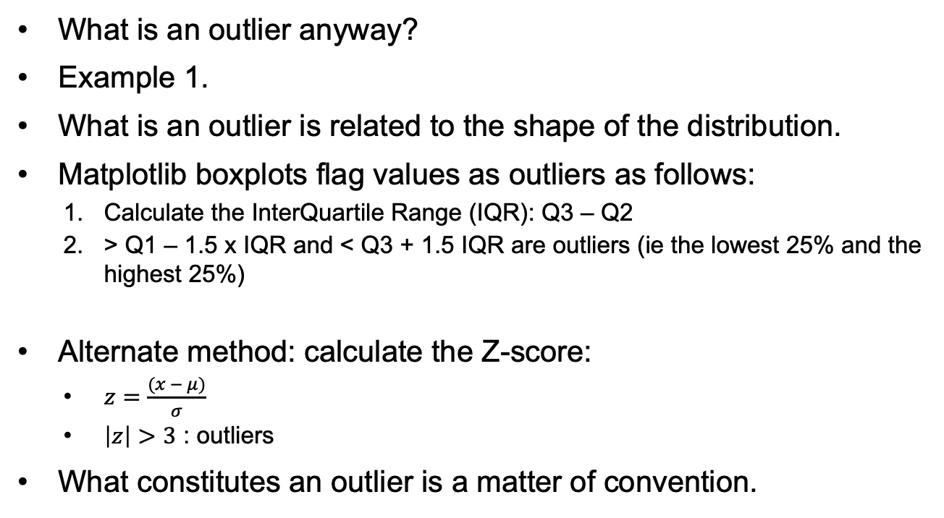
OUTLIERS (1): WHAT IS AN OUTLIER ANYWAY?
What is an outlier anyway?
Example 1.
What is an outlier is related to the shape of the distribution.
Matplotlib boxplots flag values as outliers as follows:
Calculate the InterQuartile Range (IQR): Q3 – Q2
> Q1 – 1.5 x IQR and < Q3 + 1.5 IQR are outliers (ie the lowest 25% and the highest 25%)
Alternate method: calculate the Z-score:
$z=\frac{(x − μ)}{σ}$
$\left|z\right|>3$ : outliers
What constitutes an outlier is a matter of convention.

Slide 5
OUTLIERS (2): ASSUMPTIONS
If you flag the lowest 25% and the highest 25% as outliers, there should be a clearly recognizable middle 50%.
The Z-score also also makes assumptions about the shape of the data.
Other assumptions:
Data comes from a single population
Data is continuous
Observations are independent
What could happen if one or more of these assumptions is not met?

Slide 6
OUTLIERS (3): IF DATA IS NOT NORMALLY DISTRIBUTED
Try a different method for calculation outliers
EG: Mean Absolute Deviation:
Calculate the absolute deviation of each data point from the median and then apply a scaling factor to it.
Outliers are all points with MADscaled > 2.5 (or some other value)
Turn the distribution into a normal distribution
EG: Apply a log transformation to a log normal distribution and then calculate the IQR.
Adjust the cutoff points for the IQR
Useful if the distribution is skewed
Create subgroups and apply outlier detection within each subgroup
Do this if the data is multi modal.

Slide 7
OUTLIERS (3): OUTLIERS ARE NOT ERRONEOUS DATA
Even if the data is normally distributed, the fact that a data point is an outlier does not in itself mean anything!
Outliers | Erroneous data
Unusual but valid observations | Invalid data points
Can provide valuable insights | Should be corrected or removed
Domain specific | Validation rules
May indicate important phenomena | Measurement / entry errors

Slide 8
OUTLIERS (4): BEST PRACTICES
Investigate before removing:
Check for data entry / coding errors.
Verify measurement accuracy.
Make sure you understand the domain.
Document decisions:
Record which values were modified and why.
Be transparent about criteria used.
Make sure your work is reproducible
Sensitivity analysis:
Run analyses with and without outliers.
Report differences in results.

Slide 9
TITEL SLIDE
Verder alles
In Arial

Slide 10
TITEL SLIDE
Verder alles
In Arial

Slide 11
TITEL SLIDE
Verder alles
In Arial

