Slide 1
TIME _SERIES

Slide 2
Lecture overview
Lesson goals
Preparation recap
Time series overview
Naive forecasting
ARMA
Seasonality and differencing
Measuring performance
Using statsmodels to analyse time series data
Filtering
Fourier analysis

Slide 3
Lesson goals
The student recognizes time series data as a distinct type of data and knows the techniques for making predictions using this type of data.
Relates to final qualification: data analytics

Slide 4
Preparation recap
Read Géron ch. 15 from "Forecasting a time series" until but not including "Preparing the Data for Machine Learning Models".
What did you learn from this?

Slide 5
Time Series Overview
A time series is a sequence of observations of one or more variables. These observations occur in successive order over some period of time, usually (but occasionally not) at regular intervals.
In many time series observations are closely related to each other.
This means an observation made at some point in the past can help predict an observation that is made at some later point in time: forecasting.
The default forecasting technique is to simply state that the next observation will be identical to the last observation. This works surprisingly well. Later on during this lesson we will learn what to do when it doesn't.

Slide 6
Demo 1: Naive forecast with example
Demo 1: naive forecast with example

Slide 7
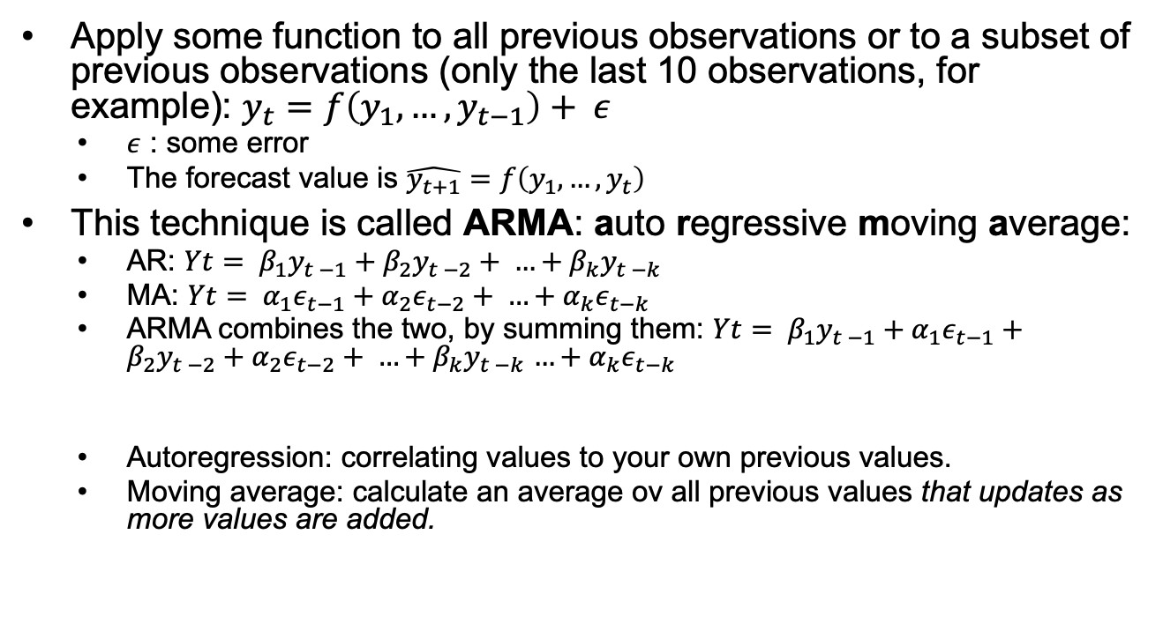
Slightly less naive forecasting: ARMA
Apply some function to all previous observations or to a subset of previous observations (only the last 10 observations, for example): $y_{t}=f\left(y_{1}, …, y_{t−1}\right)+ ε$
  $ε$ : some error
  The forecast value is $\hat{y_{t+1}}=f\left(y_{1}, …, y_{t}\right)$
This technique is called ARMA: auto regressive moving average:
  AR: $Yt= β_{1}y_{t −1}+β_{2}y_{t −2}+ …+β_{k}y_{t −k}$
  MA: $Yt= α_{1}ε_{t−1}+α_{2}ε_{t−2}+ …+α_{k}ε_{t−k}$
  ARMA combines the two, by summing them: $Yt= β_{1}y_{t −1}+α_{1}ε_{t−1}+β_{2}y_{t −2}+α_{2}ε_{t−2}+ …+β_{k}y_{t −k}$ $…+α_{k}ε_{t−k}$
  Autoregression: correlating values to your own previous values.
  Moving average: calculate an average ov all previous values that updates as more values are added.

Slide 8
Demo 2 and 3
Demo 2: manual ARMA
Demo 3: manual ARMA, does not work
  Because ARMA assumes the time series is stationary (no seasonality)

Slide 9
Demo 4: reducing seasonality using differencing
Differencing does not completely undo the effects of seasonality, but it does reduce its effects.
Differencing can also help remove underlying larger trends. In economics, for example, long term trends (continuous growth) are often less interesting than smaller trends.
Better results can be sometimes be obtained by using a technique called Fourier analysis, but we will only touch upon this technique very briefly, at the end of this lecture.

Slide 10
ARIMA and SARIMA
It is possible to combine differencing and ARMA to make predictions: ARIMA
If you need to add seasonality: SARIMA

Slide 11
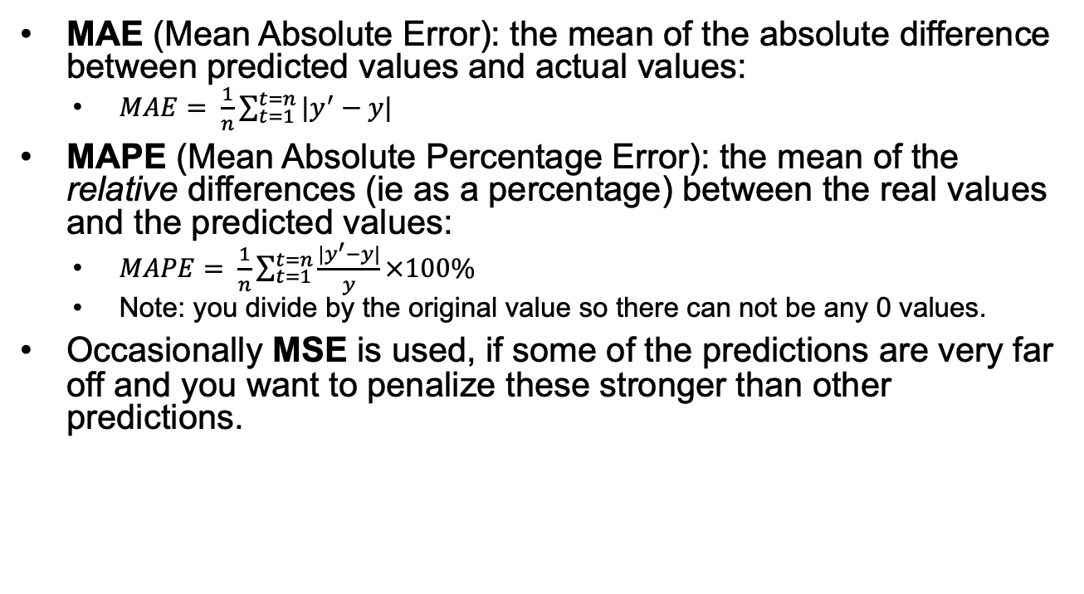
Measuring the quality of a forecast
MAE (Mean Absolute Error): the mean of the absolute difference between predicted values and actual values:
  $MAE= \frac{1}{n}\sum_{t=1}^{t=n}{|y^{′}−y|}$
MAPE (Mean Absolute Percentage Error): the mean of the relative differences (ie as a percentage) between the real values and the predicted values:
  $MAPE= \frac{1}{n}\sum_{t=1}^{t=n}{\frac{|y^{′}−y|}{y}}×100\%$
  Note: you divide by the original value so there can not be any 0 values.
Occasionally MSE is used, if some of the predictions are very far off and you want to penalize these stronger than other predictions.

Slide 12
Demos: statsmodels.tsa and statsmodels.graphics
Demo 5: using statsmodels.tsa to show trends and seasonality
  Auto correlation function plots help in data exploration:
    They show you trends and seasonality in the data.
    They help you decide which models to use. If data contains no seasonality at all, ARMA is fine. Otherwise you may need SARIMA or something else.
    They help you decide how to preprocess the data.
    They show anomalies / oddities.
Demo 6: Using statsmodels.tsa to decompose a time series
Demo 7: Using statsmodels.tsa to analyse and decompose sunspot data
  Trend and seasonality analysis using autocorrelation function plots is not foolproof. Here is an infamous example.
  Sunspot data analysis is an excellent example of the shortcomings of TS analysis:
    The performance of a simple function (the 11 year sinus cycle) is certainly no worse.
    The explanatory power of a simple function (the 11 year sinus cycle) is much greater.

Slide 13
Removing noise
Most of our data will be somewhere between the synthetic data from the demos and the sunspot data in terms of complexity. The tools in statsmodels.tsa may therefore work very well - or at least reasonably well.
Often our data is noisy, however.
To remove noise, we can apply filters to our data.
  A filter smoothes out small variations in the data.
  You can think of them in terms of audio data. Small variations can be considered to be high frequency noise (hiss). An audio filter (like an equalizer) can remove those high frequencies.
  In fact, one of the filters in the demos is used in audio applications! (synthesizers).

Slide 14
Filtering demos
Demo 8: smoothing data using filters
  For synthetic data, filters work very well - because the noise is likely just that: noise.
  For real data, the noise may in fact not be noise and may even contain additional information.
Demo 9: smoothing sunspot data using filters

Slide 15
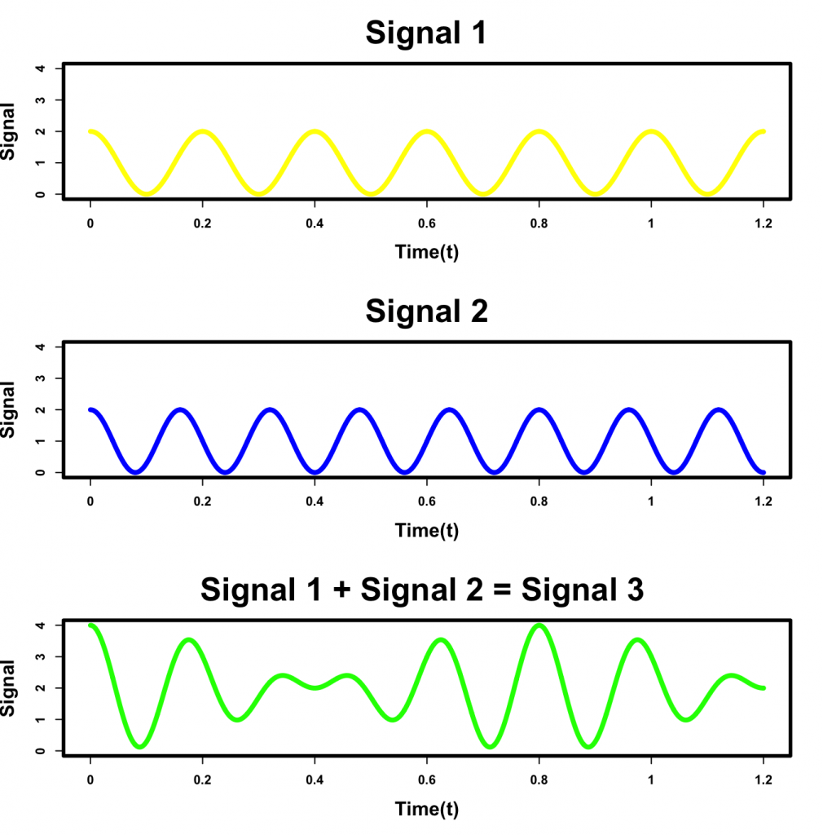
Fourier Analysis
Approximate a signal by adding sine waves together.
Can be much better than “trend + seasonality” time series.
Computationally expensive
Risk of overfitting
If you must use Fourier analysis:
  Filter beforehand (why?).
  Provide a large test set to check if you’re overfitting.
Image source:
https://sites.northwestern.edu/elannesscohn/2019/07/30/developing-an-intuition-for-fourier-transforms/

