Slide 1
PIPELINES
Ondertitel indien nodig

Slide 2
In this lesson
What is a data pipeline?
What are they used for? What types exist? What steps do they contain?
Robustness, determinism and transparency
… and how to achieve them
(a reading suggestion)
Try it yourself

Slide 3
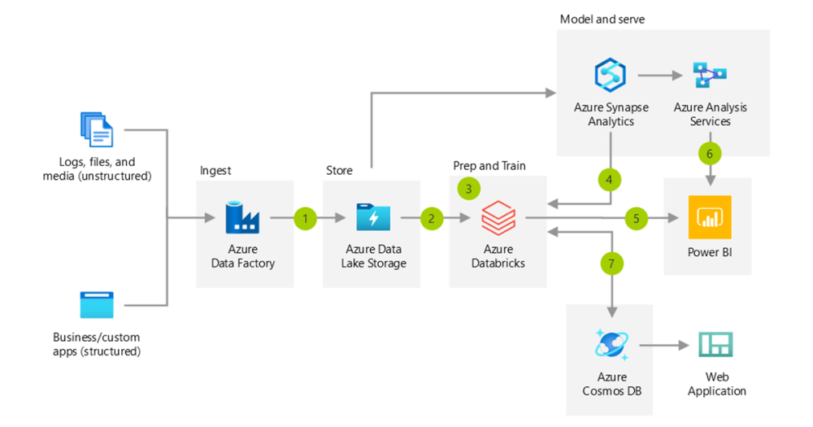
What is a data pipeline?
“A data pipeline is a method in which raw data is ingested from various data sources, transformed and then ported to a data store, such as a data lake or data warehouse, for analysis.”
https://www.ibm.com/think/topics/data-pipeline, emphasis mine
It’s called a “pipeline” because data ”flows” from one step in the process to the next.
Often, both the “flow” and the ”steps” are automated.

Slide 4
What are pipelines used for?
Data analysis
Extracting raw data from one or more sources, transforming it into a different format and loading it into a destination system
Machine learning
Automating data preparation, feature engineering and model training

Slide 5
Types of pipelines
Batch processing pipelines: data is processed in “batches”. Batches are loaded one by one. Each step in the process is executed during processing of a single batch.
Reliable
Not realtime
Only happens on predefined moments.
Streaming pipelines: data is processed as soon as it appears at the start of the pipeline.
Less reliable
Not realtime
Happens throughout the day.
Combinations of batch and streaming: parts of a pipeline can be implemented as batch pipelines while other parts work as streaming pipelines.

Slide 6
Types of steps
Extract: retrieve data from a single source.
Transform: perform operations on data to transform it in some way.
Load: store the data in a new data storage system, for further processing or for analysis.
Many pipelines are Extract Transform Load (ETL) or Extract Load Transform (ELT, more common on cloud platforms) pipelines.
There can be multiple extractions before a single transform. The transform may then simply be combining the results from the extractions: integration
E
T
L
E
E

Slide 7
A pipeline is a software product
A pipeline is a software program that takes in data (optionally from multiple sources), does something with that data and delivers it somewhere.
Like all software programs it needs to be robust and deterministic.
Deterministic: for the same inputs it should produce the same results.
The pipeline as a whole can only be robust and deterministic if each the steps that it is made up of is also robust and deterministic.

Slide 8
A pipeline should be transparent
Not only should each step and therefore the pipeline as a whole be robust and deterministic, they should also be transparent.
It should be obvious where each step gets its inputs from, what it did to them and what its output was.
If something unexpected happens or something goes wrong, this should be reported.
But also: if everything went according to plan, this should also be reported.

Slide 9
Tools for robustness, determinism and transparency
Logging: each step should report what it does and when.
Provenance reporting: for every ingested data set it should be reported where it came from and what it contained.
Exception handling: many processes can go wrong, especially those involving external systems. Errors that can occur should be handled – and reported.
Validation: each step should verify the data it receives to ensure it conforms to the expected specifications. If the data comes from an external source this is required. Quality of incoming data should be logged.
Halting the pipeline: for every exception, validation error or other detected problem, a decision needs to me made whether the pipeline can continue or not. If not: fail loudly.
Test driven development (TDD) helps ensure robustness of pipeline code.

Slide 10
How to achieve transparency
It should always be obvious where the data came from and what was done to it.
Store the original versions of the ingested data (include information on when it was ingested and what the source was!).
Do not modify the ingested data itself – only work on copies.
Store the modified versions of the data and include information on when it was modified.
The entire history of the pipeline end product should be traceable.

Slide 11
Transparency for code: version control
The code that operates on the data should also have an obvious provenance.
It should be clear which version of the code operated on which data.
This is what a version control system is for (git).
There should never be local changes to running pipeline code.
If a pipeline requires local configuration, at the very least store all of it in the same file (env file). Better is to place env files under version control and determine in some automated fashion which env file to use.

Slide 12
Some guidelines for robustness
Trust nothing.
Especially not data you receive from the internet.
Everything that can fail, will fail.
Especially connections to other systems on a network or on the internet.
Be picky.
Do not accept incoming data that is not *exactly* what you want it to be.
Failure is an option.
It’s often better to simply give up than to muddle along. Do not propagate problems downstream.

Slide 13

A reading suggestion
Many books exist on designing robust and transparent data pipelines.
This is one of them: Enda Ridge – Guerilla Analytics.
Written like a tutorial.
Caveat: ignores the existence of git.

Slide 14
Try it yourself: supermarket inventory recommendation engine
Case study: a supermarket chain wants to create a recommendation engine for its inventory system. What should each individual supermarket order on any given day?
Any data source you can think of can be used as input.
Design a pipeline for this system:
Where does the data come from?
What happens to it?
Where does it go?
Pay special attention to robustness, transparency and determinism:
For each step:
What could go wrong?
How will each error be handled?
Can the process continue if this step fails? Why / why not?
In groups

