Slide 1





A Hands-on Introduction to BioImage Simulation with DeepTrack2
DeepTrack2
AIM-Net
Guillem Guigó i Corominas
guillem.guigo@uvic.cat
Carlo Manzo
carlo.manzo@uvic.cat

Slide 2

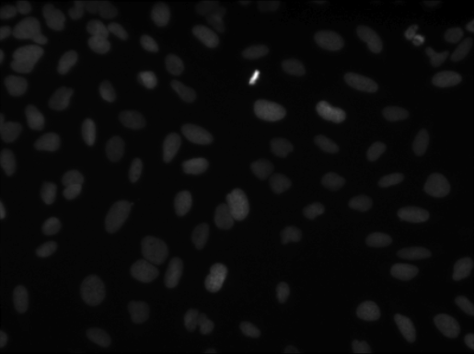
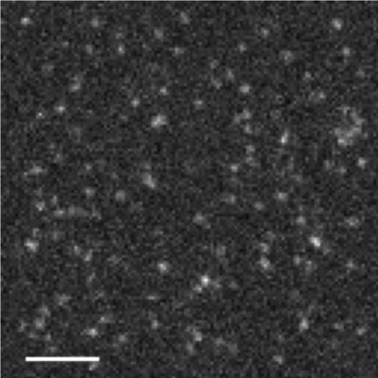
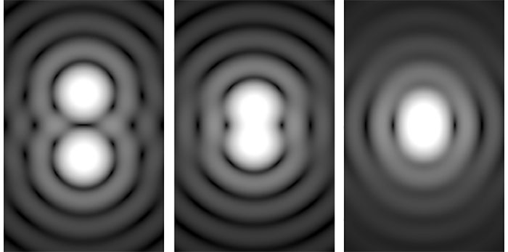


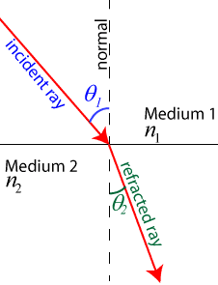
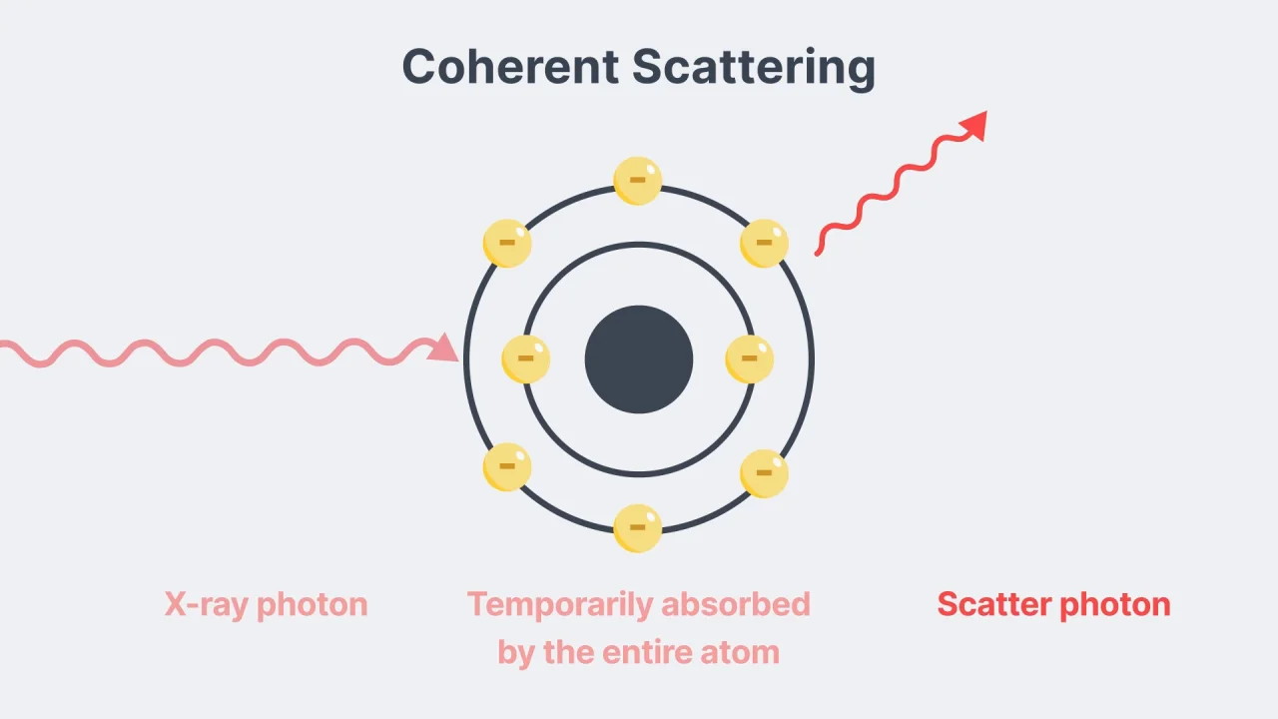
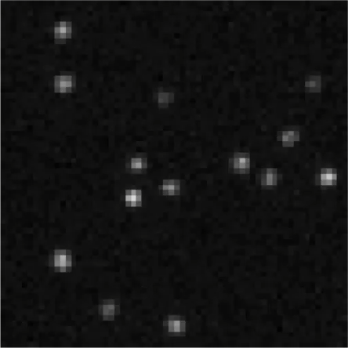
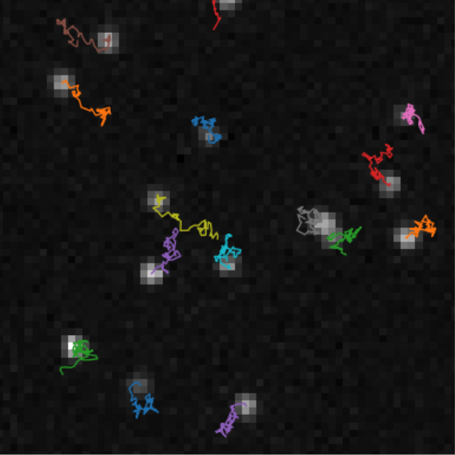
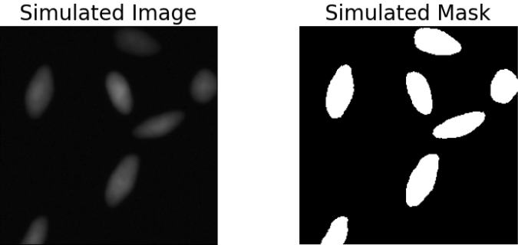
DL model
expensive, slow, hard to annotate
cheap, fast, annotation by design

Slide 3
