Slide 1



Similarity Metrics for SQL Query Clustering
G. Kul, D. T. A. Luong, T. Xie, V. Chandola, O. Kennedy and S. Upadhyaya
IEEE Transactions On Knowledge And Data Engineering, December 2018
Analysis Of Paper
Database Management System (MC-302)
Aiman Siddiqua – 2K18/MC/008
Apoorva – 2K18/MC/019
Notes:
Capusl

Slide 2
ABSTRACT
Database access logs are the starting point for many forms of database administration, from database performance tuning, to security auditing, to benchmark design, etc.
Clustering is the first step towards understanding the massive query logs, for an analyst to extract broad patterns.
Most clustering methods use pairwise similarity, which can be difficult for SQL Queries, especially without underlying database schema or data.
In the paper, query similarity is computed relying only on the query structure.
Three query similarity heuristics were applied to query clustering.
To improve the accuracy of the heuristic, a generic feature engineering method was applied using classical query rewrites to standardize query structure.
The proposed strategy results in a significant improvement in the performance of all three similarity heuristics.
Notes:
Capusl

Slide 3

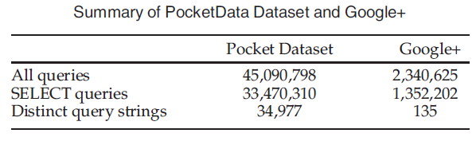
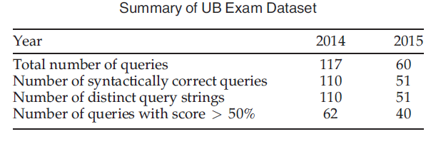
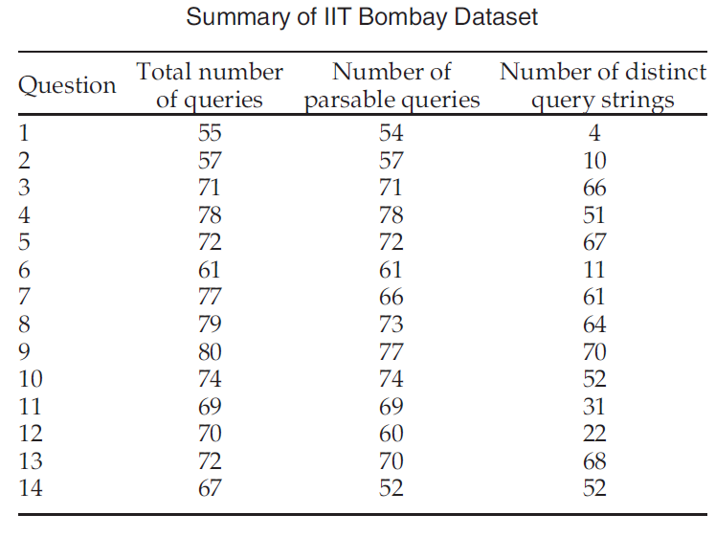
INTRODUCTION
The three metrics were evaluated on the following datasets:
A large set of student authored queries released by IIT Bombay.
A smaller set of student queries gathered at the University at Buffalo, and released as part of this publication.
SQL logs that capture all activities on 11 Android phones for a period of one month.
The paper accomplishes the following, A survey of existing SQL query similarity metrics, an evaluation of these metrics on multiple query logs, and applying query standardization.
Notes:
Capusl

Slide 4

LITERATURE REVIEW
Paper Title
Motivation
Features
Distance Function
Agrawal et al. (2006)
Q. Reply Importance
Schema, rules
Cosine Similarity
Giacometti et al. (2009)
Q. Recommendation
Difference pairs
Difference Query
Yang et al. (2009)
Q. Recommendation
Selection/Join, Projection
Jaccard coefficient on the graph edges
Chatzopoulou et al. (2011)
Q. Recommendation
Syntactic element frequency
Jaccard coefficient and cosine similarity
Aouiche et al. (2006)
View Selection
Selection/Join, Group-by
Hamming distance
Aligon et al. (2014)
Session Similarity
Selection/Join, Projection, Group-by
Jaccard Coefficient
Makiyama et al. (2016)
Workload Analysis
Term frequency of projection, selection/join, from, group-by, order-by
Cosine Similarity
Notes:
Capusl

Slide 5

Canonicalize Names and Aliases:
First regularization step attempts to create a canonical naming scheme for both attributes and tables.
Commutative Operator Ordering:
Standardizing the order of operands in an expression using commutative and associative operators by defining a canonical order of operands.
Syntax Desugaring:
SQL's redundant syntactic sugar can be removed by basic pattern replacement. Such as x BETWEEN (a,b) can be replaced by a<x AND x<b.
Nested Query De-correlation:
A common database optimization that converts some EXISTS predicates into joins for more efficient evaluation.
EXISTS Standardization:
All SQL queries containing one of (EXISTS, IN, ANY and ALL) can be rewritten using only EXISTS.
OR-UNION Transform:
We use a regularization transformation that exploits the relationship between OR and UNION.
DNF Normalization:
We normalize all boolean-valued expressions by converting them to disjunctive normal form(DNF).
Union Pull-Out:
Since the prior transformation may introduce UNION operator in nested subqueries, we push selection predicates down into the union as well.
REGULARIZATION RULES

Slide 6

EXPERIMENTAL METHODS
CLUSTERING VALIDATION MEASURES
They are used to validate the quality of a labeled dataset by estimating two quantities:
1. the degree of tightness of observations in the same label group and
2. the degree of separations between observations in different label groups.
SIMILARITY METRICS
We use the similarity metrics as defined in Aouiche et al. (2006), Aligon et al. (2014) and Makiyama et al. (2016).
SILHOUETTE COEFFICIENT
BETACV MEASURE
DUNN INDEX
It is a measure of how similar a data point is to its own cluster in comparison to other clusters.
For a data point i it is measured as
𝑏(𝑖) − 𝑎(𝑖)/𝑚𝑎𝑥(𝑎(𝑖), 𝑏(𝑖))
a(i) is the average distance from i to all other data points in the same cluster
b(i) is the average distance from i to all other data points in the closest neighboring cluster.
It is the ratio of the total mean of intra-cluster distance to the total mean of inter-cluster distance.
The smaller the value of BetaCV, the better the similarity metric characterizes the cluster partition of queries on average.
It is defined as the ratio between minimum distance between query pairs from different clusters and the maximum distance between query pairs from the same cluster.
Higher values of Dunn Index indicate better worst-case performance of the clustering metric.

Slide 7

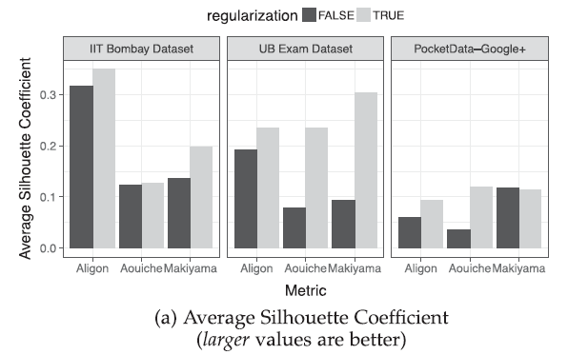
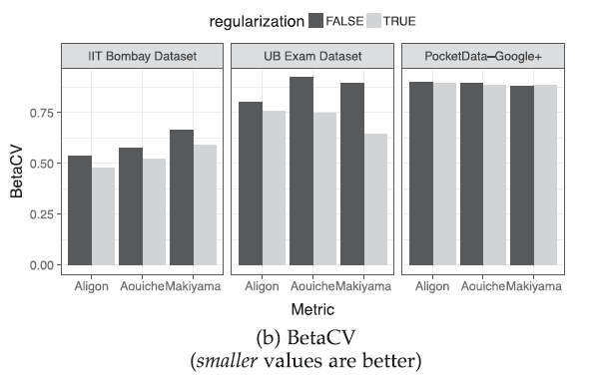
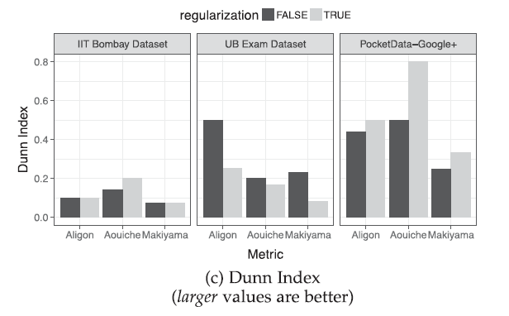
RESULTS
The first experiment was to evaluate which similarity metric can best capture the task performed by each query.
The black columns in Fig. 1 shows a comparison of three similarity metrics using each of the three quality measures.
As can be seen in Fig. 1, Aligon seems to work the best for the workloads.
Next experiment evaluated the effectiveness of regularization by applying it to each of the three metrics.
Fig. 1 shows the values of three validation measures both with and without regularization.
Fig. 1
Notes:
Capusl

Slide 8

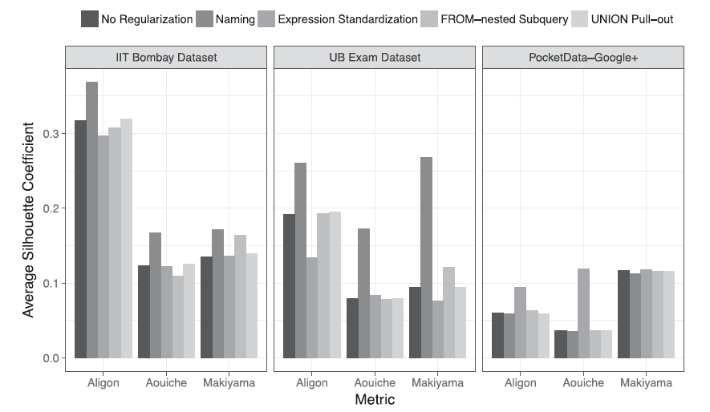
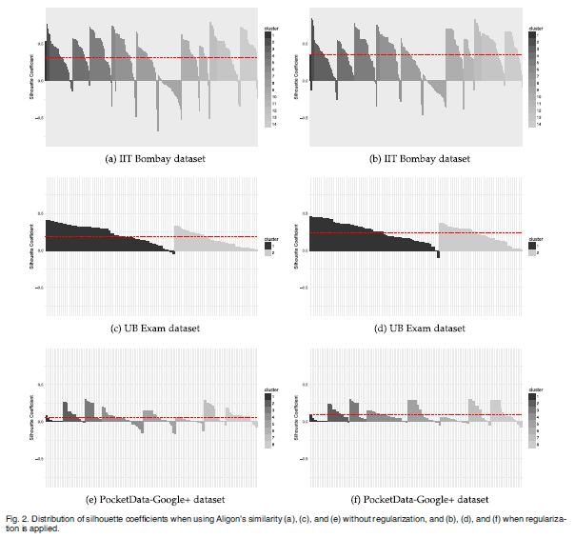
CONCLUSIONS
Finally, the Silhouette Coefficient for Aligon Metric was evaluated.
From the graphs, the overall effects of regularization could be seen.
The feature engineering steps provided an improvement across the board because they addressed the error reasons that were identified.
Notes:
Capusl

Slide 9
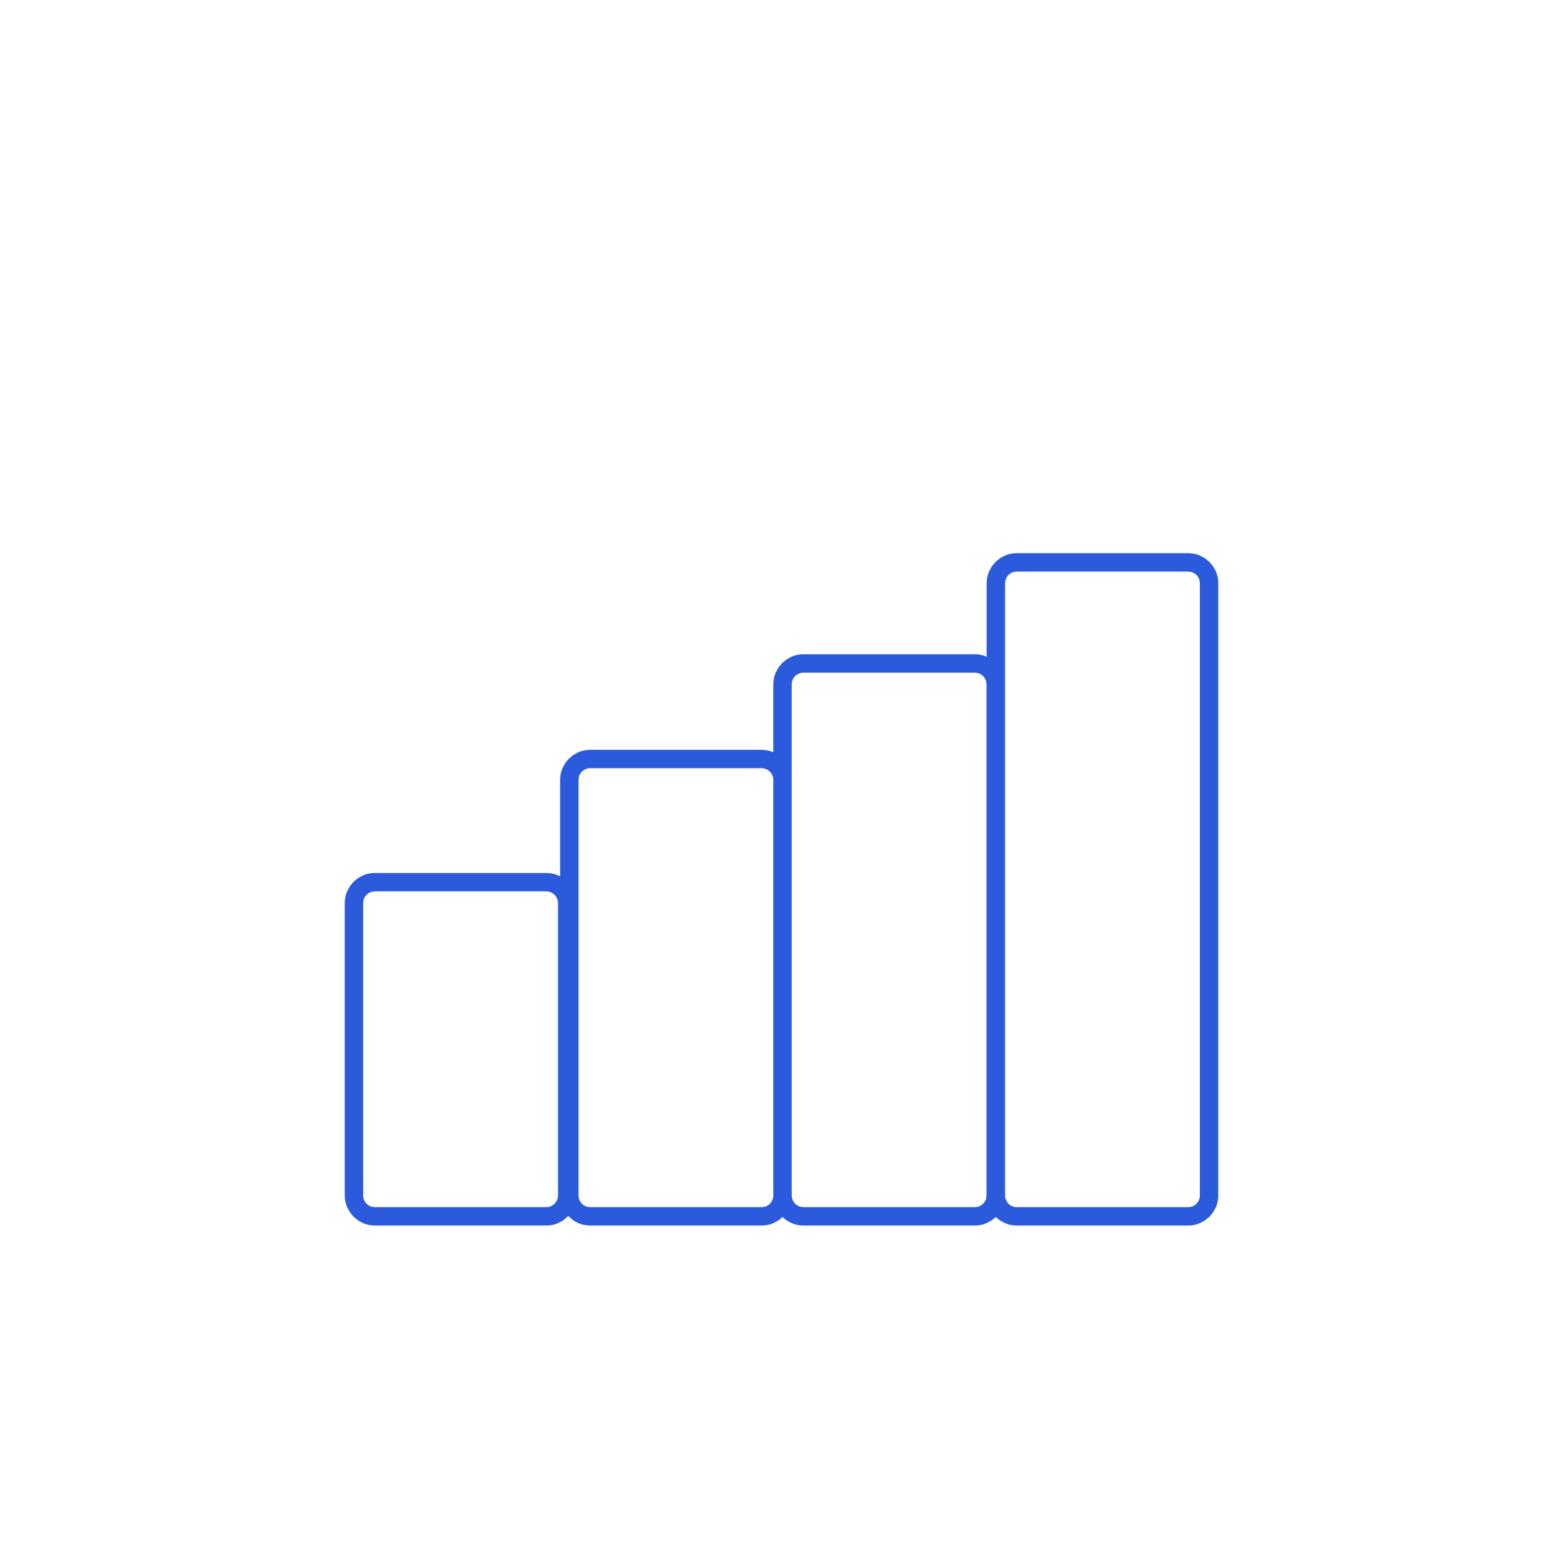

APPLICATION SCENARIOS
1.
2.
3.
IMPROVE DATABASE PERFORMANCE
By creating views of the most frequent complex queries, the database performance can be improved substantially.
DETECT OUTLIERS
By identifying the query clusters and partitioning the queries, all outliers can be detected.
RESEARCH WORK
Using Query clusters and partitioning, the properties of the SQL query dataset and its schema can be reasearched.

Slide 10





THANK YOU !

