Slide 1

LLM-based Synthetic Data Generation Text classification Tutorial 16.09.2025
Department of Methodology and Sampling Design
Statistics Spain

Slide 2
Two approaches to text classification
Two main approaches to a text classification problem:
LLM as a classifier (zero-shot, few-shot, RAG, …)
Supervised ML classification problem: get some labelled data (pairs text-code) and train a classification-specific ML/DL model (fasttext, BERT, …)
Each approach has its pros and cons:
LLMs are the state-of-the-art for NLP problems and they show nearly-human capabilities in several text processing tasks. However, they are very computationally expensive and pose several practical problems (hallucinations, security, cost, …)
A classical ML approach allows us to use much smaller models which pose less problems in production, and Transformer-based models like BERT achieve a very good performance. However, the performance of the model is very dependent on the quantity and quality of the training data, and obtaining training data can be very expensive in terms of resources.

Slide 3
Why do we need synthetic data?
The classical approach has some limitations, especially in the context of some statistical classifications:
Data gaps: Gathering enough data is unfeasible, especially for some classes.
Even if there are apparently enough samples for a class, they may not cover all the contents included on it (explanatory notes).
The data show a variety of quality issues:
Ambiguous descriptions.
Incorrectly labeled texts.
Inadequate texts: company names, other languages, too different from the expected inputs…
Most of the solution is not replicable.

Slide 4
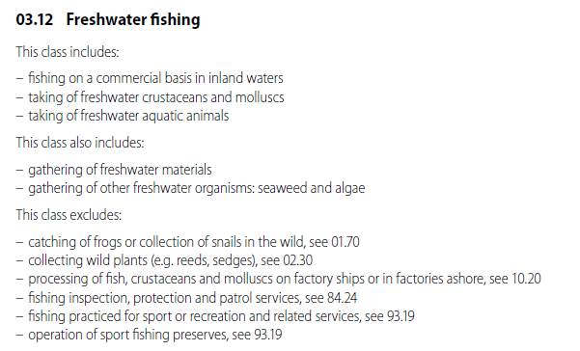
Explanatory notes
Some statistical classifications have a very high-quality source of information: explanatory notes
Includes: most common activities of the class
Also includes: less common activities also included in the class
Excludes: activities not included in this class which could be confused with the activities included in the class

Slide 5
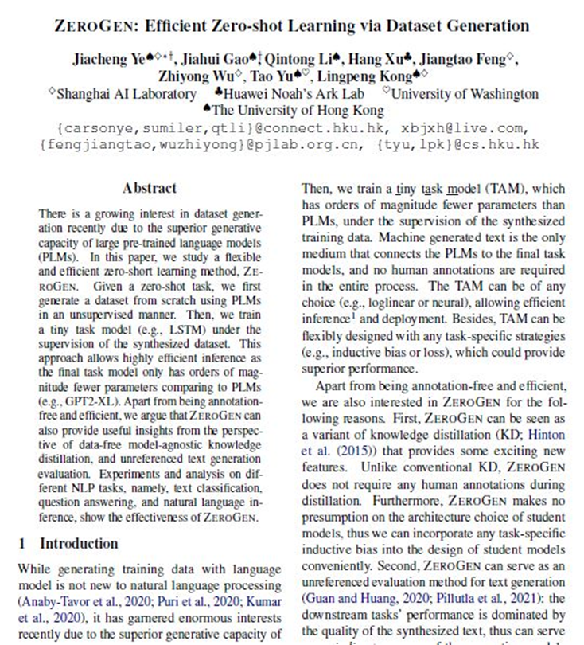
LLM data generation
ZeroGen: Efficient zero-shot learning via Dataset Generation
It takes advantages of the outstanding capabilities of LLMs without most of their downsides.
Idea: use an LLM to generate a synthetic dataset which can be used to train a supervised ML model
For statistical classifications:
StatCodGen:
LLM + explanatory notes + index (optional)
=
synthetic data

Slide 6

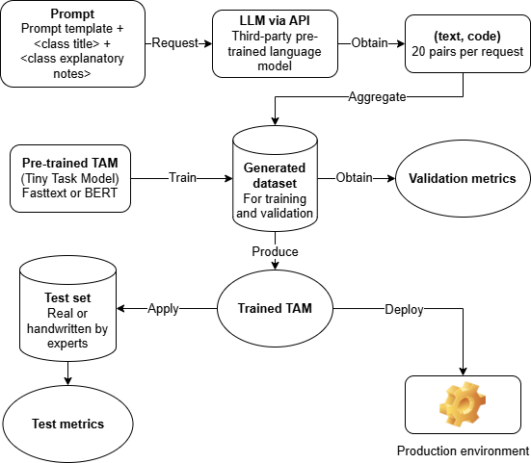
StatCodGen: ZeroGen implementation
High-quality labelling
inputs

Slide 7
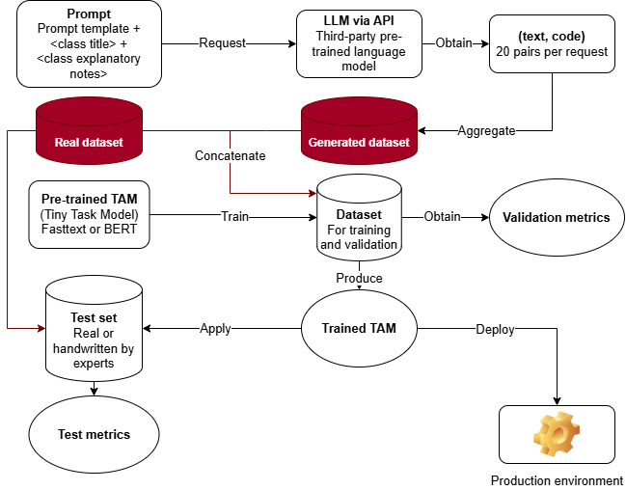
StatCodGen with real data
inputs

Slide 8
Prompt engineering
Designing the prompt is the most important part of the process.
Prompt engineering is more an art than a science, but there are some heuristics that have been proved universally useful.
A well-structured prompt should consist on the following three parts:
Task specification: the first part of the prompt should define the model task. A first sentence setting the scene has been shown to help the model focus in the given task.
Conditions: detailed instructions we want the model to follow in performing the task.
In-context examples: giving concrete examples of the expected output usually increases significantly the performance of the model.
Prompt engineering

Slide 9
Prompt engineering
You are an expert in generating training data for classification models. Your task is to take a root phrase of a general economic activity and generate training phrases from concrete examples included in a text.
Task specification
When applicable, try to introduce the word 'other' (singular or plural) and also the use or destination of the product. Whenever it is the manufacturing of an object, include the material it is made of. Avoid generating completely different phrases or changing the context, and return ONLY the phrases without introductions, comments, explanations, or additional sentences. Avoid starting your output with phrases like 'here are the generated phrases' or similar. I want to use your output directly, so I ONLY want the phrases.
Conditions
Here’s an example: Root: Production of bakery and pastry products. Text: This class includes the manufacturing of any bakery product such as: bread loaves, cakes, other flours, and bread for feed. Output: Production of bread loaves. Production of bread for feed. Production of cake products. Production of other flours.
In-context examples
Now do the same with the following root and text, generating {number} samples: Root: {root}. Text: {text}."

Slide 10
Quality of synthetic data
There are fundamentally two dimensions to measure the quality of synthetic data:
Faithfulness: The generated data should be well-labelled and relevant to the problem at hand.
Diversity: The generated data should be diverse enough to reasonably cover all expected real-world cases.
There is a trade-off between these two dimensions. Usually, if we try to increase the diversity of the generated samples, chances are that some of the generated sample is mislabeled or makes no sense, decreasing the faithfulness of the dataset.
We should aim at a good compromise between faithfulness and diversity.
Prompt engineering

Slide 11
StatCodGen at Statistics Spain (INE)
At Statistics Spain we have a generic implementation of the pipeline for statistical classifications, which can be found at:
GitHub - AIML4OS/WP10_Cluster1_StatCodGen
In production:
Model: fasttext (due to resource constraints)
Data: mixture of real-world data from several sources and synthetic data
The synthetic data used comes from:
LLM-generated data
Class titles and classical data augmentation (with dictionaries of synonims)
Examples from the explanatory notes (also includes and not includes sections)
LLM-assisted data augmentation (next slide)
Prompt engineering

Slide 12
LLM-based data augmentation
LLMs can also be used for assisting classical data augmentation techniques, such as augmentation by synonyms.
Method:
Take some description (e.g. title of the class)
Remove stopwords
Use an LLM to generate synonyms for each word taking into account the context of the class provided by the explanatory notes
Substitute one (or several) words by a synonym, creating a new sample.
Prompt engineering

Slide 13
Results
For the national version of NACE:
Model | Approach | Training set size (thousands of instances) | Accuracy | Notes
Fasttext | Classic ML | 543 | 0.57
BERT | Classic ML | 103 | 0.66
Fasttext | StatCodGen | 2752 | 0.58 | Classic data augmentation techniques also applied
BERT | StatCodGen | 103 | 0.66
Fasttext | ZeroGen + classic data | 3295 | 0.71 | Classic data augmentation techniques also applied
Prompt engineering

Slide 14
Thank you for your attention!

