Slide 1
Image Document Optimization SBI
Presented by Team South

Slide 2
Problem Statement
Todays banking and other industries need to handle lot of digital documents. Also this involves huge volume of resource hours to extract valuable information from those documents. Handling and storing digital documents occupies lot of resources.
Image size optimization technique resolves the storage issues by compressing the image and stores the information and it can retrieve the image back to almost original source.
As the documents are scanned and stored, it is always required for AI to Optimize alignment of document text.
Scanned documents are always tend to misaligned so it needs Orient & Center document text alignment.

Slide 3
Strategies experimented
Image Optimization/Compression using Deep learning
Reproduction is not accurate
Needs retraining for a different types of images
Image Optimization/Compression using GAN
Huge infrastructure required to train
Training parameters increases with image resolution/size
Image Optimization/Compression SOTA mathetical optimization
Image Orientation correction through CNN
Works good for object images
Requires training for each templates
Image Orientation correction through OpenCV

Slide 4
Why this approach
Image Optimization/Compression through SOTA approach
In the traditional approach, it is very difficult to recreate the original after compression, we are using SOTA mathematically optimised compression algorithm based architecture to reconstruct the image with almost original image
Quicker throughput, reduction in Channels and storing only required information makes this algorithm very compact.
Image alignment and Orient / Centre document
OpenCV approach which productively rectifies the image alignment issue in a quicker way

Slide 5
Benefit Comparison
Image Optimization/Compression through SOTA approach
Zero shot learning
Quality not compromised
Lesser time to compress
Easier to store in wide variety of storage systems
Only required information stored
Image alignment and Orient / Centre document
Quicker time to rectify the image
No training required
Works good for text images
Mathematical algorithms are quicker than statistical model

Slide 6
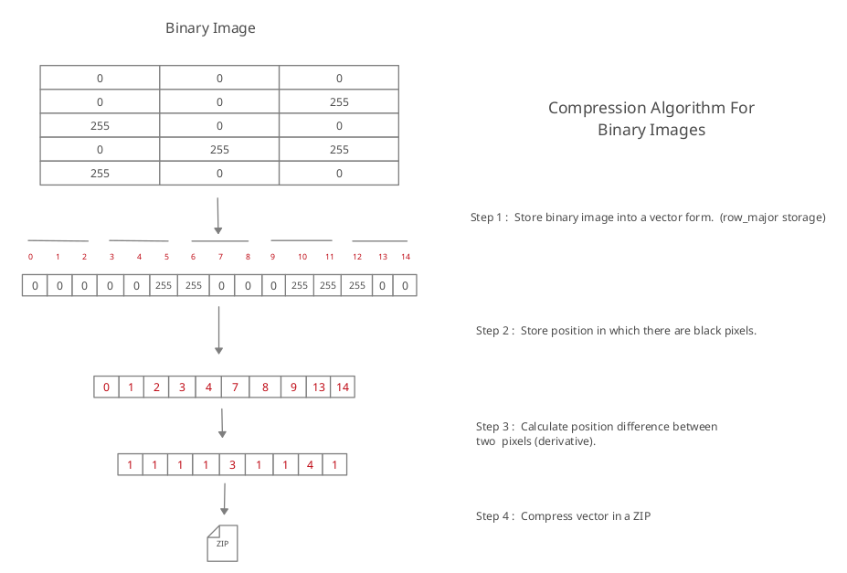
Compress Algorithm Architecture

Slide 7
Image Orientation Architecture
Skew Identification
Skew Correction
Hough Transform
Hough Peak detection
Estimated angle & Deviation Calculation
Correct Angle Deviation for Entire Image
Text Image

Slide 8
Model Statistics
Image processing combines compression, decompression algorithm which is capable of recreating the images up to 96%
File occupies only 7% to 15% space
Compression percentage is up to 93%
Orientation correction mechanism corrects up to 330 degree deviations
0.5 milliseconds to compress 1 kb of data
Latency time is negligible to store and retrieve
Recreated images are having better quality of images
Also the processing time is better

Slide 9
Prerequisites
Relevant sample documents for training and testing (300 & 100)
OCR Engine (Azure OCR)
Azure ML Pipeline, Azure Cognitive Services
Image can be of colour or grey scale

Slide 10
Assumptions
Image will to be converted into Binary(Gray scale)
Reconstructed Image will be reproduced in Gray scale only

Slide 11
Source Code (Github repo link)
https://github.com/AIMLUniverse/imagecomp
Note:- source – folder contains source code
https://github.com/AIMLUniverse/imagecomp/tree/main/source

Slide 12
Video Link
https://github.com/AIMLUniverse/imagecomp/tree/main/demo_video

Slide 13
Thank You

