Slide 1
Image Document Optimization. SBI
Presented by Team South
Powered By – Microsoft Corporation Pvt Ltd.

Slide 2
Problem Being Solved
Todays banking and other industries need to handle lot of digital documents. Also this involves huge volumne of resource hours to extract valuable information from those document.Handling and storing digital documents occupies lot of resources.
Image size optimization technique resolves the storage issues by compressing the image and stores the information and it can retrieve the image back to almost original source.
As the documents are scanned and stored, it is always required for AI to Optimize alignment of document text.
Scanned documents are always tend to misalligned so it needs Orient & Center document text allignment.

Slide 3
Approach
Image optimization/Compression
In the traditional approach, it is very difficult to recreate the original after compression, we are using GAN based architecture to reconstruct the image with almost original image
Image alignment and Orient/Center document
Opencv approach which productively rectifies the image alignment issue in a quicker way.

Slide 4
Prerequisites
Relevant sample documents for training and testing (300 & 100)
OCR Engine (Azure OCR)
Azure ML Pipeline, Azure Cognitive Services
Image can be of color or gray scale

Slide 5
Assumptions
Image will to be converted into Binary(Gray scale)
Reconstructed Image will be reproduced in Gray scale only

Slide 6
Reason for consideration
Image processing combines compression, decompression algorithm which is capable of recreating the images upto 96%
File occupies only 7% to 15% space
Compresssion percentage is upto 93%
Orientation correction mechanism corrects upto 330 degree deviations
0.5 milliseconds to compress 1 kb of data
Latency time is neglegible to store and retrieve.
Recreated images are having better quality of images
Also the processing time is better

Slide 7
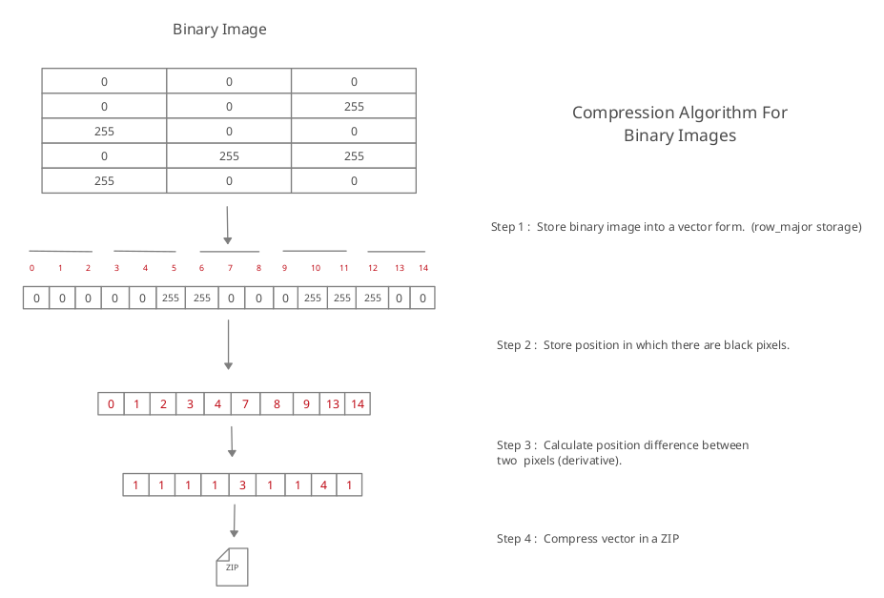
Compress Algorithm

Slide 8
Source Code (Github repo link)
https://github.com/AIMLUniverse/imagecomp
Note:- source – folder contains source code
https://github.com/AIMLUniverse/imagecomp/tree/main/source

Slide 9
Video Link
https://github.com/AIMLUniverse/imagecomp/tree/main/demo_video

Slide 10
Thank You

