Slide 1

Regression AI/ML Tutorial-3
Yi Huang

Slide 2
Table of Content
What is regression
Linear regression
One-input-one-output linear regression [notebook 1.1]
Multi-input-one-output linear regression [notebook 1.2]
Non-linear regression
Logistic regression [notebook 2]
Regularization [notebook 3]
From regression to neural network [notebook 4]

Slide 3
Notebook Description
Notebook 1.1: univariate linear regression
Notebook 1.2: multivariate linear regression
Notebook 2: logistic regression
Notebook 3: regularization
Notebook 4: from regression to neural network

Slide 4
What is Machine Learning?
According to Wikipedia, Machine learning is the study of computer algorithms that can improve automatically through experience and by the use of data.
Algorithm improves automatically according a set of updating rules;
Data drives the update, not human;
Human set the updating rules (no worry, machines are not taking over the world here, not yet).
Garbage (Data) in Garbage (algorithm) Out
Major types of ML:
Supervised learning (classification, regression)
“I know the input and output. Please, machine, find the mapping between them.”
Unsupervised learning (clustering)
“I know nothing about data. Please, machine, sort them out by similarities.”
Reinforcement learning
“I know consequences. Please, machine, learn to act properly to induce desirable consequences.”

Slide 5
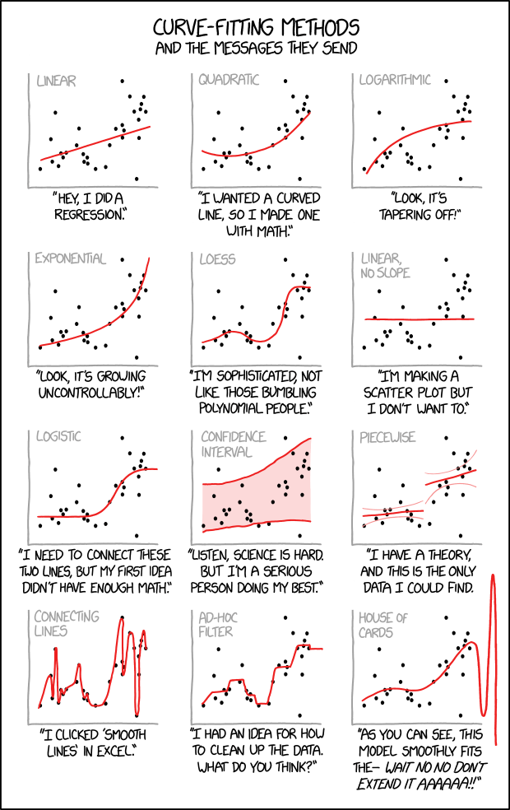
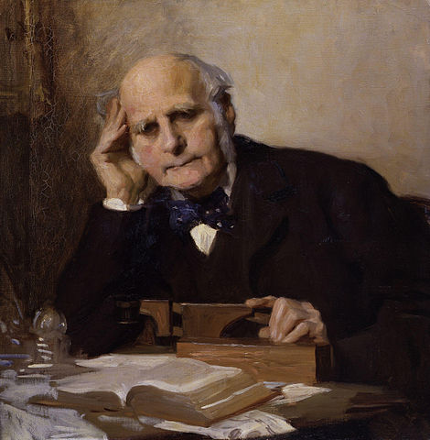
What is Regression
Why regression is call regression: (more fun reading here)
In medicine and psychology, regression means “a return to a former or less developed state”.
The term was introduced by Francis Galton, an English Victorian era polymath, in his 1886 paper “Regression towards mediocrity in hereditary stature”. In this paper, Galton derived a linear approximation to estimate a son’s height from the
father’s height. He found that a taller-than-average father would have a son that
is taller than average, but by a smaller amount than his
father is. Same with shorter-than average fathers.
Being taller and shorter than average can be “accidental”, and modern-day regression is used to find the most generally applicable mapping rule despite the presence of accidental and imperfect data.
Regression a type of supervised learning;
When the term regression is used, the input and output are more often continuous values. However, we will show later that regression can be adapted to do classification where the output is discrete (categorical).

Slide 6

Linear Regression I. Terminology (link to a nice post)
Variables (known):
Independent/explanatory variable (left-hand-side)
Dependent/response/target variable (right-hand-side)
Coefficient and bias (to be learned):
Coefficients: multipliers to the independent variables (slope in one dimension)
Biases: additive terms to the left-hand-side of the equation (intercept in one dimension)
Number of variables:
Univariate (single independent, single dependent): $ax+b=y$, here $a$ is the coefficient and $b$ is the bias
Multivariate (multiple independent, single dependent): $a_{1}x_{1}+…+a_{n}x_{n}+b=y$
Multi-response (multiple dependent):

Slide 7


Linear Regression I. Univariate and evaluation metrics (regression_1_linear.ipynb, Section 1.1)
Formula: $ax+b=y$
Data: A sequence of input-output pairs $\left(x_{1}, y_{1}\right),…, \left(x_{n}, y_{n}\right).$
Goal: Find $a$ and $b$ such at the mean squared error (MSE) is minimized.
$$MSE=\frac{1}{n}\sum_{i=1}^{n}{{\left(y_{i} −ax_{i}−b\right)}^{2}}$$
Loss function: $L=\sum_{i=1}^{n}{{\left(y_{i}−ax_{i}−b\right)}^{2}}$
Analytic solution: Find $\hat{a}$ and $\hat{b}$, such that $\frac{∂L}{∂a}=\frac{∂L}{∂b}=0.$
$$\hat{a}= \frac{\sum{x_{i}}\sum{y_{i}}−n\sum{x_{i}}y_{i}}{{\left(\sum{x_{i}}\right)}^{2} −n\sum{x_{i}^{2}}}$$
$$\hat{b}=\frac{\sum{x_{i}}\sum{{x_{i}y}_{i}}−\sum{x_{i}^{2} \sum{y_{i}}}}{{\left(\sum{x_{i}}\right)}^{2} −n\sum{x_{i}^{2}}}$$
How well does a regression work? There are a few quantities that measure how well the regression approximate the real data points. Let $\overline{y}=\frac{1}{n}\sum{y_{i}}$, $\overline{x}=\frac{1}{n}\sum{x_{i}}$, $\hat{y_{i}}=\hat{a}x_{i}+ \hat{b}$.
R-squared value:
$$R^{2}=1−\frac{\sum{{\left(y_{i} −\hat{y_{i}}\right)}^{2}}}{\sum{{\left(y_{i} − \overline{y}\right)}^{2}}}$$
P value: Let the null hypothesis be “the independent variable has no explanatory power to the dependent variable”, P value is the probability of rejecting the null hypothesis mistakenly. The smaller P value is, the more likely that the independent variable explains the dependent variable.
Standard error:
$$\sqrt{\frac{\sum{{\left(y_{i}− \hat{y_{i}}\right)}^{2}}}{\left(n −2\right)\sum{{\left(x_{i} −\overline{x}\right)}^{2}}}}$$

Slide 8

Linear Regression II. Multivariate (regression_1_linear.ipynb, Section 1.2)
Formula: $\left\langle \vec{a}, \vec{x}\right\rangle +b=y$, here $\left\langle ⋅, ⋅\right\rangle$ means inner product, and $\vec{x}$ is a vector of dimension $p$.
Data: A sequence of input-output pairs $\left({\vec{x}}_{1}, y_{1}\right),…, \left({\vec{x}}_{n}, y_{n}\right).$
Loss function: $L=\sum_{i=1}^{n}{{\left(y_{i} −\left\langle \vec{a}, {\vec{x}}_{i}\right\rangle −b\right)}^{2}}$
Goal: Find vector $\vec{a}$ and scale $b$ such at the $L$ is minimized.
Analytic Solution: Let
$$X= \left[\begin{aligned}1 x_{11} x_{12} ⋯ x_{1p} \\ 1 x_{21} x_{22} ⋯ x_{2p} \\ ⋮ ⋮ ⋮ ⋮ \\ 1 x_{n1} x_{n2}⋯ { x}_{np} \end{aligned}\right], \vec{y}={\left(y_{1},y_{2},⋯, y_{n}\right)}^{T}$$
The problem becomes finding a vector $\vec{α}=\left(\begin{aligned}b \\ \vec{a}\end{aligned}\right)$, such that the error vector $\vec{y} −X\vec{α}$ is the shortest, since
$$L= {\left\|\vec{y} −Xα\right\|}_{2}^{2}(={\vec{y}}^{T}\vec{y}−2α^{T}X^{T}\vec{y}+{\vec{α}}^{T}X^{T}X\vec{α})$$
And the analytic solution is $\hat{α}$ such that $\frac{∂L}{∂α}=0$. (here is a link to how to take derivative with vector and matrix)
Finally, we have the analytic solution to multilinear regression problem
$$\hat{α}={\left(X^{T}X\right)}^{−1}X^{T}\vec{y}$$
Design matrix

Slide 9
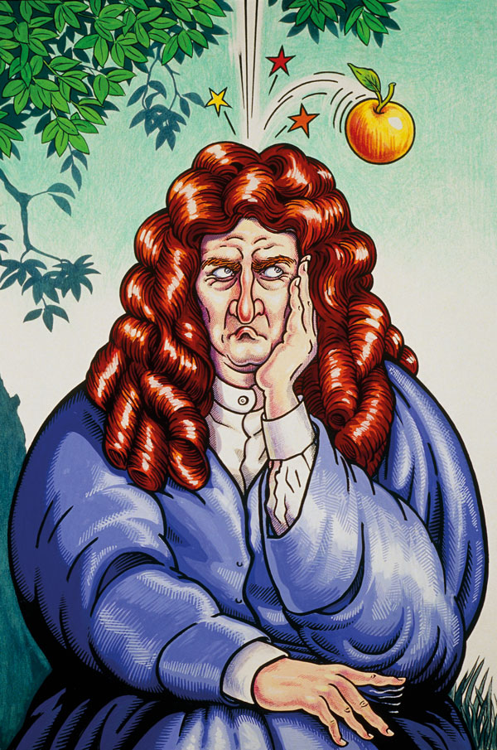
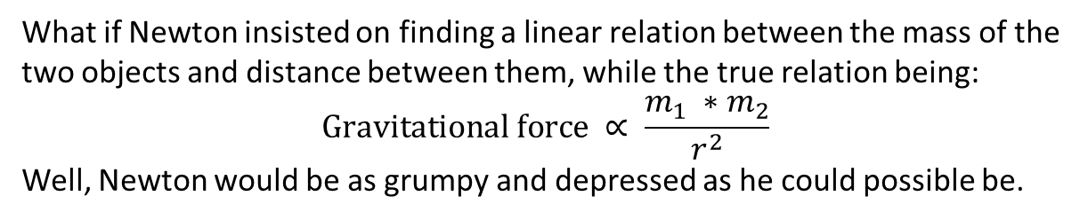

Non-linear Regression I. What happens when linearity is not enough
What if Newton insisted on finding a linear relation between the mass of the two objects and distance between them, while the true relation being:
$$\text{Gravitational} \text{force} ∝ \frac{m_{1} ∗m_{2}}{r^{2}}$$
Well, Newton would be as grumpy and depressed as he could possible be.
Featurization:
Data: the raw input
Features: quantities we can cook up with the inputs
Example: To help Sir Newton’s with his plight, we just need to take logarithm of both sides of the equation and get:
$$\log{(\text{gravitational} \text{force}\text{) = }\log{m_{1}+\log{m_{2} −2\log{r}}}}$$
Note that the right-hand side is again a linear combination.
Here, masses$m_{1}$, $m_{2}$, and distance $r$ are data, but $\log{m_{1}}$, $\log{m_{2}}$, and $r$
are features.
Copyright: MIKKI RAIN/SCIENCE PHOTO LIBRARY

Slide 10



Non-linear Regression II. Repurpose regression for categorical prediction (regression_2_logistic.ipynb)
Why logistic regression:
There are many important research topics for which the dependent variable is discrete or categorical. For example: vote for or against, morbidity, or mortality. Logistic regression is a type of regression analysis designed to handle discrete dependent variable.
A statistical view to linear regression:
Let $Y$ be a random variable whose conditional mean on a bunch of explanatory variables $x_{1},…, x_{n}$ follows a linear relation of the variables. That is
$Y = \left\langle \vec{a}, \vec{x}\right\rangle +b+ε$
where $ε$ is a random variable with zero mean. The process of solving a linear regression is to find the exact relation given samples of the random variable $Y$.
Logit:
Let $Y$ be a binary random variable with the probability of $Y=1$equals $p$, the log odds (or logit) of the event $Y=1$equals $\log{\frac{p}{1−p}}$.
Sigmoid function $σ\left(x\right)=\frac{1}{1+e^{−x}}$:
Sigmoid function is the inverse of the logit function, that is, if $x=log{\frac{y}{1−y}}$, then $y=\frac{1}{1+e^{−x}}$ .
A statistical view to logistic regression:
Let $Y$ be a binary random variable with parameter $p=P(Y=1)$, we assume that the logit (instead of mean) follows a linear relation with the independent variables $x_{1}, …,x_{n}$. Mathematically, we write it as
$$\left\langle \vec{a}, \vec{x}\right\rangle +b=\log{\frac{p}{1−p}}$$

Slide 11
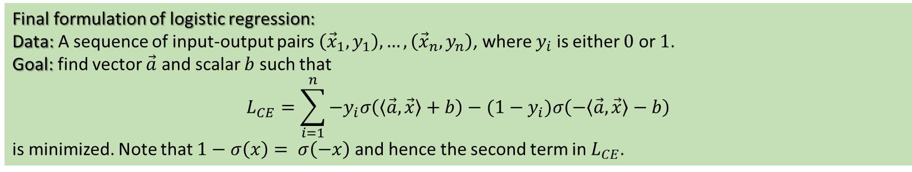
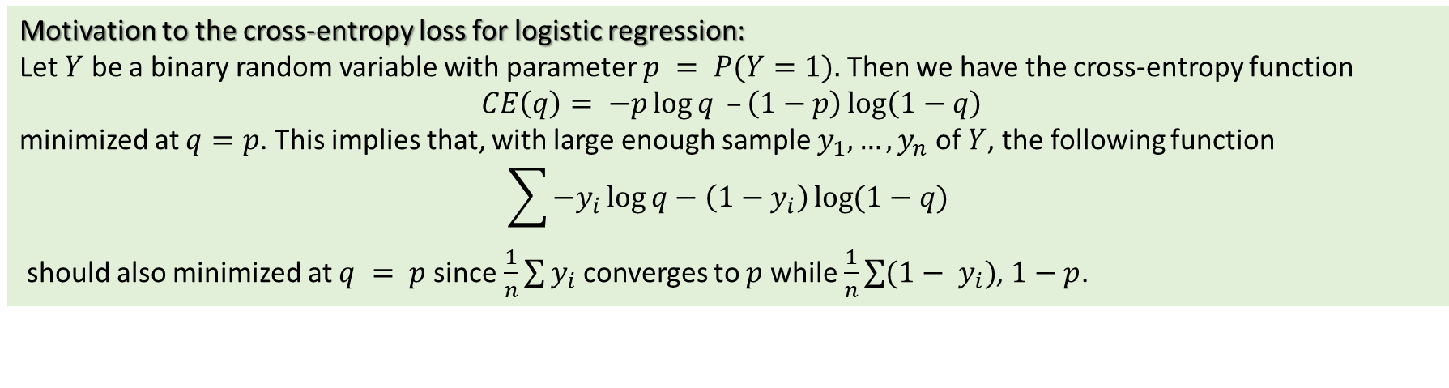
Non-linear Regression II. Repurpose regression for categorical prediction (regression_2_logistic.ipynb), cont.
Motivation to the cross-entropy loss for logistic regression:
Let $Y$ be a binary random variable with parameter $p = P(Y=1).$Then we have the cross-entropy function
$$CE\left(q\right)= −p\log{q} –\left(1−p\right)\log\left(1−q\right)$$
minimized at $q=p$. This implies that, with large enough sample $y_{1},…, y_{n}$ of $Y$, the following function
$$\sum{−y_{i}\log{q−\left(1−y_{i}\right)\log{(1−q}})}$$
should also minimized at $q = p$since $\frac{1}{n}\sum{y_{i}}$ converges to $p$ while $\frac{1}{n}\sum{({1− y}_{i})}$, $1−p$.
Final formulation of logistic regression:
Data: A sequence of input-output pairs $\left({\vec{x}}_{1}, y_{1}\right),…, \left({\vec{x}}_{n}, y_{n}\right)$, where $y_{i}$ is either $0$ or $1$.
Goal: find vector $\vec{a}$ and scalar $b$ such that
$$L_{CE}=\sum_{i=1}^{n}{−y_{i}σ\left(\left\langle \vec{a}, \vec{x}\right\rangle +b\right)−(1−y_{i})σ\left(−\left\langle \vec{a}, \vec{x}\right\rangle −b\right)}$$
is minimized. Note that $1−σ\left(x\right)= σ\left(−x\right)$ and hence the second term in $L_{CE}$.

Slide 12
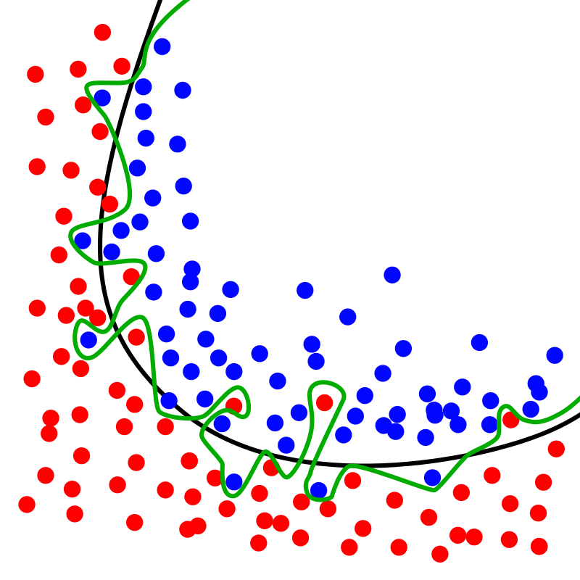
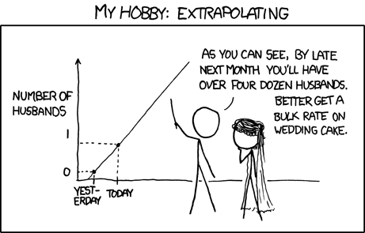
Regression goes wrong, regularization saves the day
https://xkcd.com/605/
Wiki https://en.wikipedia.org/wiki/Overfitting

Slide 13

Regression goes wrong, regularization saves the day (regression_3_regularization.ipynb)
Some reasons for regression going wrong:
Unjustified extrapolation;
Excessively complicated model that overfits on the seen (train) data and fails to generalize to unseen (test) data.
Commonly used regularization approaches for regression:
Let $\vec{α}={\left(\vec{a}, b\right)}^{T}$
Lasso (sparse features):
$$L=\sum_{i=1}^{n}{{\left(y_{i} −\left\langle \vec{a}, {\vec{x}}_{i}\right\rangle −b\right)}^{2}}+ λ({\left\|\vec{α}\right\|}_{1})$$
Ridge (reduce the impact of unimportant feature):
$$L=\sum_{i=1}^{n}{{\left(y_{i} −\left\langle \vec{a}, {\vec{x}}_{i}\right\rangle −b\right)}^{2}}+ λ\left({\left\|\vec{α}\right\|}_{2}^{2}\right)$$
ElasticNet (a little of both):
$$L=\sum_{i=1}^{n}{{\left(y_{i} −\left\langle \vec{a}, {\vec{x}}_{i}\right\rangle −b\right)}^{2}}+ λ\left({\left\|\vec{α}\right\|}_{1}+{\left\|\vec{α}\right\|}_{2}^{2}\right)$$
Analytic solution may no longer exists. Iterative method (e.g. gradient descend) may be used to train the model.
What is regularization:
Regularization is the process of adding information in order to solve an ill-posed problem or to prevent overfitting.
In regression, the added information usually reads like: “The linear coefficients are small or sparse”. And the goal is achieved by penalized big coefficients in the loss function.

Slide 14
























From Regression to Neural Network (regression_4_fromRegressionToNeuralNetwork.ipynb)
How?
Well, we stack them, and sandwich some non-linearity in between.
We know that the composition of linear maps is still a linear map, so we won’t get anything new just by doing linear regression twice, or more. However, if we pass the output from the first regression through some nonlinear function (for example, the sigmoid function in the logistic regression), and then pass the result onto a second regression, we might be able to get something new!
$$o$$
output
$$w_{1}^{(2)}$$
$$w_{7}^{(2)}$$
Linear transform
$$z_{1}$$
$$z_{2}$$
$$z_{3}$$
$$z_{4}$$
$$z_{5}$$
$$z_{6}$$
$$z_{7}$$
Nonlinear function
$$y_{1}$$
$$y_{2}$$
$$y_{3}$$
$$y_{4}$$
$$y_{5}$$
$$y_{6}$$
$$y_{7}$$
…
$$w_{11}^{(1)}$$
$$w_{57}^{(1)}$$
Linear transform
$$x_{1}$$
$$x_{2}$$
$$x_{3}$$
$$x_{4}$$
$$x_{5}$$
input

Slide 15
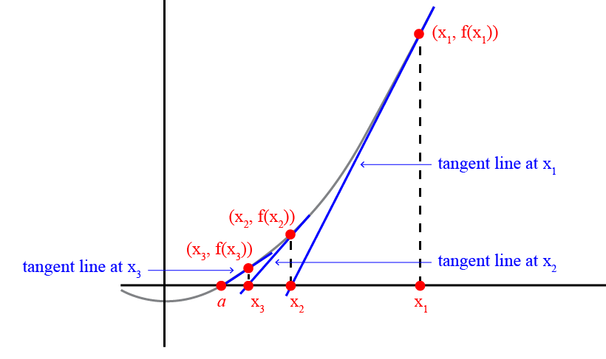
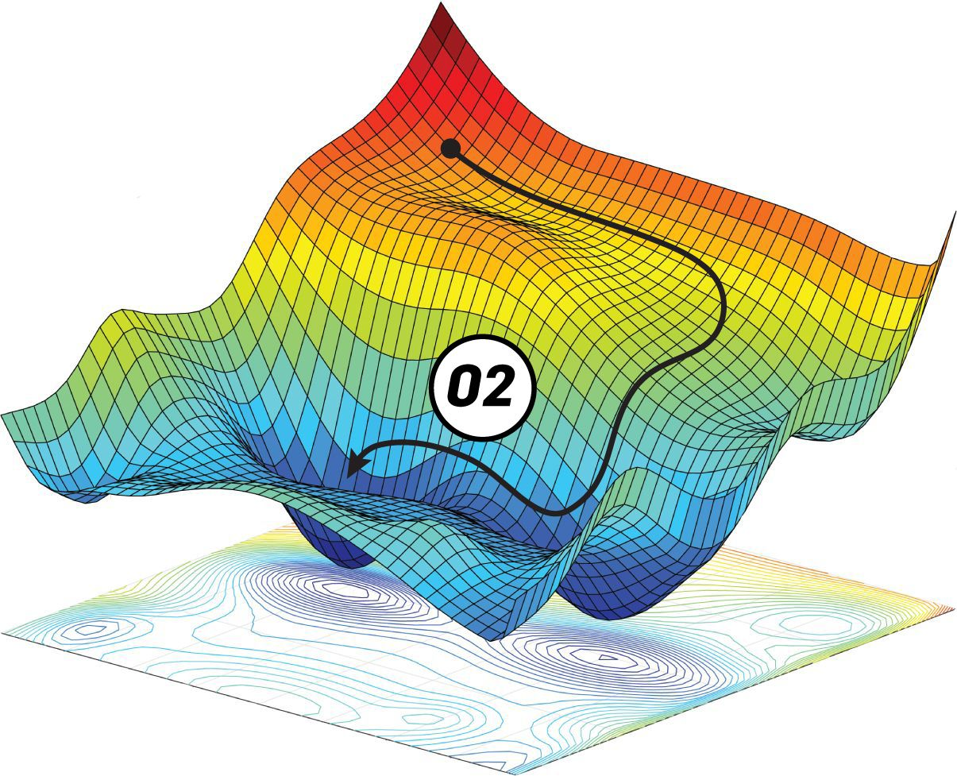
From Regression to Neural Network
Two approaches to hard-to-solve problem:
Simple or no featurization but deep neural network;
Few domain knowledge is needed;
Tend to lack interpretability.
Complex featurization but shallower neural network.
Require reliable domain knowledge;
Easier to interpret.
More on Newton’s method here
Analytic solution v.s. iterative method:
When the model gets complicated, analytic solution may not longer exists and iterative method are needed to train the model. Here are some examples of iterative method:
Newton’s method;
Gradient descent;
Stochastic gradient decent;
More on gradient descent here

