Slide 1
Data mining for research article (group-8)
BCSF14A040 Zain Asghar (Team-Lead)
BCSF14A003 Fahad Fiaz
BITF14M046 Muhammad Hassan

Slide 2
Project Pre-Learning
Basic and Advance Python concepts.
Web Scrapping.
Web Crawling.
DJANGO Framework for ( Server-side ).
Natural Language Tool Kit (NLTK) concepts.
1. Stemming
2. Chunking
3. Chinking
4. Word-net

Slide 3

Project Introduction
Technology that helps researchers and scholars.
Provide tagging facility to researcher and user.
Find crux of the document.
User have no need to read the full document/research.

Slide 4
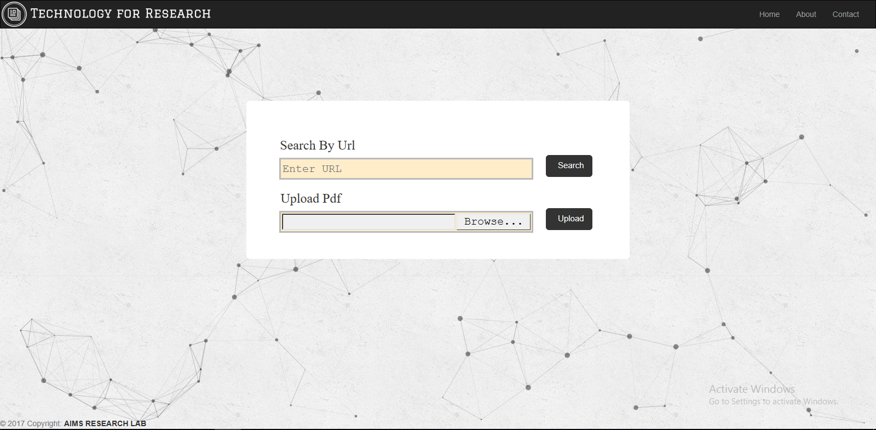
Project GUI

Slide 5
Newly added Features
provides you the facility to download research paper through Sci-hub.
You can directly upload the research paper ( Pdf ).
Store the research paper in database efficiently.
Perform different operations. 1. Sentence Tokenization 2. Word Tokenization 3. Lemmas Finding 4. lemmas Definition
Provide the facility of tagging words and sentences and classify them.
Show the sentences on the basis of lemmas.

Slide 6
Research paper through web
User can enter the URL of research paper and the application will search that paper through Sci-hub.
If paper is available on Sci-hub, paper will be downloaded for further processing.
But if paper is not found on the given URL then error message will be shown to user on the page and further processing will be stopped.
Once a paper is downloaded successfully. PDF document is converted into text and then we perform processing and save in databases.

Slide 7
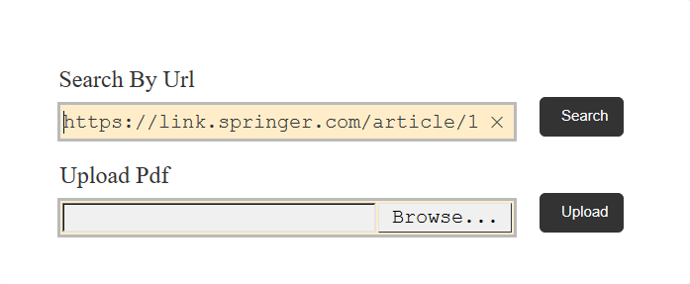
Research paper through web
Search the paper on internet
User will enter the link of the research paper.
This link will added on Sci-hub and download the pdf against that link.

Slide 8
Research Paper ( local-DISK)
User can directly upload the research paper ( pdf-format ).
Once a paper is uploaded successfully, PDF document is converted into text and then we perform processing and save in databases.

Slide 9
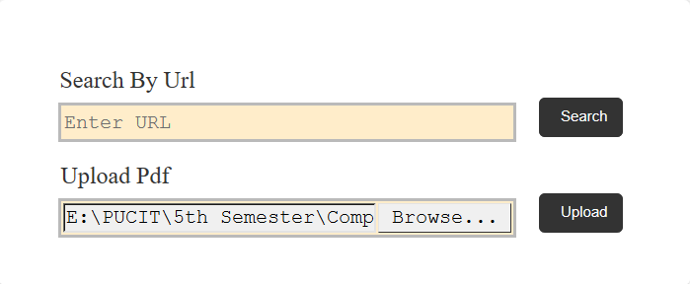
Research Paper ( local-Desktop)
Upload paper through local hard disk
User can upload research paper from local disk.
Only pdf document will be accepted no other format will be accepted

Slide 10
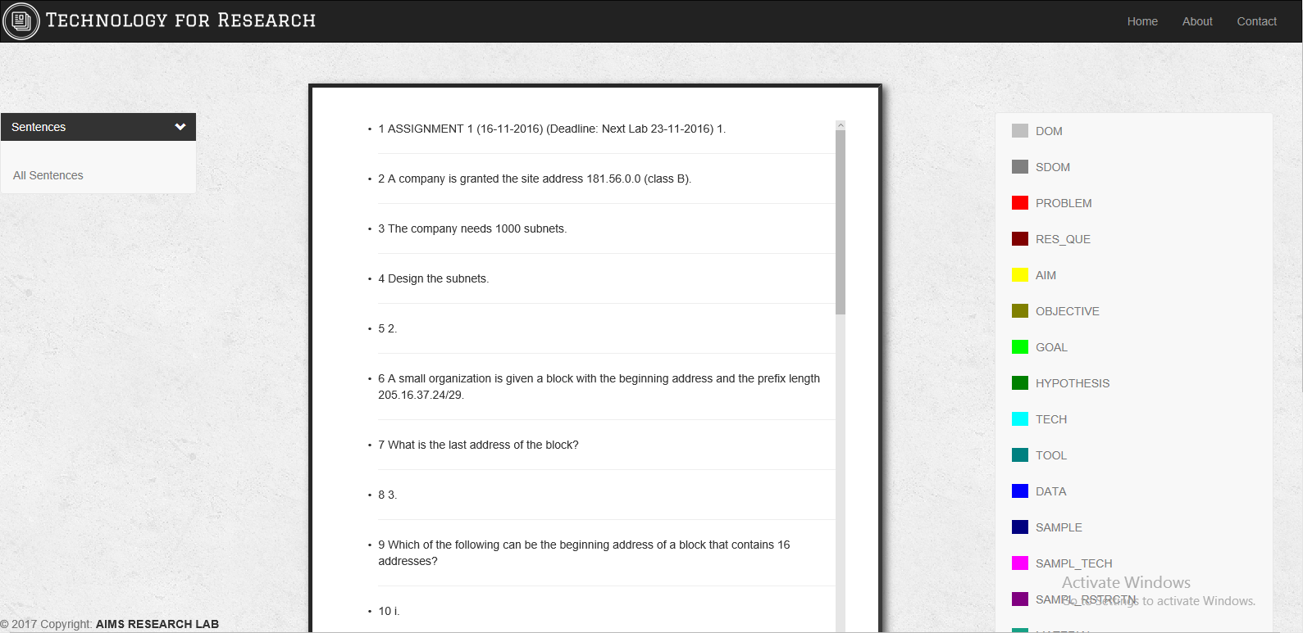
Research paper GUI

Slide 11
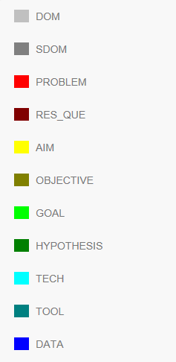
Tagging Facility
This application provides the facility of tagging.
User can tag words and sentences using diff colors which we define in Tag Box on the right side.
User just select the tag and then highlight the text.
By highlighting text will be tagged and classified.

Slide 12
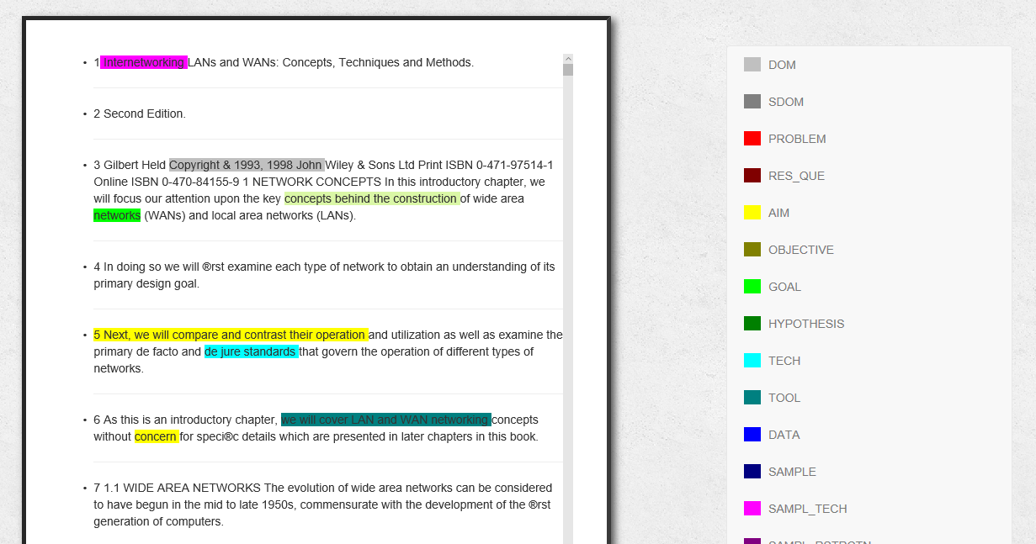
Tagging Facility
User can tag the text into different categories.
Every tag has a specific color.
When user tag some text, text will be highlighted in that specific color.

