Slide 1
Game Play Server
Evaluation # 1

Slide 2
Group Members
Ali Abbas Malik BSEF14A010
Muhammad Arslan Rauf BSEF14A032
Saad Mehmood BSEF14A038

Slide 3
Introduction
Goal of this Project
Our goal is to let programmers keep on improving their coding skills by solving the AI challenging problems, learn new concepts, and get inspired by the best developers.

Slide 4
Technologies used in this Project
Server Side
Nodejs
Database
Mongodb
Client Side
Express handelbars, javascript
Framework Used
Bootstrap, Jquery, Socket.io, Express, Mongoose, Passport

Slide 5
Development: Phase #1
Learnt how to compile and run C# code on server side
Learnt how to pass input to running program from client side after each iteration

Slide 6
Development: Phase #2
Added 6 games
3-Beaker Puzzle Problem
Tic Tac Toe
Snake
2048
Tetris
Wumpus World
Set up Ubuntu server and deployed first stable version of project

Slide 7
Development: Phase #3
Added user authentication
Converted ajax call to real time using socket.io
Deployed 2nd stable version of the project

Slide 8
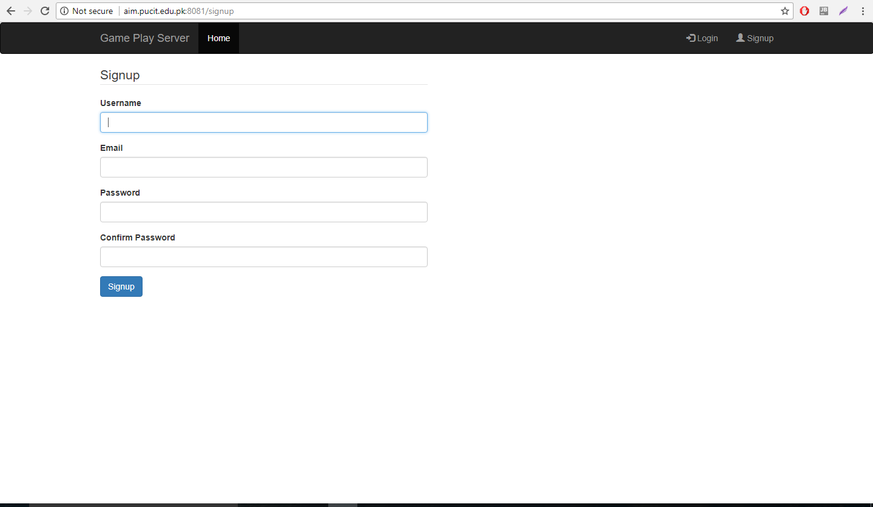
Signup Screen

Slide 9
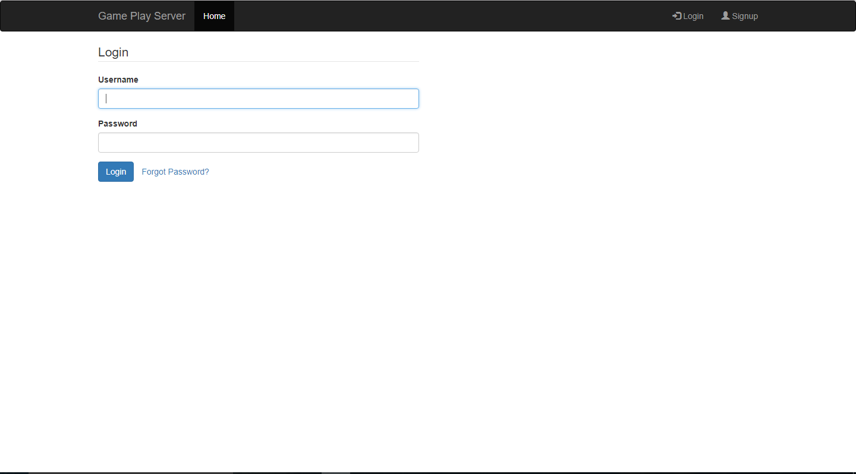
Login Screen

Slide 10
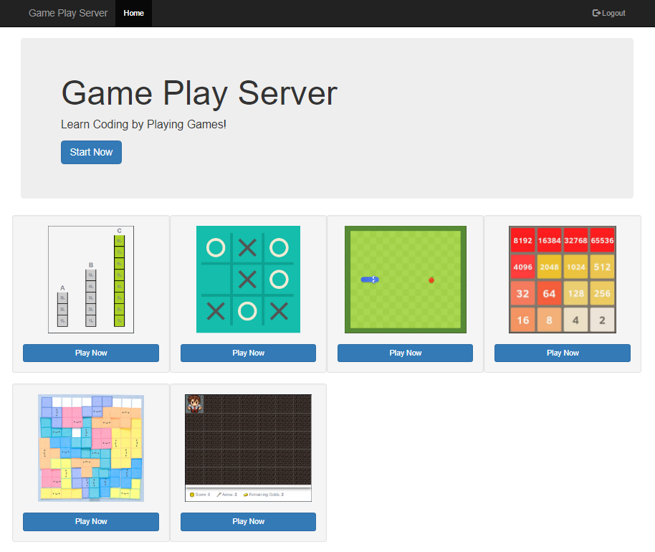
Home page

Slide 11
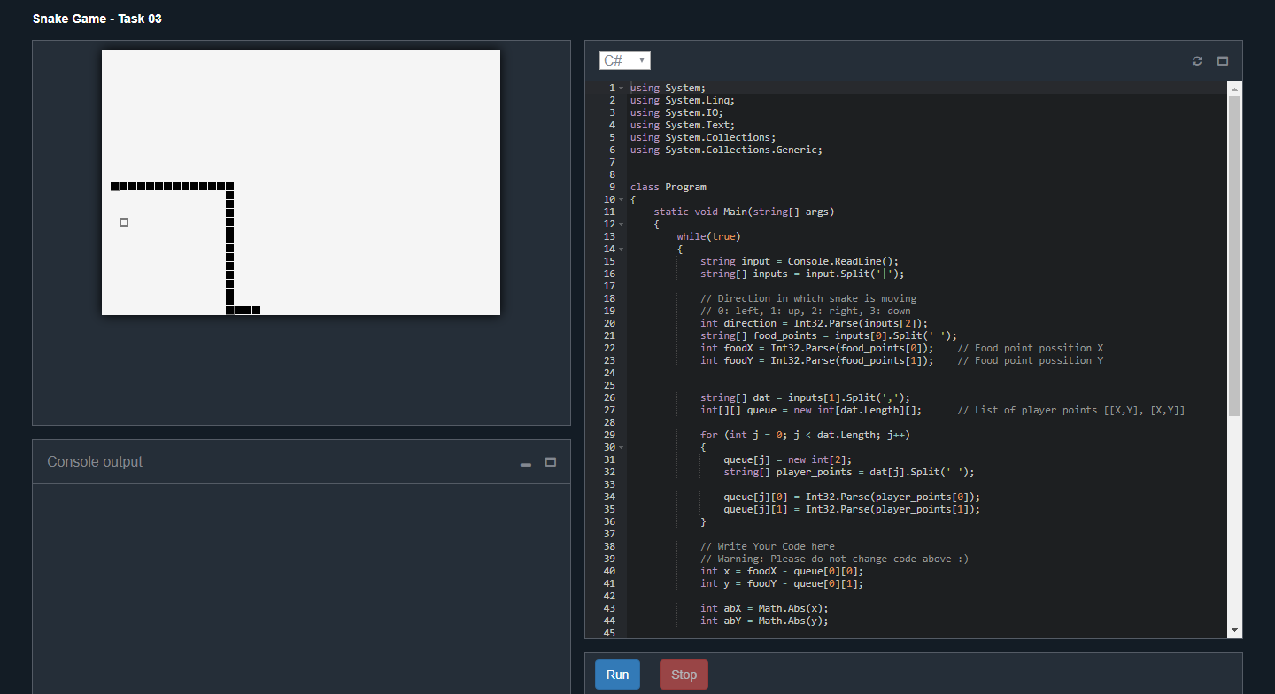
Snake Game

Slide 12
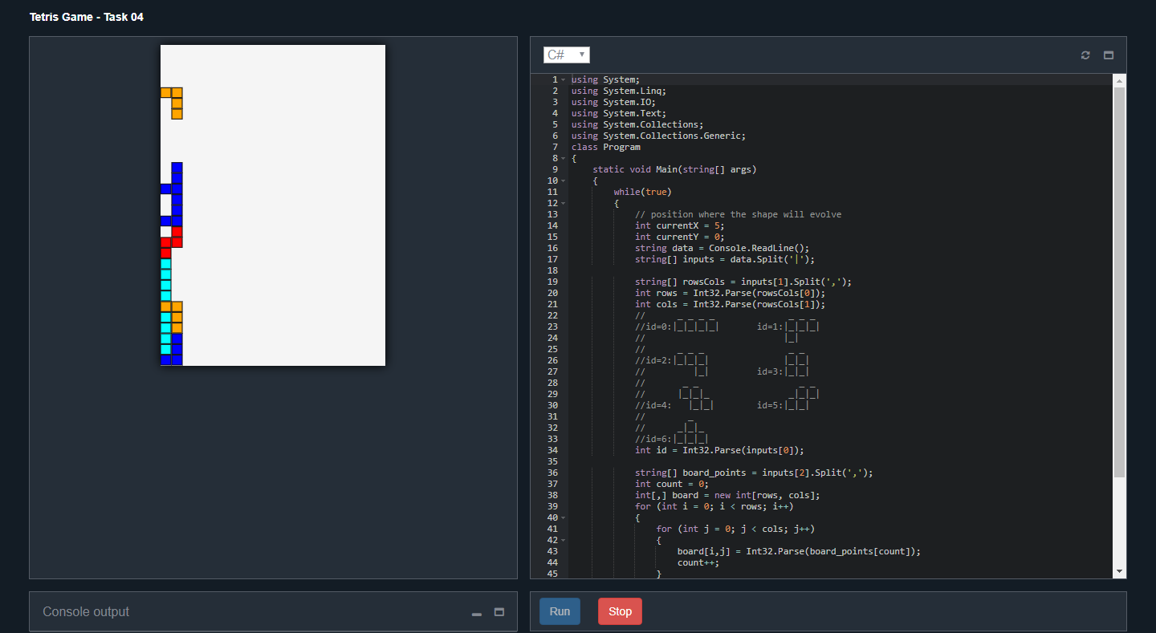
Tetris Game

Slide 13
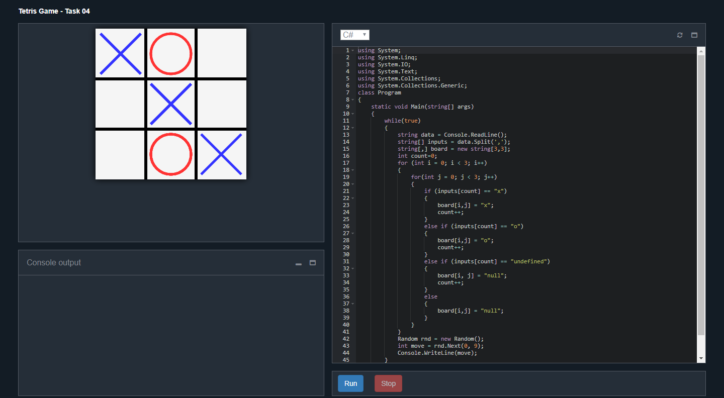
Tic-tac-toe Game

Slide 14
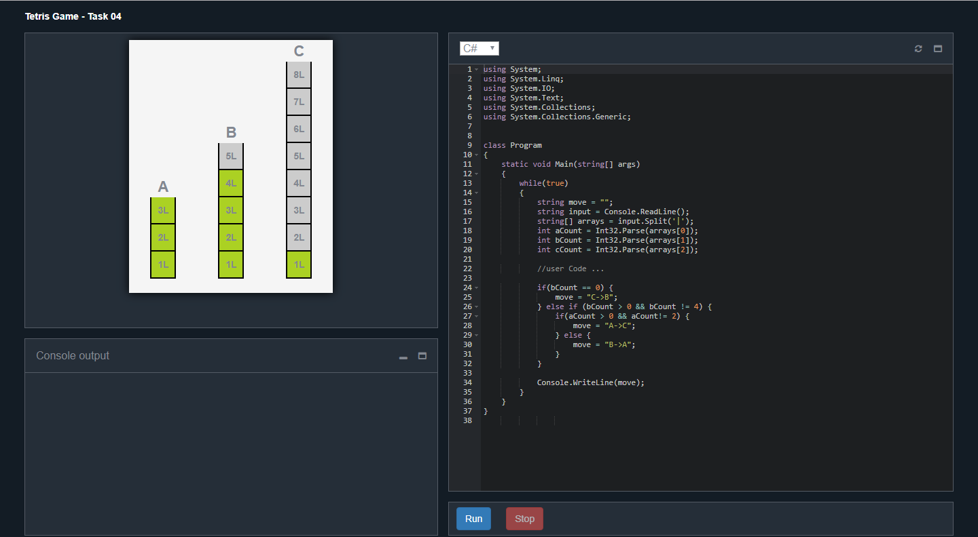
Beaker Problem

Slide 15
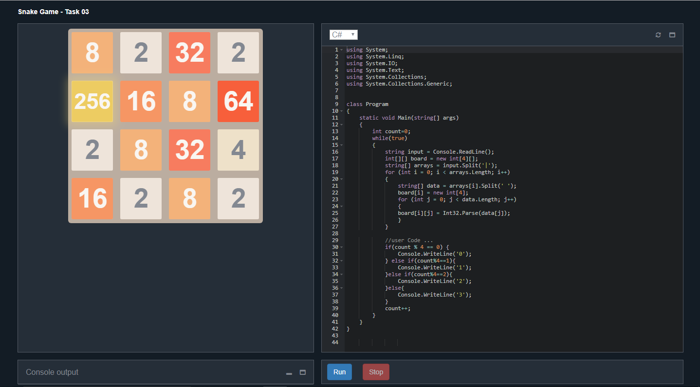
2048 Game

Slide 16
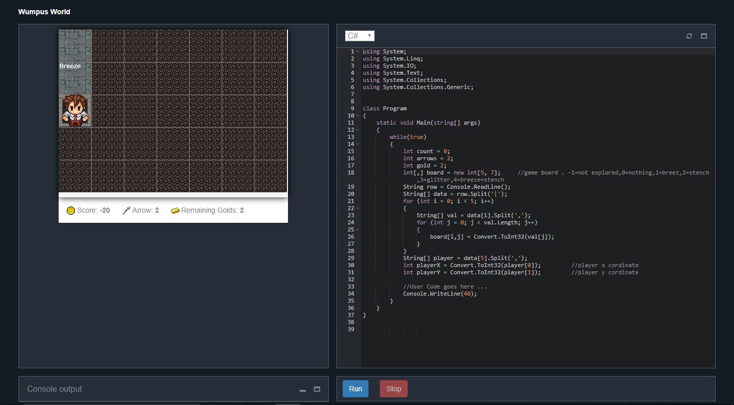
Wumpus Game

Slide 17
Demo

