Slide 1
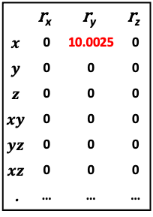
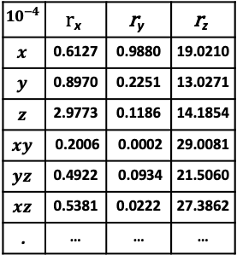






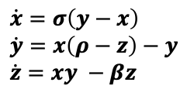

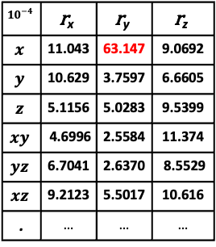
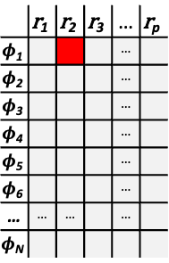

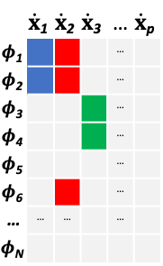




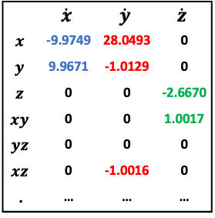
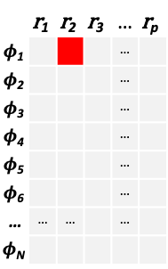



(a) Data Generation
System with
Regime Switching
Lorenz 63 System:
Illustration of CEBoosting on
Lorenz 63 with
Regime Switching
$$\dot{x}=σ\left(y−x\right) \\ \dot{y}=x\left(ρ−z\right)−y \\ \dot{z}=xy −βz$$
$$\dot{x}(t)=f\left(x\left(t\right)\right)+σ\dot{W}(t)$$
$$\dot{x}(t)=f^{∗}\left(x\left(t\right)\right)+σ\dot{W}(t)$$
$$( ρ=28 →38 )$$
$${Batch}^{(k)}$$
$$k=k+1$$
 | $$\dot{x}\text{1}$$ | $$\dot{x}\text{2}$$ | $$\dot{x}\text{3}$$ | … | $$\dot{x}\text{p}$$
$$φ\text{1}$$ |  |  |  | …
$$φ\text{2}$$ |  |  |  | …
$$φ\text{3}$$ |  |  |  | …
$$φ\text{4}$$ |  |  |  | …
$$φ\text{5}$$ |  |  |  | …
$$φ\text{6}$$ |  |  |  | …
… | … | … |  | …
$$φ\text{N}$$
No
 | $$\text{r}\text{1}$$ | $$\text{r}\text{2}$$ | $$\text{r}\text{3}$$ | … | $$\text{r}\text{p}$$
$$φ\text{1}$$ |  |  |  | …
$$φ\text{2}$$ |  |  |  | …
$$φ\text{3}$$ |  |  |  | …
$$φ\text{4}$$ |  |  |  | …
$$φ\text{5}$$ |  |  |  | …
$$φ\text{6}$$ |  |  |  | …
… | … | … |  | …
$$φ\text{N}$$
 | $$\text{r}\text{1}$$ | $$\text{r}\text{2}$$ | $$\text{r}\text{3}$$ | … | $$\text{r}\text{p}$$
$$φ\text{1}$$ |  |  |  | …
$$φ\text{2}$$ |  |  |  | …
$$φ\text{3}$$ |  |  |  | …
$$φ\text{4}$$ |  |  |  | …
$$φ\text{5}$$ |  |  |  | …
$$φ\text{6}$$ |  |  |  | …
… | … | … |  | …
$$φ\text{N}$$
$$C_{φ_{n}→r_{i}|[Φ\backslash φ_{n}]}$$
Yes
$$C^{+}\left(k\right)=…$$
$$=C^{+}\left(k−D+1\right)$$
Yes
$$C^{+}\left(k\right)>0$$
New Regime
No
Current Model:$Ξ^{{(0)}^{T}}$
$$C^{+}\left(k\right)$$
Residual Model: ${Ξ\text{r}}^{T}$
Same Regime
$$First CEM in new regime$$
$$CEM(k)$$
 | $$\dot{x}$$ | $$\dot{y}$$ | $$\dot{z}$$
$$x$$ | -9.9749 | 28.0493 | 0
$$y$$ | 9.9671 | -1.0129 | 0
$$z$$ | 0 | 0 | -2.6670
$$xy$$ | 0 | 0 | 1.0017
$$yz$$ | 0 | 0 | 0
$$xz$$ | 0 | -1.0016 | 0
. | … | … | …
Output
$${10}^{−4}$$ | $$r\text{x}$$ | $$\text{r}\text{y}$$ | $$\text{r}\text{z}$$
$$x$$ | 0.6127 | 0.9880 | 19.0210
$$y$$ | 0.8970 | 0.2251 | 13.0271
$$z$$ | 2.9773 | 0.1186 | 14.1854
$$xy$$ | 0.2006 | 0.0002 | 29.0081
$$yz$$ | 0.4922 | 0.0934 | 21.5060
$$xz$$ | 0.5381 | 0.0222 | 27.3862
. | … | … | …
$${10}^{−4}$$ | $$\text{r}\text{x}$$ | $$\text{r}\text{y}$$ | $$\text{r}\text{z}$$
$$x$$ | 11.043 | 63.147 | 9.0692
$$y$$ | 10.629 | 3.7597 | 6.6605
$$z$$ | 5.1156 | 5.0283 | 9.5399
$$xy$$ | 4.6996 | 2.5584 | 11.374
$$yz$$ | 6.7041 | 2.6370 | 8.5529
$$xz$$ | 9.2123 | 5.5017 | 10.616
. | … | … | …
 | $$\text{r}\text{x}$$ | $$\text{r}\text{y}$$ | $$\text{r}\text{z}$$
$$x$$ | 0 | 10.0025 | 0
$$y$$ | 0 | 0 | 0
$$z$$ | 0 | 0 | 0
$$xy$$ | 0 | 0 | 0
$$yz$$ | 0 | 0 | 0
$$xz$$ | 0 | 0 | 0
. | … | … | …
$$\text{Current} \text{Model}$$
$$Ξ^{{(0)}^{T}}$$
Aggregate
($Ξ$_{r} = 0)
(c) Parameter
Estimation
(b) Causation Entropy Calculation

