Slide 1
STACK AND QUEUES
Héctor Campos Romero
Beatriz Cortés Sánchez

Slide 2
ADTs
Spec QUEUE[ITEM]
genre queue, item
operations
enqueue: queue item -> queue
dequeue: queue -> item
giveFront: queue -> item
empty: queue -> boolean
listQueue: void -> void
endspec
Spec STACK[ITEM]
genre stack, item
operationos
push: stack item -> stack
pop: stack -> item
giveTop: stack -> item
empty: stack -> boolean
endspec

Slide 3
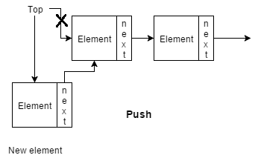
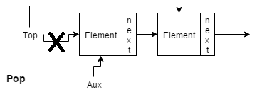
The Stack
PUSH
POP

Slide 4
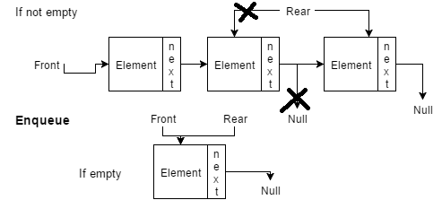
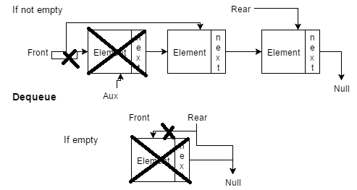
The Queue
ENQUEUE
DEQUEUE

Slide 5
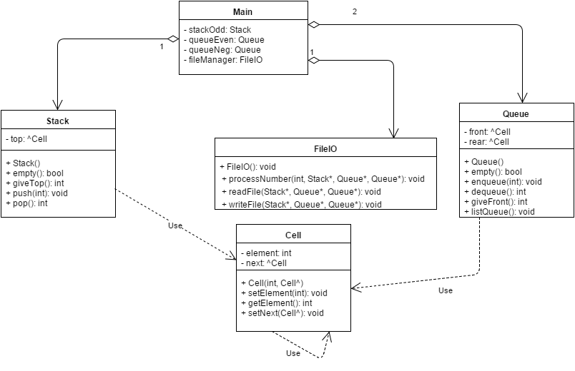
CLASS DIAGRAM

Slide 6
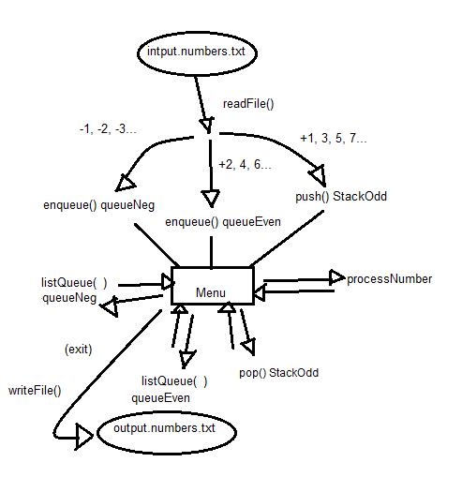
Workflow

