Slide 1
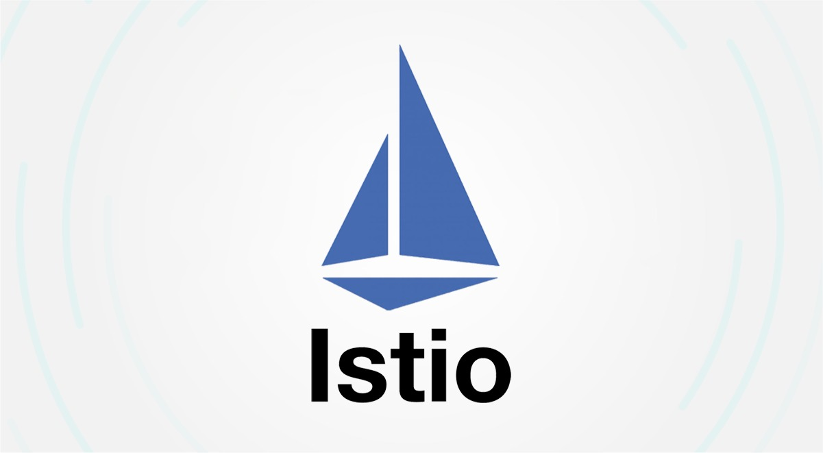
Introducing Istio: A Service Mesh for Kubernetes cluster
Author : Ainul Habib. ()
Organization : TU Dublin

Slide 2
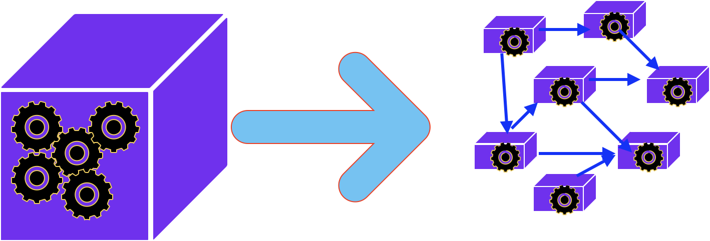
Monolith to Microservice transition
MONOLITH
MONOLITH
Clustered independent services
Each service can be a business feature
Communicating with each other
Single codebase
Contains all features of application
Single Application Unit
Running Standalone

Slide 3
Advantages of Microservice transition
Increase Resilience : Reduce Single point of failure
Scalability : Scale individual Service based on Need
Flexible: Polyglot Service, own persistence system
Faster Delivery: Small Change encourages frequent releases
Business Agility: Each team is delivering individual business capability
Better Data Security and Compliance

Slide 4

Microservice also brings Challenges
Service Discovery
Load Balancing
Fault Tolerance
Distributed Tracing
Telemetries
Security (enforcement and policy)
Granularity
Bounded Context
Independent relesable
Service Contract
Smart service dumb pipes

Slide 5

Canary / Rolling Deployment
App V1.0
Before. 100%
Rolling Deployment
App V1.0
After (100%)
TRAFFIC CONTROLLER
Before 100%
App V1.0
90% to 0%
Canary Deployment
App V1.0
10% to 100%
TRAFFIC CONTROLLER

Slide 6



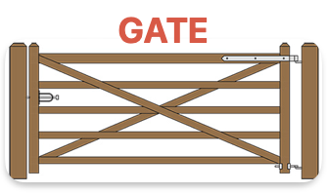


Service Mesh
MOTIVATION
DO NOT BURDEN MY CODE
WITH INFRASTRUCTURE RELATED
CODE, DEPENDENCY
AND
DESCISION
Data Plane
Application Container
Application Container
Application Container
Offload all communication heavy lifting from code to Sidecar
Sidecar container
Envoy Proxy
Sidecar container
Envoy Proxy
Sidecar container
Envoy Proxy
Push Certs , TLS, Traffic policy and Traffic Routing
Control Plane
Control Tower (manages the sidecar)

Slide 7

Traffic Management
Control
Plane
Advantage of Service Mesh is more apparent when there are large number of microservices, managed by single control plane and Sidecars, without writing any application code or employing any other heavy technologies.
Traffic Split 10%
Traffic Split 90%
Traffic Policy : header filter:
user-agent: *iphone*
Data
Plane
Sidecar container
Proxy
Sidecar container
Proxy
Sidecar container
Proxy
Sidecar container
Proxy
Http2
or
gRPC
Canary
(new version)
Application Container
( new version)
Application Container
Application Container
Application Container

Slide 8


Security Enforcements
MOTIVATION
Enforce all network security policy in the Sidecar, making the communication Secure, and centrally managed
Data Plane
Application Container
Application Container
Application Container
Policy Enforcement can be applied universally to all sidecar
OR
more granularly level like Namespaces and Services
Sidecar container
Proxy
Sidecar container
Proxy
Sidecar container
Proxy
Push security Certs , TLS, enforcements
Applications do not worry about network security.
Sidecar get the security
policy injection from control plane.
Control Plane
The Policy guides the sidecars on security enforcement and protocol to use when communicating with other services
Control Tower (manages the sidecar)

Slide 9
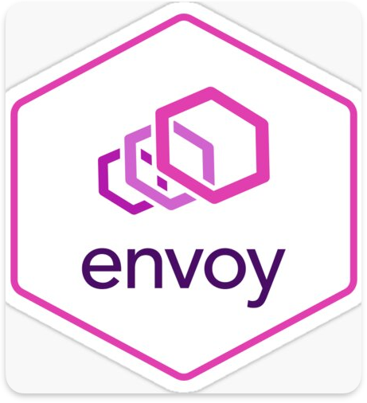
Service Mesh
Advantage of Service Mesh is more apparent when there are large number of microservices,
managed by a Single Control Plane and Sidecars
without Applications having to write a single line of code.
This Whole concept of a Control Plane and SideCar, driving the Service-to-Service Network Communication, Traffic and Security policy is what we call “Service Mesh”
One of the well-known Open Source Project which implements the “Service Mesh” is called ISTIO + Envoy

Slide 10

Istio + Envoy
Control Plane
istiod
PILOT
Galaxy
ISTIO AUTH
Citadel
MIXER
TLS Cert pushed to envoy
Traffic Management, Routing, Config Management etc
Policy Checks and Telemetry
Query Resource
Cluster
Traffic
Ingress
Gateway
Ingress Gateway
HTTP/1.1, HTTP/2
HTTP/1.1, HTTP/2
gRPC, TCP with or without TLS
gRPC, TCP with mTLS enabled
Sidecar
Sidecar
Virtual Services
( Permissible )
( Strict )
Destination Rules
Application Service
Application Service

Slide 11
Istio + Envoy
Service Mesh
Responsibilities
Service Discovery
Load Balancing (set of algorithms)
Multi-Protocol Support ( Http2/gRPC)
Fault Tolerance (Circuit Breaker, Rate Limiter, Auto-Retries)
Scaling
Tele-metrics
Distributed Tracing
Security (m-TLS, Policies
Sidecar
Proxy
Configures and controls
Service Mesh makes it possible to offload all NON-BUSINESS logic out of Microservice into a Sidecar, keeping the application container responsible for Business Only features and logics.

