Slide 1

Azure Function: Application Insight Captuered
- Ainul Habib
This Photo by Unknown Author is licensed under CC BY-SA

Slide 2
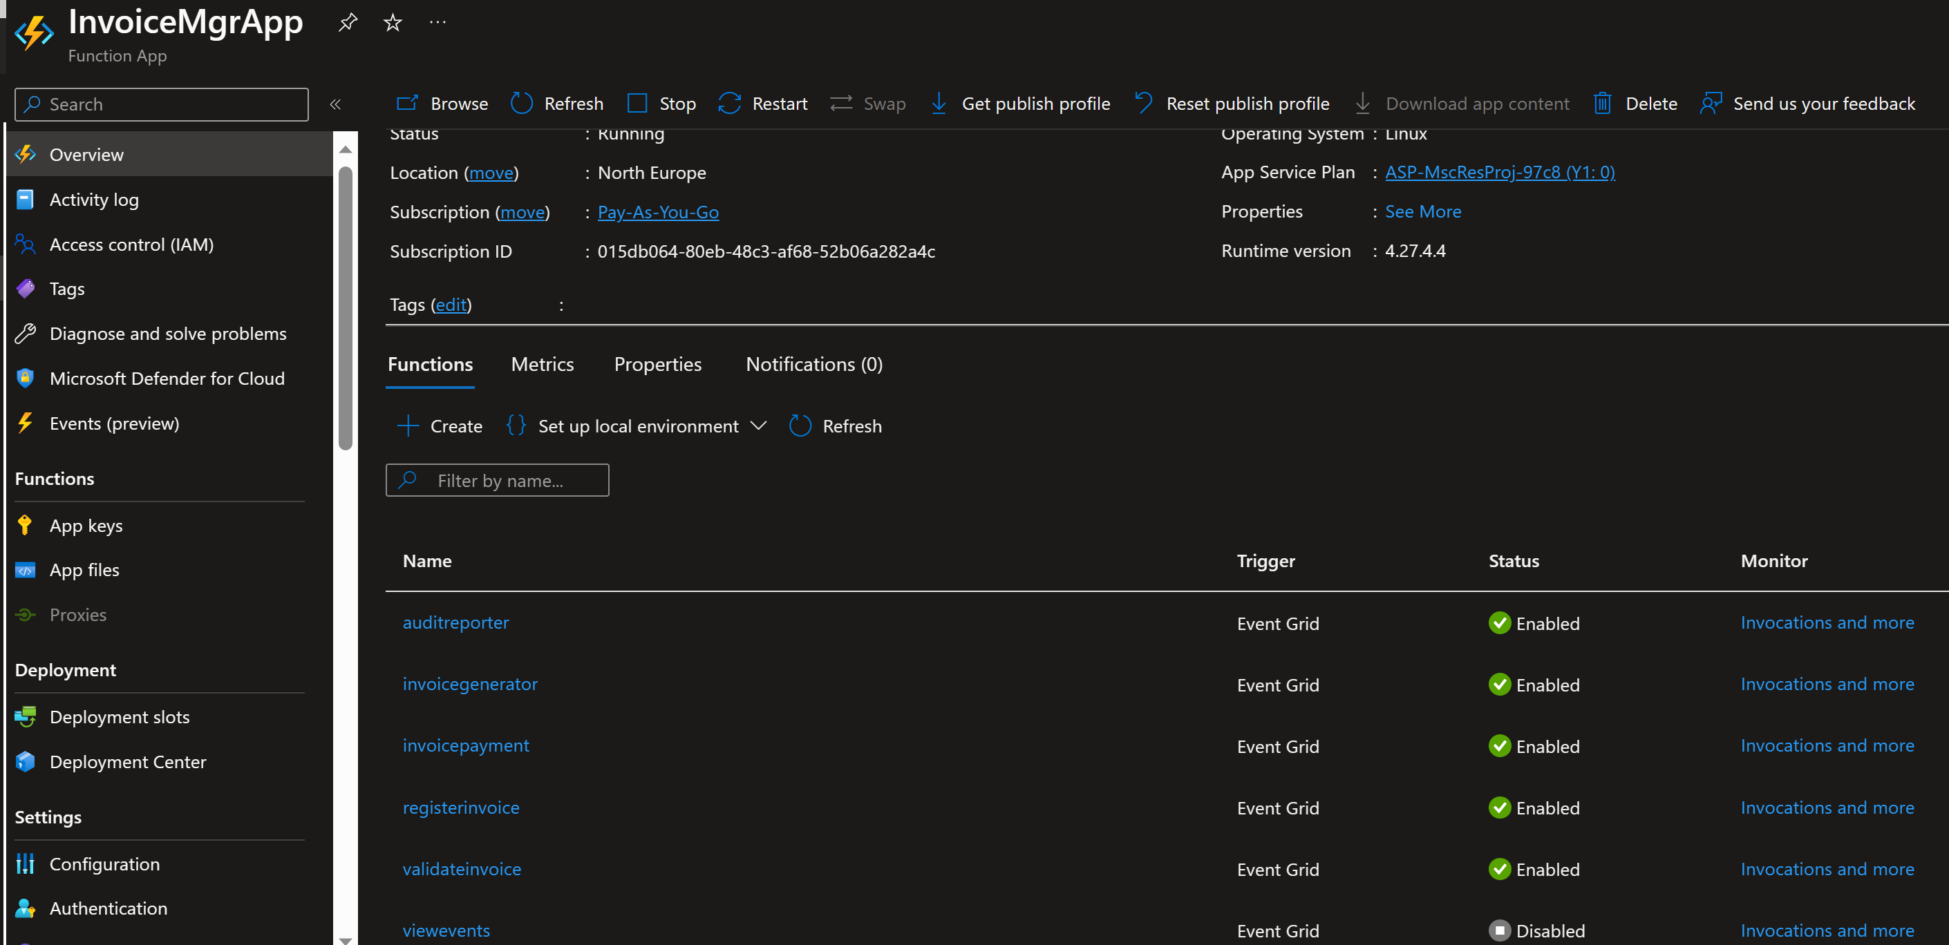
Azure Functions: Function App and Functions

