Slide 1

Knative: Metrics Captured
- Ainul Habib

Slide 2


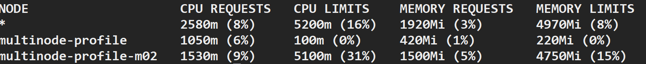
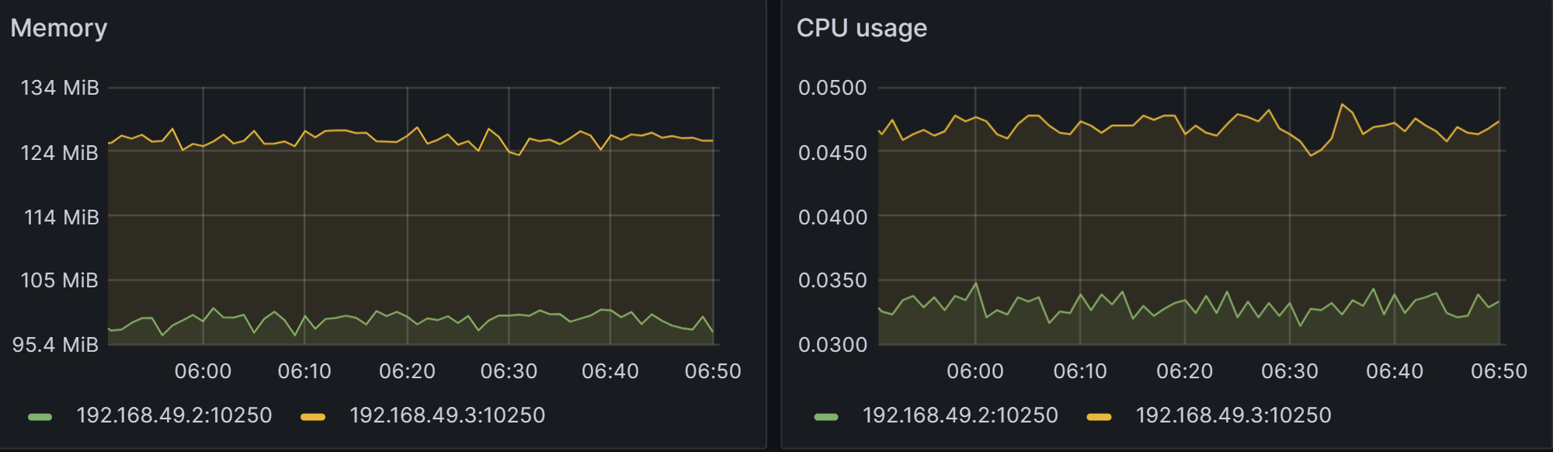
Knative: LAB SETUP
2 Node Cluster
Machine Capacity:
16 Core AMD Processor
32 GB RAM
1 TB disk Space
OS : Ubuntu 20.05.5 LTS
Node 1 :
multimode-profile
1 Core
0.4 GB RAM
192.168.49.21
Node 1:
multimode-profile-m2
5 Core
8 GB RAM
192.168.49.3
v1.25.11

Slide 3


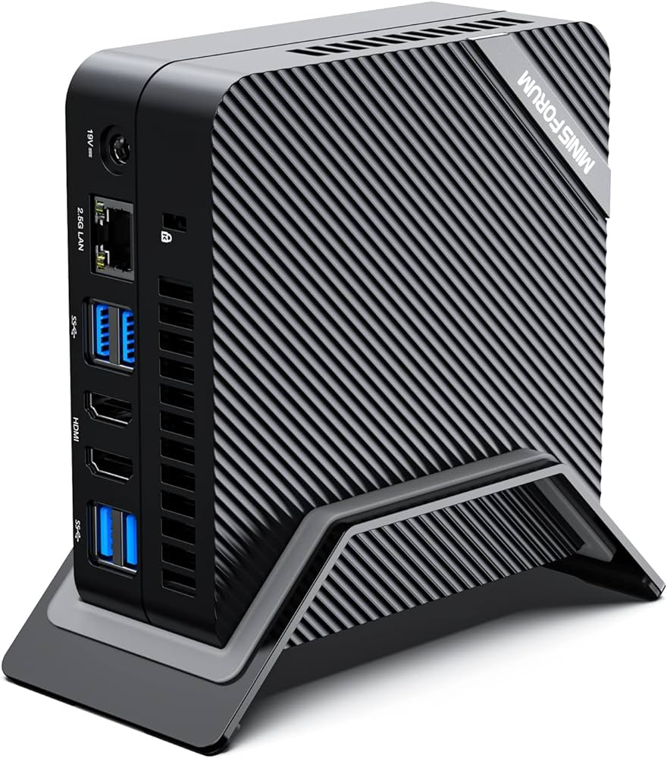






Knative provides an open API and runtime environment that enables you to run your serverless workloads on any Kubernetes Cluster
Knative Deployment
SERVING
Machine Capacity:
16 Core Processor
32 GB RAM
1 TB disk Space
2 Node Cluster
Kourier
(service Mesh)
Knative CLI
EVENTING
MONITORING

Slide 4
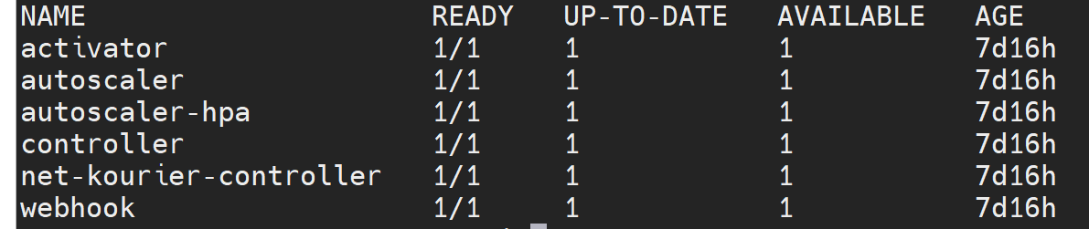
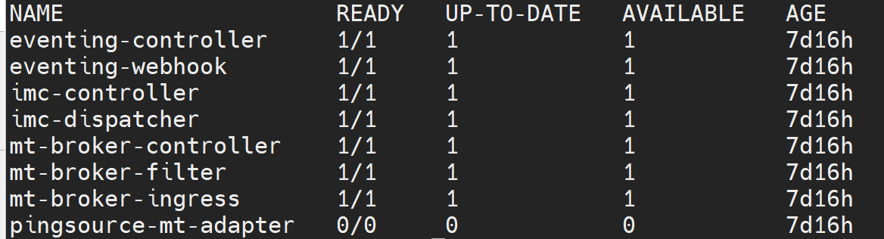
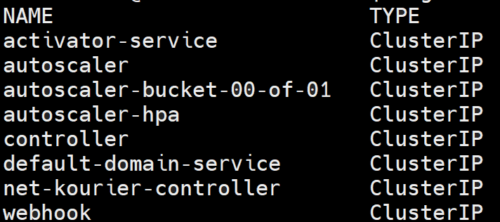
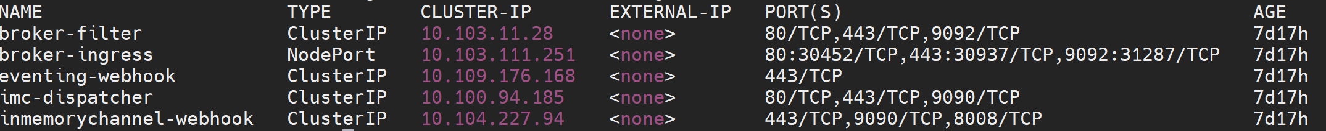
Knative: Lab DEPLOYMENTS
v1.25.11
Knative Serving
Knative Eventing
Kourier System
deployments
deployments
deployments
services
services
services

Slide 5
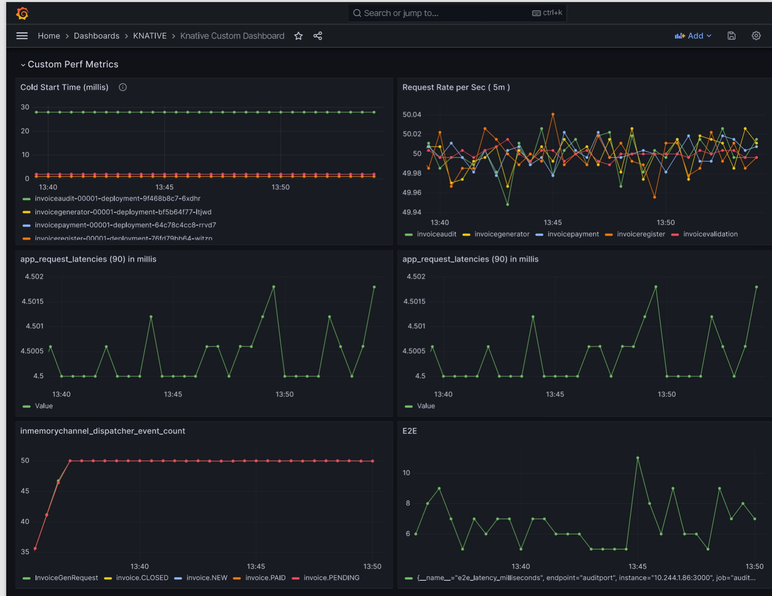
Knative: Grafana View, First Deployment
Screen short showing Grafana Metrics for First Deployment.
POD startup time of one of the function has increased t0 30 Sec, with Image Pull from registry taking maximum time.
Traffic Load nearly 50 TPS
Application request latency is 4.5 milliseconds
Rate of Event dispatch from memory channel is 50
End To End latency, time taken for the workflow to complete is between 6 to 8 milliseconds, the spike of 10 sec is due to cold start of some functions.

Slide 6
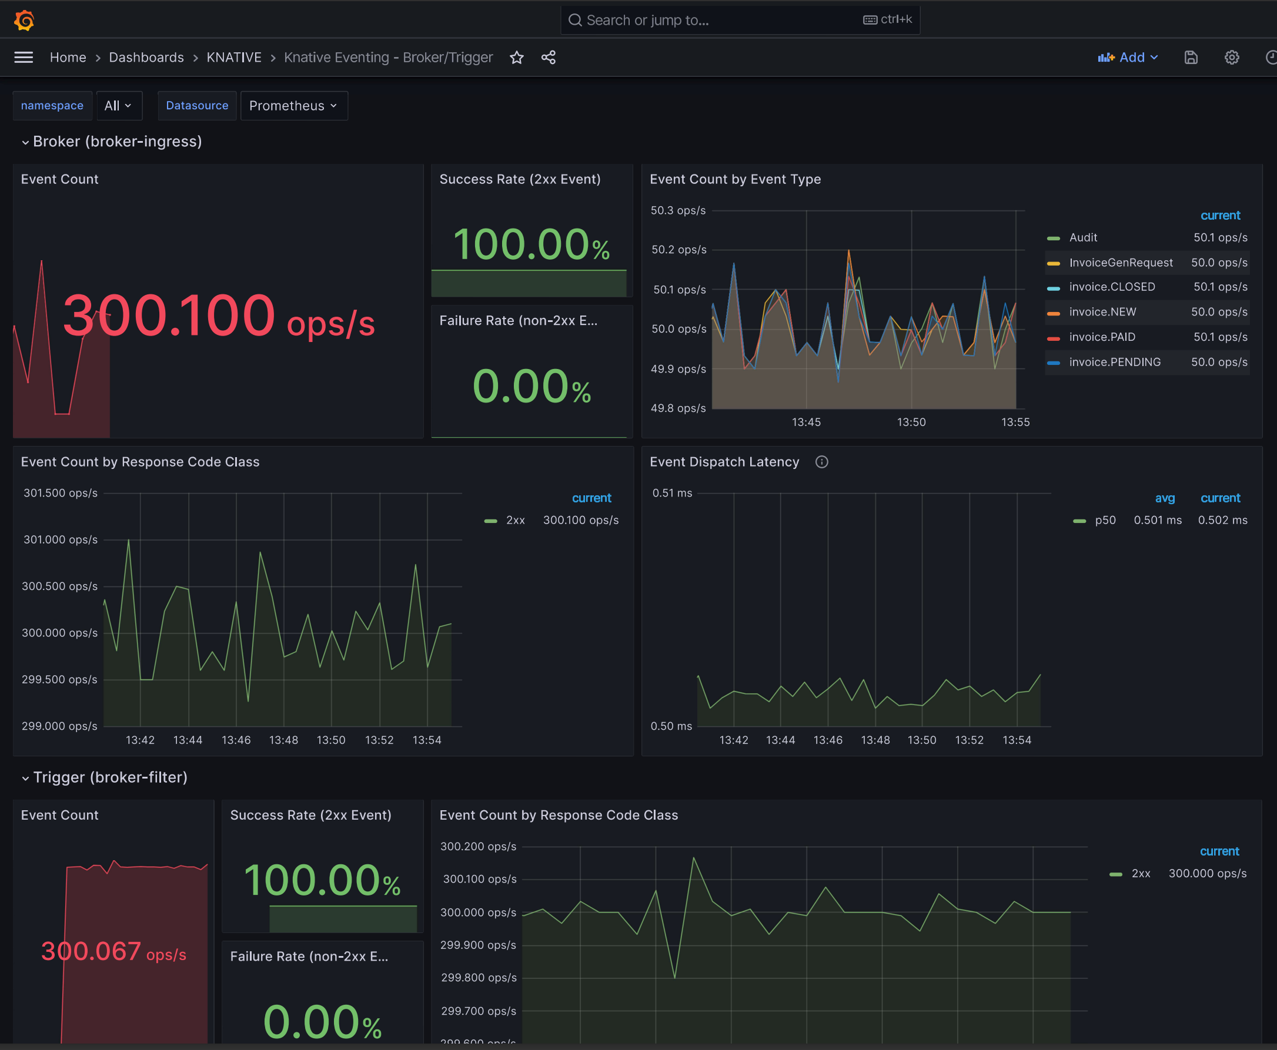
Knative: Grafana View, Broker View
Grafana Metrics of Knative Event Broker showing incoming Traffic and dispatch
Event Count is 300 operations per sec
There is 6 functions, each will consume and republish events back to broker. (50 request * 6 = 300 ops)
Average Dispatch latency from broker is 0.501 milliseconds
All events are successfully processed, none of the events suffered timeout or failure.
Events are processed by Function updating the event type. There are 50 request made to generate Invoice, Function updates each Type is every steps from NEW, PENDING, PAID and CLOSED. As such each function processed 50 events per seconds.

Slide 7
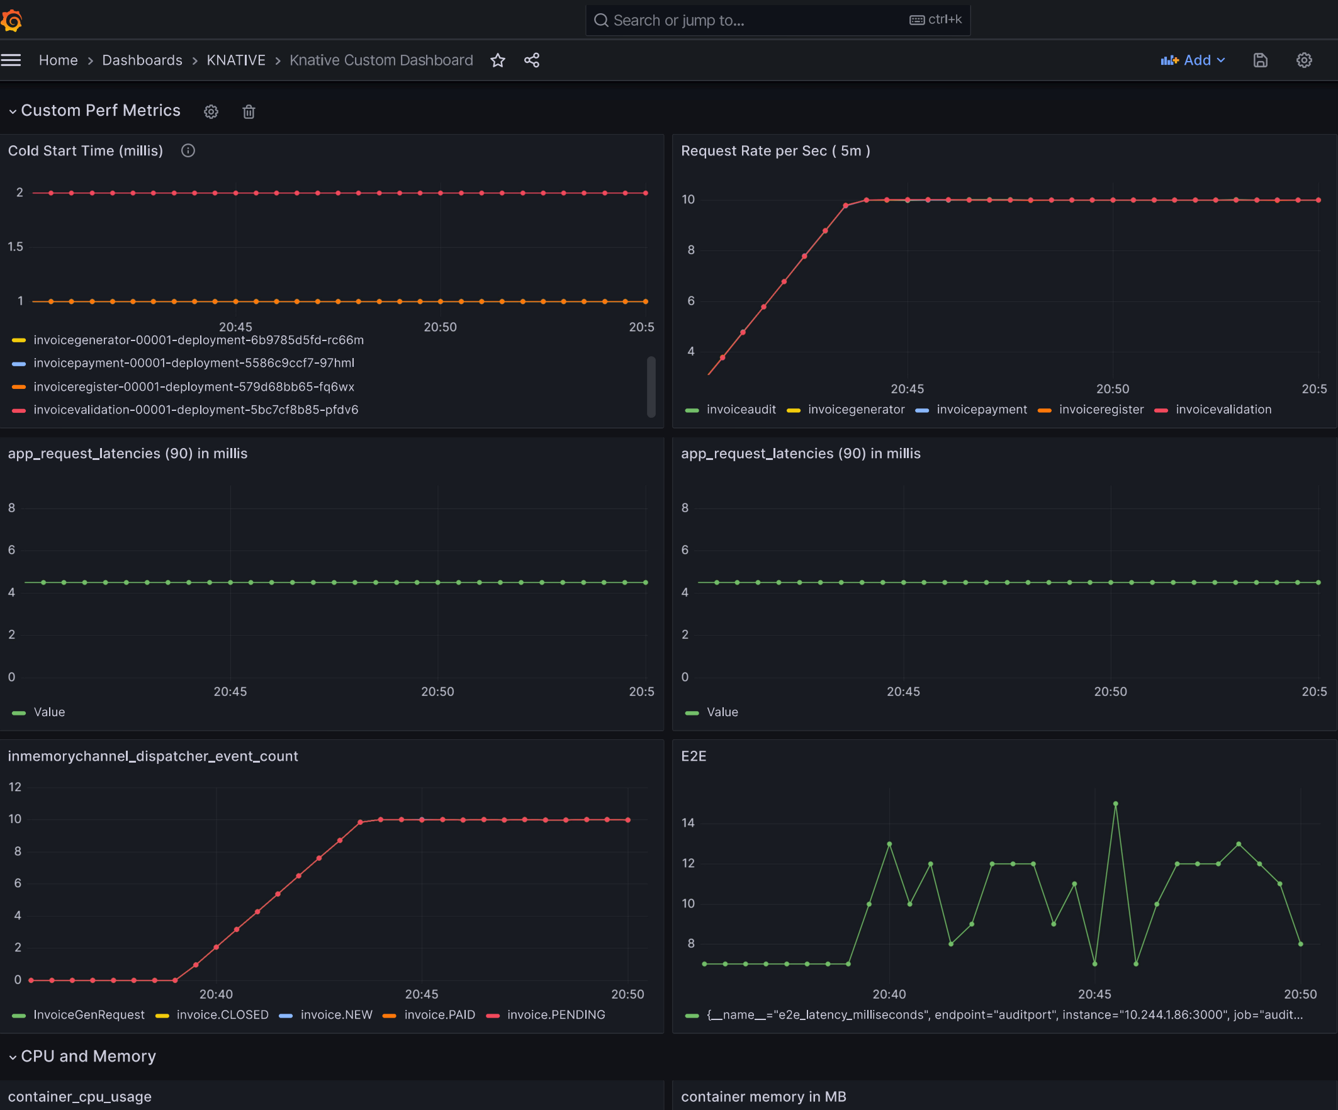
Knative: Metrics, Grafana View, ( Warm Startup )
When traffic is stopped all Knative services are terminated. When traffic resumes PODs are restarted, but this time it will be a WARM START because the PODs will not pull the container image.
Cold Start time is reduced to 1 to 2 seconds
There is slow traffic of 10 RPS, but End To End latencies varies between 6 to 14 milliseconds.
Request latencies across the all Knative Functions is 4 millisonds

Slide 8
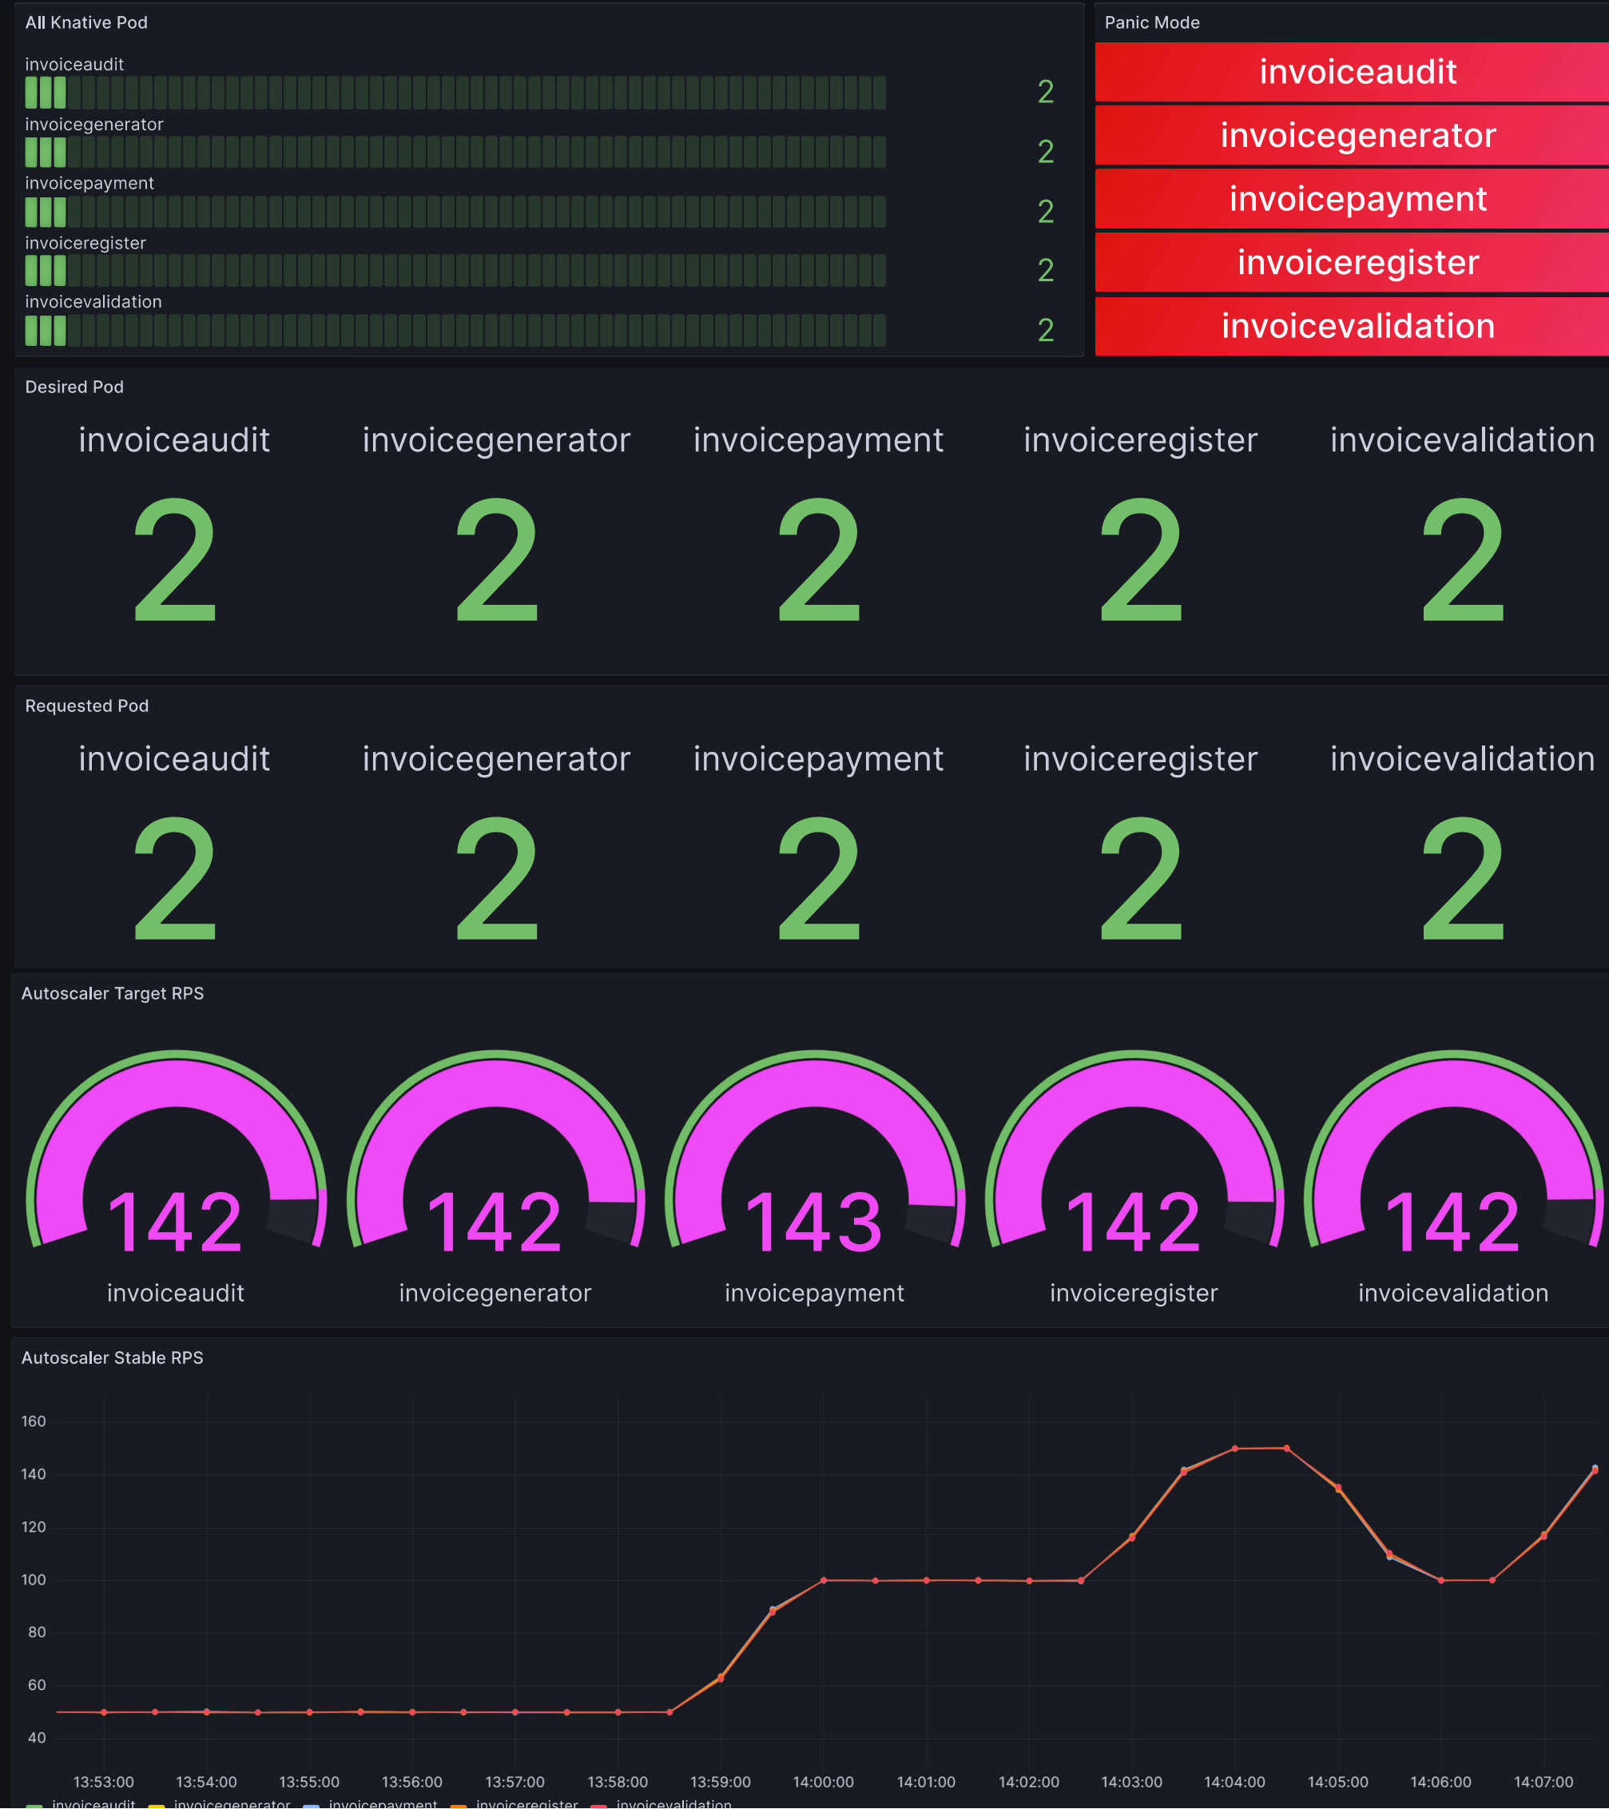
Knative: Metrics, Grafana View, ( Autoscaling )
The Autoscaling is set for Request Per Seconds, with threshold value of 200 RPS (or TPS).
But Functions will go in a PANIC state when RPS is 70% of threshold (140)
Functions PANIC state is visible Grafana view marked as RED
Autoscaler will now request 2 PODs per functions to handle the load.
Knative Serving uses Kubernetes API to Scales the PODs to 2

Slide 9
Knative: Back to Normal
The traffic is normalized below threshold, Autoscaler will request the Knative Serving to reduce the desired pod to default .
Desired functional instances is reduced to One
The requested POD is reduced to ONE
POD’s are NOT in Panic State anymore

