Slide 1
Multi AI Agents using Langgraph
Project 1

Slide 2
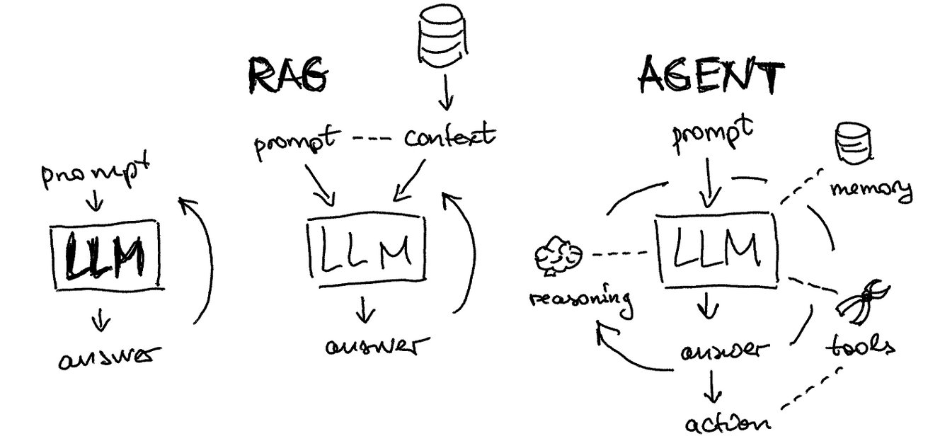

Slide 3
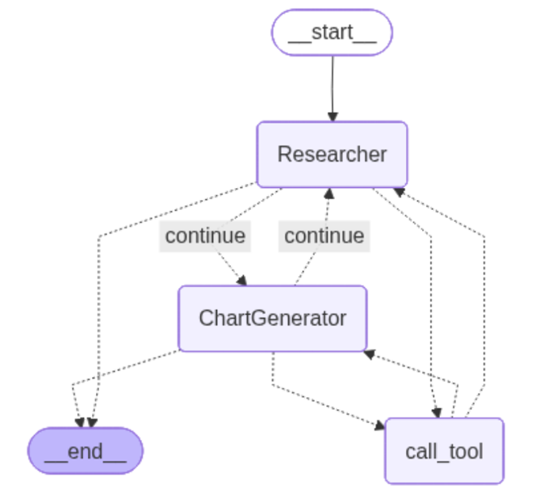
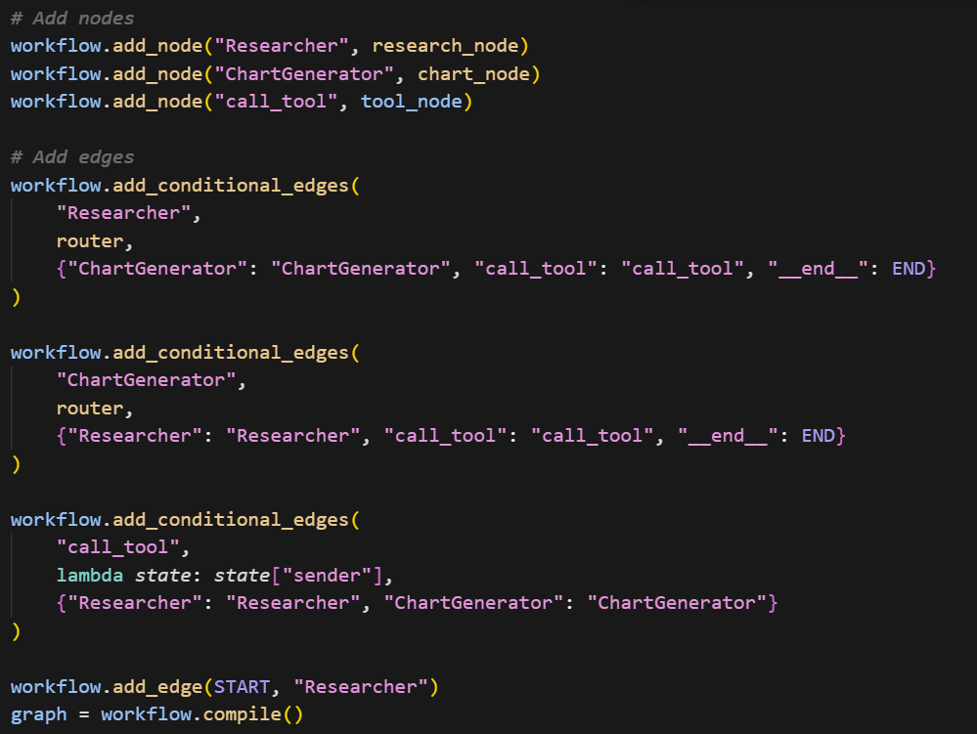
Workflow Overview

Slide 4
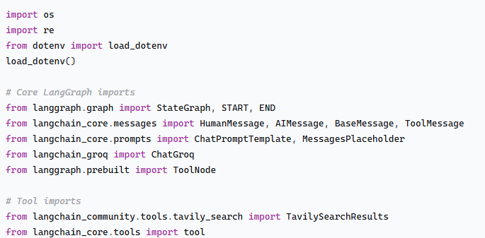
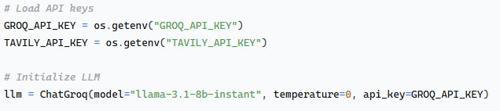
Environment Setup, Imports & LLM
load_dotenv(): Loads API keys from .env file
LangGraph: Manages agent workflow
Tavily: Provides web search capability
Groq: LLM for agent reasoning

Slide 5
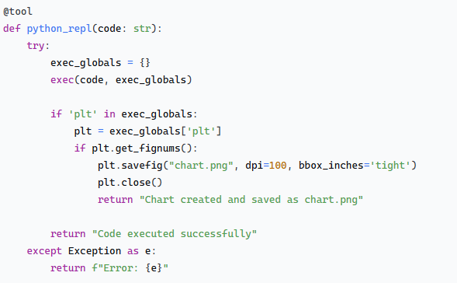
2. Tool Definitions – Defining Tools and creating Tool Node
Tool 1:
Tool 2:
In LangChain, an “Agent” is an AI entity that interacts with various “Tools” to perform tasks or answer queries. Tools are essentially functions that extend the agent's capabilities by allowing it to perform specific actions, like retrieving the current time or accessing an external database.

Slide 6
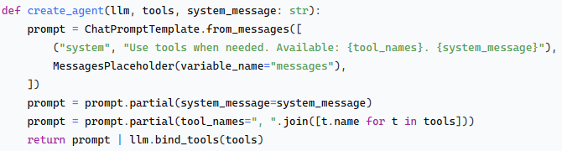
3. Agent Creation System (Option 1)
Agents let the model use tools in a loop, so that it can decide how many times to use tools.​
System Message: Agent role + available tools
Messages Placeholder: Conversation history
Tool Binding: Enables function calling
LangChain Chains connect and orchestrate multiple components such as prompts, LLMs, retrieval, output parsers.

Slide 7
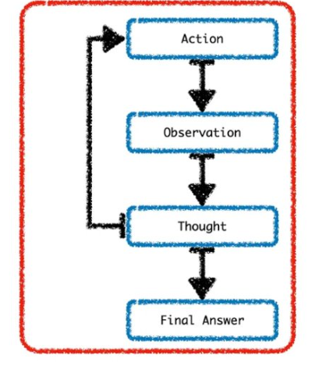

3. Agent Creation System (Option 2)
React_agent goes through a process of action, observation, thought, action, observation, thought…until the final answer is reached.​

Slide 8
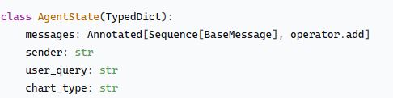
4. State Management
State Components:
messages: Conversation history (automatically accumulates)
sender: Current agent identifier
user_query: Original question
chart_type: Detected visualization type

Slide 9
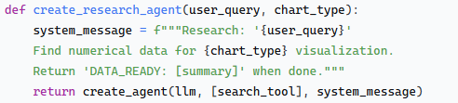
5. Specialized Agents
Agent 1: Research Agent
Responsibilities:
Web research using Tavily
Extract quantitative data
Format findings for chart generation

Slide 10
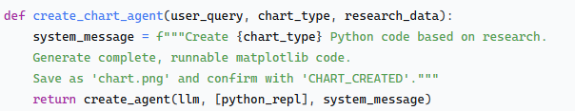
Agent 2 : Chart Agent
Responsibilities:
Convert research data to Python code
Generate appropriate visualization
Handle data completeness issues

Slide 11
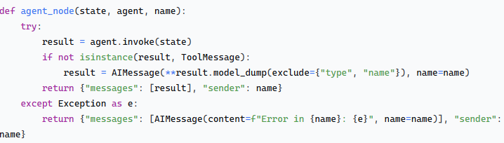
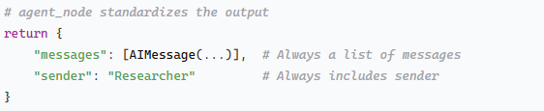
6. Standardizes Agent Output for LangGraph –Creating agent_node
Raw Agent Output → Standardized LangGraph Format

Slide 12
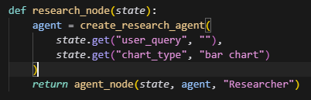
Node 1 : Research Node

Slide 13
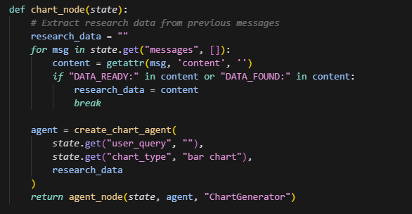
Node 2 : Chart Node

Slide 14

Node 3: Tool Node

Slide 15
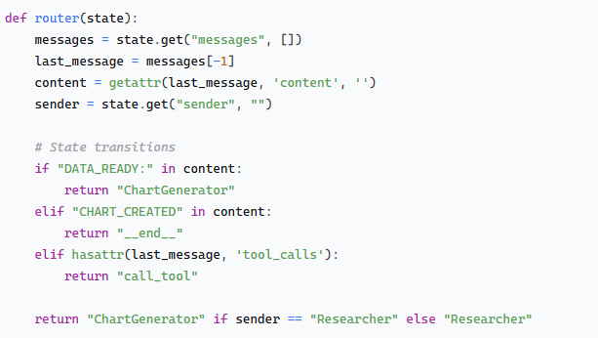
7.Router Function
Routing Logic:
DATA_READY: → Move to chart generation
CHART_CREATED → End workflow
Tool calls → Execute tools
Default → Alternate between agents

Slide 16
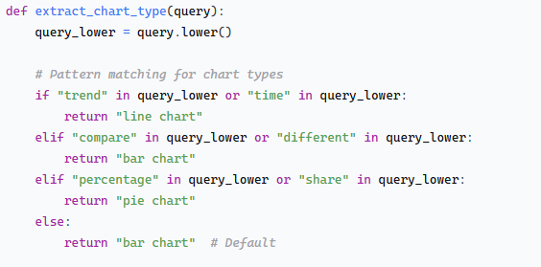
8. Chart Type Detection

Slide 17
Workflow Construction

Slide 18
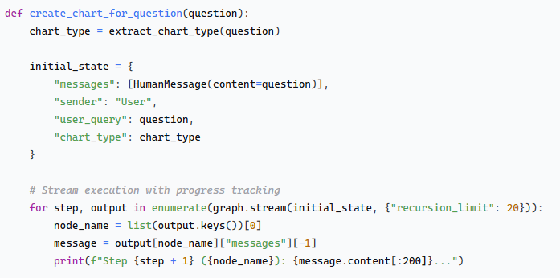
Execution : Main Function
Execution Steps:
Input: User question → Chart type detection
Research: Search → Data extraction → "DATA_READY"
Generation: Code creation → Execution → "CHART_CREATED"
Output: Display/save visualization

Slide 19
One more Example ...

Slide 20
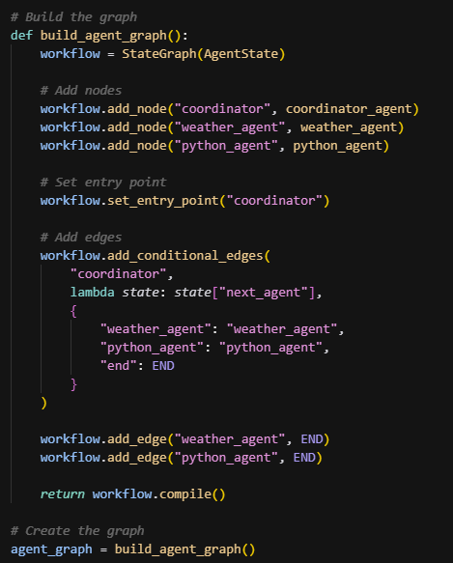
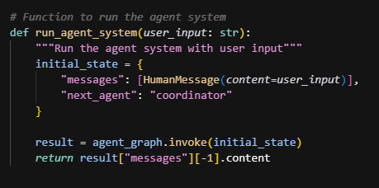
Coordinator Agent: Decides which specialized agent to invoke.
Weather Agent: Uses WeatherAPI to fetch data.
Python Agent: Uses Groq LLM to generate & run code.
END Node: Returns the final answer.
Main Function

Slide 21

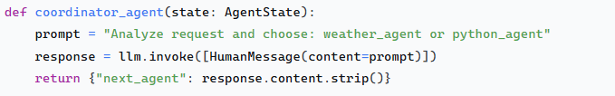
Agent 1 : Coordinator Agent
State Structure
COORDINATOR AGENT - Intelligent Router Responsibilities: - Analyze user queries - Determine intent classification - Route to appropriate specialist - Handle edge cases Key Features: - Uses LLM for intelligent routing - Pattern matching fallback - Error handling

Slide 22

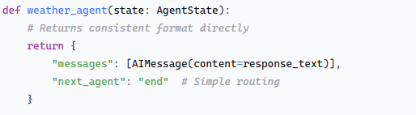
Agent 2: Weather Agent – External API Integration
- "weather in [location]"
- "temperature in [city]"
- "forecast for [place]"

Slide 23
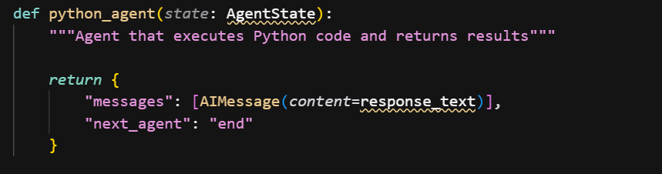

Agent 3: Python Agent - Code Executor
Features:
- Restricted module imports
- Output capture
- Error containment
- Code validation Execution
Flow: 1. LLM generatesPython code
2. Safe execution environment
3. Outputcapture
4. Result formatting​

Slide 24
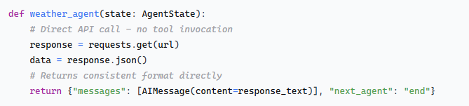
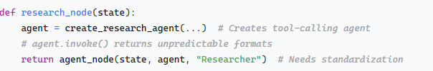
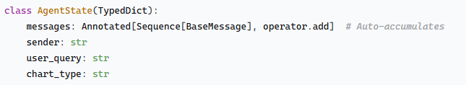
Why no Agent Node ?
Current code
Previous Code

Slide 25
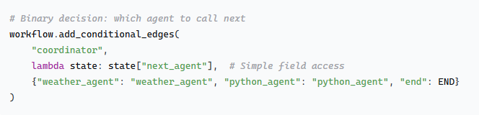
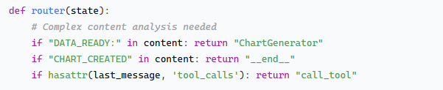
Current code
Previous Code
User → Coordinator → [Weather Agent | Python Agent] → End
Agent → Tool Call → Tool Execution → Return to Agent → Next Step

Slide 26
Best Practices
Modular Design: Each agent has clear responsibility
State Consistency: Well-defined state structure
Error Resilience: Comprehensive exception handling
Progress Tracking: Stream-based execution monitoring
Secure Secret Keys : secure in .env file

Slide 27
Types of Agents or Agentic Patterns
Tool Calling
Structure Output
Human in Loop
MultiAgents
Planning
Reflection(Reflex Agents)
ReAct Agent(Learning Agents)
Hierarchical Agents

Slide 28
Built-in AI Agent Framework or Platform
AutoGen
Crewai
PhiData
Cogniflow
LangChain
Llama-Index
Vertex AI Agent Builder
D-iD etc…

Slide 29
Next sessions will be on...
Connecting with SQL Database
RAG
MCP host, client and servers
Multimodal AI Agents
Git (If required)

