Slide 1
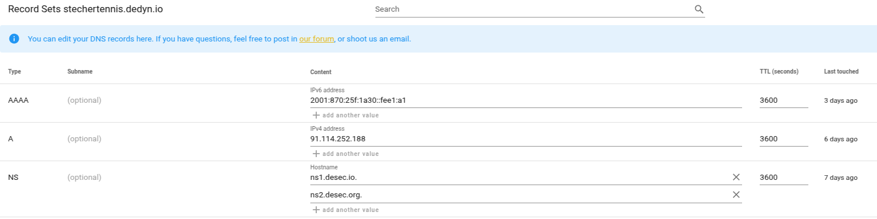
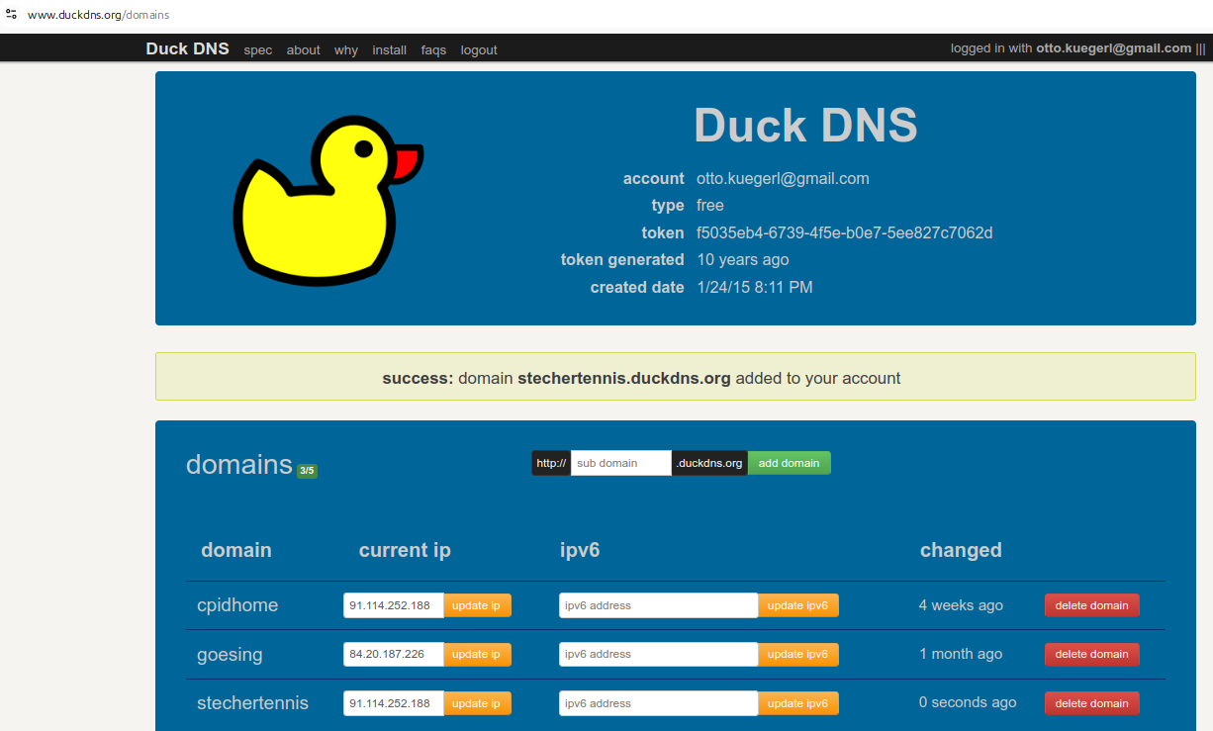
stechertennis.dedyn.io
https://stechertennis.dedyn.io/index
token: WkMmVe6sG6V6FDBnG7skamm8oWTC
stechertennis.duckdns.org
https://stechertennis.duckdns.org
token: f5035eb4-6739-4f5e-b0e7-5ee827c7062d

Slide 2
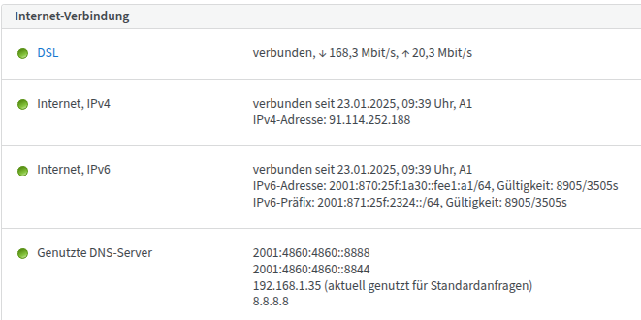
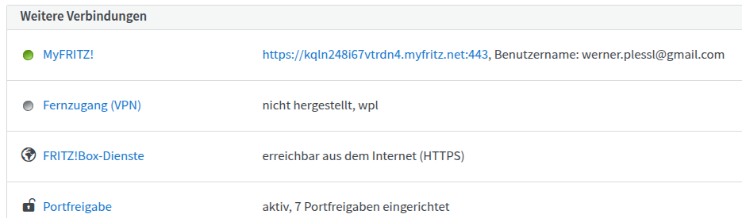
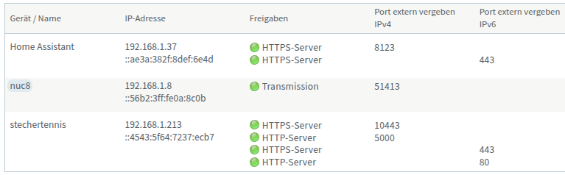
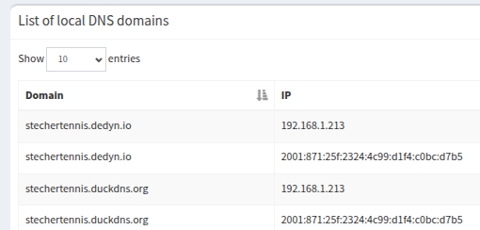
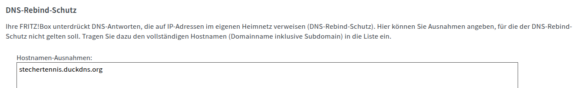
Router: FritzBox-7590
Pi-hole

Slide 3
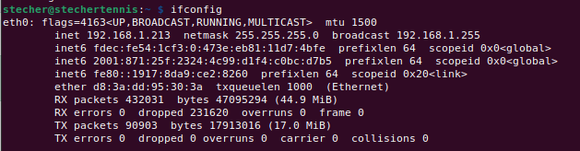
RPi
sudo certbot --nginx -d stechertennis.dedyn.io
Saving debug log to /var/log/letsencrypt/letsencrypt.log
Requesting a certificate for stechertennis.dedyn.io
Successfully received certificate.
Certificate is saved at: /etc/letsencrypt/live/stechertennis.dedyn.io/fullchain.pem
Key is saved at: /etc/letsencrypt/live/stechertennis.dedyn.io/privkey.pem
This certificate expires on 2025-05-14.
These files will be updated when the certificate renews.
Certbot has set up a scheduled task to automatically renew this certificate in the background.
Deploying certificate
Successfully deployed certificate for stechertennis.dedyn.io to /etc/nginx/sites-enabled/stecher_tennis
Congratulations! You have successfully enabled HTTPS on https://stechertennis.dedyn.io
- - - - - - - - - - - - - - - - - - - - - - - - - - - - - - - - - - - - - - - -
If you like Certbot, please consider supporting our work by:
* Donating to ISRG / Let's Encrypt: https://letsencrypt.org/donate
* Donating to EFF: https://eff.org/donate-le
- - - - - - - - - - - - - - - - - - - - - - - - - - - - - - - - - - - - - - - -
source ./bin/activate
gunicorn --worker-class gevent --bind 127.0.0.1:5000 app:app

Slide 4
RPi
server {
listen 443 ssl http2;
listen [::]:443 ssl http2;
server_name stechertennis.duckdns.org;
# Direkt weiterleiten von "/" auf "/stecher_start"
location = / {
return 301 /stecher_start;
}
location /stecher_start {
proxy_pass http://127.0.0.1:5000;
# Required for WebSocket
proxy_http_version 1.1;
proxy_set_header Upgrade $http_upgrade;
proxy_set_header Connection "Upgrade";
# (optional) keep-alive and host
proxy_set_header Host $host;
proxy_set_header X-Real-IP $remote_addr;
proxy_set_header X-Forwarded-For $proxy_add_x_forwarded_for;
proxy_set_header X-Forwarded-Proto $scheme;
}
ssl_certificate /etc/letsencrypt/live/stechertennis.dedyn.io/fullchain.pem;
ssl_certificate_key /etc/letsencrypt/live/stechertennis.dedyn.io/privkey.pem;
include /etc/letsencrypt/options-ssl-nginx.conf;
ssl_dhparam /etc/letsencrypt/ssl-dhparams.pem;
# 🔐 Sichere SSL-Einstellungen für A+ Rating auf SSL Labs
ssl_session_cache shared:SSL:10m;
ssl_stapling on;
ssl_stapling_verify on;
resolver 1.1.1.1 8.8.8.8 valid=300s;
resolver_timeout 5s;
# Sicherheitseinstellungen gegen Angriffe
add_header X-Frame-Options SAMEORIGIN;
add_header X-XSS-Protection "1; mode=block";
add_header X-Content-Type-Options nosniff;
add_header Referrer-Policy "strict-origin-when-cross-origin";
add_header Permissions-Policy "geolocation=(), microphone=(), camera=()";
# HSTS aktivieren (nur, wenn du sicher bist, dass HTTPS immer genutzt wird)
add_header Strict-Transport-Security "max-age=31536000; includeSubDomains; preload" always;
# Logging für Debugging
access_log /var/log/nginx/stechertennis.access.log;
error_log /var/log/nginx/stechertennis.error.log warn;
}
server {
listen 80;
listen [::]:80;
server_name stechertennis.duckdns.org;
# Automatische Weiterleitung von HTTP auf HTTPS
return 301 https://$host$request_uri;
}

Slide 5
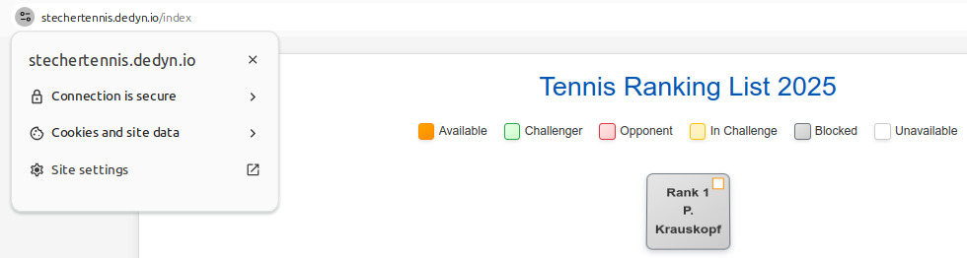
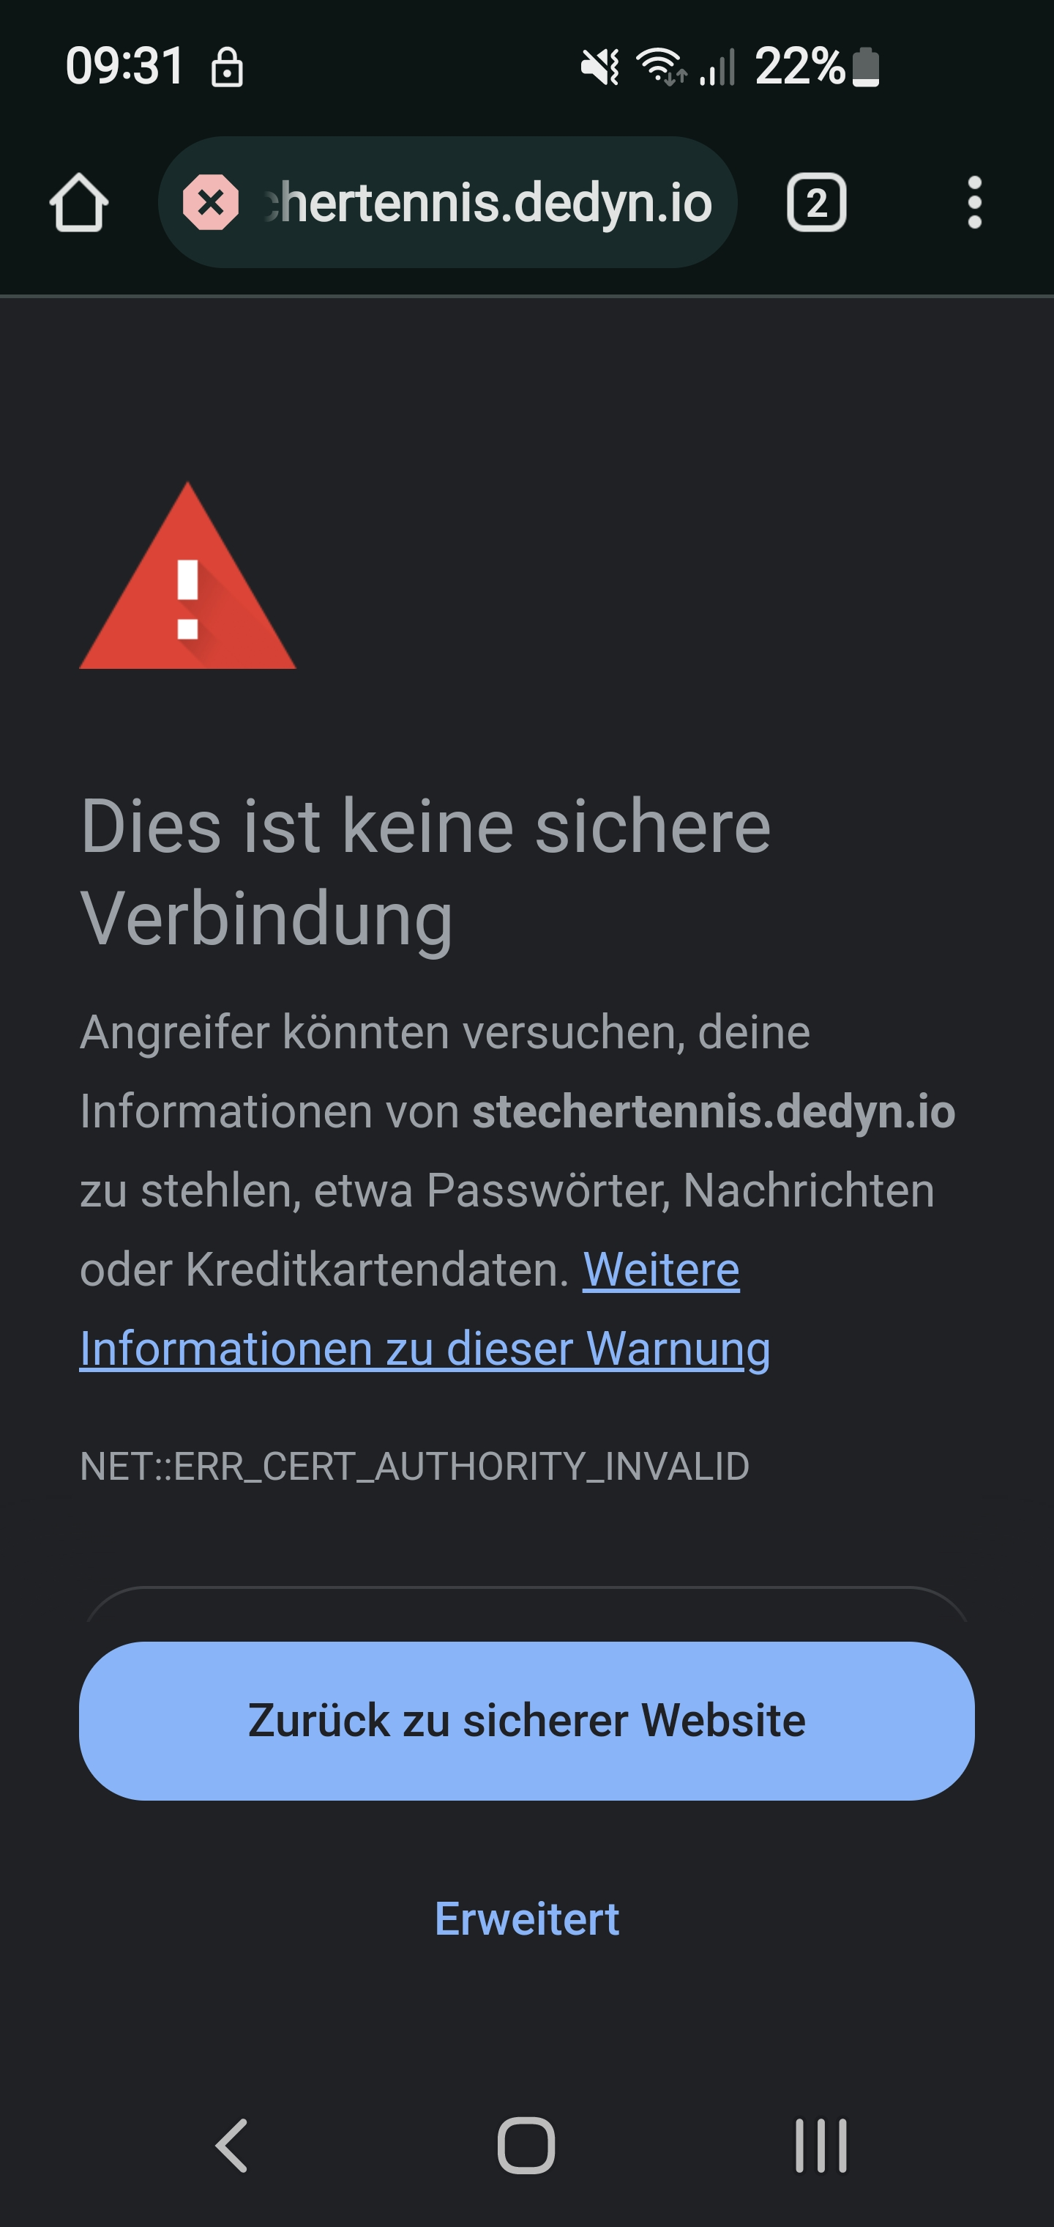
Android-Smartphone Error:
From local pc: it works

