Slide 1
Visual perception and user-centred design
AION UX DEVELOPER · DAY 2
2
Training slides: tasks, coaching, case study and feedback
Contains AI-assisted content
Module 2 (day 1 of 2)
Trainer: Muhammad Muchson · Case: CampusNow

Slide 2
The day at a glance (1)
UE | Min | What | What happens
1 | 45 | Knowledge transfer · Level 1 | The trainer presents the cards of Materi A (A1, A2, A3, A4, A5, about 60 min of cards) in the Neuro-UX Lab; participants follow in the handout.
2 | 45 | Level 1 · Task 1 | Individual work on Block 1.1 (Core, about 10 min): the first product of the day is read and its effect described. Pairs then compare their results and the trainer collects open questions.
3 | 45 | Level 1 · Task 2 | Three options are rated on the same criteria and one is chosen under the stated conditions: Block 1.2 (Core, about 8 min).
4 | 45 | Coaching · transition from Level 1 to Level 2 | Trainer-led. A short talk on the day's coaching focus, then the reflection questions in pairs. The bridge: from describing an effect to a decision you answer for. There is no worksheet block in this unit.
5–6 | 90 | Level 2 · Case study CampusNow (2 UE) incl. model solution | UE5: the trainer presents the case; participants work on Block 2.1 (Core, about 15 min). UE6: groups compare their results and defend them; the trainer closes with the model solution.
7 | 45 | Level 2 + 3 · Feedback round with a management perspective | Groups present their reasoning, not only their result. The trainer asks the day's Level 3 input questions and leads the discussion.
One UE is 45 minutes; breaks are not shown.
AION UX Developer · Day 2 · Training slides
2
Notes:
One UE (teaching unit) is counted as 45 minutes; breaks are not shown.

Slide 3
The day at a glance (2)
UE | Min | What | What happens
8 | 45 | Level 3 · Transfer project, Chief Experience Officer (3 UE: UE8–10) | The trainer presents Materi B (B1, B2, B3; use the "In plain words" and "How to decide" boxes, the rest is handout) and sets the role and the situation.
9 | 45 | Level 3 · Transfer project | Individual work or in pairs on Block 3.1 (Core, about 20 min): the strategy memo.
10 | 45 | Level 3 · Transfer project | Participants present their decision and what they give up, including the one decision made under uncertainty; the trainer debriefs with the model solution.
One UE is 45 minutes; breaks are not shown.
AION UX Developer · Day 2 · Training slides
3
Notes:
One UE (teaching unit) is counted as 45 minutes; breaks are not shown.

Slide 4
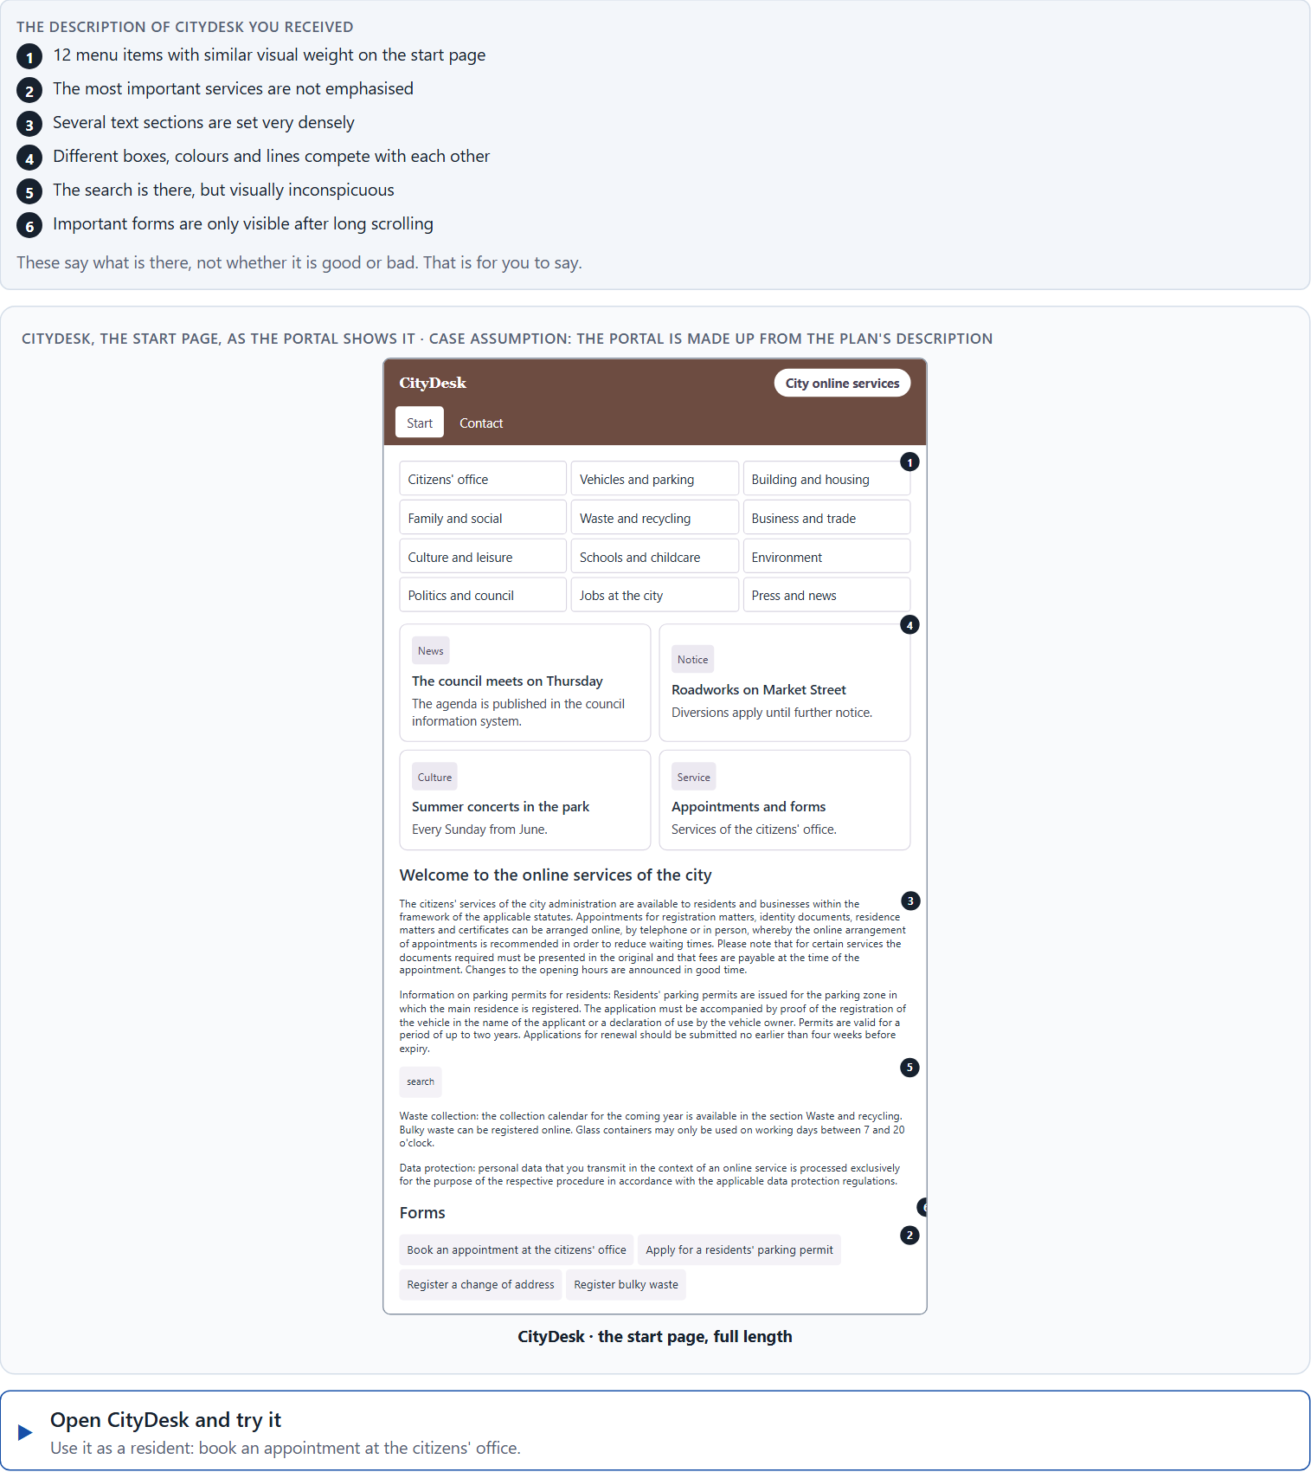
Block 1.1 · Read an interface as a user and find perception barriers: CityDesk
Level 1 · Knowledge · about 10 min
You receive the description of a fictional booking portal, CityDesk, for municipal services such as an appointment at the citizens' office or a parking permit. Open it and use it as someone who has never seen it before. You need no prior knowledge: ask yourself where your eye goes, what you would look for and what stops you. The aim is to take the user's perspective and make perception problems visible step by step.
Screenshot of the Neuro-UX Lab (aion-ux-lab.vercel.app), own work; AI-assisted, labelled on the image; the example company is fictional.
Draws on: A1 · Seeing an interface, and designing from the user's side · A2 · How people scan, select and prioritise · A3 · What guides the eye · A4 · How much at once.
AION UX Developer · Day 2 · Training slides
4
Notes:
Block 1.1 · Read an interface as a user and find perception barriers: CityDesk · about 10 min. Draws on: A1 · Seeing an interface, and designing from the user's side · A2 · How people scan, select and prioritise · A3 · What guides the eye · A4 · How much at once.

Slide 5
Block 1.1 · What you work on
Describe what a first-time user probably perceives first
1
Name 5 obstacles that could make orientation or understanding difficult
2
Assign the problems to the categories visual guidance, information density, structure, findability and readability
3
Write an effect statement for three of your observations: “For users this could mean that …”
4
Determine the two biggest hurdles from the point of view of an inexperienced user
5
AION UX Developer · Day 2 · Training slides
5
Notes:
Block 1.1 · Read an interface as a user and find perception barriers: CityDesk · about 10 min. Draws on: A1 · Seeing an interface, and designing from the user's side · A2 · How people scan, select and prioritise · A3 · What guides the eye · A4 · How much at once.

Slide 6
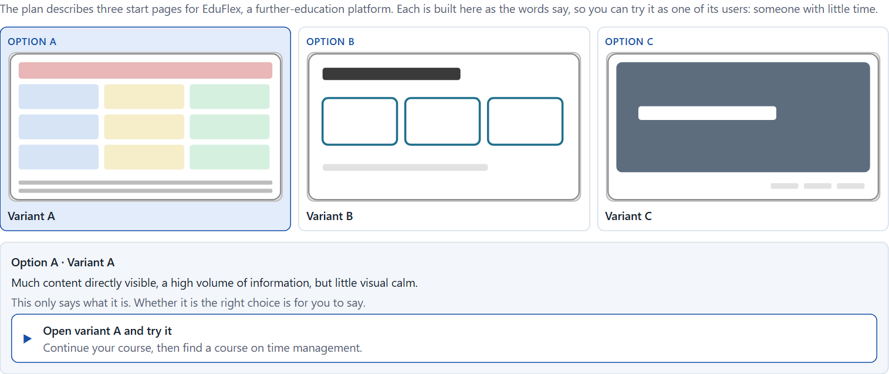
Block 1.2 · Rate user-centred design under conflicting goals: EduFlex
Level 1 · Knowledge · about 8 min
EduFlex is a platform for professional further education. Three designs for its start page are described in words: A) much content directly visible and a high volume of information, but little visual calm; B) a clear structure and less information, but more clicks to the goal; C) strongly image-led and modern, but the central functions recede into the background. The conditions: the platform is to be published within 10 weeks, the target group is working people with little time, marketing wants high activation, the department wants a lot of information directly on the start page, the budget for test runs is limited and there is no real user data yet. Decide anyway, and say what you assume.
Screenshot of the Neuro-UX Lab (aion-ux-lab.vercel.app), own work; AI-assisted, labelled on the image; the example company is fictional.
Draws on: A1 · Seeing an interface, and designing from the user's side · A4 · How much at once · A5 · Recognition instead of search, clarity instead of overload, and weighing a measure.
AION UX Developer · Day 2 · Training slides
6
Notes:
Block 1.2 · Rate user-centred design under conflicting goals: EduFlex · about 8 min. Draws on: A1 · Seeing an interface, and designing from the user's side · A4 · How much at once · A5 · Recognition instead of search, clarity instead of overload, and weighing a measure.

Slide 7
Block 1.2 · What you work on
Rate each variant on orientation, findability, understandability, focus and user-friendliness
1
Decide which variant is the most viable from a user-centred point of view at present
2
Name the conflicts of goals that make your decision difficult
3
Which risks remain, although you have to decide?
4
Formulate a short decision recommendation for the project management
5
AION UX Developer · Day 2 · Training slides
7
Notes:
Block 1.2 · Rate user-centred design under conflicting goals: EduFlex · about 8 min. Draws on: A1 · Seeing an interface, and designing from the user's side · A4 · How much at once · A5 · Recognition instead of search, clarity instead of overload, and weighing a measure.

Slide 8
Coaching · UE4
Transition: Level 1 to Level 2
From visual observation to user-centred design responsibility
From describing an effect to a decision you answer for.
AION UX Developer · Day 2 · Training slides
8
Notes:
UE4 · Coaching: transition from Level 1 to Level 2. Trainer-led: a short talk on the coaching focus, then the reflection questions in pairs.

Slide 9
Coaching · questions we talk through
What does “user-centred” mean beyond a slogan?
How do I handle conflicts between abundance of information and simplicity?
1
5
How do I tell internal logic from real user logic?
How do I argue when stakeholders want more content but users need relief?
2
6
Why is good steering of perception a leadership question and not only a layout question?
Which decisions are operational, which strategic?
3
7
Which visual decisions support orientation, and which obstruct it?
4
AION UX Developer · Day 2 · Training slides
9
Notes:
UE4 · Coaching: transition from Level 1 to Level 2. Trainer-led: a short talk on the coaching focus, then the reflection questions in pairs.

Slide 10
Coaching · reflect in pairs
1
2
3
Where do projects often decide from the provider's perspective instead of the user's?
Which UI decision often has underestimated consequences for use and trust?
How do I tell whether an interface serves the user or only mirrors internal complexity?
AION UX Developer · Day 2 · Training slides
10
Notes:
UE4 · Coaching: transition from Level 1 to Level 2. Trainer-led: a short talk on the coaching focus, then the reflection questions in pairs.

Slide 11
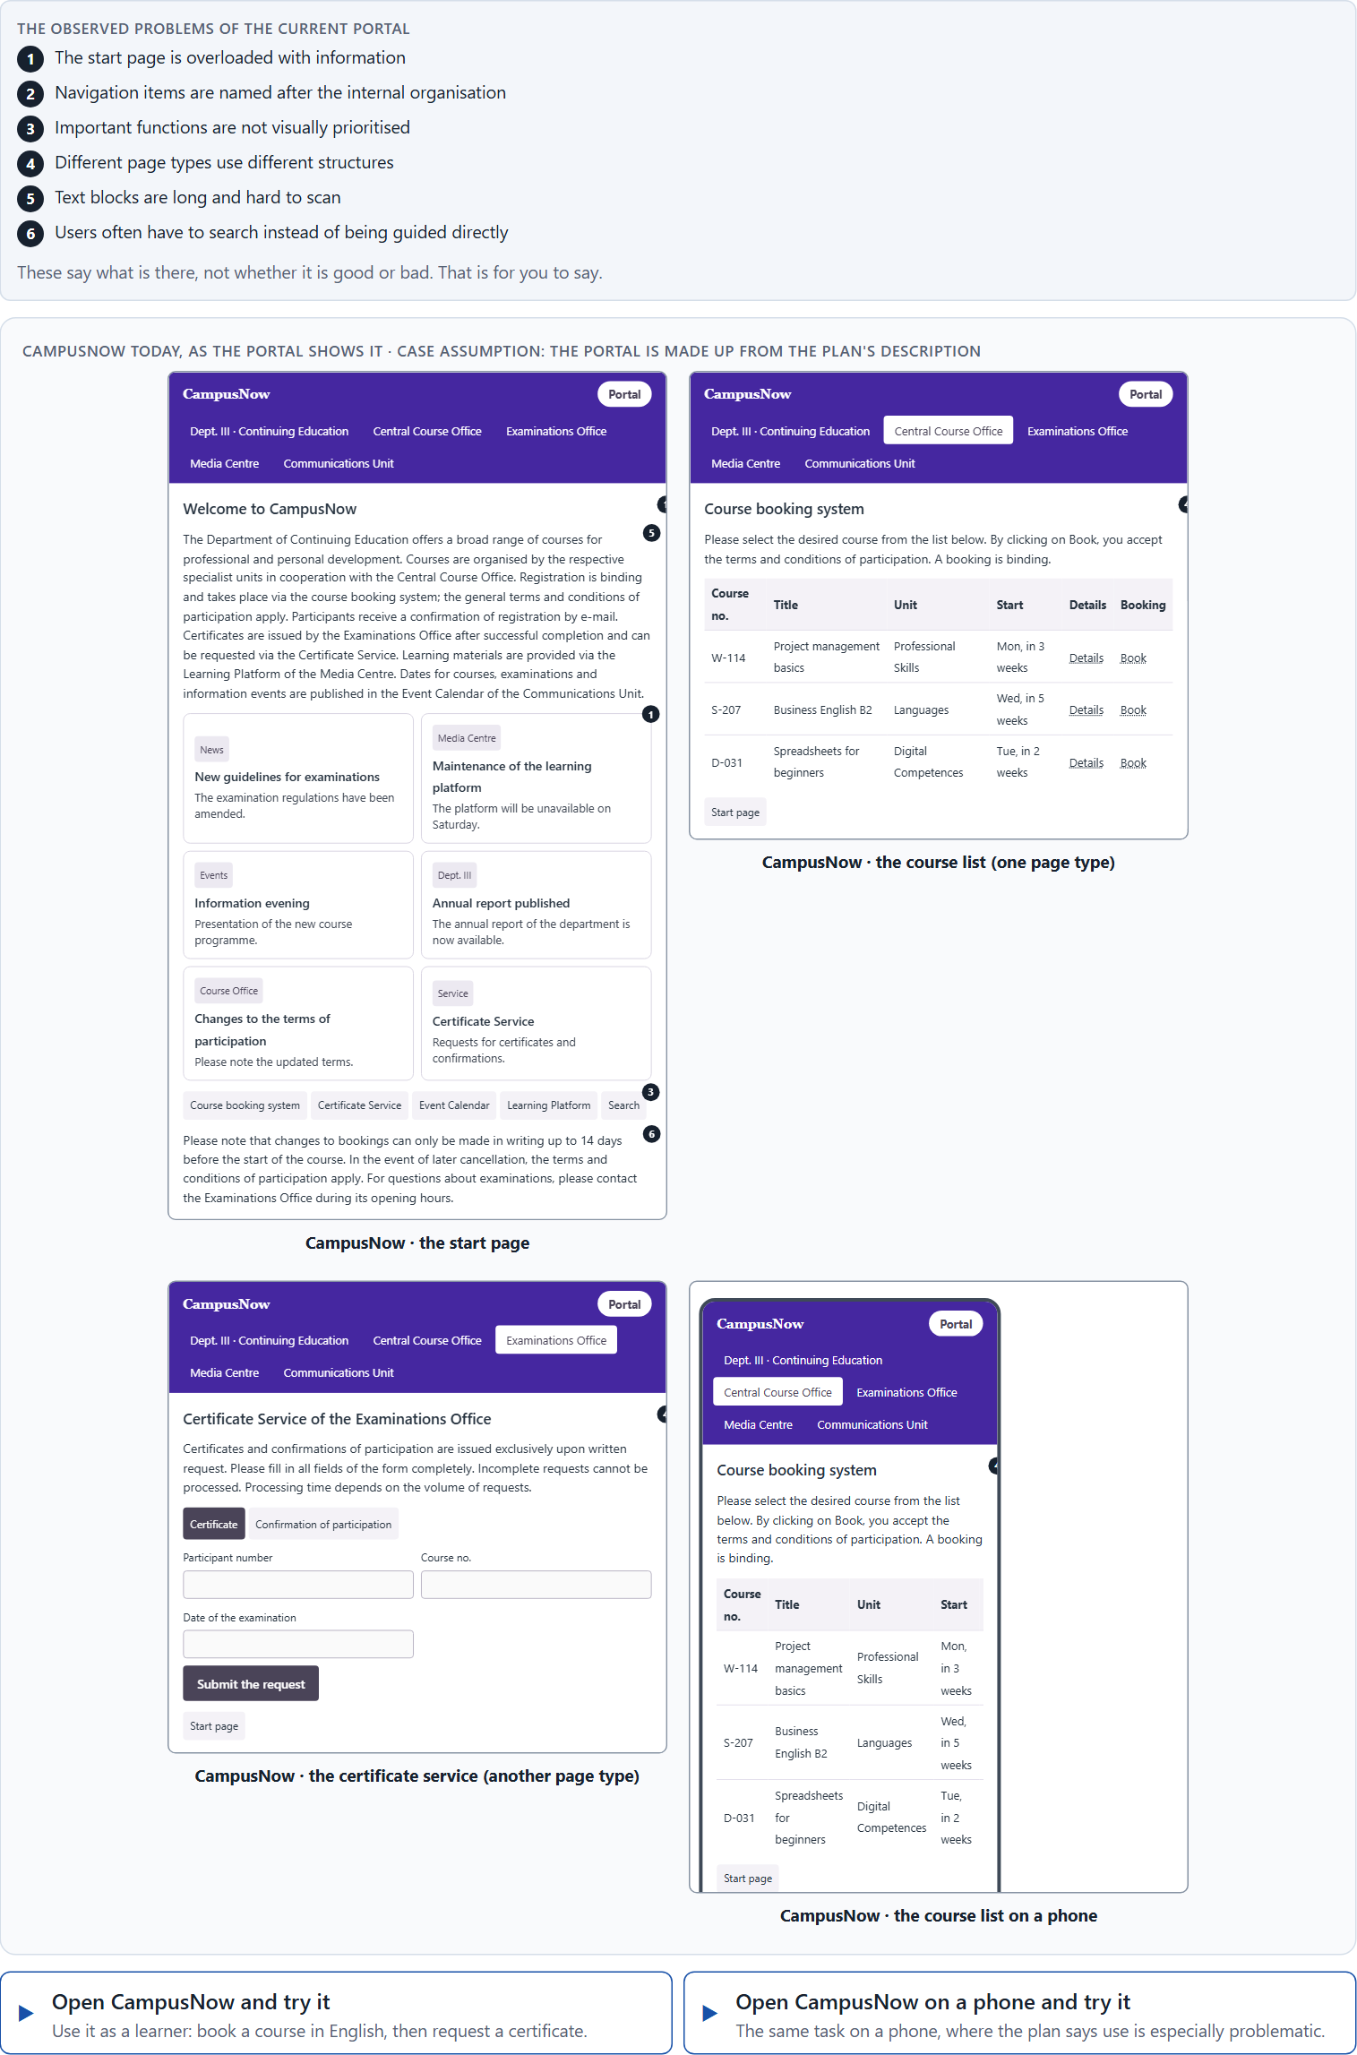
Block 2.1 · Case study: reorganising the service portal CampusNow
Level 2 · Case study · UE5–6 · about 15 min
An education organisation runs CampusNow, a digital portal for course booking, certificates, dates and learning materials. All the content is there, but users find many functions only with difficulty. Complaints are rising, abandonment in the booking process is increasing, and mobile use is especially problematic. The observed problems: the start page is overloaded with information, the navigation items are named after the internal organisation, important functions are not visually prioritised, different page types use different structures, the text blocks are long and hard to scan, and users often have to search instead of being guided directly. The conditions: a budget of €150,000, 14 weeks for the implementation, no complete relaunch, first improvements have to be visible quickly, and marketing asks for a modern look, support for fewer questions and IT for standardisation. You work through six steps.
Screenshot of the Neuro-UX Lab (aion-ux-lab.vercel.app), own work; AI-assisted, labelled on the image; the example company is fictional.
Draws on: A1 · Seeing an interface, and designing from the user's side · A2 · How people scan, select and prioritise · A3 · What guides the eye · A4 · How much at once · A5 · Recognition instead of search, clarity instead of overload, and weighing a measure.
AION UX Developer · Day 2 · Training slides
11
Notes:
Block 2.1 · Case study: reorganising the service portal CampusNow · about 15 min. Draws on: A1 · Seeing an interface, and designing from the user's side · A2 · How people scan, select and prioritise · A3 · What guides the eye · A4 · How much at once · A5 · Recognition instead of search, clarity instead of overload, and weighing a measure.

Slide 12
Block 2.1 · What you work on
Analyse the central perception and structure problems of the portal
1
Assign the problems to the categories orientation, readability, findability, consistency and cognitive load
2
Develop 4 prioritised user-centred measures
3
Rate your measures on effect on users, effort, risk and timeliness
4
Make a reasoned prioritisation decision for the first 14 weeks
5
Formulate a recommendation to the division management
6
AION UX Developer · Day 2 · Training slides
12
Notes:
Block 2.1 · Case study: reorganising the service portal CampusNow · about 15 min. Draws on: A1 · Seeing an interface, and designing from the user's side · A2 · How people scan, select and prioritise · A3 · What guides the eye · A4 · How much at once · A5 · Recognition instead of search, clarity instead of overload, and weighing a measure.

Slide 13
Feedback round · how each group presents
Each group presents its prioritisation in 5 minutes
1
The reasoning must rest on user effect, risk, feasibility and responsibility
2
Each group names one measure it deliberately did not prioritise
3
AION UX Developer · Day 2 · Training slides
13
Notes:
UE7 · Feedback round with a management perspective. Groups present their reasoning, not only their result.

Slide 14
Feedback round · questions to answer
Which measure improves usability fastest?
Which risks were accepted on purpose?
1
4
Which measure strengthens the system logic most lastingly?
Which decision can be answered for even when information is incomplete?
2
5
Where was the decision made from the user's perspective, and where from the inside?
3
AION UX Developer · Day 2 · Training slides
14
Notes:
UE7 · Feedback round with a management perspective. Groups present their reasoning, not only their result.

Slide 15
Level 3 input and discussion
INPUT LEVEL 3
DISCUSSION
User-centredness is not a question of style but a leadership and prioritisation task
Good decisions create orientation in the system, not only on the screen
Senior level means steering conflicts between user interest, feasibility, standardisation and economics
When does poor user guidance become a management problem?
AION UX Developer · Day 2 · Training slides
15
Notes:
UE7 · Feedback round with a management perspective. Groups present their reasoning, not only their result.

Slide 16
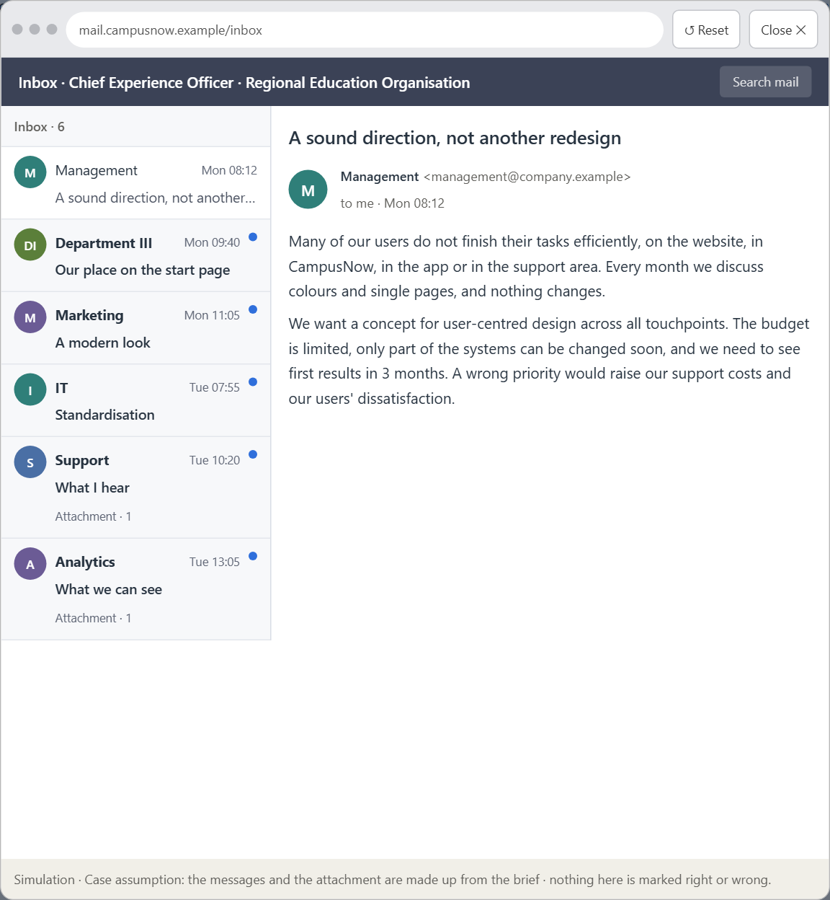
Block 3.1 · A user-centred design architecture for a digital service
Level 3 · Transfer project · UE8–10 · about 20 min
You take the perspective of the Chief Experience Officer of the education organisation that runs CampusNow. It has several digital touchpoints: a website, the self-service portal CampusNow, an app and a support area. Many users do not finish their tasks efficiently. Inside the organisation the discussion is mostly about colours, layout questions and single screens, while the real cause lies deeper: too little user-centredness, inconsistent structures and no priorities in the information architecture. You are not to optimise single screens but to develop a sound decision architecture for user-centred design based on visual perception.
Screenshot of the Neuro-UX Lab (aion-ux-lab.vercel.app), own work; AI-assisted, labelled on the image; the example company is fictional.
Draws on: B1 · Inside logic against user logic · B2 · Conflicts of goals · B3 · User-centredness as the basis of accountable decisions.
AION UX Developer · Day 2 · Training slides
16
Notes:
Block 3.1 · A user-centred design architecture for a digital service · about 20 min. Draws on: B1 · Inside logic against user logic · B2 · Conflicts of goals · B3 · User-centredness as the basis of accountable decisions.

Slide 17
Block 3.1 · What you work on
1
A guiding vision of user-centred design: which perception and user experience should be created systematically?
2
Three strategic guiding decisions for orientation, structure, information priority and user guidance
3
A prioritised architecture of measures: which areas are reworked first, and why?
4
A risk analysis: which wrong assumptions about user behaviour would be especially critical?
5
A governance model: who is responsible for user-centred decisions, and how are conflicts of goals resolved?
6
A decision under uncertainty: make at least one decision although data is missing, and justify it responsibly
7
A management statement: a recommendation to the management with a clear priority and a strategic reason
AION UX Developer · Day 2 · Training slides
17
Notes:
Block 3.1 · A user-centred design architecture for a digital service · about 20 min. Draws on: B1 · Inside logic against user logic · B2 · Conflicts of goals · B3 · User-centredness as the basis of accountable decisions.

Slide 18
Reflect before you leave
1
2
3
Which decision did you make today, and what did you give up to make it?
Which assumption would you check first with real users, and how?
What will you do differently in your next project because of today?
Use two minutes alone, then one minute with your neighbour.
AION UX Developer · Day 2 · Training slides
18

Slide 19
About these slides, sources and AI use
AI
AI-assisted content
Where to find more
AI-assisted content: these slides were drafted with an AI language model (Claude, Anthropic) from the course's own Neuro-UX Lab and were read, corrected and approved by Muhammad Muchson, who is responsible for their accuracy.
Pictures are screenshots of the course's own Neuro-UX Lab. Each one carries an AI label on the image and a source line under it.
Companies and people in the examples are fictional. Numbers inside an example are labelled Case assumption and are not data.
The coaching and feedback questions are the course plan's own, translated into English.
Neuro-UX Lab for this day: https://aion-ux-lab.vercel.app/day/2/
Handouts: the Materi and Task Word documents of the day.
Version 1.0, 29.10.2026. Reviewer and approver: Muhammad Muchson.
AION UX Developer · Day 2 · Training slides
19

