Slide 1
Colour, typography and readability
AION UX DEVELOPER · DAY 3
3
Training slides: tasks, coaching, case study and feedback
Contains AI-assisted content
Module 2 (day 2 of 2)
Trainer: Muhammad Muchson · Case: SecureLife

Slide 2
The day at a glance (1)
UE | Min | What | What happens
1 | 45 | Knowledge transfer · Level 1 | The trainer presents the cards of Materi A (A1, A2, A3, A4, A5, about 60 min of cards) in the Neuro-UX Lab; participants follow in the handout.
2 | 45 | Level 1 · Task 1 | Individual work on Block 1.1 (Core, about 10 min): the first product of the day is read and its effect described. Pairs then compare their results and the trainer collects open questions.
3 | 45 | Level 1 · Task 2 | Three options are rated on the same criteria and one is chosen under the stated conditions: Block 1.2 (Core, about 8 min).
4 | 45 | Coaching · transition from Level 1 to Level 2 | Trainer-led. A short talk on the day's coaching focus, then the reflection questions in pairs. The bridge: from describing an effect to a decision you answer for. There is no worksheet block in this unit.
5–6 | 90 | Level 2 · Case study SecureLife (2 UE) incl. model solution | UE5: the trainer presents the case; participants work on Block 2.1 (Core, about 15 min). UE6: groups compare their results and defend them; the trainer closes with the model solution.
7 | 45 | Level 2 + 3 · Feedback round with a management perspective | Groups present their reasoning, not only their result. The trainer asks the day's Level 3 input questions and leads the discussion.
One UE is 45 minutes; breaks are not shown.
AION UX Developer · Day 3 · Training slides
2
Notes:
One UE (teaching unit) is counted as 45 minutes; breaks are not shown.

Slide 3
The day at a glance (2)
UE | Min | What | What happens
8 | 45 | Level 3 · Transfer project, Chief Experience Officer (3 UE: UE8–10) | The trainer presents Materi B (B1, B2, B3; use the "In plain words" and "How to decide" boxes, the rest is handout) and sets the role and the situation.
9 | 45 | Level 3 · Transfer project | Individual work or in pairs on Block 3.1 (Core, about 20 min): the strategy memo.
10 | 45 | Level 3 · Transfer project | Participants present their decision and what they give up, including the one decision made under uncertainty; the trainer debriefs with the model solution.
One UE is 45 minutes; breaks are not shown.
AION UX Developer · Day 3 · Training slides
3
Notes:
One UE (teaching unit) is counted as 45 minutes; breaks are not shown.

Slide 4
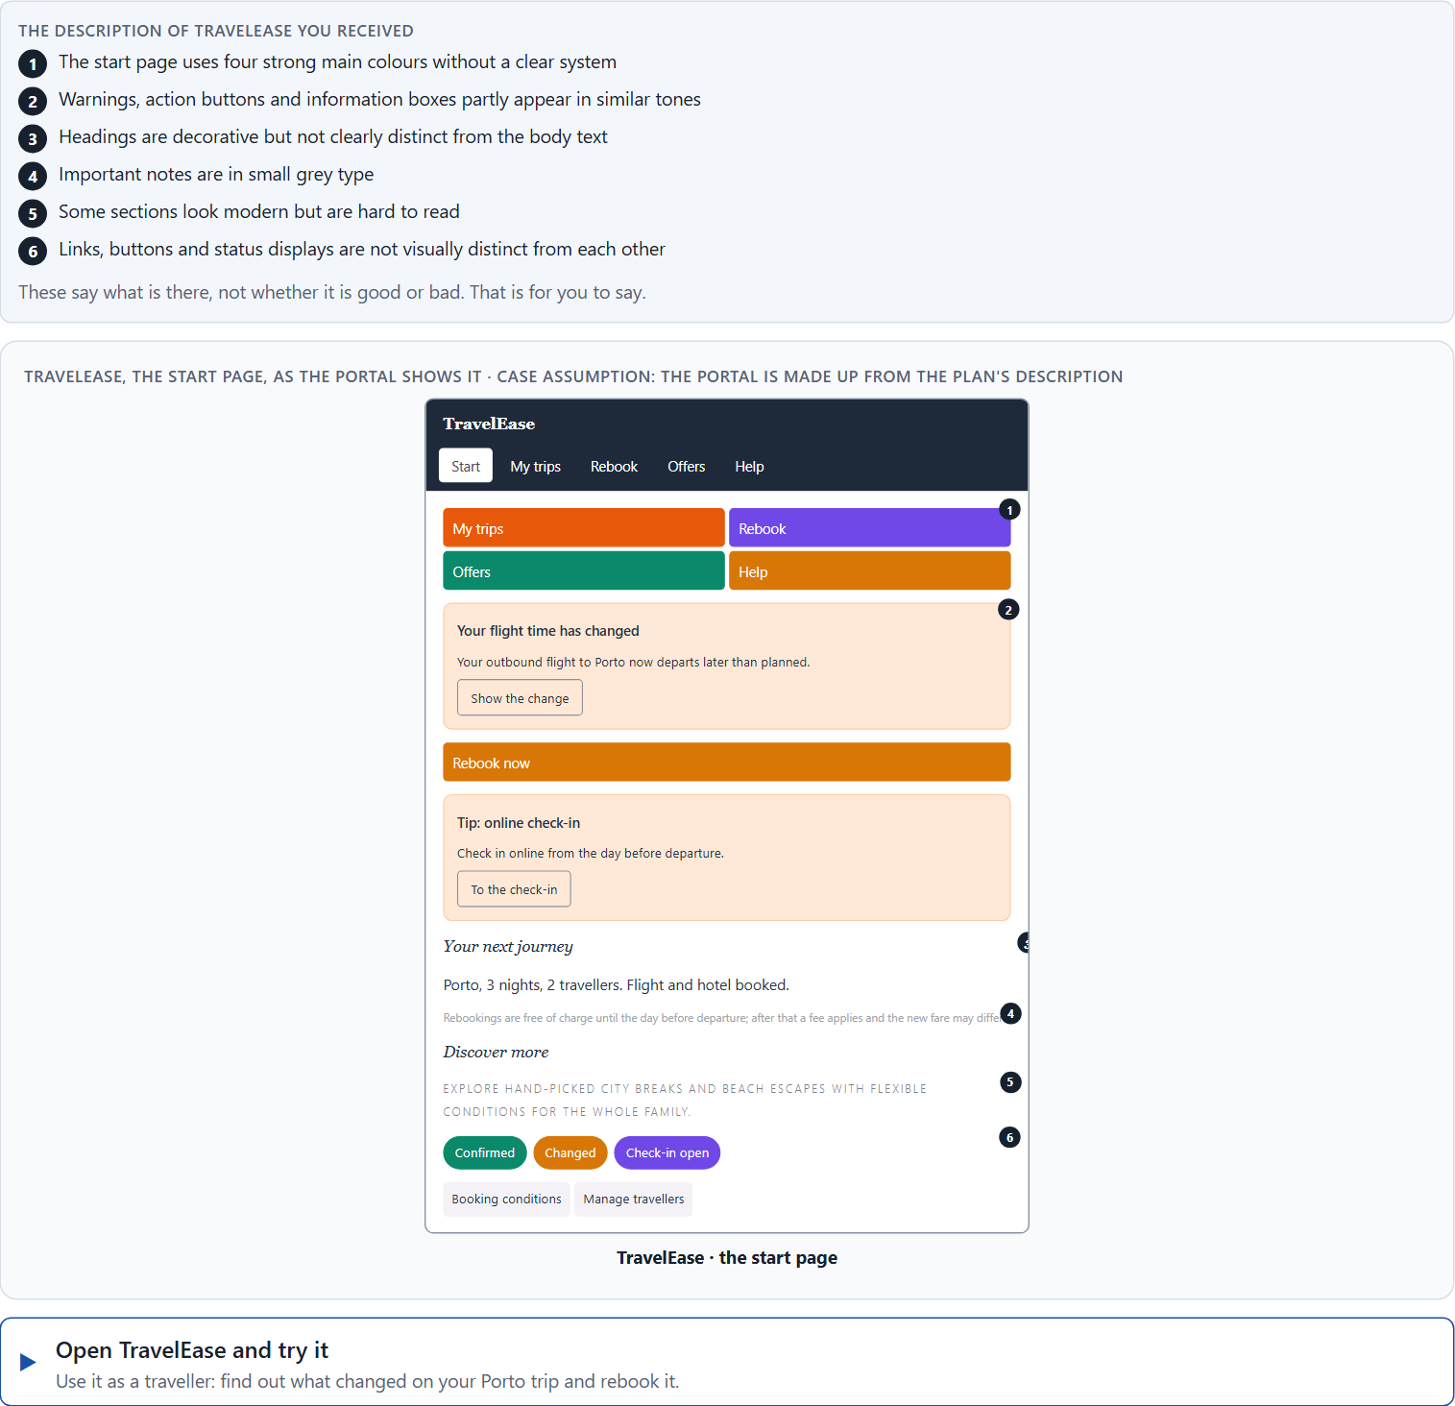
Block 1.1 · The effect of colour and type without prior knowledge: TravelEase
Level 1 · Knowledge · about 10 min
You receive the description of a fictional customer portal, TravelEase, for travel bookings and rebookings. Open it and use it as a traveller who wants to change a booking. You need no prior knowledge: say first how it feels, then what makes it hard. The aim is to recognise perception and readability problems step by step and to describe the effect before the technical terms.
Screenshot of the Neuro-UX Lab (aion-ux-lab.vercel.app), own work; AI-assisted, labelled on the image; the example company is fictional.
Draws on: A1 · What colour does · A2 · Decorative against functional colour · A3 · Readable type · A4 · Typographic hierarchy, and colour, type and structure working together.
AION UX Developer · Day 3 · Training slides
4
Notes:
Block 1.1 · The effect of colour and type without prior knowledge: TravelEase · about 10 min. Draws on: A1 · What colour does · A2 · Decorative against functional colour · A3 · Readable type · A4 · Typographic hierarchy, and colour, type and structure working together.

Slide 5
Block 1.1 · What you work on
Describe spontaneously what effect the interface has on you
1
Name at least 5 problems that could arise from colour or type design
2
Assign them to the categories orientation, readability, trust, prioritisation and understandability
3
Formulate three effect statements: “For users this could mean that …”
4
Prioritise the two most critical weaknesses from a first-time user's point of view
5
AION UX Developer · Day 3 · Training slides
5
Notes:
Block 1.1 · The effect of colour and type without prior knowledge: TravelEase · about 10 min. Draws on: A1 · What colour does · A2 · Decorative against functional colour · A3 · Readable type · A4 · Typographic hierarchy, and colour, type and structure working together.

Slide 6
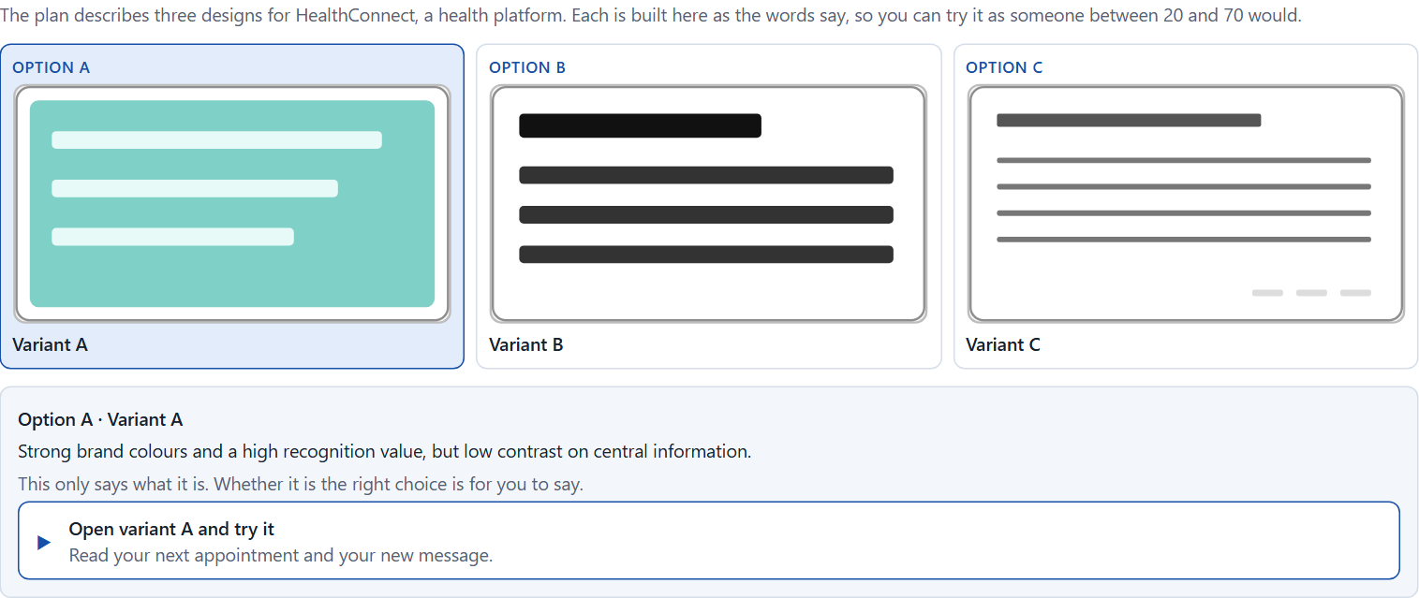
Block 1.2 · Rate colour and type decisions under conflicting goals: HealthConnect
Level 1 · Knowledge · about 8 min
HealthConnect is a health platform. Three designs for its interface are described in words: A) strong brand colours and a high recognition value, but low contrast on central information; B) very factual and high in contrast, highly readable, but with little emotional appeal; C) modern, elegant typography with a high-quality effect, but smaller type sizes and less visible navigation items. The conditions: the platform is for a broad target group from 20 to 70 years, the company wants to look modern and trustworthy, the budget for the revision is limited, the corporate design may only partly be changed, there are no user tests yet, and the release is in 8 weeks. Decide anyway, and say what you assume.
Screenshot of the Neuro-UX Lab (aion-ux-lab.vercel.app), own work; AI-assisted, labelled on the image; the example company is fictional.
Draws on: A1 · What colour does · A3 · Readable type · A5 · From colour and type to behaviour, and weighing a measure.
AION UX Developer · Day 3 · Training slides
6
Notes:
Block 1.2 · Rate colour and type decisions under conflicting goals: HealthConnect · about 8 min. Draws on: A1 · What colour does · A3 · Readable type · A5 · From colour and type to behaviour, and weighing a measure.

Slide 7
Block 1.2 · What you work on
Rate each variant on readability, orientation, trust, brand effect and usability
1
Decide which variant is the most viable under the given conditions
2
Name the conflicts of goals between the brand's claims and user-friendliness
3
Which risks remain despite your decision?
4
Formulate a short recommendation to the project management
5
AION UX Developer · Day 3 · Training slides
7
Notes:
Block 1.2 · Rate colour and type decisions under conflicting goals: HealthConnect · about 8 min. Draws on: A1 · What colour does · A3 · Readable type · A5 · From colour and type to behaviour, and weighing a measure.

Slide 8
Coaching · UE4
Transition: Level 1 to Level 2
From the choice of colour and type to a responsible design decision
From describing an effect to a decision you answer for.
AION UX Developer · Day 3 · Training slides
8
Notes:
UE4 · Coaching: transition from Level 1 to Level 2. Trainer-led: a short talk on the coaching focus, then the reflection questions in pairs.

Slide 9
Coaching · questions we talk through
Why are colour and typography not side issues but central instruments of user guidance?
Which mistakes arise when design is decided mainly from the inside?
1
5
How do I tell whether colour guides functionally or is only decorative?
How do I argue towards marketing, branding or management when usability suffers?
2
6
When does typography support information processing, and when does it make it harder?
Which colour and typography decisions have operational effect, which strategic reach?
3
7
How do I handle conflicts between brand aesthetics and legibility?
4
AION UX Developer · Day 3 · Training slides
9
Notes:
UE4 · Coaching: transition from Level 1 to Level 2. Trainer-led: a short talk on the coaching focus, then the reflection questions in pairs.

Slide 10
Coaching · reflect in pairs
1
2
3
Where does the company use colour more as a style device than as a steering instrument?
Which typographic wrong decision often has bigger consequences than assumed?
When should the brand effect give way to clarity for the user?
AION UX Developer · Day 3 · Training slides
10
Notes:
UE4 · Coaching: transition from Level 1 to Level 2. Trainer-led: a short talk on the coaching focus, then the reflection questions in pairs.

Slide 11
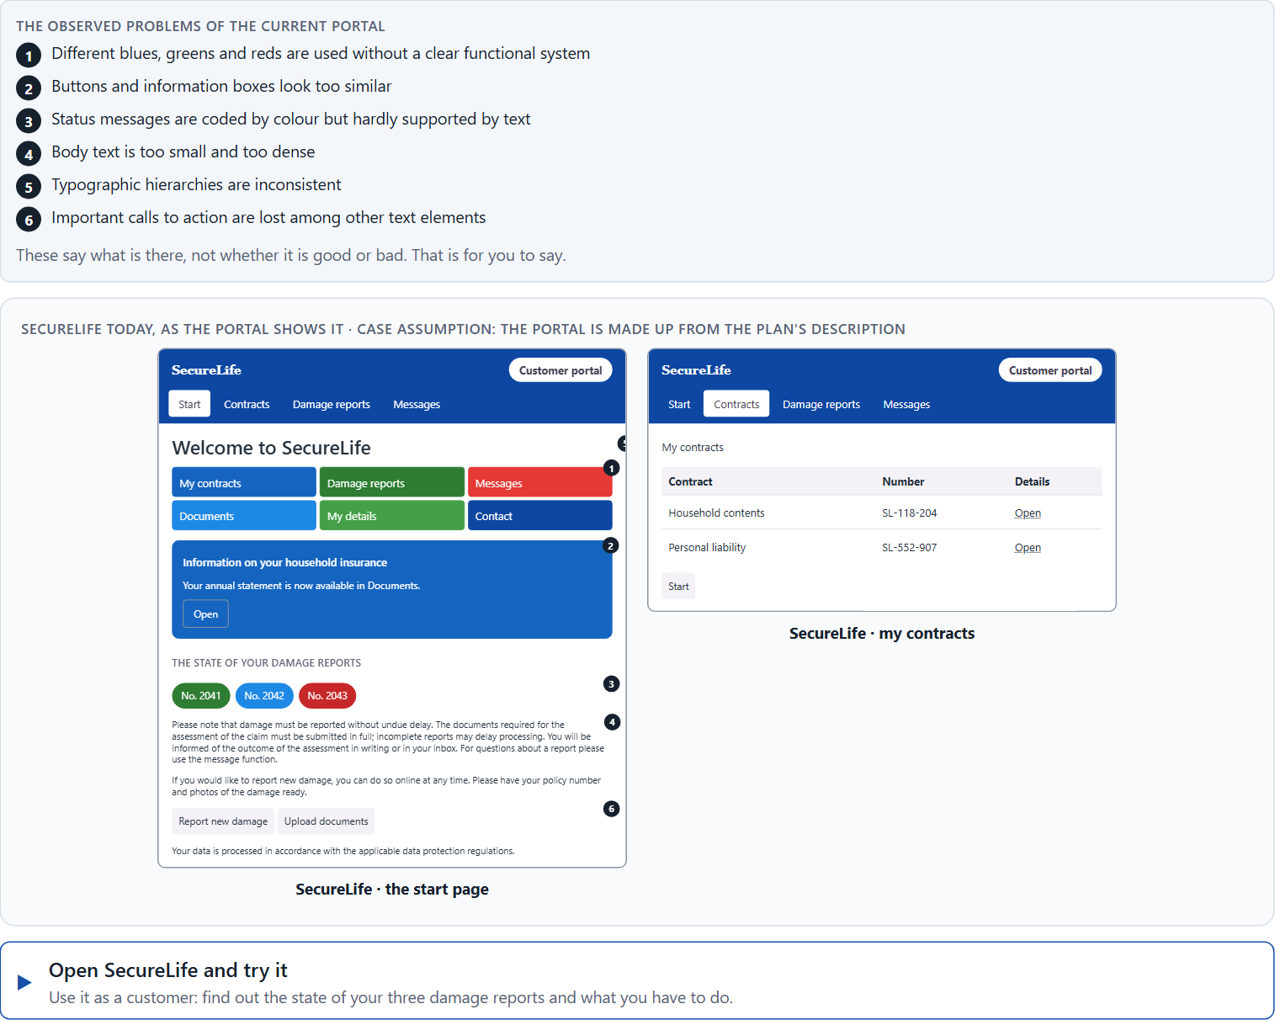
Block 2.1 · Case study: revising the insurance portal SecureLife
Level 2 · Case study · UE5–6 · about 15 min
An insurance company runs SecureLife, a digital portal for the contract overview, damage reports and communication with the service. The content is complete, but complaints pile up: users overlook important notes, do not clearly understand status messages and find the interface “exhausting” and “restless”. The observed problems: different blues, greens and reds are used without a clear functional system, buttons and information boxes look too similar, status messages are coded by colour but hardly supported by text, body text is too small and too dense, typographic hierarchies are inconsistent, and important calls to action are lost among other text elements. The conditions: a budget of €130,000, 12 weeks for the implementation, the corporate design is binding in principle but functional adjustments are possible, the portal must be easy to use for different age groups, and a complete relaunch is ruled out. You work through six steps.
Screenshot of the Neuro-UX Lab (aion-ux-lab.vercel.app), own work; AI-assisted, labelled on the image; the example company is fictional.
Draws on: A1 · What colour does · A2 · Decorative against functional colour · A3 · Readable type · A4 · Typographic hierarchy, and colour, type and structure working together · A5 · From colour and type to behaviour, and weighing a measure.
AION UX Developer · Day 3 · Training slides
11
Notes:
Block 2.1 · Case study: revising the insurance portal SecureLife · about 15 min. Draws on: A1 · What colour does · A2 · Decorative against functional colour · A3 · Readable type · A4 · Typographic hierarchy, and colour, type and structure working together · A5 · From colour and type to behaviour, and weighing a measure.

Slide 12
Block 2.1 · What you work on
Analyse the central problems in the use of colour and in the typography
1
Assign the problems to the categories readability, orientation, consistency, trust effect and action guidance
2
Develop 4 prioritised measures for improvement
3
Justify your selection using effect on users, feasibility, risk and time pressure
4
Make a prioritisation decision for the first 12 weeks
5
Formulate a recommendation to the division management
6
AION UX Developer · Day 3 · Training slides
12
Notes:
Block 2.1 · Case study: revising the insurance portal SecureLife · about 15 min. Draws on: A1 · What colour does · A2 · Decorative against functional colour · A3 · Readable type · A4 · Typographic hierarchy, and colour, type and structure working together · A5 · From colour and type to behaviour, and weighing a measure.

Slide 13
Feedback round · how each group presents
Each group presents its measures and priorities in 5 minutes
1
The reasoning runs along effect, feasibility, risk and responsibility
2
Each group names one measure it deliberately postponed
3
AION UX Developer · Day 3 · Training slides
13
Notes:
UE7 · Feedback round with a management perspective. Groups present their reasoning, not only their result.

Slide 14
Feedback round · questions to answer
Which measure improves the user experience fastest?
Which risks arise when corporate design is put above usability?
1
4
Which measure is strategically most important for consistency of the system?
Which decision can be answered for even without a complete data situation?
2
5
Where was the line between brand wish and user need drawn cleanly?
3
AION UX Developer · Day 3 · Training slides
14
Notes:
UE7 · Feedback round with a management perspective. Groups present their reasoning, not only their result.

Slide 15
Level 3 input and discussion
INPUT LEVEL 3
DISCUSSION
Colour and typography decisions are leadership decisions when they influence behaviour, understanding and trust
Senior-level thinking means steering systems instead of single designs
Good management decisions balance brand, accessibility, clarity, feasibility and time pressure
When does a colour or typography problem become a business risk?
AION UX Developer · Day 3 · Training slides
15
Notes:
UE7 · Feedback round with a management perspective. Groups present their reasoning, not only their result.

Slide 16
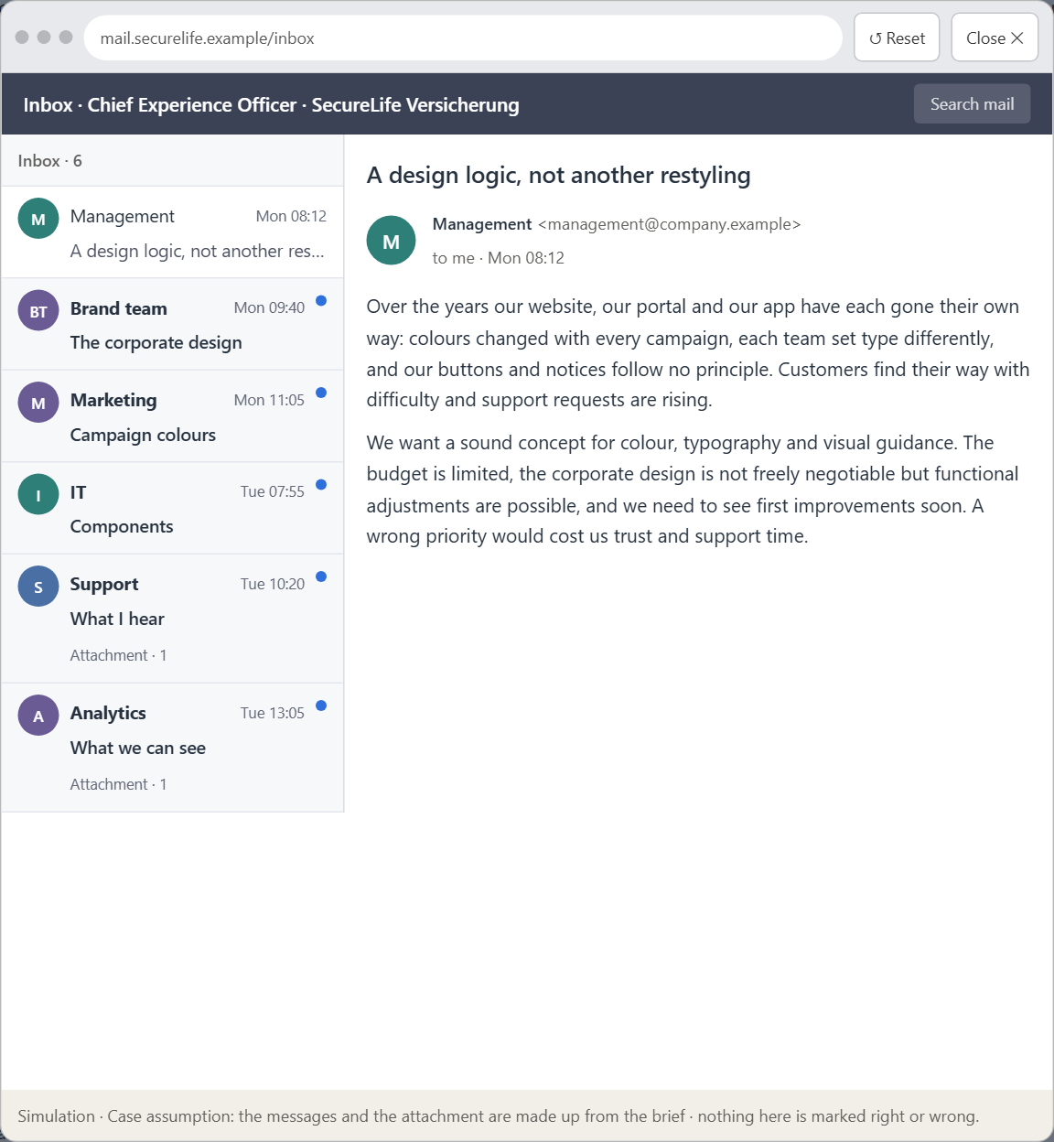
Block 3.1 · A strategic design logic for colour, typography and user guidance
Level 3 · Transfer project · UE8–10 · about 20 min
You take the perspective of the Chief Experience Officer of the insurer that runs SecureLife. The company has a website, a customer portal and an app, and over the years it has taken inconsistent design decisions. Colours were changed for each campaign, the typography was interpreted differently by each team, and the central interaction elements follow no consistent principle. Users find their way only with difficulty, support requests are rising, and inside the company the discussion is mostly about taste rather than effect. You are not to polish single screens but to develop a sound decision architecture for colour, typography and visual user guidance.
Screenshot of the Neuro-UX Lab (aion-ux-lab.vercel.app), own work; AI-assisted, labelled on the image; the example company is fictional.
Draws on: B1 · Colour and type as strategic effect decisions · B2 · Conflicts of goals · B3 · Who owns the visual standards, and deciding with incomplete data.
AION UX Developer · Day 3 · Training slides
16
Notes:
Block 3.1 · A strategic design logic for colour, typography and user guidance · about 20 min. Draws on: B1 · Colour and type as strategic effect decisions · B2 · Conflicts of goals · B3 · Who owns the visual standards, and deciding with incomplete data.

Slide 17
Block 3.1 · What you work on
1
A guiding vision for colour and typography in the company: which effect and which quality of use should be created systematically?
2
Three strategic guiding decisions for the use of colour, the reading logic, the visual hierarchy and action guidance
3
A prioritised architecture of measures: which systems or touchpoints are standardised first, and why?
4
A risk analysis: which wrong assumptions about users' perception and the brand's effect would be especially critical?
5
A governance model: who is responsible for the visual standards, and who decides in conflicts between brand and usability?
6
A decision under uncertainty: make at least one prioritised decision despite missing data and justify it
7
A management statement: a recommendation to the management with a clear priority and a strategic reason
AION UX Developer · Day 3 · Training slides
17
Notes:
Block 3.1 · A strategic design logic for colour, typography and user guidance · about 20 min. Draws on: B1 · Colour and type as strategic effect decisions · B2 · Conflicts of goals · B3 · Who owns the visual standards, and deciding with incomplete data.

Slide 18
Reflect before you leave
1
2
3
Which decision did you make today, and what did you give up to make it?
Which assumption would you check first with real users, and how?
What will you do differently in your next project because of today?
Use two minutes alone, then one minute with your neighbour.
AION UX Developer · Day 3 · Training slides
18

Slide 19
About these slides, sources and AI use
AI
AI-assisted content
Where to find more
AI-assisted content: these slides were drafted with an AI language model (Claude, Anthropic) from the course's own Neuro-UX Lab and were read, corrected and approved by Muhammad Muchson, who is responsible for their accuracy.
Pictures are screenshots of the course's own Neuro-UX Lab. Each one carries an AI label on the image and a source line under it.
Companies and people in the examples are fictional. Numbers inside an example are labelled Case assumption and are not data.
The coaching and feedback questions are the course plan's own, translated into English.
Neuro-UX Lab for this day: https://aion-ux-lab.vercel.app/day/3/
Handouts: the Materi and Task Word documents of the day.
Version 1.0, 29.10.2026. Reviewer and approver: Muhammad Muchson.
AION UX Developer · Day 3 · Training slides
19

