Slide 1
Fitts, Hick and Miller in practice
AION UX DEVELOPER · DAY 5
5
Knowledge transfer slides
Contains AI-assisted content
Module 3 (day 2 of 3)
Trainer: Muhammad Muchson · Materi A and B · v1.0

Slide 2
What we cover today
Today is about three UX laws as working tools. Fitts's law: how the size, distance and position of a target decide how fast and safely people hit it, on a screen and under a thumb. Hick's law: how the number of options decides how long a choice takes, and why priority and staged choices help. Miller's rule: how little people can hold in mind at once, and why chunking and structure help. You learn how the three work together on navigation, interaction and interface elements, and then use them on three products. This document holds everything you need to study Day 5 without the website. Every card says what the idea is in plain words, shows it in a picture, gives the details and ends with the rules you use in the tasks.
Materi A · 60 min
Materi B · 60 min
A1 Fitts's law: target size, distance and position, on a screen and under a thumb (12 min)
A2 Hick's law: fewer options, clear priority and staged choices (12 min)
A3 Miller's rule: chunking, structure and what people can hold in mind (12 min)
A4 The three laws together: reaction time, errors and load on navigation and interaction (12 min)
A5 Less searching, fewer errors, less decision stress, and weighing a measure (12 min)
B1 Interaction as an architecture of effect: the laws as standards, not details (20 min)
B2 Conflicts of goals: feature richness, speed, simplicity, brand and feasibility (20 min)
B3 Who owns the interaction standards, and deciding with incomplete data (20 min)
AION UX Developer · Day 5 · Knowledge transfer
2

Slide 3
Materi A
Route 1 · Levels 1 and 2
About 60 minutes, five cards. Levels 1 and 2: find what makes an unfamiliar banking portal slow and error-prone and match it to the three laws, rate three navigation variants under conflicting goals, then analyse a mobility portal, develop four measures, justify them and decide on the first 10 weeks. The cards give you the ideas and the rules you use in Task 1.
AION UX Developer · Day 5 · Knowledge transfer
3

Slide 4
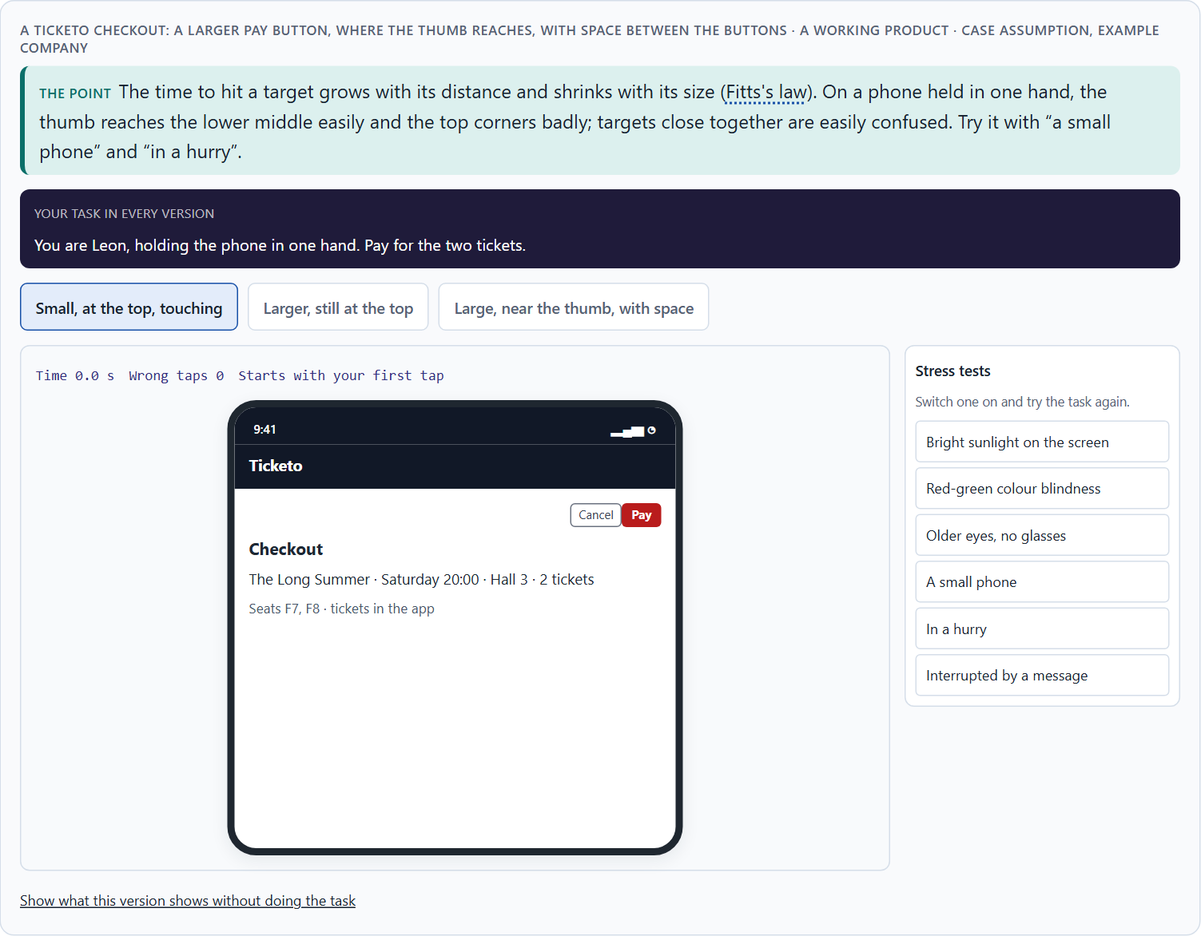
Fitts's law: target size, distance and position, on a screen and under a thumb
A1 · 12 min · Core
The time to hit a target grows with its distance and shrinks with its size (Fitts's law). Make main actions large, close to the hand and spaced apart; on a phone, where the thumb already is.
A Ticketo checkout: a larger Pay button, where the thumb reaches, with space between the buttons.
Screenshot of the Neuro-UX Lab (aion-ux-lab.vercel.app), own work; AI-assisted, labelled on the image; the example company is fictional.
Sources: Fitts 1954 · MacKenzie 1992 · Parhi et al. 2006 · Hoober 2013 · WCAG 2.2 · Baymard Institute 2024
AION UX Developer · Day 5 · Knowledge transfer
4
Notes:
A1 · Fitts's law: target size, distance and position, on a screen and under a thumb · 12 min · Core
Case assumption: Ticketo, Leon, Mara, Priya and Tobias are made up for this example. Fitts's law follows Fitts (1954) and, for screens, MacKenzie (1992); small targets under the thumb follow Parhi, Karlson and Bederson (2006); how people hold phones follows Hoober (2013); WCAG 2.2 sets a minimum target size in criterion 2.5.8. The findings in the table of real evidence are real research results, rules and cases; the sources are listed below.
Go deeper (optional reading): WCAG 2.2 criterion 2.5.8 asks that a pointer target is at least 24 by 24 CSS pixels, or has enough space around it; the older enhanced criterion 2.5.5 asks for 44 by 44. Neither is a design goal: they are a floor below which people with less precise hands, or anyone on a moving bus, start to fail.
Sources: Fitts 1954 · MacKenzie 1992 · Parhi et al. 2006 · Hoober 2013 · WCAG 2.2 · Baymard Institute 2024

Slide 5
A1 · In plain words
THE IDEA
WHY IT MATTERS
Fitts's law says that the time to hit a target grows with its distance and shrinks with its size. On a screen that means: important buttons and links must be large enough and close to where the pointer or the thumb already is. On a phone, people often hold the device in one hand, and the thumb reaches the lower middle of the screen easily and the top corners badly. Targets that are small, far away or packed close together are slow to hit and easy to miss.
Block 1.1 asks about BankDirect's small top-right transfer link, its buttons close together and its small mobile buttons, and Block 2.1 asks about MoveEasy's small, badly placed booking buttons and touch targets. This card gives you size, distance, spacing and the thumb's reach.
HOW TO READ THE PICTURE
One Ticketo checkout on a phone with three switches: a larger Pay button, placed where the thumb reaches, and space between the buttons. A table of Fitts's law in numbers follows.
Sources: Fitts 1954 · MacKenzie 1992 · Parhi et al. 2006 · Hoober 2013 · WCAG 2.2 · Baymard Institute 2024
AION UX Developer · Day 5 · Knowledge transfer
5
Notes:
A1 · Fitts's law: target size, distance and position, on a screen and under a thumb · 12 min · Core
Case assumption: Ticketo, Leon, Mara, Priya and Tobias are made up for this example. Fitts's law follows Fitts (1954) and, for screens, MacKenzie (1992); small targets under the thumb follow Parhi, Karlson and Bederson (2006); how people hold phones follows Hoober (2013); WCAG 2.2 sets a minimum target size in criterion 2.5.8. The findings in the table of real evidence are real research results, rules and cases; the sources are listed below.
Go deeper (optional reading): WCAG 2.2 criterion 2.5.8 asks that a pointer target is at least 24 by 24 CSS pixels, or has enough space around it; the older enhanced criterion 2.5.5 asks for 44 by 44. Neither is a design goal: they are a floor below which people with less precise hands, or anyone on a moving bus, start to fail.
Sources: Fitts 1954 · MacKenzie 1992 · Parhi et al. 2006 · Hoober 2013 · WCAG 2.2 · Baymard Institute 2024

Slide 6
A1 · Fitts's law on screens
Lever | What it does | A sign it is missing
Size | A larger target is hit faster and missed less. | Small links for the main task; tiny phone buttons.
Distance and position | A target near the hand is reached faster. | The main action in a far top corner.
Spacing | Space between targets prevents mix-ups. | Similar buttons that touch.
Touch area | The area that reacts can be larger than the label. | Only the word itself reacts to a tap.
Sources: Fitts 1954 · MacKenzie 1992 · Parhi et al. 2006 · Hoober 2013 · WCAG 2.2 · Baymard Institute 2024
AION UX Developer · Day 5 · Knowledge transfer
6
Notes:
A1 · Fitts's law: target size, distance and position, on a screen and under a thumb · 12 min · Core
Case assumption: Ticketo, Leon, Mara, Priya and Tobias are made up for this example. Fitts's law follows Fitts (1954) and, for screens, MacKenzie (1992); small targets under the thumb follow Parhi, Karlson and Bederson (2006); how people hold phones follows Hoober (2013); WCAG 2.2 sets a minimum target size in criterion 2.5.8. The findings in the table of real evidence are real research results, rules and cases; the sources are listed below.
Go deeper (optional reading): WCAG 2.2 criterion 2.5.8 asks that a pointer target is at least 24 by 24 CSS pixels, or has enough space around it; the older enhanced criterion 2.5.5 asks for 44 by 44. Neither is a design goal: they are a floor below which people with less precise hands, or anyone on a moving bus, start to fail.
Sources: Fitts 1954 · MacKenzie 1992 · Parhi et al. 2006 · Hoober 2013 · WCAG 2.2 · Baymard Institute 2024

Slide 7
A1 · Fitts's law in numbers
Topic | Real finding or rule | What it means for a screen
The law | The time to hit a target grows with its distance D and shrinks with its width W. The form most used on screens is MT = a + b·log2(D/W + 1) (MacKenzie 1992; first described by Fitts 1954 as log2(2D/W)). | Double the size or halve the distance, and the movement gets faster by the same step.
Thumb size | A study of one-handed thumb use on a touch screen found that 9.2 mm was large enough for single targets and 9.6 mm for a sequence of taps (Parhi et al. 2006). | Size the tap area for the thumb, not for the pointer; a label alone is often too small.
Hand and position | Of 1,333 people observed using phones in public, 49% held the phone in one hand, 36% cradled it and 15% used two hands (Hoober 2013, as reported). | Put the main action where a thumb on a one-handed grip reaches it.
Rules | WCAG 2.2 asks for pointer targets of at least 24 by 24 CSS pixels (2.5.8, level AA, with a spacing exception) and 44 by 44 at level AAA (2.5.5). | Check the size of the area that reacts and the space between neighbours.
Sources: Fitts 1954 · MacKenzie 1992 · Parhi et al. 2006 · Hoober 2013 · WCAG 2.2 · Baymard Institute 2024
AION UX Developer · Day 5 · Knowledge transfer
7
Notes:
A1 · Fitts's law: target size, distance and position, on a screen and under a thumb · 12 min · Core
Case assumption: Ticketo, Leon, Mara, Priya and Tobias are made up for this example. Fitts's law follows Fitts (1954) and, for screens, MacKenzie (1992); small targets under the thumb follow Parhi, Karlson and Bederson (2006); how people hold phones follows Hoober (2013); WCAG 2.2 sets a minimum target size in criterion 2.5.8. The findings in the table of real evidence are real research results, rules and cases; the sources are listed below.
Go deeper (optional reading): WCAG 2.2 criterion 2.5.8 asks that a pointer target is at least 24 by 24 CSS pixels, or has enough space around it; the older enhanced criterion 2.5.5 asks for 44 by 44. Neither is a design goal: they are a floor below which people with less precise hands, or anyone on a moving bus, start to fail.
Sources: Fitts 1954 · MacKenzie 1992 · Parhi et al. 2006 · Hoober 2013 · WCAG 2.2 · Baymard Institute 2024

Slide 8
A1 · How to decide when this comes up in the task
Find the most important action on each screen and check its size: can it be hit without aiming?
1
Check its distance: is it near where the pointer or the thumb already is, or in a far corner?
2
Check the space around it: targets that touch are confused, above all similar ones.
3
On a phone held in one hand, the thumb reaches the lower middle easily and the top corners badly.
4
The click or touch area can be larger than the visible label; make it so for small labels.
5
Sources: Fitts 1954 · MacKenzie 1992 · Parhi et al. 2006 · Hoober 2013 · WCAG 2.2 · Baymard Institute 2024
AION UX Developer · Day 5 · Knowledge transfer
8
Notes:
A1 · Fitts's law: target size, distance and position, on a screen and under a thumb · 12 min · Core
Case assumption: Ticketo, Leon, Mara, Priya and Tobias are made up for this example. Fitts's law follows Fitts (1954) and, for screens, MacKenzie (1992); small targets under the thumb follow Parhi, Karlson and Bederson (2006); how people hold phones follows Hoober (2013); WCAG 2.2 sets a minimum target size in criterion 2.5.8. The findings in the table of real evidence are real research results, rules and cases; the sources are listed below.
Go deeper (optional reading): WCAG 2.2 criterion 2.5.8 asks that a pointer target is at least 24 by 24 CSS pixels, or has enough space around it; the older enhanced criterion 2.5.5 asks for 44 by 44. Neither is a design goal: they are a floor below which people with less precise hands, or anyone on a moving bus, start to fail.
Sources: Fitts 1954 · MacKenzie 1992 · Parhi et al. 2006 · Hoober 2013 · WCAG 2.2 · Baymard Institute 2024

Slide 9
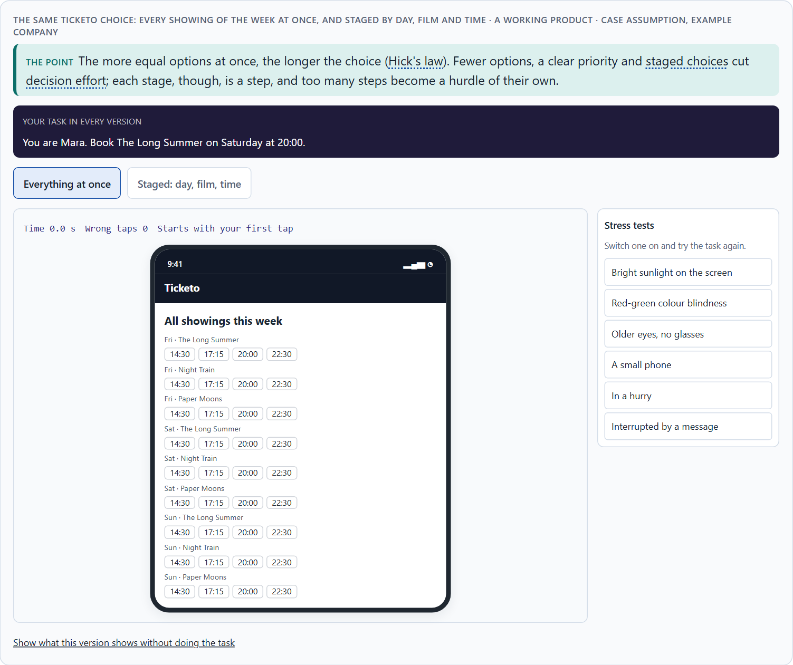
Hick's law: fewer options, clear priority and staged choices
A2 · 12 min · Core
The more equally weighted options, the longer the choice (Hick's law). Fewer options at once, a clear priority and staged choices cut decision effort; too many stages become a hurdle.
The same Ticketo choice: every showing of the week at once, and staged by day, film and time.
Screenshot of the Neuro-UX Lab (aion-ux-lab.vercel.app), own work; AI-assisted, labelled on the image; the example company is fictional.
Sources: Hick 1952 · Hyman 1953 · Iyengar & Lepper 2000 · Nielsen 2006 · Larson & Czerwinski 1998
AION UX Developer · Day 5 · Knowledge transfer
9
Notes:
A2 · Hick's law: fewer options, clear priority and staged choices · 12 min · Core
Case assumption: Ticketo, Leon, Mara, Priya and Tobias are made up for this example. Hick's law follows Hick (1952) and Hyman (1953); many options making people choose less follows Iyengar and Lepper (2000); showing options in stages follows Nielsen (2006) on progressive disclosure. The findings in the table of real evidence are real research results, rules and cases; the sources are listed below.
Go deeper (optional reading): Hick's law grows with the logarithm of the number of options, not in a straight line: going from two options to four costs about as much as going from four to eight. That is why the first few extra options hurt most, and why a short, well-ordered list often beats a cleverer structure with more steps.
Sources: Hick 1952 · Hyman 1953 · Iyengar & Lepper 2000 · Nielsen 2006 · Larson & Czerwinski 1998

Slide 10
A2 · In plain words
THE IDEA
WHY IT MATTERS
Hick's law says that the more equally weighted options people choose between, the longer the choice takes. Three things help. Fewer options at once: show what most people need. Clear priority: make the likely choice stand out. Staged choices: split one large choice into a few small ones (first the day, then the film, then the time), each with only a few options. Staging has a price: every stage is a step, and too many steps become a hurdle of their own.
Block 1.1 asks about BankDirect's 14 equal menu options, Block 1.2 asks you to rate AdminFlow's all-at-once, staged and minimalist variants, and Block 2.1 asks about MoveEasy's too many options and equal choices in every step. This card gives you the three ways to lower decision effort and the limit of reduction.
HOW TO READ THE PICTURE
The same Ticketo choice in two forms: every showing of the week at once, and staged by day, film and time. A table of evidence for lowering decision effort follows.
Sources: Hick 1952 · Hyman 1953 · Iyengar & Lepper 2000 · Nielsen 2006 · Larson & Czerwinski 1998
AION UX Developer · Day 5 · Knowledge transfer
10
Notes:
A2 · Hick's law: fewer options, clear priority and staged choices · 12 min · Core
Case assumption: Ticketo, Leon, Mara, Priya and Tobias are made up for this example. Hick's law follows Hick (1952) and Hyman (1953); many options making people choose less follows Iyengar and Lepper (2000); showing options in stages follows Nielsen (2006) on progressive disclosure. The findings in the table of real evidence are real research results, rules and cases; the sources are listed below.
Go deeper (optional reading): Hick's law grows with the logarithm of the number of options, not in a straight line: going from two options to four costs about as much as going from four to eight. That is why the first few extra options hurt most, and why a short, well-ordered list often beats a cleverer structure with more steps.
Sources: Hick 1952 · Hyman 1953 · Iyengar & Lepper 2000 · Nielsen 2006 · Larson & Czerwinski 1998

Slide 11
A2 · Three ways to lower decision effort, and their limit
Way | What it does | Its limit
Fewer options at once | Less to compare. | Rare needs must stay findable.
A clear priority | The likely choice stands out. | A wrong priority misleads.
Staged choices | A few options per step. | Each stage is a step; too many steps slow people down.
Sources: Hick 1952 · Hyman 1953 · Iyengar & Lepper 2000 · Nielsen 2006 · Larson & Czerwinski 1998
AION UX Developer · Day 5 · Knowledge transfer
11
Notes:
A2 · Hick's law: fewer options, clear priority and staged choices · 12 min · Core
Case assumption: Ticketo, Leon, Mara, Priya and Tobias are made up for this example. Hick's law follows Hick (1952) and Hyman (1953); many options making people choose less follows Iyengar and Lepper (2000); showing options in stages follows Nielsen (2006) on progressive disclosure. The findings in the table of real evidence are real research results, rules and cases; the sources are listed below.
Go deeper (optional reading): Hick's law grows with the logarithm of the number of options, not in a straight line: going from two options to four costs about as much as going from four to eight. That is why the first few extra options hurt most, and why a short, well-ordered list often beats a cleverer structure with more steps.
Sources: Hick 1952 · Hyman 1953 · Iyengar & Lepper 2000 · Nielsen 2006 · Larson & Czerwinski 1998

Slide 12
A2 · Lowering decision effort: evidence and limits
Lever | Real finding or rule | What it means for a screen
The law | The time to choose grows with the logarithm of the number of equally likely options, RT = a + b·log2(n + 1): each doubling of the options adds one fixed step of time (Hick 1952; Hyman 1953). | A few fewer options help most when the options are many and unfamiliar.
Fewer at once | A display of 24 jams drew more stops and far fewer purchases than a display of 6 (Iyengar and Lepper 2000; a small study). | Show a short list first; keep the rest one step away.
Staged choices | In theory a design can have several levels of progressive disclosure; in practice designs with more than two levels usually have low usability because users get lost between them (Nielsen 2006). | Stage a choice in at most two levels, and show where the person is.
Structure matters | A medium structure of depth and breadth beat the broadest, shallowest one in a web search study (Larson and Czerwinski 1998). | Do not trade a long list for many levels.
Sources: Hick 1952 · Hyman 1953 · Iyengar & Lepper 2000 · Nielsen 2006 · Larson & Czerwinski 1998
AION UX Developer · Day 5 · Knowledge transfer
12
Notes:
A2 · Hick's law: fewer options, clear priority and staged choices · 12 min · Core
Case assumption: Ticketo, Leon, Mara, Priya and Tobias are made up for this example. Hick's law follows Hick (1952) and Hyman (1953); many options making people choose less follows Iyengar and Lepper (2000); showing options in stages follows Nielsen (2006) on progressive disclosure. The findings in the table of real evidence are real research results, rules and cases; the sources are listed below.
Go deeper (optional reading): Hick's law grows with the logarithm of the number of options, not in a straight line: going from two options to four costs about as much as going from four to eight. That is why the first few extra options hurt most, and why a short, well-ordered list often beats a cleverer structure with more steps.
Sources: Hick 1952 · Hyman 1953 · Iyengar & Lepper 2000 · Nielsen 2006 · Larson & Czerwinski 1998

Slide 13
A2 · How to decide when this comes up in the task
Count the equal options at each decision point: menu items, tiles, buttons, list entries.
1
Show what most people need and make the likely choice stand out.
2
Split a large choice into a few small stages with few options each.
3
Count the stages too: when a short choice needs many screens, reduction has become a hurdle.
4
Long lists of similar options are a decision problem as well as a reach problem.
5
Sources: Hick 1952 · Hyman 1953 · Iyengar & Lepper 2000 · Nielsen 2006 · Larson & Czerwinski 1998
AION UX Developer · Day 5 · Knowledge transfer
13
Notes:
A2 · Hick's law: fewer options, clear priority and staged choices · 12 min · Core
Case assumption: Ticketo, Leon, Mara, Priya and Tobias are made up for this example. Hick's law follows Hick (1952) and Hyman (1953); many options making people choose less follows Iyengar and Lepper (2000); showing options in stages follows Nielsen (2006) on progressive disclosure. The findings in the table of real evidence are real research results, rules and cases; the sources are listed below.
Go deeper (optional reading): Hick's law grows with the logarithm of the number of options, not in a straight line: going from two options to four costs about as much as going from four to eight. That is why the first few extra options hurt most, and why a short, well-ordered list often beats a cleverer structure with more steps.
Sources: Hick 1952 · Hyman 1953 · Iyengar & Lepper 2000 · Nielsen 2006 · Larson & Czerwinski 1998

Slide 14
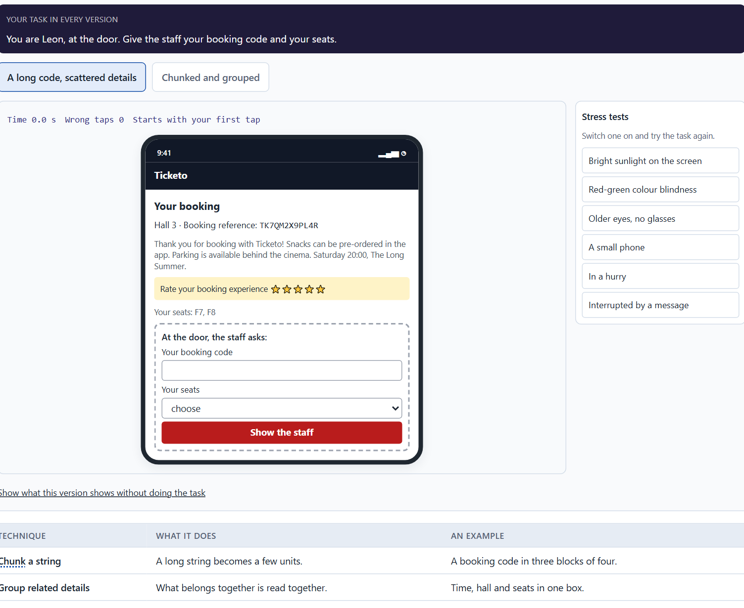
Miller's rule: chunking, structure and what people can hold in mind
A3 · 12 min · Core
Short-term memory holds only a few items (Miller's rule; later research says nearer four). Chunking and structure make information easier to take in and remember; showing it where needed avoids remembering at all.
The same Ticketo confirmation: a long code and scattered details, or a chunked code with the details in one box.
Screenshot of the Neuro-UX Lab (aion-ux-lab.vercel.app), own work; AI-assisted, labelled on the image; the example company is fictional.
Sources: Miller 1956 · Cowan 2001 · Gobet et al. 2001 · Nielsen 1994 · Chase & Simon 1973 · ISO 13616 · Sweller 1988
AION UX Developer · Day 5 · Knowledge transfer
14
Notes:
A3 · Miller's rule: chunking, structure and what people can hold in mind · 12 min · Core
Case assumption: Ticketo, Leon, Mara, Priya and Tobias are made up for this example. The limits of short-term memory follow Miller (1956) and Cowan (2001); chunking follows Gobet et al. (2001); recognition rather than recall is Nielsen's heuristic (1994). The findings in the table of real evidence are real research results, rules and cases; the sources are listed below.
Go deeper (optional reading): Chunks are meaningful units, not just shorter pieces: an experienced traveller sees a train number and a platform as one chunk, a newcomer as several. That is why grouping by meaning (all the details of one ticket together) helps more than splitting text at a fixed length.
Sources: Miller 1956 · Cowan 2001 · Gobet et al. 2001 · Nielsen 1994 · Chase & Simon 1973 · ISO 13616 · Sweller 1988

Slide 15
A3 · In plain words
THE IDEA
WHY IT MATTERS
Miller's rule says that short-term memory holds only a small number of items; later research puts it nearer four. Two things help. Chunking: group items into a few meaningful units, such as a booking code in blocks of three, or seat, time and price in one box. Structure: put what belongs together together, and show information where it is needed, so it does not have to be carried from one screen to the next. What people must remember is a common source of typing errors and wrong choices.
Block 1.1 asks about BankDirect's crowded forms and the numbers and options users must remember at once, and Block 2.1 asks about MoveEasy's tariffs and conditions to remember. This card gives you chunking and structure as fixes.
HOW TO READ THE PICTURE
The same Ticketo confirmation twice: a long code and scattered details, and a chunked code with the details in one box. A table of evidence for chunking follows.
Sources: Miller 1956 · Cowan 2001 · Gobet et al. 2001 · Nielsen 1994 · Chase & Simon 1973 · ISO 13616 · Sweller 1988
AION UX Developer · Day 5 · Knowledge transfer
15
Notes:
A3 · Miller's rule: chunking, structure and what people can hold in mind · 12 min · Core
Case assumption: Ticketo, Leon, Mara, Priya and Tobias are made up for this example. The limits of short-term memory follow Miller (1956) and Cowan (2001); chunking follows Gobet et al. (2001); recognition rather than recall is Nielsen's heuristic (1994). The findings in the table of real evidence are real research results, rules and cases; the sources are listed below.
Go deeper (optional reading): Chunks are meaningful units, not just shorter pieces: an experienced traveller sees a train number and a platform as one chunk, a newcomer as several. That is why grouping by meaning (all the details of one ticket together) helps more than splitting text at a fixed length.
Sources: Miller 1956 · Cowan 2001 · Gobet et al. 2001 · Nielsen 1994 · Chase & Simon 1973 · ISO 13616 · Sweller 1988

Slide 16
A3 · Chunking and structure
Technique | What it does | An example
Chunk a string | A long string becomes a few units. | A booking code in three blocks of four.
Group related details | What belongs together is read together. | Time, hall and seats in one box.
Show where needed | Nothing has to be carried across screens. | The conditions next to the ticket being chosen.
Split a long form | A few fields per group, each with a heading. | Who travels · When · How to pay.
Sources: Miller 1956 · Cowan 2001 · Gobet et al. 2001 · Nielsen 1994 · Chase & Simon 1973 · ISO 13616 · Sweller 1988
AION UX Developer · Day 5 · Knowledge transfer
16
Notes:
A3 · Miller's rule: chunking, structure and what people can hold in mind · 12 min · Core
Case assumption: Ticketo, Leon, Mara, Priya and Tobias are made up for this example. The limits of short-term memory follow Miller (1956) and Cowan (2001); chunking follows Gobet et al. (2001); recognition rather than recall is Nielsen's heuristic (1994). The findings in the table of real evidence are real research results, rules and cases; the sources are listed below.
Go deeper (optional reading): Chunks are meaningful units, not just shorter pieces: an experienced traveller sees a train number and a platform as one chunk, a newcomer as several. That is why grouping by meaning (all the details of one ticket together) helps more than splitting text at a fixed length.
Sources: Miller 1956 · Cowan 2001 · Gobet et al. 2001 · Nielsen 1994 · Chase & Simon 1973 · ISO 13616 · Sweller 1988

Slide 17
A3 · Chunking and structure: evidence
Finding | What it shows | What it means for a screen
Miller 1956 and Cowan 2001 | Miller described a span of about seven chunks; later work puts the limit nearer four chunks (Cowan 2001). | Plan for four, and let the system hold what a person would have to remember.
What a chunk is | A chunk is a unit that the person already knows as one thing (Gobet et al. 2001). Chess masters recalled 20 or more pieces from a real game position, in about five chunks; for pieces placed at random, every player recalled only three or four (Chase and Simon 1973, as reported). | A grouping helps only if it matches a unit the user knows: a date, a phone number, a seat, a total.
Chunking in print | UK postcodes are written in two parts, for example SW1A 1AA, and an IBAN in groups of four characters (ISO 13616). | Break a long code into groups at the places where people read or type it.
Show where needed | Effort spent on holding information that the screen could show is missing for the task (Sweller 1988). | Show the conditions next to the choice they belong to.
Sources: Miller 1956 · Cowan 2001 · Gobet et al. 2001 · Nielsen 1994 · Chase & Simon 1973 · ISO 13616 · Sweller 1988
AION UX Developer · Day 5 · Knowledge transfer
17
Notes:
A3 · Miller's rule: chunking, structure and what people can hold in mind · 12 min · Core
Case assumption: Ticketo, Leon, Mara, Priya and Tobias are made up for this example. The limits of short-term memory follow Miller (1956) and Cowan (2001); chunking follows Gobet et al. (2001); recognition rather than recall is Nielsen's heuristic (1994). The findings in the table of real evidence are real research results, rules and cases; the sources are listed below.
Go deeper (optional reading): Chunks are meaningful units, not just shorter pieces: an experienced traveller sees a train number and a platform as one chunk, a newcomer as several. That is why grouping by meaning (all the details of one ticket together) helps more than splitting text at a fixed length.
Sources: Miller 1956 · Cowan 2001 · Gobet et al. 2001 · Nielsen 1994 · Chase & Simon 1973 · ISO 13616 · Sweller 1988

Slide 18
A3 · How to decide when this comes up in the task
List what people must take in or keep in mind at each step: codes, numbers, tariffs, conditions, earlier choices.
1
Chunk long strings into blocks of three or four, and group related details in one place.
2
Show information where it is needed, so it does not have to be carried from one screen to the next.
3
Forms that show everything at once hide the few fields that matter: structure them into small groups.
4
Sources: Miller 1956 · Cowan 2001 · Gobet et al. 2001 · Nielsen 1994 · Chase & Simon 1973 · ISO 13616 · Sweller 1988
AION UX Developer · Day 5 · Knowledge transfer
18
Notes:
A3 · Miller's rule: chunking, structure and what people can hold in mind · 12 min · Core
Case assumption: Ticketo, Leon, Mara, Priya and Tobias are made up for this example. The limits of short-term memory follow Miller (1956) and Cowan (2001); chunking follows Gobet et al. (2001); recognition rather than recall is Nielsen's heuristic (1994). The findings in the table of real evidence are real research results, rules and cases; the sources are listed below.
Go deeper (optional reading): Chunks are meaningful units, not just shorter pieces: an experienced traveller sees a train number and a platform as one chunk, a newcomer as several. That is why grouping by meaning (all the details of one ticket together) helps more than splitting text at a fixed length.
Sources: Miller 1956 · Cowan 2001 · Gobet et al. 2001 · Nielsen 1994 · Chase & Simon 1973 · ISO 13616 · Sweller 1988

Slide 19
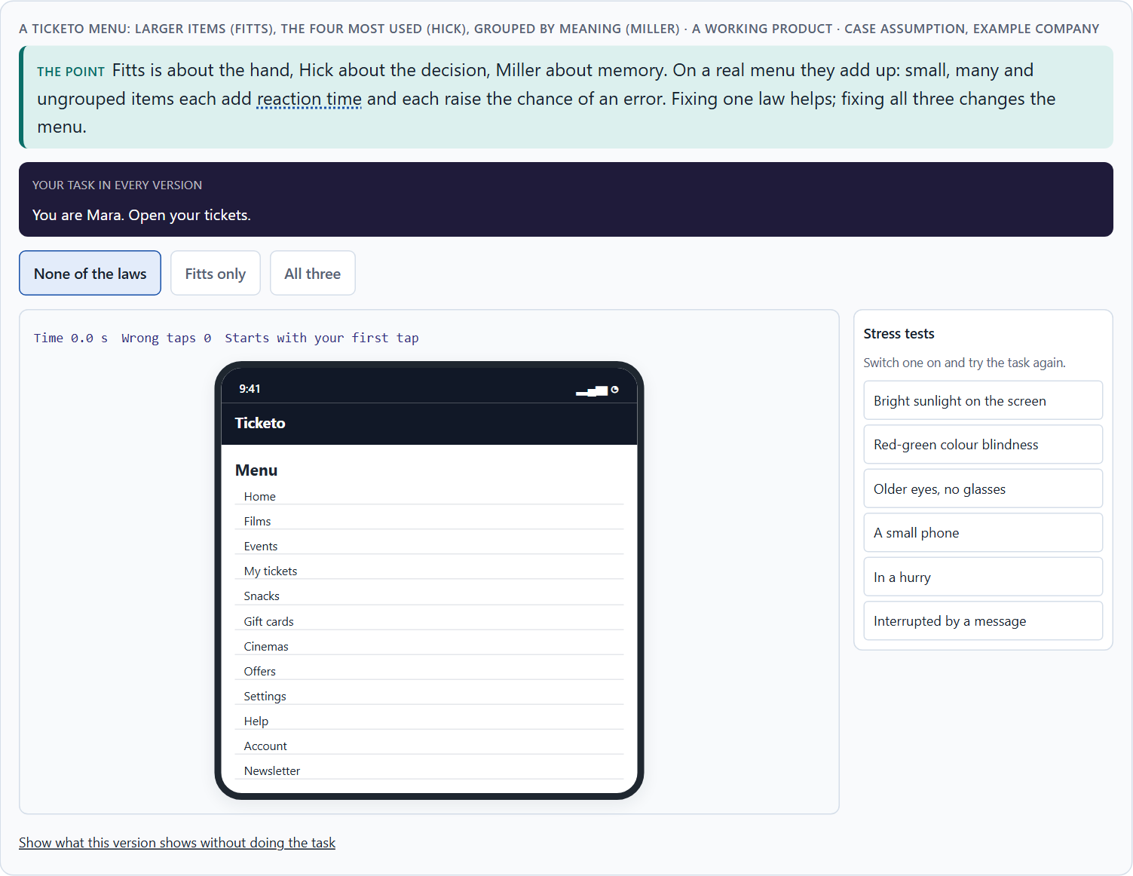
The three laws together: reaction time, errors and load on navigation and interaction
A4 · 12 min · Core
Fitts is the hand, Hick the decision, Miller the memory. On navigation, interaction and interface elements they add up: each adds reaction time, raises the error probability and the cognitive load.
A Ticketo menu: larger items (Fitts), the four most used (Hick), grouped by meaning (Miller).
Screenshot of the Neuro-UX Lab (aion-ux-lab.vercel.app), own work; AI-assisted, labelled on the image; the example company is fictional.
Sources: Yablonski 2020 · Fitts 1954 · Hick 1952 · Miller 1956 · Sweller 1988 · Baymard Institute 2024
AION UX Developer · Day 5 · Knowledge transfer
19
Notes:
A4 · The three laws together: reaction time, errors and load on navigation and interaction · 12 min · Core
Case assumption: Ticketo, Leon, Mara, Priya and Tobias are made up for this example. The three laws together follow Yablonski (2020); cognitive load follows Sweller (1988). The findings in the table of real evidence are real research results, rules and cases; the sources are listed below.
Go deeper (optional reading): The laws also trade against each other. Making every target large (Fitts) on a small screen leaves room for fewer options (Hick), which can push some into a second step that has to be remembered (Miller). Good interaction design looks for the arrangement that keeps all three costs low for the most frequent tasks.
Sources: Yablonski 2020 · Fitts 1954 · Hick 1952 · Miller 1956 · Sweller 1988 · Baymard Institute 2024

Slide 20
A4 · In plain words
THE IDEA
WHY IT MATTERS
The three laws describe different things: Fitts the hand (reaching a target), Hick the decision (choosing between options), Miller the memory (holding information). On a real screen they work together. A menu can be slow because its items are small (Fitts), because there are many of them (Hick) and because the labels have to be compared in the head (Miller). Each adds reaction time, and each raises the chance of an error; together they raise the cognitive load. Small click targets, overloaded menus and too much information at once weaken use for that reason.
Block 1.1 asks you to assign BankDirect's problems to the three laws, Block 1.2 asks you to rate AdminFlow on reachability, decision effort and memory load, and Block 2.1 asks you to sort MoveEasy's problems by reachability, decision effort, memory load, mobile usability and error risk. This card shows how to tell the laws apart and how they combine.
HOW TO READ THE PICTURE
One Ticketo menu with three switches, one per law: larger items, fewer items, and labels grouped by meaning. A table of the limits of the person follows.
Sources: Yablonski 2020 · Fitts 1954 · Hick 1952 · Miller 1956 · Sweller 1988 · Baymard Institute 2024
AION UX Developer · Day 5 · Knowledge transfer
20
Notes:
A4 · The three laws together: reaction time, errors and load on navigation and interaction · 12 min · Core
Case assumption: Ticketo, Leon, Mara, Priya and Tobias are made up for this example. The three laws together follow Yablonski (2020); cognitive load follows Sweller (1988). The findings in the table of real evidence are real research results, rules and cases; the sources are listed below.
Go deeper (optional reading): The laws also trade against each other. Making every target large (Fitts) on a small screen leaves room for fewer options (Hick), which can push some into a second step that has to be remembered (Miller). Good interaction design looks for the arrangement that keeps all three costs low for the most frequent tasks.
Sources: Yablonski 2020 · Fitts 1954 · Hick 1952 · Miller 1956 · Sweller 1988 · Baymard Institute 2024

Slide 21
A4 · The three laws side by side
Law | What it is about | Typical hurdle | Typical fix
Fitts's law | The hand: reaching and hitting a target. | Small, far, crowded targets. | Large, close, spaced targets.
Hick's law | The decision: choosing between options. | Many equal options. | Fewer, prioritised, staged options.
Miller's rule | The memory: holding information. | Codes and conditions to remember. | Chunked, grouped, shown where needed.
Sources: Yablonski 2020 · Fitts 1954 · Hick 1952 · Miller 1956 · Sweller 1988 · Baymard Institute 2024
AION UX Developer · Day 5 · Knowledge transfer
21
Notes:
A4 · The three laws together: reaction time, errors and load on navigation and interaction · 12 min · Core
Case assumption: Ticketo, Leon, Mara, Priya and Tobias are made up for this example. The three laws together follow Yablonski (2020); cognitive load follows Sweller (1988). The findings in the table of real evidence are real research results, rules and cases; the sources are listed below.
Go deeper (optional reading): The laws also trade against each other. Making every target large (Fitts) on a small screen leaves room for fewer options (Hick), which can push some into a second step that has to be remembered (Miller). Good interaction design looks for the arrangement that keeps all three costs low for the most frequent tasks.
Sources: Yablonski 2020 · Fitts 1954 · Hick 1952 · Miller 1956 · Sweller 1988 · Baymard Institute 2024

Slide 22
A4 · The three laws and the limits of the person
Limit | What the evidence says | What it means for a screen
Speed and accuracy | In Fitts's experiments, people who aimed to be faster made more errors: speed and accuracy trade off against each other (Fitts 1954). | A small target in a hurry produces errors; time pressure raises the demands on every law.
Load and errors | Effort spent on the interface leaves less for the task, and the task suffers (Sweller 1988). | Count the targets to hit, the options to weigh and the items to remember in one step.
Completion | 17% of the US online shoppers had abandoned an order in the past quarter because the checkout seemed too long or complicated (Baymard Institute 2024). | The three limits meet in forms and checkouts: reduce them there first.
Sources: Yablonski 2020 · Fitts 1954 · Hick 1952 · Miller 1956 · Sweller 1988 · Baymard Institute 2024
AION UX Developer · Day 5 · Knowledge transfer
22
Notes:
A4 · The three laws together: reaction time, errors and load on navigation and interaction · 12 min · Core
Case assumption: Ticketo, Leon, Mara, Priya and Tobias are made up for this example. The three laws together follow Yablonski (2020); cognitive load follows Sweller (1988). The findings in the table of real evidence are real research results, rules and cases; the sources are listed below.
Go deeper (optional reading): The laws also trade against each other. Making every target large (Fitts) on a small screen leaves room for fewer options (Hick), which can push some into a second step that has to be remembered (Miller). Good interaction design looks for the arrangement that keeps all three costs low for the most frequent tasks.
Sources: Yablonski 2020 · Fitts 1954 · Hick 1952 · Miller 1956 · Sweller 1988 · Baymard Institute 2024

Slide 23
A4 · How to decide when this comes up in the task
For each hurdle, ask which of the three it is about: reaching a target, choosing between options, or holding information.
1
Many hurdles touch two laws at once, such as a long list of small, similar items (Fitts and Hick).
2
Small click targets, overloaded menus and too much information at once weaken use because each law adds time and errors.
3
Reaction time, error probability and cognitive load rise together; lowering one law's cost lowers all three a little.
4
Sources: Yablonski 2020 · Fitts 1954 · Hick 1952 · Miller 1956 · Sweller 1988 · Baymard Institute 2024
AION UX Developer · Day 5 · Knowledge transfer
23
Notes:
A4 · The three laws together: reaction time, errors and load on navigation and interaction · 12 min · Core
Case assumption: Ticketo, Leon, Mara, Priya and Tobias are made up for this example. The three laws together follow Yablonski (2020); cognitive load follows Sweller (1988). The findings in the table of real evidence are real research results, rules and cases; the sources are listed below.
Go deeper (optional reading): The laws also trade against each other. Making every target large (Fitts) on a small screen leaves room for fewer options (Hick), which can push some into a second step that has to be remembered (Miller). Good interaction design looks for the arrangement that keeps all three costs low for the most frequent tasks.
Sources: Yablonski 2020 · Fitts 1954 · Hick 1952 · Miller 1956 · Sweller 1988 · Baymard Institute 2024

Slide 24
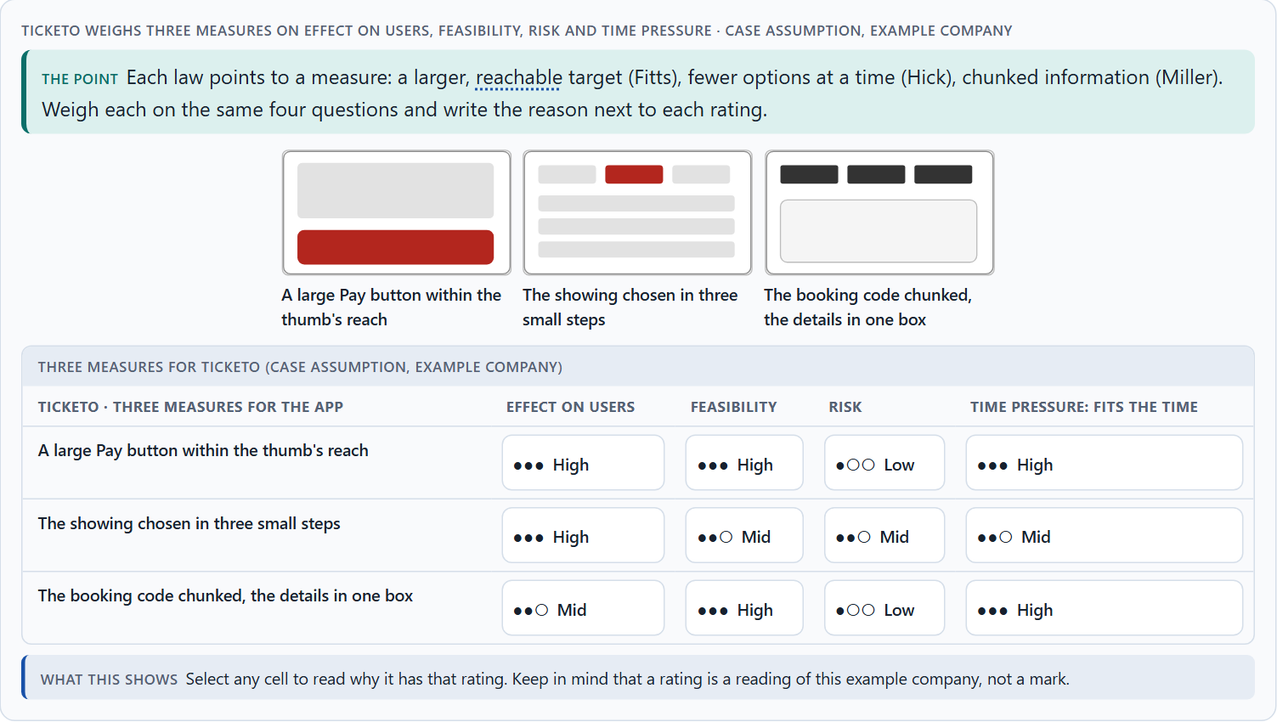
Less searching, fewer errors, less decision stress, and weighing a measure
A5 · 12 min · Core
Good UX reduces searching, operating errors and decision stress; the laws give efficient guidance a basis beyond looks. Weigh measures on effect on users, feasibility, risk and time pressure, with a reason.
Ticketo weighs three measures on effect on users, feasibility, risk and time pressure.
Screenshot of the Neuro-UX Lab (aion-ux-lab.vercel.app), own work; AI-assisted, labelled on the image; the example company is fictional.
Sources: Yablonski 2020 · Gibbons 2018 · WCAG 2.2 · Standing 1973 · Nielsen 1994 · Iyengar & Lepper 2000
AION UX Developer · Day 5 · Knowledge transfer
24
Notes:
A5 · Less searching, fewer errors, less decision stress, and weighing a measure · 12 min · Core
Case assumption: Ticketo, Leon, Mara, Priya and Tobias are made up for this example. The laws as practical tools follow Yablonski (2020); rating options on the same criteria with a reason follows Gibbons (2018). The four criteria are the ones the plan names for the case study. The findings in the table of real evidence are real research results, rules and cases; the sources are listed below.
Go deeper (optional reading): An aesthetic redesign can make all three laws worse at once: thinner buttons, more items in a sleek menu, information spread over a cleaner layout. A quick check before any visual change: is every main target as large and close as before, are there as few equal options, and is nothing new to remember?
Sources: Yablonski 2020 · Gibbons 2018 · WCAG 2.2 · Standing 1973 · Nielsen 1994 · Iyengar & Lepper 2000

Slide 25
A5 · In plain words
THE IDEA
WHY IT MATTERS
Good UX design reduces three things the laws explain: searching (where is it?), operating errors (the wrong tap, the wrong choice, the wrong number) and decision stress (too many similar options). The laws give efficient user guidance a basis, beyond how a screen looks. To put measures in order, weigh each on the four questions Block 2.1 names: effect on users, feasibility, risk and time pressure. The reason next to each rating matters more than the rating.
Block 1.1 asks for the two biggest weaknesses for efficiency and error risk, Block 1.2 for a decision between three navigation variants, and Block 2.1 for four measures, their justification on these four criteria and a decision for 10 weeks. The example uses Ticketo and its own measures, so the answer for the task cases is not given.
HOW TO READ THE PICTURE
Three measures Ticketo considered, rated on effect on users, feasibility, risk and time pressure. A rating is a reading of the example, not a mark. A table of the aims and their evidence follows.
Sources: Yablonski 2020 · Gibbons 2018 · WCAG 2.2 · Standing 1973 · Nielsen 1994 · Iyengar & Lepper 2000
AION UX Developer · Day 5 · Knowledge transfer
25
Notes:
A5 · Less searching, fewer errors, less decision stress, and weighing a measure · 12 min · Core
Case assumption: Ticketo, Leon, Mara, Priya and Tobias are made up for this example. The laws as practical tools follow Yablonski (2020); rating options on the same criteria with a reason follows Gibbons (2018). The four criteria are the ones the plan names for the case study. The findings in the table of real evidence are real research results, rules and cases; the sources are listed below.
Go deeper (optional reading): An aesthetic redesign can make all three laws worse at once: thinner buttons, more items in a sleek menu, information spread over a cleaner layout. A quick check before any visual change: is every main target as large and close as before, are there as few equal options, and is nothing new to remember?
Sources: Yablonski 2020 · Gibbons 2018 · WCAG 2.2 · Standing 1973 · Nielsen 1994 · Iyengar & Lepper 2000

Slide 26
A5 · Less searching, fewer errors, less decision stress
Aim | Real finding or rule | What it means for a measure
Less searching | Recognition rather than recall is one of the ten heuristics (Nielsen 1994); recognition memory for pictures showed no sign of saturation after 10,000 pictures (Standing 1973). | Show the option and its words instead of asking people to remember them.
Fewer errors | Error prevention is another of the ten heuristics (Nielsen 1994): design so that the wrong action is hard to take. | Space the targets, separate the destructive action and confirm only what cannot be undone.
Less decision stress | More choice drew more interest and fewer purchases (Iyengar and Lepper 2000). | Recommend one path and put the alternatives in a secondary place.
Sources: Yablonski 2020 · Gibbons 2018 · WCAG 2.2 · Standing 1973 · Nielsen 1994 · Iyengar & Lepper 2000
AION UX Developer · Day 5 · Knowledge transfer
26
Notes:
A5 · Less searching, fewer errors, less decision stress, and weighing a measure · 12 min · Core
Case assumption: Ticketo, Leon, Mara, Priya and Tobias are made up for this example. The laws as practical tools follow Yablonski (2020); rating options on the same criteria with a reason follows Gibbons (2018). The four criteria are the ones the plan names for the case study. The findings in the table of real evidence are real research results, rules and cases; the sources are listed below.
Go deeper (optional reading): An aesthetic redesign can make all three laws worse at once: thinner buttons, more items in a sleek menu, information spread over a cleaner layout. A quick check before any visual change: is every main target as large and close as before, are there as few equal options, and is nothing new to remember?
Sources: Yablonski 2020 · Gibbons 2018 · WCAG 2.2 · Standing 1973 · Nielsen 1994 · Iyengar & Lepper 2000

Slide 27
A5 · How to decide when this comes up in the task
Say for each measure which of the three it reduces: searching, operating errors or decision stress.
1
Prefer measures that change a shared element (a button, a menu, a code layout) used on many screens.
2
Rate every measure on the same four questions: effect on users, feasibility, risk, time pressure.
3
A rating is a judgement with a reason, never a mark. A different order with a better reason is a better answer.
4
Judge a design by how fast and safely people finish, not only by how it looks.
5
Sources: Yablonski 2020 · Gibbons 2018 · WCAG 2.2 · Standing 1973 · Nielsen 1994 · Iyengar & Lepper 2000
AION UX Developer · Day 5 · Knowledge transfer
27
Notes:
A5 · Less searching, fewer errors, less decision stress, and weighing a measure · 12 min · Core
Case assumption: Ticketo, Leon, Mara, Priya and Tobias are made up for this example. The laws as practical tools follow Yablonski (2020); rating options on the same criteria with a reason follows Gibbons (2018). The four criteria are the ones the plan names for the case study. The findings in the table of real evidence are real research results, rules and cases; the sources are listed below.
Go deeper (optional reading): An aesthetic redesign can make all three laws worse at once: thinner buttons, more items in a sleek menu, information spread over a cleaner layout. A quick check before any visual change: is every main target as large and close as before, are there as few equal options, and is nothing new to remember?
Sources: Yablonski 2020 · Gibbons 2018 · WCAG 2.2 · Standing 1973 · Nielsen 1994 · Iyengar & Lepper 2000

Slide 28
Materi B
Route 2 · Level 3
About 60 minutes, three cards, led by the facilitator. Level 3 in the Chief Experience Officer's chair: a guiding vision for efficient interaction, three strategic decisions, an order of what is improved first, a risk analysis, a governance model for interaction standards, one decision under uncertainty and a statement to the management. The cards give you the ideas you use in Task 2.
AION UX Developer · Day 5 · Knowledge transfer
28

Slide 29
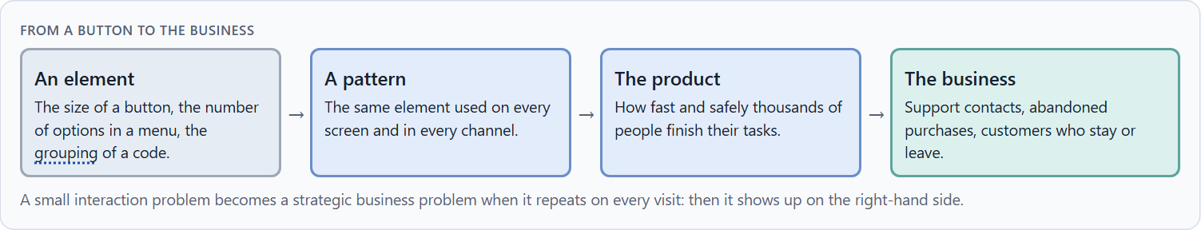
Interaction as an architecture of effect: the laws as standards, not details
B1 · 20 min · Core
An interaction decision repeats on every screen and every visit; it is an architecture of effect, not a detail. At senior level the laws become interaction standards every team follows.
From a button to the business.
Screenshot of the Neuro-UX Lab (aion-ux-lab.vercel.app), own work; AI-assisted, labelled on the image; the example company is fictional.
Sources: Yablonski 2020 · Frost 2016 · WCAG 2.2
AION UX Developer · Day 5 · Knowledge transfer
29
Notes:
B1 · Interaction as an architecture of effect: the laws as standards, not details · 20 min · Core
Case assumption: Ticketo, Leon, Mara, Priya and Tobias are made up for this example. Building interfaces from shared rules and components follows Frost (2016); the target size floor follows WCAG 2.2. The findings in the table of real evidence are real research results, rules and cases; the sources are listed below.
Go deeper (optional reading): Interaction standards work best when they live in the shared components, not only in a document: a button component that cannot be smaller than the minimum, a menu that warns beyond a number of items. Then a team that builds a new screen gets the standard without having to remember it, which is Miller's rule applied to the organisation.
Sources: Yablonski 2020 · Frost 2016 · WCAG 2.2

Slide 30
B1 · In plain words
THE IDEA
WHY IT MATTERS
An interaction decision is not a detail. The size of a button, the number of options in a menu and the way a form groups information decide how fast and safely thousands of people use a product, and how many call support. At senior level the three laws become steering tools: they are written down as interaction standards (minimum target sizes, a limit on equal options, a rule for chunking) that every team follows, so the product is fast and safe by design instead of fixed screen by screen.
Block 3.1 asks for a guiding vision for efficient interaction, three decisions on reachability, choice, information and main actions, and an order of what is improved first, for a company that adds functions while known interaction problems stay. You decide standards, not single buttons.
HOW TO READ THE PICTURE
Left Ticketo fixing details one screen at a time, right deciding interaction standards once. Below, the chain from a button to the business. A table of examples of standards follows.
Sources: Yablonski 2020 · Frost 2016 · WCAG 2.2
AION UX Developer · Day 5 · Knowledge transfer
30
Notes:
B1 · Interaction as an architecture of effect: the laws as standards, not details · 20 min · Core
Case assumption: Ticketo, Leon, Mara, Priya and Tobias are made up for this example. Building interfaces from shared rules and components follows Frost (2016); the target size floor follows WCAG 2.2. The findings in the table of real evidence are real research results, rules and cases; the sources are listed below.
Go deeper (optional reading): Interaction standards work best when they live in the shared components, not only in a document: a button component that cannot be smaller than the minimum, a menu that warns beyond a number of items. Then a team that builds a new screen gets the standard without having to remember it, which is Miller's rule applied to the organisation.
Sources: Yablonski 2020 · Frost 2016 · WCAG 2.2

Slide 31
B1 · Interaction standards as architecture: examples
Standard | Real example | What it means
A floor for targets | WCAG 2.2 sets 24 CSS pixels as the minimum target size at level AA and 44 at level AAA. | A size is a rule that every team meets, not a detail per screen.
Rules and components | Interfaces built from shared rules and components stay consistent (Frost 2016). | Write the standard once, in the components.
The laws as a toolkit | Laws of UX collects the laws, with examples and their limits (Yablonski 2020). | Use the laws as a common language between design, product and management.
Sources: Yablonski 2020 · Frost 2016 · WCAG 2.2
AION UX Developer · Day 5 · Knowledge transfer
31
Notes:
B1 · Interaction as an architecture of effect: the laws as standards, not details · 20 min · Core
Case assumption: Ticketo, Leon, Mara, Priya and Tobias are made up for this example. Building interfaces from shared rules and components follows Frost (2016); the target size floor follows WCAG 2.2. The findings in the table of real evidence are real research results, rules and cases; the sources are listed below.
Go deeper (optional reading): Interaction standards work best when they live in the shared components, not only in a document: a button component that cannot be smaller than the minimum, a menu that warns beyond a number of items. Then a team that builds a new screen gets the standard without having to remember it, which is Miller's rule applied to the organisation.
Sources: Yablonski 2020 · Frost 2016 · WCAG 2.2

Slide 32
B1 · How to decide when this comes up in the task
Look for the same interaction problem on several screens: it is a missing standard, not a missing fix.
1
Write the laws down as standards: a minimum target size and position, a limit on equal options, a rule for chunking.
2
Apply the standards to new functions from the start, so they do not undo earlier fixes.
3
Follow the chain from an element to the business: support contacts, abandoned purchases, customers who leave.
4
Sources: Yablonski 2020 · Frost 2016 · WCAG 2.2
AION UX Developer · Day 5 · Knowledge transfer
32
Notes:
B1 · Interaction as an architecture of effect: the laws as standards, not details · 20 min · Core
Case assumption: Ticketo, Leon, Mara, Priya and Tobias are made up for this example. Building interfaces from shared rules and components follows Frost (2016); the target size floor follows WCAG 2.2. The findings in the table of real evidence are real research results, rules and cases; the sources are listed below.
Go deeper (optional reading): Interaction standards work best when they live in the shared components, not only in a document: a button component that cannot be smaller than the minimum, a menu that warns beyond a number of items. Then a team that builds a new screen gets the standard without having to remember it, which is Miller's rule applied to the organisation.
Sources: Yablonski 2020 · Frost 2016 · WCAG 2.2

Slide 33
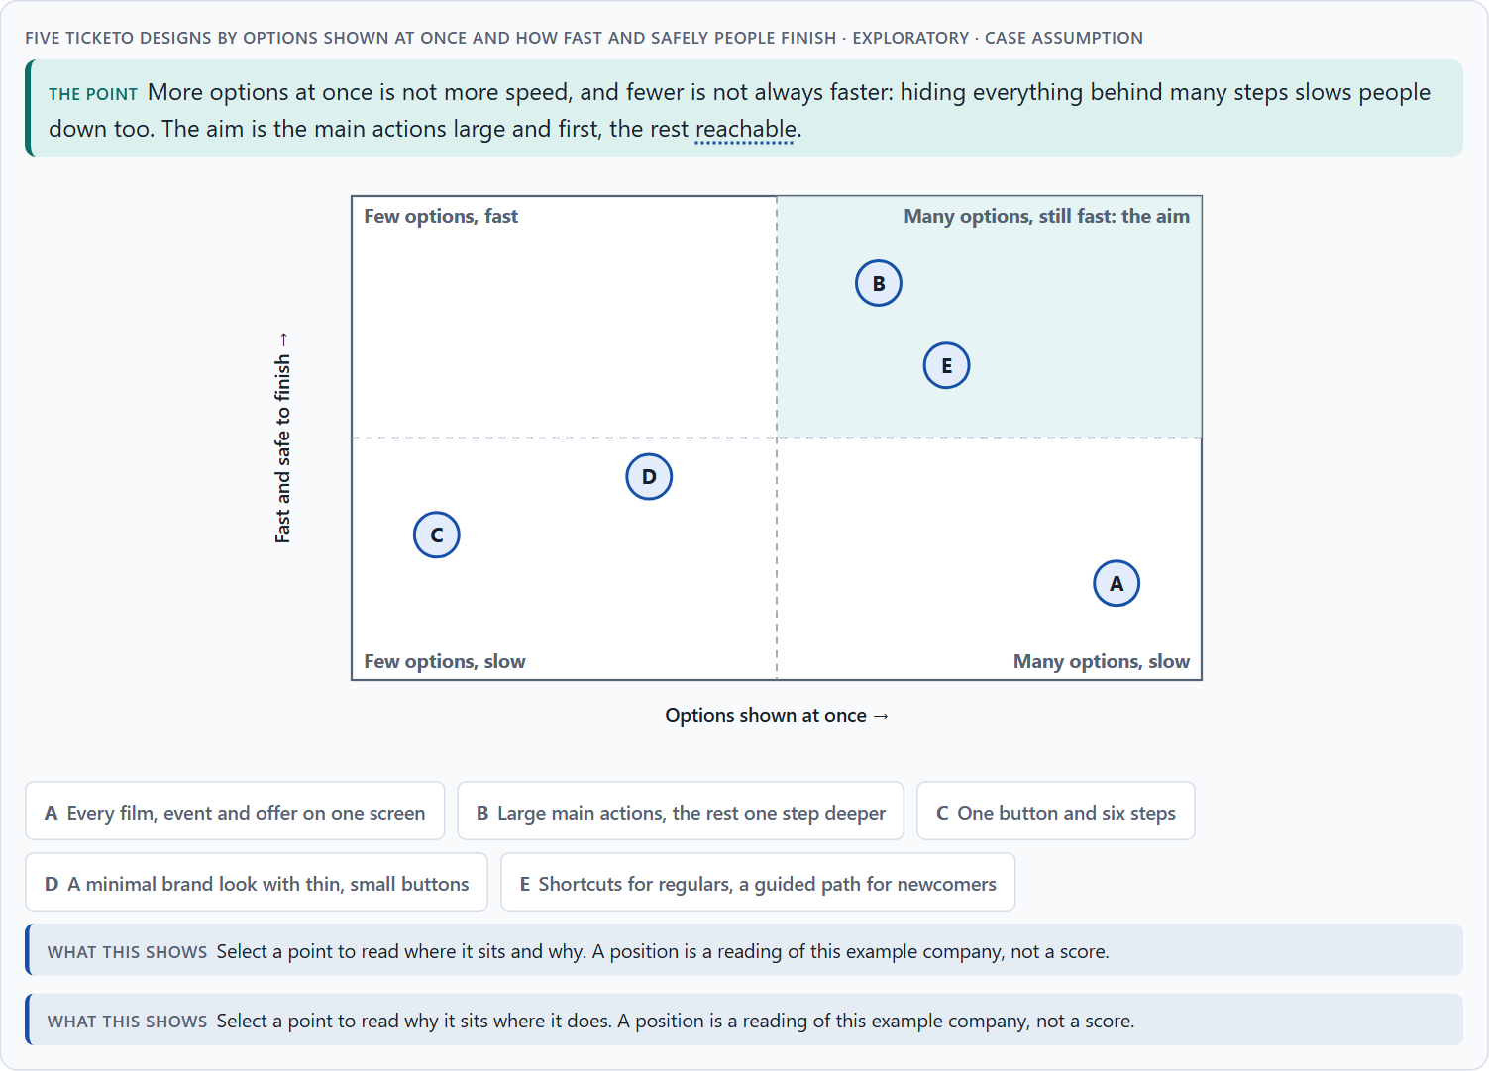
Conflicts of goals: feature richness, speed, simplicity, brand and feasibility
B2 · 20 min · Core
Feature richness against speed, simplicity against brand, the ideal against feasibility. Reduction is not always the answer: give the main actions size and priority, keep the rest reachable.
Five Ticketo designs by options shown at once and how fast and safely people finish · Exploratory.
Screenshot of the Neuro-UX Lab (aion-ux-lab.vercel.app), own work; AI-assisted, labelled on the image; the example company is fictional.
Sources: Iyengar & Lepper 2000 · Gibbons 2018 · Nielsen 2006 · Larson & Czerwinski 1998 · Hoober 2013 · Parhi et al. 2006
AION UX Developer · Day 5 · Knowledge transfer
33
Notes:
B2 · Conflicts of goals: feature richness, speed, simplicity, brand and feasibility · 20 min · Core
Case assumption: Ticketo, Leon, Mara, Priya and Tobias are made up for this example. Many options making people choose less follows Iyengar and Lepper (2000); progressive disclosure follows Nielsen (2006); the matrix is a reading of the example, not a score. The findings in the table of real evidence are real research results, rules and cases; the sources are listed below.
Go deeper (optional reading): A useful compromise for “everything visible”: keep every function one tap from the first screen, behind a clearly labelled entry, and give the first screen only to the few actions most users take. The department's functions are still reachable, and the users' main tasks are still fast.
Sources: Iyengar & Lepper 2000 · Gibbons 2018 · Nielsen 2006 · Larson & Czerwinski 1998 · Hoober 2013 · Parhi et al. 2006

Slide 34
B2 · In plain words
THE IDEA
WHY IT MATTERS
Efficient interaction sits between goals that pull against each other: feature richness against speed of use, everything visible against few, large targets, a minimal brand look against reachable buttons, and the ideal against what is technically feasible now. Reduction is not always the answer: hiding options behind many steps can be slower than showing them. The way through is to give the main actions size and priority, keep the rest reachable, and say what each choice gives up.
Block 3.1 asks for three guiding decisions, a risk analysis about user behaviour and the need for functions, and a governance model for conflicts between feature richness and usability. Each of these is a decision between conflicting goals.
HOW TO READ THE PICTURE
The matrix places five Ticketo designs by how many options they show at once (to the right) and how fast and safely people finish (upwards). A position is a reading of the example, not a score. A table of conflicts with evidence follows.
Sources: Iyengar & Lepper 2000 · Gibbons 2018 · Nielsen 2006 · Larson & Czerwinski 1998 · Hoober 2013 · Parhi et al. 2006
AION UX Developer · Day 5 · Knowledge transfer
34
Notes:
B2 · Conflicts of goals: feature richness, speed, simplicity, brand and feasibility · 20 min · Core
Case assumption: Ticketo, Leon, Mara, Priya and Tobias are made up for this example. Many options making people choose less follows Iyengar and Lepper (2000); progressive disclosure follows Nielsen (2006); the matrix is a reading of the example, not a score. The findings in the table of real evidence are real research results, rules and cases; the sources are listed below.
Go deeper (optional reading): A useful compromise for “everything visible”: keep every function one tap from the first screen, behind a clearly labelled entry, and give the first screen only to the few actions most users take. The department's functions are still reachable, and the users' main tasks are still fast.
Sources: Iyengar & Lepper 2000 · Gibbons 2018 · Nielsen 2006 · Larson & Czerwinski 1998 · Hoober 2013 · Parhi et al. 2006

Slide 35
B2 · Standing conflicts of efficient interaction
Conflict | Who usually stands for each side | What to ask
Feature richness against speed | A department or marketing, against users in a hurry. | Which actions do most users need most often?
Reduction against steps | A calm screen, against reaching the action quickly. | How many steps does the frequent task take now?
A minimal brand look against reachability | The brand team, against users on phones. | Are the main targets still large and close enough?
Sources: Iyengar & Lepper 2000 · Gibbons 2018 · Nielsen 2006 · Larson & Czerwinski 1998 · Hoober 2013 · Parhi et al. 2006
AION UX Developer · Day 5 · Knowledge transfer
35
Notes:
B2 · Conflicts of goals: feature richness, speed, simplicity, brand and feasibility · 20 min · Core
Case assumption: Ticketo, Leon, Mara, Priya and Tobias are made up for this example. Many options making people choose less follows Iyengar and Lepper (2000); progressive disclosure follows Nielsen (2006); the matrix is a reading of the example, not a score. The findings in the table of real evidence are real research results, rules and cases; the sources are listed below.
Go deeper (optional reading): A useful compromise for “everything visible”: keep every function one tap from the first screen, behind a clearly labelled entry, and give the first screen only to the few actions most users take. The department's functions are still reachable, and the users' main tasks are still fast.
Sources: Iyengar & Lepper 2000 · Gibbons 2018 · Nielsen 2006 · Larson & Czerwinski 1998 · Hoober 2013 · Parhi et al. 2006

Slide 36
B2 · Conflicts of efficient interaction, with evidence
Conflict | What the evidence says | A way to decide
Feature richness against speed | Fewer options can mean more decisions (Iyengar and Lepper 2000), and a medium structure beats the broadest one (Larson and Czerwinski 1998). | Put the actions most users need most often first.
Reduction against steps | More than two levels of progressive disclosure usually lowers usability (Nielsen 2006). | Count the steps of the frequent task before and after the reduction.
A minimal look against reachability | One-handed use is the most common grip in one observation (Hoober 2013, as reported), and 9.2 mm was the size found enough for thumb use (Parhi et al. 2006). | Keep the main targets large and in reach, whatever the brand look.
Sources: Iyengar & Lepper 2000 · Gibbons 2018 · Nielsen 2006 · Larson & Czerwinski 1998 · Hoober 2013 · Parhi et al. 2006
AION UX Developer · Day 5 · Knowledge transfer
36
Notes:
B2 · Conflicts of goals: feature richness, speed, simplicity, brand and feasibility · 20 min · Core
Case assumption: Ticketo, Leon, Mara, Priya and Tobias are made up for this example. Many options making people choose less follows Iyengar and Lepper (2000); progressive disclosure follows Nielsen (2006); the matrix is a reading of the example, not a score. The findings in the table of real evidence are real research results, rules and cases; the sources are listed below.
Go deeper (optional reading): A useful compromise for “everything visible”: keep every function one tap from the first screen, behind a clearly labelled entry, and give the first screen only to the few actions most users take. The department's functions are still reachable, and the users' main tasks are still fast.
Sources: Iyengar & Lepper 2000 · Gibbons 2018 · Nielsen 2006 · Larson & Czerwinski 1998 · Hoober 2013 · Parhi et al. 2006

Slide 37
B2 · How to decide when this comes up in the task
Name the conflict as two goals and say who stands for each: a department, marketing, IT, frequent or occasional users.
1
“Everything at a glance” and “one button, many steps” are both slow; look for main actions first, the rest one step away.
2
A minimal brand look must not shrink the targets below what hands can hit.
3
Under time and feasibility limits, prefer the change that helps most users now over the ideal later.
4
Say what the choice gives up; a decision that gives up nothing has not been made.
5
Sources: Iyengar & Lepper 2000 · Gibbons 2018 · Nielsen 2006 · Larson & Czerwinski 1998 · Hoober 2013 · Parhi et al. 2006
AION UX Developer · Day 5 · Knowledge transfer
37
Notes:
B2 · Conflicts of goals: feature richness, speed, simplicity, brand and feasibility · 20 min · Core
Case assumption: Ticketo, Leon, Mara, Priya and Tobias are made up for this example. Many options making people choose less follows Iyengar and Lepper (2000); progressive disclosure follows Nielsen (2006); the matrix is a reading of the example, not a score. The findings in the table of real evidence are real research results, rules and cases; the sources are listed below.
Go deeper (optional reading): A useful compromise for “everything visible”: keep every function one tap from the first screen, behind a clearly labelled entry, and give the first screen only to the few actions most users take. The department's functions are still reachable, and the users' main tasks are still fast.
Sources: Iyengar & Lepper 2000 · Gibbons 2018 · Nielsen 2006 · Larson & Czerwinski 1998 · Hoober 2013 · Parhi et al. 2006

Slide 38
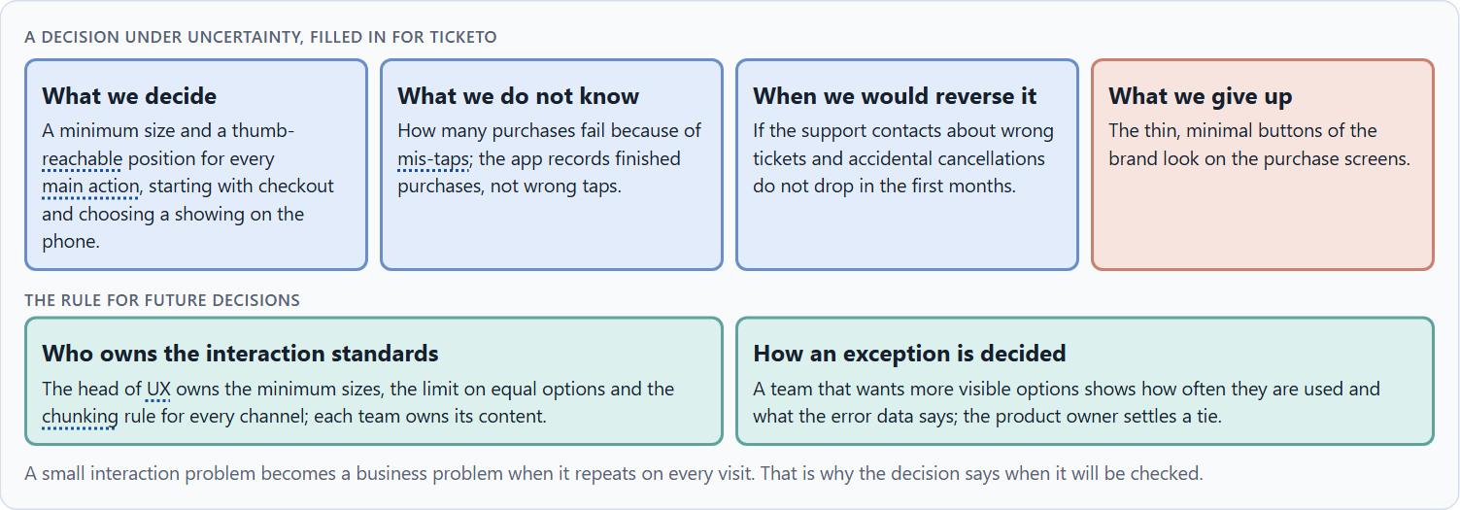
Who owns the interaction standards, and deciding with incomplete data
B3 · 20 min · Core
Interaction standards hold only with an owner and a rule for exceptions. A decision with incomplete data says what it decides, what it does not know, when it would reverse it and what it gives up.
A decision under uncertainty, filled in for Ticketo.
Screenshot of the Neuro-UX Lab (aion-ux-lab.vercel.app), own work; AI-assisted, labelled on the image; the example company is fictional.
Sources: Simon 1956 · Klein 2007 · WCAG 2.2 · Conway 1968 · Parhi et al. 2006
AION UX Developer · Day 5 · Knowledge transfer
38
Notes:
B3 · Who owns the interaction standards, and deciding with incomplete data · 20 min · Core
Case assumption: Ticketo, Leon, Mara, Priya and Tobias are made up for this example. Deciding with limited information follows Simon (1956); the premortem follows Klein (2007). The findings in the table of real evidence are real research results, rules and cases; the sources are listed below.
Go deeper (optional reading): When no one records mis-taps, the support contacts are the best available sign: “I booked the wrong ticket”, “I cancelled by mistake”. Counting them before and after a change is a simple way to check a decision made under uncertainty, without waiting for perfect data.
Sources: Simon 1956 · Klein 2007 · WCAG 2.2 · Conway 1968 · Parhi et al. 2006

Slide 39
B3 · In plain words
THE IDEA
WHY IT MATTERS
Interaction standards hold only when someone owns them and a rule decides when a team wants an exception: how often a function is needed and what errors and support data say. Because data is rarely complete, a decision under uncertainty says what you decide, what you do not know, when you would reverse it and what you give up. A small interaction problem becomes a strategic business problem when it repeats on every visit: then it costs support, abandoned processes and customers.
Block 3.1 asks for a governance model for the interaction standards, a decision despite incomplete data, and a statement to the management. This card gives you the parts of each.
HOW TO READ THE PICTURE
The four boxes at the top are the parts of a decision, filled in for Ticketo. The two boxes below are the rule for future decisions. A table of rules and evidence follows.
Sources: Simon 1956 · Klein 2007 · WCAG 2.2 · Conway 1968 · Parhi et al. 2006
AION UX Developer · Day 5 · Knowledge transfer
39
Notes:
B3 · Who owns the interaction standards, and deciding with incomplete data · 20 min · Core
Case assumption: Ticketo, Leon, Mara, Priya and Tobias are made up for this example. Deciding with limited information follows Simon (1956); the premortem follows Klein (2007). The findings in the table of real evidence are real research results, rules and cases; the sources are listed below.
Go deeper (optional reading): When no one records mis-taps, the support contacts are the best available sign: “I booked the wrong ticket”, “I cancelled by mistake”. Counting them before and after a change is a simple way to check a decision made under uncertainty, without waiting for perfect data.
Sources: Simon 1956 · Klein 2007 · WCAG 2.2 · Conway 1968 · Parhi et al. 2006

Slide 40
B3 · Three parts of a governance model for interaction standards
Part | The question | An example (Ticketo)
Who owns what | Who owns the standards; who owns the content? | The head of UX owns sizes, limits and chunking; teams own their content.
How an exception is decided | What happens when a team wants more visible options? | It shows how often they are used and what the error data says.
How a standard changes | When may a standard itself change? | Only with evidence from users, errors or support.
Sources: Simon 1956 · Klein 2007 · WCAG 2.2 · Conway 1968 · Parhi et al. 2006
AION UX Developer · Day 5 · Knowledge transfer
40
Notes:
B3 · Who owns the interaction standards, and deciding with incomplete data · 20 min · Core
Case assumption: Ticketo, Leon, Mara, Priya and Tobias are made up for this example. Deciding with limited information follows Simon (1956); the premortem follows Klein (2007). The findings in the table of real evidence are real research results, rules and cases; the sources are listed below.
Go deeper (optional reading): When no one records mis-taps, the support contacts are the best available sign: “I booked the wrong ticket”, “I cancelled by mistake”. Counting them before and after a change is a simple way to check a decision made under uncertainty, without waiting for perfect data.
Sources: Simon 1956 · Klein 2007 · WCAG 2.2 · Conway 1968 · Parhi et al. 2006

Slide 41
B3 · Owning interaction standards: rules and evidence
Part | Evidence or rule | What it means
Who owns what | The structure of a product tends to copy the structure of the organisation behind it (Conway 1968). | Name one owner of sizes, limits and chunking.
How an exception is decided | WCAG 2.5.8 allows exceptions only in set cases, such as enough space between small targets. | Write down when an exception is allowed and who decides.
How a standard changes | Study results can differ: a student replication of the thumb-size study reported a smaller minimum than the original. | Change a standard on evidence from your own users, errors and support.
Sources: Simon 1956 · Klein 2007 · WCAG 2.2 · Conway 1968 · Parhi et al. 2006
AION UX Developer · Day 5 · Knowledge transfer
41
Notes:
B3 · Who owns the interaction standards, and deciding with incomplete data · 20 min · Core
Case assumption: Ticketo, Leon, Mara, Priya and Tobias are made up for this example. Deciding with limited information follows Simon (1956); the premortem follows Klein (2007). The findings in the table of real evidence are real research results, rules and cases; the sources are listed below.
Go deeper (optional reading): When no one records mis-taps, the support contacts are the best available sign: “I booked the wrong ticket”, “I cancelled by mistake”. Counting them before and after a change is a simple way to check a decision made under uncertainty, without waiting for perfect data.
Sources: Simon 1956 · Klein 2007 · WCAG 2.2 · Conway 1968 · Parhi et al. 2006

Slide 42
B3 · How to decide when this comes up in the task
Name who owns the interaction standards across all interfaces, and who owns the content.
1
Give exceptions a rule: how often the function is needed and what the error and support data say.
2
Say what you decide, what you do not know, when you would reverse it and what you give up.
3
A small interaction problem becomes a strategic business problem when it repeats on every visit; say when you will check.
4
Sources: Simon 1956 · Klein 2007 · WCAG 2.2 · Conway 1968 · Parhi et al. 2006
AION UX Developer · Day 5 · Knowledge transfer
42
Notes:
B3 · Who owns the interaction standards, and deciding with incomplete data · 20 min · Core
Case assumption: Ticketo, Leon, Mara, Priya and Tobias are made up for this example. Deciding with limited information follows Simon (1956); the premortem follows Klein (2007). The findings in the table of real evidence are real research results, rules and cases; the sources are listed below.
Go deeper (optional reading): When no one records mis-taps, the support contacts are the best available sign: “I booked the wrong ticket”, “I cancelled by mistake”. Counting them before and after a change is a simple way to check a decision made under uncertainty, without waiting for perfect data.
Sources: Simon 1956 · Klein 2007 · WCAG 2.2 · Conway 1968 · Parhi et al. 2006

Slide 43
Sources (1)
Fitts, P. M. (1954). The information capacity of the human motor system in controlling the amplitude of movement. Journal of Experimental Psychology, 47(6), 381–391.
MacKenzie, I. S. (1992). Fitts' law as a research and design tool in human-computer interaction. Human-Computer Interaction, 7(1), 91–139.
Parhi, P., Karlson, A. K., & Bederson, B. B. (2006). Target size study for one-handed thumb use on small touchscreen devices. MobileHCI '06, 203–210.
Hoober, S. (2013). How Do Users Really Hold Mobile Devices? UXmatters. https://www.uxmatters.com/mt/archives/2013/02/how-do-users-really-hold-mobile-devices.php
W3C (2023). Web Content Accessibility Guidelines (WCAG) 2.2. https://www.w3.org/TR/WCAG22/ (Success criterion 1.4.1 Use of Color: colour must not be the only way to convey information; 1.4.3 Contrast (Minimum) for text.)
Baymard Institute (2024). Cart Abandonment Rate Statistics. https://baymard.com/lists/cart-abandonment-rate
Hick, W. E. (1952). On the rate of gain of information. Quarterly Journal of Experimental Psychology, 4(1), 11–26.
AION UX Developer · Day 5 · Knowledge transfer
43

Slide 44
Sources (2)
Hyman, R. (1953). Stimulus information as a determinant of reaction time. Journal of Experimental Psychology, 45(3), 188–196.
Iyengar, S. S., & Lepper, M. R. (2000). When choice is demotivating: Can one desire too much of a good thing? Journal of Personality and Social Psychology, 79(6), 995–1006.
Nielsen, J. (2006). Progressive Disclosure. Nielsen Norman Group. https://www.nngroup.com/articles/progressive-disclosure/
Larson, K., & Czerwinski, M. (1998). Web page design: Implications of memory, structure and scent for information retrieval. CHI '98, 25–32. https://doi.org/10.1145/274644.274649
Miller, G. A. (1956). The magical number seven, plus or minus two: Some limits on our capacity for processing information. Psychological Review, 63(2), 81–97.
Cowan, N. (2001). The magical number 4 in short-term memory: A reconsideration of mental storage capacity. Behavioral and Brain Sciences, 24(1), 87–114.
Gobet, F., Lane, P. C. R., Croker, S., Cheng, P. C.-H., Jones, G., Oliver, I., & Pine, J. M. (2001). Chunking mechanisms in human learning. Trends in Cognitive Sciences, 5(6), 236–243.
AION UX Developer · Day 5 · Knowledge transfer
44

Slide 45
Sources (3)
Nielsen, J. (1994, reviewed 2024). 10 Usability Heuristics for User Interface Design. Nielsen Norman Group. https://www.nngroup.com/articles/ten-usability-heuristics/
Chase, W. G., & Simon, H. A. (1973). Perception in chess. Cognitive Psychology, 4(1), 55–81.
ISO 13616-1:2020. Financial services: International bank account number (IBAN), Part 1.
Sweller, J. (1988). Cognitive load during problem solving: Effects on learning. Cognitive Science, 12(2), 257–285. https://doi.org/10.1207/s15516709cog1202_4
Yablonski, J. (2020). Laws of UX: Using Psychology to Design Better Products & Services. O'Reilly.
Gibbons, S. (2018). Using Prioritization Matrices to Inform UX Decisions. Nielsen Norman Group. https://www.nngroup.com/articles/prioritization-matrices/
Standing, L. (1973). Learning 10,000 pictures. Quarterly Journal of Experimental Psychology, 25(2), 207–222. https://doi.org/10.1080/14640747308400340
AION UX Developer · Day 5 · Knowledge transfer
45

Slide 46
Sources (4)
Frost, B. (2016). Atomic Design. Brad Frost. https://atomicdesign.bradfrost.com/
Simon, H. A. (1956). Rational choice and the structure of the environment. Psychological Review, 63(2), 129–138.
Klein, G. (2007). Performing a project premortem. Harvard Business Review, 85(9), 18–19.
Conway, M. E. (1968). How do committees invent? Datamation, 14(4), 28–31.
AION UX Developer · Day 5 · Knowledge transfer
46

Slide 47
About these slides, sources and AI use
AI
AI-assisted content
Where to find more
AI-assisted content: these slides were drafted with an AI language model (Claude, Anthropic) from the course's own Neuro-UX Lab and were read, corrected and approved by Muhammad Muchson, who is responsible for their accuracy.
Pictures are screenshots of the course's own Neuro-UX Lab. Each one carries an AI label on the image and a source line under it.
Companies and people in the examples are fictional. Numbers inside an example are labelled Case assumption and are not data.
Neuro-UX Lab for this day: https://aion-ux-lab.vercel.app/day/5/
Handouts: the Materi and Task Word documents of the day.
Version 1.0, 29.10.2026. Reviewer and approver: Muhammad Muchson.
AION UX Developer · Day 5 · Knowledge transfer
47

