Slide 1
Gestalt, hierarchy, progressive disclosure and design systems
AION UX DEVELOPER · DAY 6
6
Knowledge transfer slides
Contains AI-assisted content
Module 3 (day 3 of 3)
Trainer: Muhammad Muchson · Materi A and B · v1.0

Slide 2
What we cover today
Today is about how a screen is organised and how that organisation is kept across a whole product. You learn the Gestalt laws that make people see groups (proximity, similarity, continuity, closure, figure and ground, common region), how a visual hierarchy steers attention and action, how progressive disclosure shows only what matters in the current step without hiding what people need, and why these principles belong in components, patterns and a design system rather than in single screens. Then you use them on three products. This document holds everything you need to study Day 6 without the website. Every card says what the idea is in plain words, shows it in a picture, gives the details and ends with the rules you use in the tasks.
Materi A · 60 min
Materi B · 60 min
A1 Gestalt laws for navigation: how people see groups and paths (12 min)
A2 Visual hierarchy: attention, priority and the next action (12 min)
A3 Progressive disclosure: helpful reduction, not hiding (12 min)
A4 Hierarchy, navigation logic and relief: one pattern for one task (12 min)
A5 From screens to components: UX laws in a design system, and weighing a measure (12 min)
B1 Design systems for consistency, scale and steering (20 min)
B2 Conflicts of goals: consistency, flexibility, speed, clarity and standardisation (20 min)
B3 Design-system governance, and deciding with incomplete data (20 min)
AION UX Developer · Day 6 · Knowledge transfer
2

Slide 3
Materi A
Route 1 · Levels 1 and 2
About 60 minutes, five cards. Levels 1 and 2: find what makes an unfamiliar administration portal hard to navigate, rate three structures for a service platform under conflicting goals, then analyse a public self-service platform, develop four measures, justify them and decide on the first 14 weeks. The cards give you the ideas and the rules you use in Task 1.
AION UX Developer · Day 6 · Knowledge transfer
3

Slide 4
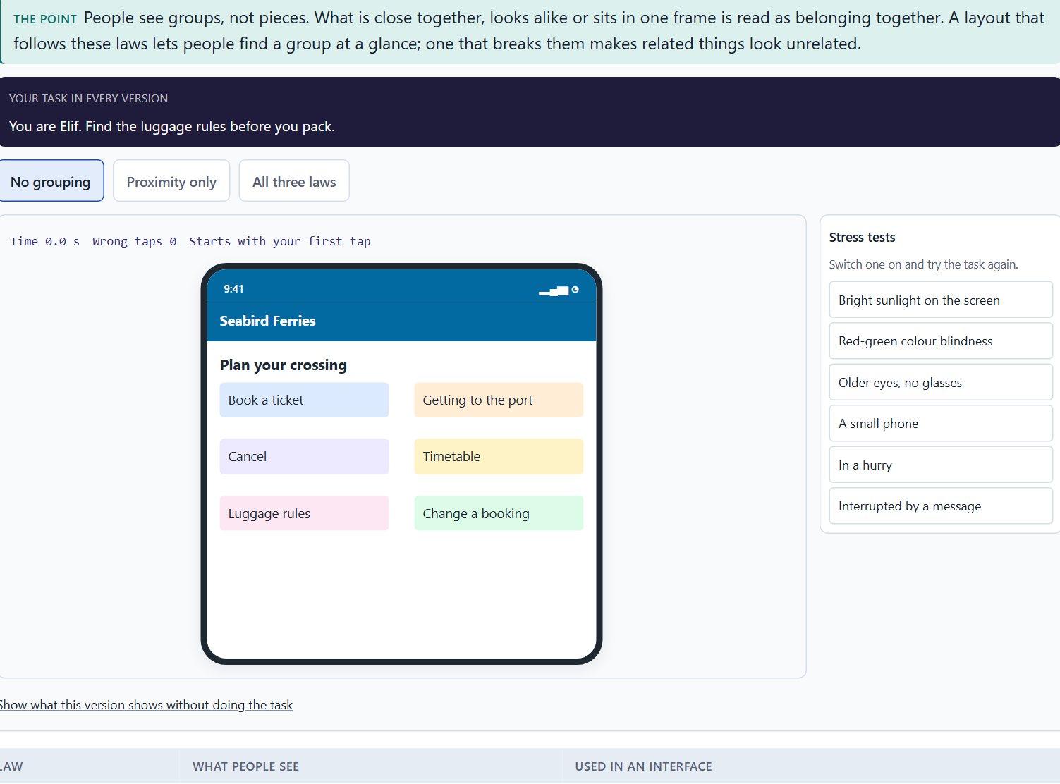
Gestalt laws for navigation: how people see groups and paths
A1 · 12 min · Core
People see groups, not pieces: what is close, alike, on one line, almost closed, standing out or inside one frame belongs together. Layouts that follow these laws let people group, tell apart and navigate at a glance.
A Seabird Ferries page: proximity, similarity and common region.
Screenshot of the Neuro-UX Lab (aion-ux-lab.vercel.app), own work; AI-assisted, labelled on the image; the example company is fictional.
Sources: Wertheimer 1923 · Palmer 1992 · Wagemans et al. 2012
AION UX Developer · Day 6 · Knowledge transfer
4
Notes:
A1 · Gestalt laws for navigation: how people see groups and paths · 12 min · Core
Case assumption: Seabird Ferries, Elif, Noah, Greta and Malte are made up for this example. The grouping laws follow Wertheimer (1923) and the review by Wagemans et al. (2012); common region follows Palmer (1992). The findings in the table of real evidence are real research results, rules and cases; the sources are listed below.
Go deeper (optional reading): When the laws disagree, the stronger one wins. Palmer (1992) showed that a common region can override proximity: two dots far apart inside one frame are grouped, two close dots in different frames are not. In an interface this means a frame or background can rescue a layout where spacing alone does not work, and can also break one when it groups the wrong things.
Sources: Wertheimer 1923 · Palmer 1992 · Wagemans et al. 2012

Slide 5
A1 · In plain words
THE IDEA
WHY IT MATTERS
People do not see a screen as separate pieces; they see groups. Things close together belong together (proximity). Things that look alike belong together (similarity). Things on one line or curve are followed as a path (continuity). An almost closed shape is seen as closed (closure). One thing stands out from a background (figure and ground). Things inside one frame or area belong together (common region). A layout that follows these laws lets people group, tell apart and navigate in a glance; one that breaks them makes related things look unrelated.
Block 1.1 asks about OfficeSphere's information without visual grouping and its similar functions that look unrelated, and Block 2.1 asks about CitizenFlow's page types that group content differently. This card gives you the six laws to name what you see.
HOW TO READ THE PICTURE
One Seabird Ferries page with three switches: proximity, similarity and common region.
Sources: Wertheimer 1923 · Palmer 1992 · Wagemans et al. 2012
AION UX Developer · Day 6 · Knowledge transfer
5
Notes:
A1 · Gestalt laws for navigation: how people see groups and paths · 12 min · Core
Case assumption: Seabird Ferries, Elif, Noah, Greta and Malte are made up for this example. The grouping laws follow Wertheimer (1923) and the review by Wagemans et al. (2012); common region follows Palmer (1992). The findings in the table of real evidence are real research results, rules and cases; the sources are listed below.
Go deeper (optional reading): When the laws disagree, the stronger one wins. Palmer (1992) showed that a common region can override proximity: two dots far apart inside one frame are grouped, two close dots in different frames are not. In an interface this means a frame or background can rescue a layout where spacing alone does not work, and can also break one when it groups the wrong things.
Sources: Wertheimer 1923 · Palmer 1992 · Wagemans et al. 2012

Slide 6
A1 · Six Gestalt laws in the interface
Law | What people see | Used in an interface
Proximity | Close things belong together. | Spacing between groups larger than within them.
Similarity | Alike things belong together. | All links of one kind in one style.
Continuity | Things on one line form a path. | Steps of a process on one line.
Closure | An almost closed shape is seen as closed. | Cards and sections without full borders still read as units.
Figure and ground | One thing stands out from the rest. | A dialog over a dimmed page.
Common region | Things in one frame belong together. | A framed section with a heading.
Sources: Wertheimer 1923 · Palmer 1992 · Wagemans et al. 2012
AION UX Developer · Day 6 · Knowledge transfer
6
Notes:
A1 · Gestalt laws for navigation: how people see groups and paths · 12 min · Core
Case assumption: Seabird Ferries, Elif, Noah, Greta and Malte are made up for this example. The grouping laws follow Wertheimer (1923) and the review by Wagemans et al. (2012); common region follows Palmer (1992). The findings in the table of real evidence are real research results, rules and cases; the sources are listed below.
Go deeper (optional reading): When the laws disagree, the stronger one wins. Palmer (1992) showed that a common region can override proximity: two dots far apart inside one frame are grouped, two close dots in different frames are not. In an interface this means a frame or background can rescue a layout where spacing alone does not work, and can also break one when it groups the wrong things.
Sources: Wertheimer 1923 · Palmer 1992 · Wagemans et al. 2012

Slide 7
A1 · The Gestalt laws: where they come from and what to check
Law | Real finding | What to check on a screen
Proximity and similarity | Max Wertheimer described grouping by closeness and likeness in 1923; a century of research since confirms and refines them (Wertheimer 1923; Wagemans et al. 2012). | Is the space inside a group smaller than the space between groups, and do alike things look alike?
Common region | Elements inside the same bounded region are seen as a group, and this grouping competes with proximity and similarity (Palmer 1992). | Use a frame or a background for a group that must be read as one, and do not frame things that do not belong together.
Continuity and closure | The eye follows a smooth line and completes almost closed shapes (Wagemans et al. 2012). | Put the steps of a process on one line; cards without full borders still read as units.
Figure and ground | One part of a scene is seen as the object and the rest as its background (Wagemans et al. 2012). | Make the thing to act on the figure: a dialog over a dimmed page.
Sources: Wertheimer 1923 · Palmer 1992 · Wagemans et al. 2012
AION UX Developer · Day 6 · Knowledge transfer
7
Notes:
A1 · Gestalt laws for navigation: how people see groups and paths · 12 min · Core
Case assumption: Seabird Ferries, Elif, Noah, Greta and Malte are made up for this example. The grouping laws follow Wertheimer (1923) and the review by Wagemans et al. (2012); common region follows Palmer (1992). The findings in the table of real evidence are real research results, rules and cases; the sources are listed below.
Go deeper (optional reading): When the laws disagree, the stronger one wins. Palmer (1992) showed that a common region can override proximity: two dots far apart inside one frame are grouped, two close dots in different frames are not. In an interface this means a frame or background can rescue a layout where spacing alone does not work, and can also break one when it groups the wrong things.
Sources: Wertheimer 1923 · Palmer 1992 · Wagemans et al. 2012

Slide 8
A1 · How to decide when this comes up in the task
Ask which elements belong together in meaning, and check whether they also look as if they belong together.
1
Proximity first: put related things close and unrelated things apart; spacing alone does much of the work.
2
Similarity: give elements of one kind one look, and elements of another kind a different one.
3
Common region: a frame or a background area turns scattered elements into a group.
4
Similar functions designed differently are not seen as related: make them look alike.
5
Sources: Wertheimer 1923 · Palmer 1992 · Wagemans et al. 2012
AION UX Developer · Day 6 · Knowledge transfer
8
Notes:
A1 · Gestalt laws for navigation: how people see groups and paths · 12 min · Core
Case assumption: Seabird Ferries, Elif, Noah, Greta and Malte are made up for this example. The grouping laws follow Wertheimer (1923) and the review by Wagemans et al. (2012); common region follows Palmer (1992). The findings in the table of real evidence are real research results, rules and cases; the sources are listed below.
Go deeper (optional reading): When the laws disagree, the stronger one wins. Palmer (1992) showed that a common region can override proximity: two dots far apart inside one frame are grouped, two close dots in different frames are not. In an interface this means a frame or background can rescue a layout where spacing alone does not work, and can also break one when it groups the wrong things.
Sources: Wertheimer 1923 · Palmer 1992 · Wagemans et al. 2012

Slide 9
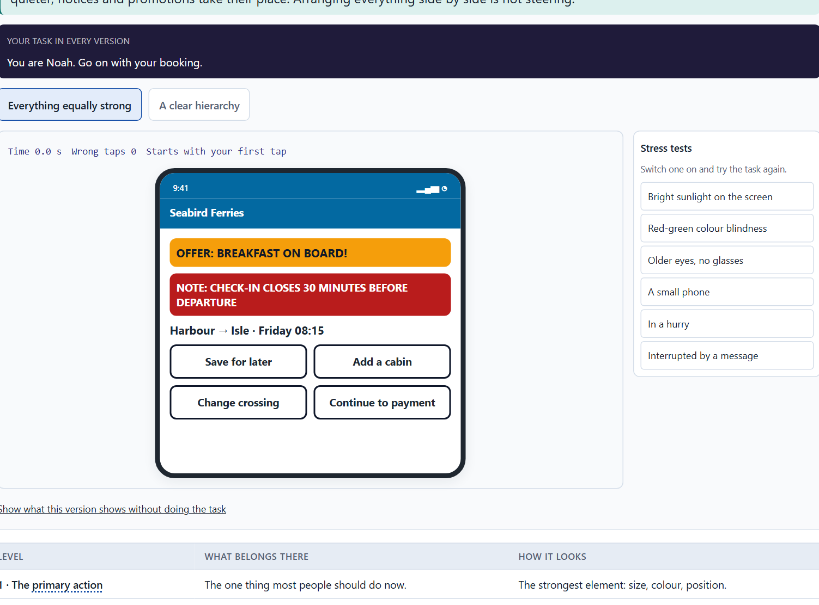
Visual hierarchy: attention, priority and the next action
A2 · 12 min · Core
A visual hierarchy is an order of importance the eye can follow. It steers attention, priority and the next action. Arranging elements side by side is not steering: decide what comes first and make it look first.
The same Seabird booking step: every element equally strong, and a clear hierarchy.
Screenshot of the Neuro-UX Lab (aion-ux-lab.vercel.app), own work; AI-assisted, labelled on the image; the example company is fictional.
Sources: Ware 2012 · Krug 2014 · Nielsen 1994 · Itti & Koch 2001 · von Restorff 1933 · Hunt 1995 · Nielsen 1997 · Pernice 2017
AION UX Developer · Day 6 · Knowledge transfer
9
Notes:
A2 · Visual hierarchy: attention, priority and the next action · 12 min · Core
Case assumption: Seabird Ferries, Elif, Noah, Greta and Malte are made up for this example. What pops out and guides the eye follows Ware (2012); a clear visual hierarchy follows Krug (2014). The findings in the table of real evidence are real research results, rules and cases; the sources are listed below.
Go deeper (optional reading): A quick test for hierarchy: squint at the screen, or blur a screenshot. What remains visible is what the eye sees first. If it is the offer banner and not the primary action, the hierarchy steers attention away from the task.
Sources: Ware 2012 · Krug 2014 · Nielsen 1994 · Itti & Koch 2001 · von Restorff 1933 · Hunt 1995 · Nielsen 1997 · Pernice 2017

Slide 10
A2 · In plain words
THE IDEA
WHY IT MATTERS
A visual hierarchy is an order of importance the eye can follow: the most important thing is the strongest, the next is weaker, and the rest is quiet. It steers attention, sets priority and shows the next action. The key difference is between primary actions (the one thing most people should do now) and secondary actions (other things they might do). Simply arranging elements side by side is not the same as steering navigation: steering means deciding what comes first and making it look first.
Block 1.1 asks about OfficeSphere's primary and secondary actions that look equally strong and its competing notices, Block 1.2 asks you to rate CareAssist on orientation and navigation clarity, and Block 2.1 asks about CitizenFlow's unseparated actions and unprioritised help and warnings. This card gives you the order and the primary-secondary distinction.
HOW TO READ THE PICTURE
The same Seabird Ferries booking step twice: every element equally strong, and a clear hierarchy with one primary action.
Sources: Ware 2012 · Krug 2014 · Nielsen 1994 · Itti & Koch 2001 · von Restorff 1933 · Hunt 1995 · Nielsen 1997 · Pernice 2017
AION UX Developer · Day 6 · Knowledge transfer
10
Notes:
A2 · Visual hierarchy: attention, priority and the next action · 12 min · Core
Case assumption: Seabird Ferries, Elif, Noah, Greta and Malte are made up for this example. What pops out and guides the eye follows Ware (2012); a clear visual hierarchy follows Krug (2014). The findings in the table of real evidence are real research results, rules and cases; the sources are listed below.
Go deeper (optional reading): A quick test for hierarchy: squint at the screen, or blur a screenshot. What remains visible is what the eye sees first. If it is the offer banner and not the primary action, the hierarchy steers attention away from the task.
Sources: Ware 2012 · Krug 2014 · Nielsen 1994 · Itti & Koch 2001 · von Restorff 1933 · Hunt 1995 · Nielsen 1997 · Pernice 2017

Slide 11
A2 · Levels of a visual hierarchy on one step
Level | What belongs there | How it looks
1 · The primary action | The one thing most people should do now. | The strongest element: size, colour, position.
2 · The content of the step | What the person needs to decide. | Clear headings and readable text.
3 · Secondary actions | Other things they might do. | Quiet links or outlined buttons.
4 · Notices and offers | Information that helps but is not the task. | Smaller, calmer; warnings only for real risks.
Sources: Ware 2012 · Krug 2014 · Nielsen 1994 · Itti & Koch 2001 · von Restorff 1933 · Hunt 1995 · Nielsen 1997 · Pernice 2017
AION UX Developer · Day 6 · Knowledge transfer
11
Notes:
A2 · Visual hierarchy: attention, priority and the next action · 12 min · Core
Case assumption: Seabird Ferries, Elif, Noah, Greta and Malte are made up for this example. What pops out and guides the eye follows Ware (2012); a clear visual hierarchy follows Krug (2014). The findings in the table of real evidence are real research results, rules and cases; the sources are listed below.
Go deeper (optional reading): A quick test for hierarchy: squint at the screen, or blur a screenshot. What remains visible is what the eye sees first. If it is the offer banner and not the primary action, the hierarchy steers attention away from the task.
Sources: Ware 2012 · Krug 2014 · Nielsen 1994 · Itti & Koch 2001 · von Restorff 1933 · Hunt 1995 · Nielsen 1997 · Pernice 2017

Slide 12
A2 · Visual hierarchy: what draws the eye and what is remembered
Finding | What it shows | What it means for a screen
Strongest difference first | Attention goes first to what differs most from its surroundings in colour, contrast, orientation or motion (Itti and Koch 2001; Ware 2012). | Give the primary action the strongest difference on the step.
The isolation effect | An item that differs from a group of like items is remembered better (von Restorff 1933; the details are reviewed by Hunt 1995). | One element that is different is noticed and remembered; many different elements cancel each other.
Scanning | 79% of users always scanned a new page (Nielsen and Morkes 1997), and the eyes follow an F-shaped path on unstructured text (Pernice 2017). | Put the levels of the hierarchy where a scan lands: the top, the left edge and the headings.
Sources: Ware 2012 · Krug 2014 · Nielsen 1994 · Itti & Koch 2001 · von Restorff 1933 · Hunt 1995 · Nielsen 1997 · Pernice 2017
AION UX Developer · Day 6 · Knowledge transfer
12
Notes:
A2 · Visual hierarchy: attention, priority and the next action · 12 min · Core
Case assumption: Seabird Ferries, Elif, Noah, Greta and Malte are made up for this example. What pops out and guides the eye follows Ware (2012); a clear visual hierarchy follows Krug (2014). The findings in the table of real evidence are real research results, rules and cases; the sources are listed below.
Go deeper (optional reading): A quick test for hierarchy: squint at the screen, or blur a screenshot. What remains visible is what the eye sees first. If it is the offer banner and not the primary action, the hierarchy steers attention away from the task.
Sources: Ware 2012 · Krug 2014 · Nielsen 1994 · Itti & Koch 2001 · von Restorff 1933 · Hunt 1995 · Nielsen 1997 · Pernice 2017

Slide 13
A2 · How to decide when this comes up in the task
Find the one primary action of each step and make it the strongest element.
1
Make secondary actions clearly quieter: a link or an outlined button, not a second strong button.
2
Give notices, warnings and help a level below the task, unless they are a real risk.
3
Check that notices, status displays and navigation do not compete for the same strength.
4
If several elements are equally strong, the page has no hierarchy, whatever its layout.
5
Sources: Ware 2012 · Krug 2014 · Nielsen 1994 · Itti & Koch 2001 · von Restorff 1933 · Hunt 1995 · Nielsen 1997 · Pernice 2017
AION UX Developer · Day 6 · Knowledge transfer
13
Notes:
A2 · Visual hierarchy: attention, priority and the next action · 12 min · Core
Case assumption: Seabird Ferries, Elif, Noah, Greta and Malte are made up for this example. What pops out and guides the eye follows Ware (2012); a clear visual hierarchy follows Krug (2014). The findings in the table of real evidence are real research results, rules and cases; the sources are listed below.
Go deeper (optional reading): A quick test for hierarchy: squint at the screen, or blur a screenshot. What remains visible is what the eye sees first. If it is the offer banner and not the primary action, the hierarchy steers attention away from the task.
Sources: Ware 2012 · Krug 2014 · Nielsen 1994 · Itti & Koch 2001 · von Restorff 1933 · Hunt 1995 · Nielsen 1997 · Pernice 2017

Slide 14
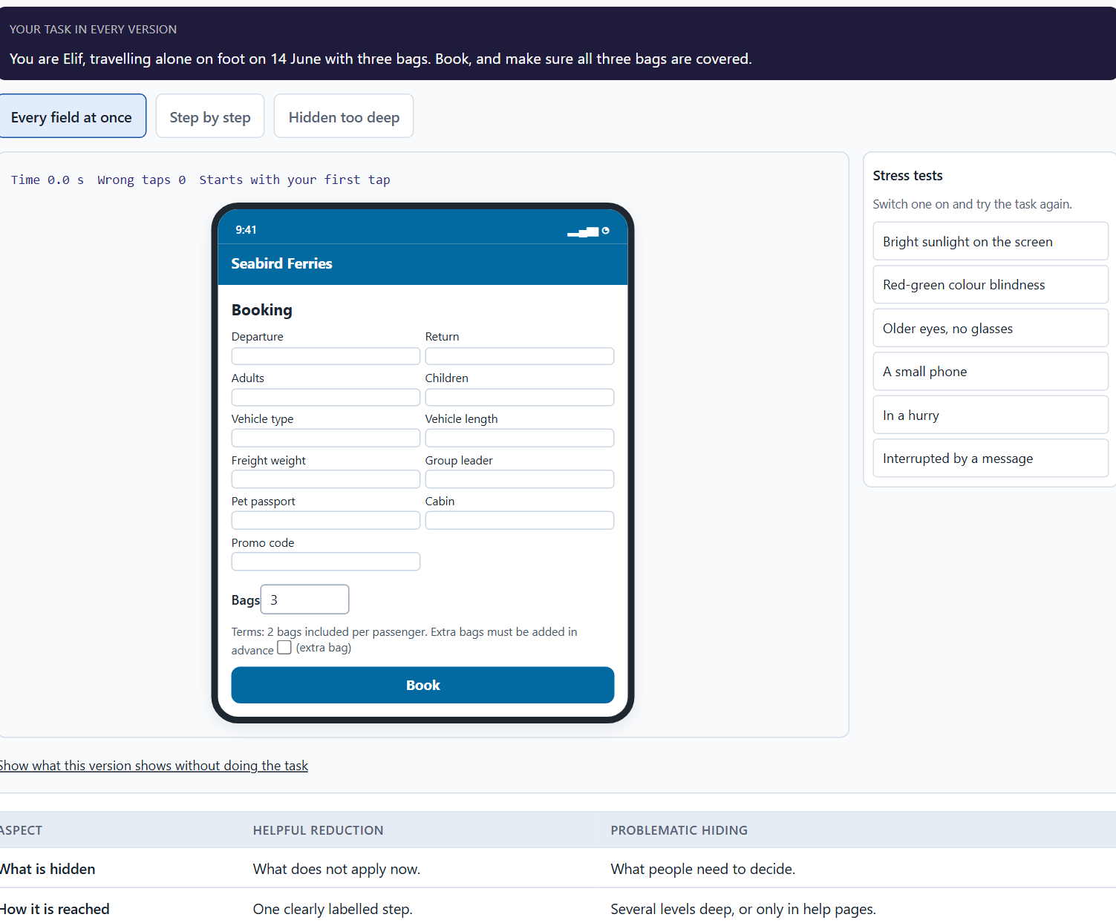
Progressive disclosure: helpful reduction, not hiding
A3 · 12 min · Core
Progressive disclosure shows what is relevant now and keeps the rest one clear step away; it lowers the load. When information people need to decide is buried too deep, reduction has become hiding.
One Seabird booking form: every field at once, step by step, and hidden too deep.
Screenshot of the Neuro-UX Lab (aion-ux-lab.vercel.app), own work; AI-assisted, labelled on the image; the example company is fictional.
Sources: Nielsen 2006 · Sweller 1988 · Krug 2014 · Pernice & Budiu 2016
AION UX Developer · Day 6 · Knowledge transfer
14
Notes:
A3 · Progressive disclosure: helpful reduction, not hiding · 12 min · Core
Case assumption: Seabird Ferries, Elif, Noah, Greta and Malte are made up for this example. Progressive disclosure follows Nielsen (2006); cognitive load follows Sweller (1988). The findings in the table of real evidence are real research results, rules and cases; the sources are listed below.
Go deeper (optional reading): Progressive disclosure has a cost that grows with each level: people have to know or guess that more exists. Nielsen (2006) advises keeping it to one, at most two levels, and making the step to the second level obvious. A third level of disclosure is usually a sign that the first level holds the wrong things.
Sources: Nielsen 2006 · Sweller 1988 · Krug 2014 · Pernice & Budiu 2016

Slide 15
A3 · In plain words
THE IDEA
WHY IT MATTERS
Progressive disclosure means showing only what is relevant in the current step and revealing the rest when it is needed. It lowers cognitive load: a form asks only the questions that apply, and details sit one clearly labelled step away. But there is a line between helpful reduction and problematic hiding. When information people need to decide (a condition, a fee, a deadline) is buried too deep, the screen is calm and the decision is unsafe.
Block 1.1 asks about OfficeSphere's forms that show every field at once, Block 1.2 asks you to judge CareAssist's three structures, one of which hides context too deep, and Block 2.1 asks about CitizenFlow's forms and its help that is not disclosed in context. This card gives you the principle and its limit.
HOW TO READ THE PICTURE
One Seabird Ferries booking form in three forms: every field at once, disclosed step by step, and reduced so far that the luggage rules are hidden.
Sources: Nielsen 2006 · Sweller 1988 · Krug 2014 · Pernice & Budiu 2016
AION UX Developer · Day 6 · Knowledge transfer
15
Notes:
A3 · Progressive disclosure: helpful reduction, not hiding · 12 min · Core
Case assumption: Seabird Ferries, Elif, Noah, Greta and Malte are made up for this example. Progressive disclosure follows Nielsen (2006); cognitive load follows Sweller (1988). The findings in the table of real evidence are real research results, rules and cases; the sources are listed below.
Go deeper (optional reading): Progressive disclosure has a cost that grows with each level: people have to know or guess that more exists. Nielsen (2006) advises keeping it to one, at most two levels, and making the step to the second level obvious. A third level of disclosure is usually a sign that the first level holds the wrong things.
Sources: Nielsen 2006 · Sweller 1988 · Krug 2014 · Pernice & Budiu 2016

Slide 16
A3 · Helpful reduction and problematic hiding
Aspect | Helpful reduction | Problematic hiding
What is hidden | What does not apply now. | What people need to decide.
How it is reached | One clearly labelled step. | Several levels deep, or only in help pages.
The effect | Less load, the same safety. | Less load at first sight, unsafe decisions.
Sources: Nielsen 2006 · Sweller 1988 · Krug 2014 · Pernice & Budiu 2016
AION UX Developer · Day 6 · Knowledge transfer
16
Notes:
A3 · Progressive disclosure: helpful reduction, not hiding · 12 min · Core
Case assumption: Seabird Ferries, Elif, Noah, Greta and Malte are made up for this example. Progressive disclosure follows Nielsen (2006); cognitive load follows Sweller (1988). The findings in the table of real evidence are real research results, rules and cases; the sources are listed below.
Go deeper (optional reading): Progressive disclosure has a cost that grows with each level: people have to know or guess that more exists. Nielsen (2006) advises keeping it to one, at most two levels, and making the step to the second level obvious. A third level of disclosure is usually a sign that the first level holds the wrong things.
Sources: Nielsen 2006 · Sweller 1988 · Krug 2014 · Pernice & Budiu 2016

Slide 17
A3 · Progressive disclosure: evidence for helpful reduction and for problematic hiding
Finding | What it shows | What it means for a screen
Levels | In theory a design can have several levels of progressive disclosure; in practice designs with more than two levels usually have low usability because users get lost between them (Nielsen 2006). | Stage information in at most two levels and show the way back.
Hidden navigation | On six live websites, people used hidden navigation less often than visible navigation and later in the task, on desktop and on phones (Pernice and Budiu 2016). | What a person needs to start or decide must stay visible.
Load | Effort spent on working out the interface is missing for the task (Sweller 1988). | Hide what does not apply now, and say where the rest is.
Sources: Nielsen 2006 · Sweller 1988 · Krug 2014 · Pernice & Budiu 2016
AION UX Developer · Day 6 · Knowledge transfer
17
Notes:
A3 · Progressive disclosure: helpful reduction, not hiding · 12 min · Core
Case assumption: Seabird Ferries, Elif, Noah, Greta and Malte are made up for this example. Progressive disclosure follows Nielsen (2006); cognitive load follows Sweller (1988). The findings in the table of real evidence are real research results, rules and cases; the sources are listed below.
Go deeper (optional reading): Progressive disclosure has a cost that grows with each level: people have to know or guess that more exists. Nielsen (2006) advises keeping it to one, at most two levels, and making the step to the second level obvious. A third level of disclosure is usually a sign that the first level holds the wrong things.
Sources: Nielsen 2006 · Sweller 1988 · Krug 2014 · Pernice & Budiu 2016

Slide 18
A3 · How to decide when this comes up in the task
For a form, ask which fields apply to everyone and which only in special cases; show the special ones only when they apply.
1
Split long processes into a few steps and show where the person is.
2
Keep the rest reachable in one clearly labelled step: “Add a vehicle”, “Show details”.
3
Never hide what people need to decide (a condition, a fee, a deadline): show it next to the choice it affects.
4
Check the line: is a hidden item something people rarely need, or something they need and miss?
5
Sources: Nielsen 2006 · Sweller 1988 · Krug 2014 · Pernice & Budiu 2016
AION UX Developer · Day 6 · Knowledge transfer
18
Notes:
A3 · Progressive disclosure: helpful reduction, not hiding · 12 min · Core
Case assumption: Seabird Ferries, Elif, Noah, Greta and Malte are made up for this example. Progressive disclosure follows Nielsen (2006); cognitive load follows Sweller (1988). The findings in the table of real evidence are real research results, rules and cases; the sources are listed below.
Go deeper (optional reading): Progressive disclosure has a cost that grows with each level: people have to know or guess that more exists. Nielsen (2006) advises keeping it to one, at most two levels, and making the step to the second level obvious. A third level of disclosure is usually a sign that the first level holds the wrong things.
Sources: Nielsen 2006 · Sweller 1988 · Krug 2014 · Pernice & Budiu 2016

Slide 19
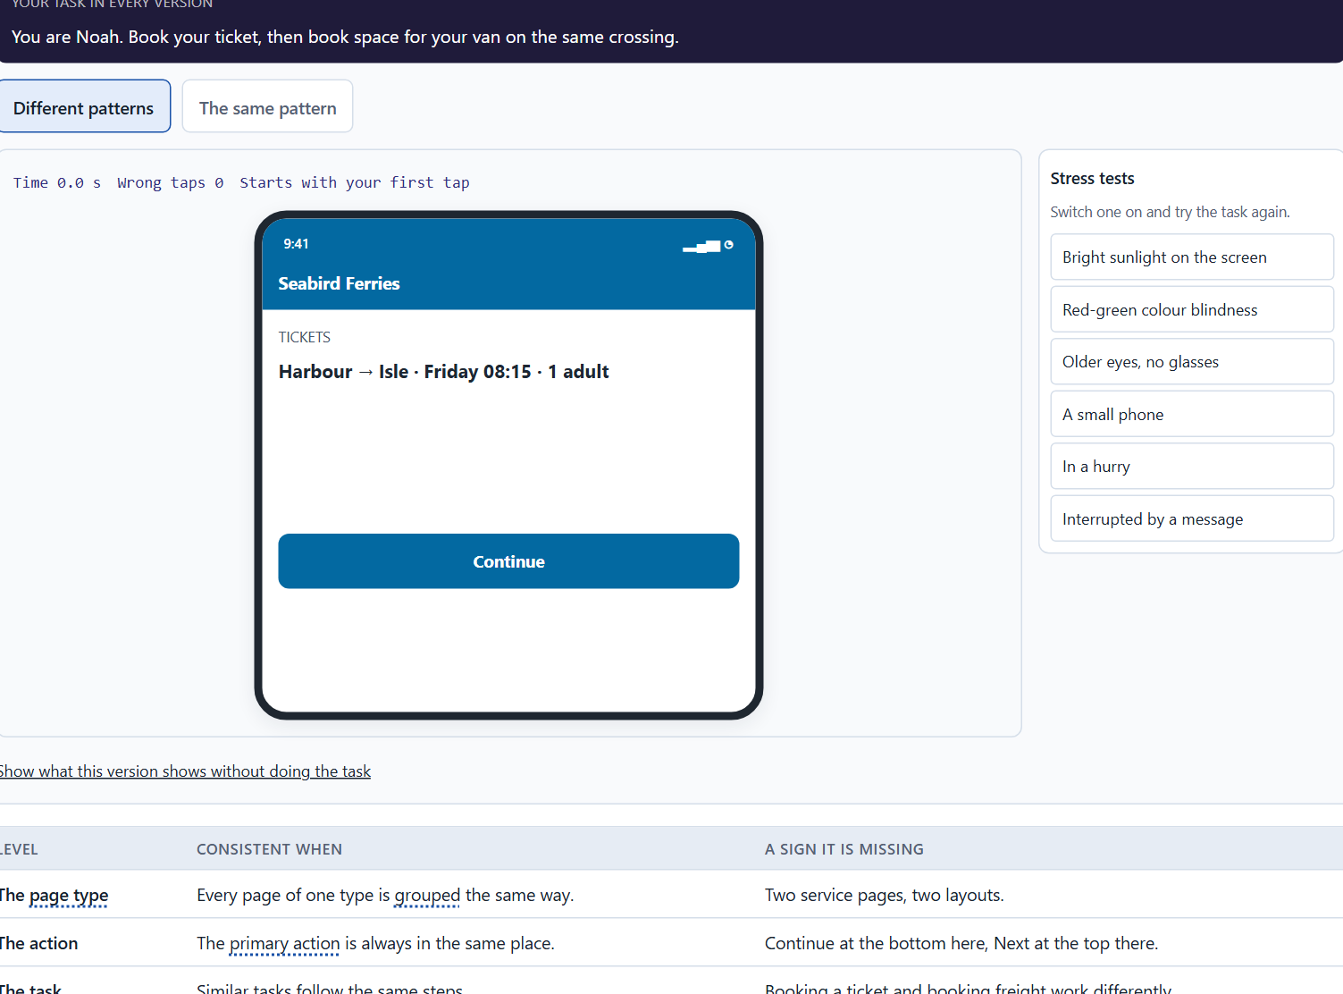
Hierarchy, navigation logic and relief: one pattern for one task
A4 · 12 min · Core
When pages of one type are grouped the same way, the primary action sits in the same place and similar tasks follow the same steps, people learn once and predict. Inconsistent patterns undermine predictability.
Two Seabird areas, tickets and freight, with different patterns and with the same pattern.
Screenshot of the Neuro-UX Lab (aion-ux-lab.vercel.app), own work; AI-assisted, labelled on the image; the example company is fictional.
Sources: Nielsen 1994 · Krug 2014 · ISO 9241-110 · Grudin 1989 · Nielsen 2000
AION UX Developer · Day 6 · Knowledge transfer
19
Notes:
A4 · Hierarchy, navigation logic and relief: one pattern for one task · 12 min · Core
Case assumption: Seabird Ferries, Elif, Noah, Greta and Malte are made up for this example. Consistency and standards is Nielsen's heuristic (1994); conformity with user expectations is an interaction principle of ISO 9241-110. The findings in the table of real evidence are real research results, rules and cases; the sources are listed below.
Go deeper (optional reading): Inconsistency usually grows from good intentions: each team improves its own area, and the improvements differ. That is why consistency is rarely fixed on the screen; it is fixed where the patterns come from, which is the subject of the next card and of Materi B.
Sources: Nielsen 1994 · Krug 2014 · ISO 9241-110 · Grudin 1989 · Nielsen 2000

Slide 20
A4 · In plain words
THE IDEA
WHY IT MATTERS
Visual hierarchy, navigation logic and cognitive relief belong together. When every page of the same type is grouped the same way, the primary action is always in the same place and similar tasks follow the same steps, people learn once and then predict. Each new pattern for a similar task costs them a fresh orientation. Inconsistent patterns across areas undermine predictability even when each single page is well designed.
Block 1.1 asks about OfficeSphere's different patterns for similar tasks, and Block 2.1 asks about CitizenFlow's navigation patterns that vary between similar areas. This card gives you the link between consistency and relief.
HOW TO READ THE PICTURE
Two Seabird Ferries areas, tickets and freight, built with different patterns and with the same pattern.
Sources: Nielsen 1994 · Krug 2014 · ISO 9241-110 · Grudin 1989 · Nielsen 2000
AION UX Developer · Day 6 · Knowledge transfer
20
Notes:
A4 · Hierarchy, navigation logic and relief: one pattern for one task · 12 min · Core
Case assumption: Seabird Ferries, Elif, Noah, Greta and Malte are made up for this example. Consistency and standards is Nielsen's heuristic (1994); conformity with user expectations is an interaction principle of ISO 9241-110. The findings in the table of real evidence are real research results, rules and cases; the sources are listed below.
Go deeper (optional reading): Inconsistency usually grows from good intentions: each team improves its own area, and the improvements differ. That is why consistency is rarely fixed on the screen; it is fixed where the patterns come from, which is the subject of the next card and of Materi B.
Sources: Nielsen 1994 · Krug 2014 · ISO 9241-110 · Grudin 1989 · Nielsen 2000

Slide 21
A4 · What consistency means on three levels
Level | Consistent when | A sign it is missing
The page type | Every page of one type is grouped the same way. | Two service pages, two layouts.
The action | The primary action is always in the same place. | Continue at the bottom here, Next at the top there.
The task | Similar tasks follow the same steps. | Booking a ticket and booking freight work differently.
Sources: Nielsen 1994 · Krug 2014 · ISO 9241-110 · Grudin 1989 · Nielsen 2000
AION UX Developer · Day 6 · Knowledge transfer
21
Notes:
A4 · Hierarchy, navigation logic and relief: one pattern for one task · 12 min · Core
Case assumption: Seabird Ferries, Elif, Noah, Greta and Malte are made up for this example. Consistency and standards is Nielsen's heuristic (1994); conformity with user expectations is an interaction principle of ISO 9241-110. The findings in the table of real evidence are real research results, rules and cases; the sources are listed below.
Go deeper (optional reading): Inconsistency usually grows from good intentions: each team improves its own area, and the improvements differ. That is why consistency is rarely fixed on the screen; it is fixed where the patterns come from, which is the subject of the next card and of Materi B.
Sources: Nielsen 1994 · Krug 2014 · ISO 9241-110 · Grudin 1989 · Nielsen 2000

Slide 22
A4 · Consistency and navigation logic: evidence and a limit
Topic | Real finding or rule | What it means for a screen
Consistency and standards | One of the ten heuristics: users should not have to wonder whether different words, situations or actions mean the same thing (Nielsen 1994). | The same action looks and sits the same on every page of a type.
Three senses of consistency | Consistency is used in three senses: with itself, with other designs the user knows, and by analogy to the world (Grudin 1989). | Say which consistency you mean before you demand it.
A limit | Grudin argued that consistency is an unreliable guide on its own, and that designers often do better to study the users' work (Grudin 1989). | Consistent is not the same as right: check the pattern against the task.
Familiar patterns | Users spend most of their time on other sites, so they expect yours to work like those (Nielsen 2000). | Use the pattern people know for navigation.
Sources: Nielsen 1994 · Krug 2014 · ISO 9241-110 · Grudin 1989 · Nielsen 2000
AION UX Developer · Day 6 · Knowledge transfer
22
Notes:
A4 · Hierarchy, navigation logic and relief: one pattern for one task · 12 min · Core
Case assumption: Seabird Ferries, Elif, Noah, Greta and Malte are made up for this example. Consistency and standards is Nielsen's heuristic (1994); conformity with user expectations is an interaction principle of ISO 9241-110. The findings in the table of real evidence are real research results, rules and cases; the sources are listed below.
Go deeper (optional reading): Inconsistency usually grows from good intentions: each team improves its own area, and the improvements differ. That is why consistency is rarely fixed on the screen; it is fixed where the patterns come from, which is the subject of the next card and of Materi B.
Sources: Nielsen 1994 · Krug 2014 · ISO 9241-110 · Grudin 1989 · Nielsen 2000

Slide 23
A4 · How to decide when this comes up in the task
List the similar tasks in different areas and check whether they follow the same pattern.
1
Check that each page type groups its content the same way, wherever it appears.
2
Keep the primary action in the same place for the same kind of step.
3
A well-designed page with its own pattern still costs users a fresh orientation.
4
Visual hierarchy, navigation logic and cognitive relief belong together: order on each page and the same order across pages.
5
Sources: Nielsen 1994 · Krug 2014 · ISO 9241-110 · Grudin 1989 · Nielsen 2000
AION UX Developer · Day 6 · Knowledge transfer
23
Notes:
A4 · Hierarchy, navigation logic and relief: one pattern for one task · 12 min · Core
Case assumption: Seabird Ferries, Elif, Noah, Greta and Malte are made up for this example. Consistency and standards is Nielsen's heuristic (1994); conformity with user expectations is an interaction principle of ISO 9241-110. The findings in the table of real evidence are real research results, rules and cases; the sources are listed below.
Go deeper (optional reading): Inconsistency usually grows from good intentions: each team improves its own area, and the improvements differ. That is why consistency is rarely fixed on the screen; it is fixed where the patterns come from, which is the subject of the next card and of Materi B.
Sources: Nielsen 1994 · Krug 2014 · ISO 9241-110 · Grudin 1989 · Nielsen 2000

Slide 24
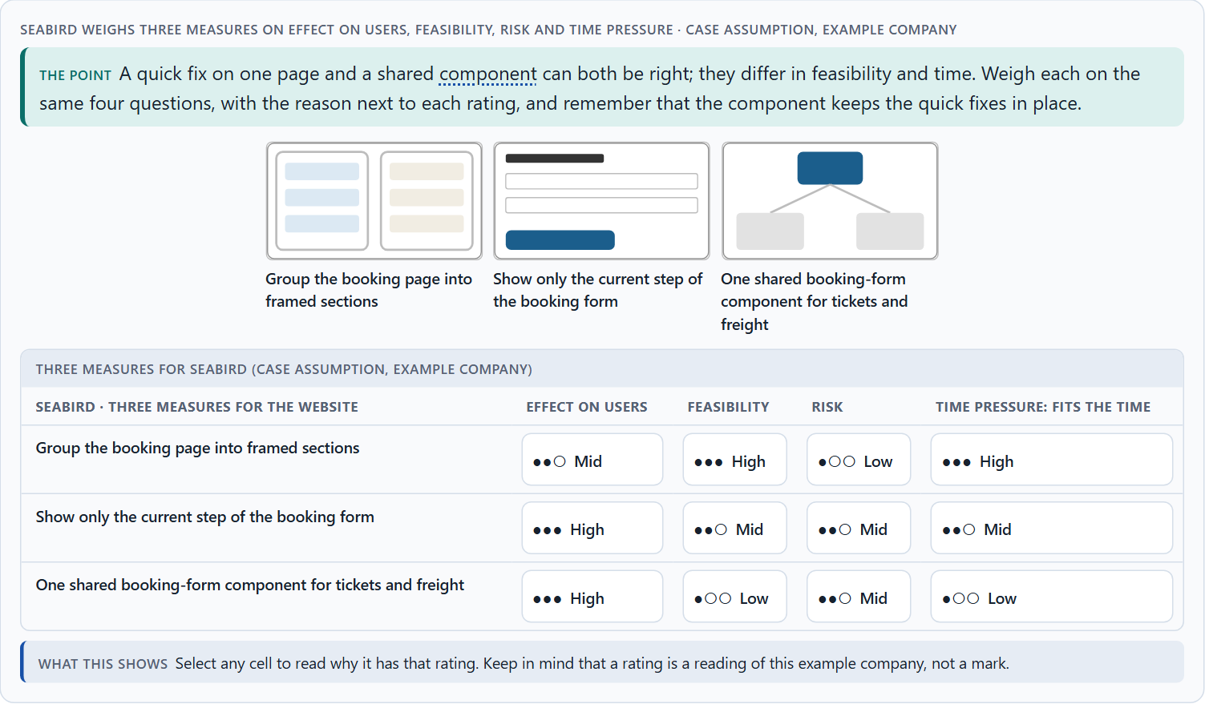
From screens to components: UX laws in a design system, and weighing a measure
A5 · 12 min · Core
UX laws belong in components, patterns and standards, not only in single screens; built in once, they hold everywhere. Weigh measures on effect on users, feasibility, risk and time pressure, with a reason.
Seabird weighs three measures on effect on users, feasibility, risk and time pressure.
Screenshot of the Neuro-UX Lab (aion-ux-lab.vercel.app), own work; AI-assisted, labelled on the image; the example company is fictional.
Sources: Frost 2016 · Kholmatova 2017 · Gibbons 2018 · Curtis 2010 · Government Digital Service 2018 · Sparkbox 2022
AION UX Developer · Day 6 · Knowledge transfer
24
Notes:
A5 · From screens to components: UX laws in a design system, and weighing a measure · 12 min · Core
Case assumption: Seabird Ferries, Elif, Noah, Greta and Malte are made up for this example. Building interfaces from shared components follows Frost (2016) and Kholmatova (2017); rating options on the same criteria with a reason follows Gibbons (2018). The four criteria are the ones the plan names for the case study. The findings in the table of real evidence are real research results, rules and cases; the sources are listed below.
Go deeper (optional reading): Evaluating a design system against the UX laws is a simple audit: take each component and ask whether it groups, ranks and discloses as the principles say. A button component that allows three equally strong buttons side by side, or a form component that cannot hide fields, will reproduce the problem on every screen that uses it.
Sources: Frost 2016 · Kholmatova 2017 · Gibbons 2018 · Curtis 2010 · Government Digital Service 2018 · Sparkbox 2022

Slide 25
A5 · In plain words
THE IDEA
WHY IT MATTERS
UX laws are not only for single screens. When they are built into components (a form that discloses step by step, a primary button, a status label), patterns (how a page type is grouped) and standards (minimum sizes, one primary action per step), every screen built from them follows the laws automatically. A design system is that set of components, patterns and standards. To put measures in order, weigh each on the four questions Block 2.1 names: effect on users, feasibility, risk and time pressure.
Block 1.2 asks for a decision between three structures, and Block 2.1 asks for four measures, one of which can anchor the others in a design system, their justification on these four criteria and a decision for 14 weeks. The example uses Seabird Ferries and its own measures, so the answer for the task cases is not given.
HOW TO READ THE PICTURE
First the chain from a UX law to the screens built from it. Then three measures Seabird considered, rated on effect on users, feasibility, risk and time pressure.
Sources: Frost 2016 · Kholmatova 2017 · Gibbons 2018 · Curtis 2010 · Government Digital Service 2018 · Sparkbox 2022
AION UX Developer · Day 6 · Knowledge transfer
25
Notes:
A5 · From screens to components: UX laws in a design system, and weighing a measure · 12 min · Core
Case assumption: Seabird Ferries, Elif, Noah, Greta and Malte are made up for this example. Building interfaces from shared components follows Frost (2016) and Kholmatova (2017); rating options on the same criteria with a reason follows Gibbons (2018). The four criteria are the ones the plan names for the case study. The findings in the table of real evidence are real research results, rules and cases; the sources are listed below.
Go deeper (optional reading): Evaluating a design system against the UX laws is a simple audit: take each component and ask whether it groups, ranks and discloses as the principles say. A button component that allows three equally strong buttons side by side, or a form component that cannot hide fields, will reproduce the problem on every screen that uses it.
Sources: Frost 2016 · Kholmatova 2017 · Gibbons 2018 · Curtis 2010 · Government Digital Service 2018 · Sparkbox 2022

Slide 26
A5 · From screens to components: real design systems
Topic | Real example | What it means
Layers | Atomic design builds interfaces from shared rules and components, from colours and type styles up to whole pages (Frost 2016); modular web design describes the same idea for components (Curtis 2010). | A law applied once in a component holds on every screen that uses it.
A public example | The GOV.UK Design System was announced in June 2018 as ready for teams across government; it brings together the styles, components and patterns of the Service Manual and GOV.UK Elements in one code base (Government Digital Service 2018). | A design system is a shared product with an owner and users.
Measuring it | In a survey of design system teams, 16% of the respondents tracked metrics (Sparkbox 2022, as reported). | Decide how the effect of the system is measured, or it cannot be defended.
Sources: Frost 2016 · Kholmatova 2017 · Gibbons 2018 · Curtis 2010 · Government Digital Service 2018 · Sparkbox 2022
AION UX Developer · Day 6 · Knowledge transfer
26
Notes:
A5 · From screens to components: UX laws in a design system, and weighing a measure · 12 min · Core
Case assumption: Seabird Ferries, Elif, Noah, Greta and Malte are made up for this example. Building interfaces from shared components follows Frost (2016) and Kholmatova (2017); rating options on the same criteria with a reason follows Gibbons (2018). The four criteria are the ones the plan names for the case study. The findings in the table of real evidence are real research results, rules and cases; the sources are listed below.
Go deeper (optional reading): Evaluating a design system against the UX laws is a simple audit: take each component and ask whether it groups, ranks and discloses as the principles say. A button component that allows three equally strong buttons side by side, or a form component that cannot hide fields, will reproduce the problem on every screen that uses it.
Sources: Frost 2016 · Kholmatova 2017 · Gibbons 2018 · Curtis 2010 · Government Digital Service 2018 · Sparkbox 2022

Slide 27
A5 · How to decide when this comes up in the task
For each fix, ask whether it can live in a component or a pattern, so every screen gets it.
1
Evaluate a design system by whether its components carry the laws: grouping, hierarchy, disclosure, one primary action.
2
Rate every measure on the same four questions: effect on users, feasibility, risk, time pressure.
3
A quick fix on a page and a shared component can both be right; the component keeps the quick fixes from drifting.
4
A rating is a judgement with a reason, never a mark.
5
Sources: Frost 2016 · Kholmatova 2017 · Gibbons 2018 · Curtis 2010 · Government Digital Service 2018 · Sparkbox 2022
AION UX Developer · Day 6 · Knowledge transfer
27
Notes:
A5 · From screens to components: UX laws in a design system, and weighing a measure · 12 min · Core
Case assumption: Seabird Ferries, Elif, Noah, Greta and Malte are made up for this example. Building interfaces from shared components follows Frost (2016) and Kholmatova (2017); rating options on the same criteria with a reason follows Gibbons (2018). The four criteria are the ones the plan names for the case study. The findings in the table of real evidence are real research results, rules and cases; the sources are listed below.
Go deeper (optional reading): Evaluating a design system against the UX laws is a simple audit: take each component and ask whether it groups, ranks and discloses as the principles say. A button component that allows three equally strong buttons side by side, or a form component that cannot hide fields, will reproduce the problem on every screen that uses it.
Sources: Frost 2016 · Kholmatova 2017 · Gibbons 2018 · Curtis 2010 · Government Digital Service 2018 · Sparkbox 2022

Slide 28
Materi B
Route 2 · Level 3
About 60 minutes, three cards, led by the facilitator. Level 3 in the Chief Experience Officer's chair: a guiding vision for systemic user guidance, three strategic decisions, an order of what is standardised first, a risk analysis, a governance model for the design system, one decision under uncertainty and a statement to the management. The cards give you the ideas you use in Task 2.
AION UX Developer · Day 6 · Knowledge transfer
28

Slide 29
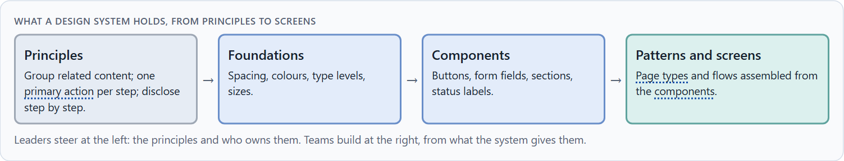
Design systems for consistency, scale and steering
B1 · 20 min · Core
A design system is a shared set of principles, components and patterns every team builds from. It gives consistency, scale and steering; leaders use it to turn UX principles into system logic, standards and governance.
What a design system holds, from principles to screens.
Screenshot of the Neuro-UX Lab (aion-ux-lab.vercel.app), own work; AI-assisted, labelled on the image; the example company is fictional.
Sources: Kholmatova 2017 · Frost 2016 · Curtis 2010 · Government Digital Service 2018 · Sparkbox 2022
AION UX Developer · Day 6 · Knowledge transfer
29
Notes:
B1 · Design systems for consistency, scale and steering · 20 min · Core
Case assumption: Seabird Ferries, Elif, Noah, Greta and Malte are made up for this example. Design systems and their parts follow Kholmatova (2017), Frost (2016) and Curtis (2010). The findings in the table of real evidence are real research results, rules and cases; the sources are listed below.
Go deeper (optional reading): A design system is a product for internal users, the teams. Like any product, it fails when it is hard to use: missing components, poor documentation, slow answers to requests. Many organisations therefore give it a small permanent team and treat the other teams' adoption as its main measure of success.
Sources: Kholmatova 2017 · Frost 2016 · Curtis 2010 · Government Digital Service 2018 · Sparkbox 2022

Slide 30
B1 · In plain words
THE IDEA
WHY IT MATTERS
A design system is a shared set of principles, components and patterns that every team uses to build its screens. It serves three purposes: consistency (the same thing looks and works the same everywhere), scale (new screens are built faster from ready parts) and steering (a change to a component reaches every screen at once). Leaders use it to translate UX principles into system logic, standards and governance, instead of optimising here and there. Without one, every team keeps inventing its own patterns, and users pay for the differences.
Block 3.1 asks for a guiding vision for systemic user guidance, three decisions on Gestalt, hierarchy, disclosure and the design system, and an order of what is standardised first, for an organisation whose teams set their own patterns. You decide the system, not the pages.
HOW TO READ THE PICTURE
Left Seabird's teams each building their own patterns, right building from one design system. Below, what a design system holds, from principles to screens.
Sources: Kholmatova 2017 · Frost 2016 · Curtis 2010 · Government Digital Service 2018 · Sparkbox 2022
AION UX Developer · Day 6 · Knowledge transfer
30
Notes:
B1 · Design systems for consistency, scale and steering · 20 min · Core
Case assumption: Seabird Ferries, Elif, Noah, Greta and Malte are made up for this example. Design systems and their parts follow Kholmatova (2017), Frost (2016) and Curtis (2010). The findings in the table of real evidence are real research results, rules and cases; the sources are listed below.
Go deeper (optional reading): A design system is a product for internal users, the teams. Like any product, it fails when it is hard to use: missing components, poor documentation, slow answers to requests. Many organisations therefore give it a small permanent team and treat the other teams' adoption as its main measure of success.
Sources: Kholmatova 2017 · Frost 2016 · Curtis 2010 · Government Digital Service 2018 · Sparkbox 2022

Slide 31
B1 · Design systems for consistency, scale and steering: examples
Part | Real example | What it means
Components and patterns | The GOV.UK Design System offers components such as checkboxes, buttons and form inputs, and patterns for common tasks such as asking for an address (Government Digital Service 2018). | Standardise the parts people meet most often, and the tasks they repeat.
Evidence before standard | New components are first published as experimental, and the experimental status is removed when research shows that the component meets user needs (GOV.UK Design System). | A standard is earned by evidence from users.
Onboarding | The survey of design system teams concluded that successful systems offer onboarding, training and support for users and contributors (Sparkbox 2022, as reported). | A system that is not taught is not used.
Sources: Kholmatova 2017 · Frost 2016 · Curtis 2010 · Government Digital Service 2018 · Sparkbox 2022
AION UX Developer · Day 6 · Knowledge transfer
31
Notes:
B1 · Design systems for consistency, scale and steering · 20 min · Core
Case assumption: Seabird Ferries, Elif, Noah, Greta and Malte are made up for this example. Design systems and their parts follow Kholmatova (2017), Frost (2016) and Curtis (2010). The findings in the table of real evidence are real research results, rules and cases; the sources are listed below.
Go deeper (optional reading): A design system is a product for internal users, the teams. Like any product, it fails when it is hard to use: missing components, poor documentation, slow answers to requests. Many organisations therefore give it a small permanent team and treat the other teams' adoption as its main measure of success.
Sources: Kholmatova 2017 · Frost 2016 · Curtis 2010 · Government Digital Service 2018 · Sparkbox 2022

Slide 32
B1 · How to decide when this comes up in the task
Look at how many teams build the same kind of element in their own way: each is a missing component.
1
Start with the principles (grouping, hierarchy, disclosure, one primary action), then the components that carry them.
2
Make the shared component the easy path for teams, or they will keep building their own.
3
Steer at the level of principles and ownership; let teams build at the level of screens.
4
Sources: Kholmatova 2017 · Frost 2016 · Curtis 2010 · Government Digital Service 2018 · Sparkbox 2022
AION UX Developer · Day 6 · Knowledge transfer
32
Notes:
B1 · Design systems for consistency, scale and steering · 20 min · Core
Case assumption: Seabird Ferries, Elif, Noah, Greta and Malte are made up for this example. Design systems and their parts follow Kholmatova (2017), Frost (2016) and Curtis (2010). The findings in the table of real evidence are real research results, rules and cases; the sources are listed below.
Go deeper (optional reading): A design system is a product for internal users, the teams. Like any product, it fails when it is hard to use: missing components, poor documentation, slow answers to requests. Many organisations therefore give it a small permanent team and treat the other teams' adoption as its main measure of success.
Sources: Kholmatova 2017 · Frost 2016 · Curtis 2010 · Government Digital Service 2018 · Sparkbox 2022

Slide 33
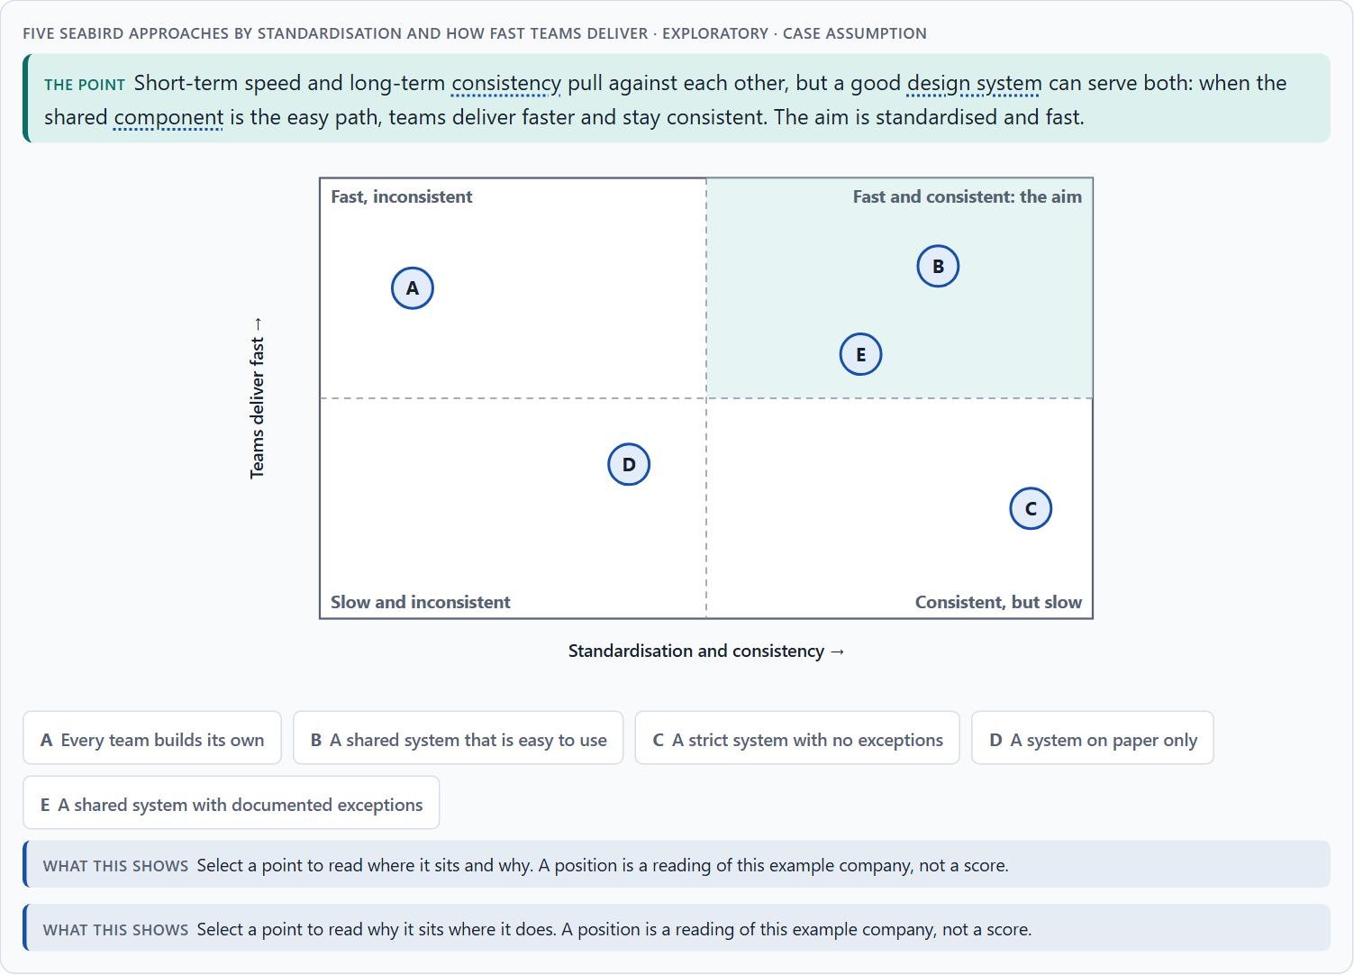
Conflicts of goals: consistency, flexibility, speed, clarity and standardisation
B2 · 20 min · Core
Consistency against flexibility, speed today against quality over years, clarity against showing more, standardisation against team autonomy. Make the shared component the easy path and allow documented exceptions.
Five Seabird approaches by standardisation and how fast teams deliver · Exploratory.
Screenshot of the Neuro-UX Lab (aion-ux-lab.vercel.app), own work; AI-assisted, labelled on the image; the example company is fictional.
Sources: Kholmatova 2017 · Nielsen 2006 · Gibbons 2018 · Grudin 1989 · Sparkbox 2022 · Pernice & Budiu 2016 · Government Digital Service 2018
AION UX Developer · Day 6 · Knowledge transfer
33
Notes:
B2 · Conflicts of goals: consistency, flexibility, speed, clarity and standardisation · 20 min · Core
Case assumption: Seabird Ferries, Elif, Noah, Greta and Malte are made up for this example. The matrix is a reading of the example, not a score. The findings in the table of real evidence are real research results, rules and cases; the sources are listed below.
Go deeper (optional reading): A useful rule for exceptions: the first time a team needs something the system lacks, it may build it with a note; the second time another team needs the same thing, it becomes a component. The system grows from real needs, and nobody waits for a perfect library.
Sources: Kholmatova 2017 · Nielsen 2006 · Gibbons 2018 · Grudin 1989 · Sparkbox 2022 · Pernice & Budiu 2016 · Government Digital Service 2018

Slide 34
B2 · In plain words
THE IDEA
WHY IT MATTERS
Design systems sit between goals that pull against each other: consistency against flexibility for a team with a special case, product speed today against system quality over years, clarity for users against the departments' wish to show more, and standardisation against each team's autonomy. Short-term pressure favours single solutions; long-term quality needs shared ones. The way through is to make the shared component the easy path, allow documented exceptions, and say what each choice gives up.
Block 3.1 asks for three guiding decisions, a risk analysis about behaviour, transparency and standardisation, and a governance model for conflicts between teams. Each of these is a decision between conflicting goals.
HOW TO READ THE PICTURE
The matrix places five Seabird approaches by how standardised they are (to the right) and how fast teams can deliver (upwards). A position is a reading of the example, not a score.
Sources: Kholmatova 2017 · Nielsen 2006 · Gibbons 2018 · Grudin 1989 · Sparkbox 2022 · Pernice & Budiu 2016 · Government Digital Service 2018
AION UX Developer · Day 6 · Knowledge transfer
34
Notes:
B2 · Conflicts of goals: consistency, flexibility, speed, clarity and standardisation · 20 min · Core
Case assumption: Seabird Ferries, Elif, Noah, Greta and Malte are made up for this example. The matrix is a reading of the example, not a score. The findings in the table of real evidence are real research results, rules and cases; the sources are listed below.
Go deeper (optional reading): A useful rule for exceptions: the first time a team needs something the system lacks, it may build it with a note; the second time another team needs the same thing, it becomes a component. The system grows from real needs, and nobody waits for a perfect library.
Sources: Kholmatova 2017 · Nielsen 2006 · Gibbons 2018 · Grudin 1989 · Sparkbox 2022 · Pernice & Budiu 2016 · Government Digital Service 2018

Slide 35
B2 · Standing conflicts of design systems
Conflict | Who usually stands for each side | What to ask
Consistency against flexibility | The design-system lead, against a team with a special case. | Is the case really special, or a missing option of a component?
Speed today against quality over years | A team with a deadline, against everyone who maintains it later. | What will this single solution cost each time it must change?
Visibility against clarity | Departments that want more shown, against users who need less at once. | What does the user need in this step, and what can be one step away?
Sources: Kholmatova 2017 · Nielsen 2006 · Gibbons 2018 · Grudin 1989 · Sparkbox 2022 · Pernice & Budiu 2016 · Government Digital Service 2018
AION UX Developer · Day 6 · Knowledge transfer
35
Notes:
B2 · Conflicts of goals: consistency, flexibility, speed, clarity and standardisation · 20 min · Core
Case assumption: Seabird Ferries, Elif, Noah, Greta and Malte are made up for this example. The matrix is a reading of the example, not a score. The findings in the table of real evidence are real research results, rules and cases; the sources are listed below.
Go deeper (optional reading): A useful rule for exceptions: the first time a team needs something the system lacks, it may build it with a note; the second time another team needs the same thing, it becomes a component. The system grows from real needs, and nobody waits for a perfect library.
Sources: Kholmatova 2017 · Nielsen 2006 · Gibbons 2018 · Grudin 1989 · Sparkbox 2022 · Pernice & Budiu 2016 · Government Digital Service 2018

Slide 36
B2 · Conflicts of design systems, with evidence
Conflict | What the evidence says | A way to decide
Consistency against flexibility | Consistency is an unreliable guide on its own (Grudin 1989); the GOV.UK Design System asks contributors to reuse existing components where relevant (GOV.UK Design System). | Ask whether the special case is really special, or a missing option of a component.
Speed against quality | Only 16% of the surveyed design system teams tracked metrics (Sparkbox 2022, as reported), so the cost of each exception stays invisible. | Put a price on each exception: how often it will have to change.
Visibility against clarity | More than two levels of disclosure usually lower usability (Nielsen 2006), and hidden navigation is used less (Pernice and Budiu 2016). | Show what the step needs; put the rest one step away, not deeper.
Sources: Kholmatova 2017 · Nielsen 2006 · Gibbons 2018 · Grudin 1989 · Sparkbox 2022 · Pernice & Budiu 2016 · Government Digital Service 2018
AION UX Developer · Day 6 · Knowledge transfer
36
Notes:
B2 · Conflicts of goals: consistency, flexibility, speed, clarity and standardisation · 20 min · Core
Case assumption: Seabird Ferries, Elif, Noah, Greta and Malte are made up for this example. The matrix is a reading of the example, not a score. The findings in the table of real evidence are real research results, rules and cases; the sources are listed below.
Go deeper (optional reading): A useful rule for exceptions: the first time a team needs something the system lacks, it may build it with a note; the second time another team needs the same thing, it becomes a component. The system grows from real needs, and nobody waits for a perfect library.
Sources: Kholmatova 2017 · Nielsen 2006 · Gibbons 2018 · Grudin 1989 · Sparkbox 2022 · Pernice & Budiu 2016 · Government Digital Service 2018

Slide 37
B2 · How to decide when this comes up in the task
Name the conflict as two goals and say who stands for each: a team under time pressure, the design-system lead, a department, the users.
1
Short-term pressure favours single solutions; long-term quality needs shared ones. Say which one you serve and why.
2
A strict system with no exceptions makes teams wait; a system without components makes teams build their own.
3
Allow exceptions with a reason and a review, and turn repeated exceptions into new components.
4
Say what the choice gives up; a decision that gives up nothing has not been made.
5
Sources: Kholmatova 2017 · Nielsen 2006 · Gibbons 2018 · Grudin 1989 · Sparkbox 2022 · Pernice & Budiu 2016 · Government Digital Service 2018
AION UX Developer · Day 6 · Knowledge transfer
37
Notes:
B2 · Conflicts of goals: consistency, flexibility, speed, clarity and standardisation · 20 min · Core
Case assumption: Seabird Ferries, Elif, Noah, Greta and Malte are made up for this example. The matrix is a reading of the example, not a score. The findings in the table of real evidence are real research results, rules and cases; the sources are listed below.
Go deeper (optional reading): A useful rule for exceptions: the first time a team needs something the system lacks, it may build it with a note; the second time another team needs the same thing, it becomes a component. The system grows from real needs, and nobody waits for a perfect library.
Sources: Kholmatova 2017 · Nielsen 2006 · Gibbons 2018 · Grudin 1989 · Sparkbox 2022 · Pernice & Budiu 2016 · Government Digital Service 2018

Slide 38
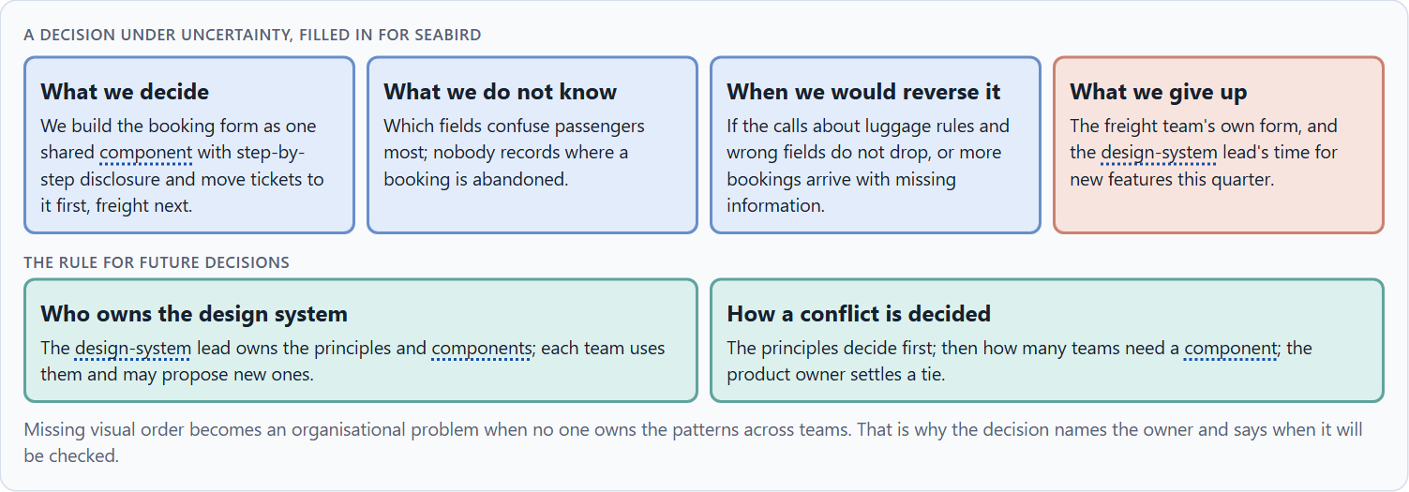
Design-system governance, and deciding with incomplete data
B3 · 20 min · Core
A design system lives only with governance: an owner of its principles and components, a way to propose new ones, and a rule for conflicts between teams. A decision with incomplete data says what it decides, what it does not know, when it would reverse it and what it gives up.
A decision under uncertainty, filled in for Seabird.
Screenshot of the Neuro-UX Lab (aion-ux-lab.vercel.app), own work; AI-assisted, labelled on the image; the example company is fictional.
Sources: Simon 1956 · Klein 2007 · Kholmatova 2017 · Government Digital Service 2018
AION UX Developer · Day 6 · Knowledge transfer
38
Notes:
B3 · Design-system governance, and deciding with incomplete data · 20 min · Core
Case assumption: Seabird Ferries, Elif, Noah, Greta and Malte are made up for this example. Deciding with limited information follows Simon (1956); the premortem follows Klein (2007). The findings in the table of real evidence are real research results, rules and cases; the sources are listed below.
Go deeper (optional reading): Imagine it is a year later and the design system has failed, and ask why (Klein 2007). The usual answers: the components came too late, so teams built their own; nobody answered requests; the principles were written but never enforced in reviews. Each answer is a governance gap, not a design gap.
Sources: Simon 1956 · Klein 2007 · Kholmatova 2017 · Government Digital Service 2018

Slide 39
B3 · In plain words
THE IDEA
WHY IT MATTERS
A design system lives only with governance: a team that owns its principles and components, a clear way for other teams to propose new components or ask for an exception, and a rule for conflicts between teams. Because data is rarely complete, a decision under uncertainty says what you decide, what you do not know, when you would reverse it and what you give up. Missing visual order becomes a structural problem of the organisation when no one is responsible for the patterns across teams.
Block 3.1 asks for a governance model for component standards and UX principles, a decision despite incomplete data, and a statement to the management. This card gives you the parts of each.
HOW TO READ THE PICTURE
The four boxes at the top are the parts of a decision, filled in for Seabird. The two boxes below are the rule for future decisions.
Sources: Simon 1956 · Klein 2007 · Kholmatova 2017 · Government Digital Service 2018
AION UX Developer · Day 6 · Knowledge transfer
39
Notes:
B3 · Design-system governance, and deciding with incomplete data · 20 min · Core
Case assumption: Seabird Ferries, Elif, Noah, Greta and Malte are made up for this example. Deciding with limited information follows Simon (1956); the premortem follows Klein (2007). The findings in the table of real evidence are real research results, rules and cases; the sources are listed below.
Go deeper (optional reading): Imagine it is a year later and the design system has failed, and ask why (Klein 2007). The usual answers: the components came too late, so teams built their own; nobody answered requests; the principles were written but never enforced in reviews. Each answer is a governance gap, not a design gap.
Sources: Simon 1956 · Klein 2007 · Kholmatova 2017 · Government Digital Service 2018

Slide 40
B3 · Three parts of design-system governance
Part | The question | An example (Seabird)
Who owns what | Who owns the principles and components; who uses them? | The design-system lead owns them; teams use them.
How a request is decided | How does a team get a new component or an exception? | It proposes; the lead decides on need and effect on users.
How a conflict is decided | What happens when two teams want different patterns? | The principles decide; the product owner settles a tie.
Sources: Simon 1956 · Klein 2007 · Kholmatova 2017 · Government Digital Service 2018
AION UX Developer · Day 6 · Knowledge transfer
40
Notes:
B3 · Design-system governance, and deciding with incomplete data · 20 min · Core
Case assumption: Seabird Ferries, Elif, Noah, Greta and Malte are made up for this example. Deciding with limited information follows Simon (1956); the premortem follows Klein (2007). The findings in the table of real evidence are real research results, rules and cases; the sources are listed below.
Go deeper (optional reading): Imagine it is a year later and the design system has failed, and ask why (Klein 2007). The usual answers: the components came too late, so teams built their own; nobody answered requests; the principles were written but never enforced in reviews. Each answer is a governance gap, not a design gap.
Sources: Simon 1956 · Klein 2007 · Kholmatova 2017 · Government Digital Service 2018

Slide 41
B3 · Design-system governance: a real process
Part | Real example | What it means
How a request is decided | A contribution to the GOV.UK Design System must be of high quality, meet user needs and reuse existing styles and components; the team checks it before a working group reviews it (GOV.UK Design System). | Write down the criteria a request must meet.
Who decides | The working group is a multidisciplinary panel of representatives from across government that votes on whether a contribution is published as it is or needs changes; it does not review minor changes (GOV.UK Design System). | Give the decision to a group that represents the users of the system, and say which changes it need not see.
How a conflict is decided | New components start as experimental until research shows they work for users (GOV.UK Design System). | Let evidence from users decide when two teams want different patterns.
Sources: Simon 1956 · Klein 2007 · Kholmatova 2017 · Government Digital Service 2018
AION UX Developer · Day 6 · Knowledge transfer
41
Notes:
B3 · Design-system governance, and deciding with incomplete data · 20 min · Core
Case assumption: Seabird Ferries, Elif, Noah, Greta and Malte are made up for this example. Deciding with limited information follows Simon (1956); the premortem follows Klein (2007). The findings in the table of real evidence are real research results, rules and cases; the sources are listed below.
Go deeper (optional reading): Imagine it is a year later and the design system has failed, and ask why (Klein 2007). The usual answers: the components came too late, so teams built their own; nobody answered requests; the principles were written but never enforced in reviews. Each answer is a governance gap, not a design gap.
Sources: Simon 1956 · Klein 2007 · Kholmatova 2017 · Government Digital Service 2018

Slide 42
B3 · How to decide when this comes up in the task
Name who owns the principles and the components, and who only uses them.
1
Give teams a clear way to propose a component or ask for an exception, and say who decides on what basis.
2
Settle conflicts between teams by the principles first, then by need and effect on users, then by a named person.
3
Say what you decide, what you do not know, when you would reverse it and what you give up.
4
Missing visual order becomes an organisational problem when no one owns the patterns across teams.
5
Sources: Simon 1956 · Klein 2007 · Kholmatova 2017 · Government Digital Service 2018
AION UX Developer · Day 6 · Knowledge transfer
42
Notes:
B3 · Design-system governance, and deciding with incomplete data · 20 min · Core
Case assumption: Seabird Ferries, Elif, Noah, Greta and Malte are made up for this example. Deciding with limited information follows Simon (1956); the premortem follows Klein (2007). The findings in the table of real evidence are real research results, rules and cases; the sources are listed below.
Go deeper (optional reading): Imagine it is a year later and the design system has failed, and ask why (Klein 2007). The usual answers: the components came too late, so teams built their own; nobody answered requests; the principles were written but never enforced in reviews. Each answer is a governance gap, not a design gap.
Sources: Simon 1956 · Klein 2007 · Kholmatova 2017 · Government Digital Service 2018

Slide 43
Sources (1)
Wertheimer, M. (1923). Untersuchungen zur Lehre von der Gestalt II. Psychologische Forschung, 4, 301–350.
Palmer, S. E. (1992). Common region: A new principle of perceptual grouping. Cognitive Psychology, 24(3), 436–447.
Wagemans, J., Elder, J. H., Kubovy, M., Palmer, S. E., Peterson, M. A., Singh, M., & von der Heydt, R. (2012). A century of Gestalt psychology in visual perception: I. Perceptual grouping and figure–ground organization. Psychological Bulletin, 138(6), 1172–1217.
Ware, C. (2012). Information Visualization: Perception for Design (3rd ed.). Morgan Kaufmann.
Krug, S. (2014). Don't Make Me Think, Revisited (3rd ed.). New Riders.
Nielsen, J. (1994, reviewed 2024). 10 Usability Heuristics for User Interface Design. Nielsen Norman Group. https://www.nngroup.com/articles/ten-usability-heuristics/
Itti, L., & Koch, C. (2001). Computational modelling of visual attention. Nature Reviews Neuroscience, 2(3), 194–203.
AION UX Developer · Day 6 · Knowledge transfer
43

Slide 44
Sources (2)
von Restorff, H. (1933). Über die Wirkung von Bereichsbildungen im Spurenfeld. Psychologische Forschung, 18, 299–342.
Hunt, R. R. (1995). The subtlety of distinctiveness: What von Restorff really did. Psychonomic Bulletin & Review, 2(1), 105–112.
Nielsen, J. (1997). How Users Read on the Web. Nielsen Norman Group. https://www.nngroup.com/articles/how-users-read-on-the-web/
Pernice, K. (2017). F-Shaped Pattern of Reading on the Web: Misunderstood, But Still Relevant (Even on Mobile). Nielsen Norman Group. https://www.nngroup.com/articles/f-shaped-pattern-reading-web-content/
Nielsen, J. (2006). Progressive Disclosure. Nielsen Norman Group. https://www.nngroup.com/articles/progressive-disclosure/
Sweller, J. (1988). Cognitive load during problem solving: Effects on learning. Cognitive Science, 12(2), 257–285. https://doi.org/10.1207/s15516709cog1202_4
Pernice, K., & Budiu, R. (2016). Hamburger Menus and Hidden Navigation Hurt UX Metrics. Nielsen Norman Group. https://www.nngroup.com/articles/find-navigation-mobile-even-hamburger/
AION UX Developer · Day 6 · Knowledge transfer
44

Slide 45
Sources (3)
ISO 9241-110:2020. Ergonomics of human-system interaction, Part 110: Interaction principles. (Suitability for the task, self-descriptiveness, conformity with user expectations, learnability, controllability, use error robustness and user engagement.) Check the current edition before you teach from it.
Grudin, J. (1989). The case against user interface consistency. Communications of the ACM, 32(10), 1164–1173. https://doi.org/10.1145/67933.67934
Nielsen, J. (2000). End of Web Design. Nielsen Norman Group. https://www.nngroup.com/articles/end-of-web-design/
Frost, B. (2016). Atomic Design. Brad Frost. https://atomicdesign.bradfrost.com/
Kholmatova, A. (2017). Design Systems: A practical guide to creating design languages for digital products. Smashing Media.
Gibbons, S. (2018). Using Prioritization Matrices to Inform UX Decisions. Nielsen Norman Group. https://www.nngroup.com/articles/prioritization-matrices/
Curtis, N. (2010). Modular Web Design: Creating Reusable Components for User Experience Design and Documentation. New Riders.
AION UX Developer · Day 6 · Knowledge transfer
45

Slide 46
Sources (4)
Government Digital Service (2018). Introducing the GOV.UK Design System. https://gds.blog.gov.uk/2018/06/22/introducing-the-gov-uk-design-system/ and the GOV.UK Design System community pages, https://design-system.service.gov.uk/community
Sparkbox (2022). The 2022 Design Systems Survey. https://sparkbox.com/foundry/2022_design_systems_survey
Simon, H. A. (1956). Rational choice and the structure of the environment. Psychological Review, 63(2), 129–138.
Klein, G. (2007). Performing a project premortem. Harvard Business Review, 85(9), 18–19.
AION UX Developer · Day 6 · Knowledge transfer
46

Slide 47
About these slides, sources and AI use
AI
AI-assisted content
Where to find more
AI-assisted content: these slides were drafted with an AI language model (Claude, Anthropic) from the course's own Neuro-UX Lab and were read, corrected and approved by Muhammad Muchson, who is responsible for their accuracy.
Pictures are screenshots of the course's own Neuro-UX Lab. Each one carries an AI label on the image and a source line under it.
Companies and people in the examples are fictional. Numbers inside an example are labelled Case assumption and are not data.
Neuro-UX Lab for this day: https://aion-ux-lab.vercel.app/day/6/
Handouts: the Materi and Task Word documents of the day.
Version 1.0, 29.10.2026. Reviewer and approver: Muhammad Muchson.
AION UX Developer · Day 6 · Knowledge transfer
47

