Slide 1
Emotional bonding in design
AION UX DEVELOPER · DAY 7
7
Training slides: tasks, coaching, case study and feedback
Contains AI-assisted content
Module 4 (day 1 of 3)
Trainer: Muhammad Muchson · Case: LifeSupport

Slide 2
The day at a glance (1)
UE | Min | What | What happens
1 | 45 | Knowledge transfer · Level 1 | The trainer presents the cards of Materi A (A1, A2, A3, A4, A5, about 60 min of cards) in the Neuro-UX Lab; participants follow in the handout.
2 | 45 | Level 1 · Task 1 | Individual work on Block 1.1 (Core, about 10 min): the first product of the day is read and its effect described. Pairs then compare their results and the trainer collects open questions.
3 | 45 | Level 1 · Task 2 | Three options are rated on the same criteria and one is chosen under the stated conditions: Block 1.2 (Core, about 8 min).
4 | 45 | Coaching · transition from Level 1 to Level 2 | Trainer-led. A short talk on the day's coaching focus, then the reflection questions in pairs. The bridge: from describing an effect to a decision you answer for. There is no worksheet block in this unit.
5–6 | 90 | Level 2 · Case study LifeSupport (2 UE) incl. model solution | UE5: the trainer presents the case; participants work on Block 2.1 (Core, about 15 min). UE6: groups compare their results and defend them; the trainer closes with the model solution.
7 | 45 | Level 2 + 3 · Feedback round with a management perspective | Groups present their reasoning, not only their result. The trainer asks the day's Level 3 input questions and leads the discussion.
One UE is 45 minutes; breaks are not shown.
AION UX Developer · Day 7 · Training slides
2
Notes:
One UE (teaching unit) is counted as 45 minutes; breaks are not shown.

Slide 3
The day at a glance (2)
UE | Min | What | What happens
8 | 45 | Level 3 · Transfer project, Chief Experience Officer (3 UE: UE8–10) | The trainer presents Materi B (B1, B2, B3; use the "In plain words" and "How to decide" boxes, the rest is handout) and sets the role and the situation.
9 | 45 | Level 3 · Transfer project | Individual work or in pairs on Block 3.1 (Core, about 20 min): the strategy memo.
10 | 45 | Level 3 · Transfer project | Participants present their decision and what they give up, including the one decision made under uncertainty; the trainer debriefs with the model solution.
One UE is 45 minutes; breaks are not shown.
AION UX Developer · Day 7 · Training slides
3
Notes:
One UE (teaching unit) is counted as 45 minutes; breaks are not shown.

Slide 4
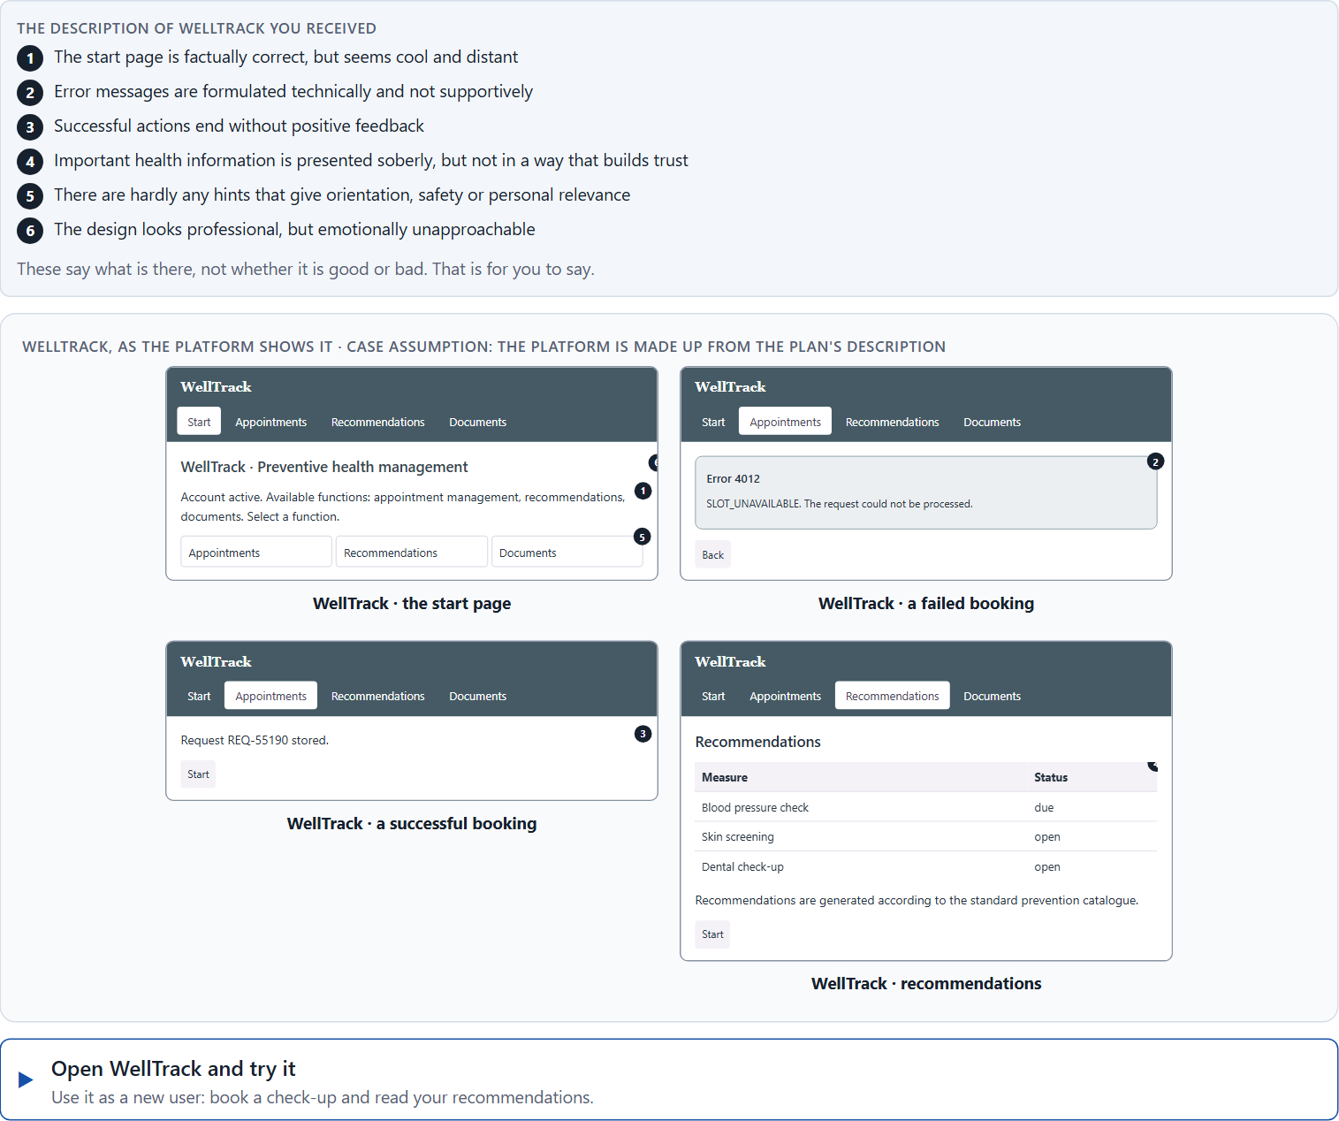
Block 1.1 · Analyse the emotional effect of a digital offer from the user's side: WellTrack
Level 1 · Knowledge · about 10 min
You receive the description of a fictional health platform, WellTrack, for prevention, appointment management and personal recommendations. Open it and use it as someone who has just signed up: book a check-up and read your recommendations. You need no prior knowledge: notice how it makes you feel, not only whether it works. The aim is to recognise emotional effect step by step and to tell it apart from a purely functional judgement.
Screenshot of the Neuro-UX Lab (aion-ux-lab.vercel.app), own work; AI-assisted, labelled on the image; the example company is fictional.
Draws on: A1 · Emotions steer behaviour · A2 · Usable is not enough · A3 · Where feelings come from · A4 · Activation, overload and manipulation.
AION UX Developer · Day 7 · Training slides
4
Notes:
Block 1.1 · Analyse the emotional effect of a digital offer from the user's side: WellTrack · about 10 min. Draws on: A1 · Emotions steer behaviour · A2 · Usable is not enough · A3 · Where feelings come from · A4 · Activation, overload and manipulation.

Slide 5
Block 1.1 · What you work on
Describe spontaneously which emotional effect the offer could have on a first-time user
1
Name at least 5 places where the emotional bond is weakened or built
2
Assign the observations to the categories trust, safety, motivation, frustration, closeness and experience quality
3
Write an effect statement for three points: “For users this could mean that …”
4
Prioritise the two biggest emotional weaknesses of the offer
5
AION UX Developer · Day 7 · Training slides
5
Notes:
Block 1.1 · Analyse the emotional effect of a digital offer from the user's side: WellTrack · about 10 min. Draws on: A1 · Emotions steer behaviour · A2 · Usable is not enough · A3 · Where feelings come from · A4 · Activation, overload and manipulation.

Slide 6
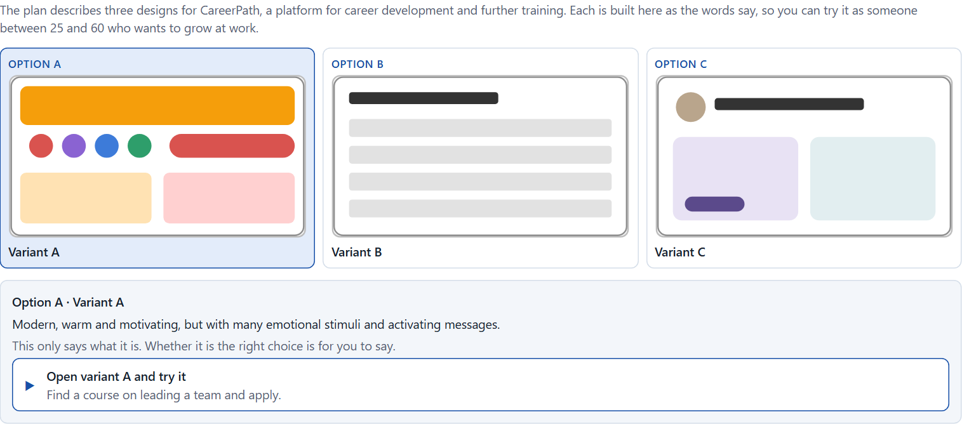
Block 1.2 · Rate emotional UX under conflicting goals: CareerPath
Level 1 · Knowledge · about 8 min
CareerPath is a platform for career development and further training. Three designs for its interface are described in words: A) modern, warm and motivating, but with many emotional stimuli and activating messages; B) factual, clear and trustworthy, but not very inspiring or connecting; C) high quality and personal in feel, but in some situations a little unclear in its interaction feedback. The conditions: the target group is working people between 25 and 60, the company wants to look professional and approachable, the budget for a deep revision is limited, there are no user tests yet, the release is in 9 weeks, and the department demands seriousness while marketing demands stronger activation. Decide anyway, and say what you assume.
Screenshot of the Neuro-UX Lab (aion-ux-lab.vercel.app), own work; AI-assisted, labelled on the image; the example company is fictional.
Draws on: A2 · Usable is not enough · A4 · Activation, overload and manipulation · A5 · Trust and perceived competence, and weighing a measure.
AION UX Developer · Day 7 · Training slides
6
Notes:
Block 1.2 · Rate emotional UX under conflicting goals: CareerPath · about 8 min. Draws on: A2 · Usable is not enough · A4 · Activation, overload and manipulation · A5 · Trust and perceived competence, and weighing a measure.

Slide 7
Block 1.2 · What you work on
Rate each variant on trust, motivation, safety, clarity and experience quality
1
Decide which variant is the most viable under the given conditions
2
Name the conflicts of goals between emotionalisation and professional credibility
3
Which risks remain despite your decision?
4
Formulate a recommendation to the project management
5
AION UX Developer · Day 7 · Training slides
7
Notes:
Block 1.2 · Rate emotional UX under conflicting goals: CareerPath · about 8 min. Draws on: A2 · Usable is not enough · A4 · Activation, overload and manipulation · A5 · Trust and perceived competence, and weighing a measure.

Slide 8
Coaching · UE4
Transition: Level 1 to Level 2
From functional usability to emotionally responsible experience design
From describing an effect to a decision you answer for.
AION UX Developer · Day 7 · Training slides
8
Notes:
UE4 · Coaching: transition from Level 1 to Level 2. Trainer-led: a short talk on the coaching focus, then the reflection questions in pairs.

Slide 9
Coaching · questions we talk through
Why is emotional attachment not an extra but a central effect factor of digital products?
How do I deal with conflicts between seriousness, brand impact and activation?
1
5
How do I tell whether an interface builds trust or creates distance?
How do I argue towards stakeholders who see emotional UX as “soft” or not measurable?
2
6
When does emotionalisation support use, and when does it undermine credibility?
Which decisions are operational, which strategic for loyalty, acceptance and user experience?
3
7
What role do language, feedback, visual mood and interaction logic play for the quality of the experience?
4
AION UX Developer · Day 7 · Training slides
9
Notes:
UE4 · Coaching: transition from Level 1 to Level 2. Trainer-led: a short talk on the coaching focus, then the reflection questions in pairs.

Slide 10
Coaching · reflect in pairs
1
2
3
Where do digital offers lose emotional effect although they are functionally correct?
Which kind of feedback strengthens trust especially strongly?
When does a lack of emotional quality become a competitive disadvantage?
AION UX Developer · Day 7 · Training slides
10
Notes:
UE4 · Coaching: transition from Level 1 to Level 2. Trainer-led: a short talk on the coaching focus, then the reflection questions in pairs.

Slide 11
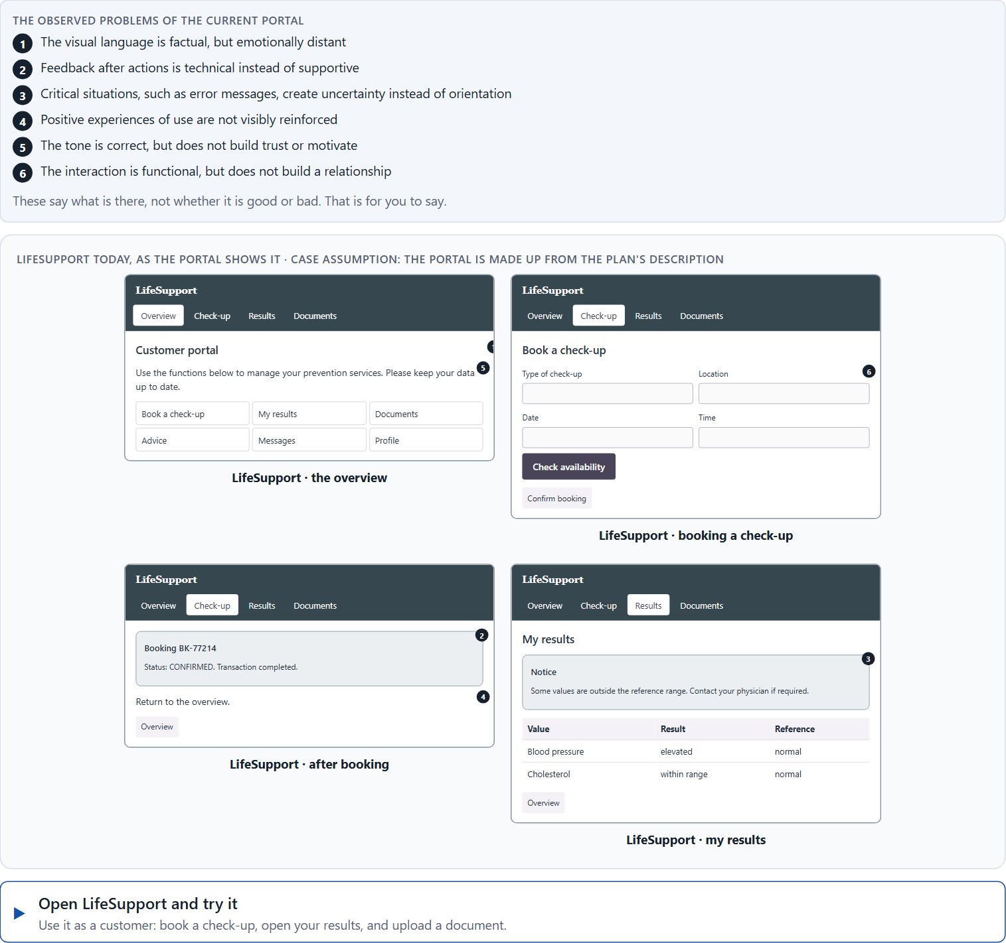
Block 2.1 · Case study: realigning the service portal LifeSupport
Level 2 · Case study · UE5–6 · about 15 min
A provider of health prevention runs LifeSupport, a digital portal for advice, appointment booking and document management. Technically the system does its job, but users perceive it as “impersonal”, “exhausting” and “not very supportive”. Use stays below expectations although the range of functions is large. The observed problems: the visual language is factual but emotionally distant, feedback after actions is technical instead of supportive, critical situations such as error messages create uncertainty instead of orientation, positive experiences are not visibly reinforced, the tone is correct but does not build trust or motivate, and the interaction is functional but does not build a relationship. The conditions: a budget of €145,000, 12 weeks for the implementation, no complete relaunch, the brand should stay serious but become emotionally more approachable, user data is only partly available, and the department and marketing set different priorities. You work through six steps.
Screenshot of the Neuro-UX Lab (aion-ux-lab.vercel.app), own work; AI-assisted, labelled on the image; the example company is fictional.
Draws on: A1 · Emotions steer behaviour · A2 · Usable is not enough · A3 · Where feelings come from · A4 · Activation, overload and manipulation · A5 · Trust and perceived competence, and weighing a measure.
AION UX Developer · Day 7 · Training slides
11
Notes:
Block 2.1 · Case study: realigning the service portal LifeSupport · about 15 min. Draws on: A1 · Emotions steer behaviour · A2 · Usable is not enough · A3 · Where feelings come from · A4 · Activation, overload and manipulation · A5 · Trust and perceived competence, and weighing a measure.

Slide 12
Block 2.1 · What you work on
Analyse the central emotional deficits of the portal
1
Assign the problems to the categories trust, emotional safety, motivation, reducing frustration and experience quality
2
Develop 4 prioritised measures for improvement
3
Justify your selection using effect on users, feasibility, risk and time pressure
4
Make a prioritisation decision for the first 12 weeks
5
Formulate a recommendation to the division management
6
AION UX Developer · Day 7 · Training slides
12
Notes:
Block 2.1 · Case study: realigning the service portal LifeSupport · about 15 min. Draws on: A1 · Emotions steer behaviour · A2 · Usable is not enough · A3 · Where feelings come from · A4 · Activation, overload and manipulation · A5 · Trust and perceived competence, and weighing a measure.

Slide 13
Feedback round · how each group presents
Each group presents its prioritised measures in 5 minutes
1
The reasoning runs along effect, feasibility, risk and responsibility
2
Each group names one measure that was deliberately postponed
3
AION UX Developer · Day 7 · Training slides
13
Notes:
UE7 · Feedback round with a management perspective. Groups present their reasoning, not only their result.

Slide 14
Feedback round · questions to answer
Which measure strengthens emotional safety fastest?
Which risks arise when an emotional approach does not fit the situation of use?
1
4
Which measure is strategically most important for attachment and trust?
Which decision can be answered for despite an incomplete data situation?
2
5
Where was the emotional appeal credible, and where was the design only superficial?
3
AION UX Developer · Day 7 · Training slides
14
Notes:
UE7 · Feedback round with a management perspective. Groups present their reasoning, not only their result.

Slide 15
Level 3 input and discussion
INPUT LEVEL 3
DISCUSSION
At senior level emotional UX becomes a leadership task when it influences loyalty, acceptance and how the product is perceived
Good decisions balance seriousness, closeness, motivation and credibility
Being able to answer for a decision shows in not leaving the emotional effect to chance but to clear principles and priorities
When does a lack of emotional quality become a strategic risk for the brand and for use?
AION UX Developer · Day 7 · Training slides
15
Notes:
UE7 · Feedback round with a management perspective. Groups present their reasoning, not only their result.

Slide 16
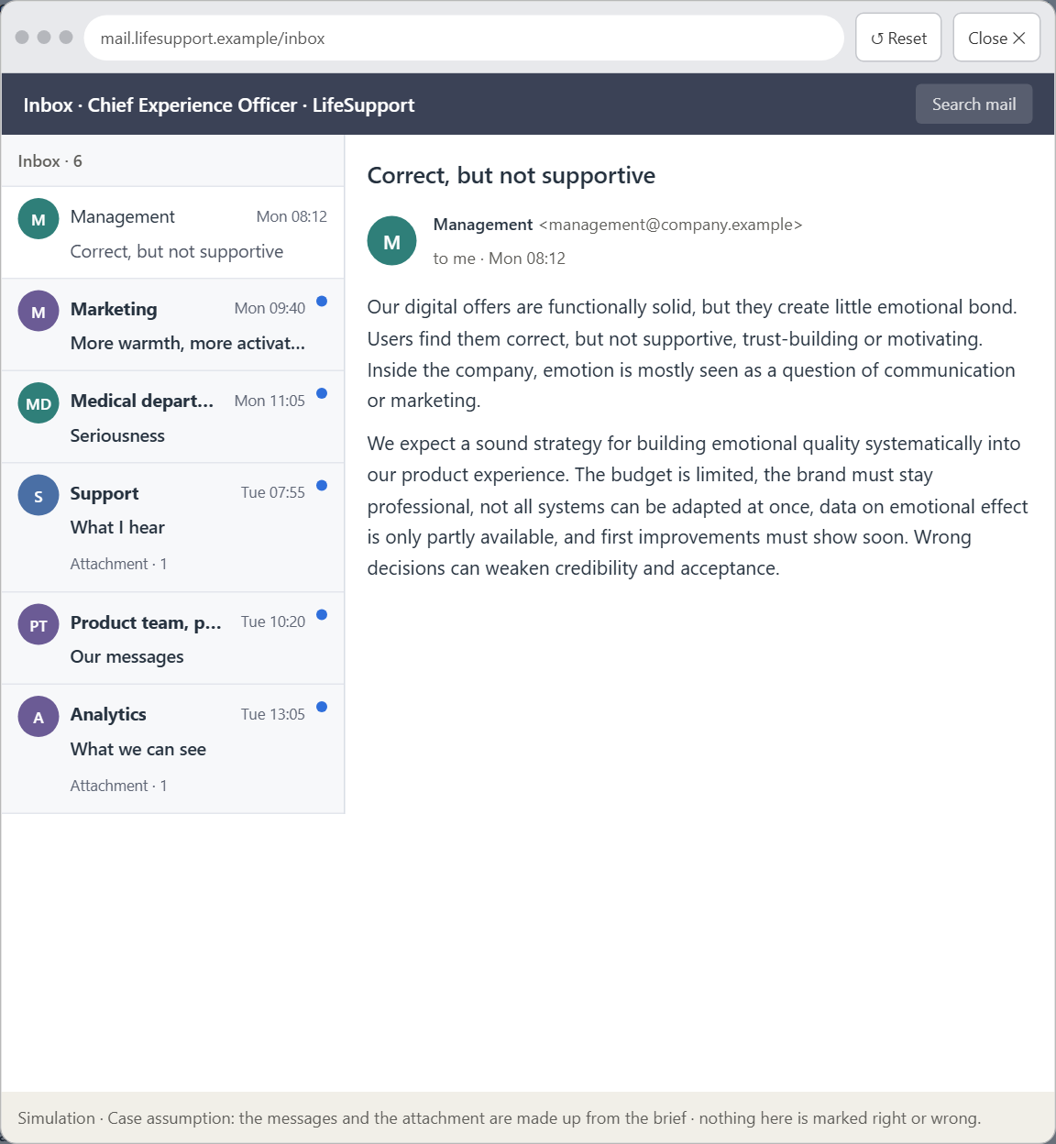
Block 3.1 · An emotionally effective UX strategy for a digital service
Level 3 · Transfer project · UE8–10 · about 20 min
You take the perspective of the Chief Experience Officer of the health-prevention provider that runs LifeSupport. The company has a website, a customer portal and an app. Its digital offers are functionally solid but create little emotional bond: users find them correct, but not supportive, trust-building or motivating. Inside the company, emotion is mostly seen as a question of communication or marketing, not as part of the UX architecture. The management expects a sound strategy for building emotional quality systematically into the digital product experience. You are not to polish single screens but to develop a sound decision architecture for emotional bonding, trust design and experience quality.
Screenshot of the Neuro-UX Lab (aion-ux-lab.vercel.app), own work; AI-assisted, labelled on the image; the example company is fictional.
Draws on: B1 · Emotional UX as part of the UX architecture, not a campaign · B2 · Seriousness against closeness · B3 · Who owns emotional UX, and deciding with little data on feelings.
AION UX Developer · Day 7 · Training slides
16
Notes:
Block 3.1 · An emotionally effective UX strategy for a digital service · about 20 min. Draws on: B1 · Emotional UX as part of the UX architecture, not a campaign · B2 · Seriousness against closeness · B3 · Who owns emotional UX, and deciding with little data on feelings.

Slide 17
Block 3.1 · What you work on
1
A guiding vision for emotional UX: which emotional effect and which experience quality should users experience systematically?
2
Three strategic guiding decisions on trust, emotional safety, motivation and supportive interaction
3
A prioritised architecture of measures: which touchpoints, interactions or communication patterns are improved first, and why?
4
A risk analysis: which wrong assumptions about emotional effect, credibility and user behaviour would be especially critical?
5
A governance model: who is responsible for the emotional UX principles, and how are conflicts between brand, expertise and user effect decided?
6
A decision under uncertainty: make at least one prioritised decision despite patchy data and justify it responsibly
7
A management statement: a recommendation to the management with a clear priority and a strategic reason
AION UX Developer · Day 7 · Training slides
17
Notes:
Block 3.1 · An emotionally effective UX strategy for a digital service · about 20 min. Draws on: B1 · Emotional UX as part of the UX architecture, not a campaign · B2 · Seriousness against closeness · B3 · Who owns emotional UX, and deciding with little data on feelings.

Slide 18
Reflect before you leave
1
2
3
Which decision did you make today, and what did you give up to make it?
Which assumption would you check first with real users, and how?
What will you do differently in your next project because of today?
Use two minutes alone, then one minute with your neighbour.
AION UX Developer · Day 7 · Training slides
18

Slide 19
About these slides, sources and AI use
AI
AI-assisted content
Where to find more
AI-assisted content: these slides were drafted with an AI language model (Claude, Anthropic) from the course's own Neuro-UX Lab and were read, corrected and approved by Muhammad Muchson, who is responsible for their accuracy.
Pictures are screenshots of the course's own Neuro-UX Lab. Each one carries an AI label on the image and a source line under it.
Companies and people in the examples are fictional. Numbers inside an example are labelled Case assumption and are not data.
The coaching and feedback questions are the course plan's own, translated into English.
Neuro-UX Lab for this day: https://aion-ux-lab.vercel.app/day/7/
Handouts: the Materi and Task Word documents of the day.
Version 1.0, 29.10.2026. Reviewer and approver: Muhammad Muchson.
AION UX Developer · Day 7 · Training slides
19

