Slide 1
Voice interfaces, neuro-design and testing AI interfaces
AION UX DEVELOPER · DAY 11
11
Training slides: tasks, coaching, case study and feedback
Contains AI-assisted content
Module 5 (day 2 of 2)
Trainer: Muhammad Muchson · Case: CityHelp Voice

Slide 2
The day at a glance (1)
UE | Min | What | What happens
1 | 45 | Knowledge transfer · Level 1 | The trainer presents the cards of Materi A (A1, A2, A3, A4, A5, about 60 min of cards) in the Neuro-UX Lab; participants follow in the handout.
2 | 45 | Level 1 · Task 1 | Individual work on Block 1.1 (Core, about 10 min): the first product of the day is read and its effect described. Pairs then compare their results and the trainer collects open questions.
3 | 45 | Level 1 · Task 2 | Three options are rated on the same criteria and one is chosen under the stated conditions: Block 1.2 (Core, about 8 min).
4 | 45 | Coaching · transition from Level 1 to Level 2 | Trainer-led. A short talk on the day's coaching focus, then the reflection questions in pairs. The bridge: from describing an effect to a decision you answer for. There is no worksheet block in this unit.
5–6 | 90 | Level 2 · Case study CityHelp Voice (2 UE) incl. model solution | UE5: the trainer presents the case; participants work on Block 2.1 (Core, about 15 min). UE6: groups compare their results and defend them; the trainer closes with the model solution.
7 | 45 | Level 2 + 3 · Feedback round with a management perspective | Groups present their reasoning, not only their result. The trainer asks the day's Level 3 input questions and leads the discussion.
One UE is 45 minutes; breaks are not shown.
AION UX Developer · Day 11 · Training slides
2
Notes:
One UE (teaching unit) is counted as 45 minutes; breaks are not shown.

Slide 3
The day at a glance (2)
UE | Min | What | What happens
8 | 45 | Level 3 · Transfer project, Chief Experience Officer (3 UE: UE8–10) | The trainer presents Materi B (B1, B2, B3; use the "In plain words" and "How to decide" boxes, the rest is handout) and sets the role and the situation.
9 | 45 | Level 3 · Transfer project | Individual work or in pairs on Block 3.1 (Core, about 20 min): the strategy memo.
10 | 45 | Level 3 · Transfer project | Participants present their decision and what they give up, including the one decision made under uncertainty; the trainer debriefs with the model solution.
One UE is 45 minutes; breaks are not shown.
AION UX Developer · Day 11 · Training slides
3
Notes:
One UE (teaching unit) is counted as 45 minutes; breaks are not shown.

Slide 4
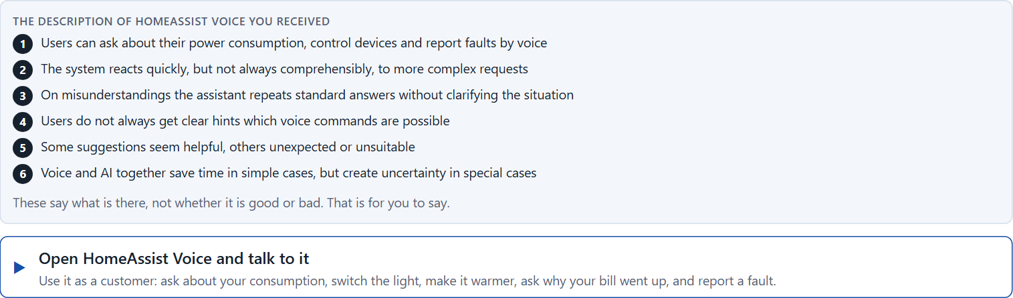
Block 1.1 · Analyse voice and AI interaction from the user's side: HomeAssist Voice
Level 1 · Knowledge · about 10 min
You receive the description of a fictional digital assistant, HomeAssist Voice, for energy management, device control and service requests. Open it and talk to it as a customer: ask about your consumption, switch a device, ask something complicated, and report a fault. You need no prior knowledge: notice when it helps you, when you do not know what to say, and what happens when it misunderstands. The aim is to judge voice and AI interaction from the user's side, apart from what the technology can do.
Screenshot of the Neuro-UX Lab (aion-ux-lab.vercel.app), own work; AI-assisted, labelled on the image; the example company is fictional.
Draws on: A1 · Screen, chat or voice · A2 · A good voice dialogue · A3 · Neuro-design.
AION UX Developer · Day 11 · Training slides
4
Notes:
Block 1.1 · Analyse voice and AI interaction from the user's side: HomeAssist Voice · about 10 min. Draws on: A1 · Screen, chat or voice · A2 · A good voice dialogue · A3 · Neuro-design.

Slide 5
Block 1.1 · What you work on
Describe spontaneously which chances and risks this interface brings from the user's point of view
1
Name at least 5 places where comprehensibility, trust or control are strengthened or weakened
2
Assign the observations to the categories comprehensibility, error robustness, user control, predictability, relief and trust
3
Write an effect statement for three points: “For users this could mean that …”
4
Prioritise the two biggest weaknesses of the system with regard to intelligent interaction
5
AION UX Developer · Day 11 · Training slides
5
Notes:
Block 1.1 · Analyse voice and AI interaction from the user's side: HomeAssist Voice · about 10 min. Draws on: A1 · Screen, chat or voice · A2 · A good voice dialogue · A3 · Neuro-design.

Slide 6
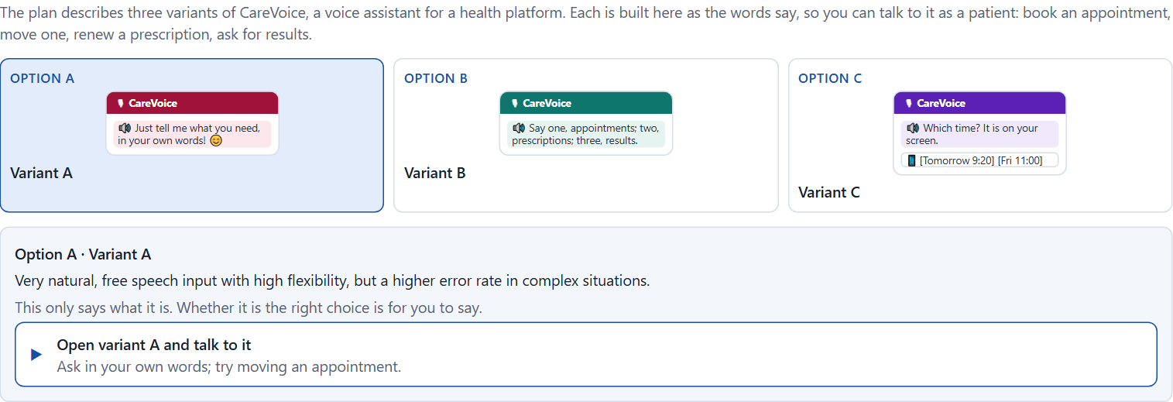
Block 1.2 · Rate voice and AI interactions under conflicting goals: CareVoice
Level 1 · Knowledge · about 8 min
CareVoice is a voice assistant for a platform in the health field. Three variants are described in words: A) very natural, free speech input with high flexibility, but a higher error rate in complex situations; B) clearly guided voice dialogues with a limited set of commands, but high comprehensibility and robustness; C) a combination of voice control, visual support and AI help, but a higher implementation effort. The conditions: the target group covers different ages and levels of experience, the company wants to look innovative and reliable at the same time, the budget for technical development is limited, the release is in 12 weeks, user tests exist only in first approaches, and data protection, trust and avoiding errors are critical. Decide anyway, and say what you assume.
Screenshot of the Neuro-UX Lab (aion-ux-lab.vercel.app), own work; AI-assisted, labelled on the image; the example company is fictional.
Draws on: A1 · Screen, chat or voice · A2 · A good voice dialogue · A4 · Prototyping and testing an AI interface · A5 · Where voice belongs, and weighing a measure.
AION UX Developer · Day 11 · Training slides
6
Notes:
Block 1.2 · Rate voice and AI interactions under conflicting goals: CareVoice · about 8 min. Draws on: A1 · Screen, chat or voice · A2 · A good voice dialogue · A4 · Prototyping and testing an AI interface · A5 · Where voice belongs, and weighing a measure.

Slide 7
Block 1.2 · What you work on
Rate each variant on comprehensibility, user control, error robustness, comfort, trust and scalability
1
Decide which variant is the most viable under the given conditions
2
Name the conflicts of goals between naturalness, precision and feasibility
3
Which risks remain despite your decision?
4
Formulate a recommendation to the project management
5
AION UX Developer · Day 11 · Training slides
7
Notes:
Block 1.2 · Rate voice and AI interactions under conflicting goals: CareVoice · about 8 min. Draws on: A1 · Screen, chat or voice · A2 · A good voice dialogue · A4 · Prototyping and testing an AI interface · A5 · Where voice belongs, and weighing a measure.

Slide 8
Coaching · UE4
Transition: Level 1 to Level 2
From voice that impresses to voice that reliably supports
From describing an effect to a decision you answer for.
AION UX Developer · Day 11 · Training slides
8
Notes:
UE4 · Coaching: transition from Level 1 to Level 2. Trainer-led: a short talk on the coaching focus, then the reflection questions in pairs.

Slide 9
Coaching · questions we talk through
When is voice the better channel than a screen, and when is it not?
How do I weigh naturalness against precision and feasibility?
1
5
What makes a voice dialogue predictable: clear expectations, feedback, error handling, repeatability?
Which tests belong to which prototype: functional, interaction or test prototype?
2
6
How do I tell whether an intelligent interface lowers or raises the cognitive load?
Which decisions are operational, which strategic?
3
7
How do I argue towards stakeholders who want the most natural conversation possible?
4
AION UX Developer · Day 11 · Training slides
9
Notes:
UE4 · Coaching: transition from Level 1 to Level 2. Trainer-led: a short talk on the coaching focus, then the reflection questions in pairs.

Slide 10
Coaching · reflect in pairs
1
2
3
Where does a voice assistant create invisible options and false expectations?
Which error handling keeps trust even when the assistant has not understood?
When does voice become a risk for sensitive requests?
AION UX Developer · Day 11 · Training slides
10
Notes:
UE4 · Coaching: transition from Level 1 to Level 2. Trainer-led: a short talk on the coaching focus, then the reflection questions in pairs.

Slide 11
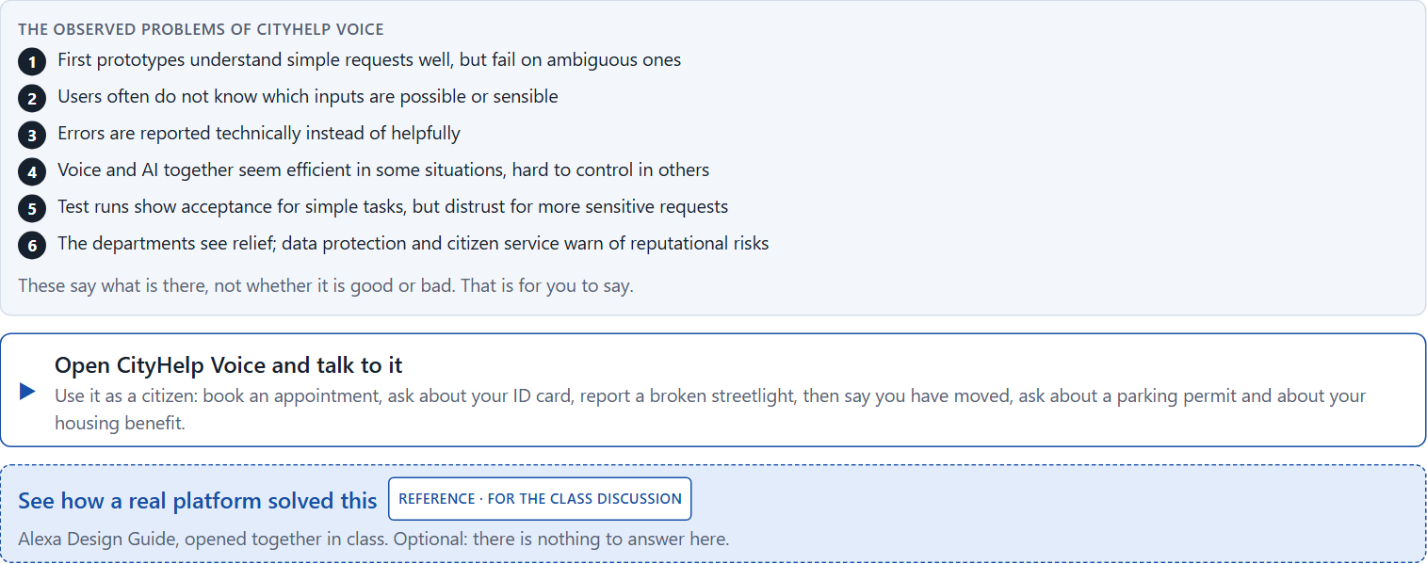
Block 2.1 · Case study: developing the voice service assistant CityHelp Voice
Level 2 · Case study · UE5–6 · about 15 min
A municipal service platform wants to introduce a voice assistant, CityHelp Voice, for appointments, status queries and simple citizen requests. The aim is to lower barriers to use, improve reachability and relieve service processes. At the same time there is uncertainty about comprehensibility, error-proneness, acceptance and the quality of AI-supported answers. The observed problems: first prototypes understand simple requests well but fail on ambiguous ones; users often do not know which inputs are possible or sensible; errors are reported technically instead of helpfully; the combination of voice and AI seems efficient in some situations and hard to control in others; test runs show acceptance for simple tasks but distrust for more sensitive requests; and the departments see relief, while data protection and citizen service warn of reputational risks. The conditions: a budget of €190,000, 14 weeks for the implementation, no full multichannel solution at once, a system that people who are not at home with technology can follow, limited data from earlier tests, and first results that must show soon. You work through six steps.
Screenshot of the Neuro-UX Lab (aion-ux-lab.vercel.app), own work; AI-assisted, labelled on the image; the example company is fictional.
Draws on: A1 · Screen, chat or voice · A2 · A good voice dialogue · A3 · Neuro-design · A4 · Prototyping and testing an AI interface · A5 · Where voice belongs, and weighing a measure.
AION UX Developer · Day 11 · Training slides
11
Notes:
Block 2.1 · Case study: developing the voice service assistant CityHelp Voice · about 15 min. Draws on: A1 · Screen, chat or voice · A2 · A good voice dialogue · A3 · Neuro-design · A4 · Prototyping and testing an AI interface · A5 · Where voice belongs, and weighing a measure.

Slide 12
Block 2.1 · What you work on
Analyse the central chances and risks of the voice assistant
1
Assign the observations to the categories comprehensibility, error robustness, control, trust, relief and acceptance
2
Develop 4 prioritised measures for improvement
3
Justify your selection using effect on users, feasibility, risk and time pressure
4
Make a prioritisation decision for the first 14 weeks
5
Formulate a recommendation to the division management
6
AION UX Developer · Day 11 · Training slides
12
Notes:
Block 2.1 · Case study: developing the voice service assistant CityHelp Voice · about 15 min. Draws on: A1 · Screen, chat or voice · A2 · A good voice dialogue · A3 · Neuro-design · A4 · Prototyping and testing an AI interface · A5 · Where voice belongs, and weighing a measure.

Slide 13
Feedback round · how each group presents
Each group presents its prioritised measures in 5 minutes
1
The reasoning runs along effect, feasibility, risk and responsibility
2
Each group names one measure it deliberately postponed
3
AION UX Developer · Day 11 · Training slides
13
Notes:
UE7 · Feedback round with a management perspective. Groups present their reasoning, not only their result.

Slide 14
Feedback round · questions to answer
Which measure makes the service understandable fastest?
Which risks remain for sensitive requests?
1
4
Which measure is the most important strategically for a reliable voice service?
Which decision can be answered for despite limited test data?
2
5
Where does the voice interface support, and where does it only impress?
3
AION UX Developer · Day 11 · Training slides
14
Notes:
UE7 · Feedback round with a management perspective. Groups present their reasoning, not only their result.

Slide 15
Level 3 input and discussion
INPUT LEVEL 3
DISCUSSION
Technology that reliably supports is worth more than technology that impresses
Good decisions balance innovation, reliability, data protection, trust and economics
Responsibility shows in limiting voice to the uses where it works
When does an intelligent interface become a service advantage, and when a trust problem?
AION UX Developer · Day 11 · Training slides
15
Notes:
UE7 · Feedback round with a management perspective. Groups present their reasoning, not only their result.

Slide 16
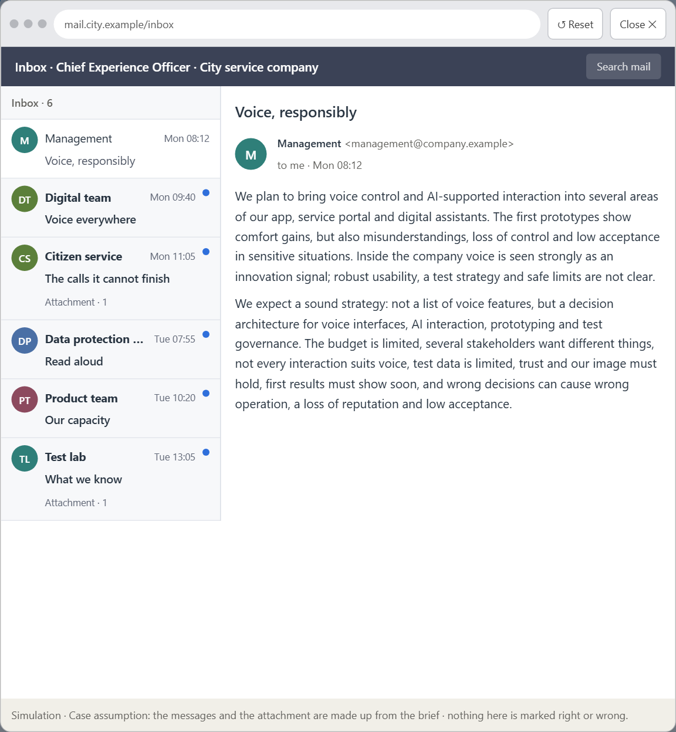
Block 3.1 · A strategic UX architecture for voice, AI interaction and intelligent testing
Level 3 · Transfer project · UE8–10 · about 20 min
You take the perspective of the Chief Experience Officer of the company that runs the city's digital services: an app, a service portal and digital assistants. It plans to bring voice control and AI-supported interaction into several areas. First prototypes show comfort gains, but also problems with misunderstandings, loss of control and acceptance in sensitive situations. Inside the company the technology is seen strongly as an innovation signal, while robust usability, a test strategy and safe limits are not yet clear. The management expects a sound strategy for using intelligent interfaces responsibly. You are not to choose single voice features, but to develop a sound decision architecture for voice interfaces, AI interaction, prototyping and test governance.
Screenshot of the Neuro-UX Lab (aion-ux-lab.vercel.app), own work; AI-assisted, labelled on the image; the example company is fictional.
Draws on: B1 · Voice and AI as a service architecture, not an innovation signal · B2 · Comfort, precision, trust, effort · B3 · Voice principles, test standards and deciding with little test data.
AION UX Developer · Day 11 · Training slides
16
Notes:
Block 3.1 · A strategic UX architecture for voice, AI interaction and intelligent testing · about 20 min. Draws on: B1 · Voice and AI as a service architecture, not an innovation signal · B2 · Comfort, precision, trust, effort · B3 · Voice principles, test standards and deciding with little test data.

Slide 17
Block 3.1 · What you work on
1
A guiding vision for intelligent voice and AI interaction: which form of relief, steerability and service experience should be created systematically?
2
Three strategic guiding decisions on fields of use for voice, neuro-design principles, error robustness, prototyping and testing
3
A prioritised architecture of measures: which journeys, functions or touchpoints are supported with voice and AI first, and why?
4
A risk analysis: which wrong assumptions about naturalness, user behaviour, acceptance and scalability would be especially critical?
5
A governance model: who is responsible for voice principles, test standards and decisions on conflicts between innovation, trust and effort?
6
A decision under uncertainty: make at least one prioritised decision despite patchy data and justify it responsibly
7
A management statement: a recommendation to the management with a clear priority and a strategic reason
AION UX Developer · Day 11 · Training slides
17
Notes:
Block 3.1 · A strategic UX architecture for voice, AI interaction and intelligent testing · about 20 min. Draws on: B1 · Voice and AI as a service architecture, not an innovation signal · B2 · Comfort, precision, trust, effort · B3 · Voice principles, test standards and deciding with little test data.

Slide 18
Reflect before you leave
1
2
3
Which decision did you make today, and what did you give up to make it?
Which assumption would you check first with real users, and how?
What will you do differently in your next project because of today?
Use two minutes alone, then one minute with your neighbour.
AION UX Developer · Day 11 · Training slides
18

Slide 19
About these slides, sources and AI use
AI
AI-assisted content
Where to find more
AI-assisted content: these slides were drafted with an AI language model (Claude, Anthropic) from the course's own Neuro-UX Lab and were read, corrected and approved by Muhammad Muchson, who is responsible for their accuracy.
Pictures are screenshots of the course's own Neuro-UX Lab. Each one carries an AI label on the image and a source line under it.
Companies and people in the examples are fictional. Numbers inside an example are labelled Case assumption and are not data.
The coaching and feedback questions are the course plan's own, translated into English.
Neuro-UX Lab for this day: https://aion-ux-lab.vercel.app/day/11/
Handouts: the Materi and Task Word documents of the day.
Version 1.0, 29.10.2026. Reviewer and approver: Muhammad Muchson.
AION UX Developer · Day 11 · Training slides
19

