Slide 1
Neurodiversity, inclusive patterns and assistive technologies
AION UX DEVELOPER · DAY 13
13
Training slides: tasks, coaching, case study and feedback
Contains AI-assisted content
Module 6 (day 2 of 2)
Trainer: Muhammad Muchson · Case: LifeGuide

Slide 2
The day at a glance (1)
UE | Min | What | What happens
1 | 45 | Knowledge transfer · Level 1 | The trainer presents the cards of Materi A (A1, A2, A3, A4, A5, about 60 min of cards) in the Neuro-UX Lab; participants follow in the handout.
2 | 45 | Level 1 · Task 1 | Individual work on Block 1.1 (Core, about 10 min): the first product of the day is read and its effect described. Pairs then compare their results and the trainer collects open questions.
3 | 45 | Level 1 · Task 2 | Three options are rated on the same criteria and one is chosen under the stated conditions: Block 1.2 (Core, about 8 min).
4 | 45 | Coaching · transition from Level 1 to Level 2 | Trainer-led. A short talk on the day's coaching focus, then the reflection questions in pairs. The bridge: from describing an effect to a decision you answer for. There is no worksheet block in this unit.
5–6 | 90 | Level 2 · Case study LifeGuide (2 UE) incl. model solution | UE5: the trainer presents the case; participants work on Block 2.1 (Core, about 15 min). UE6: groups compare their results and defend them; the trainer closes with the model solution.
7 | 45 | Level 2 + 3 · Feedback round with a management perspective | Groups present their reasoning, not only their result. The trainer asks the day's Level 3 input questions and leads the discussion.
One UE is 45 minutes; breaks are not shown.
AION UX Developer · Day 13 · Training slides
2
Notes:
One UE (teaching unit) is counted as 45 minutes; breaks are not shown.

Slide 3
The day at a glance (2)
UE | Min | What | What happens
8 | 45 | Level 3 · Transfer project, Chief Experience Officer (3 UE: UE8–10) | The trainer presents Materi B (B1, B2, B3; use the "In plain words" and "How to decide" boxes, the rest is handout) and sets the role and the situation.
9 | 45 | Level 3 · Transfer project | Individual work or in pairs on Block 3.1 (Core, about 20 min): the strategy memo.
10 | 45 | Level 3 · Transfer project | Participants present their decision and what they give up, including the one decision made under uncertainty; the trainer debriefs with the model solution.
One UE is 45 minutes; breaks are not shown.
AION UX Developer · Day 13 · Training slides
3
Notes:
One UE (teaching unit) is counted as 45 minutes; breaks are not shown.

Slide 4
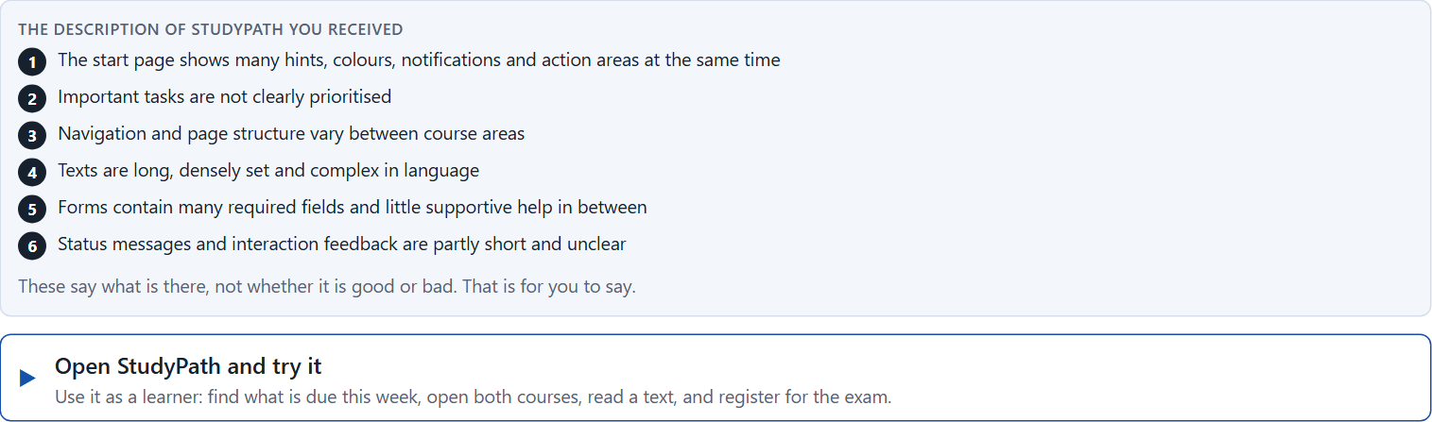
Block 1.1 · Recognise neurodiverse hurdles in an interface: StudyPath
Level 1 · Knowledge · about 10 min
You receive the description of a fictional learning platform, StudyPath, for digital further training and exam organisation. Open it and use it as a learner: find what you have to do this week, move between two course areas, read a course text, and register for an exam. You need no prior knowledge: notice what pulls your attention, where you lose your way, and what tires you. Then ask how it would feel for someone with ADHD, an autistic person, or someone with dyslexia. The aim is to recognise neurodiverse requirements systematically and to tell them apart from general usability.
Screenshot of the Neuro-UX Lab (aion-ux-lab.vercel.app), own work; AI-assisted, labelled on the image; the example company is fictional.
Draws on: A1 · Neurodiversity · A2 · Stimuli and focus · A3 · Predictability · A4 · Readability.
AION UX Developer · Day 13 · Training slides
4
Notes:
Block 1.1 · Recognise neurodiverse hurdles in an interface: StudyPath · about 10 min. Draws on: A1 · Neurodiversity · A2 · Stimuli and focus · A3 · Predictability · A4 · Readability.

Slide 5
Block 1.1 · What you work on
Describe which hurdles the offer could have for people with different ways of perceiving and processing
1
Name at least 5 barriers with a view to ADHD, autism or dyslexia
2
Assign the observations to the categories stimulus load, orientation, readability, predictability, clarity of the task and comprehensibility
3
Write an effect statement for three points: “For users this could mean that …”
4
Prioritise the two most serious hurdles with regard to inclusive usability
5
AION UX Developer · Day 13 · Training slides
5
Notes:
Block 1.1 · Recognise neurodiverse hurdles in an interface: StudyPath · about 10 min. Draws on: A1 · Neurodiversity · A2 · Stimuli and focus · A3 · Predictability · A4 · Readability.

Slide 6
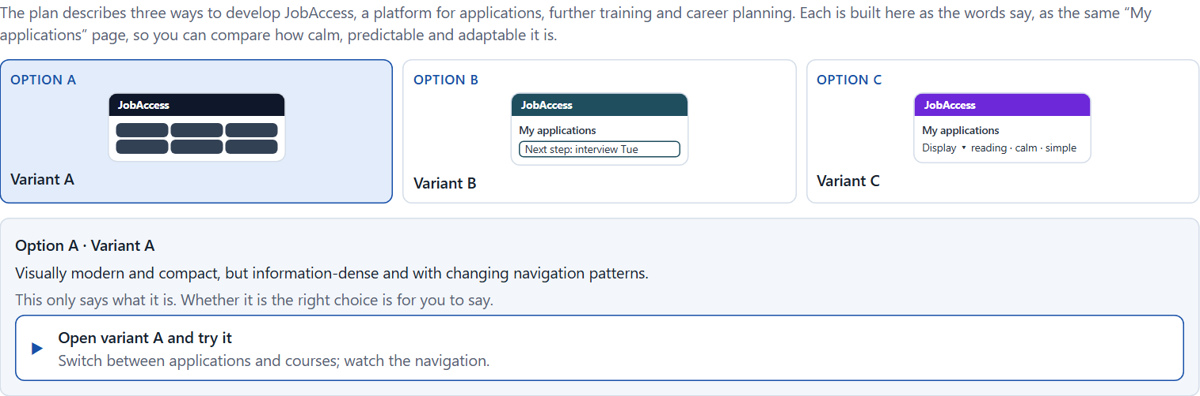
Block 1.2 · Rate inclusive design approaches under conflicting goals: JobAccess
Level 1 · Knowledge · about 8 min
JobAccess is a platform for applications, further training and career planning. Three variants for its development are described in words: A) visually modern and compact, but information-dense and with changing navigation patterns; B) clearly structured, calm, readable and consistent, but less dynamic and less brand-strong; C) a good base structure with optional adaptation functions such as a reading mode, stimulus reduction and a simplified view, but a higher implementation effort. The conditions: the target group is very heterogeneous, the company wants to look modern, inclusive and professional, the budget for technical development is limited, the release is in 12 weeks, legal and reputational requirements are relevant, and data from specific neurodiverse user tests is not yet available. Decide anyway, and say what you assume.
Screenshot of the Neuro-UX Lab (aion-ux-lab.vercel.app), own work; AI-assisted, labelled on the image; the example company is fictional.
Draws on: A2 · Stimuli and focus · A3 · Predictability · A4 · Readability · A5 · Inclusive patterns, assistive technologies, and testing a prototype.
AION UX Developer · Day 13 · Training slides
6
Notes:
Block 1.2 · Rate inclusive design approaches under conflicting goals: JobAccess · about 8 min. Draws on: A2 · Stimuli and focus · A3 · Predictability · A4 · Readability · A5 · Inclusive patterns, assistive technologies, and testing a prototype.

Slide 7
Block 1.2 · What you work on
Rate each variant on inclusion, comprehensibility, predictability, adaptability, brand effect and feasibility
1
Decide which variant is the most viable under the given conditions
2
Name the conflicts of goals between standardisation, adaptability and effort
3
Which risks remain despite your decision?
4
Formulate a recommendation to the project management
5
AION UX Developer · Day 13 · Training slides
7
Notes:
Block 1.2 · Rate inclusive design approaches under conflicting goals: JobAccess · about 8 min. Draws on: A2 · Stimuli and focus · A3 · Predictability · A4 · Readability · A5 · Inclusive patterns, assistive technologies, and testing a prototype.

Slide 8
Coaching · UE4
Transition: Level 1 to Level 2
From single patterns to an inclusive prototype and test approach
From describing an effect to a decision you answer for.
AION UX Developer · Day 13 · Training slides
8
Notes:
UE4 · Coaching: transition from Level 1 to Level 2. Trainer-led: a short talk on the coaching focus, then the reflection questions in pairs.

Slide 9
Coaching · questions we talk through
Which design patterns help people with concentration difficulties, sensory sensitivity or reading hurdles?
How do I argue when only a limited number of tests is possible?
1
5
How do I reduce stimulus load without taking away function?
Which decisions are operational, which strategic?
2
6
How do I make navigation and forms predictable?
How does assistive technology change what I have to test?
3
7
How do I decide which functions or patterns an inclusive prototype tests first?
4
AION UX Developer · Day 13 · Training slides
9
Notes:
UE4 · Coaching: transition from Level 1 to Level 2. Trainer-led: a short talk on the coaching focus, then the reflection questions in pairs.

Slide 10
Coaching · reflect in pairs
1
2
3
Where do well-meant patterns still overload people?
Which option for adaptation is used most, and which is never found?
When does inclusive design become a question of the product strategy?
AION UX Developer · Day 13 · Training slides
10
Notes:
UE4 · Coaching: transition from Level 1 to Level 2. Trainer-led: a short talk on the coaching focus, then the reflection questions in pairs.

Slide 11
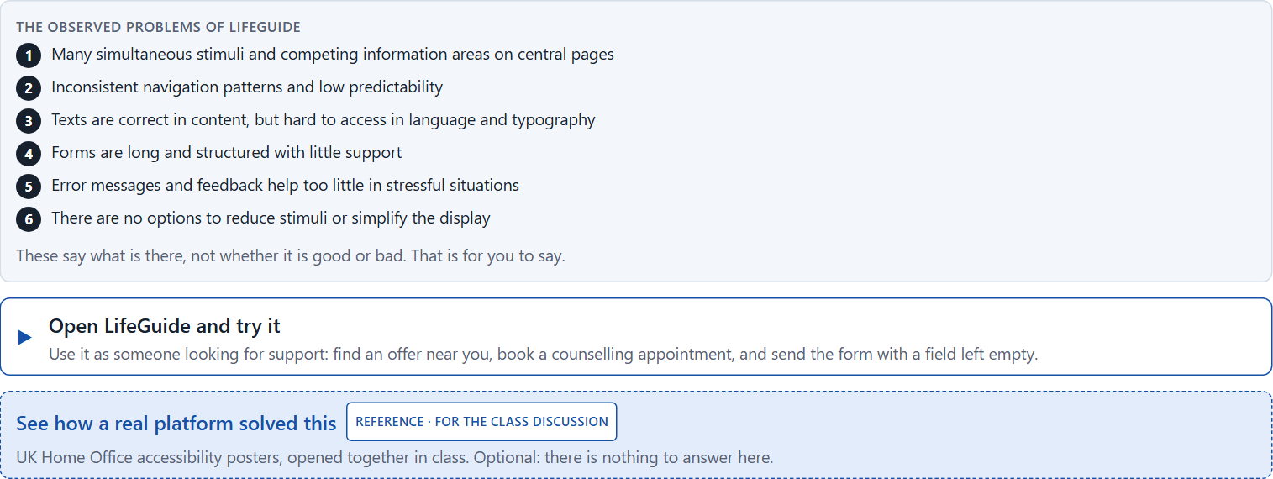
Block 2.1 · Case study: an inclusive prototype for the service portal LifeGuide
Level 2 · Case study · UE5–6 · about 15 min
A digital portal for health, counselling and support offers is to be reworked for a very diverse group of users. First feedback shows that people with concentration difficulties, sensory sensitivity and reading hurdles in particular have problems with orientation, stimulus density and comprehensibility. The organisation wants a more inclusive experience and to prepare first usability tests on the basis of a prototype. The observed problems: many simultaneous stimuli and competing information areas on central pages; inconsistent navigation patterns and low predictability; texts that are correct in content but hard to access in language and typography; long forms with little supportive structure; error messages and feedback that help too little in stressful situations; and no options to reduce stimuli or simplify the display. The conditions: a budget of €175,000, 14 weeks for the implementation, no complete relaunch, the platform must stay usable for broad groups, only limited test data from different groups exists, and first prototypes are to be tried soon. You work through six steps; step 5 is the start of the practice project.
Screenshot of the Neuro-UX Lab (aion-ux-lab.vercel.app), own work; AI-assisted, labelled on the image; the example company is fictional.
Draws on: A1 · Neurodiversity · A2 · Stimuli and focus · A3 · Predictability · A4 · Readability · A5 · Inclusive patterns, assistive technologies, and testing a prototype.
AION UX Developer · Day 13 · Training slides
11
Notes:
Block 2.1 · Case study: an inclusive prototype for the service portal LifeGuide · about 15 min. Draws on: A1 · Neurodiversity · A2 · Stimuli and focus · A3 · Predictability · A4 · Readability · A5 · Inclusive patterns, assistive technologies, and testing a prototype.

Slide 12
Block 2.1 · What you work on
Analyse the central deficits of the portal with a view to neurodiverse use
1
Assign the problems to the categories stimulus load, readability, predictability, task structure, error tolerance and adaptability
2
Develop 4 prioritised measures for improvement
3
Justify your selection using effect on users, gain for inclusion, feasibility, risk and time pressure
4
Sketch an inclusive prototype approach and name which functions or patterns should be tested first
5
Formulate a recommendation to the division management
6
AION UX Developer · Day 13 · Training slides
12
Notes:
Block 2.1 · Case study: an inclusive prototype for the service portal LifeGuide · about 15 min. Draws on: A1 · Neurodiversity · A2 · Stimuli and focus · A3 · Predictability · A4 · Readability · A5 · Inclusive patterns, assistive technologies, and testing a prototype.

Slide 13
Feedback round · how each group presents
Each group presents its prioritised measures in 5 minutes
1
The reasoning runs along effect, feasibility, risk and responsibility
2
Each group names one measure it deliberately postponed
3
AION UX Developer · Day 13 · Training slides
13
Notes:
UE7 · Feedback round with a management perspective. Groups present their reasoning, not only their result.

Slide 14
Feedback round · questions to answer
Which measure reduces the load for the most people fastest?
Which risks remain if tests are few?
1
4
Which pattern should be tested first, and why?
Which decision can be answered for despite limited test data?
2
5
Where was inclusion built in, and where only added at the end?
3
AION UX Developer · Day 13 · Training slides
14
Notes:
UE7 · Feedback round with a management perspective. Groups present their reasoning, not only their result.

Slide 15
Level 3 input and discussion
INPUT LEVEL 3
DISCUSSION
Inclusive design is a strategic architecture, not a collection of patterns
Good decisions balance inclusion gain, feasibility, risk and time pressure
Responsibility shows in testing early with the people concerned
When does an inclusive prototype become a strategic decision and not only a design exercise?
AION UX Developer · Day 13 · Training slides
15
Notes:
UE7 · Feedback round with a management perspective. Groups present their reasoning, not only their result.

Slide 16
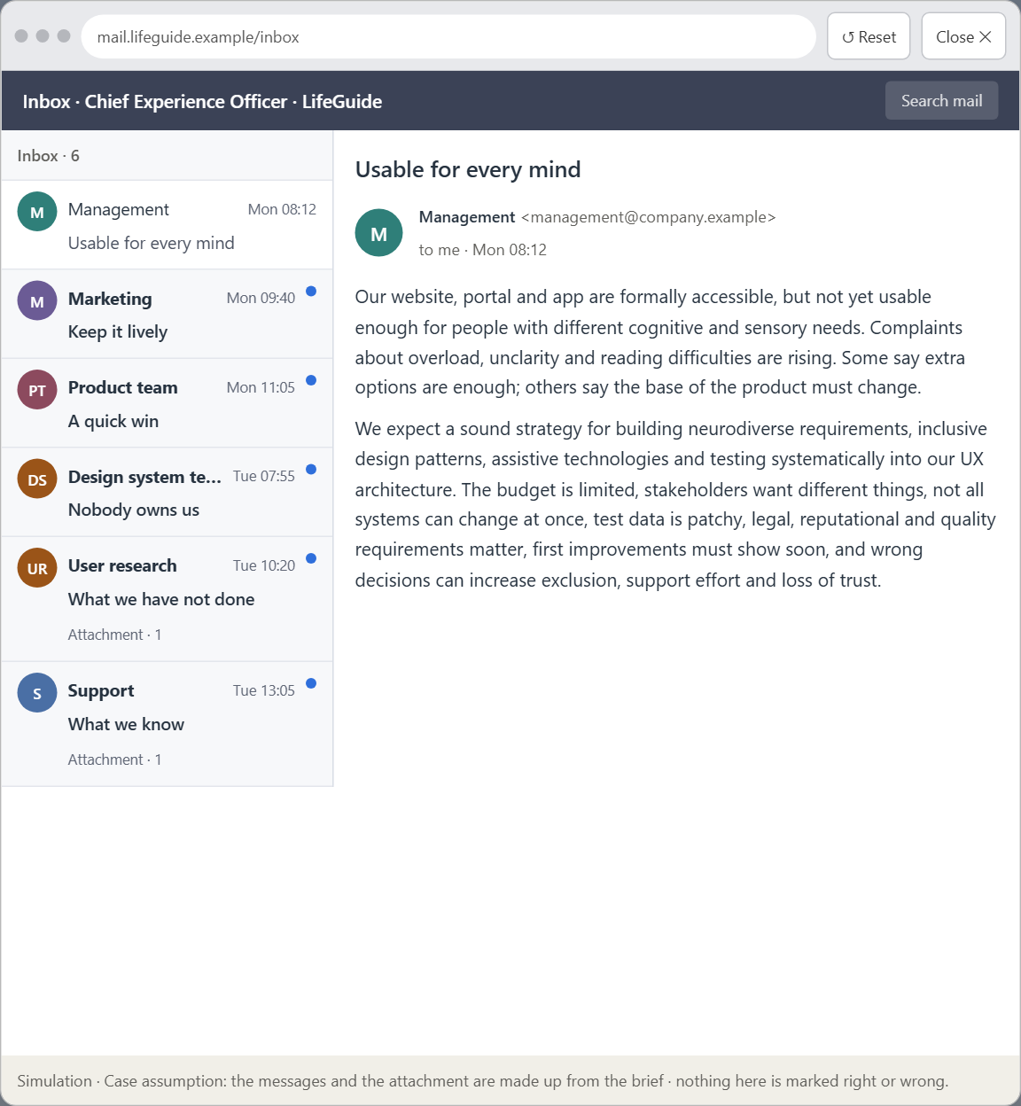
Block 3.1 · A strategic UX architecture for neurodiverse and adaptive use
Level 3 · Transfer project · UE8–10 · about 20 min
You take the perspective of the Chief Experience Officer of the organisation behind LifeGuide, which runs a website, a portal and an app. Its digital offers are formally accessible, but not yet usable enough for people with different cognitive and sensory needs. Complaints about overload, unclarity and reading difficulties are rising. Inside, people discuss whether extra options are enough or whether the base architecture of the product has to be rethought. The management expects a sound strategy for building neurodiverse requirements, inclusive design patterns, assistive technologies and testing systematically into the UX architecture. You are not to adapt single screens, but to develop a sound decision architecture for neurodiverse usability, inclusive standards, prototyping and test governance.
Screenshot of the Neuro-UX Lab (aion-ux-lab.vercel.app), own work; AI-assisted, labelled on the image; the example company is fictional.
Draws on: B1 · Neurodiverse UX as better base architecture, not a special case · B2 · One standard or many modes · B3 · Who owns it, how it is tested, and deciding with patchy data.
AION UX Developer · Day 13 · Training slides
16
Notes:
Block 3.1 · A strategic UX architecture for neurodiverse and adaptive use · about 20 min. Draws on: B1 · Neurodiverse UX as better base architecture, not a special case · B2 · One standard or many modes · B3 · Who owns it, how it is tested, and deciding with patchy data.

Slide 17
Block 3.1 · What you work on
1
A guiding vision for neurodiverse UX: which form of relief, predictability, readability and adaptability should be guaranteed systematically?
2
Three strategic guiding decisions on base architecture, inclusive design patterns, assistive technologies, adaptation modes and test strategy
3
A prioritised architecture of measures: which journeys, components or product areas are improved first, and why?
4
A risk analysis: which wrong assumptions about user diversity, standardisation and economic viability would be especially critical?
5
A governance model: who is responsible for neurodiverse UX principles, and how are conflicts between brand, technology, product logic and inclusion decided?
6
A decision under uncertainty: make at least one prioritised decision despite patchy test and usage data and justify it responsibly
7
A management statement: a recommendation to the management with a clear priority and a strategic reason
AION UX Developer · Day 13 · Training slides
17
Notes:
Block 3.1 · A strategic UX architecture for neurodiverse and adaptive use · about 20 min. Draws on: B1 · Neurodiverse UX as better base architecture, not a special case · B2 · One standard or many modes · B3 · Who owns it, how it is tested, and deciding with patchy data.

Slide 18
Reflect before you leave
1
2
3
Which decision did you make today, and what did you give up to make it?
Which assumption would you check first with real users, and how?
What will you do differently in your next project because of today?
Use two minutes alone, then one minute with your neighbour.
AION UX Developer · Day 13 · Training slides
18

Slide 19
About these slides, sources and AI use
AI
AI-assisted content
Where to find more
AI-assisted content: these slides were drafted with an AI language model (Claude, Anthropic) from the course's own Neuro-UX Lab and were read, corrected and approved by Muhammad Muchson, who is responsible for their accuracy.
Pictures are screenshots of the course's own Neuro-UX Lab. Each one carries an AI label on the image and a source line under it.
Companies and people in the examples are fictional. Numbers inside an example are labelled Case assumption and are not data.
The coaching and feedback questions are the course plan's own, translated into English.
Neuro-UX Lab for this day: https://aion-ux-lab.vercel.app/day/13/
Handouts: the Materi and Task Word documents of the day.
Version 1.0, 29.10.2026. Reviewer and approver: Muhammad Muchson.
AION UX Developer · Day 13 · Training slides
19

