Slide 1
Immersive technologies and neuroscientific UX basics
AION UX DEVELOPER · DAY 14
14
Training slides: tasks, coaching, case study and feedback
Contains AI-assisted content
Module 7 (day 1 of 3)
Trainer: Muhammad Muchson · Case: IndustryXR

Slide 2
The day at a glance (1)
UE | Min | What | What happens
1 | 45 | Knowledge transfer · Level 1 | The trainer presents the cards of Materi A (A1, A2, A3, A4, A5, about 60 min of cards) in the Neuro-UX Lab; participants follow in the handout.
2 | 45 | Level 1 · Task 1 | Individual work on Block 1.1 (Core, about 10 min): the first product of the day is read and its effect described. Pairs then compare their results and the trainer collects open questions.
3 | 45 | Level 1 · Task 2 | Three options are rated on the same criteria and one is chosen under the stated conditions: Block 1.2 (Core, about 8 min).
4 | 45 | Coaching · transition from Level 1 to Level 2 | Trainer-led. A short talk on the day's coaching focus, then the reflection questions in pairs. The bridge: from describing an effect to a decision you answer for. There is no worksheet block in this unit.
5–6 | 90 | Level 2 · Case study IndustryXR (2 UE) incl. model solution | UE5: the trainer presents the case; participants work on Block 2.1 (Core, about 15 min). UE6: groups compare their results and defend them; the trainer closes with the model solution.
7 | 45 | Level 2 + 3 · Feedback round with a management perspective | Groups present their reasoning, not only their result. The trainer asks the day's Level 3 input questions and leads the discussion.
One UE is 45 minutes; breaks are not shown.
AION UX Developer · Day 14 · Training slides
2
Notes:
One UE (teaching unit) is counted as 45 minutes; breaks are not shown.

Slide 3
The day at a glance (2)
UE | Min | What | What happens
8 | 45 | Level 3 · Transfer project, Chief Experience Officer (3 UE: UE8–10) | The trainer presents Materi B (B1, B2, B3; use the "In plain words" and "How to decide" boxes, the rest is handout) and sets the role and the situation.
9 | 45 | Level 3 · Transfer project | Individual work or in pairs on Block 3.1 (Core, about 20 min): the strategy memo.
10 | 45 | Level 3 · Transfer project | Participants present their decision and what they give up, including the one decision made under uncertainty; the trainer debriefs with the model solution.
One UE is 45 minutes; breaks are not shown.
AION UX Developer · Day 14 · Training slides
3
Notes:
One UE (teaching unit) is counted as 45 minutes; breaks are not shown.

Slide 4
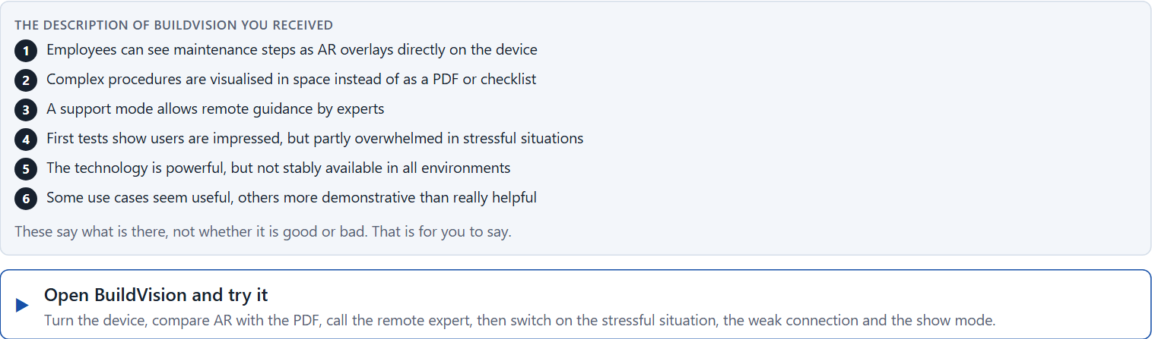
Block 1.1 · Analyse immersive potentials and risks of a future scenario: BuildVision
Level 1 · Knowledge · about 10 min
You receive the description of a fictional platform, BuildVision, for planning, training and remote support in technical service. Open it: a real 3D service device you can turn, with AR overlays of the maintenance steps. Compare the overlays with the PDF checklist, switch on the remote expert, then try it in a stressful situation and with a weak connection. You need no prior knowledge: notice what really helps you at the device and what only impresses. The aim is to analyse immersive technology not only as innovation, but as a system of effects with a logic of benefit and risk.
Screenshot of the Neuro-UX Lab (aion-ux-lab.vercel.app), own work; AI-assisted, labelled on the image; the example company is fictional.
Draws on: A1 · From screen to space · A2 · Presence, attention and load · A3 · Intensify or overwhelm · A4 · Fascination or impact.
AION UX Developer · Day 14 · Training slides
4
Notes:
Block 1.1 · Analyse immersive potentials and risks of a future scenario: BuildVision · about 10 min. Draws on: A1 · From screen to space · A2 · Presence, attention and load · A3 · Intensify or overwhelm · A4 · Fascination or impact.

Slide 5
Block 1.1 · What you work on
Describe spontaneously which chances and risks this scenario could have from the user's and the company's point of view
1
Name at least 5 places where immersive technology creates real value or potential overload
2
Assign the observations to the categories user value, orientation, load, maturity, acceptance and feasibility
3
Write an effect statement for three points: “For users or the organisation this could mean that …”
4
Prioritise the two biggest chances and the two biggest risks of the scenario
5
AION UX Developer · Day 14 · Training slides
5
Notes:
Block 1.1 · Analyse immersive potentials and risks of a future scenario: BuildVision · about 10 min. Draws on: A1 · From screen to space · A2 · Presence, attention and load · A3 · Intensify or overwhelm · A4 · Fascination or impact.

Slide 6
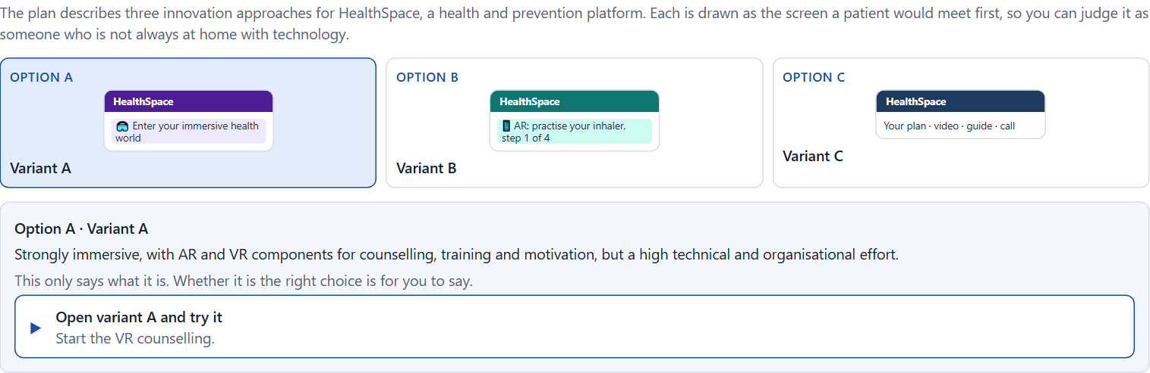
Block 1.2 · Rate future technologies in UX design under conflicting goals: HealthSpace
Level 1 · Knowledge · about 8 min
HealthSpace is a platform in health and prevention. Three innovation approaches are described in words: A) a strongly immersive application with AR and VR components for counselling, training and motivation, but a high technical and organisational effort; B) targeted use of single immersive elements for clearly defined situations, with high practical relevance and a controllable scope; C) classic UX for now, with preparatory technology monitoring and later piloting. The conditions: the company wants to act innovatively but trustworthily and economically, the budget for future projects is limited, the target group is heterogeneous and not always tech-savvy, first pilot solutions can be released in 6 months, there is hardly any real user data on immersive formats yet, and the management wants visible innovation signals while the departments want robust value. Decide anyway, and say what you assume.
Screenshot of the Neuro-UX Lab (aion-ux-lab.vercel.app), own work; AI-assisted, labelled on the image; the example company is fictional.
Draws on: A3 · Intensify or overwhelm · A4 · Fascination or impact · A5 · Ethics and responsibility, and weighing a measure.
AION UX Developer · Day 14 · Training slides
6
Notes:
Block 1.2 · Rate future technologies in UX design under conflicting goals: HealthSpace · about 8 min. Draws on: A3 · Intensify or overwhelm · A4 · Fascination or impact · A5 · Ethics and responsibility, and weighing a measure.

Slide 7
Block 1.2 · What you work on
Rate each variant on user value, degree of innovation, maturity, acceptance, risk and economic viability
1
Decide which variant is the most viable under the given conditions
2
Name the conflicts of goals between visible innovation and responsible introduction
3
Which risks remain despite your decision?
4
Formulate a recommendation to the project management
5
AION UX Developer · Day 14 · Training slides
7
Notes:
Block 1.2 · Rate future technologies in UX design under conflicting goals: HealthSpace · about 8 min. Draws on: A3 · Intensify or overwhelm · A4 · Fascination or impact · A5 · Ethics and responsibility, and weighing a measure.

Slide 8
Coaching · UE4
Transition: Level 1 to Level 2
From the attraction of a new technology to a reasoned immersive roadmap
From describing an effect to a decision you answer for.
AION UX Developer · Day 14 · Training slides
8
Notes:
UE4 · Coaching: transition from Level 1 to Level 2. Trainer-led: a short talk on the coaching focus, then the reflection questions in pairs.

Slide 9
Coaching · questions we talk through
When is an immersive technology a real gain for users, and when only a demonstration?
Which pilots give the most learning at acceptable risk?
1
5
What do neuroscience foundations say about overload, motion and presence in immersive interfaces?
Which decisions are operational, which strategic?
2
6
How do I judge maturity, cost and risk of a technology that is new to the company?
How do I deal with missing tests and market experience?
3
7
How do I argue towards stakeholders who want an immersive project for its signal value?
4
AION UX Developer · Day 14 · Training slides
9
Notes:
UE4 · Coaching: transition from Level 1 to Level 2. Trainer-led: a short talk on the coaching focus, then the reflection questions in pairs.

Slide 10
Coaching · reflect in pairs
1
2
3
Where do immersive projects promise more than they deliver?
Which effect on the body or attention is most often underestimated?
When does an innovation signal turn into a distraction project?
AION UX Developer · Day 14 · Training slides
10
Notes:
UE4 · Coaching: transition from Level 1 to Level 2. Trainer-led: a short talk on the coaching focus, then the reflection questions in pairs.

Slide 11
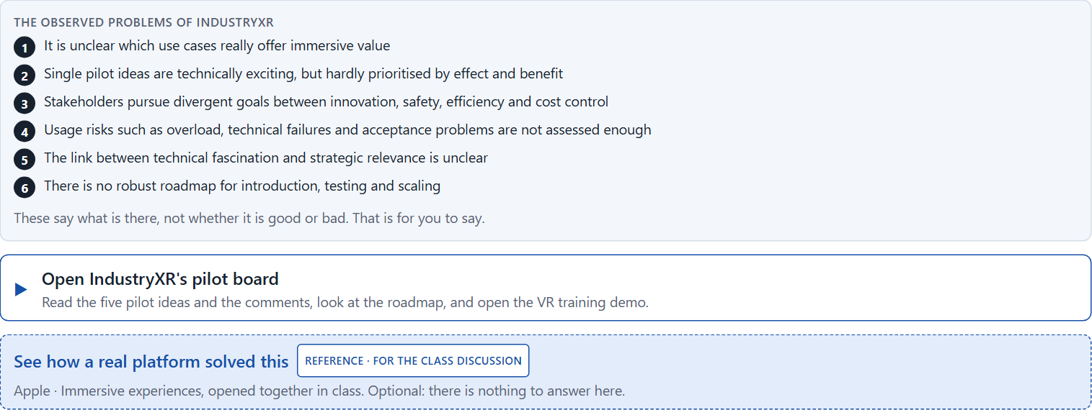
Block 2.1 · Case study: a future strategy for the training and service offer IndustryXR
Level 2 · Case study · UE5–6 · about 15 min
An industrial company plans to develop its training, maintenance and support processes with immersive technologies. AR instructions, VR training environments and neuroscience-informed UX concepts for better attention steering are being discussed. Inside there is enthusiasm for the technology, but robust experience of acceptance, economic viability and fit with existing processes is missing. The observed problems: it is unclear which use cases really offer immersive value; single pilot ideas are technically exciting but hardly prioritised by effect and benefit; stakeholders pursue divergent goals between innovation, safety, efficiency and cost control; usage risks such as overload, technical failures and acceptance problems have not been assessed enough; the link between technical fascination and strategic relevance is unclear; and there is no robust roadmap for introduction, testing and scaling. The conditions: a budget of €220,000 for the first phase, 16 weeks for piloting and decision preparation, full technological integration not possible in the short term, several business units that want to take part, hardly any data from real user tests, and first visible innovation steps the management wants to see soon. You work through six steps.
Screenshot of the Neuro-UX Lab (aion-ux-lab.vercel.app), own work; AI-assisted, labelled on the image; the example company is fictional.
Draws on: A1 · From screen to space · A2 · Presence, attention and load · A3 · Intensify or overwhelm · A4 · Fascination or impact · A5 · Ethics and responsibility, and weighing a measure.
AION UX Developer · Day 14 · Training slides
11
Notes:
Block 2.1 · Case study: a future strategy for the training and service offer IndustryXR · about 15 min. Draws on: A1 · From screen to space · A2 · Presence, attention and load · A3 · Intensify or overwhelm · A4 · Fascination or impact · A5 · Ethics and responsibility, and weighing a measure.

Slide 12
Block 2.1 · What you work on
Analyse the central chances and risks of the planned immersive development
1
Assign the observations to the categories user value, maturity, acceptance, overload, economic viability and scalability
2
Develop 4 prioritised measures for a responsible pilot strategy
3
Justify your selection using effect on users, feasibility, risk, time pressure and investment security
4
Make a prioritisation decision for the first 16 weeks
5
Formulate a recommendation to the division management
6
AION UX Developer · Day 14 · Training slides
12
Notes:
Block 2.1 · Case study: a future strategy for the training and service offer IndustryXR · about 15 min. Draws on: A1 · From screen to space · A2 · Presence, attention and load · A3 · Intensify or overwhelm · A4 · Fascination or impact · A5 · Ethics and responsibility, and weighing a measure.

Slide 13
Feedback round · how each group presents
Each group presents its prioritised measures in 5 minutes
1
The reasoning runs along effect, feasibility, risk and responsibility
2
Each group names one measure it deliberately postponed
3
AION UX Developer · Day 14 · Training slides
13
Notes:
UE7 · Feedback round with a management perspective. Groups present their reasoning, not only their result.

Slide 14
Feedback round · questions to answer
Which measure gives the greatest learning at acceptable risk?
Which risks arise if immersive innovation is introduced faster than its maturity?
1
4
Which measure is the most important for a viable future roadmap?
Which decision is responsible despite missing tests?
2
5
Where was a real effect prioritised, and where only attractiveness?
3
AION UX Developer · Day 14 · Training slides
14
Notes:
UE7 · Feedback round with a management perspective. Groups present their reasoning, not only their result.

Slide 15
Level 3 input and discussion
INPUT LEVEL 3
DISCUSSION
Portfolio, governance and investment responsibility
Balance innovation signal, user value, risk and economics
Make new technologies assessable and steerable
When is a future technology a real competitive advantage, and when an expensive distraction project?
AION UX Developer · Day 14 · Training slides
15
Notes:
UE7 · Feedback round with a management perspective. Groups present their reasoning, not only their result.

Slide 16
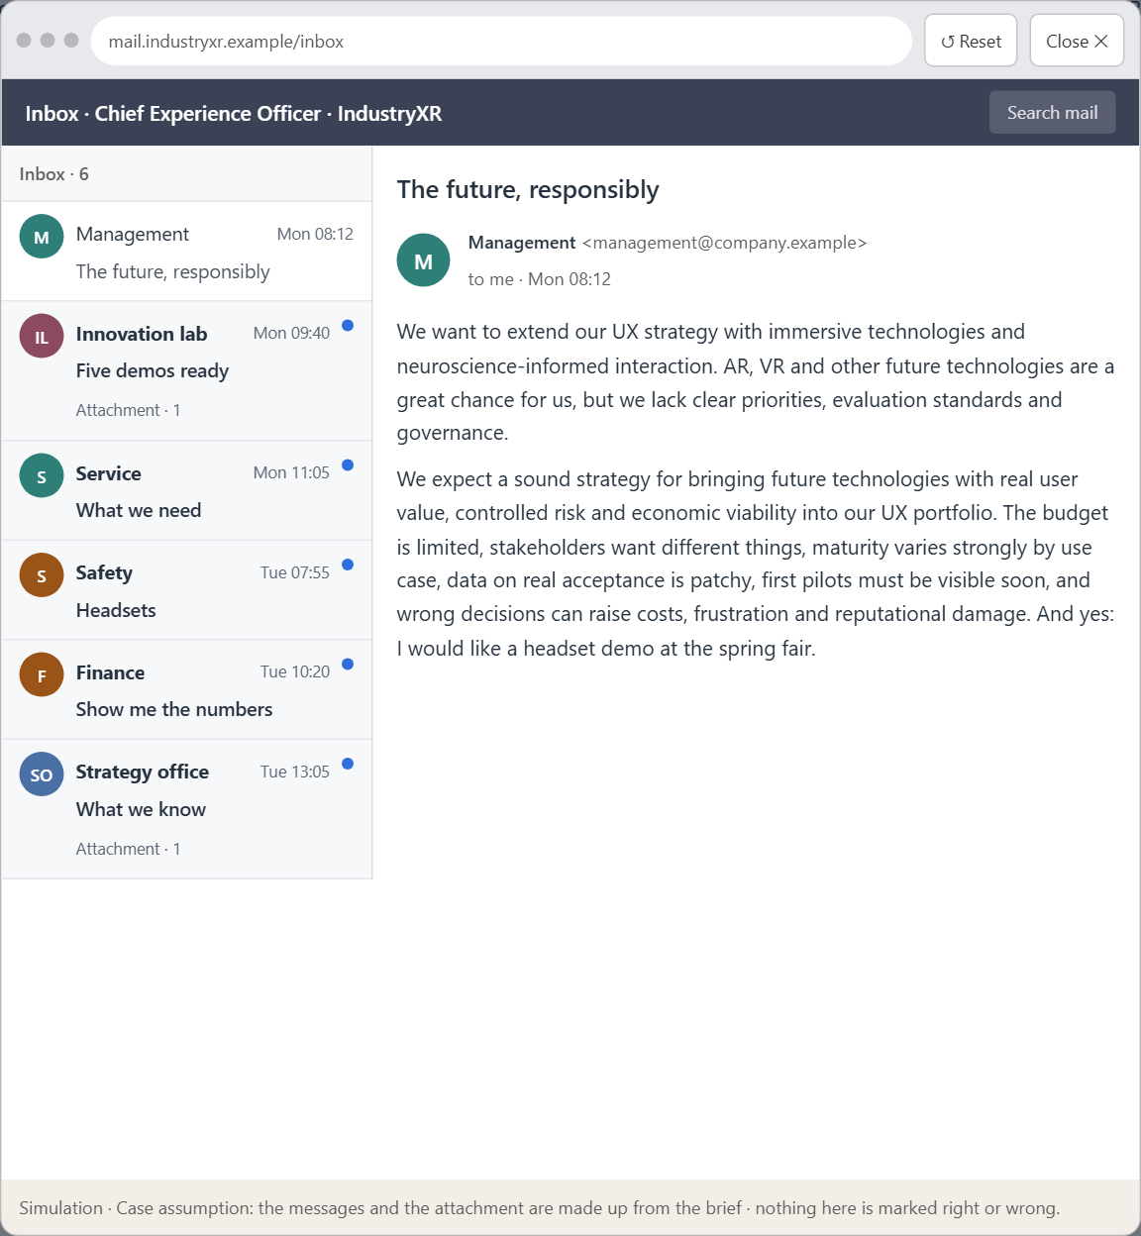
Block 3.1 · A strategic UX innovation architecture for immersive and neuro-based future technologies
Level 3 · Transfer project · UE8–10 · about 20 min
You take the perspective of the Chief Experience Officer of the company behind IndustryXR, which offers digital service, training and support solutions. It wants to extend its UX strategy with immersive technologies and neuroscience-informed interaction concepts. AR, VR and other future technologies are seen inside as a great chance for innovation, but clear priorities, evaluation standards and governance rules are missing. The management expects a sound strategy for bringing future technologies with real user value, controlled risk and economic viability into the UX portfolio. You are not to pick single trend technologies, but to develop a sound decision architecture for immersive UX, neuroscience-based user guidance and innovation governance.
Screenshot of the Neuro-UX Lab (aion-ux-lab.vercel.app), own work; AI-assisted, labelled on the image; the example company is fictional.
Draws on: B1 · Future technologies as decision architecture, not a trend · B2 · Innovation, value, maturity, risk, ethics · B3 · Who decides on future technologies, and deciding without test data.
AION UX Developer · Day 14 · Training slides
16
Notes:
Block 3.1 · A strategic UX innovation architecture for immersive and neuro-based future technologies · about 20 min. Draws on: B1 · Future technologies as decision architecture, not a trend · B2 · Innovation, value, maturity, risk, ethics · B3 · Who decides on future technologies, and deciding without test data.

Slide 17
Block 3.1 · What you work on
1
A guiding vision for future UX innovation: which form of immersive value and user experience should be aimed for systematically?
2
Three strategic guiding decisions on technology use, maturity assessment, user value and innovation portfolio
3
A prioritised architecture of measures: which use cases, touchpoints or product areas are piloted first, and why?
4
A risk analysis: which wrong assumptions about innovation, user behaviour, market maturity and economic viability would be especially critical?
5
A governance model: who is responsible for future technologies in the UX portfolio, and how are conflicts between visibility, effect, risk and effort decided?
6
A decision under uncertainty: make at least one prioritised decision despite patchy practical tests and justify it responsibly
7
A management statement: a recommendation to the management with a clear priority and a strategic reason
AION UX Developer · Day 14 · Training slides
17
Notes:
Block 3.1 · A strategic UX innovation architecture for immersive and neuro-based future technologies · about 20 min. Draws on: B1 · Future technologies as decision architecture, not a trend · B2 · Innovation, value, maturity, risk, ethics · B3 · Who decides on future technologies, and deciding without test data.

Slide 18
Reflect before you leave
1
2
3
Which decision did you make today, and what did you give up to make it?
Which assumption would you check first with real users, and how?
What will you do differently in your next project because of today?
Use two minutes alone, then one minute with your neighbour.
AION UX Developer · Day 14 · Training slides
18

Slide 19
About these slides, sources and AI use
AI
AI-assisted content
Where to find more
AI-assisted content: these slides were drafted with an AI language model (Claude, Anthropic) from the course's own Neuro-UX Lab and were read, corrected and approved by Muhammad Muchson, who is responsible for their accuracy.
Pictures are screenshots of the course's own Neuro-UX Lab. Each one carries an AI label on the image and a source line under it.
Companies and people in the examples are fictional. Numbers inside an example are labelled Case assumption and are not data.
The coaching and feedback questions are the course plan's own, translated into English.
Neuro-UX Lab for this day: https://aion-ux-lab.vercel.app/day/14/
Handouts: the Materi and Task Word documents of the day.
Version 1.0, 29.10.2026. Reviewer and approver: Muhammad Muchson.
AION UX Developer · Day 14 · Training slides
19

