Slide 1
Immersive prototyping and testing, future strategies and ethical aspects
AION UX DEVELOPER · DAY 16
16
Training slides: tasks, coaching, case study and feedback
Contains AI-assisted content
Module 7 (day 3 of 3)
Trainer: Muhammad Muchson · Case: NextWorld UX

Slide 2
The day at a glance (1)
UE | Min | What | What happens
1 | 45 | Knowledge transfer · Level 1 | The trainer presents the cards of Materi A (A1, A2, A3, A4, A5, about 60 min of cards) in the Neuro-UX Lab; participants follow in the handout.
2 | 45 | Level 1 · Task 1 | Individual work on Block 1.1 (Core, about 10 min): the first product of the day is read and its effect described. Pairs then compare their results and the trainer collects open questions.
3 | 45 | Level 1 · Task 2 | Three options are rated on the same criteria and one is chosen under the stated conditions: Block 1.2 (Core, about 8 min).
4 | 45 | Coaching · transition from Level 1 to Level 2 | Trainer-led. A short talk on the day's coaching focus, then the reflection questions in pairs. The bridge: from describing an effect to a decision you answer for. There is no worksheet block in this unit.
5–6 | 90 | Level 2 · Case study NextWorld UX (2 UE) incl. model solution | UE5: the trainer presents the case; participants work on Block 2.1 (Core, about 15 min). UE6: groups compare their results and defend them; the trainer closes with the model solution.
7 | 45 | Level 2 + 3 · Feedback round with a management perspective | Groups present their reasoning, not only their result. The trainer asks the day's Level 3 input questions and leads the discussion.
One UE is 45 minutes; breaks are not shown.
AION UX Developer · Day 16 · Training slides
2
Notes:
One UE (teaching unit) is counted as 45 minutes; breaks are not shown.

Slide 3
The day at a glance (2)
UE | Min | What | What happens
8 | 45 | Level 3 · Transfer project, Chief Experience Officer (3 UE: UE8–10) | The trainer presents Materi B (B1, B2, B3; use the "In plain words" and "How to decide" boxes, the rest is handout) and sets the role and the situation.
9 | 45 | Level 3 · Transfer project | Individual work or in pairs on Block 3.1 (Core, about 20 min): the strategy memo.
10 | 45 | Level 3 · Transfer project | Participants present their decision and what they give up, including the one decision made under uncertainty; the trainer debriefs with the model solution.
One UE is 45 minutes; breaks are not shown.
AION UX Developer · Day 16 · Training slides
3
Notes:
One UE (teaching unit) is counted as 45 minutes; breaks are not shown.

Slide 4
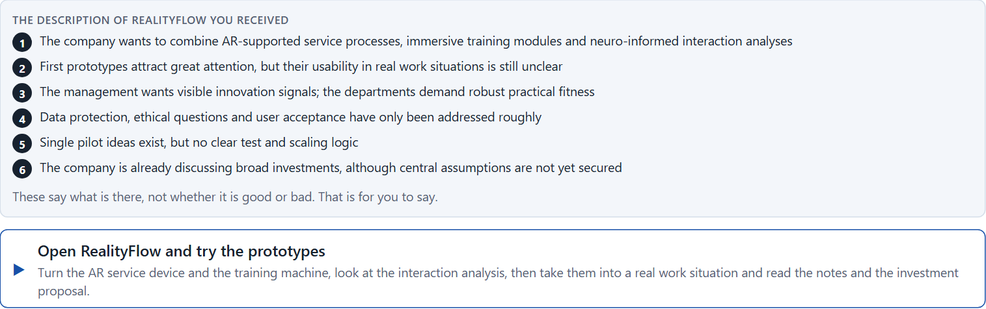
Block 1.1 · Judge how future-proof an immersive UX concept is: RealityFlow
Level 1 · Knowledge · about 10 min
You receive the description of a fictional innovation project, RealityFlow, for immersive advice, service support and training. Open it: three prototypes you can try, an AR service guide on a real 3D device, a training module on a real 3D machine and a neuro-informed analysis dashboard. Then take them into a real work situation, read what the management and the departments want, and look at the investment proposal. You need no prior knowledge: notice what is shown and what has not been tested. The aim is to judge immersive future projects not only technically, but strategically, organisationally and ethically.
Screenshot of the Neuro-UX Lab (aion-ux-lab.vercel.app), own work; AI-assisted, labelled on the image; the example company is fictional.
Draws on: A1 · From concept idea to scalable solution · A2 · Testing immersive systems · A3 · Feasible or responsible · A4 · Responsible, connectable, governable.
AION UX Developer · Day 16 · Training slides
4
Notes:
Block 1.1 · Judge how future-proof an immersive UX concept is: RealityFlow · about 10 min. Draws on: A1 · From concept idea to scalable solution · A2 · Testing immersive systems · A3 · Feasible or responsible · A4 · Responsible, connectable, governable.

Slide 5
Block 1.1 · What you work on
Describe spontaneously which chances and risks this project could have for users, the organisation and the market position
1
Name at least 5 places where prototyping, testing, strategy or ethics are not yet clarified enough
2
Assign the observations to the categories user value, test maturity, scalability, ethics, investment risk and organisational capability
3
Write an effect statement for three points: “For users, the organisation or the management this could mean that …”
4
Prioritise the two biggest strategic chances and the two biggest risks of the project
5
AION UX Developer · Day 16 · Training slides
5
Notes:
Block 1.1 · Judge how future-proof an immersive UX concept is: RealityFlow · about 10 min. Draws on: A1 · From concept idea to scalable solution · A2 · Testing immersive systems · A3 · Feasible or responsible · A4 · Responsible, connectable, governable.

Slide 6
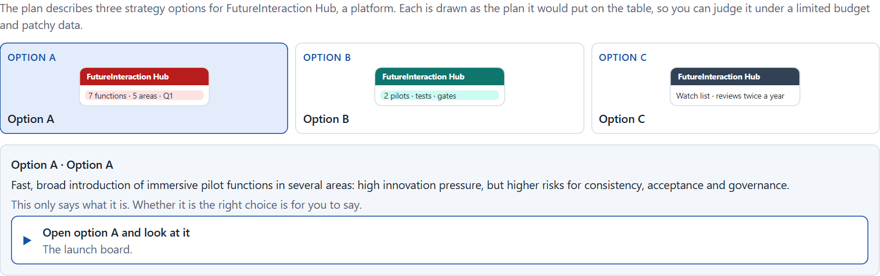
Block 1.2 · Prioritise future-proof UX strategies under uncertainty: FutureInteraction Hub
Level 1 · Knowledge · about 8 min
FutureInteraction Hub is a platform. Three strategy options for its future are described in words: A) a fast, broad introduction of immersive pilot functions in several areas, with high innovation pressure but higher risks for consistency, acceptance and governance; B) focused piloting of a few clearly prioritised future applications with a strong test and ethics framework; C) a waiting strategy with observation, research and little immediate implementation, with lower risk and lower visibility. The conditions: the company wants to be seen as innovative, the budget is limited and not all lines of innovation can be pursued at once, data from earlier tests is patchy, several stakeholders stand for different interests between visibility, safety, economic viability and a pioneer role, first visible results are wanted within 6 months, and wrong decisions can lead to costs, loss of trust or an innovation backlog. Decide anyway, and say what you assume.
Screenshot of the Neuro-UX Lab (aion-ux-lab.vercel.app), own work; AI-assisted, labelled on the image; the example company is fictional.
Draws on: A3 · Feasible or responsible · A4 · Responsible, connectable, governable · A5 · When not to scale, and weighing a scaling decision.
AION UX Developer · Day 16 · Training slides
6
Notes:
Block 1.2 · Prioritise future-proof UX strategies under uncertainty: FutureInteraction Hub · about 8 min. Draws on: A3 · Feasible or responsible · A4 · Responsible, connectable, governable · A5 · When not to scale, and weighing a scaling decision.

Slide 7
Block 1.2 · What you work on
Rate each option on capacity to innovate, user value, risk, steerability, ethics and economic viability
1
Decide which option is the most viable under the given conditions
2
Name the conflicts of goals between visible innovation, responsibility and maturity
3
Which risks remain despite your decision?
4
Formulate a recommendation to the project lead
5
AION UX Developer · Day 16 · Training slides
7
Notes:
Block 1.2 · Prioritise future-proof UX strategies under uncertainty: FutureInteraction Hub · about 8 min. Draws on: A3 · Feasible or responsible · A4 · Responsible, connectable, governable · A5 · When not to scale, and weighing a scaling decision.

Slide 8
Coaching · UE4
Transition: Level 1 to Level 2
From pilot ideas to a responsible architecture of the future and of governance
From describing an effect to a decision you answer for.
AION UX Developer · Day 16 · Training slides
8
Notes:
UE4 · Coaching: transition from Level 1 to Level 2. Trainer-led: a short talk on the coaching focus, then the reflection questions in pairs.

Slide 9
Coaching · questions we talk through
When is a future project strategically connectable, and when only symbolically innovative?
When should a technology deliberately not be scaled?
1
5
Are prototyping and testing robust enough for management decisions?
How do I argue towards stakeholders who weigh fast visibility above readiness for a decision?
2
6
What do ethics, data protection, inclusion and transparency demand?
Which decisions are operational, which strategic for the future portfolio, governance and market position?
3
7
How do I handle conflicts between pressure to innovate, investment logic and responsibility for users?
4
AION UX Developer · Day 16 · Training slides
9
Notes:
UE4 · Coaching: transition from Level 1 to Level 2. Trainer-led: a short talk on the coaching focus, then the reflection questions in pairs.

Slide 10
Coaching · reflect in pairs
1
2
3
What are the biggest blind spots between feasibility and responsibility?
Which kind of testing is most underestimated although it is strategically decisive?
When does an unreflected future initiative become a risk for trust or investment?
AION UX Developer · Day 16 · Training slides
10
Notes:
UE4 · Coaching: transition from Level 1 to Level 2. Trainer-led: a short talk on the coaching focus, then the reflection questions in pairs.

Slide 11
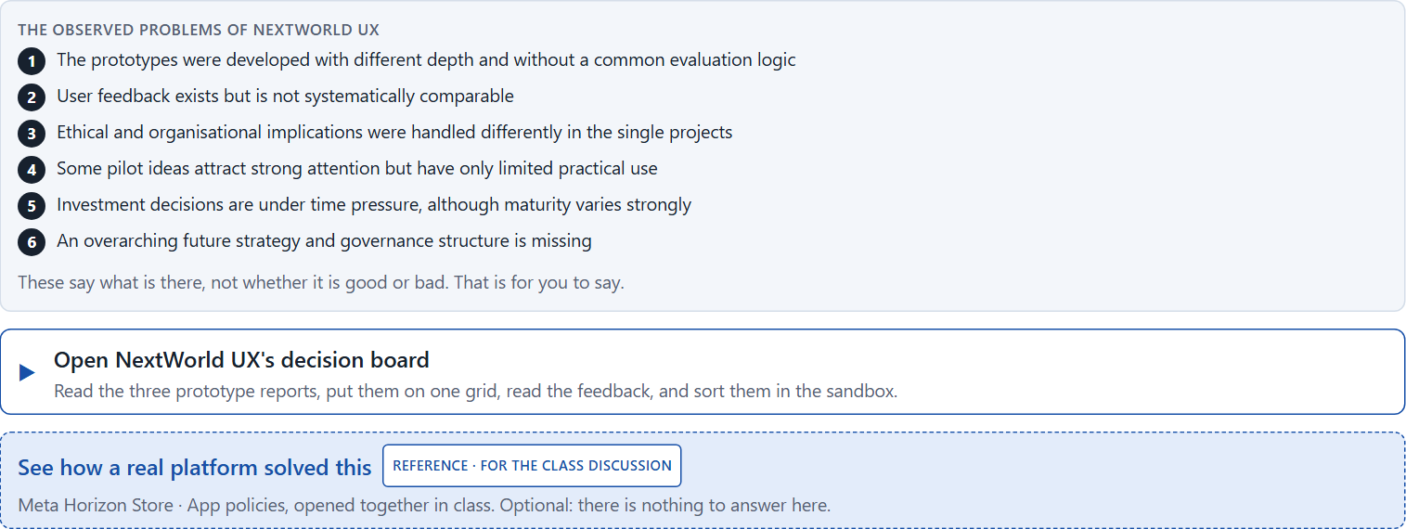
Block 2.1 · Case study: a scaling decision for the immersive innovation programme NextWorld UX
Level 2 · Case study · UE5–6 · about 15 min
Over the past months a company has developed several prototypes for AR-supported advice, VR-based training and neuro-informed UX research. First results are promising but uneven. Some users experience high value, others show overload or scepticism. The management now demands a decision on which approaches are scaled, which are tested further and which are stopped for now. The observed problems: the prototypes were developed with different depth and without a common evaluation logic; user feedback exists but is not systematically comparable; ethical and organisational implications were handled differently in the single projects; some pilot ideas attract strong attention but have only limited practical use; investment decisions are under time pressure although maturity varies strongly; and an overarching future strategy and governance structure is missing. The conditions: a budget of €260,000 for the next scaling and pilot phase, 16 weeks for prioritisation, building governance and planning new pilots, not all approaches can be continued at once, stakeholders from innovation, IT, the department, data protection and management pursue different goals, first market signals should stay visible, and wrong decisions could increase costs, reputational risks and internal blockades. You work through six steps.
Screenshot of the Neuro-UX Lab (aion-ux-lab.vercel.app), own work; AI-assisted, labelled on the image; the example company is fictional.
Draws on: A1 · From concept idea to scalable solution · A2 · Testing immersive systems · A3 · Feasible or responsible · A4 · Responsible, connectable, governable · A5 · When not to scale, and weighing a scaling decision.
AION UX Developer · Day 16 · Training slides
11
Notes:
Block 2.1 · Case study: a scaling decision for the immersive innovation programme NextWorld UX · about 15 min. Draws on: A1 · From concept idea to scalable solution · A2 · Testing immersive systems · A3 · Feasible or responsible · A4 · Responsible, connectable, governable · A5 · When not to scale, and weighing a scaling decision.

Slide 12
Block 2.1 · What you work on
Analyse the central weaknesses of the approach so far regarding prototyping, testing, ethics and strategy
1
Assign the problems to the categories evaluation logic, scaling maturity, user value, ethics, governance and investment security
2
Develop 4 prioritised measures for a responsible scaling decision
3
Justify your selection using effect on users, feasibility, risk, time pressure and strategic viability
4
Make a prioritisation decision for the first 16 weeks
5
Formulate a recommendation to the division head
6
AION UX Developer · Day 16 · Training slides
12
Notes:
Block 2.1 · Case study: a scaling decision for the immersive innovation programme NextWorld UX · about 15 min. Draws on: A1 · From concept idea to scalable solution · A2 · Testing immersive systems · A3 · Feasible or responsible · A4 · Responsible, connectable, governable · A5 · When not to scale, and weighing a scaling decision.

Slide 13
Feedback round · how each group presents
Each group presents its prioritised measures in 5 minutes
1
The reasoning runs along effect, feasibility, risk and responsibility
2
Each group names one measure it deliberately postponed
3
AION UX Developer · Day 16 · Training slides
13
Notes:
UE7 · Feedback round with a management perspective. Groups present their reasoning, not only their result.

Slide 14
Feedback round · questions to answer
Which measure raises the strategic readiness for a decision fastest?
Which risks arise if ethical questions are considered only after scaling?
1
4
Which measure is the most important for long-term responsible UX innovation?
Which decision is responsible despite patchy test and market data?
2
5
Where was future-proofing defined cleanly, and where was only visibility preferred?
3
AION UX Developer · Day 16 · Training slides
14
Notes:
UE7 · Feedback round with a management perspective. Groups present their reasoning, not only their result.

Slide 15
Level 3 input and discussion
INPUT LEVEL 3
DISCUSSION
Portfolio architecture, governance and ethical leadership
Balance innovation dynamics, user interest, investment security and reputation-safe implementation
Responsibility shows in not only starting the technological future but deliberately limiting, focusing and scaling it responsibly
When is stopping an innovation the better leadership decision than scaling it fast?
AION UX Developer · Day 16 · Training slides
15
Notes:
UE7 · Feedback round with a management perspective. Groups present their reasoning, not only their result.

Slide 16
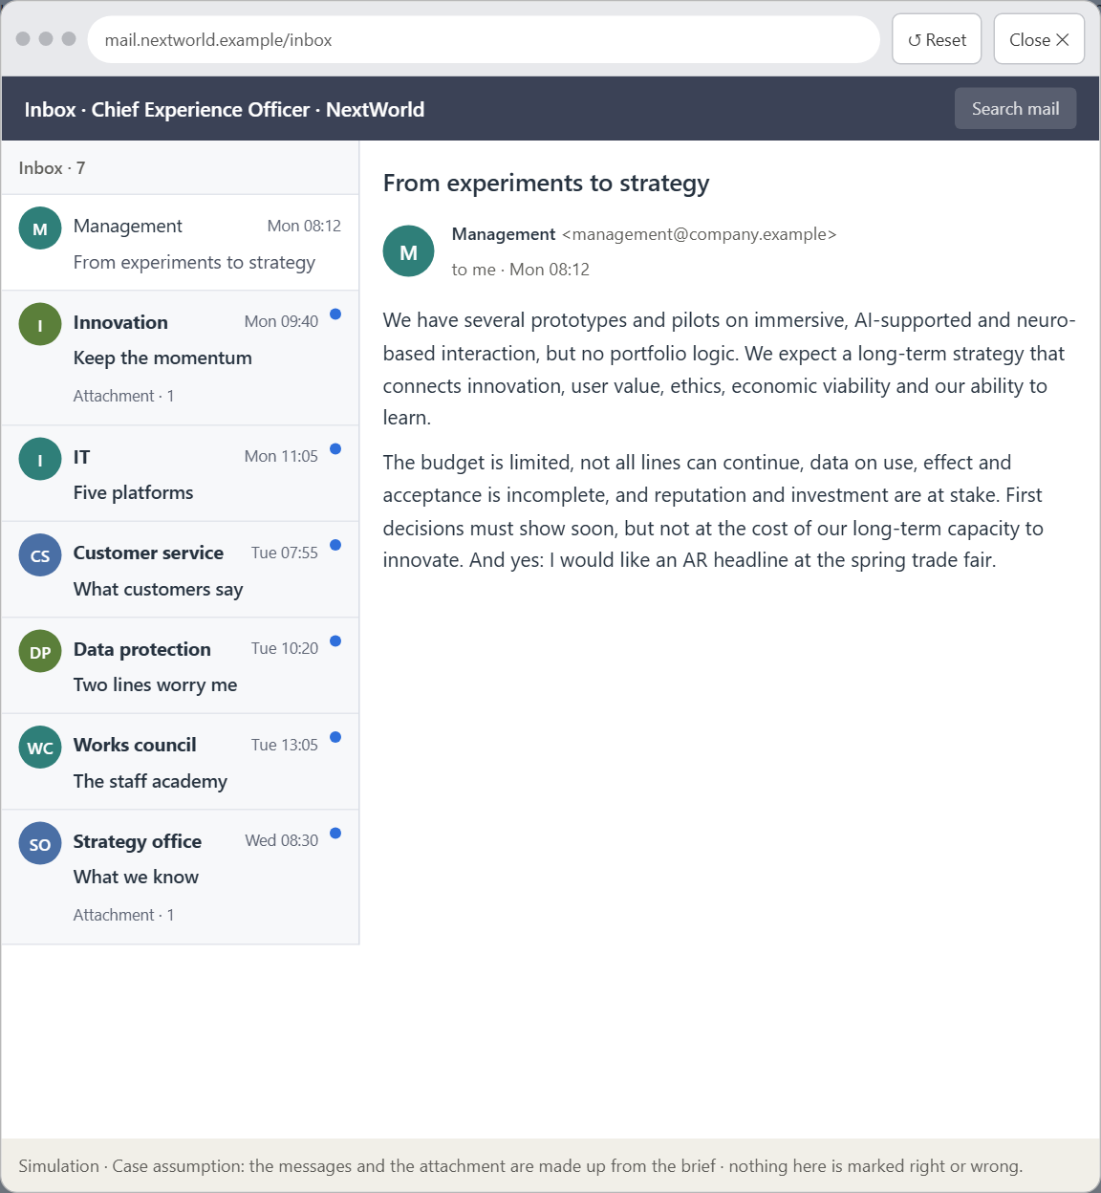
Block 3.1 · A future-proof UX and innovation governance for immersive and neuro-based systems
Level 3 · Transfer project · UE8–10 · about 20 min
You take the perspective of the Chief Experience Officer of the company behind NextWorld UX. It stands at the transition from experimental future projects to a strategically steered UX innovation landscape. Several prototypes and pilots for immersive, AI-supported and neuro-based interaction exist, but there is no overarching portfolio logic. The management expects a long-term strategy that connects innovation, user value, ethics, economic viability and the organisation's ability to learn. Your task is not to judge single technologies in isolation, but to develop a sound decision architecture for prototyping, testing, ethics, scaling and the governance of future UX systems.
Screenshot of the Neuro-UX Lab (aion-ux-lab.vercel.app), own work; AI-assisted, labelled on the image; the example company is fictional.
Draws on: B1 · Future-proof UX as a responsible innovation and decision architecture · B2 · Innovation pressure, ethics, economics, value, maturity, portfolio · B3 · Who decides to scale, pause or stop, and deciding with incomplete data.
AION UX Developer · Day 16 · Training slides
16
Notes:
Block 3.1 · A future-proof UX and innovation governance for immersive and neuro-based systems · about 20 min. Draws on: B1 · Future-proof UX as a responsible innovation and decision architecture · B2 · Innovation pressure, ethics, economics, value, maturity, portfolio · B3 · Who decides to scale, pause or stop, and deciding with incomplete data.

Slide 17
Block 3.1 · What you work on
1
A guiding vision for future-proof UX: which form of innovation, user value and responsibility should the company pursue systematically?
2
Three strategic guiding decisions on prototyping, testing, scaling, ethics and the innovation portfolio
3
A prioritised architecture of measures: which initiatives, technologies or product fields are continued, paused or ended first, and why?
4
A risk analysis: which wrong assumptions about future technologies, market maturity, user acceptance and governance would be especially critical?
5
A governance model: who is responsible for evaluating innovation, ethical approvals, scaling decisions and portfolio adjustments?
6
A decision under uncertainty: make at least one prioritised decision despite incomplete data and justify it responsibly
7
A management statement: a recommendation to the management with a clear priority and a strategic reason
AION UX Developer · Day 16 · Training slides
17
Notes:
Block 3.1 · A future-proof UX and innovation governance for immersive and neuro-based systems · about 20 min. Draws on: B1 · Future-proof UX as a responsible innovation and decision architecture · B2 · Innovation pressure, ethics, economics, value, maturity, portfolio · B3 · Who decides to scale, pause or stop, and deciding with incomplete data.

Slide 18
Reflect before you leave
1
2
3
Which decision did you make today, and what did you give up to make it?
Which assumption would you check first with real users, and how?
What will you do differently in your next project because of today?
Use two minutes alone, then one minute with your neighbour.
AION UX Developer · Day 16 · Training slides
18

Slide 19
About these slides, sources and AI use
AI
AI-assisted content
Where to find more
AI-assisted content: these slides were drafted with an AI language model (Claude, Anthropic) from the course's own Neuro-UX Lab and were read, corrected and approved by Muhammad Muchson, who is responsible for their accuracy.
Pictures are screenshots of the course's own Neuro-UX Lab. Each one carries an AI label on the image and a source line under it.
Companies and people in the examples are fictional. Numbers inside an example are labelled Case assumption and are not data.
The coaching and feedback questions are the course plan's own, translated into English.
Neuro-UX Lab for this day: https://aion-ux-lab.vercel.app/day/16/
Handouts: the Materi and Task Word documents of the day.
Version 1.0, 29.10.2026. Reviewer and approver: Muhammad Muchson.
AION UX Developer · Day 16 · Training slides
19

