Slide 1
UX DEVELOPER · DAY 1
Psychological UX design and neuro-design
Training slides: tasks, coaching, case study and feedback
Module 1 (day 1 of 1)
Trainer: Muhammad Muchson · Case: SafeHome Online
Contains AI-assisted content

Slide 2
The day at a glance (1)
UE | Min | What | What happens
1 | 45 | Knowledge transfer · Level 1 | The trainer presents the cards of Materi A (A1, A2, A3, A4, A5, about 60 min of cards) in the Neuro-UX Lab; participants follow in the handout.
2 | 45 | Level 1 · Task 1 | Individual work on Block 1.1 (Core, about 10 min): the first product of the day is read and its effect described. Pairs then compare their results and the trainer collects open questions.
3 | 45 | Level 1 · Task 2 | Three options are rated on the same criteria and one is chosen under the stated conditions: Block 1.2 (Core, about 8 min).
4 | 45 | Coaching · transition from Level 1 to Level 2 | Trainer-led. A short talk on the day's coaching focus, then the reflection questions in pairs. The bridge: from describing an effect to a decision you answer for. There is no worksheet block in this unit.
5–6 | 90 | Level 2 · Case study SafeHome Online (2 UE) incl. model solution | UE5: the trainer presents the case; participants work on Block 2.1 (Core, about 15 min). UE6: groups compare their results and defend them; the trainer closes with the model solution.
7 | 45 | Level 2 + 3 · Feedback round with a management perspective | Groups present their reasoning, not only their result. The trainer asks the day's Level 3 input questions and leads the discussion.
One UE is 45 minutes; breaks are not shown.
Notes:
One UE (teaching unit) is counted as 45 minutes; breaks are not shown.

Slide 3
The day at a glance (2)
UE | Min | What | What happens
8 | 45 | Level 3 · Transfer project, Chief Experience Officer (3 UE: UE8–10) | The trainer presents Materi B (B1, B2, B3; use the "In plain words" and "How to decide" boxes, the rest is handout) and sets the role and the situation.
9 | 45 | Level 3 · Transfer project | Individual work or in pairs on Block 3.1 (Core, about 20 min): the strategy memo.
10 | 45 | Level 3 · Transfer project | Participants present their decision and what they give up, including the one decision made under uncertainty; the trainer debriefs with the model solution.
One UE is 45 minutes; breaks are not shown.
Notes:
One UE (teaching unit) is counted as 45 minutes; breaks are not shown.

Slide 4
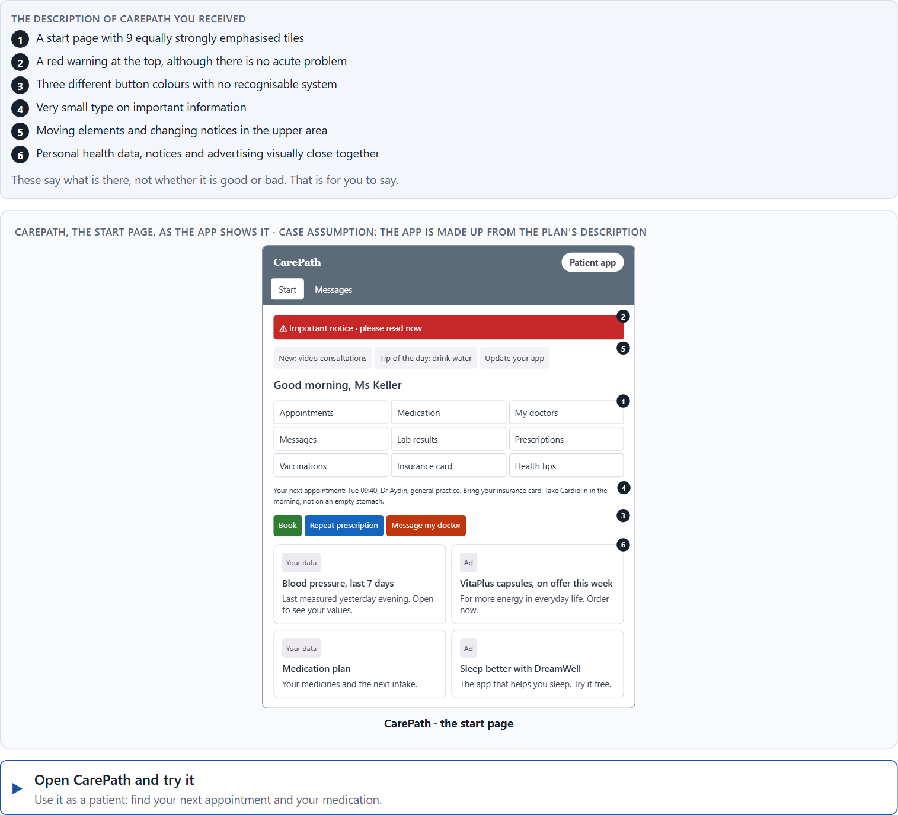
Block 1.1 · The effect of an unfamiliar interface: CarePath
Level 1 · Knowledge · about 10 min
You receive the description of a fictional product, CarePath, a health app for organising appointments, medication notes and contact with doctors. Open it and use it as a patient would. You need no prior knowledge: ask yourself what feels confusing, stressful, unsafe or unclear. The aim is to see the effect before you judge it.
Screenshot of the Neuro-UX Lab (aion-ux-lab.vercel.app), own work; AI-assisted, labelled on the image; the example company is fictional.
Draws on: A1 · UX, UI and the psychology behind them · A2 · How people see · A3 · Expectations and habits, and three aims of an interface · A4 · Feelings that work before thinking.
Notes:
Block 1.1 · The effect of an unfamiliar interface: CarePath · about 10 min. Draws on: A1 · UX, UI and the psychology behind them · A2 · How people see · A3 · Expectations and habits, and three aims of an interface · A4 · Feelings that work before thinking.

Slide 5
Block 1.1 · What you work on
Mark all the elements that could bind or distract attention
1
Assign the possible problems to the categories attention, orientation, trust, emotional effect and cognitive load
2
Formulate a hypothesis for each category: “This design element could trigger the following effect in the user …”
3
Name three places where an unconscious design effect could play a role
4
Develop a first simple prioritisation: what would have to be improved first, and why?
5
Notes:
Block 1.1 · The effect of an unfamiliar interface: CarePath · about 10 min. Draws on: A1 · UX, UI and the psychology behind them · A2 · How people see · A3 · Expectations and habits, and three aims of an interface · A4 · Feelings that work before thinking.

Slide 6
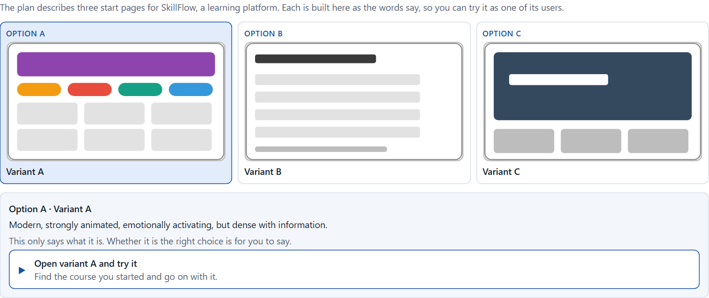
Block 1.2 · Rate design effects and decide under uncertainty: SkillFlow
Level 1 · Knowledge · about 8 min
SkillFlow is a learning platform. Three alternative designs for its start page are described in words: A) modern, strongly animated and emotionally activating, but dense with information; B) very sober and factual, clearly structured, but not very motivating; C) visually high quality with strong imagery and a reduced navigation, but less transparent about the next steps. The conditions: the product goes live within 8 weeks, the target group is working adults between 25 and 55, the budget for the revision is limited, management asks for a “modern effect” and the support team for “as few questions as possible”, and there are no user tests yet. As in most projects, how large the budget is and how many users there are is not set. Decide anyway, and say what you assume.
Screenshot of the Neuro-UX Lab (aion-ux-lab.vercel.app), own work; AI-assisted, labelled on the image; the example company is fictional.
Draws on: A3 · Expectations and habits, and three aims of an interface · A4 · Feelings that work before thinking · A5 · Weighing a design measure.
Notes:
Block 1.2 · Rate design effects and decide under uncertainty: SkillFlow · about 8 min. Draws on: A3 · Expectations and habits, and three aims of an interface · A4 · Feelings that work before thinking · A5 · Weighing a design measure.

Slide 7
Block 1.2 · What you work on
Rate each variant on orientation, cognitive load, trust, activation and understandability
1
Make a reasoned prioritisation decision: which variant would be the most viable under the given conditions?
2
Which risks are you knowingly taking with your decision?
3
Which information is missing for a safe decision?
4
Formulate a management statement: “Under uncertainty we provisionally decide for …, because …”
5
Notes:
Block 1.2 · Rate design effects and decide under uncertainty: SkillFlow · about 8 min. Draws on: A3 · Expectations and habits, and three aims of an interface · A4 · Feelings that work before thinking · A5 · Weighing a design measure.

Slide 8
Coaching · UE4
Transition: Level 1 to Level 2
From describing to a responsible UX decision
From describing an effect to a decision you answer for.
Notes:
UE4 · Coaching: transition from Level 1 to Level 2. Trainer-led: a short talk on the coaching focus, then the reflection questions in pairs.

Slide 9
Coaching · questions we talk through
Why is user psychology not a nice-to-have but the basis of effective design?
How do I deal with an incomplete data situation?
1
5
The difference between subjective taste and a reliable effect assumption
Which UX decisions have operational effect, and which have strategic reach?
2
6
How do I tell whether a design steers attention or destroys it?
The role of those responsible for UX: executing design, or co-architect of user behaviour?
3
7
How do I argue against internal preferences when the effect on users speaks against them?
4
Notes:
UE4 · Coaching: transition from Level 1 to Level 2. Trainer-led: a short talk on the coaching focus, then the reflection questions in pairs.

Slide 10
Coaching · reflect in pairs
1
2
3
Which design decision influences behaviour most?
Where would you object, as an adviser or a product owner?
Which wrong design assumption can be the most expensive for a company, a brand or its users?
Notes:
UE4 · Coaching: transition from Level 1 to Level 2. Trainer-led: a short talk on the coaching focus, then the reflection questions in pairs.

Slide 11
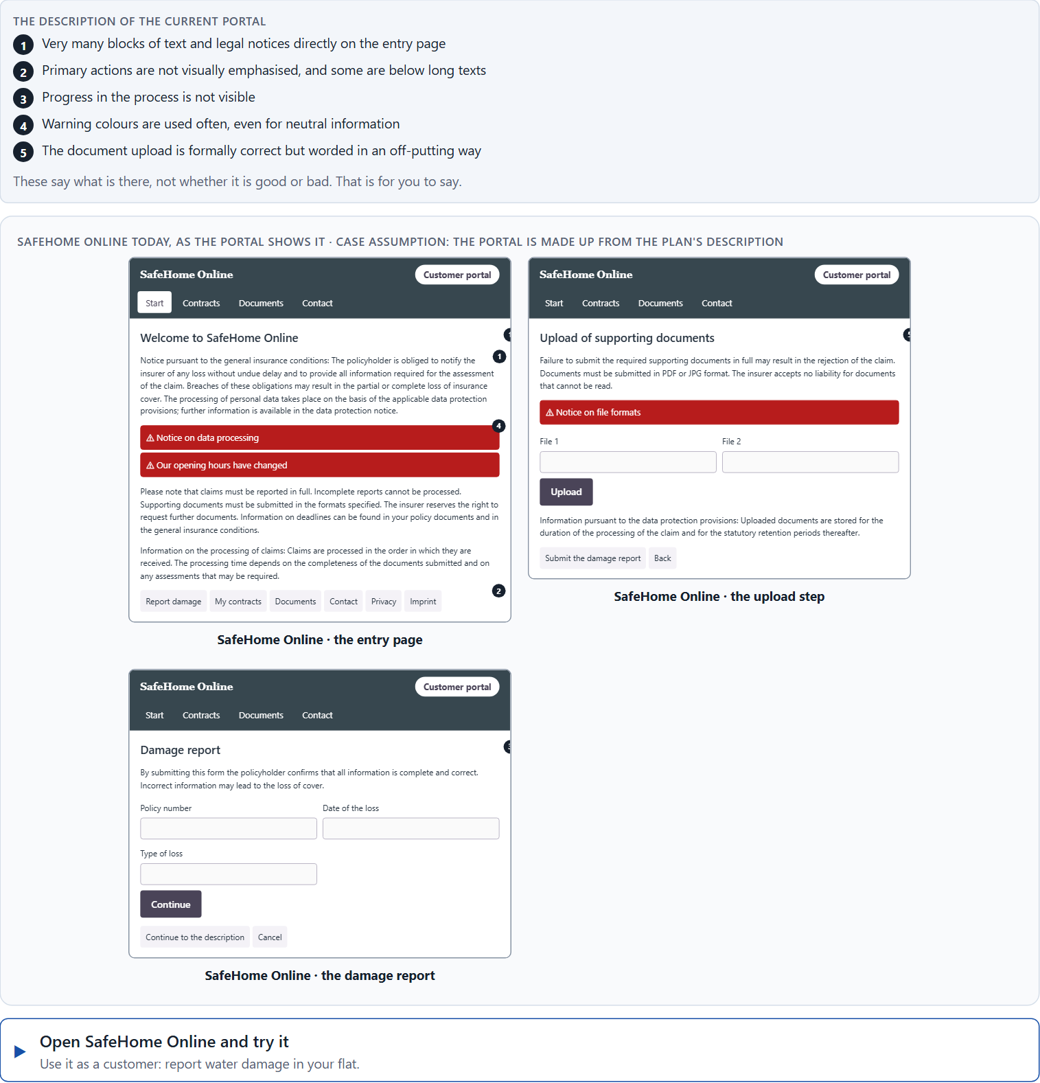
Block 2.1 · Case study: redesigning SafeHome Online
Level 2 · Case study · UE5–6 · about 15 min
An insurance company runs SafeHome Online, a self-service portal for damage reports, contract overviews and document downloads. It is judged complete in content but has massive usage problems: 46 % of damage reports are abandoned, many customers call the service centre although the functions exist online, users call the portal “complicated”, “cold” and “unsafe”, the specialist departments want to add more notices and safeguards, and the management wants a modern, trustworthy and more efficient customer experience. The current portal: very many blocks of text and legal notices on the entry page, primary actions that are not visually emphasised, no visible progress in the process, warning colours used often, even for neutral information, an upload that is formally correct but worded in an off-putting way, and important actions partly placed below long texts. The conditions: €180,000 and 12 weeks for a first optimisation, the legal notices must stay, IT can only intervene to a limited extent at short notice, and there is no full relaunch, so the measures must be targeted. You carry out a simplified psychological UX analysis in five steps.
Screenshot of the Neuro-UX Lab (aion-ux-lab.vercel.app), own work; AI-assisted, labelled on the image; the example company is fictional.
Draws on: A1 · UX, UI and the psychology behind them · A2 · How people see · A3 · Expectations and habits, and three aims of an interface · A4 · Feelings that work before thinking · A5 · Weighing a design measure.
Notes:
Block 2.1 · Case study: redesigning SafeHome Online · about 15 min. Draws on: A1 · UX, UI and the psychology behind them · A2 · How people see · A3 · Expectations and habits, and three aims of an interface · A4 · Feelings that work before thinking · A5 · Weighing a design measure.

Slide 12
Block 2.1 · What you work on
Identify at least 5 central effect problems in the current portal
1
Assign the problems to the categories perception, cognitive load, trust, emotional effect and action guidance
2
Develop 4 prioritised improvement measures
3
Justify your prioritisation using the criteria effect on users, feasibility, risk and time pressure
4
Formulate a short recommendation to the management
5
Notes:
Block 2.1 · Case study: redesigning SafeHome Online · about 15 min. Draws on: A1 · UX, UI and the psychology behind them · A2 · How people see · A3 · Expectations and habits, and three aims of an interface · A4 · Feelings that work before thinking · A5 · Weighing a design measure.

Slide 13
Feedback round · how each group presents
Each group presents its prioritised measures in 5 minutes
1
The reasoning is not only about design but runs along effect, risk, priority and responsibility
2
Each group must name one measure it deliberately did not prioritise
3
Notes:
UE7 · Feedback round with a management perspective. Groups present their reasoning, not only their result.

Slide 14
Feedback round · questions to answer
Which measure creates the biggest effect in the short term?
Where was design still thought of too operationally, and not as a decision architecture?
1
4
Which measure would be the most valuable strategically, even if it takes more effort?
Which risks arise if you follow only internal preferences?
2
5
Which decision is robust although information is missing?
3
Notes:
UE7 · Feedback round with a management perspective. Groups present their reasoning, not only their result.

Slide 15
Level 3 input and discussion
INPUT LEVEL 3
DISCUSSION
Senior level means not only producing solutions but steering the logic of effects
Good management decisions in a UX context balance user interest, feasibility, regulatory requirements, brand impact and resources
What counts is not perfect information but a responsible prioritisation under uncertainty
When does a UX problem stop being a design problem and become a leadership and decision problem?
Notes:
UE7 · Feedback round with a management perspective. Groups present their reasoning, not only their result.

Slide 16
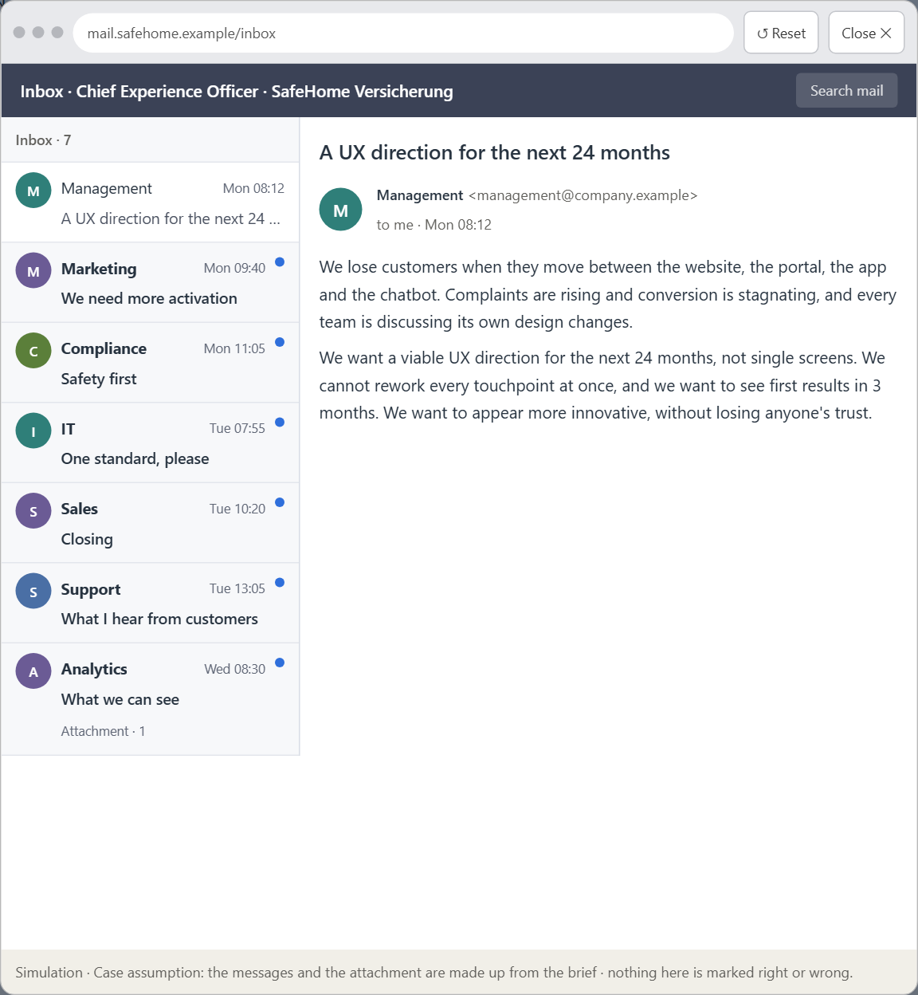
Block 3.1 · A Neuro-UX strategy for a digital service ecosystem
Level 3 · Transfer project · UE8–10 · about 20 min
You take the perspective of the Chief Experience Officer of the insurer that runs SafeHome Online. The company has several digital touchpoints: a website, the customer portal, an app and a chatbot. It loses users when they move between them, complaints are rising, conversion is stagnating, and inside the company people discuss isolated design changes. The management wants a viable UX direction for the next 24 months. You are not to optimise single screens but to design a sound decision architecture for psychologically effective and responsible UX.
Screenshot of the Neuro-UX Lab (aion-ux-lab.vercel.app), own work; AI-assisted, labelled on the image; the example company is fictional.
Draws on: B1 · Design steers perception, behaviour and decision · B2 · Conflicting goals · B3 · Accountable decisions under uncertainty.
Notes:
Block 3.1 · A Neuro-UX strategy for a digital service ecosystem · about 20 min. Draws on: B1 · Design steers perception, behaviour and decision · B2 · Conflicting goals · B3 · Accountable decisions under uncertainty.

Slide 17
Block 3.1 · What you work on
1
A Neuro-UX guiding vision for the company: which psychological effect on users should be created systematically?
2
Three strategic guiding decisions for the next 24 months, for example on the priority of orientation, trust design, reducing cognitive load or consistency across channels
3
A prioritised intervention architecture: which touchpoints are changed first, and why these in particular?
4
A risk analysis: which wrong assumptions would be especially dangerous, and what happens if you optimise for aesthetics instead of effect?
5
A governance model: who may take UX-relevant decisions, who carries the professional responsibility, and how are conflicts of goals decided?
6
A decision under uncertainty: make at least one prioritised decision although important information is missing, and say why it is still responsible
7
A management statement: a short statement to the board in which you stand for your strategy
Notes:
Block 3.1 · A Neuro-UX strategy for a digital service ecosystem · about 20 min. Draws on: B1 · Design steers perception, behaviour and decision · B2 · Conflicting goals · B3 · Accountable decisions under uncertainty.

Slide 18
Reflect before you leave
1
2
3
Which decision did you make today, and what did you give up to make it?
Which assumption would you check first with real users, and how?
What will you do differently in your next project because of today?
Use two minutes alone, then one minute with your neighbour.

Slide 19
About these slides, sources and AI use
AI
AI-assisted content
Where to find more
AI-assisted content: these slides were drafted with an AI language model (Claude, Anthropic) from the course's own Neuro-UX Lab and were read, corrected and approved by Muhammad Muchson, who is responsible for their accuracy.
Pictures are screenshots of the course's own Neuro-UX Lab. Each one carries an AI label on the image and a source line under it.
Companies and people in the examples are fictional. Numbers inside an example are labelled Case assumption and are not data.
The coaching and feedback questions are the course plan's own, translated into English.
Neuro-UX Lab for this day: https://aion-ux-lab.vercel.app/day/1/
Handouts: the Materi and Task Word documents of the day.
Version 1.0, 29.10.2026. Reviewer and approver: Muhammad Muchson.

