Slide 1
UX DEVELOPER · DAY 4
UX laws and cognitive perception
Training slides: tasks, coaching, case study and feedback
Module 3 (day 1 of 3)
Trainer: Muhammad Muchson · Case: MyEnergy
Contains AI-assisted content

Slide 2
The day at a glance (1)
UE | Min | What | What happens
1 | 45 | Knowledge transfer · Level 1 | The trainer presents the cards of Materi A (A1, A2, A3, A4, A5, about 60 min of cards) in the Neuro-UX Lab; participants follow in the handout.
2 | 45 | Level 1 · Task 1 | Individual work on Block 1.1 (Core, about 10 min): the first product of the day is read and its effect described. Pairs then compare their results and the trainer collects open questions.
3 | 45 | Level 1 · Task 2 | Three options are rated on the same criteria and one is chosen under the stated conditions: Block 1.2 (Core, about 8 min).
4 | 45 | Coaching · transition from Level 1 to Level 2 | Trainer-led. A short talk on the day's coaching focus, then the reflection questions in pairs. The bridge: from describing an effect to a decision you answer for. There is no worksheet block in this unit.
5–6 | 90 | Level 2 · Case study MyEnergy (2 UE) incl. model solution | UE5: the trainer presents the case; participants work on Block 2.1 (Core, about 15 min). UE6: groups compare their results and defend them; the trainer closes with the model solution.
7 | 45 | Level 2 + 3 · Feedback round with a management perspective | Groups present their reasoning, not only their result. The trainer asks the day's Level 3 input questions and leads the discussion.
One UE is 45 minutes; breaks are not shown.
Notes:
One UE (teaching unit) is counted as 45 minutes; breaks are not shown.

Slide 3
The day at a glance (2)
UE | Min | What | What happens
8 | 45 | Level 3 · Transfer project, Chief Experience Officer (3 UE: UE8–10) | The trainer presents Materi B (B1, B2, B3; use the "In plain words" and "How to decide" boxes, the rest is handout) and sets the role and the situation.
9 | 45 | Level 3 · Transfer project | Individual work or in pairs on Block 3.1 (Core, about 20 min): the strategy memo.
10 | 45 | Level 3 · Transfer project | Participants present their decision and what they give up, including the one decision made under uncertainty; the trainer debriefs with the model solution.
One UE is 45 minutes; breaks are not shown.
Notes:
One UE (teaching unit) is counted as 45 minutes; breaks are not shown.

Slide 4
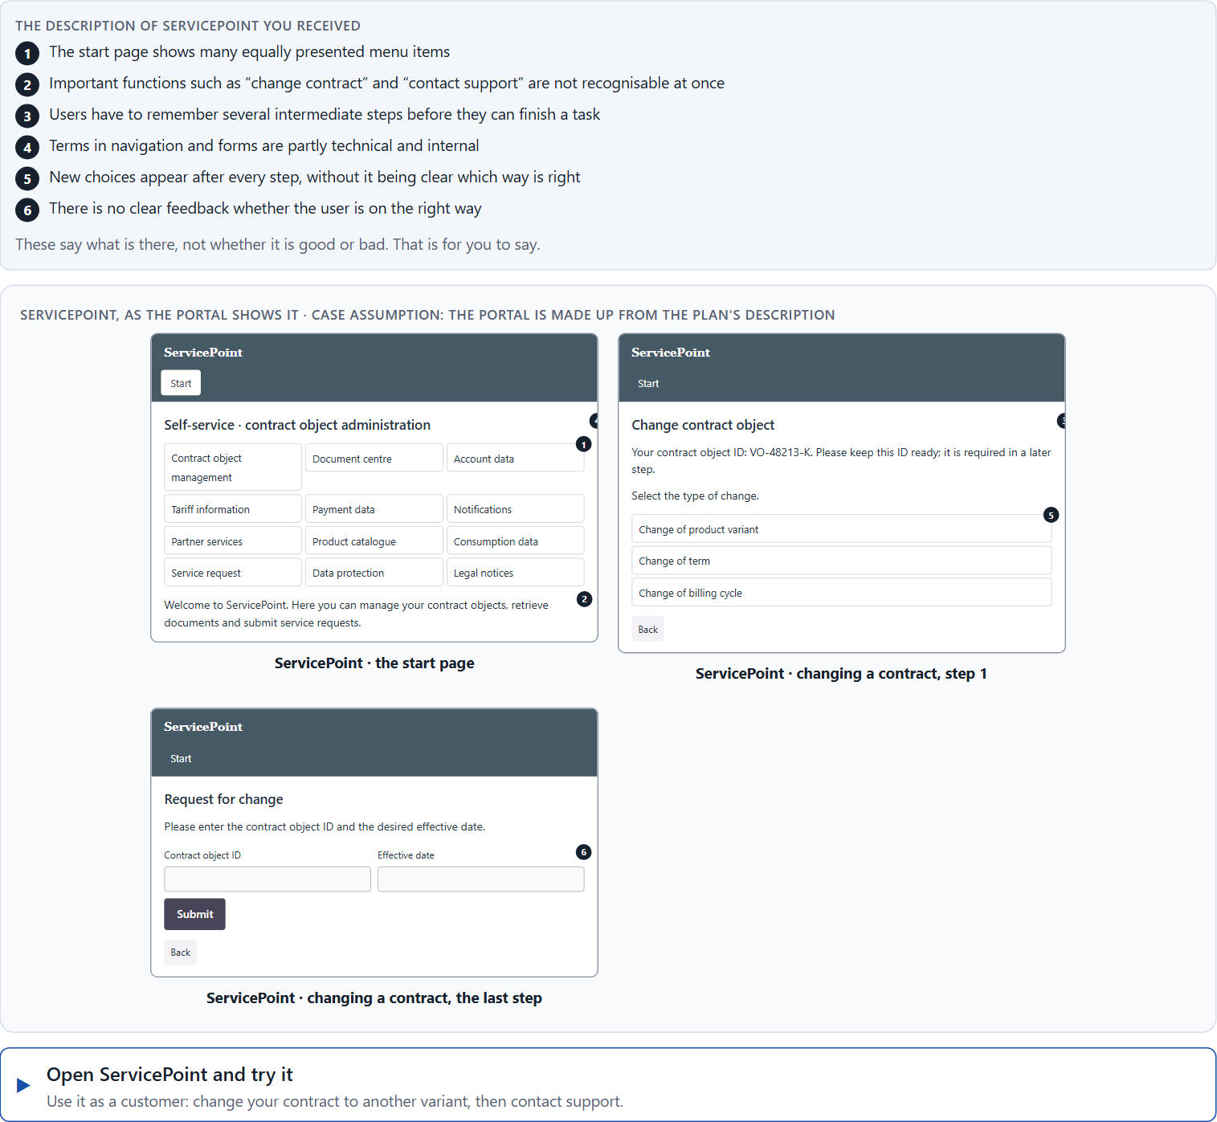
Block 1.1 · Recognise the hurdles of use in a digital application: ServicePoint
Level 1 · Knowledge · about 10 min
You receive the description of a fictional self-service portal, ServicePoint, for contract changes, document downloads and support requests. Open it and try to change your contract as a customer would. You need no prior knowledge: notice where you hesitate, search, have to remember something or are not sure you are on the right way. The aim is to observe usability from the user's side and to recognise cognitive friction step by step.
Screenshot of the Neuro-UX Lab (aion-ux-lab.vercel.app), own work; AI-assisted, labelled on the image; the example company is fictional.
Draws on: A1 · Intuitive use is designed · A2 · How people compare options and decide · A3 · Expectations, recognisability and a clear action logic · A4 · Memory and load.
Notes:
Block 1.1 · Recognise the hurdles of use in a digital application: ServicePoint · about 10 min. Draws on: A1 · Intuitive use is designed · A2 · How people compare options and decide · A3 · Expectations, recognisability and a clear action logic · A4 · Memory and load.

Slide 5
Block 1.1 · What you work on
Describe which places could feel unclear or tiring from the user's point of view
1
Name at least 5 possible obstacles to intuitive use
2
Assign the observations to the categories orientation, decision effort, memory load, understandability and action logic
3
Write an effect statement for three points: “For users this could mean that …”
4
Prioritise the two biggest hurdles of use for a first-time user
5
Notes:
Block 1.1 · Recognise the hurdles of use in a digital application: ServicePoint · about 10 min. Draws on: A1 · Intuitive use is designed · A2 · How people compare options and decide · A3 · Expectations, recognisability and a clear action logic · A4 · Memory and load.

Slide 6
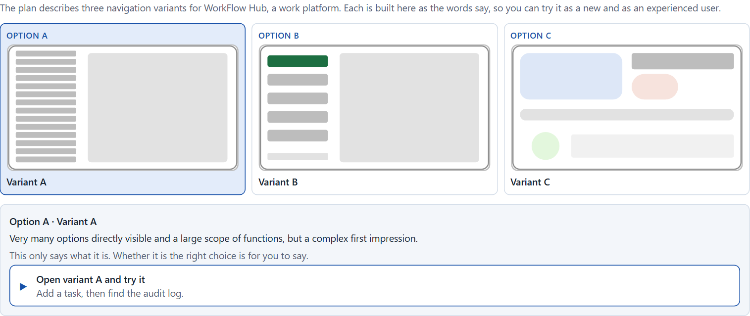
Block 1.2 · Rate UX decisions under conflicting goals: WorkFlow Hub
Level 1 · Knowledge · about 8 min
WorkFlow Hub is a work platform. Three variants for its navigation are described in words: A) very many options directly visible and a large scope of functions, but a complex first impression; B) a reduced navigation with a clear focus on the main tasks, but some rare functions lie deeper in the system; C) a modern presentation with interactive elements, but patterns that change between the areas. The conditions: the product must work for new and for existing users, the department demands that all functions are fully visible, the UX team demands reduction and a clear priority, the budget for deep changes is limited, the release is in 9 weeks, and user tests are only partly available. Decide anyway, and say what you assume.
Screenshot of the Neuro-UX Lab (aion-ux-lab.vercel.app), own work; AI-assisted, labelled on the image; the example company is fictional.
Draws on: A2 · How people compare options and decide · A3 · Expectations, recognisability and a clear action logic · A5 · UX laws as tools against friction, and weighing a measure.
Notes:
Block 1.2 · Rate UX decisions under conflicting goals: WorkFlow Hub · about 8 min. Draws on: A2 · How people compare options and decide · A3 · Expectations, recognisability and a clear action logic · A5 · UX laws as tools against friction, and weighing a measure.

Slide 7
Block 1.2 · What you work on
Rate each variant on orientation, efficiency, understandability, learning effort and error risk
1
Decide which variant is the most viable at present
2
Name the conflicts of goals that influence your decision
3
Which risks do you knowingly accept under time pressure?
4
Formulate a decision recommendation for the project management
5
Notes:
Block 1.2 · Rate UX decisions under conflicting goals: WorkFlow Hub · about 8 min. Draws on: A2 · How people compare options and decide · A3 · Expectations, recognisability and a clear action logic · A5 · UX laws as tools against friction, and weighing a measure.

Slide 8
Coaching · UE4
Transition: Level 1 to Level 2
From interfaces to cognitively sustainable user guidance
From describing an effect to a decision you answer for.
Notes:
UE4 · Coaching: transition from Level 1 to Level 2. Trainer-led: a short talk on the coaching focus, then the reflection questions in pairs.

Slide 9
Coaching · questions we talk through
What makes an operation truly intuitive and not only visually appealing?
How do I deal with conflicts between completeness and simplicity?
1
5
Why is cognitive relief a strategic success factor?
How do I argue towards departments that want to make more functions visible?
2
6
How do I recognise that users have to search, remember or interpret too much?
Which UX decisions improve not only the surface but the whole logic of action?
3
7
Which kinds of complexity are unavoidable and which are home-made?
4
Notes:
UE4 · Coaching: transition from Level 1 to Level 2. Trainer-led: a short talk on the coaching focus, then the reflection questions in pairs.

Slide 10
Coaching · reflect in pairs
1
2
3
Where do systems create unnecessary thinking work instead of orientation?
Which operating hurdle is most often underestimated in projects?
When should efficiency take priority over functional completeness?
Notes:
UE4 · Coaching: transition from Level 1 to Level 2. Trainer-led: a short talk on the coaching focus, then the reflection questions in pairs.

Slide 11
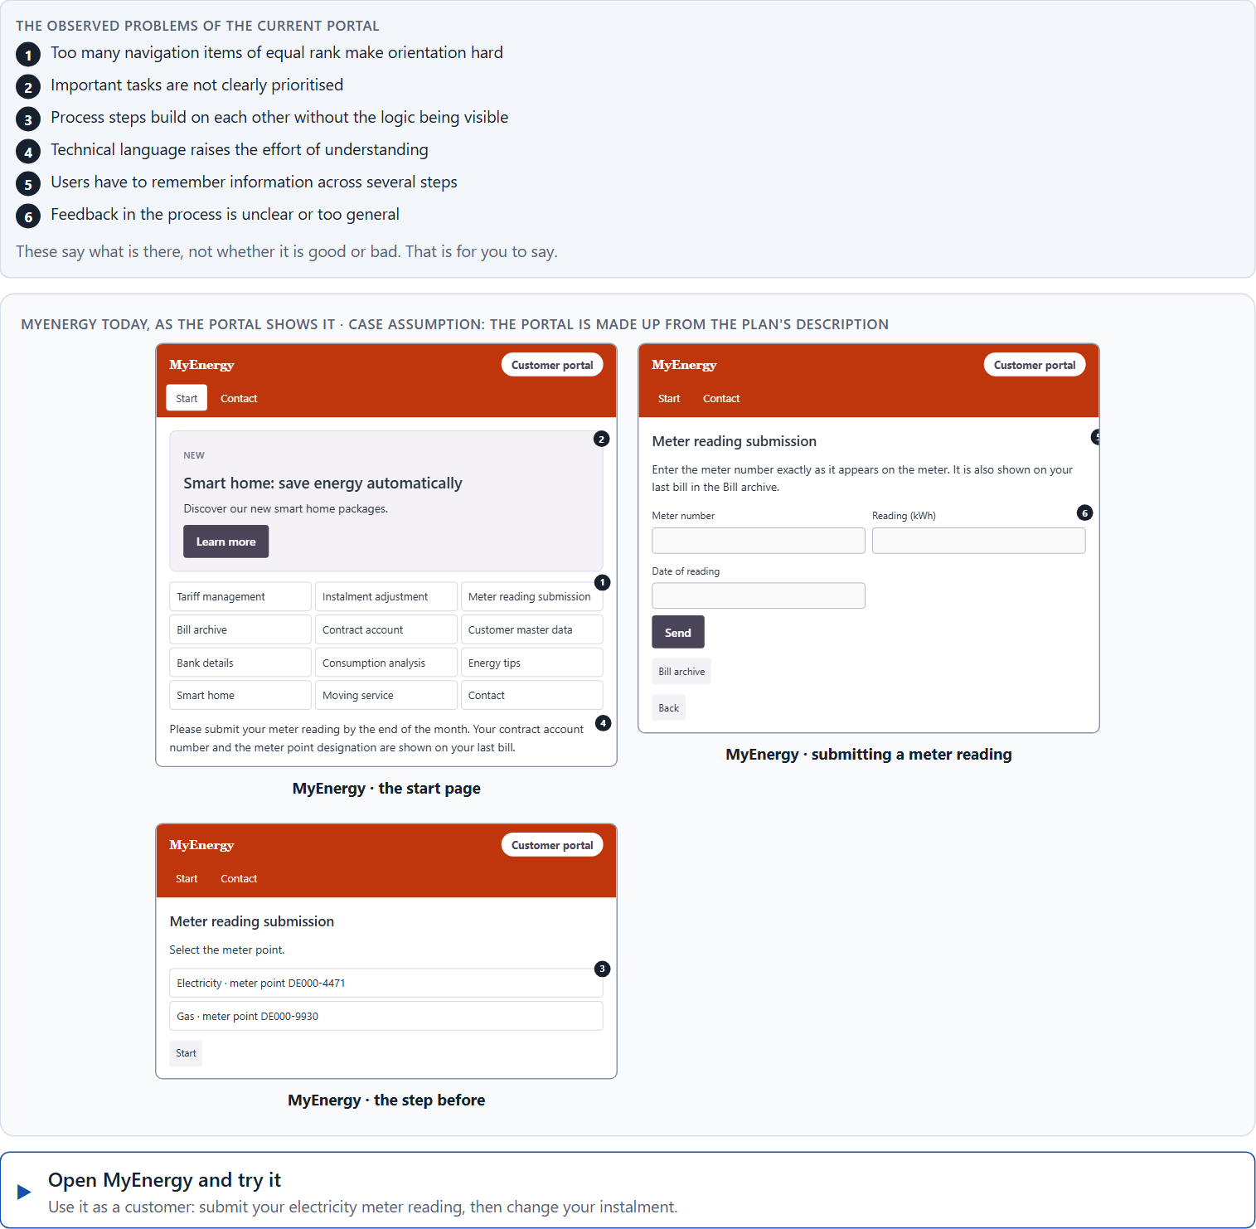
Block 2.1 · Case study: reorganising the customer portal MyEnergy
Level 2 · Case study · UE5–6 · about 15 min
An energy supplier runs MyEnergy, an online portal for tariff changes, adjusting instalments, submitting meter readings and retrieving bills. The portal offers many functions, but users often report that they cannot find tasks quickly or that they abandon processes. The company wants use to be more efficient and intuitive without reducing the scope of functions much. The observed problems: too many navigation items of equal rank make orientation hard, important tasks are not clearly prioritised, process steps build on each other without the logic being visible, technical language raises the effort of understanding, users have to remember information across several steps, and feedback in the process is unclear or too general. The conditions: a budget of €160,000, 12 weeks for the implementation, no complete relaunch, several departments want to keep their functions prominently visible, and user data is only partly available. You work through six steps.
Screenshot of the Neuro-UX Lab (aion-ux-lab.vercel.app), own work; AI-assisted, labelled on the image; the example company is fictional.
Draws on: A1 · Intuitive use is designed · A2 · How people compare options and decide · A3 · Expectations, recognisability and a clear action logic · A4 · Memory and load · A5 · UX laws as tools against friction, and weighing a measure.
Notes:
Block 2.1 · Case study: reorganising the customer portal MyEnergy · about 15 min. Draws on: A1 · Intuitive use is designed · A2 · How people compare options and decide · A3 · Expectations, recognisability and a clear action logic · A4 · Memory and load · A5 · UX laws as tools against friction, and weighing a measure.

Slide 12
Block 2.1 · What you work on
Analyse the central problems of use and cognition in the portal
1
Assign the problems to the categories orientation, decision effort, memory load, feedback and understandability
2
Develop 4 prioritised measures to improve intuitive use
3
Justify your selection using effect on users, feasibility, risk and time pressure
4
Make a prioritisation decision for the first 12 weeks
5
Formulate a recommendation to the division management
6
Notes:
Block 2.1 · Case study: reorganising the customer portal MyEnergy · about 15 min. Draws on: A1 · Intuitive use is designed · A2 · How people compare options and decide · A3 · Expectations, recognisability and a clear action logic · A4 · Memory and load · A5 · UX laws as tools against friction, and weighing a measure.

Slide 13
Feedback round · how each group presents
Each group presents its prioritised measures in 5 minutes
1
The reasoning must rest on user effect, risk, feasibility and responsibility
2
Each group names one measure it deliberately did not prioritise
3
Notes:
UE7 · Feedback round with a management perspective. Groups present their reasoning, not only their result.

Slide 14
Feedback round · questions to answer
Which measure lowers the cognitive load fastest?
Which risks remain despite the prioritisation?
1
4
Which decision improves the system logic most lastingly?
Which decision can still be answered for under an incomplete data situation?
2
5
Where was the focus on real relief for users, and where only on correcting the surface?
3
Notes:
UE7 · Feedback round with a management perspective. Groups present their reasoning, not only their result.

Slide 15
Level 3 input and discussion
INPUT LEVEL 3
DISCUSSION
UX laws become strategically relevant only when they influence prioritisation and product direction
Senior-level thinking means not only improving interfaces but reducing friction in the whole system
Good decisions balance user relief, department interests, feasibility and time pressure
When does a lack of intuitive operation become an economic and organisational risk?
Notes:
UE7 · Feedback round with a management perspective. Groups present their reasoning, not only their result.

Slide 16
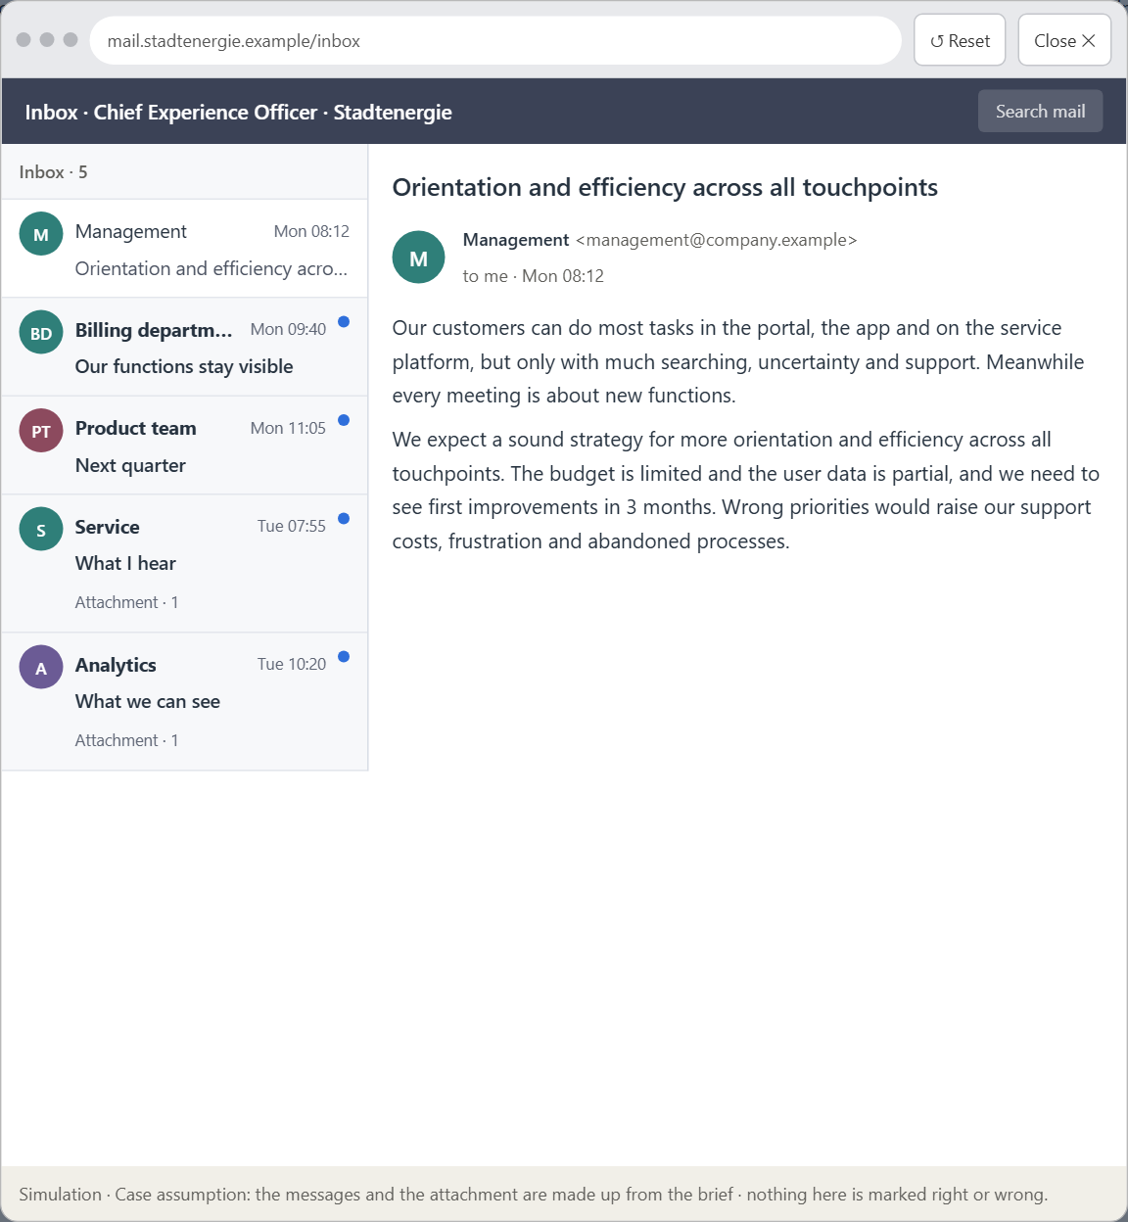
Block 3.1 · A strategy for intuitive use in a complex digital product system
Level 3 · Transfer project · UE8–10 · about 20 min
You take the perspective of the Chief Experience Officer of the energy supplier that runs MyEnergy. The company has a customer portal, a mobile app and a service platform. Customers can do most tasks in principle, but only with much searching, uncertainty and support. Inside the company the discussion is about new functions, while the central problems of use remain unsolved. The management expects a sound strategy for more orientation and efficiency across all digital touchpoints. You are not to correct single screens but to develop a sound decision architecture for intuitive use based on cognitive principles.
Screenshot of the Neuro-UX Lab (aion-ux-lab.vercel.app), own work; AI-assisted, labelled on the image; the example company is fictional.
Draws on: B1 · Usability as a strategic factor · B2 · Conflicts of goals · B3 · Who owns the interaction logic, and deciding with partial user data.
Notes:
Block 3.1 · A strategy for intuitive use in a complex digital product system · about 20 min. Draws on: B1 · Usability as a strategic factor · B2 · Conflicts of goals · B3 · Who owns the interaction logic, and deciding with partial user data.

Slide 17
Block 3.1 · What you work on
1
A guiding vision for intuitive use: which user experience and which action logic should be enabled systematically?
2
Three strategic guiding decisions on orientation, efficiency, reducing complexity and prioritising the main tasks
3
A prioritised architecture of measures: which systems or processes are improved first, and why?
4
A risk analysis: which wrong assumptions about user behaviour and internal requirements would be especially critical?
5
A governance model: who is responsible for decisions on the interaction logic, and how are conflicts of goals decided?
6
A decision under uncertainty: make at least one prioritised decision despite incomplete data and justify it responsibly
7
A management statement: a recommendation to the management with a clear priority and a strategic reason
Notes:
Block 3.1 · A strategy for intuitive use in a complex digital product system · about 20 min. Draws on: B1 · Usability as a strategic factor · B2 · Conflicts of goals · B3 · Who owns the interaction logic, and deciding with partial user data.

Slide 18
Reflect before you leave
1
2
3
Which decision did you make today, and what did you give up to make it?
Which assumption would you check first with real users, and how?
What will you do differently in your next project because of today?
Use two minutes alone, then one minute with your neighbour.

Slide 19
About these slides, sources and AI use
AI
AI-assisted content
Where to find more
AI-assisted content: these slides were drafted with an AI language model (Claude, Anthropic) from the course's own Neuro-UX Lab and were read, corrected and approved by Muhammad Muchson, who is responsible for their accuracy.
Pictures are screenshots of the course's own Neuro-UX Lab. Each one carries an AI label on the image and a source line under it.
Companies and people in the examples are fictional. Numbers inside an example are labelled Case assumption and are not data.
The coaching and feedback questions are the course plan's own, translated into English.
Neuro-UX Lab for this day: https://aion-ux-lab.vercel.app/day/4/
Handouts: the Materi and Task Word documents of the day.
Version 1.0, 29.10.2026. Reviewer and approver: Muhammad Muchson.

