Slide 1
UX DEVELOPER · DAY 5
Fitts, Hick and Miller in practice
Training slides: tasks, coaching, case study and feedback
Module 3 (day 2 of 3)
Trainer: Muhammad Muchson · Case: MoveEasy
Contains AI-assisted content

Slide 2
The day at a glance (1)
UE | Min | What | What happens
1 | 45 | Knowledge transfer · Level 1 | The trainer presents the cards of Materi A (A1, A2, A3, A4, A5, about 60 min of cards) in the Neuro-UX Lab; participants follow in the handout.
2 | 45 | Level 1 · Task 1 | Individual work on Block 1.1 (Core, about 10 min): the first product of the day is read and its effect described. Pairs then compare their results and the trainer collects open questions.
3 | 45 | Level 1 · Task 2 | Three options are rated on the same criteria and one is chosen under the stated conditions: Block 1.2 (Core, about 8 min).
4 | 45 | Coaching · transition from Level 1 to Level 2 | Trainer-led. A short talk on the day's coaching focus, then the reflection questions in pairs. The bridge: from describing an effect to a decision you answer for. There is no worksheet block in this unit.
5–6 | 90 | Level 2 · Case study MoveEasy (2 UE) incl. model solution | UE5: the trainer presents the case; participants work on Block 2.1 (Core, about 15 min). UE6: groups compare their results and defend them; the trainer closes with the model solution.
7 | 45 | Level 2 + 3 · Feedback round with a management perspective | Groups present their reasoning, not only their result. The trainer asks the day's Level 3 input questions and leads the discussion.
One UE is 45 minutes; breaks are not shown.
Notes:
One UE (teaching unit) is counted as 45 minutes; breaks are not shown.

Slide 3
The day at a glance (2)
UE | Min | What | What happens
8 | 45 | Level 3 · Transfer project, Chief Experience Officer (3 UE: UE8–10) | The trainer presents Materi B (B1, B2, B3; use the "In plain words" and "How to decide" boxes, the rest is handout) and sets the role and the situation.
9 | 45 | Level 3 · Transfer project | Individual work or in pairs on Block 3.1 (Core, about 20 min): the strategy memo.
10 | 45 | Level 3 · Transfer project | Participants present their decision and what they give up, including the one decision made under uncertainty; the trainer debriefs with the model solution.
One UE is 45 minutes; breaks are not shown.
Notes:
One UE (teaching unit) is counted as 45 minutes; breaks are not shown.

Slide 4
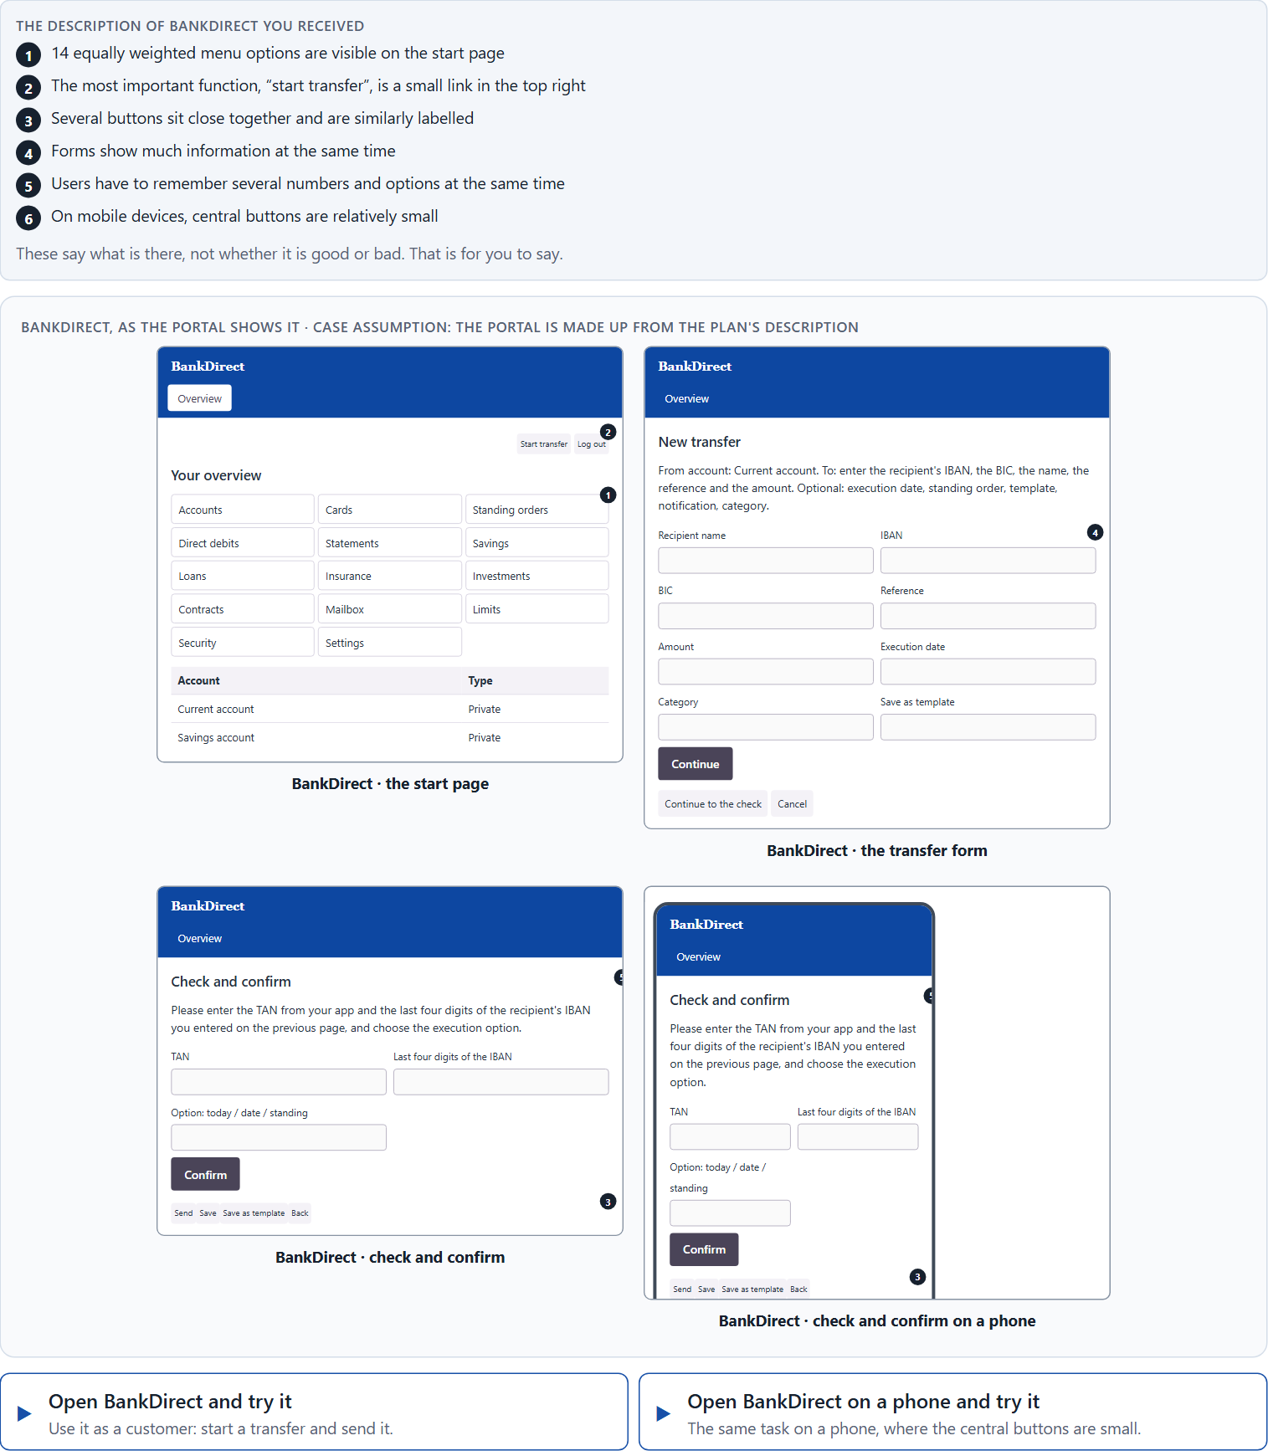
Block 1.1 · Recognise interaction hurdles in a portal: BankDirect
Level 1 · Knowledge · about 10 min
You receive the description of a fictional customer portal, BankDirect, for transfers, card management and contract services. Open it, on the desktop and on a phone, and try to start a transfer as a customer would. You need no prior knowledge: notice where you are slow, unsure or close to a mistake. The aim is to recognise the three UX laws in concrete problems of use and to describe their effect step by step.
Screenshot of the Neuro-UX Lab (aion-ux-lab.vercel.app), own work; AI-assisted, labelled on the image; the example company is fictional.
Draws on: A1 · Fitts's law · A2 · Hick's law · A3 · Miller's rule · A4 · The three laws together.
Notes:
Block 1.1 · Recognise interaction hurdles in a portal: BankDirect · about 10 min. Draws on: A1 · Fitts's law · A2 · Hick's law · A3 · Miller's rule · A4 · The three laws together.

Slide 5
Block 1.1 · What you work on
Describe which places could feel slow, unclear or error-prone from the user's point of view
1
Assign the observations to the three laws Fitts's law, Hick's law and Miller's rule
2
Name at least 5 concrete hurdles of use
3
Write an effect statement for three points: “For users this could mean that …”
4
Prioritise the two biggest weaknesses with regard to efficiency and error risk
5
Notes:
Block 1.1 · Recognise interaction hurdles in a portal: BankDirect · about 10 min. Draws on: A1 · Fitts's law · A2 · Hick's law · A3 · Miller's rule · A4 · The three laws together.

Slide 6
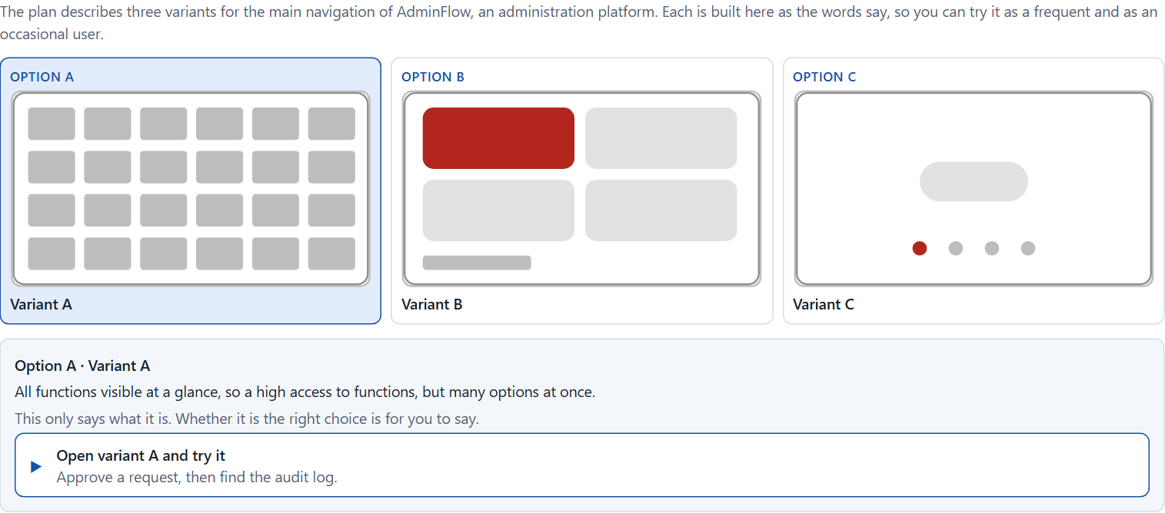
Block 1.2 · Rate navigation and interaction concepts under conflicting goals: AdminFlow
Level 1 · Knowledge · about 8 min
AdminFlow is an administration platform. Three variants for its main navigation are described in words: A) all functions visible at a glance, so a high access to functions, but many options at once; B) the central tasks are large and easy to reach, while rare functions lie deeper in submenus; C) a modern, minimalist layout with few visible options, but many steps to the actual action. The conditions: the target group is frequent and occasional users, the department demands that all functions are visible, IT wants to manage with little rework, mobile use is rising strongly, the release is in 7 weeks, and only limited user test data exists. Decide anyway, and say what you assume.
Screenshot of the Neuro-UX Lab (aion-ux-lab.vercel.app), own work; AI-assisted, labelled on the image; the example company is fictional.
Draws on: A1 · Fitts's law · A2 · Hick's law · A3 · Miller's rule · A5 · Less searching, fewer errors, less decision stress, and weighing a measure.
Notes:
Block 1.2 · Rate navigation and interaction concepts under conflicting goals: AdminFlow · about 8 min. Draws on: A1 · Fitts's law · A2 · Hick's law · A3 · Miller's rule · A5 · Less searching, fewer errors, less decision stress, and weighing a measure.

Slide 7
Block 1.2 · What you work on
Rate each variant on reachability, decision effort, memory load, efficiency and error risk
1
Decide which variant is the most viable under the given conditions
2
Name the conflicts of goals that make your decision difficult
3
Which risks do you knowingly take with your decision?
4
Formulate a recommendation to the project management
5
Notes:
Block 1.2 · Rate navigation and interaction concepts under conflicting goals: AdminFlow · about 8 min. Draws on: A1 · Fitts's law · A2 · Hick's law · A3 · Miller's rule · A5 · Less searching, fewer errors, less decision stress, and weighing a measure.

Slide 8
Coaching · UE4
Transition: Level 1 to Level 2
From UX laws to sound interaction decisions
From describing an effect to a decision you answer for.
Notes:
UE4 · Coaching: transition from Level 1 to Level 2. Trainer-led: a short talk on the coaching focus, then the reflection questions in pairs.

Slide 9
Coaching · questions we talk through
Why are Fitts' Law, Hick's Law and Miller's Rule not theory but directly relevant to the business?
How do I argue against the wish to make “everything visible at a glance”?
1
5
How do I tell whether an interface demands too many options at once?
Which risks arise when users have to remember or compare too much?
2
6
When is reduction sensible, and when does it become a hurdle itself?
Which decisions are operational, which strategic for product quality and efficiency?
3
7
How do small click targets and awkward positions affect the quality of use?
4
Notes:
UE4 · Coaching: transition from Level 1 to Level 2. Trainer-led: a short talk on the coaching focus, then the reflection questions in pairs.

Slide 10
Coaching · reflect in pairs
1
2
3
Where do digital products create unnecessary effort of decision?
Which interaction decision especially often causes hidden error costs?
When should accessibility be more important than the full visibility of functions?
Notes:
UE4 · Coaching: transition from Level 1 to Level 2. Trainer-led: a short talk on the coaching focus, then the reflection questions in pairs.

Slide 11
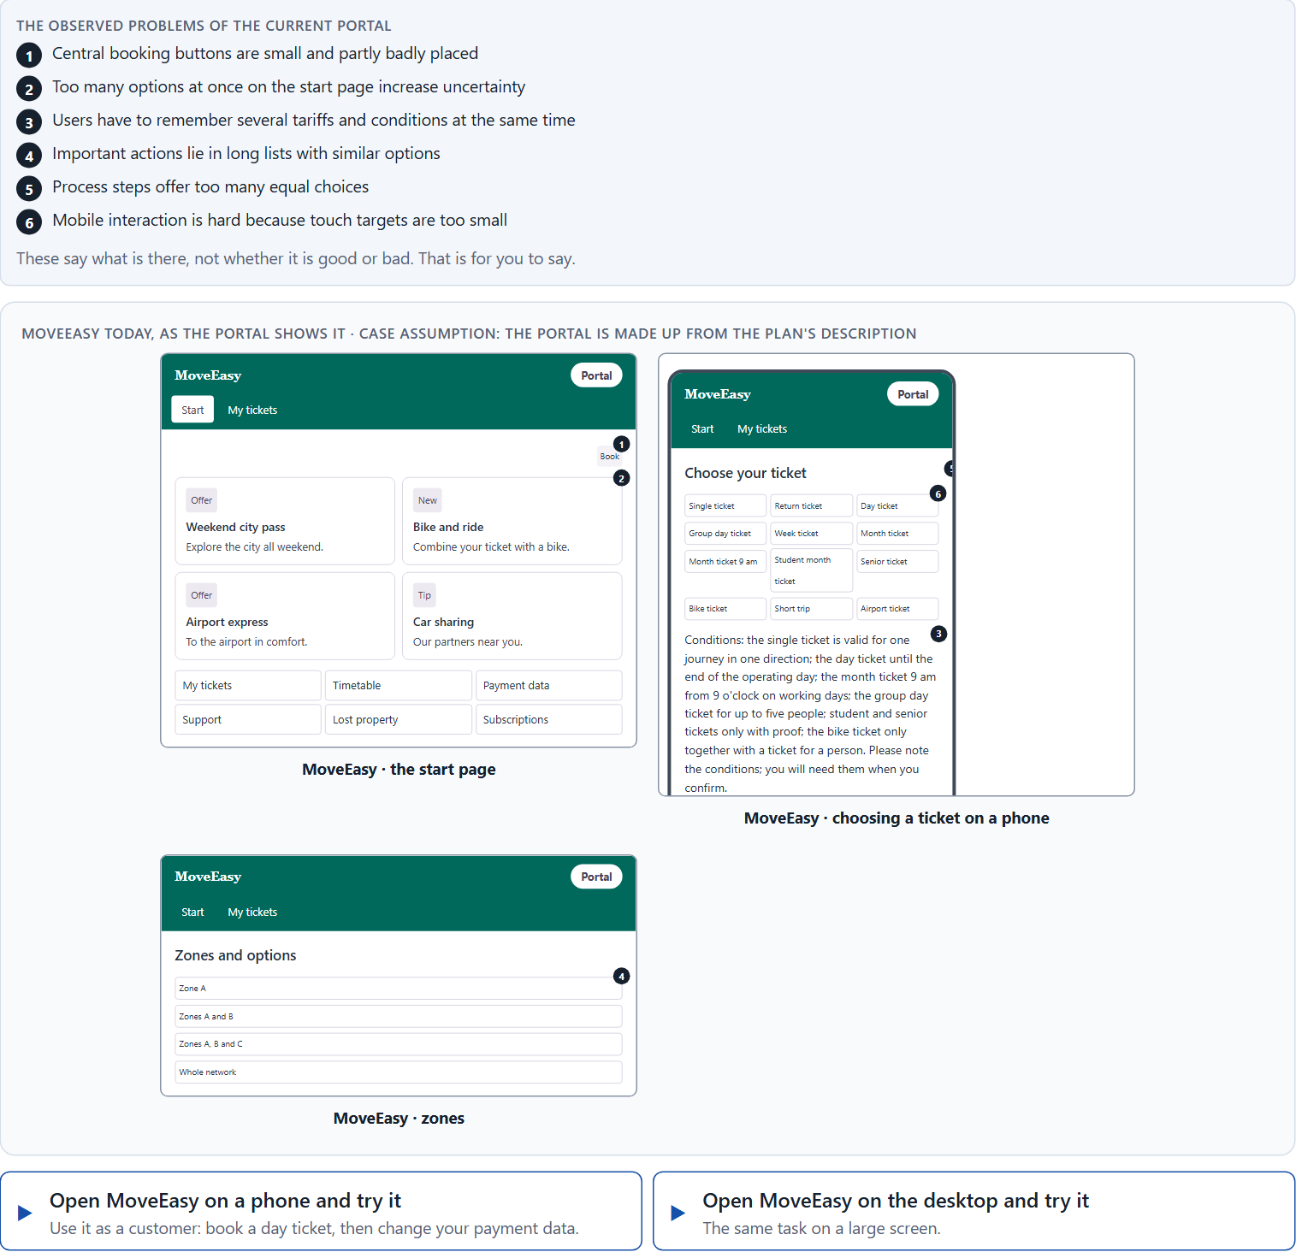
Block 2.1 · Case study: optimising the booking and management portal MoveEasy
Level 2 · Case study · UE5–6 · about 15 min
A provider of mobility services runs MoveEasy, a portal where users book trips, manage tickets, change payment data and send support requests. The portal is rich in functions, but use is slow and error-prone; above all on mobile devices, mis-taps and abandoned processes pile up. The observed problems: central booking buttons are small and partly badly placed, too many options at once on the start page raise uncertainty, users have to remember several tariffs and conditions at once, important actions lie in long lists of similar options, process steps offer too many equal choices, and mobile interaction is hard because touch targets are too small. The conditions: a budget of €140,000, 10 weeks for the implementation, mobile use is already above 60 %, a complete relaunch is not possible, marketing wants to keep as many offers visible as possible, and support demands fewer operating errors and questions. You work through six steps.
Screenshot of the Neuro-UX Lab (aion-ux-lab.vercel.app), own work; AI-assisted, labelled on the image; the example company is fictional.
Draws on: A1 · Fitts's law · A2 · Hick's law · A3 · Miller's rule · A4 · The three laws together · A5 · Less searching, fewer errors, less decision stress, and weighing a measure.
Notes:
Block 2.1 · Case study: optimising the booking and management portal MoveEasy · about 15 min. Draws on: A1 · Fitts's law · A2 · Hick's law · A3 · Miller's rule · A4 · The three laws together · A5 · Less searching, fewer errors, less decision stress, and weighing a measure.

Slide 12
Block 2.1 · What you work on
Analyse the central problems of interaction and decision in the portal
1
Assign the problems to the categories reachability, decision effort, memory load, mobile usability and error risk
2
Develop 4 prioritised measures for improvement
3
Justify your selection using effect on users, feasibility, risk and time pressure
4
Make a prioritisation decision for the first 10 weeks
5
Formulate a recommendation to the division management
6
Notes:
Block 2.1 · Case study: optimising the booking and management portal MoveEasy · about 15 min. Draws on: A1 · Fitts's law · A2 · Hick's law · A3 · Miller's rule · A4 · The three laws together · A5 · Less searching, fewer errors, less decision stress, and weighing a measure.

Slide 13
Feedback round · how each group presents
Each group presents its prioritised measures in 5 minutes
1
The argument runs along user effect, feasibility, risk and responsibility
2
Each group names one measure that was deliberately put back
3
Notes:
UE7 · Feedback round with a management perspective. Groups present their reasoning, not only their result.

Slide 14
Feedback round · questions to answer
Which measure raises the speed of operation most?
Which decision is well defensible despite an incomplete data situation?
1
4
Which measure reduces the risk of errors most lastingly?
Which risks arise when abundance of functions is valued higher than efficiency of interaction?
2
5
Where was the prioritisation clean, and where were only symptoms corrected?
3
Notes:
UE7 · Feedback round with a management perspective. Groups present their reasoning, not only their result.

Slide 15
Level 3 input and discussion
INPUT LEVEL 3
DISCUSSION
At senior level the three UX laws become steering instruments for product architecture
Good management decisions reduce not only surface problems but systemic friction
Being able to answer for a decision shows in setting clear interaction priorities even under uncertainty
When does a seemingly small interaction problem become a strategic business problem?
Notes:
UE7 · Feedback round with a management perspective. Groups present their reasoning, not only their result.

Slide 16
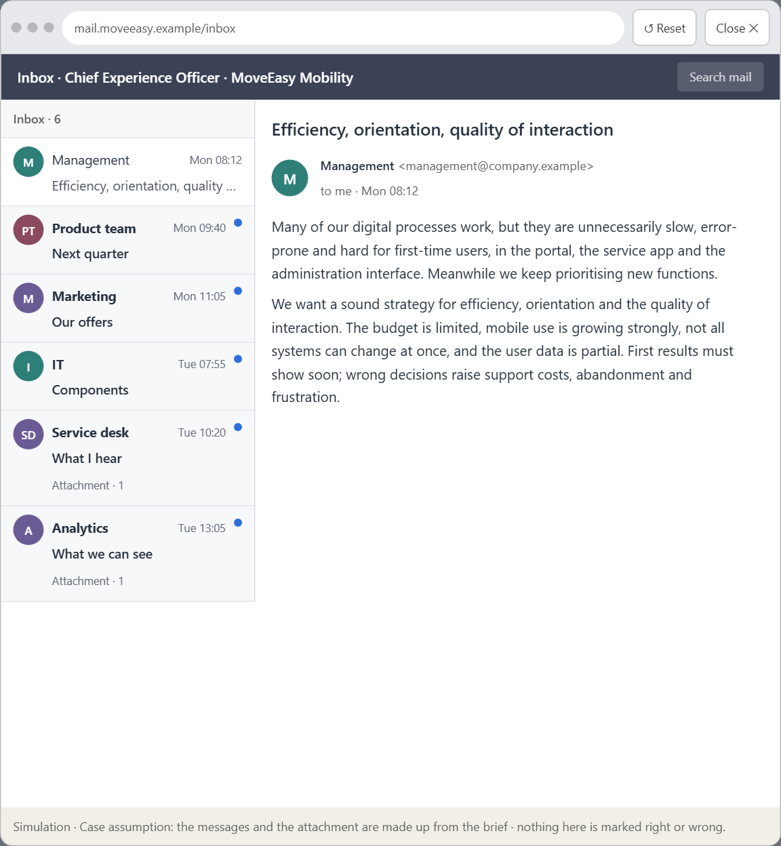
Block 3.1 · An interaction strategy for efficient, low-load digital use
Level 3 · Transfer project · UE8–10 · about 20 min
You take the perspective of the Chief Experience Officer of the mobility provider that runs MoveEasy. The company has a customer portal, a service app and an administration interface. Many digital processes work, but they are unnecessarily slow, error-prone and hard to access for first-time users. Inside the company new functions are prioritised, although known problems of reach, choice complexity and information overload remain unsolved. The management demands a sound strategy to improve efficiency, orientation and the quality of interaction. You are not to correct single buttons or menus but to develop a sound decision architecture for navigation, interaction and action logic based on Fitts's law, Hick's law and Miller's rule.
Screenshot of the Neuro-UX Lab (aion-ux-lab.vercel.app), own work; AI-assisted, labelled on the image; the example company is fictional.
Draws on: B1 · Interaction as an architecture of effect · B2 · Conflicts of goals · B3 · Who owns the interaction standards, and deciding with incomplete data.
Notes:
Block 3.1 · An interaction strategy for efficient, low-load digital use · about 20 min. Draws on: B1 · Interaction as an architecture of effect · B2 · Conflicts of goals · B3 · Who owns the interaction standards, and deciding with incomplete data.

Slide 17
Block 3.1 · What you work on
1
A guiding vision for efficient interaction: which quality of use and which relief for users should be reached systematically?
2
Three strategic guiding decisions on reachability, reducing choice, structuring information and prioritising main actions
3
A prioritised architecture of measures: which processes, screens or systems are improved first, and why?
4
A risk analysis: which wrong assumptions about user behaviour and the need for functions would be especially critical?
5
A governance model: who is responsible for the interaction standards, and how are conflicts between feature richness and usability decided?
6
A decision under uncertainty: make at least one prioritised decision despite incomplete data and justify it
7
A management statement: a recommendation to the management with a clear priority and a strategic reason
Notes:
Block 3.1 · An interaction strategy for efficient, low-load digital use · about 20 min. Draws on: B1 · Interaction as an architecture of effect · B2 · Conflicts of goals · B3 · Who owns the interaction standards, and deciding with incomplete data.

Slide 18
Reflect before you leave
1
2
3
Which decision did you make today, and what did you give up to make it?
Which assumption would you check first with real users, and how?
What will you do differently in your next project because of today?
Use two minutes alone, then one minute with your neighbour.

Slide 19
About these slides, sources and AI use
AI
AI-assisted content
Where to find more
AI-assisted content: these slides were drafted with an AI language model (Claude, Anthropic) from the course's own Neuro-UX Lab and were read, corrected and approved by Muhammad Muchson, who is responsible for their accuracy.
Pictures are screenshots of the course's own Neuro-UX Lab. Each one carries an AI label on the image and a source line under it.
Companies and people in the examples are fictional. Numbers inside an example are labelled Case assumption and are not data.
The coaching and feedback questions are the course plan's own, translated into English.
Neuro-UX Lab for this day: https://aion-ux-lab.vercel.app/day/5/
Handouts: the Materi and Task Word documents of the day.
Version 1.0, 29.10.2026. Reviewer and approver: Muhammad Muchson.

