Slide 1
UX DEVELOPER · DAY 6
Gestalt, hierarchy, progressive disclosure and design systems
Training slides: tasks, coaching, case study and feedback
Module 3 (day 3 of 3)
Trainer: Muhammad Muchson · Case: CitizenFlow
Contains AI-assisted content

Slide 2
The day at a glance (1)
UE | Min | What | What happens
1 | 45 | Knowledge transfer · Level 1 | The trainer presents the cards of Materi A (A1, A2, A3, A4, A5, about 60 min of cards) in the Neuro-UX Lab; participants follow in the handout.
2 | 45 | Level 1 · Task 1 | Individual work on Block 1.1 (Core, about 10 min): the first product of the day is read and its effect described. Pairs then compare their results and the trainer collects open questions.
3 | 45 | Level 1 · Task 2 | Three options are rated on the same criteria and one is chosen under the stated conditions: Block 1.2 (Core, about 8 min).
4 | 45 | Coaching · transition from Level 1 to Level 2 | Trainer-led. A short talk on the day's coaching focus, then the reflection questions in pairs. The bridge: from describing an effect to a decision you answer for. There is no worksheet block in this unit.
5–6 | 90 | Level 2 · Case study CitizenFlow (2 UE) incl. model solution | UE5: the trainer presents the case; participants work on Block 2.1 (Core, about 15 min). UE6: groups compare their results and defend them; the trainer closes with the model solution.
7 | 45 | Level 2 + 3 · Feedback round with a management perspective | Groups present their reasoning, not only their result. The trainer asks the day's Level 3 input questions and leads the discussion.
One UE is 45 minutes; breaks are not shown.
Notes:
One UE (teaching unit) is counted as 45 minutes; breaks are not shown.

Slide 3
The day at a glance (2)
UE | Min | What | What happens
8 | 45 | Level 3 · Transfer project, Chief Experience Officer (3 UE: UE8–10) | The trainer presents Materi B (B1, B2, B3; use the "In plain words" and "How to decide" boxes, the rest is handout) and sets the role and the situation.
9 | 45 | Level 3 · Transfer project | Individual work or in pairs on Block 3.1 (Core, about 20 min): the strategy memo.
10 | 45 | Level 3 · Transfer project | Participants present their decision and what they give up, including the one decision made under uncertainty; the trainer debriefs with the model solution.
One UE is 45 minutes; breaks are not shown.
Notes:
One UE (teaching unit) is counted as 45 minutes; breaks are not shown.

Slide 4
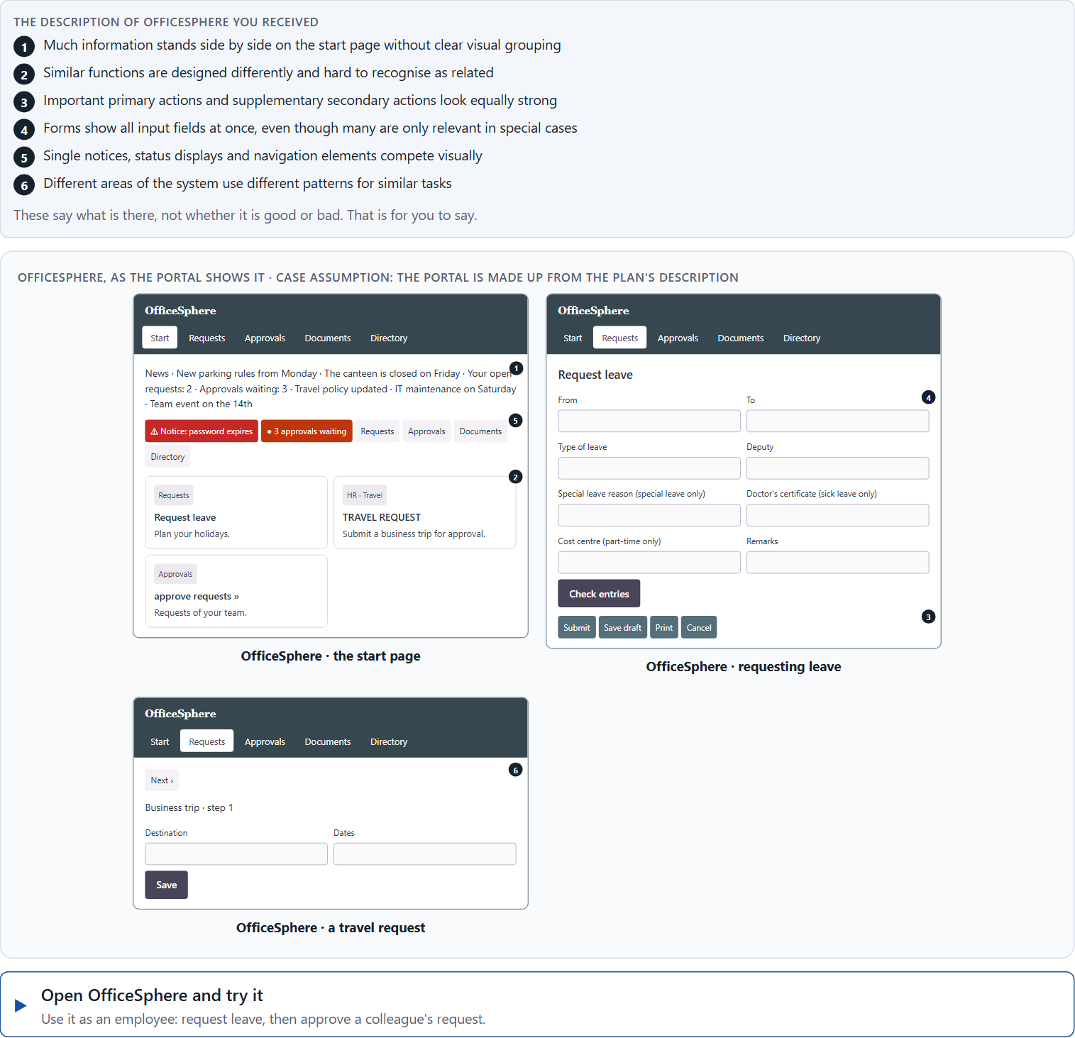
Block 1.1 · Recognise navigation and structure problems in a complex interface: OfficeSphere
Level 1 · Knowledge · about 10 min
You receive the description of a fictional administration portal, OfficeSphere, for internal processes, requests and approvals. Open it and try to request leave and approve a colleague's request, as an employee would. You need no prior knowledge: notice where the page feels unclear or overwhelming and where you cannot tell what belongs together. The aim is to recognise Gestalt and structure problems step by step and to describe their influence on navigation and mental load.
Screenshot of the Neuro-UX Lab (aion-ux-lab.vercel.app), own work; AI-assisted, labelled on the image; the example company is fictional.
Draws on: A1 · Gestalt laws for navigation · A2 · Visual hierarchy · A3 · Progressive disclosure · A4 · Hierarchy, navigation logic and relief.
Notes:
Block 1.1 · Recognise navigation and structure problems in a complex interface: OfficeSphere · about 10 min. Draws on: A1 · Gestalt laws for navigation · A2 · Visual hierarchy · A3 · Progressive disclosure · A4 · Hierarchy, navigation logic and relief.

Slide 5
Block 1.1 · What you work on
Describe which places could feel unclear or overwhelming from the user's point of view
1
Assign the observations to the categories Gestalt laws, visual hierarchy, amount of information, navigation logic and consistency
2
Name at least 5 problems that make intuitive navigation difficult
3
Write an effect statement for three points: “For users this could mean that …”
4
Prioritise the two biggest weaknesses with regard to orientation and cognitive relief
5
Notes:
Block 1.1 · Recognise navigation and structure problems in a complex interface: OfficeSphere · about 10 min. Draws on: A1 · Gestalt laws for navigation · A2 · Visual hierarchy · A3 · Progressive disclosure · A4 · Hierarchy, navigation logic and relief.

Slide 6
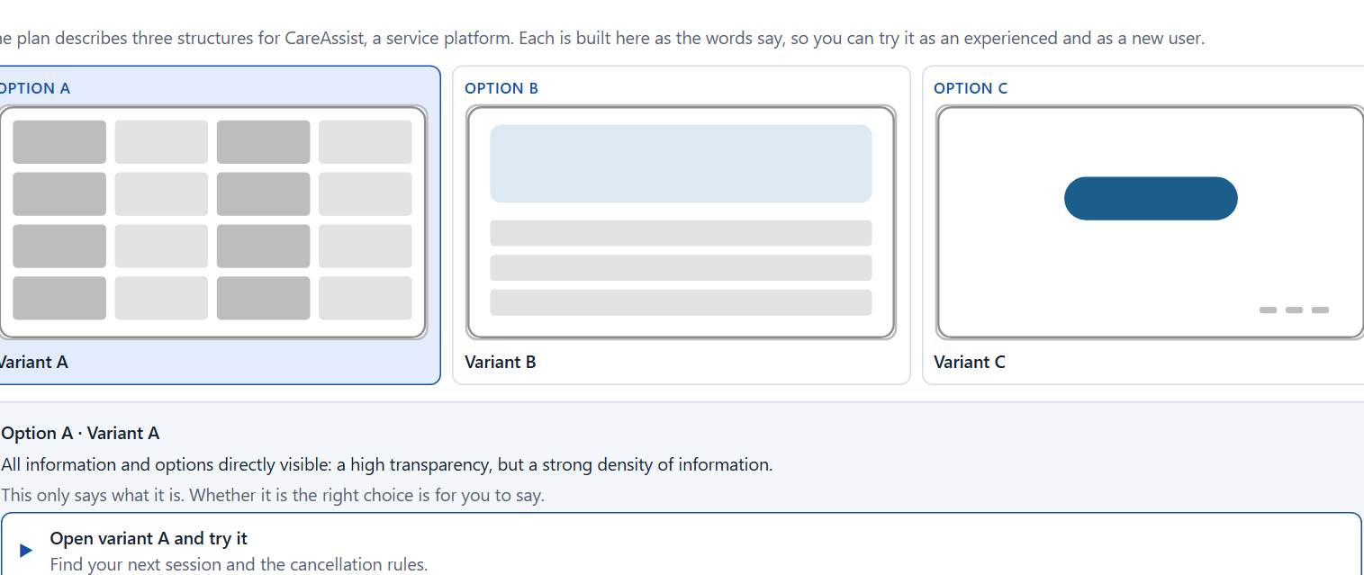
Block 1.2 · Rate progressive disclosure and visual hierarchy under conflicting goals: CareAssist
Level 1 · Knowledge · about 8 min
CareAssist is a service platform. Three structures are described in words: A) all information and options directly visible, a high transparency but a strong density of information; B) central content clearly prioritised, additional information only shown step by step; C) a modern, reduced layout with strong compression, but important context information partly hidden too deep. The conditions: the target group includes experienced and inexperienced users, the departments want as much information as possible visible at once, the UX team asks for a stronger hierarchy and progressive disclosure, technical resources for large changes are limited, the release is in 8 weeks, and only little user data is available. Decide anyway, and say what you assume.
Screenshot of the Neuro-UX Lab (aion-ux-lab.vercel.app), own work; AI-assisted, labelled on the image; the example company is fictional.
Draws on: A2 · Visual hierarchy · A3 · Progressive disclosure · A5 · From screens to components.
Notes:
Block 1.2 · Rate progressive disclosure and visual hierarchy under conflicting goals: CareAssist · about 8 min. Draws on: A2 · Visual hierarchy · A3 · Progressive disclosure · A5 · From screens to components.

Slide 7
Block 1.2 · What you work on
Rate each variant on orientation, transparency, cognitive load, navigation clarity and error risk
1
Decide which variant is the most viable under the given conditions
2
Name the conflicts of goals between visibility, simplicity and user safety
3
Which risks remain despite your decision?
4
Formulate a recommendation to the project management
5
Notes:
Block 1.2 · Rate progressive disclosure and visual hierarchy under conflicting goals: CareAssist · about 8 min. Draws on: A2 · Visual hierarchy · A3 · Progressive disclosure · A5 · From screens to components.

Slide 8
Coaching · UE4
Transition: Level 1 to Level 2
From screen optimisation to systemic user guidance
From describing an effect to a decision you answer for.
Notes:
UE4 · Coaching: transition from Level 1 to Level 2. Trainer-led: a short talk on the coaching focus, then the reflection questions in pairs.

Slide 9
Coaching · questions we talk through
Why are the Gestalt laws not visual details but the basis of intuitive navigation?
Why is it not enough to optimise single screens when the patterns in the whole system stay inconsistent?
1
5
How do I tell whether visual hierarchy creates orientation or only makes the design “pretty”?
How do I argue for design systems when departments prefer quick one-off solutions?
2
6
When does progressive disclosure reduce complexity, and when does it create new hurdles?
Which decisions are operational, which strategic for consistency, scaling and UX quality?
3
7
How do I handle the wish to make as much information as possible visible at once?
4
Notes:
UE4 · Coaching: transition from Level 1 to Level 2. Trainer-led: a short talk on the coaching focus, then the reflection questions in pairs.

Slide 10
Coaching · reflect in pairs
1
2
3
Where does confusion arise in digital products from missing grouping and prioritisation?
Which kind of disclosure of information especially often creates unnecessary load?
When does a lack of consistency become a leadership and governance problem?
Notes:
UE4 · Coaching: transition from Level 1 to Level 2. Trainer-led: a short talk on the coaching focus, then the reflection questions in pairs.

Slide 11
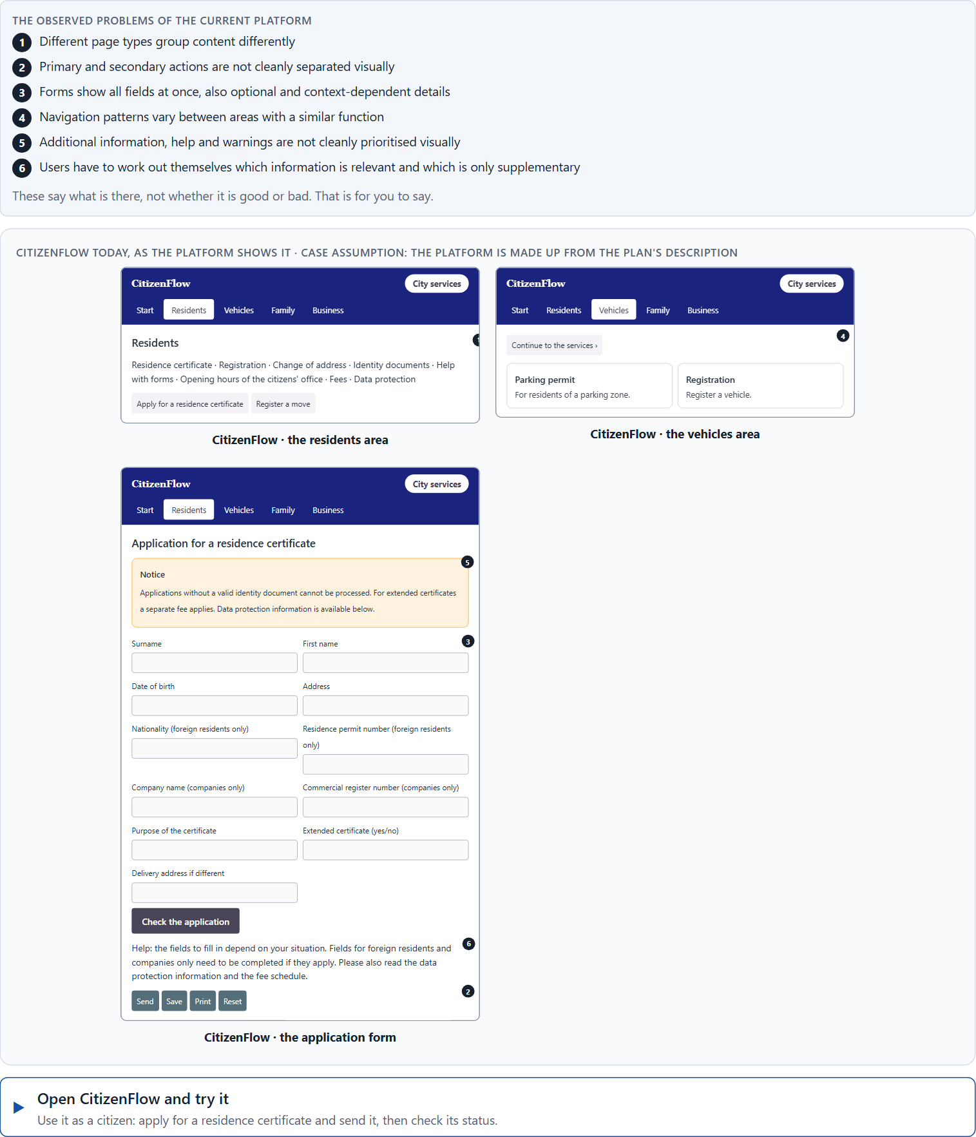
Block 2.1 · Case study: consolidating the self-service system CitizenFlow
Level 2 · Case study · UE5–6 · about 15 min
A public service platform gives citizens access to applications, appointment bookings, certificates and status queries. It is extensive in functions, but in many areas it feels inconsistent and overwhelming. Users often lose orientation, abandon applications or contact support although self-service is available. The observed problems: different page types group content differently, primary and secondary actions are not cleanly separated, forms show all fields at once, also optional and context-dependent ones, navigation patterns vary between areas with a similar function, additional information, help and warnings are not cleanly prioritised, and users have to work out themselves which information is relevant and which is only supplementary. The conditions: a budget of €170,000, 14 weeks for the implementation, a complete relaunch is ruled out, several departments have their own requirements, consistency across the service areas is low so far, and usage data is only partly available. You work through six steps.
Screenshot of the Neuro-UX Lab (aion-ux-lab.vercel.app), own work; AI-assisted, labelled on the image; the example company is fictional.
Draws on: A1 · Gestalt laws for navigation · A2 · Visual hierarchy · A3 · Progressive disclosure · A4 · Hierarchy, navigation logic and relief · A5 · From screens to components.
Notes:
Block 2.1 · Case study: consolidating the self-service system CitizenFlow · about 15 min. Draws on: A1 · Gestalt laws for navigation · A2 · Visual hierarchy · A3 · Progressive disclosure · A4 · Hierarchy, navigation logic and relief · A5 · From screens to components.

Slide 12
Block 2.1 · What you work on
Analyse the central problems with regard to Gestalt laws, visual hierarchy and progressive disclosure
1
Assign the problems to the categories grouping, prioritisation, disclosure of information, consistency and navigation logic
2
Develop 4 prioritised measures for improvement
3
Justify your selection using effect on users, feasibility, risk and time pressure
4
Make a prioritisation decision for the first 14 weeks
5
Formulate a recommendation to the division management
6
Notes:
Block 2.1 · Case study: consolidating the self-service system CitizenFlow · about 15 min. Draws on: A1 · Gestalt laws for navigation · A2 · Visual hierarchy · A3 · Progressive disclosure · A4 · Hierarchy, navigation logic and relief · A5 · From screens to components.

Slide 13
Feedback round · how each group presents
Each group presents its prioritised measures in 5 minutes
1
The reasoning runs along user effect, feasibility, risk and responsibility
2
Each group names one measure that was deliberately postponed
3
Notes:
UE7 · Feedback round with a management perspective. Groups present their reasoning, not only their result.

Slide 14
Feedback round · questions to answer
Which measure improves orientation and navigation fastest?
Which risks remain if progressive disclosure is used wrongly?
1
4
Which measure matters most for the long-term consistency of the system?
Which decision is strategically defensible despite a patchy data situation?
2
5
Where was the thinking systemic, and where was there only a reaction to single screens?
3
Notes:
UE7 · Feedback round with a management perspective. Groups present their reasoning, not only their result.

Slide 15
Level 3 input and discussion
INPUT LEVEL 3
DISCUSSION
Senior-level thinking means translating UX laws into components, standards and governance
Good decisions reduce not only friction on one page but create predictability in the whole system
Being able to answer for a decision shows in prioritising soundly between short-term pressure to optimise and long-term system quality
When does a lack of visual order become a structural problem of the organisation?
Notes:
UE7 · Feedback round with a management perspective. Groups present their reasoning, not only their result.

Slide 16
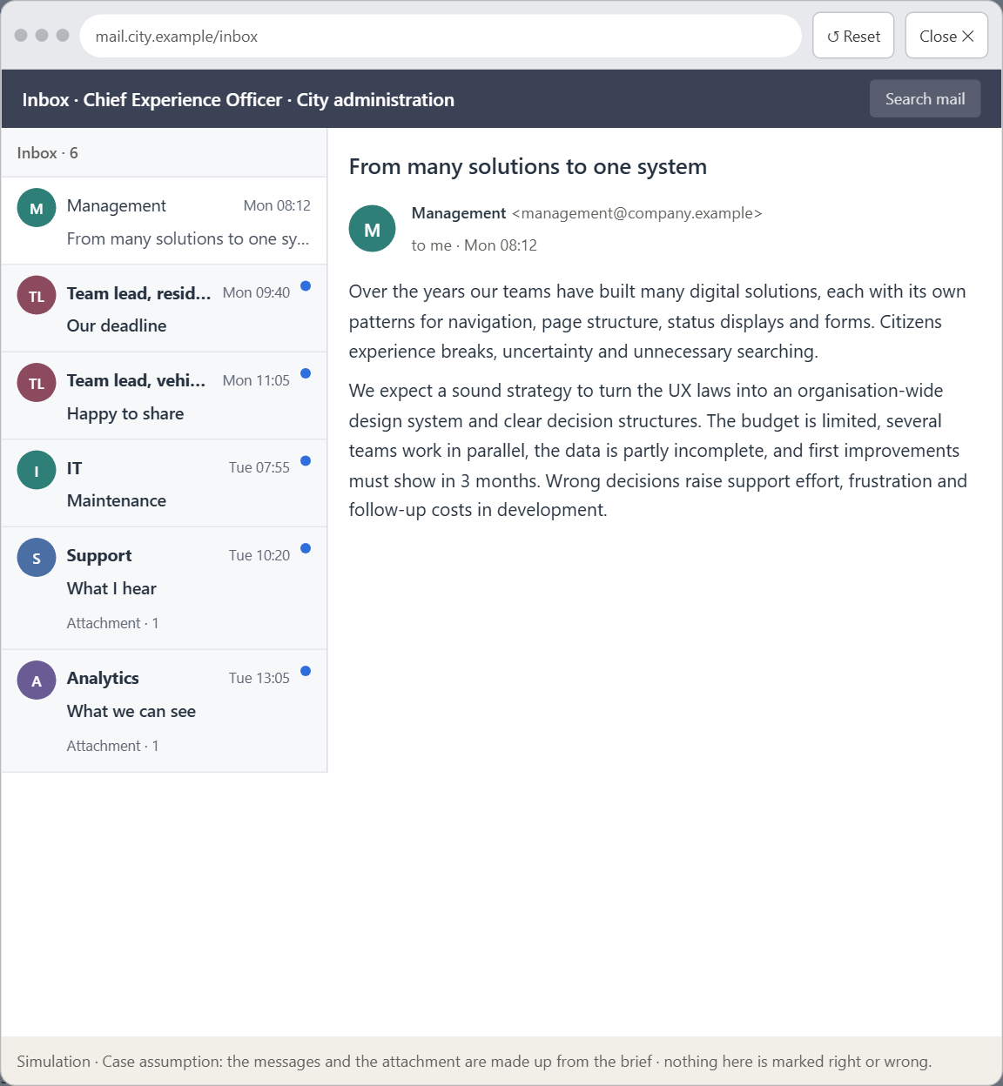
Block 3.1 · A systemic UX architecture for navigation, disclosure and design governance
Level 3 · Transfer project · UE8–10 · about 20 min
You take the perspective of the Chief Experience Officer of the public administration that runs CitizenFlow. It has a citizen portal, an app and an internal administration interface, and over the years it has built many digital solutions. Single teams have set up different patterns for navigation, page structure, status displays and forms. Users therefore experience breaks, uncertainty and unnecessary searching. The management expects a sound strategy to turn the UX laws into an organisation-wide design system and into clear decision structures. You are not to correct single pages but to develop a sound decision architecture for visual hierarchy, progressive disclosure, navigation logic and design-system governance.
Screenshot of the Neuro-UX Lab (aion-ux-lab.vercel.app), own work; AI-assisted, labelled on the image; the example company is fictional.
Draws on: B1 · Design systems for consistency, scale and steering · B2 · Conflicts of goals · B3 · Design-system governance, and deciding with incomplete data.
Notes:
Block 3.1 · A systemic UX architecture for navigation, disclosure and design governance · about 20 min. Draws on: B1 · Design systems for consistency, scale and steering · B2 · Conflicts of goals · B3 · Design-system governance, and deciding with incomplete data.

Slide 17
Block 3.1 · What you work on
1
A guiding vision for systemic user guidance: which orientation, relief and predictability should users experience systematically in future?
2
Three strategic guiding decisions on Gestalt principles, visual hierarchy, progressive disclosure and the use of the design system
3
A prioritised architecture of measures: which components, processes or product areas are standardised first, and why?
4
A risk analysis: which wrong assumptions about user behaviour, the need for transparency and standardisation would be especially critical?
5
A governance model: who is responsible for the component standards and UX principles, and who decides conflicts of goals between teams?
6
A decision under uncertainty: make at least one prioritised decision despite incomplete data and justify it responsibly
7
A management statement: a recommendation to the management with a clear priority and a strategic reason
Notes:
Block 3.1 · A systemic UX architecture for navigation, disclosure and design governance · about 20 min. Draws on: B1 · Design systems for consistency, scale and steering · B2 · Conflicts of goals · B3 · Design-system governance, and deciding with incomplete data.

Slide 18
Reflect before you leave
1
2
3
Which decision did you make today, and what did you give up to make it?
Which assumption would you check first with real users, and how?
What will you do differently in your next project because of today?
Use two minutes alone, then one minute with your neighbour.

Slide 19
About these slides, sources and AI use
AI
AI-assisted content
Where to find more
AI-assisted content: these slides were drafted with an AI language model (Claude, Anthropic) from the course's own Neuro-UX Lab and were read, corrected and approved by Muhammad Muchson, who is responsible for their accuracy.
Pictures are screenshots of the course's own Neuro-UX Lab. Each one carries an AI label on the image and a source line under it.
Companies and people in the examples are fictional. Numbers inside an example are labelled Case assumption and are not data.
The coaching and feedback questions are the course plan's own, translated into English.
Neuro-UX Lab for this day: https://aion-ux-lab.vercel.app/day/6/
Handouts: the Materi and Task Word documents of the day.
Version 1.0, 29.10.2026. Reviewer and approver: Muhammad Muchson.

