Slide 1
UX DEVELOPER · DAY 7
Emotional bonding in design
Knowledge transfer slides
Module 4 (day 1 of 3)
Trainer: Muhammad Muchson · Materi A and B · v1.0
Contains AI-assisted content

Slide 2
What we cover today
Today is about the feelings a digital product creates and why they matter as much as its functions. You learn how emotions steer attention, motivation, trust, memory and decisions, the difference between being usable and being a good experience, the emotional factors that matter in UX (safety, control, joy, belonging, frustration, uncertainty, recognition), how visual mood, interaction, tone and feedback create them, and where emotion turns into over-emotionalisation or manipulation. Then you use it on three products. This document holds everything you need to study Day 7 without the website. Every card says what the idea is in plain words, shows it in a picture, gives the details and ends with the rules you use in the tasks.
Materi A · 60 min
Materi B · 60 min
A1 Emotions steer behaviour: attention, motivation, trust, memory and decisions (12 min)
A2 Usable is not enough: the emotional factors of an experience (12 min)
A3 Where feelings come from: visual mood, interaction, tone and feedback (12 min)
A4 Activation, overload and manipulation: when emotion turns against use (12 min)
A5 Trust and perceived competence, and weighing a measure (12 min)
B1 Emotional UX as part of the UX architecture, not a campaign (20 min)
B2 Seriousness against closeness: the conflicts of emotional UX (20 min)
B3 Who owns emotional UX, and deciding with little data on feelings (20 min)

Slide 3
A
Materi A
Route 1 · Levels 1 and 2
About 60 minutes, five cards. Levels 1 and 2: describe the emotional effect of an unfamiliar health platform, rate three designs of a career platform between warmth and credibility, then analyse a health-prevention portal, develop four measures, justify them and decide on the first 12 weeks. The cards give you the ideas and the rules you use in Task 1.

Slide 4
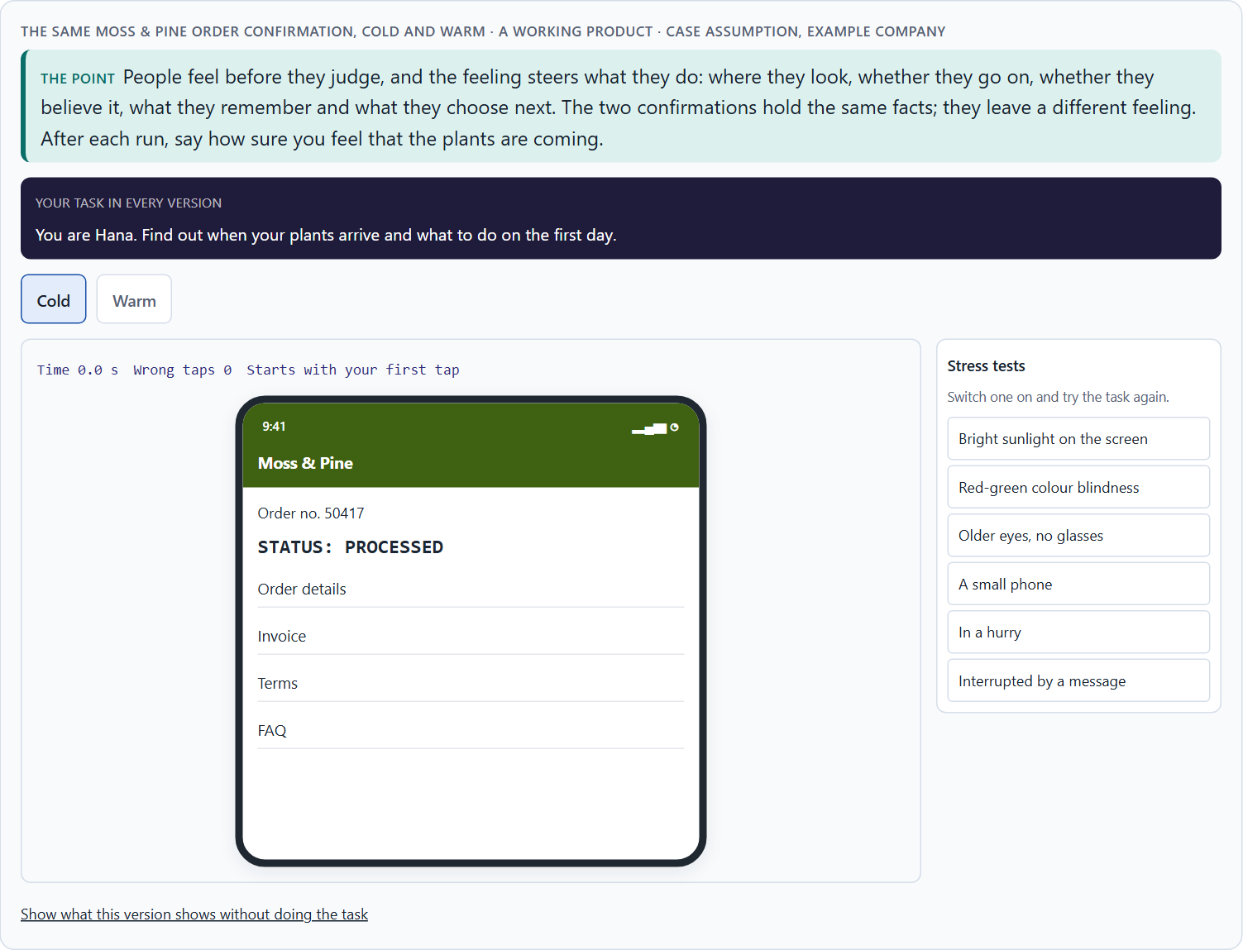
Emotions steer behaviour: attention, motivation, trust, memory and decisions
A1 · 12 min · Core
People feel before they judge, and the feeling steers attention, motivation, trust, memory and decisions. Emotional bonding is the result over time: the sense that a product is on your side.
The same Moss & Pine order confirmation, cold and warm.
Screenshot of the Neuro-UX Lab (aion-ux-lab.vercel.app), own work; AI-assisted, labelled on the image; the example company is fictional.
Sources: Norman 2004 · Damasio 1994 · Kahneman et al. 1993 · Fogg et al. 2003 · Hassenzahl 2010
Notes:
A1 · Emotions steer behaviour: attention, motivation, trust, memory and decisions · 12 min · Core
Case assumption: Moss & Pine, Hana, Jonas, Wanda and Bruno are made up for this example. The three levels of emotional design follow Norman (2004); emotion as part of reasoning follows Damasio (1994); the peak-end rule follows Kahneman et al. (1993). The findings in the table of real evidence are real research results, rules and cases; the sources are listed below.
Go deeper (optional reading): Norman (2004) describes three levels on which a product acts. The visceral level is the immediate reaction to how it looks. The behavioural level is how it feels to use: whether it works, responds and lets you stay in control. The reflective level is what it means to you afterwards, what you tell others about it. A product can win one level and lose another: beautiful at first sight, frustrating to use, and remembered as frustrating.
Sources: Norman 2004 · Damasio 1994 · Kahneman et al. 1993 · Fogg et al. 2003 · Hassenzahl 2010

Slide 5
A1 · In plain words
THE IDEA
WHY IT MATTERS
People feel before they judge. Within moments a screen makes them feel welcome or distant, safe or unsure, and that feeling steers what they do next: where they look (attention), whether they go on (motivation), whether they believe what they read (trust), what they remember afterwards (memory) and what they choose (decisions). Psychology and neuro-design study these effects. Emotional bonding is the result over time: the sense that a product is on your side, which makes people come back.
Block 1.1 asks for the spontaneous emotional effect of WellTrack on a first-time user and for effect statements of the form “for users this could mean that …”. This card gives you the five things a feeling acts on, so you can say what it does.
HOW TO READ THE PICTURE
The same Moss & Pine order confirmation twice: cold and warm.
Sources: Norman 2004 · Damasio 1994 · Kahneman et al. 1993 · Fogg et al. 2003 · Hassenzahl 2010
Notes:
A1 · Emotions steer behaviour: attention, motivation, trust, memory and decisions · 12 min · Core
Case assumption: Moss & Pine, Hana, Jonas, Wanda and Bruno are made up for this example. The three levels of emotional design follow Norman (2004); emotion as part of reasoning follows Damasio (1994); the peak-end rule follows Kahneman et al. (1993). The findings in the table of real evidence are real research results, rules and cases; the sources are listed below.
Go deeper (optional reading): Norman (2004) describes three levels on which a product acts. The visceral level is the immediate reaction to how it looks. The behavioural level is how it feels to use: whether it works, responds and lets you stay in control. The reflective level is what it means to you afterwards, what you tell others about it. A product can win one level and lose another: beautiful at first sight, frustrating to use, and remembered as frustrating.
Sources: Norman 2004 · Damasio 1994 · Kahneman et al. 1993 · Fogg et al. 2003 · Hassenzahl 2010

Slide 6
A1 · What a feeling acts on
Acts on | What it means | In an interface
Attention | What people notice and what they miss. | A worried person reads the warning, not the offer.
Motivation | Whether they go on or stop. | A sense of progress keeps people in a long form.
Trust | Whether they believe what they read. | A calm, clear confirmation is believed.
Memory | What stays after the visit. | The end of a visit colours the whole of it.
Decisions | What they choose next. | Uncertainty makes people postpone or go elsewhere.
Sources: Norman 2004 · Damasio 1994 · Kahneman et al. 1993 · Fogg et al. 2003 · Hassenzahl 2010
Notes:
A1 · Emotions steer behaviour: attention, motivation, trust, memory and decisions · 12 min · Core
Case assumption: Moss & Pine, Hana, Jonas, Wanda and Bruno are made up for this example. The three levels of emotional design follow Norman (2004); emotion as part of reasoning follows Damasio (1994); the peak-end rule follows Kahneman et al. (1993). The findings in the table of real evidence are real research results, rules and cases; the sources are listed below.
Go deeper (optional reading): Norman (2004) describes three levels on which a product acts. The visceral level is the immediate reaction to how it looks. The behavioural level is how it feels to use: whether it works, responds and lets you stay in control. The reflective level is what it means to you afterwards, what you tell others about it. A product can win one level and lose another: beautiful at first sight, frustrating to use, and remembered as frustrating.
Sources: Norman 2004 · Damasio 1994 · Kahneman et al. 1993 · Fogg et al. 2003 · Hassenzahl 2010

Slide 7
A1 · What a feeling acts on: evidence
Effect | Real finding | What it means for a screen
Decisions | Damasio described patients with damage to the part of the brain that links feeling to decision-making: their reasoning stayed intact, but their everyday decisions were poor (Damasio 1994). | Feelings are part of how people decide, not noise around it; a screen that ignores them still has an effect.
Memory | In a study with cold water, 22 of 32 participants (69%) chose to repeat a 90-second trial rather than a 60-second one, because it ended slightly warmer; the end of an episode weighs more than its length (Kahneman et al. 1993, as reported). | Take care with the end of a visit: the confirmation and the last screen colour the whole memory.
Trust | The design look was the factor named most often when 2,684 people judged the credibility of 100 websites, in 46.1% of their comments (Fogg et al. 2003). | The look and the tone are read as signs of care before any content is judged.
Motivation | Hassenzahl separates pragmatic quality, whether a product helps to reach a goal, from hedonic quality, whether it stimulates, expresses who one is and carries meaning (Hassenzahl 2010). | A product that only works can be used and still be left; hedonic quality is part of why people return.
Sources: Norman 2004 · Damasio 1994 · Kahneman et al. 1993 · Fogg et al. 2003 · Hassenzahl 2010
Notes:
A1 · Emotions steer behaviour: attention, motivation, trust, memory and decisions · 12 min · Core
Case assumption: Moss & Pine, Hana, Jonas, Wanda and Bruno are made up for this example. The three levels of emotional design follow Norman (2004); emotion as part of reasoning follows Damasio (1994); the peak-end rule follows Kahneman et al. (1993). The findings in the table of real evidence are real research results, rules and cases; the sources are listed below.
Go deeper (optional reading): Norman (2004) describes three levels on which a product acts. The visceral level is the immediate reaction to how it looks. The behavioural level is how it feels to use: whether it works, responds and lets you stay in control. The reflective level is what it means to you afterwards, what you tell others about it. A product can win one level and lose another: beautiful at first sight, frustrating to use, and remembered as frustrating.
Sources: Norman 2004 · Damasio 1994 · Kahneman et al. 1993 · Fogg et al. 2003 · Hassenzahl 2010

Slide 8
A1 · How to decide when this comes up in the task
Describe the first feeling a screen gives, before you judge whether it works.
1
Ask what the feeling does: where people look, whether they go on, whether they believe it, what they remember, what they choose.
2
Write an effect as a hypothesis: “for users this could mean that …”.
3
Look hardest at the strongest moment and at the end of a visit: people remember those.
4
A correct product that feels distant is used once; a product that feels on your side is used again.
5
Sources: Norman 2004 · Damasio 1994 · Kahneman et al. 1993 · Fogg et al. 2003 · Hassenzahl 2010
Notes:
A1 · Emotions steer behaviour: attention, motivation, trust, memory and decisions · 12 min · Core
Case assumption: Moss & Pine, Hana, Jonas, Wanda and Bruno are made up for this example. The three levels of emotional design follow Norman (2004); emotion as part of reasoning follows Damasio (1994); the peak-end rule follows Kahneman et al. (1993). The findings in the table of real evidence are real research results, rules and cases; the sources are listed below.
Go deeper (optional reading): Norman (2004) describes three levels on which a product acts. The visceral level is the immediate reaction to how it looks. The behavioural level is how it feels to use: whether it works, responds and lets you stay in control. The reflective level is what it means to you afterwards, what you tell others about it. A product can win one level and lose another: beautiful at first sight, frustrating to use, and remembered as frustrating.
Sources: Norman 2004 · Damasio 1994 · Kahneman et al. 1993 · Fogg et al. 2003 · Hassenzahl 2010

Slide 9
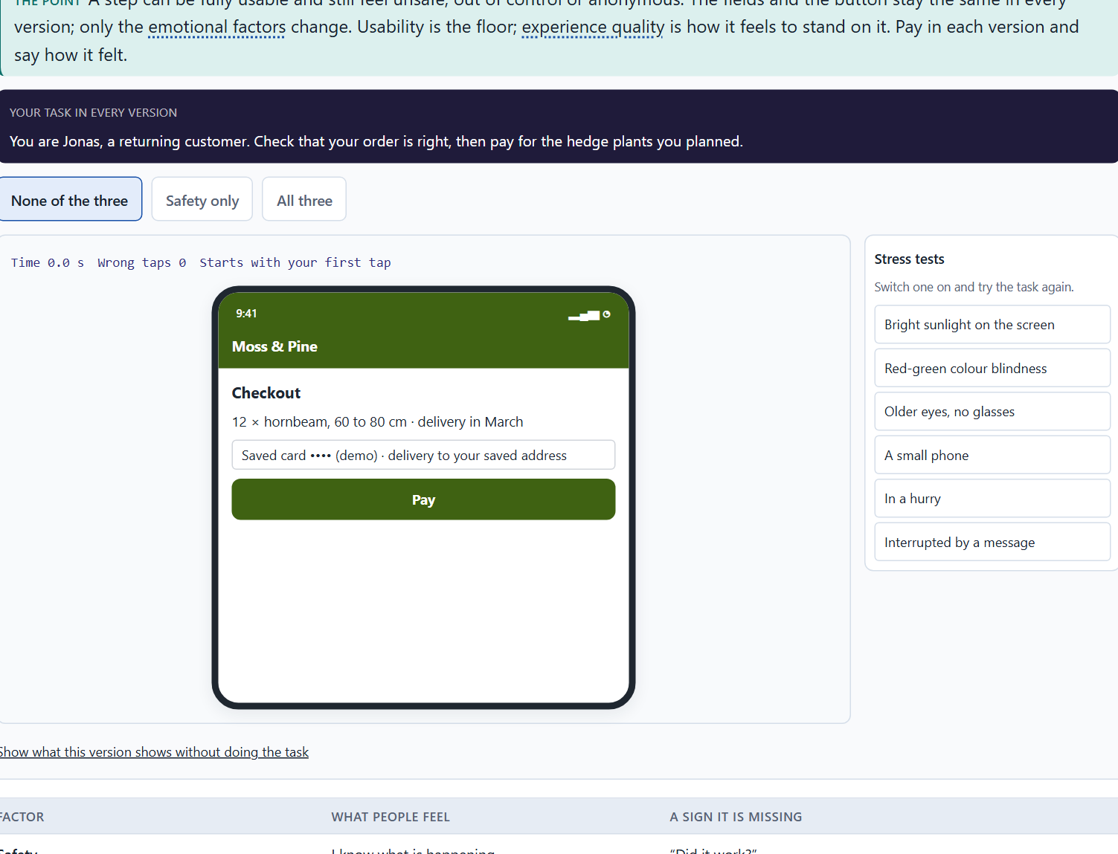
Usable is not enough: the emotional factors of an experience
A2 · 12 min · Core
Usable is not the same as a good experience. Safety, control, joy, belonging and recognition, and their opposites, frustration and uncertainty, decide how a usable product feels.
A Moss & Pine checkout step: safety, control and recognition.
Screenshot of the Neuro-UX Lab (aion-ux-lab.vercel.app), own work; AI-assisted, labelled on the image; the example company is fictional.
Sources: Hassenzahl 2010 · Norman 2004 · ISO 9241-210
Notes:
A2 · Usable is not enough: the emotional factors of an experience · 12 min · Core
Case assumption: Moss & Pine, Hana, Jonas, Wanda and Bruno are made up for this example. Experience beyond usability follows Hassenzahl (2010); user experience as perceptions and responses before, during and after use follows ISO 9241-210. The findings in the table of real evidence are real research results, rules and cases; the sources are listed below.
Go deeper (optional reading): Hassenzahl (2010) separates what a product does (its pragmatic quality: useful, usable) from what it means to people (its hedonic quality: stimulation, identification). Both shape the overall experience. A health or career product that is only pragmatic is used when people must; one that also gives a sense of competence and being understood is used when they could choose otherwise.
Sources: Hassenzahl 2010 · Norman 2004 · ISO 9241-210

Slide 10
A2 · In plain words
THE IDEA
WHY IT MATTERS
A product can be usable and still a poor experience. Usability asks whether people can reach their goal; emotional experience quality asks how it feels on the way and afterwards. The emotional factors that matter most in UX are safety (I know what is happening), control (I can steer and undo), joy (something is pleasant), belonging (this is for people like me), recognition (my effort is seen), and their opposites: frustration and uncertainty. A screen can pass every usability check and still leave people unsure, unseen or frustrated.
Block 1.1 asks you to sort WellTrack's observations into trust, safety, motivation, frustration, closeness and experience quality, Block 1.2 asks you to rate three designs on trust, motivation, safety, clarity and experience quality, and Block 2.1 asks you to sort LifeSupport's problems into five such categories. This card gives you the factors to name what you see.
HOW TO READ THE PICTURE
One Moss & Pine checkout with three switches: safety, control and recognition.
Sources: Hassenzahl 2010 · Norman 2004 · ISO 9241-210
Notes:
A2 · Usable is not enough: the emotional factors of an experience · 12 min · Core
Case assumption: Moss & Pine, Hana, Jonas, Wanda and Bruno are made up for this example. Experience beyond usability follows Hassenzahl (2010); user experience as perceptions and responses before, during and after use follows ISO 9241-210. The findings in the table of real evidence are real research results, rules and cases; the sources are listed below.
Go deeper (optional reading): Hassenzahl (2010) separates what a product does (its pragmatic quality: useful, usable) from what it means to people (its hedonic quality: stimulation, identification). Both shape the overall experience. A health or career product that is only pragmatic is used when people must; one that also gives a sense of competence and being understood is used when they could choose otherwise.
Sources: Hassenzahl 2010 · Norman 2004 · ISO 9241-210

Slide 11
A2 · The emotional factors of UX
Factor | What people feel | A sign it is missing
Safety | I know what is happening. | “Did it work?”
Control | I can steer and undo. | No way back from a step.
Joy | Something is pleasant. | Every step feels like a chore.
Belonging | This is for people like me. | Words and pictures for someone else.
Recognition | My effort is seen. | A finished task ends in silence.
Frustration and uncertainty | I am stuck, or I do not know. | Errors that blame; waiting without a word.
Sources: Hassenzahl 2010 · Norman 2004 · ISO 9241-210
Notes:
A2 · Usable is not enough: the emotional factors of an experience · 12 min · Core
Case assumption: Moss & Pine, Hana, Jonas, Wanda and Bruno are made up for this example. Experience beyond usability follows Hassenzahl (2010); user experience as perceptions and responses before, during and after use follows ISO 9241-210. The findings in the table of real evidence are real research results, rules and cases; the sources are listed below.
Go deeper (optional reading): Hassenzahl (2010) separates what a product does (its pragmatic quality: useful, usable) from what it means to people (its hedonic quality: stimulation, identification). Both shape the overall experience. A health or career product that is only pragmatic is used when people must; one that also gives a sense of competence and being understood is used when they could choose otherwise.
Sources: Hassenzahl 2010 · Norman 2004 · ISO 9241-210

Slide 12
A2 · Emotional factors in the definitions and models
Source | What it says | What it means for a screen
ISO 9241-210 | User experience covers the user's emotions, beliefs, preferences, perceptions and responses before, during and after use (ISO 9241-210). | Emotion is part of the standard definition, so a UX review that skips it is incomplete.
Three levels (Norman 2004) | Norman names a visceral level (the first look and feel), a behavioural level (how it works in use) and a reflective level (what it means afterwards). | Check each level: first impression, use, and the story people tell later.
Pragmatic and hedonic quality | Hassenzahl's model separates the quality of reaching goals from the quality of stimulation, identification and meaning (Hassenzahl 2010). | Name which of the emotional factors (safety, control, joy, belonging, recognition) your measure is for.
Sources: Hassenzahl 2010 · Norman 2004 · ISO 9241-210
Notes:
A2 · Usable is not enough: the emotional factors of an experience · 12 min · Core
Case assumption: Moss & Pine, Hana, Jonas, Wanda and Bruno are made up for this example. Experience beyond usability follows Hassenzahl (2010); user experience as perceptions and responses before, during and after use follows ISO 9241-210. The findings in the table of real evidence are real research results, rules and cases; the sources are listed below.
Go deeper (optional reading): Hassenzahl (2010) separates what a product does (its pragmatic quality: useful, usable) from what it means to people (its hedonic quality: stimulation, identification). Both shape the overall experience. A health or career product that is only pragmatic is used when people must; one that also gives a sense of competence and being understood is used when they could choose otherwise.
Sources: Hassenzahl 2010 · Norman 2004 · ISO 9241-210

Slide 13
A2 · How to decide when this comes up in the task
First check usability: can people reach their goal? Then ask how it feels on the way.
1
Safety: do people know what is happening and what comes next?
2
Control: can they steer, change and undo?
3
Recognition and belonging: does the product see their effort and feel made for people like them?
4
Frustration and uncertainty: where do they get stuck or wonder whether something worked?
5
Sources: Hassenzahl 2010 · Norman 2004 · ISO 9241-210
Notes:
A2 · Usable is not enough: the emotional factors of an experience · 12 min · Core
Case assumption: Moss & Pine, Hana, Jonas, Wanda and Bruno are made up for this example. Experience beyond usability follows Hassenzahl (2010); user experience as perceptions and responses before, during and after use follows ISO 9241-210. The findings in the table of real evidence are real research results, rules and cases; the sources are listed below.
Go deeper (optional reading): Hassenzahl (2010) separates what a product does (its pragmatic quality: useful, usable) from what it means to people (its hedonic quality: stimulation, identification). Both shape the overall experience. A health or career product that is only pragmatic is used when people must; one that also gives a sense of competence and being understood is used when they could choose otherwise.
Sources: Hassenzahl 2010 · Norman 2004 · ISO 9241-210

Slide 14
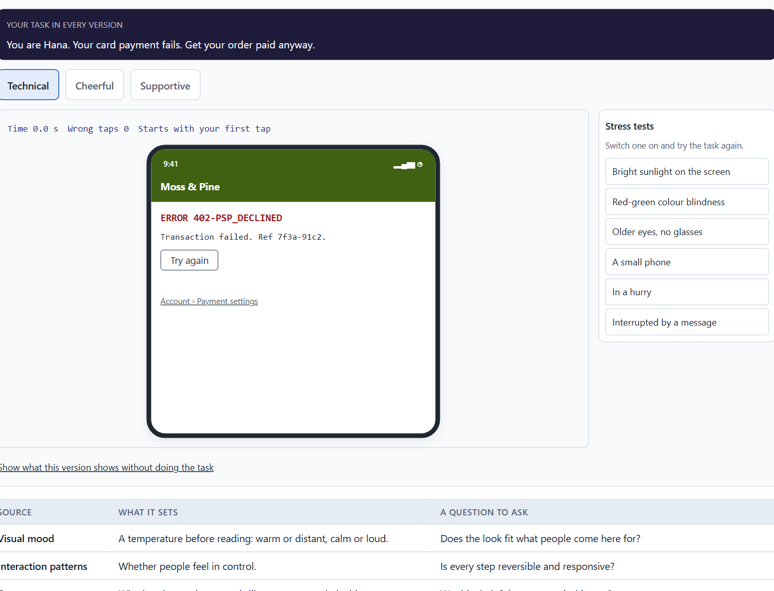
Where feelings come from: visual mood, interaction, tone and feedback
A3 · 12 min · Core
Feelings come from four things on the screen: visual mood, interaction patterns, tone and feedback. Most of the effect sits in feedback and tone at critical moments: an error, a wait, a success.
One Moss & Pine payment error: technical, cheerful and supportive.
Screenshot of the Neuro-UX Lab (aion-ux-lab.vercel.app), own work; AI-assisted, labelled on the image; the example company is fictional.
Sources: Walter 2011 · Norman 2013 · Nielsen 1994 · Mailchimp, Voice and Tone · Kahneman et al. 1993
Notes:
A3 · Where feelings come from: visual mood, interaction, tone and feedback · 12 min · Core
Case assumption: Moss & Pine, Hana, Jonas, Wanda and Bruno are made up for this example. Tone and personality in interfaces follow Walter (2011); visibility of system status and helpful error messages are Nielsen's heuristics (1994); feedback as a basic design principle follows Norman (2013). The findings in the table of real evidence are real research results, rules and cases; the sources are listed below.
Go deeper (optional reading): A supportive error message has four parts: what happened, in plain words; what it means for the person (was anything lost or charged?); what they can do now; and where help is. It never blames, never hides behind a code, and never jokes about a problem the person feels. The same four parts work for waiting: what is happening, how long it may take, what the person can do meanwhile.
Sources: Walter 2011 · Norman 2013 · Nielsen 1994 · Mailchimp, Voice and Tone · Kahneman et al. 1993

Slide 15
A3 · In plain words
THE IDEA
WHY IT MATTERS
Feelings in a product are not added by a campaign; they come from four things on the screen. Visual mood: colour, images, space and type set a temperature before anything is read. Interaction patterns: what happens when people act, how fast, and whether they can undo. Tone: the words, above all in microcopy, error messages and confirmations. Feedback: whether the product says what happened, what comes next and that it went well. Most of the emotional effect sits in feedback and tone at the critical moments: an error, a wait, a success.
Block 1.1 asks about WellTrack's technical errors and missing positive feedback, Block 1.2 asks about CareerPath's unclear feedback, and Block 2.1 asks about LifeSupport's distant visual language, technical feedback and correct but cold tone. This card gives you the four sources to say where a feeling comes from.
HOW TO READ THE PICTURE
One Moss & Pine error message written three ways: technical, cheerful and supportive.
Sources: Walter 2011 · Norman 2013 · Nielsen 1994 · Mailchimp, Voice and Tone · Kahneman et al. 1993
Notes:
A3 · Where feelings come from: visual mood, interaction, tone and feedback · 12 min · Core
Case assumption: Moss & Pine, Hana, Jonas, Wanda and Bruno are made up for this example. Tone and personality in interfaces follow Walter (2011); visibility of system status and helpful error messages are Nielsen's heuristics (1994); feedback as a basic design principle follows Norman (2013). The findings in the table of real evidence are real research results, rules and cases; the sources are listed below.
Go deeper (optional reading): A supportive error message has four parts: what happened, in plain words; what it means for the person (was anything lost or charged?); what they can do now; and where help is. It never blames, never hides behind a code, and never jokes about a problem the person feels. The same four parts work for waiting: what is happening, how long it may take, what the person can do meanwhile.
Sources: Walter 2011 · Norman 2013 · Nielsen 1994 · Mailchimp, Voice and Tone · Kahneman et al. 1993

Slide 16
A3 · Four sources of emotional effect
Source | What it sets | A question to ask
Visual mood | A temperature before reading: warm or distant, calm or loud. | Does the look fit what people come here for?
Interaction patterns | Whether people feel in control. | Is every step reversible and responsive?
Tone | Whether the product sounds like a person on their side. | Would a helpful person say it this way?
Feedback | Safety and recognition after each action. | Does it say what happened, what comes next, and that it went well?
Sources: Walter 2011 · Norman 2013 · Nielsen 1994 · Mailchimp, Voice and Tone · Kahneman et al. 1993
Notes:
A3 · Where feelings come from: visual mood, interaction, tone and feedback · 12 min · Core
Case assumption: Moss & Pine, Hana, Jonas, Wanda and Bruno are made up for this example. Tone and personality in interfaces follow Walter (2011); visibility of system status and helpful error messages are Nielsen's heuristics (1994); feedback as a basic design principle follows Norman (2013). The findings in the table of real evidence are real research results, rules and cases; the sources are listed below.
Go deeper (optional reading): A supportive error message has four parts: what happened, in plain words; what it means for the person (was anything lost or charged?); what they can do now; and where help is. It never blames, never hides behind a code, and never jokes about a problem the person feels. The same four parts work for waiting: what is happening, how long it may take, what the person can do meanwhile.
Sources: Walter 2011 · Norman 2013 · Nielsen 1994 · Mailchimp, Voice and Tone · Kahneman et al. 1993

Slide 17
A3 · Where feelings come from: models and a real case
Source | Real finding or example | What it means for a screen
A hierarchy of needs | Walter ordered the needs of users as functional, reliable, usable, pleasurable and meaningful; pleasure is built on a product that works (Walter 2011). | Fix what fails before adding delight.
Tone follows the reader | Mailchimp's content guide keeps its voice steady and lets its tone change with the situation: you would not speak in the same tone to someone who is upset as to someone who is laughing (Mailchimp, Voice and Tone). | Write a tone guide by situation: success, error, waiting, money.
Feedback and control | One of the ten heuristics asks that the system always tells users what is going on, through appropriate feedback within a reasonable time (Nielsen 1994). | Each action gets a clear answer: what happened and what comes next.
The end counts | The end of an episode weighs more than its length in the memory of it (Kahneman et al. 1993, as reported). | Make the last step of a task a calm, clear confirmation.
Sources: Walter 2011 · Norman 2013 · Nielsen 1994 · Mailchimp, Voice and Tone · Kahneman et al. 1993
Notes:
A3 · Where feelings come from: visual mood, interaction, tone and feedback · 12 min · Core
Case assumption: Moss & Pine, Hana, Jonas, Wanda and Bruno are made up for this example. Tone and personality in interfaces follow Walter (2011); visibility of system status and helpful error messages are Nielsen's heuristics (1994); feedback as a basic design principle follows Norman (2013). The findings in the table of real evidence are real research results, rules and cases; the sources are listed below.
Go deeper (optional reading): A supportive error message has four parts: what happened, in plain words; what it means for the person (was anything lost or charged?); what they can do now; and where help is. It never blames, never hides behind a code, and never jokes about a problem the person feels. The same four parts work for waiting: what is happening, how long it may take, what the person can do meanwhile.
Sources: Walter 2011 · Norman 2013 · Nielsen 1994 · Mailchimp, Voice and Tone · Kahneman et al. 1993

Slide 18
A3 · How to decide when this comes up in the task
Visual mood: what temperature do colour, images, space and type set before anything is read?
1
Interaction: what happens when people act, and can they undo it?
2
Tone: read the error messages and confirmations aloud; would a person say that?
3
Feedback: after every action, does the product say what happened and what comes next?
4
Celebrate real successes calmly; a finished task that ends in silence wastes a moment of recognition.
5
Sources: Walter 2011 · Norman 2013 · Nielsen 1994 · Mailchimp, Voice and Tone · Kahneman et al. 1993
Notes:
A3 · Where feelings come from: visual mood, interaction, tone and feedback · 12 min · Core
Case assumption: Moss & Pine, Hana, Jonas, Wanda and Bruno are made up for this example. Tone and personality in interfaces follow Walter (2011); visibility of system status and helpful error messages are Nielsen's heuristics (1994); feedback as a basic design principle follows Norman (2013). The findings in the table of real evidence are real research results, rules and cases; the sources are listed below.
Go deeper (optional reading): A supportive error message has four parts: what happened, in plain words; what it means for the person (was anything lost or charged?); what they can do now; and where help is. It never blames, never hides behind a code, and never jokes about a problem the person feels. The same four parts work for waiting: what is happening, how long it may take, what the person can do meanwhile.
Sources: Walter 2011 · Norman 2013 · Nielsen 1994 · Mailchimp, Voice and Tone · Kahneman et al. 1993

Slide 19
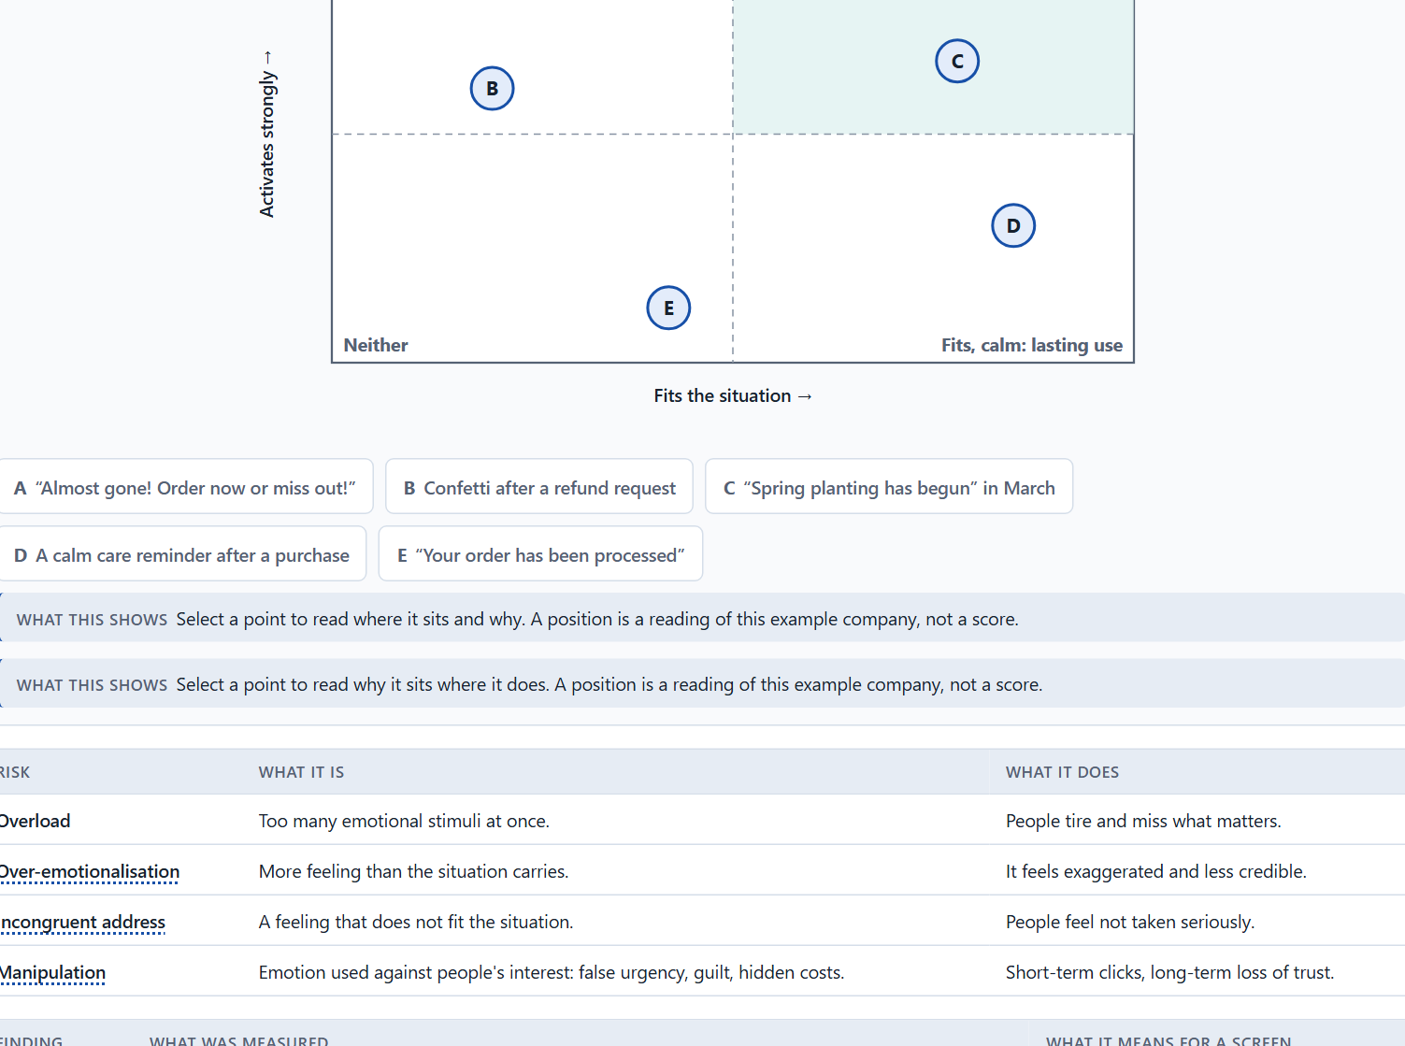
Activation, overload and manipulation: when emotion turns against use
A4 · 12 min · Core
Activation is not bonding. Many stimuli can overload and push; more feeling than the situation carries is over-emotionalisation; a feeling that does not fit is incongruent; emotion used against people is manipulation.
Five Moss & Pine messages by how strongly they activate and how well they fit the situation · Exploratory.
Screenshot of the Neuro-UX Lab (aion-ux-lab.vercel.app), own work; AI-assisted, labelled on the image; the example company is fictional.
Sources: Mathur et al. 2019 · Fogg 2003 · Walter 2011 · EU Digital Services Act · CJEU Planet49 2019
Notes:
A4 · Activation, overload and manipulation: when emotion turns against use · 12 min · Core
Case assumption: Moss & Pine, Hana, Jonas, Wanda and Bruno are made up for this example. False urgency, scarcity and confirmshaming as dark patterns follow Mathur et al. (2019); the ethics of persuasive technology follow Fogg (2003). The findings in the table of real evidence are real research results, rules and cases; the sources are listed below.
Go deeper (optional reading): A simple test for manipulation: would the message still work if the person knew exactly why it was written this way? A care reminder still works when people know it is meant to keep their plants alive. A countdown that resets every visit stops working the moment people see through it, and takes their trust in the next message with it.
Sources: Mathur et al. 2019 · Fogg 2003 · Walter 2011 · EU Digital Services Act · CJEU Planet49 2019

Slide 20
A4 · In plain words
THE IDEA
WHY IT MATTERS
Emotion can activate people for a moment or bond them for years, and the two are not the same. Many stimuli, badges, countdowns and exclamation marks raise activation, but they can overload, tire and feel pushy. Over-emotionalisation is more feeling than the situation carries; incongruent address is a feeling that does not fit it, such as cheerfulness about a worry. Manipulation, often called dark patterns, uses emotion against people's own interest: false urgency, guilt, hidden costs. Lasting use comes from feelings that fit the situation and keep their promise.
Block 1.1 asks for WellTrack's two biggest emotional weaknesses, Block 1.2 asks you to judge CareerPath's Variant A with many emotional stimuli and to name the conflicts between emotionalisation and credibility, and Block 2.1 warns against measures that are only decoration. This card gives you the line between activation and manipulation.
HOW TO READ THE PICTURE
The matrix places five Moss & Pine messages by how strongly they activate (upwards) and how well they fit the situation (to the right). A position is a reading of the example, not a score.
Sources: Mathur et al. 2019 · Fogg 2003 · Walter 2011 · EU Digital Services Act · CJEU Planet49 2019
Notes:
A4 · Activation, overload and manipulation: when emotion turns against use · 12 min · Core
Case assumption: Moss & Pine, Hana, Jonas, Wanda and Bruno are made up for this example. False urgency, scarcity and confirmshaming as dark patterns follow Mathur et al. (2019); the ethics of persuasive technology follow Fogg (2003). The findings in the table of real evidence are real research results, rules and cases; the sources are listed below.
Go deeper (optional reading): A simple test for manipulation: would the message still work if the person knew exactly why it was written this way? A care reminder still works when people know it is meant to keep their plants alive. A countdown that resets every visit stops working the moment people see through it, and takes their trust in the next message with it.
Sources: Mathur et al. 2019 · Fogg 2003 · Walter 2011 · EU Digital Services Act · CJEU Planet49 2019

Slide 21
A4 · Where emotion turns against use
Risk | What it is | What it does
Overload | Too many emotional stimuli at once. | People tire and miss what matters.
Over-emotionalisation | More feeling than the situation carries. | It feels exaggerated and less credible.
Incongruent address | A feeling that does not fit the situation. | People feel not taken seriously.
Manipulation | Emotion used against people's interest: false urgency, guilt, hidden costs. | Short-term clicks, long-term loss of trust.
Sources: Mathur et al. 2019 · Fogg 2003 · Walter 2011 · EU Digital Services Act · CJEU Planet49 2019
Notes:
A4 · Activation, overload and manipulation: when emotion turns against use · 12 min · Core
Case assumption: Moss & Pine, Hana, Jonas, Wanda and Bruno are made up for this example. False urgency, scarcity and confirmshaming as dark patterns follow Mathur et al. (2019); the ethics of persuasive technology follow Fogg (2003). The findings in the table of real evidence are real research results, rules and cases; the sources are listed below.
Go deeper (optional reading): A simple test for manipulation: would the message still work if the person knew exactly why it was written this way? A care reminder still works when people know it is meant to keep their plants alive. A countdown that resets every visit stops working the moment people see through it, and takes their trust in the next message with it.
Sources: Mathur et al. 2019 · Fogg 2003 · Walter 2011 · EU Digital Services Act · CJEU Planet49 2019

Slide 22
A4 · When emotion turns against use: real findings
Finding | What was measured | What it means for a screen
Dark patterns at scale | A crawl of about 11,000 shopping websites found 1,818 instances of dark patterns, of 15 types in 7 categories, on 1,254 websites (about 11.1%); some, such as countdown timers and low-stock messages, work through false urgency and scarcity (Mathur et al. 2019). | Pressure and guilt sell in the short term; people who learn they were pushed stop trusting.
Sold as a service | The same study identified 22 third parties that offer dark patterns to shops as a ready-made feature (Mathur et al. 2019). | A team can adopt manipulation by installing a plug-in without noticing.
The legal line | The EU Digital Services Act (Article 25) forbids online platforms to design interfaces that deceive or manipulate users, and the Court of Justice ruled in Planet49 (2019) that a pre-ticked box is not valid consent. | Emotional pressure that works against the person's interest is a legal risk, not only an ethical one.
Credibility | Credibility is judged from the elements people notice and how they interpret them (Fogg 2003). | An exaggerated message looks less credible: match the feeling to the situation.
Sources: Mathur et al. 2019 · Fogg 2003 · Walter 2011 · EU Digital Services Act · CJEU Planet49 2019
Notes:
A4 · Activation, overload and manipulation: when emotion turns against use · 12 min · Core
Case assumption: Moss & Pine, Hana, Jonas, Wanda and Bruno are made up for this example. False urgency, scarcity and confirmshaming as dark patterns follow Mathur et al. (2019); the ethics of persuasive technology follow Fogg (2003). The findings in the table of real evidence are real research results, rules and cases; the sources are listed below.
Go deeper (optional reading): A simple test for manipulation: would the message still work if the person knew exactly why it was written this way? A care reminder still works when people know it is meant to keep their plants alive. A countdown that resets every visit stops working the moment people see through it, and takes their trust in the next message with it.
Sources: Mathur et al. 2019 · Fogg 2003 · Walter 2011 · EU Digital Services Act · CJEU Planet49 2019

Slide 23
A4 · How to decide when this comes up in the task
Count the stimuli on a screen: badges, banners, countdowns, exclamation marks. Do they help the task or compete with it?
1
Ask whether the feeling fits the situation: a worry needs calm, a success may be celebrated.
2
Check every urgency or scarcity message: is it true?
3
Ask whom the emotion serves: the user's goal, or only the company's?
4
Prefer feelings that keep their promise; they build lasting use.
5
Sources: Mathur et al. 2019 · Fogg 2003 · Walter 2011 · EU Digital Services Act · CJEU Planet49 2019
Notes:
A4 · Activation, overload and manipulation: when emotion turns against use · 12 min · Core
Case assumption: Moss & Pine, Hana, Jonas, Wanda and Bruno are made up for this example. False urgency, scarcity and confirmshaming as dark patterns follow Mathur et al. (2019); the ethics of persuasive technology follow Fogg (2003). The findings in the table of real evidence are real research results, rules and cases; the sources are listed below.
Go deeper (optional reading): A simple test for manipulation: would the message still work if the person knew exactly why it was written this way? A care reminder still works when people know it is meant to keep their plants alive. A countdown that resets every visit stops working the moment people see through it, and takes their trust in the next message with it.
Sources: Mathur et al. 2019 · Fogg 2003 · Walter 2011 · EU Digital Services Act · CJEU Planet49 2019

Slide 24
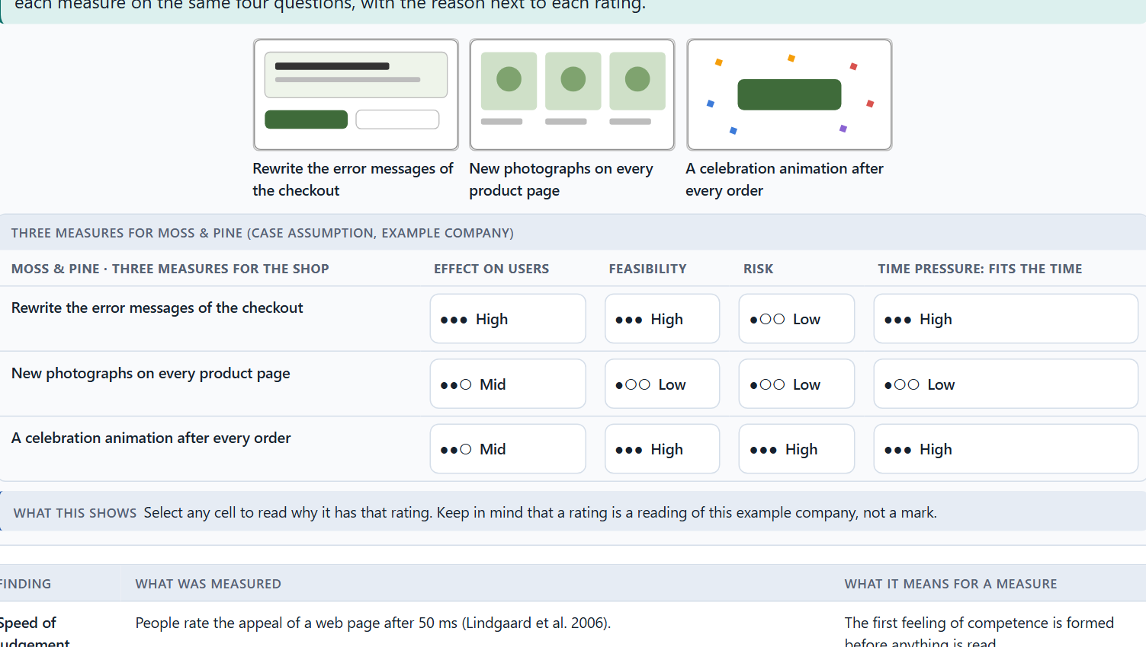
Trust and perceived competence, and weighing a measure
A5 · 12 min · Core
Trust links thinking and feeling. People judge competence, honesty and goodwill from small signals. Weigh measures on effect on users, feasibility, risk and time pressure, with a reason.
Moss & Pine weighs three measures on effect on users, feasibility, risk and time pressure.
Screenshot of the Neuro-UX Lab (aion-ux-lab.vercel.app), own work; AI-assisted, labelled on the image; the example company is fictional.
Sources: Fogg 2003 · Lindgaard et al. 2006 · Gibbons 2018 · Sillence et al. 2004 · Tractinsky et al. 2000 · Fogg et al. 2003
Notes:
A5 · Trust and perceived competence, and weighing a measure · 12 min · Core
Case assumption: Moss & Pine, Hana, Jonas, Wanda and Bruno are made up for this example. Credibility and perceived competence follow Fogg (2003); first impressions within a fraction of a second follow Lindgaard et al. (2006); rating options on the same criteria with a reason follows Gibbons (2018). The four criteria are the ones the plan names for the case study. The findings in the table of real evidence are real research results, rules and cases; the sources are listed below.
Go deeper (optional reading): Fogg (2003) found that people judge the credibility of a website largely from surface signals: design, clarity, small errors. This is why a typo or a technical error message can cost more trust than its size suggests, and why careful wording in confirmations and errors is one of the cheapest ways to build it.
Sources: Fogg 2003 · Lindgaard et al. 2006 · Gibbons 2018 · Sillence et al. 2004 · Tractinsky et al. 2000 · Fogg et al. 2003

Slide 25
A5 · In plain words
THE IDEA
WHY IT MATTERS
Trust is where thinking and feeling meet. People trust a product when it seems competent (it knows what it is doing), honest (it says what will happen) and benevolent (it is on their side), and they judge all three from small signals: a clear confirmation, an error message that does not blame, information that says where it comes from. A beautiful design raises perceived competence at first; broken promises lower it fast. To put measures in order, weigh each on the four questions Block 2.1 names: effect on users, feasibility, risk and time pressure.
Block 1.1 asks about WellTrack's health information that does not build trust, Block 1.2 asks you to rate trust in three designs and choose one, and Block 2.1 asks for four measures, their justification on these four criteria and a decision for 12 weeks. The example uses Moss & Pine and its own measures, so the answer for the task cases is not given.
HOW TO READ THE PICTURE
First the chain from a small signal to trust and use. Then three measures Moss & Pine considered, rated on effect on users, feasibility, risk and time pressure.
Sources: Fogg 2003 · Lindgaard et al. 2006 · Gibbons 2018 · Sillence et al. 2004 · Tractinsky et al. 2000 · Fogg et al. 2003
Notes:
A5 · Trust and perceived competence, and weighing a measure · 12 min · Core
Case assumption: Moss & Pine, Hana, Jonas, Wanda and Bruno are made up for this example. Credibility and perceived competence follow Fogg (2003); first impressions within a fraction of a second follow Lindgaard et al. (2006); rating options on the same criteria with a reason follows Gibbons (2018). The four criteria are the ones the plan names for the case study. The findings in the table of real evidence are real research results, rules and cases; the sources are listed below.
Go deeper (optional reading): Fogg (2003) found that people judge the credibility of a website largely from surface signals: design, clarity, small errors. This is why a typo or a technical error message can cost more trust than its size suggests, and why careful wording in confirmations and errors is one of the cheapest ways to build it.
Sources: Fogg 2003 · Lindgaard et al. 2006 · Gibbons 2018 · Sillence et al. 2004 · Tractinsky et al. 2000 · Fogg et al. 2003

Slide 26
A5 · Trust and perceived competence: findings
Finding | What was measured | What it means for a measure
Speed of judgement | People rate the appeal of a web page after 50 ms (Lindgaard et al. 2006). | The first feeling of competence is formed before anything is read.
Design and rejection | In a four-week study, women searching for health advice rejected sites because of their design appeal, and chose sites for the credibility of the content (Sillence et al. 2004). | Design earns the right to be read; content earns the trust.
Beauty and ease | People rate an attractive interface as easier to use before they have used it (Tractinsky et al. 2000). | A polished look raises expectations: the interface must live up to them.
Credibility | The design look was named in 46.1% of the comments on credibility (Fogg et al. 2003). | Count a care detail (spelling, alignment, tone) as a trust measure.
Sources: Fogg 2003 · Lindgaard et al. 2006 · Gibbons 2018 · Sillence et al. 2004 · Tractinsky et al. 2000 · Fogg et al. 2003
Notes:
A5 · Trust and perceived competence, and weighing a measure · 12 min · Core
Case assumption: Moss & Pine, Hana, Jonas, Wanda and Bruno are made up for this example. Credibility and perceived competence follow Fogg (2003); first impressions within a fraction of a second follow Lindgaard et al. (2006); rating options on the same criteria with a reason follows Gibbons (2018). The four criteria are the ones the plan names for the case study. The findings in the table of real evidence are real research results, rules and cases; the sources are listed below.
Go deeper (optional reading): Fogg (2003) found that people judge the credibility of a website largely from surface signals: design, clarity, small errors. This is why a typo or a technical error message can cost more trust than its size suggests, and why careful wording in confirmations and errors is one of the cheapest ways to build it.
Sources: Fogg 2003 · Lindgaard et al. 2006 · Gibbons 2018 · Sillence et al. 2004 · Tractinsky et al. 2000 · Fogg et al. 2003

Slide 27
A5 · How to decide when this comes up in the task
Look for the small signals of competence: clear feedback, careful wording, information that says where it comes from.
1
Look for signals of honesty: no surprises, no hidden conditions, errors that say what happened.
2
A good look raises trust at first; a broken promise lowers it fast.
3
Rate every measure on the same four questions: effect on users, feasibility, risk, time pressure.
4
A rating is a judgement with a reason, never a mark.
5
Sources: Fogg 2003 · Lindgaard et al. 2006 · Gibbons 2018 · Sillence et al. 2004 · Tractinsky et al. 2000 · Fogg et al. 2003
Notes:
A5 · Trust and perceived competence, and weighing a measure · 12 min · Core
Case assumption: Moss & Pine, Hana, Jonas, Wanda and Bruno are made up for this example. Credibility and perceived competence follow Fogg (2003); first impressions within a fraction of a second follow Lindgaard et al. (2006); rating options on the same criteria with a reason follows Gibbons (2018). The four criteria are the ones the plan names for the case study. The findings in the table of real evidence are real research results, rules and cases; the sources are listed below.
Go deeper (optional reading): Fogg (2003) found that people judge the credibility of a website largely from surface signals: design, clarity, small errors. This is why a typo or a technical error message can cost more trust than its size suggests, and why careful wording in confirmations and errors is one of the cheapest ways to build it.
Sources: Fogg 2003 · Lindgaard et al. 2006 · Gibbons 2018 · Sillence et al. 2004 · Tractinsky et al. 2000 · Fogg et al. 2003

Slide 28
B
Materi B
Route 2 · Level 3
About 60 minutes, three cards, led by the facilitator. Level 3 in the Chief Experience Officer's chair: a guiding vision for emotional UX, three strategic decisions, an order of what is improved first, a risk analysis, a governance model for emotional UX principles, one decision under uncertainty and a statement to the management. The cards give you the ideas you use in Task 2.

Slide 29
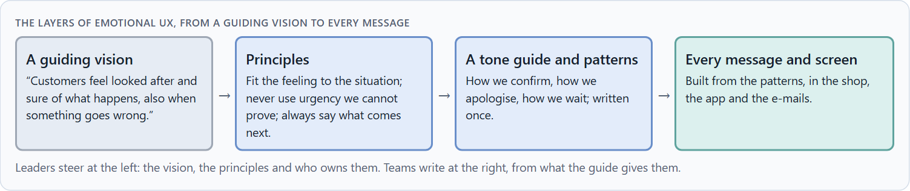
Emotional UX as part of the UX architecture, not a campaign
B1 · 20 min · Core
What people feel in a product comes mostly from feedback, tone and interaction, which teams build every day. Emotional UX belongs in the UX architecture, with a vision, principles, a tone guide, patterns and an owner.
The layers of emotional UX, from a guiding vision to every message.
Screenshot of the Neuro-UX Lab (aion-ux-lab.vercel.app), own work; AI-assisted, labelled on the image; the example company is fictional.
Sources: Norman 2004 · Walter 2011 · Hassenzahl 2010 · Mailchimp, Voice and Tone · ISO 9241-210
Notes:
B1 · Emotional UX as part of the UX architecture, not a campaign · 20 min · Core
Case assumption: Moss & Pine, Hana, Jonas, Wanda and Bruno are made up for this example. Emotion as a property of the product follows Norman (2004) and Hassenzahl (2010); tone and personality as a design system of their own follow Walter (2011). The findings in the table of real evidence are real research results, rules and cases; the sources are listed below.
Go deeper (optional reading): A guiding vision for emotional UX is short and testable: one sentence that names the feeling and covers the hard moments. “Customers feel looked after and sure of what happens, also when something goes wrong” can be checked on every screen. “We delight our customers” cannot, and it invites over-emotionalisation.
Sources: Norman 2004 · Walter 2011 · Hassenzahl 2010 · Mailchimp, Voice and Tone · ISO 9241-210

Slide 30
B1 · In plain words
THE IDEA
WHY IT MATTERS
In many companies emotion is treated as a marketing question: a campaign, a slogan, a nicer picture. But what people feel in a product comes mostly from its feedback, its tone in critical moments and its interaction logic, which product teams build every day. Emotional UX therefore belongs in the UX architecture: principles for how every touchpoint should feel, a tone guide, patterns for confirmations, errors and waiting, and someone who owns them. At senior level it becomes a leadership task when it shapes loyalty, acceptance and how the company is perceived.
Block 3.1 asks for a guiding vision for emotional UX, three decisions on trust, emotional safety, motivation and supportive interaction, and an order of which touchpoints, interactions or communication patterns come first, for a company that sees emotion as marketing. You decide the principles, not the pictures.
HOW TO READ THE PICTURE
Left Moss & Pine treating emotion as a campaign, right building it into the UX architecture. Below, the layers from a guiding vision to every message.
Sources: Norman 2004 · Walter 2011 · Hassenzahl 2010 · Mailchimp, Voice and Tone · ISO 9241-210
Notes:
B1 · Emotional UX as part of the UX architecture, not a campaign · 20 min · Core
Case assumption: Moss & Pine, Hana, Jonas, Wanda and Bruno are made up for this example. Emotion as a property of the product follows Norman (2004) and Hassenzahl (2010); tone and personality as a design system of their own follow Walter (2011). The findings in the table of real evidence are real research results, rules and cases; the sources are listed below.
Go deeper (optional reading): A guiding vision for emotional UX is short and testable: one sentence that names the feeling and covers the hard moments. “Customers feel looked after and sure of what happens, also when something goes wrong” can be checked on every screen. “We delight our customers” cannot, and it invites over-emotionalisation.
Sources: Norman 2004 · Walter 2011 · Hassenzahl 2010 · Mailchimp, Voice and Tone · ISO 9241-210

Slide 31
B1 · Emotional UX in the architecture: real structures
Part | Real example | What it means
Voice and tone as a system | Mailchimp publishes a voice and tone guide with a steady voice and a tone that follows the situation of the reader (Mailchimp, Voice and Tone). | Treat the tone as a written, shared standard, not as the taste of one writer.
Layers of emotional effect | Norman's three levels and Walter's hierarchy give a structure to plan for: first look, use, meaning (Norman 2004; Walter 2011). | Decide which level each touchpoint must serve.
Part of the definition | ISO 9241-210 includes emotions in the definition of user experience. | A UX strategy that leaves emotion out is not complete by the standard's own definition.
Sources: Norman 2004 · Walter 2011 · Hassenzahl 2010 · Mailchimp, Voice and Tone · ISO 9241-210
Notes:
B1 · Emotional UX as part of the UX architecture, not a campaign · 20 min · Core
Case assumption: Moss & Pine, Hana, Jonas, Wanda and Bruno are made up for this example. Emotion as a property of the product follows Norman (2004) and Hassenzahl (2010); tone and personality as a design system of their own follow Walter (2011). The findings in the table of real evidence are real research results, rules and cases; the sources are listed below.
Go deeper (optional reading): A guiding vision for emotional UX is short and testable: one sentence that names the feeling and covers the hard moments. “Customers feel looked after and sure of what happens, also when something goes wrong” can be checked on every screen. “We delight our customers” cannot, and it invites over-emotionalisation.
Sources: Norman 2004 · Walter 2011 · Hassenzahl 2010 · Mailchimp, Voice and Tone · ISO 9241-210

Slide 32
B1 · How to decide when this comes up in the task
Check where emotion is decided today: by marketing in campaigns, or in the product's feedback and tone?
1
Write a guiding vision that says how people should feel in every touchpoint, including when something goes wrong.
2
Turn it into a few principles and a tone guide every team uses.
3
Build patterns once for the critical moments: confirmations, errors, waiting.
4
At senior level, emotional UX is a leadership task when it shapes loyalty, acceptance and how the company is seen.
5
Sources: Norman 2004 · Walter 2011 · Hassenzahl 2010 · Mailchimp, Voice and Tone · ISO 9241-210
Notes:
B1 · Emotional UX as part of the UX architecture, not a campaign · 20 min · Core
Case assumption: Moss & Pine, Hana, Jonas, Wanda and Bruno are made up for this example. Emotion as a property of the product follows Norman (2004) and Hassenzahl (2010); tone and personality as a design system of their own follow Walter (2011). The findings in the table of real evidence are real research results, rules and cases; the sources are listed below.
Go deeper (optional reading): A guiding vision for emotional UX is short and testable: one sentence that names the feeling and covers the hard moments. “Customers feel looked after and sure of what happens, also when something goes wrong” can be checked on every screen. “We delight our customers” cannot, and it invites over-emotionalisation.
Sources: Norman 2004 · Walter 2011 · Hassenzahl 2010 · Mailchimp, Voice and Tone · ISO 9241-210

Slide 33
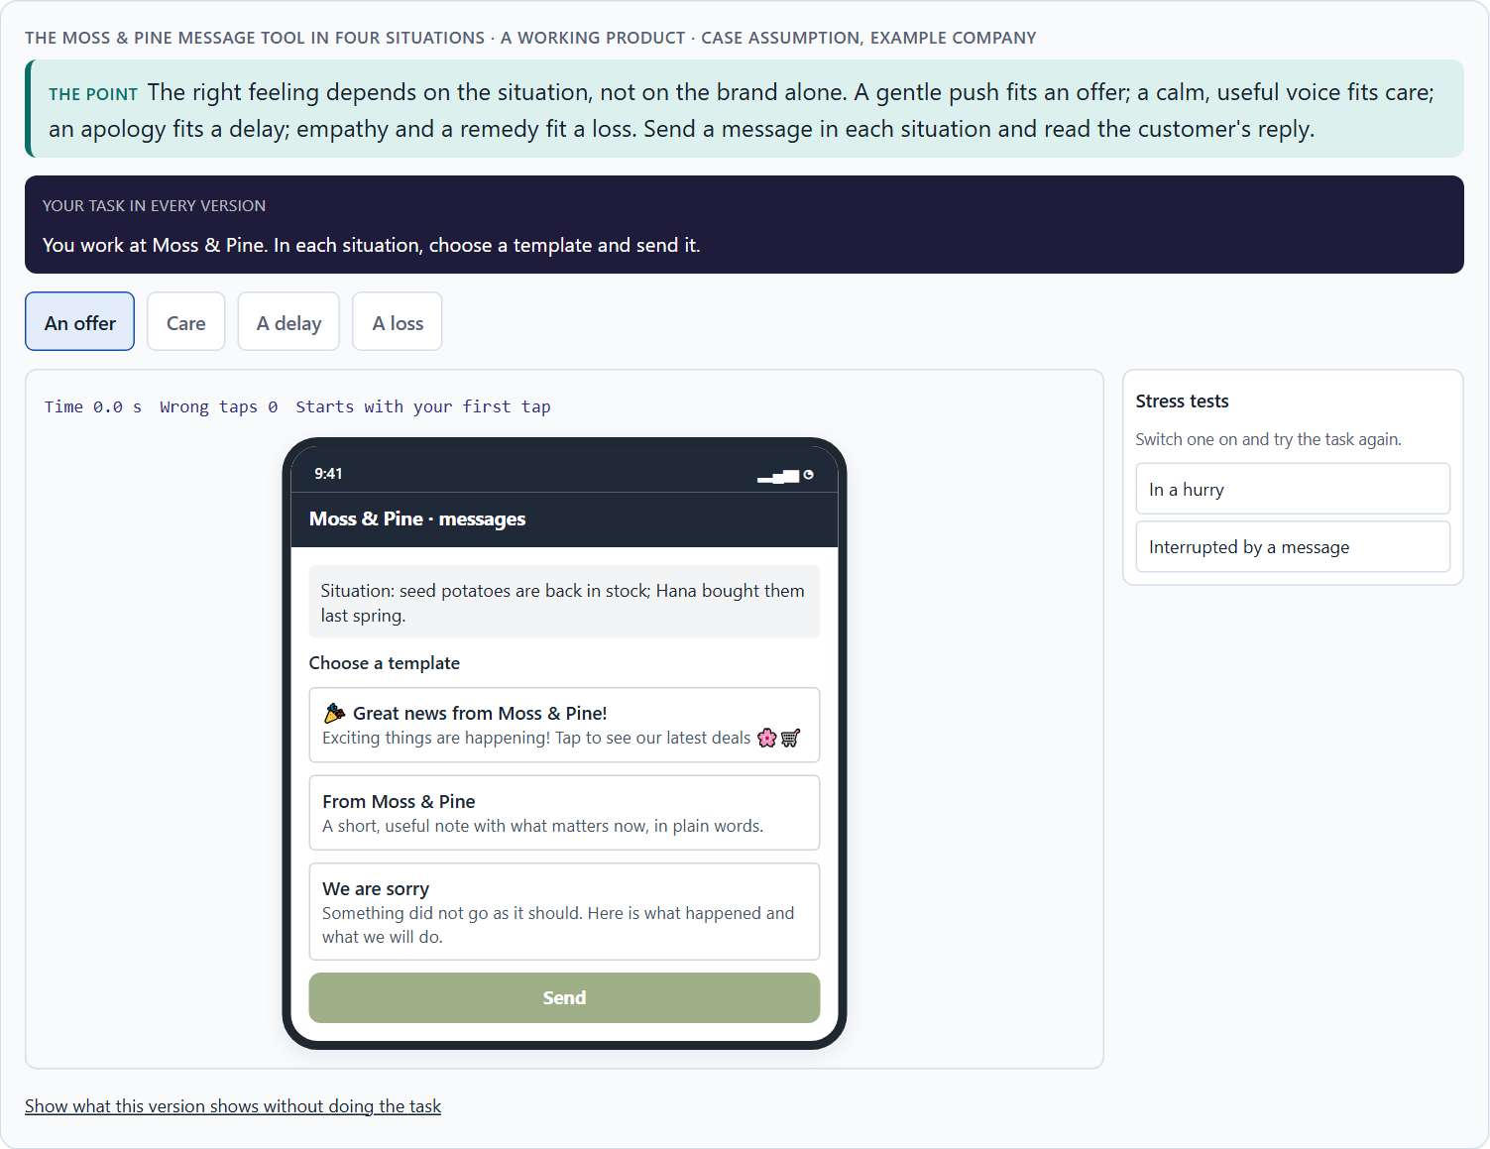
Seriousness against closeness: the conflicts of emotional UX
B2 · 20 min · Core
Seriousness against closeness, activation against credibility, brand effect against user effect. Over-emotionalisation and manipulation are strategic risks. Fit the feeling to the situation and say what each choice gives up.
The Moss & Pine message tool in four situations.
Screenshot of the Neuro-UX Lab (aion-ux-lab.vercel.app), own work; AI-assisted, labelled on the image; the example company is fictional.
Sources: Mathur et al. 2019 · Fogg 2003 · Gibbons 2018 · Mailchimp, Voice and Tone · Fogg et al. 2003 · Sillence et al. 2004
Notes:
B2 · Seriousness against closeness: the conflicts of emotional UX · 20 min · Core
Case assumption: Moss & Pine, Hana, Jonas, Wanda and Bruno are made up for this example. The four situations are a reading of the example, not a rule for every product. The findings in the table of real evidence are real research results, rules and cases; the sources are listed below.
Go deeper (optional reading): Over-emotionalisation is often a symptom of a conflict that was never settled: marketing adds warmth to every message because no one decided where warmth belongs. A short matrix in the tone guide (which feeling for which situation) settles it once and gives every team the same answer.
Sources: Mathur et al. 2019 · Fogg 2003 · Gibbons 2018 · Mailchimp, Voice and Tone · Fogg et al. 2003 · Sillence et al. 2004

Slide 34
B2 · In plain words
THE IDEA
WHY IT MATTERS
Emotional UX sits between goals that pull against each other: seriousness against closeness (a brand that must be credible and approachable), activation against credibility (more stimuli against looking like a sales channel), brand effect against user effect (what marketing wants to say against what a worried user needs to hear), and speed against care. Over-emotionalisation and manipulation are not only design faults but strategic risks: they weaken credibility and acceptance. The way through is to fit the feeling to the situation, write the rule down, and say what each choice gives up.
Block 3.1 asks for three guiding decisions, a risk analysis of wrong assumptions about emotional effect, credibility and user behaviour, and a governance model for conflicts between brand, expertise and user effect. Each of these is a decision between conflicting goals.
HOW TO READ THE PICTURE
The same Moss & Pine reminder for four situations, with the feeling each one needs.
Sources: Mathur et al. 2019 · Fogg 2003 · Gibbons 2018 · Mailchimp, Voice and Tone · Fogg et al. 2003 · Sillence et al. 2004
Notes:
B2 · Seriousness against closeness: the conflicts of emotional UX · 20 min · Core
Case assumption: Moss & Pine, Hana, Jonas, Wanda and Bruno are made up for this example. The four situations are a reading of the example, not a rule for every product. The findings in the table of real evidence are real research results, rules and cases; the sources are listed below.
Go deeper (optional reading): Over-emotionalisation is often a symptom of a conflict that was never settled: marketing adds warmth to every message because no one decided where warmth belongs. A short matrix in the tone guide (which feeling for which situation) settles it once and gives every team the same answer.
Sources: Mathur et al. 2019 · Fogg 2003 · Gibbons 2018 · Mailchimp, Voice and Tone · Fogg et al. 2003 · Sillence et al. 2004

Slide 35
B2 · Standing conflicts of emotional UX
Conflict | Who usually stands for each side | What to ask
Seriousness against closeness | The experts, against marketing and the brand. | Can it be warm and correct at once?
Activation against credibility | Marketing's targets, against long-term trust. | Would the message still work if people knew why it was written?
Brand effect against user effect | What the company wants to say, against what the person needs now. | What does this person need in this situation?
Sources: Mathur et al. 2019 · Fogg 2003 · Gibbons 2018 · Mailchimp, Voice and Tone · Fogg et al. 2003 · Sillence et al. 2004
Notes:
B2 · Seriousness against closeness: the conflicts of emotional UX · 20 min · Core
Case assumption: Moss & Pine, Hana, Jonas, Wanda and Bruno are made up for this example. The four situations are a reading of the example, not a rule for every product. The findings in the table of real evidence are real research results, rules and cases; the sources are listed below.
Go deeper (optional reading): Over-emotionalisation is often a symptom of a conflict that was never settled: marketing adds warmth to every message because no one decided where warmth belongs. A short matrix in the tone guide (which feeling for which situation) settles it once and gives every team the same answer.
Sources: Mathur et al. 2019 · Fogg 2003 · Gibbons 2018 · Mailchimp, Voice and Tone · Fogg et al. 2003 · Sillence et al. 2004

Slide 36
B2 · Conflicts of emotional UX, with evidence
Conflict | What the evidence says | A way to decide
Seriousness against closeness | Tone can change with the situation while the voice stays the same (Mailchimp, Voice and Tone). | Keep the voice of the brand and set the tone by the situation: warm for a welcome, plain for an error.
Activation against credibility | Pressure patterns were found on about 11% of the crawled shopping websites (Mathur et al. 2019), and exaggeration lowers credibility (Fogg 2003). | Apply the test: would the message still work if people knew why it was written?
Brand effect against user effect | The design look drives judgements of credibility (Fogg et al. 2003), and design appeal decides rejection (Sillence et al. 2004). | Judge a campaign by what the person needs now, then by the brand.
Sources: Mathur et al. 2019 · Fogg 2003 · Gibbons 2018 · Mailchimp, Voice and Tone · Fogg et al. 2003 · Sillence et al. 2004
Notes:
B2 · Seriousness against closeness: the conflicts of emotional UX · 20 min · Core
Case assumption: Moss & Pine, Hana, Jonas, Wanda and Bruno are made up for this example. The four situations are a reading of the example, not a rule for every product. The findings in the table of real evidence are real research results, rules and cases; the sources are listed below.
Go deeper (optional reading): Over-emotionalisation is often a symptom of a conflict that was never settled: marketing adds warmth to every message because no one decided where warmth belongs. A short matrix in the tone guide (which feeling for which situation) settles it once and gives every team the same answer.
Sources: Mathur et al. 2019 · Fogg 2003 · Gibbons 2018 · Mailchimp, Voice and Tone · Fogg et al. 2003 · Sillence et al. 2004

Slide 37
B2 · How to decide when this comes up in the task
Name the conflict as two goals and say who stands for each: marketing, the experts, the product team, the users.
1
Decide the feeling by the situation: offer, care, delay, loss; not by the brand alone.
2
Treat every false urgency or inappropriate cheerfulness as a risk to credibility, not as a style question.
3
Write the rule down, so the conflict is not fought again on every message.
4
Say what the choice gives up; a decision that gives up nothing has not been made.
5
Sources: Mathur et al. 2019 · Fogg 2003 · Gibbons 2018 · Mailchimp, Voice and Tone · Fogg et al. 2003 · Sillence et al. 2004
Notes:
B2 · Seriousness against closeness: the conflicts of emotional UX · 20 min · Core
Case assumption: Moss & Pine, Hana, Jonas, Wanda and Bruno are made up for this example. The four situations are a reading of the example, not a rule for every product. The findings in the table of real evidence are real research results, rules and cases; the sources are listed below.
Go deeper (optional reading): Over-emotionalisation is often a symptom of a conflict that was never settled: marketing adds warmth to every message because no one decided where warmth belongs. A short matrix in the tone guide (which feeling for which situation) settles it once and gives every team the same answer.
Sources: Mathur et al. 2019 · Fogg 2003 · Gibbons 2018 · Mailchimp, Voice and Tone · Fogg et al. 2003 · Sillence et al. 2004

Slide 38
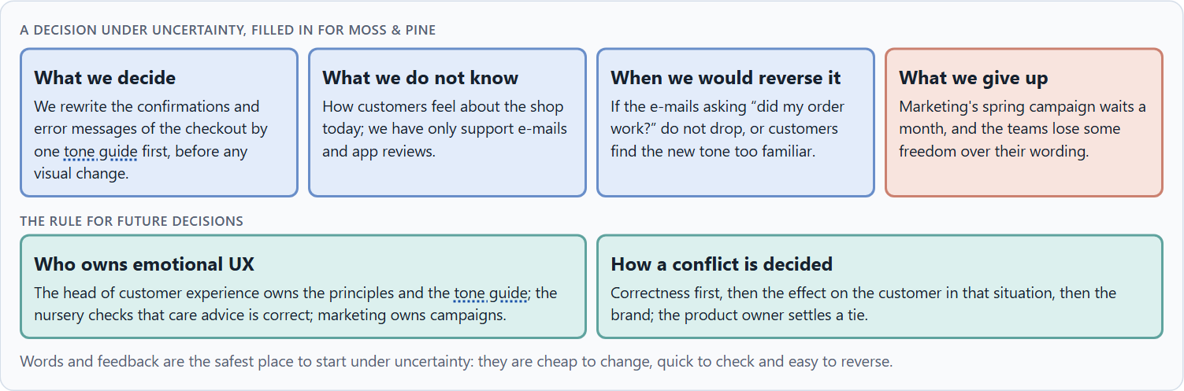
Who owns emotional UX, and deciding with little data on feelings
B3 · 20 min · Core
Emotional quality lives only with governance: an owner of the principles and the tone guide, experts who check correctness, marketing who owns the brand, and a rule for conflicts. A decision with little data says what it decides, does not know, would reverse and gives up.
A decision under uncertainty, filled in for Moss & Pine.
Screenshot of the Neuro-UX Lab (aion-ux-lab.vercel.app), own work; AI-assisted, labelled on the image; the example company is fictional.
Sources: Simon 1956 · Klein 2007 · Walter 2011 · Mailchimp, Voice and Tone · Mathur et al. 2019 · EU Digital Services Act
Notes:
B3 · Who owns emotional UX, and deciding with little data on feelings · 20 min · Core
Case assumption: Moss & Pine, Hana, Jonas, Wanda and Bruno are made up for this example. Deciding with limited information follows Simon (1956); the premortem follows Klein (2007). The findings in the table of real evidence are real research results, rules and cases; the sources are listed below.
Go deeper (optional reading): Imagine it is a year later and the new tone has failed, and ask why (Klein 2007). The usual answers: it sounded friendly but stopped being precise, so the experts withdrew; marketing used it for urgency; each team bent it until there were five tones again. Each answer is a governance gap, not a writing gap.
Sources: Simon 1956 · Klein 2007 · Walter 2011 · Mailchimp, Voice and Tone · Mathur et al. 2019 · EU Digital Services Act

Slide 39
B3 · In plain words
THE IDEA
WHY IT MATTERS
Emotional quality lives only with governance: someone who owns the principles and the tone guide, the experts who check that a warm message is still correct, marketing who owns the brand, and a rule for when they disagree. Data on feelings is rarely complete, so a decision under uncertainty says what you decide, what you do not know, when you would reverse it and what you give up. Small, reversible changes to words and feedback are the safest place to start, because they can be checked soon.
Block 3.1 asks for a governance model for emotional UX principles, a decision despite patchy data, and a statement to the management. This card gives you the parts of each.
HOW TO READ THE PICTURE
The four boxes at the top are the parts of a decision, filled in for Moss & Pine. The two boxes below are the rule for future decisions.
Sources: Simon 1956 · Klein 2007 · Walter 2011 · Mailchimp, Voice and Tone · Mathur et al. 2019 · EU Digital Services Act
Notes:
B3 · Who owns emotional UX, and deciding with little data on feelings · 20 min · Core
Case assumption: Moss & Pine, Hana, Jonas, Wanda and Bruno are made up for this example. Deciding with limited information follows Simon (1956); the premortem follows Klein (2007). The findings in the table of real evidence are real research results, rules and cases; the sources are listed below.
Go deeper (optional reading): Imagine it is a year later and the new tone has failed, and ask why (Klein 2007). The usual answers: it sounded friendly but stopped being precise, so the experts withdrew; marketing used it for urgency; each team bent it until there were five tones again. Each answer is a governance gap, not a writing gap.
Sources: Simon 1956 · Klein 2007 · Walter 2011 · Mailchimp, Voice and Tone · Mathur et al. 2019 · EU Digital Services Act

Slide 40
B3 · Three parts of emotional UX governance
Part | The question | An example (Moss & Pine)
Who owns what | Who owns the principles and the tone guide; who uses them? | The head of customer experience owns them; every team uses them.
Who checks | Who makes sure warmth stays correct? | The nursery checks care advice; marketing checks the brand.
How a conflict is decided | What happens when brand, expertise and user effect disagree? | Correctness, then the customer, then the brand; the product owner settles a tie.
Sources: Simon 1956 · Klein 2007 · Walter 2011 · Mailchimp, Voice and Tone · Mathur et al. 2019 · EU Digital Services Act
Notes:
B3 · Who owns emotional UX, and deciding with little data on feelings · 20 min · Core
Case assumption: Moss & Pine, Hana, Jonas, Wanda and Bruno are made up for this example. Deciding with limited information follows Simon (1956); the premortem follows Klein (2007). The findings in the table of real evidence are real research results, rules and cases; the sources are listed below.
Go deeper (optional reading): Imagine it is a year later and the new tone has failed, and ask why (Klein 2007). The usual answers: it sounded friendly but stopped being precise, so the experts withdrew; marketing used it for urgency; each team bent it until there were five tones again. Each answer is a governance gap, not a writing gap.
Sources: Simon 1956 · Klein 2007 · Walter 2011 · Mailchimp, Voice and Tone · Mathur et al. 2019 · EU Digital Services Act

Slide 41
B3 · Owning emotional UX: real rules and a real case
Part | Real example or rule | What it means
Who owns the tone | Mailchimp's voice and tone guide is a public document that its writers share (Mailchimp, Voice and Tone). | Name an owner and publish the guide.
Who checks | Manipulative patterns can be bought as a ready-made feature (Mathur et al. 2019), so someone has to check what is installed. | Review third-party components for pressure and guilt.
The legal check | Article 25 of the EU Digital Services Act forbids manipulative interface design on online platforms. | Add a legal check to the release of emotional features.
Sources: Simon 1956 · Klein 2007 · Walter 2011 · Mailchimp, Voice and Tone · Mathur et al. 2019 · EU Digital Services Act
Notes:
B3 · Who owns emotional UX, and deciding with little data on feelings · 20 min · Core
Case assumption: Moss & Pine, Hana, Jonas, Wanda and Bruno are made up for this example. Deciding with limited information follows Simon (1956); the premortem follows Klein (2007). The findings in the table of real evidence are real research results, rules and cases; the sources are listed below.
Go deeper (optional reading): Imagine it is a year later and the new tone has failed, and ask why (Klein 2007). The usual answers: it sounded friendly but stopped being precise, so the experts withdrew; marketing used it for urgency; each team bent it until there were five tones again. Each answer is a governance gap, not a writing gap.
Sources: Simon 1956 · Klein 2007 · Walter 2011 · Mailchimp, Voice and Tone · Mathur et al. 2019 · EU Digital Services Act

Slide 42
B3 · How to decide when this comes up in the task
Name who owns the emotional UX principles and the tone guide, and who only uses them.
1
Give the experts a veto on correctness, and marketing ownership of campaigns.
2
Settle conflicts by correctness first, then the effect on the person in that situation, then the brand.
3
Say what you decide, what you do not know, when you would reverse it and what you give up.
4
Start where changes are cheap, quick to check and easy to reverse: words and feedback.
5
Sources: Simon 1956 · Klein 2007 · Walter 2011 · Mailchimp, Voice and Tone · Mathur et al. 2019 · EU Digital Services Act
Notes:
B3 · Who owns emotional UX, and deciding with little data on feelings · 20 min · Core
Case assumption: Moss & Pine, Hana, Jonas, Wanda and Bruno are made up for this example. Deciding with limited information follows Simon (1956); the premortem follows Klein (2007). The findings in the table of real evidence are real research results, rules and cases; the sources are listed below.
Go deeper (optional reading): Imagine it is a year later and the new tone has failed, and ask why (Klein 2007). The usual answers: it sounded friendly but stopped being precise, so the experts withdrew; marketing used it for urgency; each team bent it until there were five tones again. Each answer is a governance gap, not a writing gap.
Sources: Simon 1956 · Klein 2007 · Walter 2011 · Mailchimp, Voice and Tone · Mathur et al. 2019 · EU Digital Services Act

Slide 43
Sources (1)
Norman, D. A. (2004). Emotional Design: Why We Love (or Hate) Everyday Things. Basic Books.
Damasio, A. R. (1994). Descartes' Error: Emotion, Reason, and the Human Brain. Putnam.
Kahneman, D., Fredrickson, B. L., Schreiber, C. A., & Redelmeier, D. A. (1993). When more pain is preferred to less: Adding a better end. Psychological Science, 4(6), 401–405.
Fogg, B. J., Soohoo, C., Danielson, D. R., Marable, L., Stanford, J., & Tauber, E. R. (2003). How do users evaluate the credibility of Web sites? A study with over 2,500 participants. Proceedings of DUX '03.
Hassenzahl, M. (2010). Experience Design: Technology for All the Right Reasons. Morgan & Claypool.
ISO 9241-210:2019. Ergonomics of human-system interaction, Part 210: Human-centred design for interactive systems. (Defines user experience as a person's perceptions and responses that result from the use or anticipated use of a product, system or service.) Check the current edition before you teach from it.
Walter, A. (2011). Designing for Emotion. A Book Apart.

Slide 44
Sources (2)
Norman, D. A. (2013). The Design of Everyday Things (revised and expanded edition). Basic Books.
Nielsen, J. (1994, reviewed 2024). 10 Usability Heuristics for User Interface Design. Nielsen Norman Group. https://www.nngroup.com/articles/ten-usability-heuristics/
Mailchimp. Content Style Guide: Voice and Tone. https://styleguide.mailchimp.com/voice-and-tone/
Mathur, A., Acar, G., Friedman, M. J., Lucherini, E., Mayer, J., Chetty, M., & Narayanan, A. (2019). Dark patterns at scale: Findings from a crawl of 11K shopping websites. Proceedings of the ACM on Human-Computer Interaction, 3(CSCW), 1–32.
Fogg, B. J. (2003). Prominence-interpretation theory: Explaining how people assess credibility online. CHI '03 Extended Abstracts, 722–723.
Regulation (EU) 2022/2065 of the European Parliament and of the Council (Digital Services Act), Article 25. https://eur-lex.europa.eu/eli/reg/2022/2065/oj
Court of Justice of the European Union (2019). Judgment of 1 October 2019, Planet49, C-673/17.

Slide 45
Sources (3)
Lindgaard, G., Fernandes, G., Dudek, C., & Brown, J. (2006). Attention web designers: You have 50 milliseconds to make a good first impression! Behaviour & Information Technology, 25(2), 115–126.
Gibbons, S. (2018). Using Prioritization Matrices to Inform UX Decisions. Nielsen Norman Group. https://www.nngroup.com/articles/prioritization-matrices/
Sillence, E., Briggs, P., Fishwick, L., & Harris, P. (2004). Trust and mistrust of online health sites. Proceedings of CHI 2004, 663–670.
Tractinsky, N., Katz, A. S., & Ikar, D. (2000). What is beautiful is usable. Interacting with Computers, 13(2), 127–145.
Simon, H. A. (1956). Rational choice and the structure of the environment. Psychological Review, 63(2), 129–138.
Klein, G. (2007). Performing a project premortem. Harvard Business Review, 85(9), 18–19.

Slide 46
About these slides, sources and AI use
AI
AI-assisted content
Where to find more
AI-assisted content: these slides were drafted with an AI language model (Claude, Anthropic) from the course's own Neuro-UX Lab and were read, corrected and approved by Muhammad Muchson, who is responsible for their accuracy.
Pictures are screenshots of the course's own Neuro-UX Lab. Each one carries an AI label on the image and a source line under it.
Companies and people in the examples are fictional. Numbers inside an example are labelled Case assumption and are not data.
Neuro-UX Lab for this day: https://aion-ux-lab.vercel.app/day/7/
Handouts: the Materi and Task Word documents of the day.
Version 1.0, 29.10.2026. Reviewer and approver: Muhammad Muchson.

