Slide 1
UX DEVELOPER · DAY 8
Storytelling in UX/UI design
Knowledge transfer slides
Module 4 (day 2 of 3)
Trainer: Muhammad Muchson · Materi A and B · v1.0
Contains AI-assisted content

Slide 2
What we cover today
Today is about the story a digital product tells while people use it. You learn why people experience a process as a journey and not only as a list of functions, the elements of narrative guidance (a starting situation, a goal, relevance, an obstacle, support, progress, a resolution), the dramaturgical means of tension, expectation, sequence, transition, confirmation and emotional context, how they raise orientation, motivation and memorability, and where storytelling turns into overload. Then you use it on three products. This document holds everything you need to study Day 8 without the website. Every card says what the idea is in plain words, shows it in a picture, gives the details and ends with the rules you use in the tasks.
Materi A · 60 min
Materi B · 60 min
A1 Why people experience a process as a story (12 min)
A2 The elements of narrative guidance: from starting point to resolution (12 min)
A3 Telling a story or guiding with one: dramaturgy in a journey (12 min)
A4 Orientation, motivation and memorability, and the risk of overload (12 min)
A5 Embedding an action in its context, and weighing a measure (12 min)
B1 Narrative UX as experience architecture, not communication (20 min)
B2 Efficiency against story: the conflicts of narrative UX (20 min)
B3 Who owns narrative UX, and deciding without seeing where people stop (20 min)

Slide 3
A
Materi A
Route 1 · Levels 1 and 2
About 60 minutes, five cards. Levels 1 and 2: describe the narrative gaps of an unfamiliar start-up platform, rate three journeys of a further-training platform between efficiency and dramaturgy, then analyse an onboarding flow, develop four measures, justify them and decide on the first 12 weeks. The cards give you the ideas and the rules you use in Task 1.

Slide 4
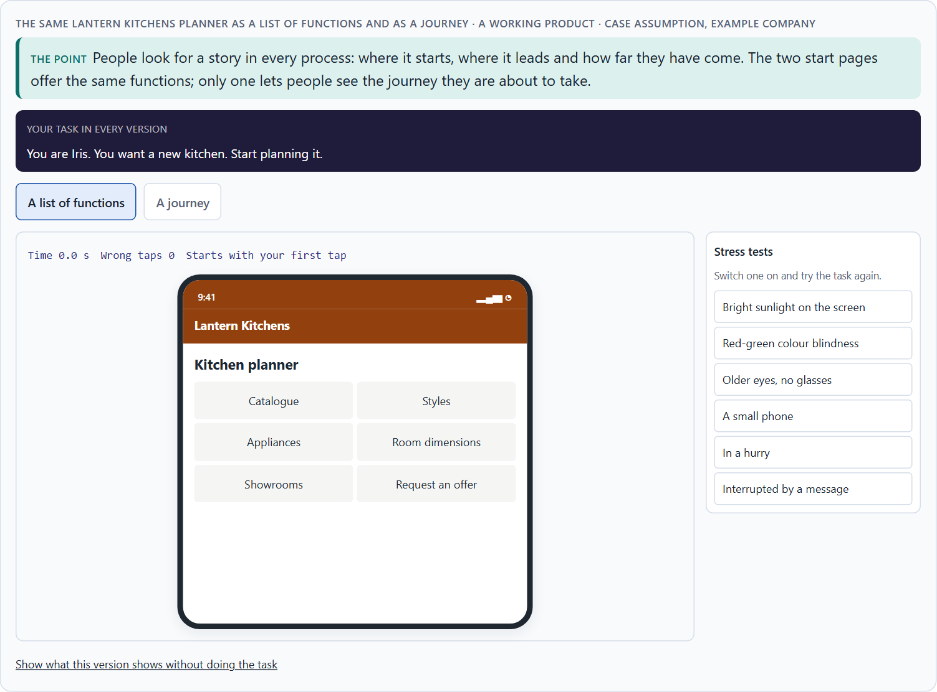
Why people experience a process as a story
A1 · 12 min · Core
People make sense of what they do as a story: where they start, where they are going, how far they have come. A process that shows only functions still gets read as a journey, and without a story it feels lost or endless.
The same Lantern Kitchens planner as a list of functions and as a journey.
Screenshot of the Neuro-UX Lab (aion-ux-lab.vercel.app), own work; AI-assisted, labelled on the image; the example company is fictional.
Sources: Bruner 1991 · Quesenbery & Brooks 2010 · Lupton 2017 · Green & Brock 2000 · Kivetz et al. 2006 · Nunes & Drèze 2006
Notes:
A1 · Why people experience a process as a story · 12 min · Core
Case assumption: Lantern Kitchens, Iris, Pavel, June and Arne are made up for this example. Narrative as a way of making sense of experience follows Bruner (1991); storytelling for user experience follows Quesenbery and Brooks (2010); design as a sequence with a beginning, tension and resolution follows Lupton (2017). The findings in the table of real evidence are real research results, rules and cases; the sources are listed below.
Go deeper (optional reading): Bruner (1991) argued that people do not store experience as a list of facts but as stories with actors, goals and turns. In a digital product the actor is the user, the goal is what they came to do, and the turns are the steps, the obstacles and the help. A product that does not offer this structure leaves people to build it themselves, and many give up before they do.
Sources: Bruner 1991 · Quesenbery & Brooks 2010 · Lupton 2017 · Green & Brock 2000 · Kivetz et al. 2006 · Nunes & Drèze 2006

Slide 5
A1 · In plain words
THE IDEA
WHY IT MATTERS
People make sense of what they do as a story: where they started, where they want to go, what stands in the way and how far they have come. A digital process is experienced the same way, whether it was designed as a story or not. When it shows only functions and forms, people still look for the story, and when they cannot find one they feel lost, bored or left alone. Storytelling in UX/UI design means building the journey so that the story people look for is there: a beginning that shows the goal, a way that shows progress, and an end that feels like an end.
Block 1.1 asks for the effect of StartSmart on a first-time user and for effect statements of the form “for users this could mean that …”, and Block 2.1 asks why GreenHome's complete onboarding is abandoned. This card gives you the reason a working process can still feel like no journey at all.
HOW TO READ THE PICTURE
The same Lantern Kitchens planner twice: as a list of functions and as a journey.
Sources: Bruner 1991 · Quesenbery & Brooks 2010 · Lupton 2017 · Green & Brock 2000 · Kivetz et al. 2006 · Nunes & Drèze 2006
Notes:
A1 · Why people experience a process as a story · 12 min · Core
Case assumption: Lantern Kitchens, Iris, Pavel, June and Arne are made up for this example. Narrative as a way of making sense of experience follows Bruner (1991); storytelling for user experience follows Quesenbery and Brooks (2010); design as a sequence with a beginning, tension and resolution follows Lupton (2017). The findings in the table of real evidence are real research results, rules and cases; the sources are listed below.
Go deeper (optional reading): Bruner (1991) argued that people do not store experience as a list of facts but as stories with actors, goals and turns. In a digital product the actor is the user, the goal is what they came to do, and the turns are the steps, the obstacles and the help. A product that does not offer this structure leaves people to build it themselves, and many give up before they do.
Sources: Bruner 1991 · Quesenbery & Brooks 2010 · Lupton 2017 · Green & Brock 2000 · Kivetz et al. 2006 · Nunes & Drèze 2006

Slide 6
A1 · Processing a process as a story
People look for | What they ask | If it is missing
A beginning | Where do I start, and is this for me? | They browse and leave.
A goal | What will I have at the end? | No reason to begin or to go on.
A way | How far have I come, how much is left? | It feels endless; they give up halfway.
An end | Am I done, and was it worth it? | They are unsure it worked.
Sources: Bruner 1991 · Quesenbery & Brooks 2010 · Lupton 2017 · Green & Brock 2000 · Kivetz et al. 2006 · Nunes & Drèze 2006
Notes:
A1 · Why people experience a process as a story · 12 min · Core
Case assumption: Lantern Kitchens, Iris, Pavel, June and Arne are made up for this example. Narrative as a way of making sense of experience follows Bruner (1991); storytelling for user experience follows Quesenbery and Brooks (2010); design as a sequence with a beginning, tension and resolution follows Lupton (2017). The findings in the table of real evidence are real research results, rules and cases; the sources are listed below.
Go deeper (optional reading): Bruner (1991) argued that people do not store experience as a list of facts but as stories with actors, goals and turns. In a digital product the actor is the user, the goal is what they came to do, and the turns are the steps, the obstacles and the help. A product that does not offer this structure leaves people to build it themselves, and many give up before they do.
Sources: Bruner 1991 · Quesenbery & Brooks 2010 · Lupton 2017 · Green & Brock 2000 · Kivetz et al. 2006 · Nunes & Drèze 2006

Slide 7
A1 · Why people experience a process as a story: evidence
Idea | Real finding | What it means for a screen
Narrative as a way of thinking | Jerome Bruner described narrative as one of two basic ways in which people order experience, next to logical argument (Bruner 1991). | People make sense of a sequence of steps as “what happens to me”, whether or not the designer meant a story.
Absorption | Green and Brock described transportation: absorption into a story through imagery, feeling and focused attention, which makes people more open to the story's view (Green and Brock 2000). | A well-told step holds attention; the same effect can carry a message that has not been checked, so tell only what is true.
Progress pulls | In a real café reward programme, customers bought coffee more often the closer they were to a free coffee, and customers who got a card with two stamps already filled in completed it faster (Kivetz et al. 2006). | Show where the person is on the way, because the felt distance to the goal drives effort.
A head start | At a car wash, customers who got a card that needed ten stamps with two filled in were compared with customers who got a card that needed eight (Nunes and Drèze 2006; the study is often quoted for its effect on completion). | A visible head start makes a long path feel begun.
Sources: Bruner 1991 · Quesenbery & Brooks 2010 · Lupton 2017 · Green & Brock 2000 · Kivetz et al. 2006 · Nunes & Drèze 2006
Notes:
A1 · Why people experience a process as a story · 12 min · Core
Case assumption: Lantern Kitchens, Iris, Pavel, June and Arne are made up for this example. Narrative as a way of making sense of experience follows Bruner (1991); storytelling for user experience follows Quesenbery and Brooks (2010); design as a sequence with a beginning, tension and resolution follows Lupton (2017). The findings in the table of real evidence are real research results, rules and cases; the sources are listed below.
Go deeper (optional reading): Bruner (1991) argued that people do not store experience as a list of facts but as stories with actors, goals and turns. In a digital product the actor is the user, the goal is what they came to do, and the turns are the steps, the obstacles and the help. A product that does not offer this structure leaves people to build it themselves, and many give up before they do.
Sources: Bruner 1991 · Quesenbery & Brooks 2010 · Lupton 2017 · Green & Brock 2000 · Kivetz et al. 2006 · Nunes & Drèze 2006

Slide 8
A1 · How to decide when this comes up in the task
Look at the first screen and ask: does it show where the journey leads, or only what the product can do?
1
Ask whether people can tell, at any point, where they are and how much is left.
2
Ask whether the end of the journey feels like an end.
3
Write an effect as a hypothesis: “for users this could mean that …”.
4
A process that works but tells no story is still experienced as a journey: a poor one.
5
Sources: Bruner 1991 · Quesenbery & Brooks 2010 · Lupton 2017 · Green & Brock 2000 · Kivetz et al. 2006 · Nunes & Drèze 2006
Notes:
A1 · Why people experience a process as a story · 12 min · Core
Case assumption: Lantern Kitchens, Iris, Pavel, June and Arne are made up for this example. Narrative as a way of making sense of experience follows Bruner (1991); storytelling for user experience follows Quesenbery and Brooks (2010); design as a sequence with a beginning, tension and resolution follows Lupton (2017). The findings in the table of real evidence are real research results, rules and cases; the sources are listed below.
Go deeper (optional reading): Bruner (1991) argued that people do not store experience as a list of facts but as stories with actors, goals and turns. In a digital product the actor is the user, the goal is what they came to do, and the turns are the steps, the obstacles and the help. A product that does not offer this structure leaves people to build it themselves, and many give up before they do.
Sources: Bruner 1991 · Quesenbery & Brooks 2010 · Lupton 2017 · Green & Brock 2000 · Kivetz et al. 2006 · Nunes & Drèze 2006

Slide 9
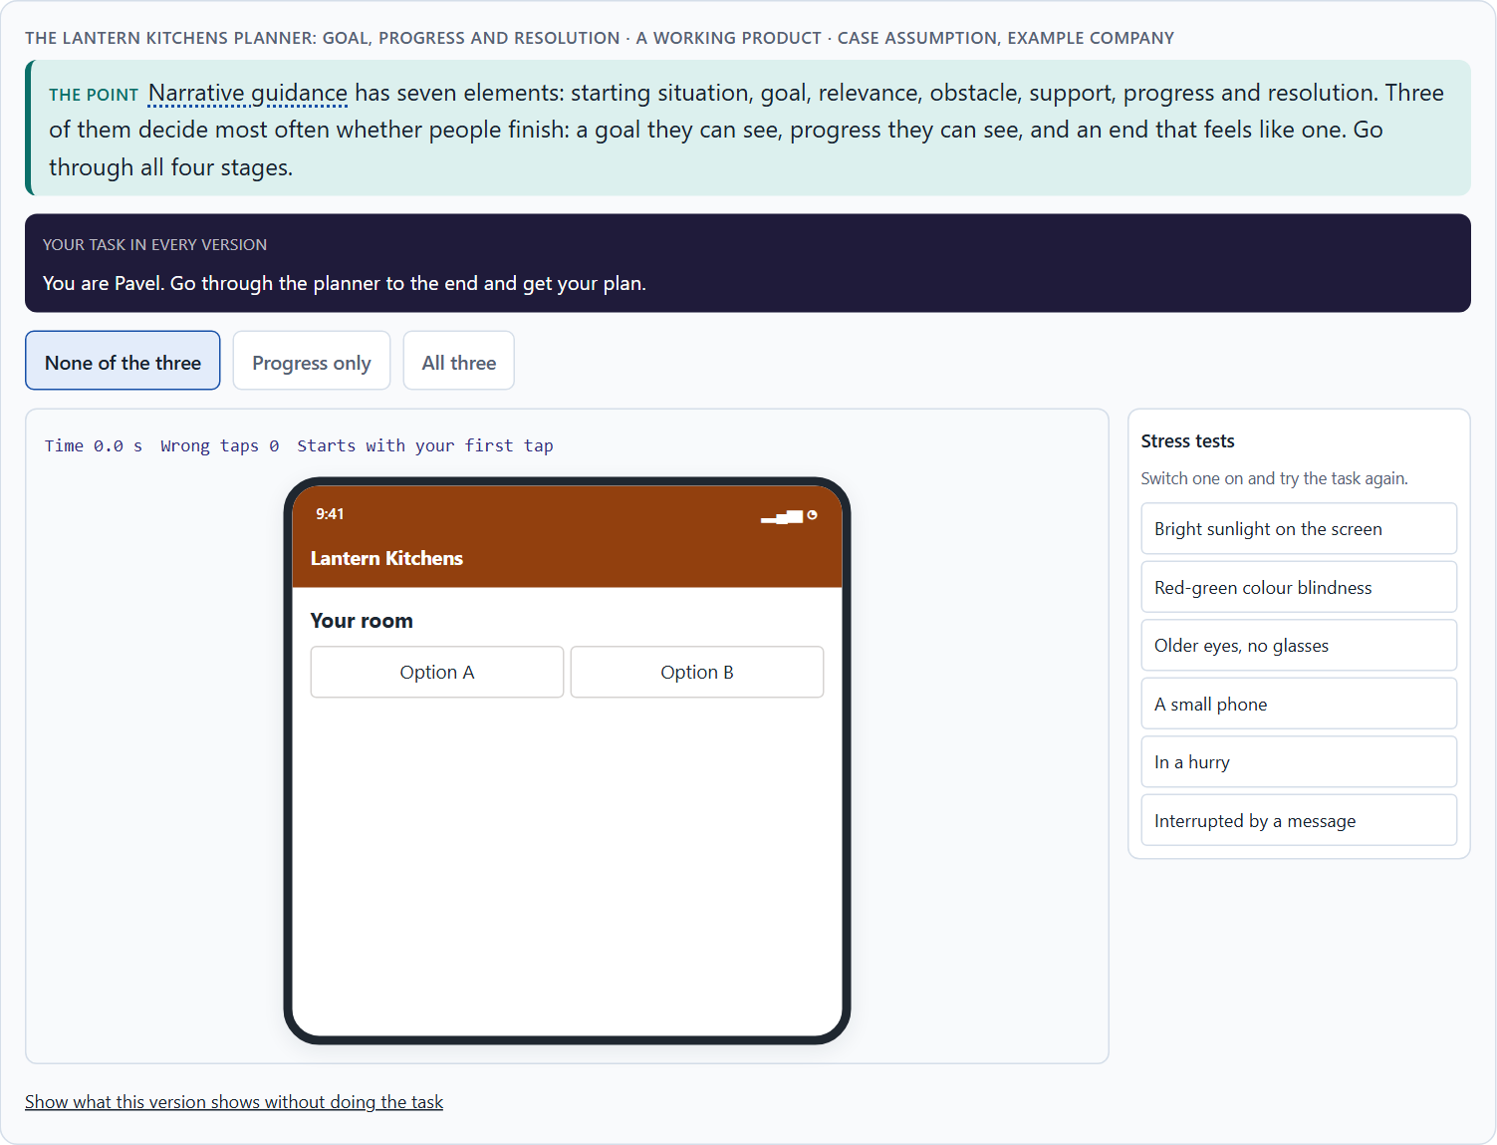
The elements of narrative guidance: from starting point to resolution
A2 · 12 min · Core
Seven elements guide a journey: starting situation, goal, relevance, obstacle, support, progress and resolution. Without a visible goal and progress it feels endless; without a resolution it ends without achievement.
The Lantern Kitchens planner: goal, progress and resolution.
Screenshot of the Neuro-UX Lab (aion-ux-lab.vercel.app), own work; AI-assisted, labelled on the image; the example company is fictional.
Sources: Quesenbery & Brooks 2010 · Freytag 1863 · Kivetz et al. 2006 · GOV.UK Design System, Question pages
Notes:
A2 · The elements of narrative guidance: from starting point to resolution · 12 min · Core
Case assumption: Lantern Kitchens, Iris, Pavel, June and Arne are made up for this example. The dramatic arc follows Freytag (1863); people speeding up as they see a goal come closer follows Kivetz et al. (2006). The findings in the table of real evidence are real research results, rules and cases; the sources are listed below.
Go deeper (optional reading): Kivetz et al. (2006) showed the goal-gradient effect: people work faster the closer they see themselves to a goal, and even an illusion of progress (a card that starts with two stamps already filled) makes them finish more often. In a journey this is why visible progress matters most in the middle, where people are furthest from both the start and the end and most likely to stop.
Sources: Quesenbery & Brooks 2010 · Freytag 1863 · Kivetz et al. 2006 · GOV.UK Design System, Question pages

Slide 10
A2 · In plain words
THE IDEA
WHY IT MATTERS
Narrative guidance has seven elements. The starting situation: where the user is now. The goal: what they will have at the end. Relevance: why it matters for them. The obstacle: what makes it hard, said honestly. Support: what helps them over it. Progress: how far they have come. The resolution: the end, where the goal is reached and seen. A process that leaves out the goal or the progress feels endless; one that leaves out the resolution ends without a sense of achievement.
Block 1.1 asks for five places where StartSmart's narrative guidance is missing and for its two biggest weaknesses, and Block 2.1 asks for GreenHome's central narrative deficits. This card gives you the seven elements to say which part of the journey is missing.
HOW TO READ THE PICTURE
One Lantern Kitchens planner with three switches: a goal, visible progress and a resolution.
Sources: Quesenbery & Brooks 2010 · Freytag 1863 · Kivetz et al. 2006 · GOV.UK Design System, Question pages
Notes:
A2 · The elements of narrative guidance: from starting point to resolution · 12 min · Core
Case assumption: Lantern Kitchens, Iris, Pavel, June and Arne are made up for this example. The dramatic arc follows Freytag (1863); people speeding up as they see a goal come closer follows Kivetz et al. (2006). The findings in the table of real evidence are real research results, rules and cases; the sources are listed below.
Go deeper (optional reading): Kivetz et al. (2006) showed the goal-gradient effect: people work faster the closer they see themselves to a goal, and even an illusion of progress (a card that starts with two stamps already filled) makes them finish more often. In a journey this is why visible progress matters most in the middle, where people are furthest from both the start and the end and most likely to stop.
Sources: Quesenbery & Brooks 2010 · Freytag 1863 · Kivetz et al. 2006 · GOV.UK Design System, Question pages

Slide 11
A2 · The seven elements of narrative guidance
Element | In a story | In a digital journey
Starting situation | Where the hero is. | “You have a room and an idea.”
Goal | What the hero wants. | “At the end you have a plan and an offer.”
Relevance | Why it matters. | “So your cabinets fit to the centimetre.”
Obstacle | What stands in the way. | “Measuring is the hardest part.”
Support | Who helps. | A short guide right at that step.
Progress | How far the hero has come. | A path of stages with “you are here”.
Resolution | The goal reached. | The plan shown, the next step named.
Sources: Quesenbery & Brooks 2010 · Freytag 1863 · Kivetz et al. 2006 · GOV.UK Design System, Question pages
Notes:
A2 · The elements of narrative guidance: from starting point to resolution · 12 min · Core
Case assumption: Lantern Kitchens, Iris, Pavel, June and Arne are made up for this example. The dramatic arc follows Freytag (1863); people speeding up as they see a goal come closer follows Kivetz et al. (2006). The findings in the table of real evidence are real research results, rules and cases; the sources are listed below.
Go deeper (optional reading): Kivetz et al. (2006) showed the goal-gradient effect: people work faster the closer they see themselves to a goal, and even an illusion of progress (a card that starts with two stamps already filled) makes them finish more often. In a journey this is why visible progress matters most in the middle, where people are furthest from both the start and the end and most likely to stop.
Sources: Quesenbery & Brooks 2010 · Freytag 1863 · Kivetz et al. 2006 · GOV.UK Design System, Question pages

Slide 12
A2 · The elements of narrative guidance: sources and use
Source | Real finding or example | What it means for a screen
Dramatic structure | Gustav Freytag described a drama as a pyramid of exposition, rising action, climax, falling action and resolution (Freytag 1863). | Start with the situation, build to the decision, and end with a clear resolution.
Stories in UX | Quesenbery and Brooks describe how stories help teams and users with context, goals and obstacles (Quesenbery and Brooks 2010). | Write the starting situation and the goal in the person's words, not the company's.
One step at a time | The GOV.UK Design System asks, in its question pages pattern, to start with one question per page, so users understand what they are asked and can focus on it (GOV.UK Design System). | A sequence gives a path with an end: each page is a step.
Progress | Customers bought more often as they neared a reward (Kivetz et al. 2006). | Show a path of stages with “you are here”.
Sources: Quesenbery & Brooks 2010 · Freytag 1863 · Kivetz et al. 2006 · GOV.UK Design System, Question pages
Notes:
A2 · The elements of narrative guidance: from starting point to resolution · 12 min · Core
Case assumption: Lantern Kitchens, Iris, Pavel, June and Arne are made up for this example. The dramatic arc follows Freytag (1863); people speeding up as they see a goal come closer follows Kivetz et al. (2006). The findings in the table of real evidence are real research results, rules and cases; the sources are listed below.
Go deeper (optional reading): Kivetz et al. (2006) showed the goal-gradient effect: people work faster the closer they see themselves to a goal, and even an illusion of progress (a card that starts with two stamps already filled) makes them finish more often. In a journey this is why visible progress matters most in the middle, where people are furthest from both the start and the end and most likely to stop.
Sources: Quesenbery & Brooks 2010 · Freytag 1863 · Kivetz et al. 2006 · GOV.UK Design System, Question pages

Slide 13
A2 · How to decide when this comes up in the task
Starting situation: does the journey begin where the user is, in their words?
1
Goal and relevance: does it say what they will have and why it matters for them?
2
Obstacle and support: does it say honestly what is hard and offer help at that point?
3
Progress: can they see how far they have come?
4
Resolution: does the end show that the goal is reached?
5
Sources: Quesenbery & Brooks 2010 · Freytag 1863 · Kivetz et al. 2006 · GOV.UK Design System, Question pages
Notes:
A2 · The elements of narrative guidance: from starting point to resolution · 12 min · Core
Case assumption: Lantern Kitchens, Iris, Pavel, June and Arne are made up for this example. The dramatic arc follows Freytag (1863); people speeding up as they see a goal come closer follows Kivetz et al. (2006). The findings in the table of real evidence are real research results, rules and cases; the sources are listed below.
Go deeper (optional reading): Kivetz et al. (2006) showed the goal-gradient effect: people work faster the closer they see themselves to a goal, and even an illusion of progress (a card that starts with two stamps already filled) makes them finish more often. In a journey this is why visible progress matters most in the middle, where people are furthest from both the start and the end and most likely to stop.
Sources: Quesenbery & Brooks 2010 · Freytag 1863 · Kivetz et al. 2006 · GOV.UK Design System, Question pages

Slide 14
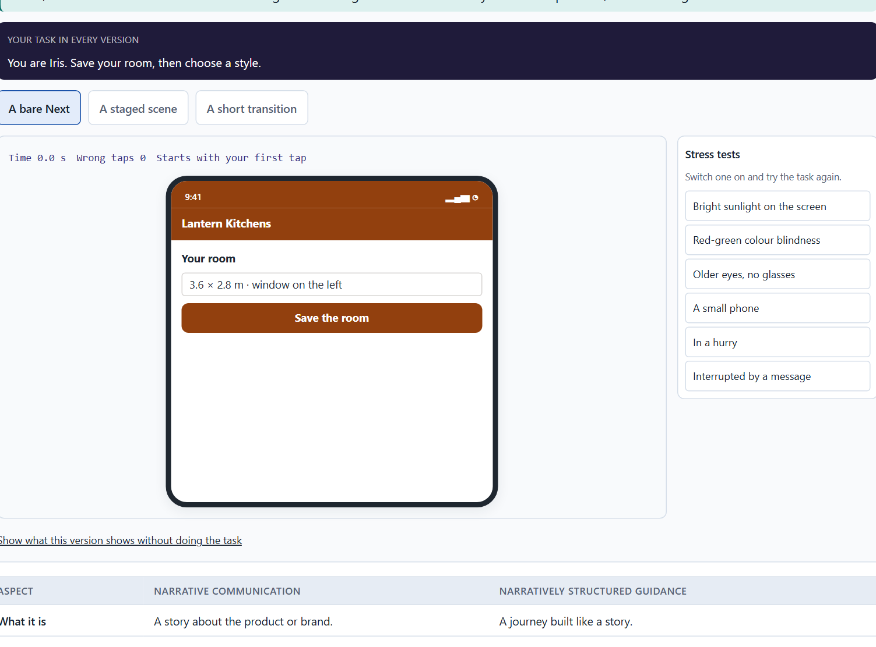
Telling a story or guiding with one: dramaturgy in a journey
A3 · 12 min · Core
Telling a story is not guiding with one. Dramaturgy in a journey is tension, expectation, sequence, transition, confirmation and emotional context, and it lives in small places: the first screen, the line between steps, the message after a step.
The moment between two Lantern Kitchens steps: bare, staged and short.
Screenshot of the Neuro-UX Lab (aion-ux-lab.vercel.app), own work; AI-assisted, labelled on the image; the example company is fictional.
Sources: Lupton 2017 · Freytag 1863 · Nielsen 1994 · GOV.UK Service Manual, Form structure · Government Digital Service 2015 · GOV.UK Design System, Question pages
Notes:
A3 · Telling a story or guiding with one: dramaturgy in a journey · 12 min · Core
Case assumption: Lantern Kitchens, Iris, Pavel, June and Arne are made up for this example. The dramatic arc follows Freytag (1863) and its use in design follows Lupton (2017); visibility of system status is Nielsen's heuristic (1994). The findings in the table of real evidence are real research results, rules and cases; the sources are listed below.
Go deeper (optional reading): A good transition has three parts and fits in one line: a confirmation of what was done (“Your room is in.”), the expectation of what comes next (“Next: your style.”) and a word on its size or difficulty (“A few choices, all changeable.”). It is the cheapest piece of dramaturgy there is, and the one most often missing.
Sources: Lupton 2017 · Freytag 1863 · Nielsen 1994 · GOV.UK Service Manual, Form structure · Government Digital Service 2015 · GOV.UK Design System, Question pages

Slide 15
A3 · In plain words
THE IDEA
WHY IT MATTERS
Telling a story about a product (a video, a slogan, a brand story) is not the same as guiding people with a story. Narratively structured guidance builds the journey itself: tension (something is at stake), expectation (people know what comes next), sequence (the steps follow a logic people can feel, not an administrative one), transition (each step leads to the next), confirmation (a finished step is acknowledged) and emotional context (the step is framed by what it means for them). Most of it lives in small places: the first screen, the line between two steps, the message after a step is done.
Block 1.1 asks about StartSmart's missing transitions and steps that are not picked up, Block 1.2 asks you to judge a strongly narrative journey against an efficient one, and Block 2.1 asks about GreenHome's administrative sequence and transitions. This card gives you the dramaturgical means to name them.
HOW TO READ THE PICTURE
The moment between two steps of the Lantern Kitchens planner, written three ways: a bare Next, a staged scene and a short transition.
Sources: Lupton 2017 · Freytag 1863 · Nielsen 1994 · GOV.UK Service Manual, Form structure · Government Digital Service 2015 · GOV.UK Design System, Question pages
Notes:
A3 · Telling a story or guiding with one: dramaturgy in a journey · 12 min · Core
Case assumption: Lantern Kitchens, Iris, Pavel, June and Arne are made up for this example. The dramatic arc follows Freytag (1863) and its use in design follows Lupton (2017); visibility of system status is Nielsen's heuristic (1994). The findings in the table of real evidence are real research results, rules and cases; the sources are listed below.
Go deeper (optional reading): A good transition has three parts and fits in one line: a confirmation of what was done (“Your room is in.”), the expectation of what comes next (“Next: your style.”) and a word on its size or difficulty (“A few choices, all changeable.”). It is the cheapest piece of dramaturgy there is, and the one most often missing.
Sources: Lupton 2017 · Freytag 1863 · Nielsen 1994 · GOV.UK Service Manual, Form structure · Government Digital Service 2015 · GOV.UK Design System, Question pages

Slide 16
A3 · Narrative communication and narratively structured guidance
Aspect | Narrative communication | Narratively structured guidance
What it is | A story about the product or brand. | A journey built like a story.
Where it lives | Films, campaigns, the website. | The first screen, transitions, confirmations.
Whose story | The company's. | The user's.
Its cost | Attention and time before the task. | A line or two inside the task.
Sources: Lupton 2017 · Freytag 1863 · Nielsen 1994 · GOV.UK Service Manual, Form structure · Government Digital Service 2015 · GOV.UK Design System, Question pages
Notes:
A3 · Telling a story or guiding with one: dramaturgy in a journey · 12 min · Core
Case assumption: Lantern Kitchens, Iris, Pavel, June and Arne are made up for this example. The dramatic arc follows Freytag (1863) and its use in design follows Lupton (2017); visibility of system status is Nielsen's heuristic (1994). The findings in the table of real evidence are real research results, rules and cases; the sources are listed below.
Go deeper (optional reading): A good transition has three parts and fits in one line: a confirmation of what was done (“Your room is in.”), the expectation of what comes next (“Next: your style.”) and a word on its size or difficulty (“A few choices, all changeable.”). It is the cheapest piece of dramaturgy there is, and the one most often missing.
Sources: Lupton 2017 · Freytag 1863 · Nielsen 1994 · GOV.UK Service Manual, Form structure · Government Digital Service 2015 · GOV.UK Design System, Question pages

Slide 17
A3 · Narrative communication or narrative guidance: a real pattern
Topic | Real finding or example | What it means for a screen
A real pattern of guidance | The GOV.UK Service Manual advises to split a form across several pages with each page containing just one thing (GOV.UK Service Manual, Form structure). | Structure the journey by what the person decides now, page by page.
What it buys | A 2015 GDS design note found the one-question-per-page layout better at handling errors, branches, loops and saving progress than the alternatives it compared (Government Digital Service 2015). | The sequence is not only dramaturgy: it carries the logic of the process.
What it costs | The pattern lengthens a form, so a service should only ask for what it needs (Scottish Government Design System; GOV.UK Design System). | Count the pages: each transition needs a reason.
System status | Keep users informed about what is going on, through appropriate feedback within a reasonable time (Nielsen 1994). | Each transition says where you are and what comes next.
Sources: Lupton 2017 · Freytag 1863 · Nielsen 1994 · GOV.UK Service Manual, Form structure · Government Digital Service 2015 · GOV.UK Design System, Question pages
Notes:
A3 · Telling a story or guiding with one: dramaturgy in a journey · 12 min · Core
Case assumption: Lantern Kitchens, Iris, Pavel, June and Arne are made up for this example. The dramatic arc follows Freytag (1863) and its use in design follows Lupton (2017); visibility of system status is Nielsen's heuristic (1994). The findings in the table of real evidence are real research results, rules and cases; the sources are listed below.
Go deeper (optional reading): A good transition has three parts and fits in one line: a confirmation of what was done (“Your room is in.”), the expectation of what comes next (“Next: your style.”) and a word on its size or difficulty (“A few choices, all changeable.”). It is the cheapest piece of dramaturgy there is, and the one most often missing.
Sources: Lupton 2017 · Freytag 1863 · Nielsen 1994 · GOV.UK Service Manual, Form structure · Government Digital Service 2015 · GOV.UK Design System, Question pages

Slide 18
A3 · How to decide when this comes up in the task
Tension: does the user know what is at stake for them?
1
Expectation: do they know what comes next, and roughly how much?
2
Sequence: do the steps follow the user's logic, or the order of the database?
3
Transition: does each step say what was done and lead to the next?
4
Confirmation and emotional context: is a finished step acknowledged and framed by what it means for them?
5
Sources: Lupton 2017 · Freytag 1863 · Nielsen 1994 · GOV.UK Service Manual, Form structure · Government Digital Service 2015 · GOV.UK Design System, Question pages
Notes:
A3 · Telling a story or guiding with one: dramaturgy in a journey · 12 min · Core
Case assumption: Lantern Kitchens, Iris, Pavel, June and Arne are made up for this example. The dramatic arc follows Freytag (1863) and its use in design follows Lupton (2017); visibility of system status is Nielsen's heuristic (1994). The findings in the table of real evidence are real research results, rules and cases; the sources are listed below.
Go deeper (optional reading): A good transition has three parts and fits in one line: a confirmation of what was done (“Your room is in.”), the expectation of what comes next (“Next: your style.”) and a word on its size or difficulty (“A few choices, all changeable.”). It is the cheapest piece of dramaturgy there is, and the one most often missing.
Sources: Lupton 2017 · Freytag 1863 · Nielsen 1994 · GOV.UK Service Manual, Form structure · Government Digital Service 2015 · GOV.UK Design System, Question pages

Slide 19
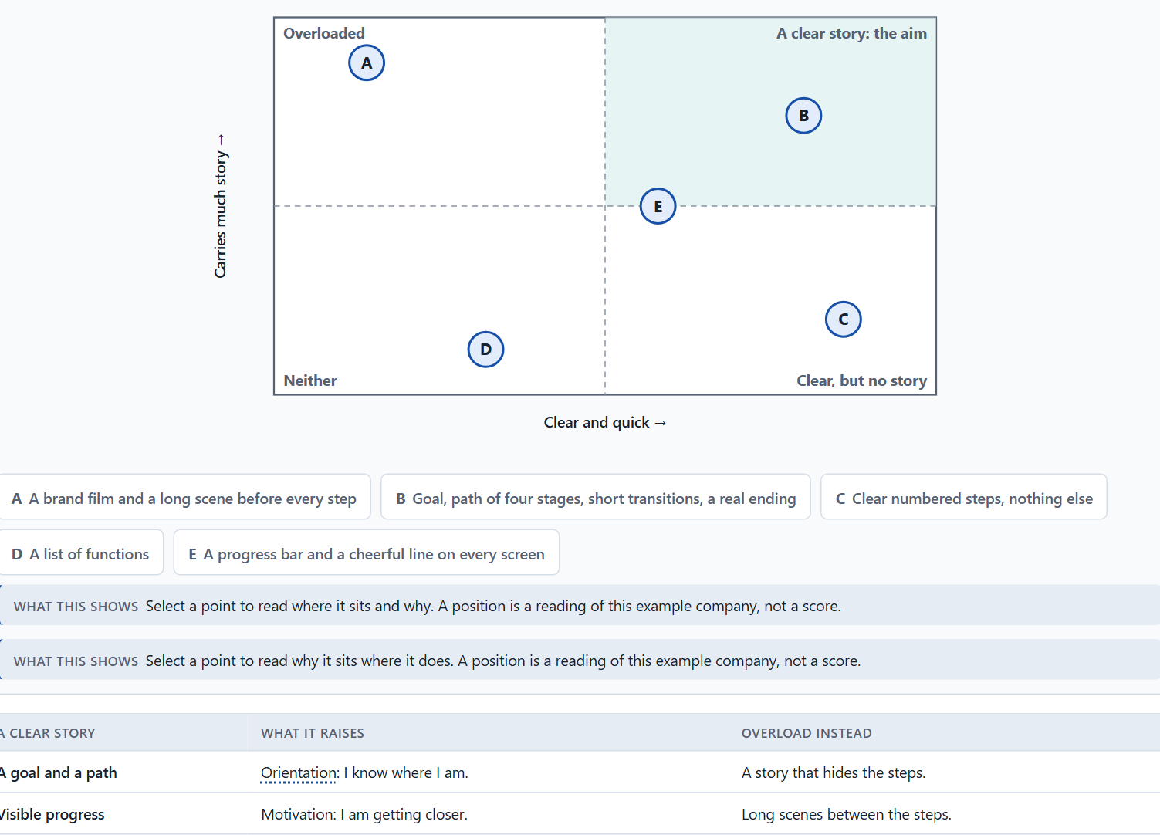
Orientation, motivation and memorability, and the risk of overload
A4 · 12 min · Core
A clear story raises orientation, motivation and memorability, and makes people feel the product is for them. Too much staging, too little clarity, more text and longer paths turn it into overload that costs time and trust.
Five Lantern Kitchens journeys by how much story they carry and how clear and quick they stay · Exploratory.
Screenshot of the Neuro-UX Lab (aion-ux-lab.vercel.app), own work; AI-assisted, labelled on the image; the example company is fictional.
Sources: Green & Brock 2000 · Kivetz et al. 2006 · Krug 2014 · Kahneman et al. 1993 · Nielsen 1997
Notes:
A4 · Orientation, motivation and memorability, and the risk of overload · 12 min · Core
Case assumption: Lantern Kitchens, Iris, Pavel, June and Arne are made up for this example. Being absorbed in a story and moved by it follows Green and Brock (2000); the goal-gradient effect follows Kivetz et al. (2006); not making people think follows Krug (2014). The findings in the table of real evidence are real research results, rules and cases; the sources are listed below.
Go deeper (optional reading): Green and Brock (2000) found that stories move people when they are absorbed in them, and that absorption depends on the story fitting the reader. In a product, users absorbed in a staged story about someone else's kitchen are not absorbed in their own task. The narrative that works in a journey is the user's own: their goal, their progress, their result.
Sources: Green & Brock 2000 · Kivetz et al. 2006 · Krug 2014 · Kahneman et al. 1993 · Nielsen 1997

Slide 20
A4 · In plain words
THE IDEA
WHY IT MATTERS
A clear story raises three things. Orientation: people know where they are and what comes next. Motivation: they see that they are getting closer. Memorability: they remember the journey and its end. Narrative clarity, emotional bond and perceived relevance go together: when people see why a step matters for them, they feel the product is for them. But storytelling can overload: too much staging, too little clarity, more text and longer paths. Then it costs efficiency and trust instead of building them.
Block 1.1 asks for StartSmart's two biggest weaknesses, Block 1.2 asks you to rate three journeys on orientation, motivation, relevance, efficiency and experience quality and to name the conflicts between efficiency and dramaturgy, and Block 2.1 warns against measures that are only staging. This card gives you what a story does and where it stops helping.
HOW TO READ THE PICTURE
The matrix places five Lantern Kitchens journeys by how much story they carry (upwards) and how clear and quick they stay (to the right). A position is a reading of the example, not a score.
Sources: Green & Brock 2000 · Kivetz et al. 2006 · Krug 2014 · Kahneman et al. 1993 · Nielsen 1997
Notes:
A4 · Orientation, motivation and memorability, and the risk of overload · 12 min · Core
Case assumption: Lantern Kitchens, Iris, Pavel, June and Arne are made up for this example. Being absorbed in a story and moved by it follows Green and Brock (2000); the goal-gradient effect follows Kivetz et al. (2006); not making people think follows Krug (2014). The findings in the table of real evidence are real research results, rules and cases; the sources are listed below.
Go deeper (optional reading): Green and Brock (2000) found that stories move people when they are absorbed in them, and that absorption depends on the story fitting the reader. In a product, users absorbed in a staged story about someone else's kitchen are not absorbed in their own task. The narrative that works in a journey is the user's own: their goal, their progress, their result.
Sources: Green & Brock 2000 · Kivetz et al. 2006 · Krug 2014 · Kahneman et al. 1993 · Nielsen 1997

Slide 21
A4 · What a clear story does, and how it turns into overload
A clear story | What it raises | Overload instead
A goal and a path | Orientation: I know where I am. | A story that hides the steps.
Visible progress | Motivation: I am getting closer. | Long scenes between the steps.
A real ending | Memorability: I remember it worked. | A finale that delays the result.
The user's goal | Relevance and bond: this is for me. | The brand's story instead of mine.
Sources: Green & Brock 2000 · Kivetz et al. 2006 · Krug 2014 · Kahneman et al. 1993 · Nielsen 1997
Notes:
A4 · Orientation, motivation and memorability, and the risk of overload · 12 min · Core
Case assumption: Lantern Kitchens, Iris, Pavel, June and Arne are made up for this example. Being absorbed in a story and moved by it follows Green and Brock (2000); the goal-gradient effect follows Kivetz et al. (2006); not making people think follows Krug (2014). The findings in the table of real evidence are real research results, rules and cases; the sources are listed below.
Go deeper (optional reading): Green and Brock (2000) found that stories move people when they are absorbed in them, and that absorption depends on the story fitting the reader. In a product, users absorbed in a staged story about someone else's kitchen are not absorbed in their own task. The narrative that works in a journey is the user's own: their goal, their progress, their result.
Sources: Green & Brock 2000 · Kivetz et al. 2006 · Krug 2014 · Kahneman et al. 1993 · Nielsen 1997

Slide 22
A4 · Orientation, motivation, memory and overload: findings
Effect | Real finding | What it means for a screen
Orientation | A visitor should be able to tell at once where they are and what they can do (Krug 2014). | Every step names its place in the journey.
Motivation | Effort rises as the goal gets closer (Kivetz et al. 2006). | Show progress early, and show how much is left.
Memory | The end of an episode weighs more than its length in the memory of it (Kahneman et al. 1993, as reported). | Give the journey a real ending: the result, and the next step.
Overload | 79% of users always scanned a new page (Nielsen and Morkes 1997). | A scene that must be read before the task starts will be skipped; keep the story to a line or two inside the task.
Sources: Green & Brock 2000 · Kivetz et al. 2006 · Krug 2014 · Kahneman et al. 1993 · Nielsen 1997
Notes:
A4 · Orientation, motivation and memorability, and the risk of overload · 12 min · Core
Case assumption: Lantern Kitchens, Iris, Pavel, June and Arne are made up for this example. Being absorbed in a story and moved by it follows Green and Brock (2000); the goal-gradient effect follows Kivetz et al. (2006); not making people think follows Krug (2014). The findings in the table of real evidence are real research results, rules and cases; the sources are listed below.
Go deeper (optional reading): Green and Brock (2000) found that stories move people when they are absorbed in them, and that absorption depends on the story fitting the reader. In a product, users absorbed in a staged story about someone else's kitchen are not absorbed in their own task. The narrative that works in a journey is the user's own: their goal, their progress, their result.
Sources: Green & Brock 2000 · Kivetz et al. 2006 · Krug 2014 · Kahneman et al. 1993 · Nielsen 1997

Slide 23
A4 · How to decide when this comes up in the task
Check that every narrative element serves the task: does it orient, motivate or give context?
1
Count what the story adds: screens, words, seconds. Is it worth it for these users?
2
Prefer a goal, a path and short transitions to scenes and long texts.
3
Make the story about the user's goal, not about the brand.
4
If the steps are harder to find than before, the story has become overload.
5
Sources: Green & Brock 2000 · Kivetz et al. 2006 · Krug 2014 · Kahneman et al. 1993 · Nielsen 1997
Notes:
A4 · Orientation, motivation and memorability, and the risk of overload · 12 min · Core
Case assumption: Lantern Kitchens, Iris, Pavel, June and Arne are made up for this example. Being absorbed in a story and moved by it follows Green and Brock (2000); the goal-gradient effect follows Kivetz et al. (2006); not making people think follows Krug (2014). The findings in the table of real evidence are real research results, rules and cases; the sources are listed below.
Go deeper (optional reading): Green and Brock (2000) found that stories move people when they are absorbed in them, and that absorption depends on the story fitting the reader. In a product, users absorbed in a staged story about someone else's kitchen are not absorbed in their own task. The narrative that works in a journey is the user's own: their goal, their progress, their result.
Sources: Green & Brock 2000 · Kivetz et al. 2006 · Krug 2014 · Kahneman et al. 1993 · Nielsen 1997

Slide 24
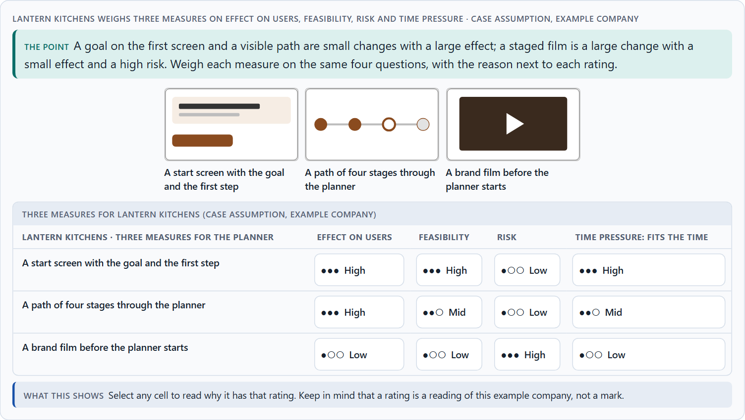
Embedding an action in its context, and weighing a measure
A5 · 12 min · Core
Storytelling activates, gives context and embeds an action in a meaning: a goal makes it easy to begin, a reason turns a demand into sense, a finished step framed as progress feels like achievement. Weigh measures on effect on users, feasibility, risk and time pressure.
Lantern Kitchens weighs three measures on effect on users, feasibility, risk and time pressure.
Screenshot of the Neuro-UX Lab (aion-ux-lab.vercel.app), own work; AI-assisted, labelled on the image; the example company is fictional.
Sources: Quesenbery & Brooks 2010 · Kivetz et al. 2006 · Gibbons 2018 · Green & Brock 2000 · Fogg et al. 2003
Notes:
A5 · Embedding an action in its context, and weighing a measure · 12 min · Core
Case assumption: Lantern Kitchens, Iris, Pavel, June and Arne are made up for this example. Designing around users' goals follows Quesenbery and Brooks (2010); rating options on the same criteria with a reason follows Gibbons (2018). The four criteria are the ones the plan names for the case study. The findings in the table of real evidence are real research results, rules and cases; the sources are listed below.
Go deeper (optional reading): Context turns a demand into a reason. “Enter your annual consumption” is a demand; “Your annual consumption shows which funding you can get” is the same field with a reason. The second needs a few more words, but it answers the question people ask silently at every field: why do they want this?
Sources: Quesenbery & Brooks 2010 · Kivetz et al. 2006 · Gibbons 2018 · Green & Brock 2000 · Fogg et al. 2003

Slide 25
A5 · In plain words
THE IDEA
WHY IT MATTERS
Storytelling can activate people, give them context and embed what they do in a meaning. Activation: a goal and a next step make it easy to begin. Context: a line that says why a question is asked turns a demand into a reason. Emotional embedding: a finished step framed as progress towards their own goal feels like an achievement, not like paperwork. To put measures in order, weigh each on the four questions Block 2.1 names: effect on users, feasibility, risk and time pressure.
Block 1.2 asks for a decision between three journeys, and Block 2.1 asks for four measures, their justification on these four criteria and a decision for 12 weeks. The example uses Lantern Kitchens and its own measures, so the answer for the task cases is not given.
HOW TO READ THE PICTURE
First the chain from an action to its meaning for the user. Then three measures Lantern Kitchens considered, rated on effect on users, feasibility, risk and time pressure.
Sources: Quesenbery & Brooks 2010 · Kivetz et al. 2006 · Gibbons 2018 · Green & Brock 2000 · Fogg et al. 2003
Notes:
A5 · Embedding an action in its context, and weighing a measure · 12 min · Core
Case assumption: Lantern Kitchens, Iris, Pavel, June and Arne are made up for this example. Designing around users' goals follows Quesenbery and Brooks (2010); rating options on the same criteria with a reason follows Gibbons (2018). The four criteria are the ones the plan names for the case study. The findings in the table of real evidence are real research results, rules and cases; the sources are listed below.
Go deeper (optional reading): Context turns a demand into a reason. “Enter your annual consumption” is a demand; “Your annual consumption shows which funding you can get” is the same field with a reason. The second needs a few more words, but it answers the question people ask silently at every field: why do they want this?
Sources: Quesenbery & Brooks 2010 · Kivetz et al. 2006 · Gibbons 2018 · Green & Brock 2000 · Fogg et al. 2003

Slide 26
A5 · Embedding an action in its context: findings
Finding | What it shows | What it means for a measure
Context makes relevance | Transported readers take more of a story's view (Green and Brock 2000). | Explain why a step matters in the person's situation, in one line, before asking for the action.
Progress as context | Perceived distance to the goal drives effort (Kivetz et al. 2006). | A path of stages with “you are here” is a measure with a visible effect.
Credibility | The design look and the tone are read as signs of care (Fogg et al. 2003). | A story that reads as marketing in a serious context costs trust: weigh it.
Sources: Quesenbery & Brooks 2010 · Kivetz et al. 2006 · Gibbons 2018 · Green & Brock 2000 · Fogg et al. 2003
Notes:
A5 · Embedding an action in its context, and weighing a measure · 12 min · Core
Case assumption: Lantern Kitchens, Iris, Pavel, June and Arne are made up for this example. Designing around users' goals follows Quesenbery and Brooks (2010); rating options on the same criteria with a reason follows Gibbons (2018). The four criteria are the ones the plan names for the case study. The findings in the table of real evidence are real research results, rules and cases; the sources are listed below.
Go deeper (optional reading): Context turns a demand into a reason. “Enter your annual consumption” is a demand; “Your annual consumption shows which funding you can get” is the same field with a reason. The second needs a few more words, but it answers the question people ask silently at every field: why do they want this?
Sources: Quesenbery & Brooks 2010 · Kivetz et al. 2006 · Gibbons 2018 · Green & Brock 2000 · Fogg et al. 2003

Slide 27
A5 · How to decide when this comes up in the task
Activation: does the first screen give a goal and a clear first step?
1
Context: does each demanding question say why it is asked?
2
Emotional embedding: is each finished step framed as progress towards the user's goal?
3
Rate every measure on the same four questions: effect on users, feasibility, risk, time pressure.
4
A rating is a judgement with a reason, never a mark.
5
Sources: Quesenbery & Brooks 2010 · Kivetz et al. 2006 · Gibbons 2018 · Green & Brock 2000 · Fogg et al. 2003
Notes:
A5 · Embedding an action in its context, and weighing a measure · 12 min · Core
Case assumption: Lantern Kitchens, Iris, Pavel, June and Arne are made up for this example. Designing around users' goals follows Quesenbery and Brooks (2010); rating options on the same criteria with a reason follows Gibbons (2018). The four criteria are the ones the plan names for the case study. The findings in the table of real evidence are real research results, rules and cases; the sources are listed below.
Go deeper (optional reading): Context turns a demand into a reason. “Enter your annual consumption” is a demand; “Your annual consumption shows which funding you can get” is the same field with a reason. The second needs a few more words, but it answers the question people ask silently at every field: why do they want this?
Sources: Quesenbery & Brooks 2010 · Kivetz et al. 2006 · Gibbons 2018 · Green & Brock 2000 · Fogg et al. 2003

Slide 28
B
Materi B
Route 2 · Level 3
About 60 minutes, three cards, led by the facilitator. Level 3 in the Chief Experience Officer's chair: a guiding vision for narrative UX, three strategic decisions, an order of which journeys come first, a risk analysis, a governance model for narrative UX principles, one decision under uncertainty and a statement to the management. The cards give you the ideas you use in Task 2.

Slide 29
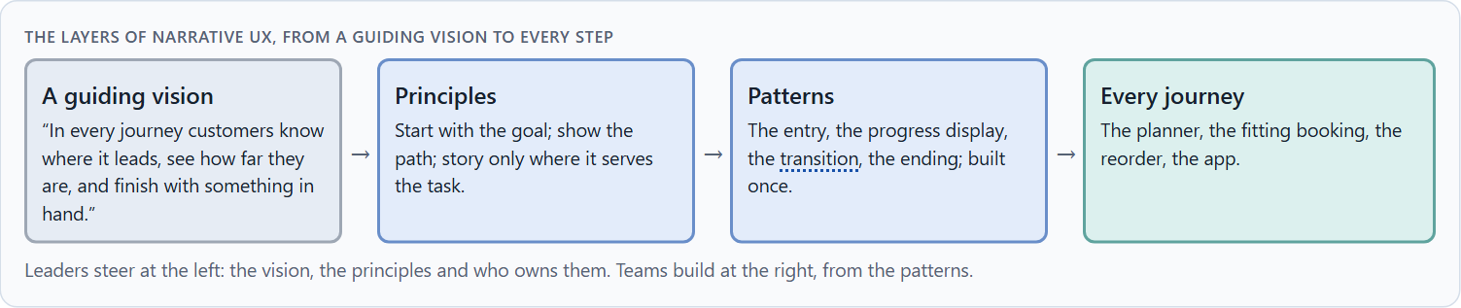
Narrative UX as experience architecture, not communication
B1 · 20 min · Core
The journey people experience is built by product teams step by step, not by communication. Narrative UX designs it on purpose: a guiding vision, principles, patterns for entries, progress, transitions and endings, and an owner.
The layers of narrative UX, from a guiding vision to every step.
Screenshot of the Neuro-UX Lab (aion-ux-lab.vercel.app), own work; AI-assisted, labelled on the image; the example company is fictional.
Sources: Quesenbery & Brooks 2010 · Lupton 2017 · Bruner 1991 · GOV.UK Service Manual, Form structure · Mailchimp, Voice and Tone · Freytag 1863
Notes:
B1 · Narrative UX as experience architecture, not communication · 20 min · Core
Case assumption: Lantern Kitchens, Iris, Pavel, June and Arne are made up for this example. Storytelling as part of UX design follows Quesenbery and Brooks (2010) and Lupton (2017). The findings in the table of real evidence are real research results, rules and cases; the sources are listed below.
Go deeper (optional reading): A guiding vision for narrative UX is short and testable: one sentence that names the beginning, the way and the end. “In every journey customers know where it leads, see how far they are, and finish with something in hand” can be checked on every flow. “Every click tells a story” cannot, and it invites staging.
Sources: Quesenbery & Brooks 2010 · Lupton 2017 · Bruner 1991 · GOV.UK Service Manual, Form structure · Mailchimp, Voice and Tone · Freytag 1863

Slide 30
B1 · In plain words
THE IDEA
WHY IT MATTERS
In many companies storytelling is a matter for communication: the brand story on the website, a campaign film. But the journey people experience is built by product teams, step by step, usually from the specialist logic. Narrative UX means designing that journey on purpose: a guiding vision for how every journey begins, carries people and ends, patterns for entries, progress, transitions and endings, and someone who owns them. At senior level it becomes a design logic for relevance, activation and bond, and part of the decision architecture.
Block 3.1 asks for a guiding vision for narrative UX, three decisions on entry, dramaturgical guidance, the experience of progress and narrative relevance, and an order of which journeys, touchpoints or interactions come first, for a company that sees storytelling as communication. You decide the journeys, not the texts.
HOW TO READ THE PICTURE
Left Lantern Kitchens treating storytelling as communication, right building it into the experience architecture. Below, the layers from a guiding vision to every step.
Sources: Quesenbery & Brooks 2010 · Lupton 2017 · Bruner 1991 · GOV.UK Service Manual, Form structure · Mailchimp, Voice and Tone · Freytag 1863
Notes:
B1 · Narrative UX as experience architecture, not communication · 20 min · Core
Case assumption: Lantern Kitchens, Iris, Pavel, June and Arne are made up for this example. Storytelling as part of UX design follows Quesenbery and Brooks (2010) and Lupton (2017). The findings in the table of real evidence are real research results, rules and cases; the sources are listed below.
Go deeper (optional reading): A guiding vision for narrative UX is short and testable: one sentence that names the beginning, the way and the end. “In every journey customers know where it leads, see how far they are, and finish with something in hand” can be checked on every flow. “Every click tells a story” cannot, and it invites staging.
Sources: Quesenbery & Brooks 2010 · Lupton 2017 · Bruner 1991 · GOV.UK Service Manual, Form structure · Mailchimp, Voice and Tone · Freytag 1863

Slide 31
B1 · Narrative UX as experience architecture: real structures
Part | Real example | What it means
A journey of single steps | The GOV.UK pattern of one thing per page turns a whole service into a sequence of small decisions (GOV.UK Service Manual). | Plan the journey as a sequence across channels, not as a campaign.
A tone by situation | A steady voice with a tone that follows the situation of the reader (Mailchimp, Voice and Tone). | Decide how the story sounds at each point of the journey.
A dramatic structure | Freytag's five parts give the arc of a journey: situation, build-up, decision, resolution (Freytag 1863). | Name the moment of decision and the moment of resolution of each journey.
Sources: Quesenbery & Brooks 2010 · Lupton 2017 · Bruner 1991 · GOV.UK Service Manual, Form structure · Mailchimp, Voice and Tone · Freytag 1863
Notes:
B1 · Narrative UX as experience architecture, not communication · 20 min · Core
Case assumption: Lantern Kitchens, Iris, Pavel, June and Arne are made up for this example. Storytelling as part of UX design follows Quesenbery and Brooks (2010) and Lupton (2017). The findings in the table of real evidence are real research results, rules and cases; the sources are listed below.
Go deeper (optional reading): A guiding vision for narrative UX is short and testable: one sentence that names the beginning, the way and the end. “In every journey customers know where it leads, see how far they are, and finish with something in hand” can be checked on every flow. “Every click tells a story” cannot, and it invites staging.
Sources: Quesenbery & Brooks 2010 · Lupton 2017 · Bruner 1991 · GOV.UK Service Manual, Form structure · Mailchimp, Voice and Tone · Freytag 1863

Slide 32
B1 · How to decide when this comes up in the task
Check where the story is decided today: in campaigns, or in the journeys themselves?
1
Write a guiding vision that says how every journey begins, carries people and ends.
2
Turn it into a few principles and patterns every team uses.
3
Decide by journey which ones need most guidance: the long, important ones first.
4
At senior level, storytelling is a design logic for relevance, activation and bond, and part of the decision architecture.
5
Sources: Quesenbery & Brooks 2010 · Lupton 2017 · Bruner 1991 · GOV.UK Service Manual, Form structure · Mailchimp, Voice and Tone · Freytag 1863
Notes:
B1 · Narrative UX as experience architecture, not communication · 20 min · Core
Case assumption: Lantern Kitchens, Iris, Pavel, June and Arne are made up for this example. Storytelling as part of UX design follows Quesenbery and Brooks (2010) and Lupton (2017). The findings in the table of real evidence are real research results, rules and cases; the sources are listed below.
Go deeper (optional reading): A guiding vision for narrative UX is short and testable: one sentence that names the beginning, the way and the end. “In every journey customers know where it leads, see how far they are, and finish with something in hand” can be checked on every flow. “Every click tells a story” cannot, and it invites staging.
Sources: Quesenbery & Brooks 2010 · Lupton 2017 · Bruner 1991 · GOV.UK Service Manual, Form structure · Mailchimp, Voice and Tone · Freytag 1863

Slide 33
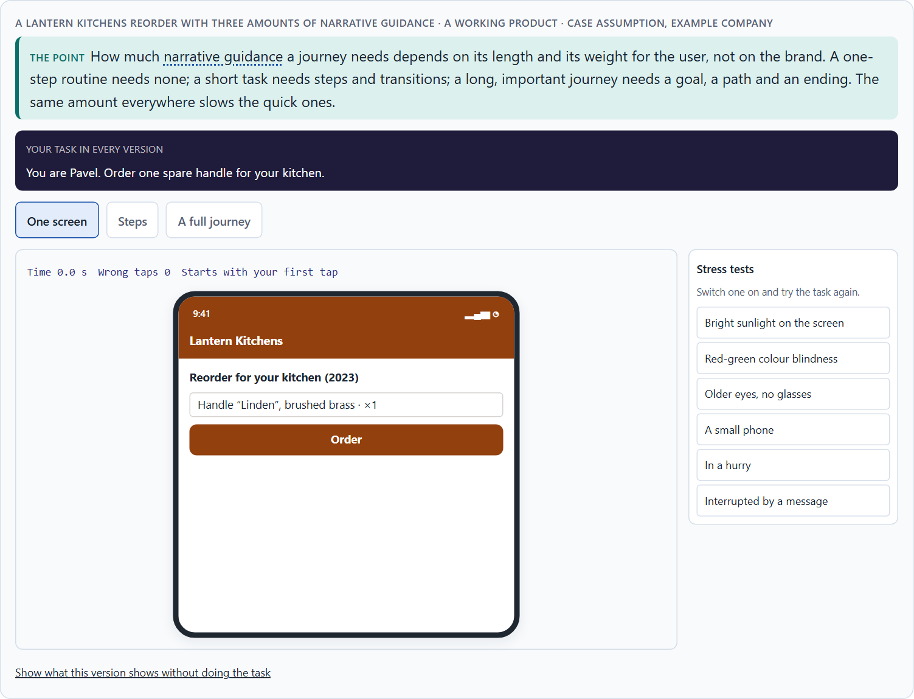
Efficiency against story: the conflicts of narrative UX
B2 · 20 min · Core
Efficiency against dramaturgy, emotionalisation against seriousness, comprehensibility against staging, brand effect against the user's task. Use story only where it serves the task, keep it short, and decide by journey.
A Lantern Kitchens reorder with three amounts of narrative guidance.
Screenshot of the Neuro-UX Lab (aion-ux-lab.vercel.app), own work; AI-assisted, labelled on the image; the example company is fictional.
Sources: Green & Brock 2000 · Krug 2014 · Gibbons 2018 · Nielsen 1997 · GOV.UK Design System, Question pages · Mathur et al. 2019 · Government Digital Service 2012
Notes:
B2 · Efficiency against story: the conflicts of narrative UX · 20 min · Core
Case assumption: Lantern Kitchens, Iris, Pavel, June and Arne are made up for this example. The three journeys are a reading of the example, not a rule for every product. The findings in the table of real evidence are real research results, rules and cases; the sources are listed below.
Go deeper (optional reading): A simple rule settles most conflicts: the amount of narrative guidance grows with the length of the journey and its weight for the user. A rule like this, written into the principles, lets marketing tell its story where people have time for it (the website) and keeps it out of the steps where they do not.
Sources: Green & Brock 2000 · Krug 2014 · Gibbons 2018 · Nielsen 1997 · GOV.UK Design System, Question pages · Mathur et al. 2019 · Government Digital Service 2012

Slide 34
B2 · In plain words
THE IDEA
WHY IT MATTERS
Narrative UX sits between goals that pull against each other: efficiency against dramaturgy (people with little time against a journey with moments), emotionalisation against seriousness (inspiring against credible), comprehensibility against staging (plain steps against a story), and brand effect against the user's task (what marketing wants to tell against what the user came to do). The way through is to use story only where it serves the task, keep it short, and decide by journey: a long, important journey needs more guidance than a quick routine one.
Block 3.1 asks for three guiding decisions, a risk analysis of wrong assumptions about user needs, storytelling and seriousness, and a governance model for conflicts between clarity, brand and experience quality. Each of these is a decision between conflicting goals.
HOW TO READ THE PICTURE
Three Lantern Kitchens journeys of different length and weight, with how much narrative guidance each needs.
Sources: Green & Brock 2000 · Krug 2014 · Gibbons 2018 · Nielsen 1997 · GOV.UK Design System, Question pages · Mathur et al. 2019 · Government Digital Service 2012
Notes:
B2 · Efficiency against story: the conflicts of narrative UX · 20 min · Core
Case assumption: Lantern Kitchens, Iris, Pavel, June and Arne are made up for this example. The three journeys are a reading of the example, not a rule for every product. The findings in the table of real evidence are real research results, rules and cases; the sources are listed below.
Go deeper (optional reading): A simple rule settles most conflicts: the amount of narrative guidance grows with the length of the journey and its weight for the user. A rule like this, written into the principles, lets marketing tell its story where people have time for it (the website) and keeps it out of the steps where they do not.
Sources: Green & Brock 2000 · Krug 2014 · Gibbons 2018 · Nielsen 1997 · GOV.UK Design System, Question pages · Mathur et al. 2019 · Government Digital Service 2012

Slide 35
B2 · Standing conflicts of narrative UX
Conflict | Who usually stands for each side | What to ask
Efficiency against dramaturgy | Users with little time, against a journey with moments. | How long and how important is this journey for them?
Emotionalisation against seriousness | Marketing, against the specialist department. | Can it be inspiring and correct in the same line?
Brand effect against the user's task | The brand story, against what the user came to do. | Whose story is this step telling?
Sources: Green & Brock 2000 · Krug 2014 · Gibbons 2018 · Nielsen 1997 · GOV.UK Design System, Question pages · Mathur et al. 2019 · Government Digital Service 2012
Notes:
B2 · Efficiency against story: the conflicts of narrative UX · 20 min · Core
Case assumption: Lantern Kitchens, Iris, Pavel, June and Arne are made up for this example. The three journeys are a reading of the example, not a rule for every product. The findings in the table of real evidence are real research results, rules and cases; the sources are listed below.
Go deeper (optional reading): A simple rule settles most conflicts: the amount of narrative guidance grows with the length of the journey and its weight for the user. A rule like this, written into the principles, lets marketing tell its story where people have time for it (the website) and keeps it out of the steps where they do not.
Sources: Green & Brock 2000 · Krug 2014 · Gibbons 2018 · Nielsen 1997 · GOV.UK Design System, Question pages · Mathur et al. 2019 · Government Digital Service 2012

Slide 36
B2 · Conflicts of narrative UX, with evidence
Conflict | What the evidence says | A way to decide
Efficiency against dramaturgy | 79% of users always scanned a new page (Nielsen and Morkes 1997), and a one-question-per-page form is longer (GOV.UK Design System). | Ask how long and how important the journey is for the person, and tell the story only where it helps the task.
Emotionalisation against seriousness | Pressure and false urgency were found on about 11% of the crawled shopping websites (Mathur et al. 2019). | Keep the emotion true to the situation; test whether the message would work if people knew why it was written.
Brand effect against the user's task | GOV.UK started from user needs, not from the existing way of working (Government Digital Service 2012). | Ask whose story each step tells.
Sources: Green & Brock 2000 · Krug 2014 · Gibbons 2018 · Nielsen 1997 · GOV.UK Design System, Question pages · Mathur et al. 2019 · Government Digital Service 2012
Notes:
B2 · Efficiency against story: the conflicts of narrative UX · 20 min · Core
Case assumption: Lantern Kitchens, Iris, Pavel, June and Arne are made up for this example. The three journeys are a reading of the example, not a rule for every product. The findings in the table of real evidence are real research results, rules and cases; the sources are listed below.
Go deeper (optional reading): A simple rule settles most conflicts: the amount of narrative guidance grows with the length of the journey and its weight for the user. A rule like this, written into the principles, lets marketing tell its story where people have time for it (the website) and keeps it out of the steps where they do not.
Sources: Green & Brock 2000 · Krug 2014 · Gibbons 2018 · Nielsen 1997 · GOV.UK Design System, Question pages · Mathur et al. 2019 · Government Digital Service 2012

Slide 37
B2 · How to decide when this comes up in the task
Name the conflict as two goals and say who stands for each: marketing, the department, the product team, the users.
1
Decide by journey: a quick routine needs no story, a long and important one needs a goal, a path and an ending.
2
Treat every staged scene and long text inside a flow as a cost to efficiency and clarity, and ask what it buys.
3
Write the rule down, so the conflict is not fought again in every flow.
4
Say what the choice gives up; a decision that gives up nothing has not been made.
5
Sources: Green & Brock 2000 · Krug 2014 · Gibbons 2018 · Nielsen 1997 · GOV.UK Design System, Question pages · Mathur et al. 2019 · Government Digital Service 2012
Notes:
B2 · Efficiency against story: the conflicts of narrative UX · 20 min · Core
Case assumption: Lantern Kitchens, Iris, Pavel, June and Arne are made up for this example. The three journeys are a reading of the example, not a rule for every product. The findings in the table of real evidence are real research results, rules and cases; the sources are listed below.
Go deeper (optional reading): A simple rule settles most conflicts: the amount of narrative guidance grows with the length of the journey and its weight for the user. A rule like this, written into the principles, lets marketing tell its story where people have time for it (the website) and keeps it out of the steps where they do not.
Sources: Green & Brock 2000 · Krug 2014 · Gibbons 2018 · Nielsen 1997 · GOV.UK Design System, Question pages · Mathur et al. 2019 · Government Digital Service 2012

Slide 38
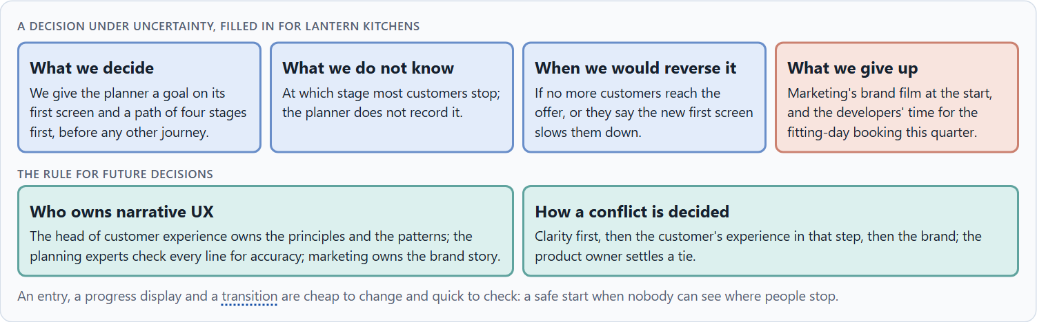
Who owns narrative UX, and deciding without seeing where people stop
B3 · 20 min · Core
Narrative UX lives only with governance: an owner of the principles and patterns, experts who check the facts, marketing who owns the brand story, and a rule for conflicts. A decision with little data says what it decides, does not know, would reverse and gives up.
A decision under uncertainty, filled in for Lantern Kitchens.
Screenshot of the Neuro-UX Lab (aion-ux-lab.vercel.app), own work; AI-assisted, labelled on the image; the example company is fictional.
Sources: Simon 1956 · Klein 2007 · Quesenbery & Brooks 2010 · GOV.UK Design System, Question pages · EU Digital Services Act · Mailchimp, Voice and Tone
Notes:
B3 · Who owns narrative UX, and deciding without seeing where people stop · 20 min · Core
Case assumption: Lantern Kitchens, Iris, Pavel, June and Arne are made up for this example. Deciding with limited information follows Simon (1956); the premortem follows Klein (2007). The findings in the table of real evidence are real research results, rules and cases; the sources are listed below.
Go deeper (optional reading): Imagine it is a year later and the narrative journeys have failed, and ask why (Klein 2007). The usual answers: the story grew in every release until the steps were hard to find; marketing used the patterns for campaigns; the experts stopped checking the lines. Each answer is a governance gap, not a writing gap.
Sources: Simon 1956 · Klein 2007 · Quesenbery & Brooks 2010 · GOV.UK Design System, Question pages · EU Digital Services Act · Mailchimp, Voice and Tone

Slide 39
B3 · In plain words
THE IDEA
WHY IT MATTERS
Narrative UX lives only with governance: someone who owns the principles and the patterns, the experts who check that the story never blurs the facts, marketing who owns the brand story, and a rule for when they disagree. Data on journeys is often incomplete; people cannot be seen where they stop. A decision under uncertainty says what you decide, what you do not know, when you would reverse it and what you give up. An entry, a progress display and a transition are cheap to change and quick to check, which makes them a safe start.
Block 3.1 asks for a governance model for narrative UX principles, a decision despite patchy data, and a statement to the management. This card gives you the parts of each.
HOW TO READ THE PICTURE
The four boxes at the top are the parts of a decision, filled in for Lantern Kitchens. The two boxes below are the rule for future decisions.
Sources: Simon 1956 · Klein 2007 · Quesenbery & Brooks 2010 · GOV.UK Design System, Question pages · EU Digital Services Act · Mailchimp, Voice and Tone
Notes:
B3 · Who owns narrative UX, and deciding without seeing where people stop · 20 min · Core
Case assumption: Lantern Kitchens, Iris, Pavel, June and Arne are made up for this example. Deciding with limited information follows Simon (1956); the premortem follows Klein (2007). The findings in the table of real evidence are real research results, rules and cases; the sources are listed below.
Go deeper (optional reading): Imagine it is a year later and the narrative journeys have failed, and ask why (Klein 2007). The usual answers: the story grew in every release until the steps were hard to find; marketing used the patterns for campaigns; the experts stopped checking the lines. Each answer is a governance gap, not a writing gap.
Sources: Simon 1956 · Klein 2007 · Quesenbery & Brooks 2010 · GOV.UK Design System, Question pages · EU Digital Services Act · Mailchimp, Voice and Tone

Slide 40
B3 · Three parts of narrative UX governance
Part | The question | An example (Lantern Kitchens)
Who owns what | Who owns the principles and patterns; who uses them? | The head of customer experience owns them; every team uses them.
Who checks | Who makes sure the story never blurs the facts? | The planning experts check every line; marketing checks the brand.
How a conflict is decided | What happens when clarity, brand and experience quality disagree? | Clarity, then the customer, then the brand; the product owner settles a tie.
Sources: Simon 1956 · Klein 2007 · Quesenbery & Brooks 2010 · GOV.UK Design System, Question pages · EU Digital Services Act · Mailchimp, Voice and Tone
Notes:
B3 · Who owns narrative UX, and deciding without seeing where people stop · 20 min · Core
Case assumption: Lantern Kitchens, Iris, Pavel, June and Arne are made up for this example. Deciding with limited information follows Simon (1956); the premortem follows Klein (2007). The findings in the table of real evidence are real research results, rules and cases; the sources are listed below.
Go deeper (optional reading): Imagine it is a year later and the narrative journeys have failed, and ask why (Klein 2007). The usual answers: the story grew in every release until the steps were hard to find; marketing used the patterns for campaigns; the experts stopped checking the lines. Each answer is a governance gap, not a writing gap.
Sources: Simon 1956 · Klein 2007 · Quesenbery & Brooks 2010 · GOV.UK Design System, Question pages · EU Digital Services Act · Mailchimp, Voice and Tone

Slide 41
B3 · Owning narrative UX: real rules and cases
Part | Real example or rule | What it means
Who owns the pattern | The GOV.UK Design System keeps its question pages pattern as a shared, reviewed standard (GOV.UK Design System). | Name an owner for the patterns and let teams use them.
Who checks | Article 25 of the EU Digital Services Act forbids manipulative interface design on online platforms. | Have the specialist and the legal view check every line that carries emotion.
A shared guide | Mailchimp's voice and tone guide is a public document its writers share (Mailchimp, Voice and Tone). | Publish the story and tone rules, so a conflict can be decided against them.
Sources: Simon 1956 · Klein 2007 · Quesenbery & Brooks 2010 · GOV.UK Design System, Question pages · EU Digital Services Act · Mailchimp, Voice and Tone
Notes:
B3 · Who owns narrative UX, and deciding without seeing where people stop · 20 min · Core
Case assumption: Lantern Kitchens, Iris, Pavel, June and Arne are made up for this example. Deciding with limited information follows Simon (1956); the premortem follows Klein (2007). The findings in the table of real evidence are real research results, rules and cases; the sources are listed below.
Go deeper (optional reading): Imagine it is a year later and the narrative journeys have failed, and ask why (Klein 2007). The usual answers: the story grew in every release until the steps were hard to find; marketing used the patterns for campaigns; the experts stopped checking the lines. Each answer is a governance gap, not a writing gap.
Sources: Simon 1956 · Klein 2007 · Quesenbery & Brooks 2010 · GOV.UK Design System, Question pages · EU Digital Services Act · Mailchimp, Voice and Tone

Slide 42
B3 · How to decide when this comes up in the task
Name who owns the narrative UX principles and patterns, and who only uses them.
1
Give the specialist department a veto on clarity, and marketing ownership of the brand story.
2
Settle conflicts by clarity first, then the user's experience in that step, then the brand.
3
Say what you decide, what you do not know, when you would reverse it and what you give up.
4
Start where changes are cheap, quick to check and easy to reverse: entries, progress, transitions.
5
Sources: Simon 1956 · Klein 2007 · Quesenbery & Brooks 2010 · GOV.UK Design System, Question pages · EU Digital Services Act · Mailchimp, Voice and Tone
Notes:
B3 · Who owns narrative UX, and deciding without seeing where people stop · 20 min · Core
Case assumption: Lantern Kitchens, Iris, Pavel, June and Arne are made up for this example. Deciding with limited information follows Simon (1956); the premortem follows Klein (2007). The findings in the table of real evidence are real research results, rules and cases; the sources are listed below.
Go deeper (optional reading): Imagine it is a year later and the narrative journeys have failed, and ask why (Klein 2007). The usual answers: the story grew in every release until the steps were hard to find; marketing used the patterns for campaigns; the experts stopped checking the lines. Each answer is a governance gap, not a writing gap.
Sources: Simon 1956 · Klein 2007 · Quesenbery & Brooks 2010 · GOV.UK Design System, Question pages · EU Digital Services Act · Mailchimp, Voice and Tone

Slide 43
Sources (1)
Bruner, J. (1991). The narrative construction of reality. Critical Inquiry, 18(1), 1–21.
Quesenbery, W., & Brooks, K. (2010). Storytelling for User Experience: Crafting Stories for Better Design. Rosenfeld Media.
Lupton, E. (2017). Design Is Storytelling. Cooper Hewitt, Smithsonian Design Museum.
Green, M. C., & Brock, T. C. (2000). The role of transportation in the persuasiveness of public narratives. Journal of Personality and Social Psychology, 79(5), 701–721.
Kivetz, R., Urminsky, O., & Zheng, Y. (2006). The goal-gradient hypothesis resurrected: Purchase acceleration, illusionary goal progress, and customer retention. Journal of Marketing Research, 43(1), 39–58.
Nunes, J. C., & Drèze, X. (2006). The endowed progress effect: How artificial advancement increases effort. Journal of Consumer Research, 32(4), 504–512.
Freytag, G. (1863). Die Technik des Dramas. Hirzel.

Slide 44
Sources (2)
GOV.UK Design System. Question pages. https://design-system.service.gov.uk/patterns/question-pages
Nielsen, J. (1994, reviewed 2024). 10 Usability Heuristics for User Interface Design. Nielsen Norman Group. https://www.nngroup.com/articles/ten-usability-heuristics/
GOV.UK Service Manual. Form structure. https://www.gov.uk/service-manual/design/form-structure
Government Digital Service (2015). One thing per page. GDS Design Notes, 3 July 2015. https://designnotes.blog.gov.uk/2015/07/03/one-thing-per-page/
Krug, S. (2014). Don't Make Me Think, Revisited (3rd ed.). New Riders.
Kahneman, D., Fredrickson, B. L., Schreiber, C. A., & Redelmeier, D. A. (1993). When more pain is preferred to less: Adding a better end. Psychological Science, 4(6), 401–405.
Nielsen, J. (1997). How Users Read on the Web. Nielsen Norman Group. https://www.nngroup.com/articles/how-users-read-on-the-web/

Slide 45
Sources (3)
Gibbons, S. (2018). Using Prioritization Matrices to Inform UX Decisions. Nielsen Norman Group. https://www.nngroup.com/articles/prioritization-matrices/
Fogg, B. J., Soohoo, C., Danielson, D. R., Marable, L., Stanford, J., & Tauber, E. R. (2003). How do users evaluate the credibility of Web sites? A study with over 2,500 participants. Proceedings of DUX '03.
Mailchimp. Content Style Guide: Voice and Tone. https://styleguide.mailchimp.com/voice-and-tone/
Mathur, A., Acar, G., Friedman, M. J., Lucherini, E., Mayer, J., Chetty, M., & Narayanan, A. (2019). Dark patterns at scale: Findings from a crawl of 11K shopping websites. Proceedings of the ACM on Human-Computer Interaction, 3(CSCW), 1–32.
Government Digital Service (2012). Why GOV.UK matters, and the GOV.UK design principles. Government Digital Service blog. https://gds.blog.gov.uk/2012/10/17/why-gov-uk-matters
Simon, H. A. (1956). Rational choice and the structure of the environment. Psychological Review, 63(2), 129–138.
Klein, G. (2007). Performing a project premortem. Harvard Business Review, 85(9), 18–19.

Slide 46
Sources (4)
Regulation (EU) 2022/2065 of the European Parliament and of the Council (Digital Services Act), Article 25. https://eur-lex.europa.eu/eli/reg/2022/2065/oj

Slide 47
About these slides, sources and AI use
AI
AI-assisted content
Where to find more
AI-assisted content: these slides were drafted with an AI language model (Claude, Anthropic) from the course's own Neuro-UX Lab and were read, corrected and approved by Muhammad Muchson, who is responsible for their accuracy.
Pictures are screenshots of the course's own Neuro-UX Lab. Each one carries an AI label on the image and a source line under it.
Companies and people in the examples are fictional. Numbers inside an example are labelled Case assumption and are not data.
Neuro-UX Lab for this day: https://aion-ux-lab.vercel.app/day/8/
Handouts: the Materi and Task Word documents of the day.
Version 1.0, 29.10.2026. Reviewer and approver: Muhammad Muchson.

