Slide 1
UX DEVELOPER · DAY 8
Storytelling in UX/UI design
Training slides: tasks, coaching, case study and feedback
Module 4 (day 2 of 3)
Trainer: Muhammad Muchson · Case: GreenHome
Contains AI-assisted content

Slide 2
The day at a glance (1)
UE | Min | What | What happens
1 | 45 | Knowledge transfer · Level 1 | The trainer presents the cards of Materi A (A1, A2, A3, A4, A5, about 60 min of cards) in the Neuro-UX Lab; participants follow in the handout.
2 | 45 | Level 1 · Task 1 | Individual work on Block 1.1 (Core, about 10 min): the first product of the day is read and its effect described. Pairs then compare their results and the trainer collects open questions.
3 | 45 | Level 1 · Task 2 | Three options are rated on the same criteria and one is chosen under the stated conditions: Block 1.2 (Core, about 8 min).
4 | 45 | Coaching · transition from Level 1 to Level 2 | Trainer-led. A short talk on the day's coaching focus, then the reflection questions in pairs. The bridge: from describing an effect to a decision you answer for. There is no worksheet block in this unit.
5–6 | 90 | Level 2 · Case study GreenHome (2 UE) incl. model solution | UE5: the trainer presents the case; participants work on Block 2.1 (Core, about 15 min). UE6: groups compare their results and defend them; the trainer closes with the model solution.
7 | 45 | Level 2 + 3 · Feedback round with a management perspective | Groups present their reasoning, not only their result. The trainer asks the day's Level 3 input questions and leads the discussion.
One UE is 45 minutes; breaks are not shown.
Notes:
One UE (teaching unit) is counted as 45 minutes; breaks are not shown.

Slide 3
The day at a glance (2)
UE | Min | What | What happens
8 | 45 | Level 3 · Transfer project, Chief Experience Officer (3 UE: UE8–10) | The trainer presents Materi B (B1, B2, B3; use the "In plain words" and "How to decide" boxes, the rest is handout) and sets the role and the situation.
9 | 45 | Level 3 · Transfer project | Individual work or in pairs on Block 3.1 (Core, about 20 min): the strategy memo.
10 | 45 | Level 3 · Transfer project | Participants present their decision and what they give up, including the one decision made under uncertainty; the trainer debriefs with the model solution.
One UE is 45 minutes; breaks are not shown.
Notes:
One UE (teaching unit) is counted as 45 minutes; breaks are not shown.

Slide 4
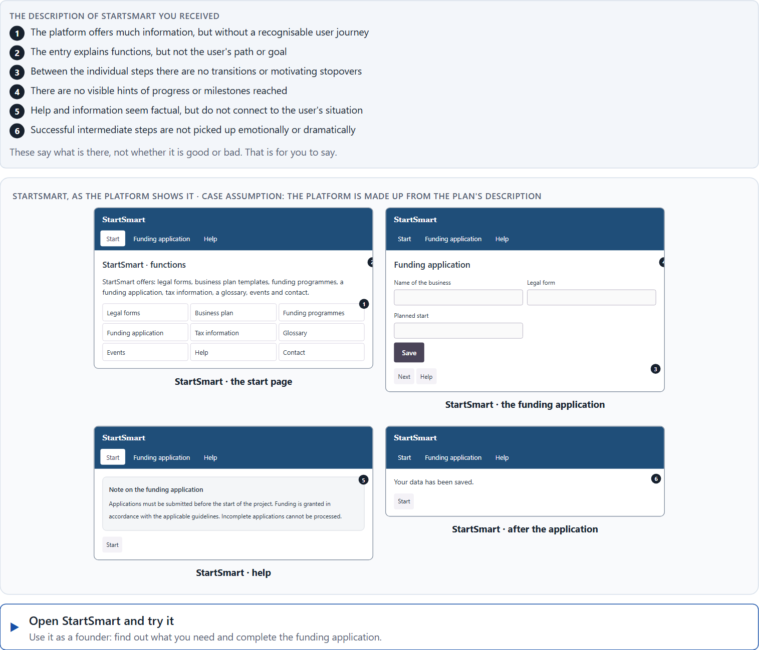
Block 1.1 · Recognise the narrative potential of a digital offer: StartSmart
Level 1 · Knowledge · about 10 min
You receive the description of a fictional platform, StartSmart, for start-up advice and funding applications. Open it and use it as someone who wants to found a business: find out what you need and start an application. You need no prior knowledge: notice whether you know where you are going and how far you have come, not only whether the steps work. The aim is to recognise narrative gaps in the experience and tell them apart from a purely functional presentation of a process.
Screenshot of the Neuro-UX Lab (aion-ux-lab.vercel.app), own work; AI-assisted, labelled on the image; the example company is fictional.
Draws on: A1 · Why people experience a process as a story · A2 · The elements of narrative guidance · A3 · Telling a story or guiding with one · A4 · Orientation, motivation and memorability, and the risk of overload.
Notes:
Block 1.1 · Recognise the narrative potential of a digital offer: StartSmart · about 10 min. Draws on: A1 · Why people experience a process as a story · A2 · The elements of narrative guidance · A3 · Telling a story or guiding with one · A4 · Orientation, motivation and memorability, and the risk of overload.

Slide 5
Block 1.1 · What you work on
Describe the effect the offer could have on a first-time user
1
Name at least 5 places where narrative guidance is missing or could be improved
2
Assign the observations to the categories entry, orientation, motivation, transition, progress and completion
3
Write an effect statement for three points: “For users this could mean that …”
4
Prioritise the two biggest weaknesses with regard to emotionally connecting user guidance
5
Notes:
Block 1.1 · Recognise the narrative potential of a digital offer: StartSmart · about 10 min. Draws on: A1 · Why people experience a process as a story · A2 · The elements of narrative guidance · A3 · Telling a story or guiding with one · A4 · Orientation, motivation and memorability, and the risk of overload.

Slide 6
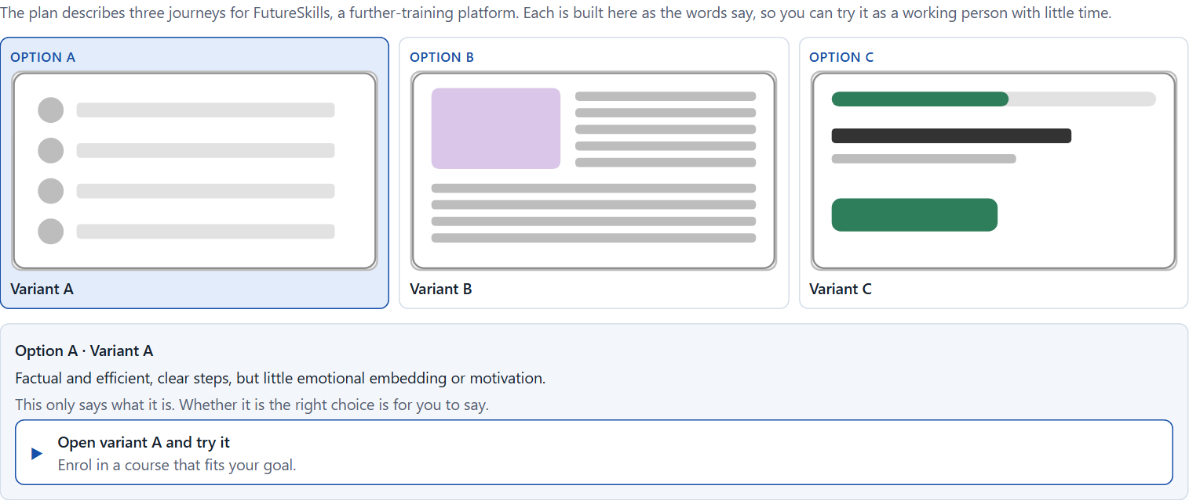
Block 1.2 · Rate storytelling approaches under conflicting goals: FutureSkills
Level 1 · Knowledge · about 8 min
FutureSkills is a further-training platform. Three journeys for its users are described in words: A) factual and efficient, with clear steps, but little emotional embedding or motivation; B) strongly narrative and emotionally activating, but with more text and longer guidance; C) a balanced mix of clarity, motivating address and visible progress, but with a somewhat higher implementation effort. The conditions: the target group is working people with little time, the company wants to look professional and inspiring, the budget is limited, the release is in 10 weeks, marketing demands stronger activation while the department demands high clarity, and there are no user tests yet. Decide anyway, and say what you assume.
Screenshot of the Neuro-UX Lab (aion-ux-lab.vercel.app), own work; AI-assisted, labelled on the image; the example company is fictional.
Draws on: A3 · Telling a story or guiding with one · A4 · Orientation, motivation and memorability, and the risk of overload · A5 · Embedding an action in its context, and weighing a measure.
Notes:
Block 1.2 · Rate storytelling approaches under conflicting goals: FutureSkills · about 8 min. Draws on: A3 · Telling a story or guiding with one · A4 · Orientation, motivation and memorability, and the risk of overload · A5 · Embedding an action in its context, and weighing a measure.

Slide 7
Block 1.2 · What you work on
Rate each variant on orientation, motivation, relevance, efficiency and experience quality
1
Decide which variant is the most viable under the given conditions
2
Name the conflicts of goals between efficiency and dramaturgical guidance
3
Which risks remain despite your decision?
4
Formulate a recommendation to the project management
5
Notes:
Block 1.2 · Rate storytelling approaches under conflicting goals: FutureSkills · about 8 min. Draws on: A3 · Telling a story or guiding with one · A4 · Orientation, motivation and memorability, and the risk of overload · A5 · Embedding an action in its context, and weighing a measure.

Slide 8
Coaching · UE4
Transition: Level 1 to Level 2
From showing a process to a narrative architecture of experience
From describing an effect to a decision you answer for.
Notes:
UE4 · Coaching: transition from Level 1 to Level 2. Trainer-led: a short talk on the coaching focus, then the reflection questions in pairs.

Slide 9
Coaching · questions we talk through
Why is storytelling in UX/UI design more than marketing or text design?
How do I handle conflicts between efficiency, clarity and emotional staging?
1
5
How do I tell whether a user journey is only functional or also emotionally connectable?
How do I argue towards stakeholders who see storytelling as “soft” or superfluous?
2
6
Which dramaturgical elements support motivation and orientation?
Which decisions are operational, which strategic for brand impact, attachment and activation?
3
7
When does storytelling support use, and when does it slow down or overload the process?
4
Notes:
UE4 · Coaching: transition from Level 1 to Level 2. Trainer-led: a short talk on the coaching focus, then the reflection questions in pairs.

Slide 10
Coaching · reflect in pairs
1
2
3
Where do digital processes stay functionally correct but emotionally empty?
Which user actions profit especially from a narrative frame?
When does a lack of narrative guidance become a competitive disadvantage?
Notes:
UE4 · Coaching: transition from Level 1 to Level 2. Trainer-led: a short talk on the coaching focus, then the reflection questions in pairs.

Slide 11
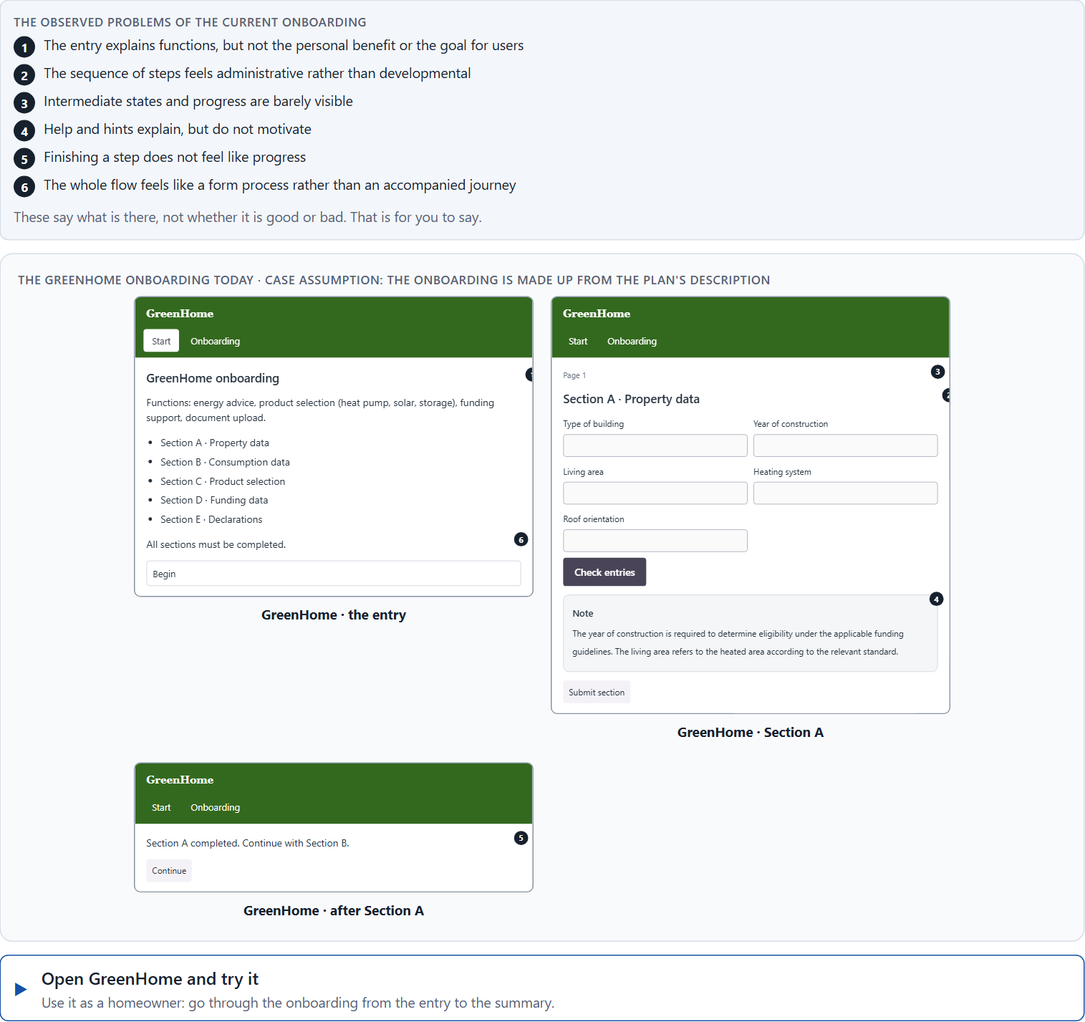
Block 2.1 · Case study: redesigning the GreenHome onboarding
Level 2 · Case study · UE5–6 · about 15 min
A company for sustainable energy solutions offers GreenHome, a digital platform for advice, product selection and funding support. The onboarding is functionally complete, but users experience it as sober, long-winded and not very motivating. Many start the process but abandon it before the end. The company wants to make it emotionally more connecting and dramaturgically clearer, without losing specialist clarity. The observed problems: the entry explains functions, but not the personal benefit or the goal for users; the sequence of steps feels administrative rather than developmental; intermediate states and progress are barely visible; help and hints explain but do not motivate; finishing a step does not feel like progress; and the whole feels like a form process rather than an accompanied journey. The conditions: a budget of €155,000, 12 weeks for the implementation, contents and specialist logic must largely be kept, the company wants to look inspiring but serious, user data is only partly available, and a complete relaunch is not possible. You work through six steps.
Screenshot of the Neuro-UX Lab (aion-ux-lab.vercel.app), own work; AI-assisted, labelled on the image; the example company is fictional.
Draws on: A1 · Why people experience a process as a story · A2 · The elements of narrative guidance · A3 · Telling a story or guiding with one · A4 · Orientation, motivation and memorability, and the risk of overload · A5 · Embedding an action in its context, and weighing a measure.
Notes:
Block 2.1 · Case study: redesigning the GreenHome onboarding · about 15 min. Draws on: A1 · Why people experience a process as a story · A2 · The elements of narrative guidance · A3 · Telling a story or guiding with one · A4 · Orientation, motivation and memorability, and the risk of overload · A5 · Embedding an action in its context, and weighing a measure.

Slide 12
Block 2.1 · What you work on
Analyse the central narrative and dramaturgical deficits of the onboarding
1
Assign the problems to the categories entry, relevance, transitions, progress, motivation and completion
2
Develop 4 prioritised measures for improvement
3
Justify your selection using effect on users, feasibility, risk and time pressure
4
Make a prioritisation decision for the first 12 weeks
5
Formulate a recommendation to the division management
6
Notes:
Block 2.1 · Case study: redesigning the GreenHome onboarding · about 15 min. Draws on: A1 · Why people experience a process as a story · A2 · The elements of narrative guidance · A3 · Telling a story or guiding with one · A4 · Orientation, motivation and memorability, and the risk of overload · A5 · Embedding an action in its context, and weighing a measure.

Slide 13
Feedback round · how each group presents
Each group presents its prioritised measures in 5 minutes
1
The reasoning runs along effect, feasibility, risk and responsibility
2
Each group names one measure that was deliberately postponed
3
Notes:
UE7 · Feedback round with a management perspective. Groups present their reasoning, not only their result.

Slide 14
Feedback round · questions to answer
Which measure raises motivation and connection fastest?
Which risks arise when dramaturgy overlays clarity?
1
4
Which measure is strategically most important for a memorable user journey?
Which decision can be answered for despite an incomplete data situation?
2
5
Where was storytelling integrated sensibly, and where is there a danger of over-staging?
3
Notes:
UE7 · Feedback round with a management perspective. Groups present their reasoning, not only their result.

Slide 15
Level 3 input and discussion
INPUT LEVEL 3
DISCUSSION
At senior level storytelling becomes a design logic for relevance, activation and attachment
Good management decisions balance efficiency, brand impact, domain logic and quality of experience
Being able to answer for a decision shows in using narrative elements not by chance but along strategic aims of effect
When does a purely functional process become a strategically missed user experience?
Notes:
UE7 · Feedback round with a management perspective. Groups present their reasoning, not only their result.

Slide 16
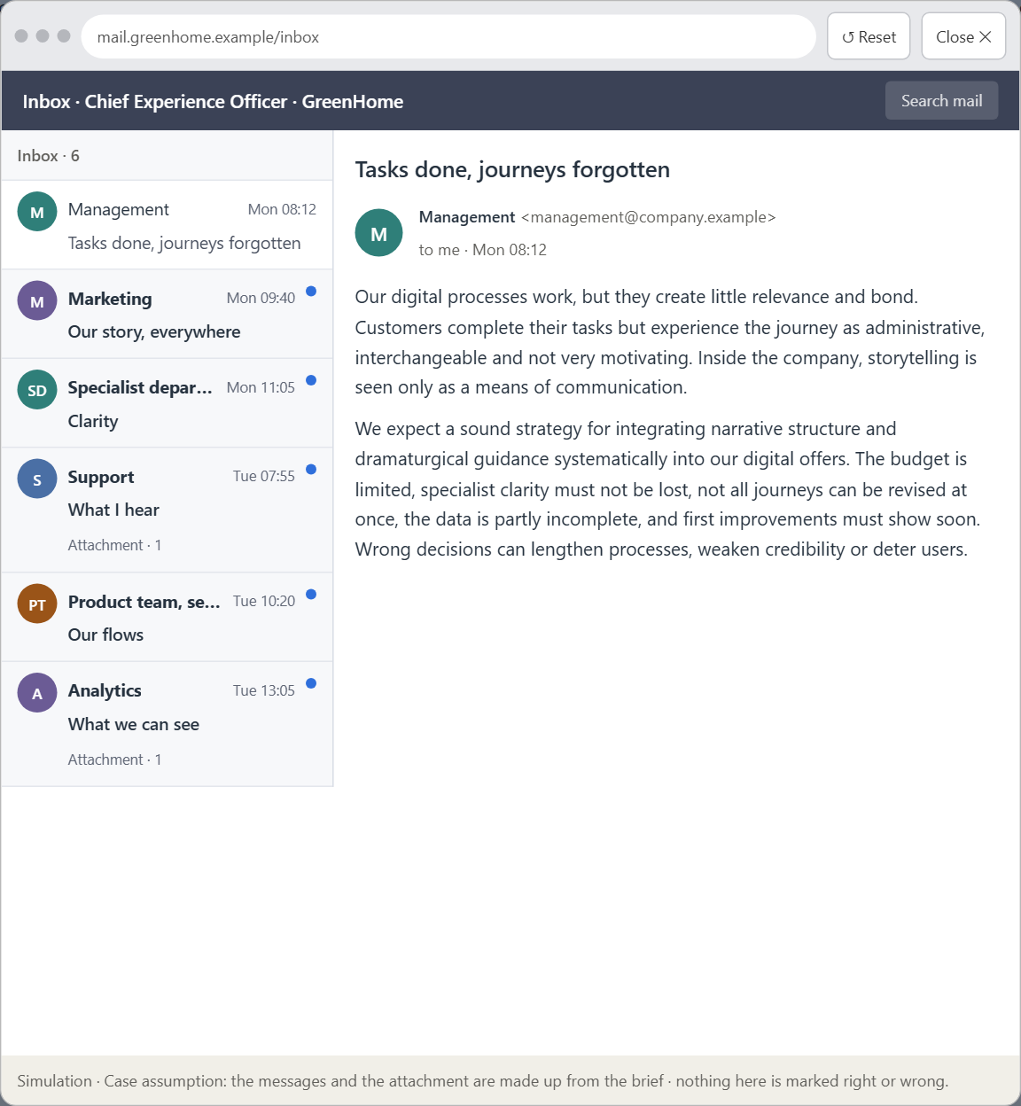
Block 3.1 · A narrative UX strategy for digital user journeys
Level 3 · Transfer project · UE8–10 · about 20 min
You take the perspective of the Chief Experience Officer of the sustainable-energy provider that runs GreenHome. The company has a website, an advisory platform and self-service flows. Its digital processes work, but they create little relevance and bond: users complete their tasks but experience the journey as administrative, interchangeable and not very motivating. Inside the company, storytelling is seen only as a means of communication, not as part of the UX architecture. The management expects a sound strategy for integrating narrative structure and dramaturgical guidance systematically into the digital offers. You are not to write beautiful texts but to develop a sound decision architecture for storytelling, user relevance and dramaturgical guidance.
Screenshot of the Neuro-UX Lab (aion-ux-lab.vercel.app), own work; AI-assisted, labelled on the image; the example company is fictional.
Draws on: B1 · Narrative UX as experience architecture, not communication · B2 · Efficiency against story · B3 · Who owns narrative UX, and deciding without seeing where people stop.
Notes:
Block 3.1 · A narrative UX strategy for digital user journeys · about 20 min. Draws on: B1 · Narrative UX as experience architecture, not communication · B2 · Efficiency against story · B3 · Who owns narrative UX, and deciding without seeing where people stop.

Slide 17
Block 3.1 · What you work on
1
A guiding vision for narrative UX: which emotional effect and which user journey should be created systematically?
2
Three strategic guiding decisions on entry, dramaturgical guidance, the experience of progress and narrative relevance
3
A prioritised architecture of measures: which journeys, touchpoints or interactions are improved first, and why?
4
A risk analysis: which wrong assumptions about user needs, storytelling and seriousness would be especially critical?
5
A governance model: who is responsible for the narrative UX principles, and how are conflicts between clarity, brand and experience quality decided?
6
A decision under uncertainty: make at least one prioritised decision despite patchy data and justify it responsibly
7
A management statement: a recommendation to the management with a clear priority and a strategic reason
Notes:
Block 3.1 · A narrative UX strategy for digital user journeys · about 20 min. Draws on: B1 · Narrative UX as experience architecture, not communication · B2 · Efficiency against story · B3 · Who owns narrative UX, and deciding without seeing where people stop.

Slide 18
Reflect before you leave
1
2
3
Which decision did you make today, and what did you give up to make it?
Which assumption would you check first with real users, and how?
What will you do differently in your next project because of today?
Use two minutes alone, then one minute with your neighbour.

Slide 19
About these slides, sources and AI use
AI
AI-assisted content
Where to find more
AI-assisted content: these slides were drafted with an AI language model (Claude, Anthropic) from the course's own Neuro-UX Lab and were read, corrected and approved by Muhammad Muchson, who is responsible for their accuracy.
Pictures are screenshots of the course's own Neuro-UX Lab. Each one carries an AI label on the image and a source line under it.
Companies and people in the examples are fictional. Numbers inside an example are labelled Case assumption and are not data.
The coaching and feedback questions are the course plan's own, translated into English.
Neuro-UX Lab for this day: https://aion-ux-lab.vercel.app/day/8/
Handouts: the Materi and Task Word documents of the day.
Version 1.0, 29.10.2026. Reviewer and approver: Muhammad Muchson.

