Slide 1
UX DEVELOPER · DAY 9
Gamification strategies, and storytelling with gamification
Knowledge transfer slides
Module 4 (day 3 of 3)
Trainer: Muhammad Muchson · Materi A and B · v1.0
Contains AI-assisted content

Slide 2
What we cover today
Today is about why people start using a product and why they keep using it. You learn what gamification is and is not, why people react to progress, feedback, recognition, challenge and reaching a goal, what points, badges, levels, challenges, streaks and status displays can and cannot do, how gamification goes wrong (manipulation, overstimulation, reward inflation, lost motivation, lost trust), how a story makes the same mechanics mean more, why a quick spike is not lasting use, and when gamification stays credible in a serious field. Then you use it on three platforms, and you look at how two real ones decided. This document holds everything you need to study Day 9 without the website. Every card says what the idea is in plain words, shows it in a picture, gives the details and ends with the rules you use in the tasks.
Materi A · 60 min
Materi B · 60 min
A1 Gamification, playful design and a game: three different requests (12 min)
A2 Why people react to progress, feedback and recognition: the levers under a mechanic (12 min)
A3 Points, badges, levels, streaks: what each tool does, and how gamification goes wrong (12 min)
A4 Story and game together, and a quick spike against lasting use (12 min)
A5 Intrinsic motivation, credible gamification in serious fields, and weighing a measure (12 min)
B1 Gamification as activation architecture, not a game layer (20 min)
B2 Motivation against seriousness and autonomy: the conflicts of activation (20 min)
B3 Who answers for a mechanic, and deciding without knowing who stays (20 min)

Slide 3
A
Materi A
Route 1 · Levels 1 and 2
About 60 minutes, five cards. Levels 1 and 2: find where a further-training platform weakens and promotes activation and retention, rate three activation designs of a prevention platform under conflicting goals, then analyse a prevention platform's deficits, develop four measures, justify them and decide on the first 12 weeks. The cards give you the ideas and the rules you use in Task 1.

Slide 4
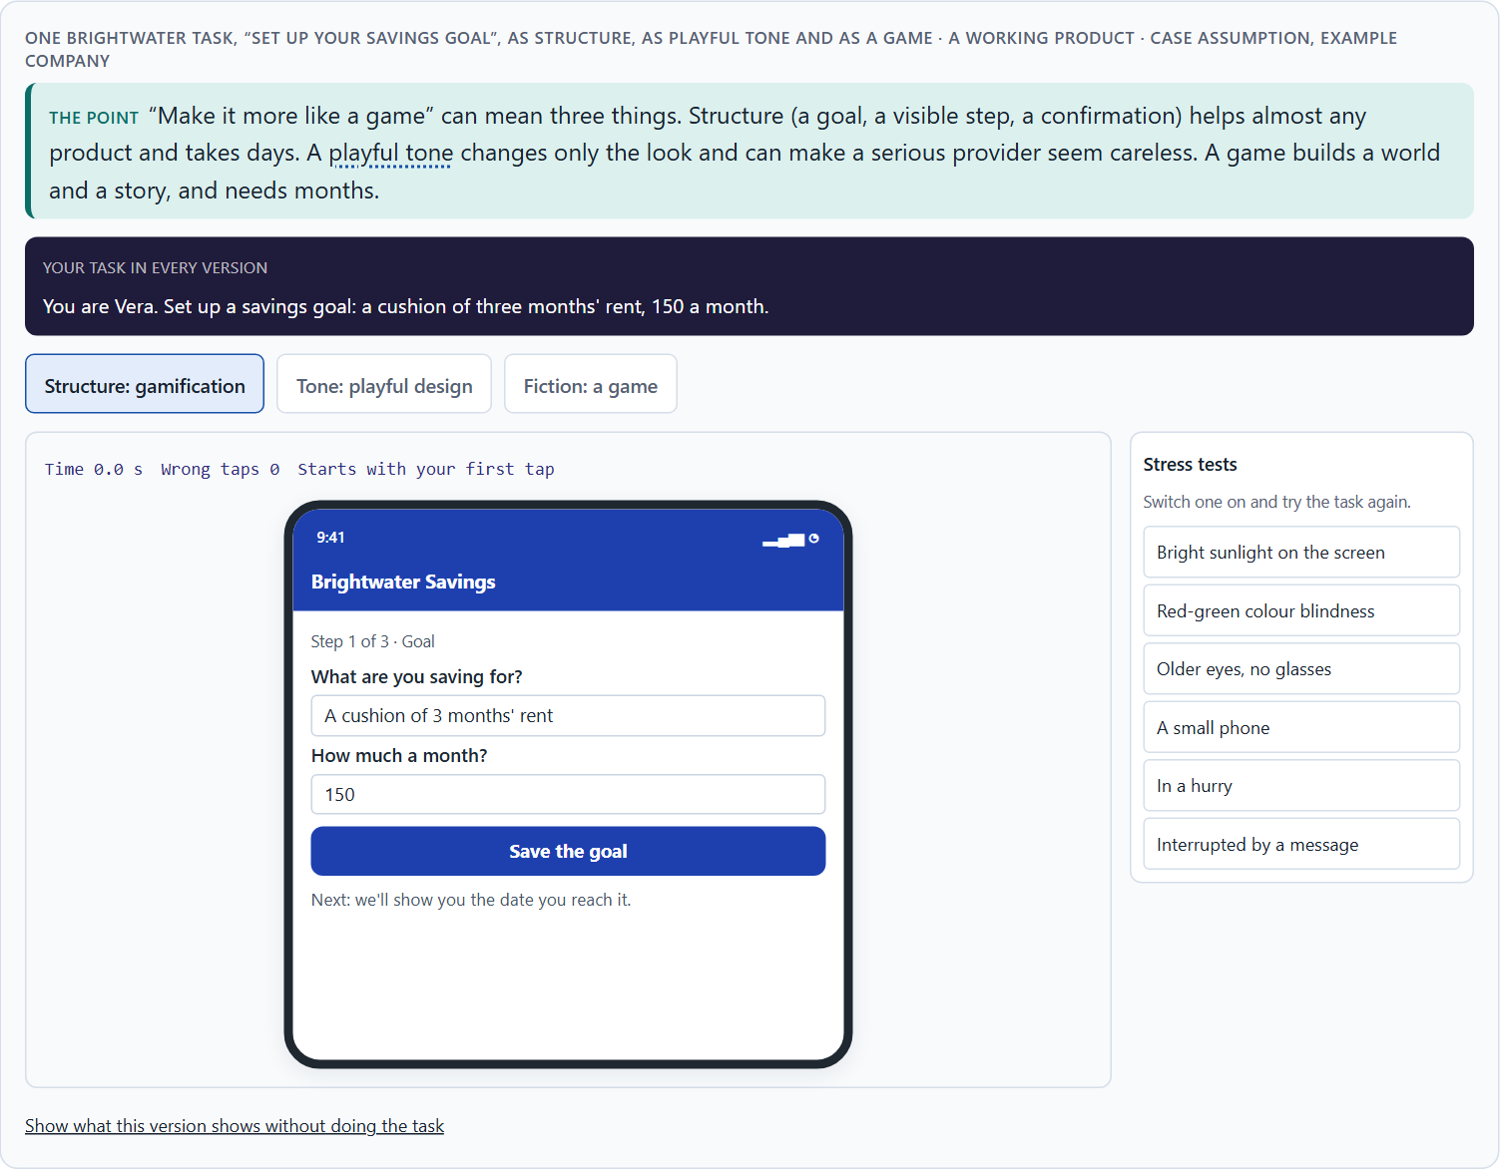
Gamification, playful design and a game: three different requests
A1 · 12 min · Core
Gamification borrows the structure of games (a goal, a position, feedback). Playful design changes only the tone. A game builds a world. They differ in effort and risk; gamification strategies aim at activation (starting) and retention (staying).
One Brightwater task, “set up your savings goal”, as structure, as playful tone and as a game.
Screenshot of the Neuro-UX Lab (aion-ux-lab.vercel.app), own work; AI-assisted, labelled on the image; the example company is fictional.
Sources: Deterding et al. 2011 · Hamari et al. 2014 · Nicholson 2015
Notes:
A1 · Gamification, playful design and a game: three different requests · 12 min · Core
Case assumption: Brightwater Savings, Vera, Kaspar, Rhea and Dominik are made up for this example. Gamification as game design elements in non-game contexts, apart from playful design and full games, follows Deterding et al. (2011); its context-dependent effects follow Hamari et al. (2014). The findings in the table of real evidence are real research results, rules and cases; the sources are listed below.
Go deeper (optional reading): A health insurer, a bank or a public service can use the structure layer freely: visible progress, milestones, confirmation. What it can rarely risk is the playful tone: the moment a claims or a savings screen looks cheerful, people read it as a company that takes their situation less seriously than they do. Most failed gamification projects tried to build the fiction layer with the time and the team of a structure project.
Sources: Deterding et al. 2011 · Hamari et al. 2014 · Nicholson 2015

Slide 5
A1 · In plain words
THE IDEA
WHY IT MATTERS
Three different things are called gamification. Gamification proper borrows the structure of games: a goal, a visible position, feedback, a challenge, inside something that is not a game. Playful design changes only the tone: colours, round shapes, cheerful words. A game builds a world with characters and a story of its own. They differ in effort (a few days for one person against months for a team) and in risk: structure helps almost any product, a playful tone can make a serious provider look careless, and a game that does not convince is worse than none. Gamification strategies aim at two different things: activation (people start and do something now) and retention (they keep coming back).
Block 1.1 asks what SkillRise's plain learning paths do to motivation and retention, Block 1.2 asks you to rate three activation designs for HealthJourney, and Block 2.1 asks for measures for MoveWell that keep it serious. This card gives you the words to say which of the three a design asks for.
HOW TO READ THE PICTURE
One Brightwater Savings task, “set up your savings goal”, in three versions: with structure, with a playful tone, and as a game.
Sources: Deterding et al. 2011 · Hamari et al. 2014 · Nicholson 2015
Notes:
A1 · Gamification, playful design and a game: three different requests · 12 min · Core
Case assumption: Brightwater Savings, Vera, Kaspar, Rhea and Dominik are made up for this example. Gamification as game design elements in non-game contexts, apart from playful design and full games, follows Deterding et al. (2011); its context-dependent effects follow Hamari et al. (2014). The findings in the table of real evidence are real research results, rules and cases; the sources are listed below.
Go deeper (optional reading): A health insurer, a bank or a public service can use the structure layer freely: visible progress, milestones, confirmation. What it can rarely risk is the playful tone: the moment a claims or a savings screen looks cheerful, people read it as a company that takes their situation less seriously than they do. Most failed gamification projects tried to build the fiction layer with the time and the team of a structure project.
Sources: Deterding et al. 2011 · Hamari et al. 2014 · Nicholson 2015

Slide 6
A1 · Three things called gamification
What it is | What changes | Effort | Main risk
Gamification (structure) | Goals, a visible position, feedback, recognition, challenges. | Days; one or two people. | Little, if the goal is real.
Playful design (tone) | Colours, shapes, a cheerful voice. | Weeks; design and writing. | A serious provider looks careless.
A game (fiction) | A world, characters, a story of its own. | Months; a whole team. | Unconvincing fiction; looks childish.
Sources: Deterding et al. 2011 · Hamari et al. 2014 · Nicholson 2015
Notes:
A1 · Gamification, playful design and a game: three different requests · 12 min · Core
Case assumption: Brightwater Savings, Vera, Kaspar, Rhea and Dominik are made up for this example. Gamification as game design elements in non-game contexts, apart from playful design and full games, follows Deterding et al. (2011); its context-dependent effects follow Hamari et al. (2014). The findings in the table of real evidence are real research results, rules and cases; the sources are listed below.
Go deeper (optional reading): A health insurer, a bank or a public service can use the structure layer freely: visible progress, milestones, confirmation. What it can rarely risk is the playful tone: the moment a claims or a savings screen looks cheerful, people read it as a company that takes their situation less seriously than they do. Most failed gamification projects tried to build the fiction layer with the time and the team of a structure project.
Sources: Deterding et al. 2011 · Hamari et al. 2014 · Nicholson 2015

Slide 7
A1 · Gamification, playful design and a game: definitions and evidence
Source | Real finding | What it means for a screen
The definition | Gamification is the use of game design elements in non-game contexts (Deterding et al. 2011). | Ask which element you borrow (a goal, a position, feedback) and for what real task.
Does it work? | A review of 24 empirical studies found mostly positive effects, but the effects depended greatly on the context and on the users (Hamari et al. 2014). | Do not assume an effect: name the context and the group, and measure.
Meaningful gamification | Nicholson argues that gamification should be built around what is meaningful for the user, not around rewards alone (Nicholson 2015). | Start from the user's own goal, then choose the mechanic.
Sources: Deterding et al. 2011 · Hamari et al. 2014 · Nicholson 2015
Notes:
A1 · Gamification, playful design and a game: three different requests · 12 min · Core
Case assumption: Brightwater Savings, Vera, Kaspar, Rhea and Dominik are made up for this example. Gamification as game design elements in non-game contexts, apart from playful design and full games, follows Deterding et al. (2011); its context-dependent effects follow Hamari et al. (2014). The findings in the table of real evidence are real research results, rules and cases; the sources are listed below.
Go deeper (optional reading): A health insurer, a bank or a public service can use the structure layer freely: visible progress, milestones, confirmation. What it can rarely risk is the playful tone: the moment a claims or a savings screen looks cheerful, people read it as a company that takes their situation less seriously than they do. Most failed gamification projects tried to build the fiction layer with the time and the team of a structure project.
Sources: Deterding et al. 2011 · Hamari et al. 2014 · Nicholson 2015

Slide 8
A1 · How to decide when this comes up in the task
Ask which of the three a request wants: structure, tone or a game.
1
Structure helps almost any product; check whether people can see their goal, their position and what a step did.
2
Treat a playful tone in a serious field as a risk to credibility, not as a free extra.
3
Treat a game as a project of months; do not accept it with the time and people of a small change.
4
Say whether a measure aims at activation (people start now) or retention (they keep coming back).
5
Sources: Deterding et al. 2011 · Hamari et al. 2014 · Nicholson 2015
Notes:
A1 · Gamification, playful design and a game: three different requests · 12 min · Core
Case assumption: Brightwater Savings, Vera, Kaspar, Rhea and Dominik are made up for this example. Gamification as game design elements in non-game contexts, apart from playful design and full games, follows Deterding et al. (2011); its context-dependent effects follow Hamari et al. (2014). The findings in the table of real evidence are real research results, rules and cases; the sources are listed below.
Go deeper (optional reading): A health insurer, a bank or a public service can use the structure layer freely: visible progress, milestones, confirmation. What it can rarely risk is the playful tone: the moment a claims or a savings screen looks cheerful, people read it as a company that takes their situation less seriously than they do. Most failed gamification projects tried to build the fiction layer with the time and the team of a structure project.
Sources: Deterding et al. 2011 · Hamari et al. 2014 · Nicholson 2015

Slide 9
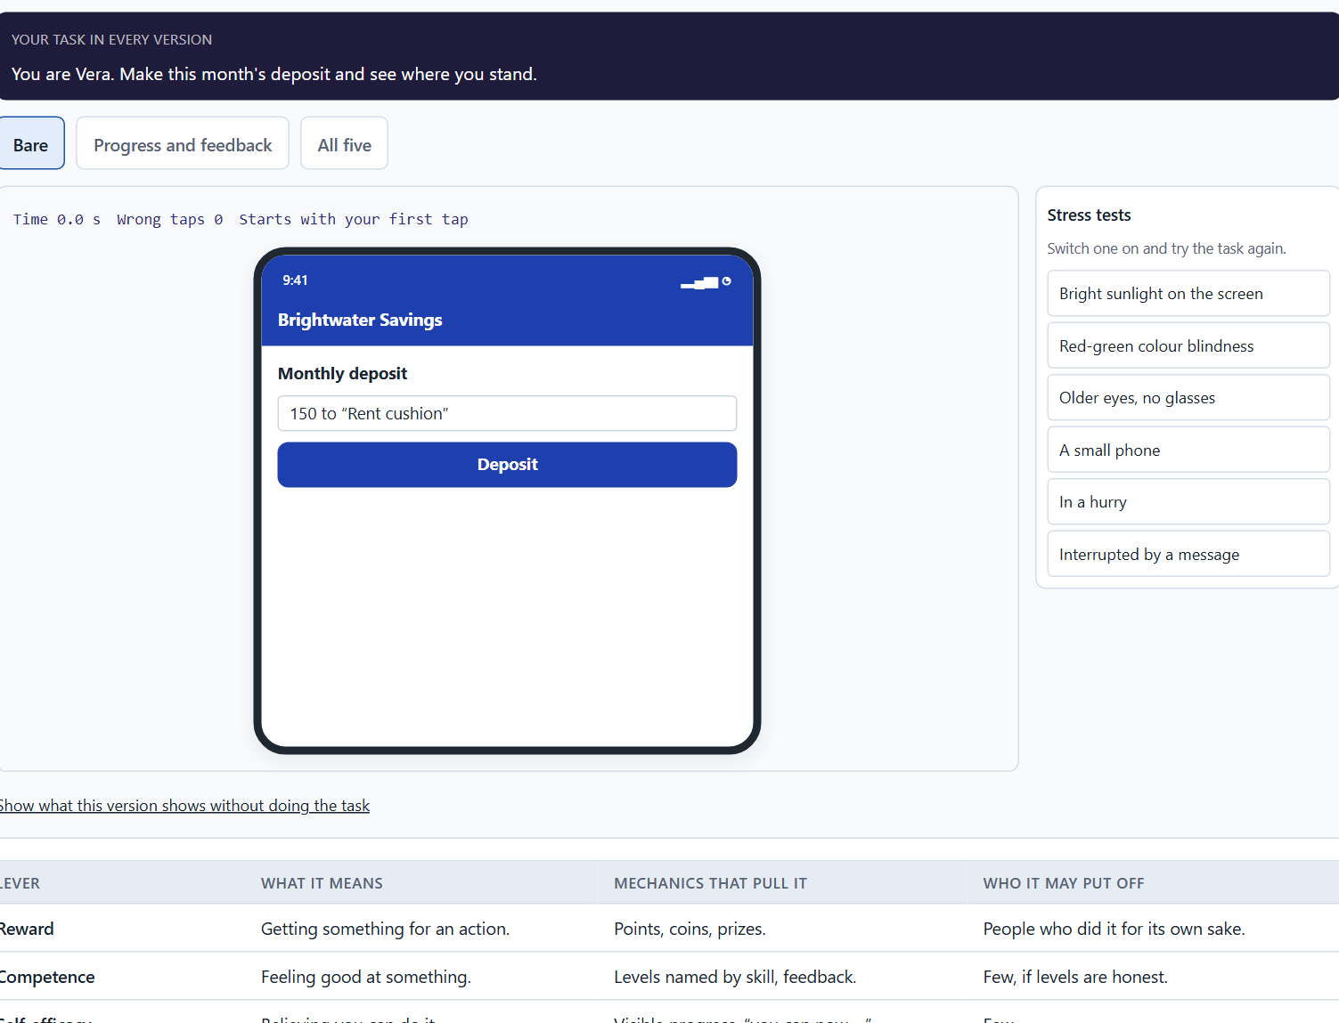
Why people react to progress, feedback and recognition: the levers under a mechanic
A2 · 12 min · Core
People react to information about their own position: progress, feedback, recognition, a challenge, a goal reached. Under every mechanic is a lever: reward, competence, self-efficacy, social validation, the experience of progress, an activation trigger.
Brightwater after a deposit: progress, feedback, recognition, a challenge and a goal.
Screenshot of the Neuro-UX Lab (aion-ux-lab.vercel.app), own work; AI-assisted, labelled on the image; the example company is fictional.
Sources: Ryan & Deci 2000 · Bandura 1977 · Festinger 1954 · Kivetz et al. 2006
Notes:
A2 · Why people react to progress, feedback and recognition: the levers under a mechanic · 12 min · Core
Case assumption: Brightwater Savings, Vera, Kaspar, Rhea and Dominik are made up for this example. Competence, autonomy and relatedness as needs behind lasting motivation follow Ryan and Deci (2000); self-efficacy follows Bandura (1977); social comparison follows Festinger (1954). The findings in the table of real evidence are real research results, rules and cases; the sources are listed below.
Go deeper (optional reading): In a prevention or health product, the people who most need to continue are often the ones doing worst. A ranking tells exactly those people, every week, that they are at the bottom, in a field where being at the bottom is already a source of shame. It works on the fittest few, who need it least. That is the clearest case of a mechanic that raises the average while harming the people the product exists for.
Sources: Ryan & Deci 2000 · Bandura 1977 · Festinger 1954 · Kivetz et al. 2006

Slide 10
A2 · In plain words
THE IDEA
WHY IT MATTERS
People do not react to rewards as such. They react to information about their own position: how far they have come, whether what they just did counted, how much is left, whether they are good at it. Progress, feedback, recognition, a challenge and reaching a goal are ways of giving that information. Underneath every mechanic is a lever: reward, a feeling of competence, self-efficacy (believing you can do it), social validation, the experience of progress, or an activation trigger (a reminder, a nudge). The mechanic is what people see; the lever is what moves them. Choosing a mechanic without naming its lever is how a leaderboard lands in a product where nobody wants to be compared.
Block 1.1 asks you to sort SkillRise's weak spots into motivation, progress, recognition, feedback, retention and self-efficacy, and Block 2.1 asks the same for MoveWell. This card tells the six apart and shows which lever each mechanic pulls.
HOW TO READ THE PICTURE
One Brightwater Savings screen after a deposit, with five switches: progress, feedback, recognition, challenge and a reached goal.
Sources: Ryan & Deci 2000 · Bandura 1977 · Festinger 1954 · Kivetz et al. 2006
Notes:
A2 · Why people react to progress, feedback and recognition: the levers under a mechanic · 12 min · Core
Case assumption: Brightwater Savings, Vera, Kaspar, Rhea and Dominik are made up for this example. Competence, autonomy and relatedness as needs behind lasting motivation follow Ryan and Deci (2000); self-efficacy follows Bandura (1977); social comparison follows Festinger (1954). The findings in the table of real evidence are real research results, rules and cases; the sources are listed below.
Go deeper (optional reading): In a prevention or health product, the people who most need to continue are often the ones doing worst. A ranking tells exactly those people, every week, that they are at the bottom, in a field where being at the bottom is already a source of shame. It works on the fittest few, who need it least. That is the clearest case of a mechanic that raises the average while harming the people the product exists for.
Sources: Ryan & Deci 2000 · Bandura 1977 · Festinger 1954 · Kivetz et al. 2006

Slide 11
A2 · The motivation levers and the mechanics that pull them
Lever | What it means | Mechanics that pull it | Who it may put off
Reward | Getting something for an action. | Points, coins, prizes. | People who did it for its own sake.
Competence | Feeling good at something. | Levels named by skill, feedback. | Few, if levels are honest.
Self-efficacy | Believing you can do it. | Visible progress, “you can now …”. | Few.
Social validation | Others see or confirm it. | Rankings, sharing, likes. | Those at the bottom; private people.
Experience of progress | Getting closer to a goal. | Progress bars, milestones, stages. | Few, if the goal is theirs.
Activation trigger | A cue to act now. | Reminders, notifications, streaks. | People who feel pushed.
Sources: Ryan & Deci 2000 · Bandura 1977 · Festinger 1954 · Kivetz et al. 2006
Notes:
A2 · Why people react to progress, feedback and recognition: the levers under a mechanic · 12 min · Core
Case assumption: Brightwater Savings, Vera, Kaspar, Rhea and Dominik are made up for this example. Competence, autonomy and relatedness as needs behind lasting motivation follow Ryan and Deci (2000); self-efficacy follows Bandura (1977); social comparison follows Festinger (1954). The findings in the table of real evidence are real research results, rules and cases; the sources are listed below.
Go deeper (optional reading): In a prevention or health product, the people who most need to continue are often the ones doing worst. A ranking tells exactly those people, every week, that they are at the bottom, in a field where being at the bottom is already a source of shame. It works on the fittest few, who need it least. That is the clearest case of a mechanic that raises the average while harming the people the product exists for.
Sources: Ryan & Deci 2000 · Bandura 1977 · Festinger 1954 · Kivetz et al. 2006

Slide 12
A2 · Why people react to progress, feedback and recognition: sources
Lever | Real finding | What it means for a mechanic
Autonomy, competence, relatedness | Self-determination theory names three basic needs whose satisfaction supports lasting motivation (Ryan and Deci 2000). | Check each mechanic against the three needs: does it give choice, a sense of skill and a link to others?
Self-efficacy | Bandura described the belief that one can do something as a main source of effort and persistence (Bandura 1977). | Show what the person can do now that they could not before.
Social comparison | People judge their own ability by comparing themselves with others (Festinger 1954). | Rankings motivate those near the top and can discourage those at the bottom.
Progress | Customers in a real reward programme bought more often the closer they were to the reward (Kivetz et al. 2006). | Show the distance to a goal that is the person's own.
Sources: Ryan & Deci 2000 · Bandura 1977 · Festinger 1954 · Kivetz et al. 2006
Notes:
A2 · Why people react to progress, feedback and recognition: the levers under a mechanic · 12 min · Core
Case assumption: Brightwater Savings, Vera, Kaspar, Rhea and Dominik are made up for this example. Competence, autonomy and relatedness as needs behind lasting motivation follow Ryan and Deci (2000); self-efficacy follows Bandura (1977); social comparison follows Festinger (1954). The findings in the table of real evidence are real research results, rules and cases; the sources are listed below.
Go deeper (optional reading): In a prevention or health product, the people who most need to continue are often the ones doing worst. A ranking tells exactly those people, every week, that they are at the bottom, in a field where being at the bottom is already a source of shame. It works on the fittest few, who need it least. That is the clearest case of a mechanic that raises the average while harming the people the product exists for.
Sources: Ryan & Deci 2000 · Bandura 1977 · Festinger 1954 · Kivetz et al. 2006

Slide 13
A2 · How to decide when this comes up in the task
Progress: can people see how far they have come and how much is left?
1
Feedback: does a finished step say what it did, in the person's terms?
2
Recognition: is a real achievement noticed?
3
Self-efficacy: does the product show people what they can now do?
4
Name the lever under every mechanic before you choose it: whom does it move, and whom does it put off?
5
Sources: Ryan & Deci 2000 · Bandura 1977 · Festinger 1954 · Kivetz et al. 2006
Notes:
A2 · Why people react to progress, feedback and recognition: the levers under a mechanic · 12 min · Core
Case assumption: Brightwater Savings, Vera, Kaspar, Rhea and Dominik are made up for this example. Competence, autonomy and relatedness as needs behind lasting motivation follow Ryan and Deci (2000); self-efficacy follows Bandura (1977); social comparison follows Festinger (1954). The findings in the table of real evidence are real research results, rules and cases; the sources are listed below.
Go deeper (optional reading): In a prevention or health product, the people who most need to continue are often the ones doing worst. A ranking tells exactly those people, every week, that they are at the bottom, in a field where being at the bottom is already a source of shame. It works on the fittest few, who need it least. That is the clearest case of a mechanic that raises the average while harming the people the product exists for.
Sources: Ryan & Deci 2000 · Bandura 1977 · Festinger 1954 · Kivetz et al. 2006

Slide 14
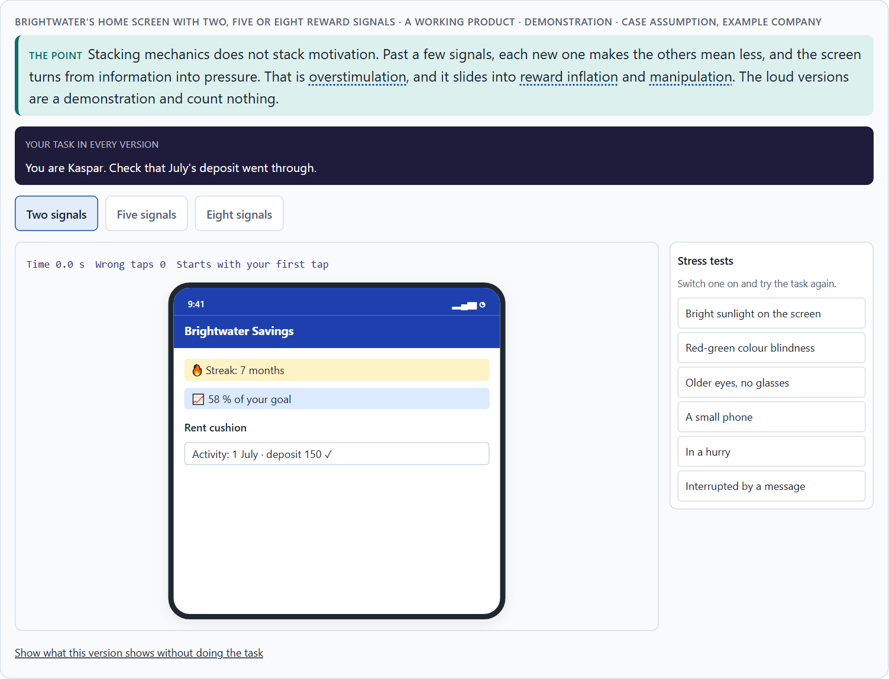
Points, badges, levels, streaks: what each tool does, and how gamification goes wrong
A3 · 12 min · Core
Points, badges, levels, challenges, streaks, feedback and status displays each have one job and one limit. Stacking them does not stack motivation. Bad gamification fails through manipulation, overstimulation, reward inflation, lost motivation and lost trust.
Brightwater's home screen with two, five or eight reward signals · demonstration.
Screenshot of the Neuro-UX Lab (aion-ux-lab.vercel.app), own work; AI-assisted, labelled on the image; the example company is fictional.
Sources: Hamari et al. 2014 · Deci et al. 1999 · Tversky & Kahneman 1991 · Lepper et al. 1973
Notes:
A3 · Points, badges, levels, streaks: what each tool does, and how gamification goes wrong · 12 min · Core
Case assumption: Brightwater Savings, Vera, Kaspar, Rhea and Dominik are made up for this example. Mixed effects of gamification follow Hamari et al. (2014); rewards lowering intrinsic motivation follow Deci et al. (1999); loss aversion, the lever behind “don't lose your streak”, follows Tversky and Kahneman (1991). The findings in the table of real evidence are real research results, rules and cases; the sources are listed below.
Go deeper (optional reading): The five failures are not equally repairable. Overstimulation and lost motivation can be fixed by removing things. Reward inflation can be fixed slowly, because people expect the bigger rewards. Lost trust hardly repairs: once people decide a product is trying to trick them, they discount everything it says. In a game they would leave; in a bank, a health service or a public service they often cannot, so they stay and stop believing the messages. That is worse than leaving.
Sources: Hamari et al. 2014 · Deci et al. 1999 · Tversky & Kahneman 1991 · Lepper et al. 1973

Slide 15
A3 · In plain words
THE IDEA
WHY IT MATTERS
Each tool has one job. Points count activity; badges mark something rare; levels name a capability; challenges set a bounded task; streaks reward regularity; feedback says what an action did; a status display shows a position. Each also has a limit: points count effort, not value; badges lose meaning when there are many; streaks punish one missed day; a ranking motivates the top and shames the bottom. Stacking tools does not stack motivation: past a certain number each new one makes the others mean less. Bad gamification fails in five ways: manipulation (fake urgency, guilt), overstimulation (too many signals), reward inflation (more and bigger rewards for less), loss of motivation (the reward replaces the reason), and damage to trust. The first ones can be repaired by removing things; damaged trust repairs slowly, if at all.
Block 1.2 asks you to rate a variant with points, badges, daily challenges and rankings against two quieter ones on motivation, credibility, retention, clarity and acceptance, and to name the risks that remain. Block 2.1 asks for gamification that stays serious. This card gives you what each tool is for and how it goes wrong.
HOW TO READ THE PICTURE
The same Brightwater Savings home screen with one reward signal or with eight.
Sources: Hamari et al. 2014 · Deci et al. 1999 · Tversky & Kahneman 1991 · Lepper et al. 1973
Notes:
A3 · Points, badges, levels, streaks: what each tool does, and how gamification goes wrong · 12 min · Core
Case assumption: Brightwater Savings, Vera, Kaspar, Rhea and Dominik are made up for this example. Mixed effects of gamification follow Hamari et al. (2014); rewards lowering intrinsic motivation follow Deci et al. (1999); loss aversion, the lever behind “don't lose your streak”, follows Tversky and Kahneman (1991). The findings in the table of real evidence are real research results, rules and cases; the sources are listed below.
Go deeper (optional reading): The five failures are not equally repairable. Overstimulation and lost motivation can be fixed by removing things. Reward inflation can be fixed slowly, because people expect the bigger rewards. Lost trust hardly repairs: once people decide a product is trying to trick them, they discount everything it says. In a game they would leave; in a bank, a health service or a public service they often cannot, so they stay and stop believing the messages. That is worse than leaving.
Sources: Hamari et al. 2014 · Deci et al. 1999 · Tversky & Kahneman 1991 · Lepper et al. 1973

Slide 16
A3 · The tools of gamification: their job and their limit
Tool | Its job | Where it stops working
Points | Count activity. | They count effort, not value; easy to game.
Badges | Mark something rare. | When there are many, none means anything.
Levels | Name a capability. | When they name activity (“Level 6”), not skill.
Challenges | Set a bounded task. | When they are daily duties, not invitations.
Streaks | Reward regularity. | One missed day resets them; people stop altogether.
Feedback | Say what an action did. | When it is technical or empty praise.
Status displays | Show a position or rank. | They motivate the top and shame the bottom.
Sources: Hamari et al. 2014 · Deci et al. 1999 · Tversky & Kahneman 1991 · Lepper et al. 1973
Notes:
A3 · Points, badges, levels, streaks: what each tool does, and how gamification goes wrong · 12 min · Core
Case assumption: Brightwater Savings, Vera, Kaspar, Rhea and Dominik are made up for this example. Mixed effects of gamification follow Hamari et al. (2014); rewards lowering intrinsic motivation follow Deci et al. (1999); loss aversion, the lever behind “don't lose your streak”, follows Tversky and Kahneman (1991). The findings in the table of real evidence are real research results, rules and cases; the sources are listed below.
Go deeper (optional reading): The five failures are not equally repairable. Overstimulation and lost motivation can be fixed by removing things. Reward inflation can be fixed slowly, because people expect the bigger rewards. Lost trust hardly repairs: once people decide a product is trying to trick them, they discount everything it says. In a game they would leave; in a bank, a health service or a public service they often cannot, so they stay and stop believing the messages. That is worse than leaving.
Sources: Hamari et al. 2014 · Deci et al. 1999 · Tversky & Kahneman 1991 · Lepper et al. 1973

Slide 17
A3 · The limits of the tools: evidence
Finding | What was measured | What it means for a mechanic
Rewards can undermine interest | A meta-analysis of 128 experiments found that tangible rewards undermined intrinsic motivation (Deci et al. 1999). | Do not pay for what people already do for its own sake.
Expected rewards | Preschool children who liked drawing and were promised a certificate drew less in later free play than children who got the same certificate unexpectedly or none (Lepper et al. 1973; 18, 18 and 15 children, as reported). | A reward that is announced turns the activity into a means to the reward.
Losses weigh more | Losses loom larger than equal gains (Tversky and Kahneman 1991). | A broken streak hurts more than a kept streak pleases: offer a way to recover.
Context decides | The effects of gamification depended greatly on context and on users (Hamari et al. 2014). | Test each tool in the setting where it will be used.
Sources: Hamari et al. 2014 · Deci et al. 1999 · Tversky & Kahneman 1991 · Lepper et al. 1973
Notes:
A3 · Points, badges, levels, streaks: what each tool does, and how gamification goes wrong · 12 min · Core
Case assumption: Brightwater Savings, Vera, Kaspar, Rhea and Dominik are made up for this example. Mixed effects of gamification follow Hamari et al. (2014); rewards lowering intrinsic motivation follow Deci et al. (1999); loss aversion, the lever behind “don't lose your streak”, follows Tversky and Kahneman (1991). The findings in the table of real evidence are real research results, rules and cases; the sources are listed below.
Go deeper (optional reading): The five failures are not equally repairable. Overstimulation and lost motivation can be fixed by removing things. Reward inflation can be fixed slowly, because people expect the bigger rewards. Lost trust hardly repairs: once people decide a product is trying to trick them, they discount everything it says. In a game they would leave; in a bank, a health service or a public service they often cannot, so they stay and stop believing the messages. That is worse than leaving.
Sources: Hamari et al. 2014 · Deci et al. 1999 · Tversky & Kahneman 1991 · Lepper et al. 1973

Slide 18
A3 · How to decide when this comes up in the task
Give each tool one job; if you cannot say its job, leave it out.
1
Count the signals on a screen: past a few, each new one makes the others mean less.
2
Check for manipulation: fake urgency, guilt, a countdown that never ends.
3
Check for reward inflation: are rewards getting bigger for less?
4
Remember the asymmetry: too much can be removed, lost trust repairs slowly.
5
Sources: Hamari et al. 2014 · Deci et al. 1999 · Tversky & Kahneman 1991 · Lepper et al. 1973
Notes:
A3 · Points, badges, levels, streaks: what each tool does, and how gamification goes wrong · 12 min · Core
Case assumption: Brightwater Savings, Vera, Kaspar, Rhea and Dominik are made up for this example. Mixed effects of gamification follow Hamari et al. (2014); rewards lowering intrinsic motivation follow Deci et al. (1999); loss aversion, the lever behind “don't lose your streak”, follows Tversky and Kahneman (1991). The findings in the table of real evidence are real research results, rules and cases; the sources are listed below.
Go deeper (optional reading): The five failures are not equally repairable. Overstimulation and lost motivation can be fixed by removing things. Reward inflation can be fixed slowly, because people expect the bigger rewards. Lost trust hardly repairs: once people decide a product is trying to trick them, they discount everything it says. In a game they would leave; in a bank, a health service or a public service they often cannot, so they stay and stop believing the messages. That is worse than leaving.
Sources: Hamari et al. 2014 · Deci et al. 1999 · Tversky & Kahneman 1991 · Lepper et al. 1973

Slide 19
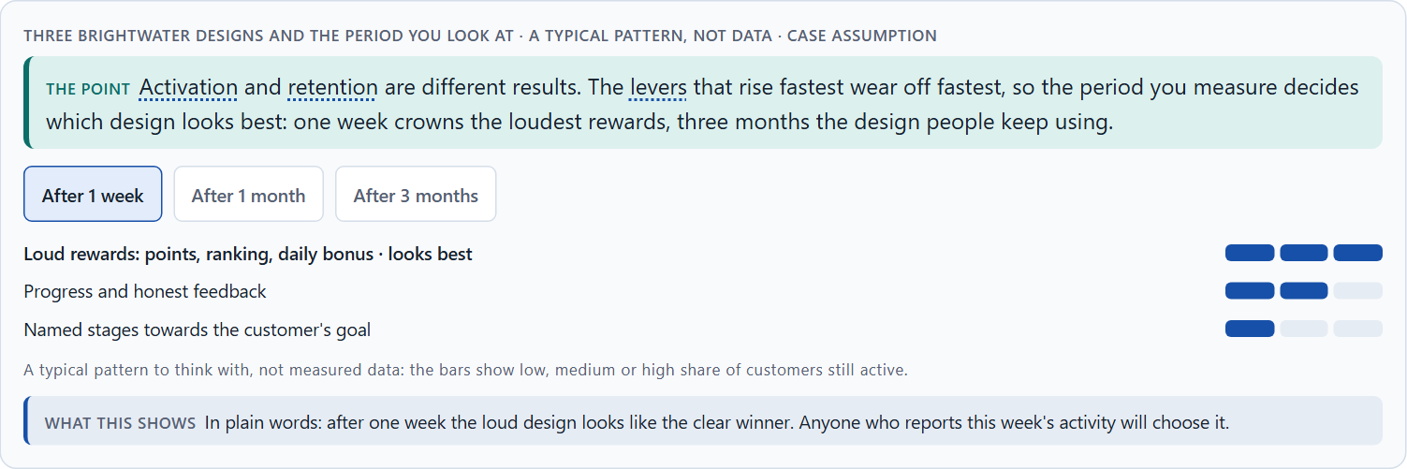
Story and game together, and a quick spike against lasting use
A4 · 12 min · Core
Progress logic says where you are; a story says why it matters. Together they make the same mechanics mean more. Activation and retention differ: the loudest rewards win the first week and often lose the third month, so the period you measure picks the winner.
Three Brightwater designs and the period you look at · a typical pattern, not data.
Screenshot of the Neuro-UX Lab (aion-ux-lab.vercel.app), own work; AI-assisted, labelled on the image; the example company is fictional.
Sources: Nicholson 2015 · Kivetz et al. 2006 · Ryan & Deci 2000 · Patel et al. 2017
Notes:
A4 · Story and game together, and a quick spike against lasting use · 12 min · Core
Case assumption: Brightwater Savings, Vera, Kaspar, Rhea and Dominik are made up for this example. Meaningful gamification built on the person's own goals follows Nicholson (2015); people speeding up as a goal comes closer follows Kivetz et al. (2006). The bars in the second picture are a typical pattern to think with, not measured data. The findings in the table of real evidence are real research results, rules and cases; the sources are listed below.
Go deeper (optional reading): The best story material in a serious field is usually the real process, described well: what changes at each stage, why the third week is the hard one, what the person can do now that they could not before. That is storytelling: it has stages, causes and stakes, and none of it is invented. Inventing a quest is what teams do when they have not looked closely at what people actually go through.
Sources: Nicholson 2015 · Kivetz et al. 2006 · Ryan & Deci 2000 · Patel et al. 2017

Slide 20
A4 · In plain words
THE IDEA
WHY IT MATTERS
Progress logic answers “where am I?”; a story answers “why does this place matter?”. Put together, they make the same mechanics mean more: a step called “Month 3: your emergency fund covers a broken boiler” motivates more than “Step 3 of 12”, and nothing new had to be built. The story should be the real process told well, not an invented quest. Activation and retention are different results: heavy rewards win the first week and often lose the third month, because the levers that rise fastest wear off fastest. Which result you measure, and over which period, decides which design looks like the winner.
Block 1.2 asks you to judge a narrative variant against a heavily gamified one, and Block 2.1 asks for measures that combine visible progress, encouraging feedback and a narrative frame for MoveWell. This card shows how story and game work together and why a fast start is not lasting use.
HOW TO READ THE PICTURE
The same Brightwater Savings plan with numbered steps or with named stages; the mechanics underneath do not change. Then three designs and a choice of period: 1 week, 1 month or 3 months.
Sources: Nicholson 2015 · Kivetz et al. 2006 · Ryan & Deci 2000 · Patel et al. 2017
Notes:
A4 · Story and game together, and a quick spike against lasting use · 12 min · Core
Case assumption: Brightwater Savings, Vera, Kaspar, Rhea and Dominik are made up for this example. Meaningful gamification built on the person's own goals follows Nicholson (2015); people speeding up as a goal comes closer follows Kivetz et al. (2006). The bars in the second picture are a typical pattern to think with, not measured data. The findings in the table of real evidence are real research results, rules and cases; the sources are listed below.
Go deeper (optional reading): The best story material in a serious field is usually the real process, described well: what changes at each stage, why the third week is the hard one, what the person can do now that they could not before. That is storytelling: it has stages, causes and stakes, and none of it is invented. Inventing a quest is what teams do when they have not looked closely at what people actually go through.
Sources: Nicholson 2015 · Kivetz et al. 2006 · Ryan & Deci 2000 · Patel et al. 2017

Slide 21
A4 · A quick spike against lasting use: a real trial
Finding | What was measured | What it means for a mechanic
A real trial | In the BE FIT randomized trial, 200 adults of 94 families played a game with points and levels based on step goals for 12 weeks; their steps rose by 1,661 a day against 636 in the control group (Patel et al. 2017, as reported). | A mechanic that is built around a real goal can move behaviour.
After the game | In the 12 weeks after the game, the gain shrank to 1,385 against 798 steps, still above the control group (Patel et al. 2017, as reported). | Plan for the decay: a mechanic needs a renewal or a hand-over to a habit.
Progress and story | Perceived distance to the goal drives effort (Kivetz et al. 2006), and a narrative frame carries a person through a long path (Nicholson 2015). | Use the story to explain why the goal matters and the progress to show the way.
Sources: Nicholson 2015 · Kivetz et al. 2006 · Ryan & Deci 2000 · Patel et al. 2017
Notes:
A4 · Story and game together, and a quick spike against lasting use · 12 min · Core
Case assumption: Brightwater Savings, Vera, Kaspar, Rhea and Dominik are made up for this example. Meaningful gamification built on the person's own goals follows Nicholson (2015); people speeding up as a goal comes closer follows Kivetz et al. (2006). The bars in the second picture are a typical pattern to think with, not measured data. The findings in the table of real evidence are real research results, rules and cases; the sources are listed below.
Go deeper (optional reading): The best story material in a serious field is usually the real process, described well: what changes at each stage, why the third week is the hard one, what the person can do now that they could not before. That is storytelling: it has stages, causes and stakes, and none of it is invented. Inventing a quest is what teams do when they have not looked closely at what people actually go through.
Sources: Nicholson 2015 · Kivetz et al. 2006 · Ryan & Deci 2000 · Patel et al. 2017

Slide 22
A4 · How to decide when this comes up in the task
Give each stage a name that says what it means in the person's life.
1
Tell the real process well; do not invent a quest.
2
Keep the mechanics; let the story change their meaning.
3
Say whether a design aims at activation or at retention.
4
Judge a design over the period that matters for its goal, not over its launch week.
5
Sources: Nicholson 2015 · Kivetz et al. 2006 · Ryan & Deci 2000 · Patel et al. 2017
Notes:
A4 · Story and game together, and a quick spike against lasting use · 12 min · Core
Case assumption: Brightwater Savings, Vera, Kaspar, Rhea and Dominik are made up for this example. Meaningful gamification built on the person's own goals follows Nicholson (2015); people speeding up as a goal comes closer follows Kivetz et al. (2006). The bars in the second picture are a typical pattern to think with, not measured data. The findings in the table of real evidence are real research results, rules and cases; the sources are listed below.
Go deeper (optional reading): The best story material in a serious field is usually the real process, described well: what changes at each stage, why the third week is the hard one, what the person can do now that they could not before. That is storytelling: it has stages, causes and stakes, and none of it is invented. Inventing a quest is what teams do when they have not looked closely at what people actually go through.
Sources: Nicholson 2015 · Kivetz et al. 2006 · Ryan & Deci 2000 · Patel et al. 2017

Slide 23
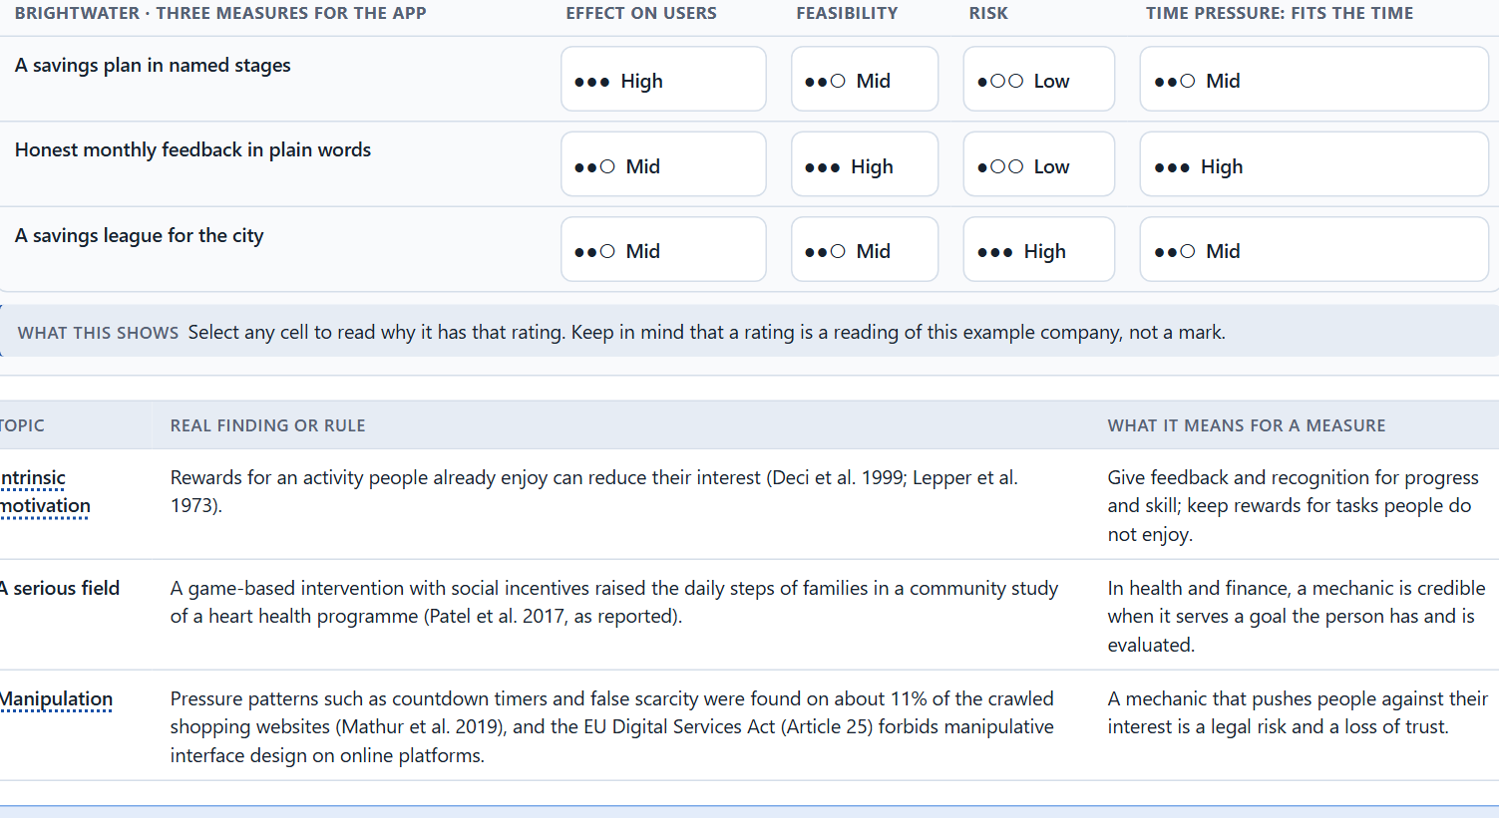
Intrinsic motivation, credible gamification in serious fields, and weighing a measure
A5 · 12 min · Core
A reward for something people already do gladly can replace their own reason. In serious fields credible gamification is a different selection: structure and honest feedback yes, playful tone rarely, rankings and urgency almost never. Weigh measures on effect on users, feasibility, risk and time pressure.
Brightwater weighs three measures on effect on users, feasibility, risk and time pressure.
Screenshot of the Neuro-UX Lab (aion-ux-lab.vercel.app), own work; AI-assisted, labelled on the image; the example company is fictional.
Sources: Lepper et al. 1973 · Deci et al. 1999 · Gibbons 2018 · Patel et al. 2017 · Mathur et al. 2019 · EU Digital Services Act
Notes:
A5 · Intrinsic motivation, credible gamification in serious fields, and weighing a measure · 12 min · Core
Case assumption: Brightwater Savings, Vera, Kaspar, Rhea and Dominik are made up for this example. The overjustification effect follows Lepper et al. (1973) and Deci et al. (1999); rating options on the same criteria with a reason follows Gibbons (2018). The four criteria are the ones the plan names for the case study. The findings in the table of real evidence are real research results, rules and cases; the sources are listed below.
Go deeper (optional reading): In professional learning, health and public services, the people who take part without being pushed are the intrinsically motivated ones, and they are exactly the people a reward layer can damage. The people a points programme moves are often those who were not taking part, and they tend to stop again when the points stop. So a successful points quarter can leave a product weaker than it started: it lost some of the people it had and rented the people it wanted.
Sources: Lepper et al. 1973 · Deci et al. 1999 · Gibbons 2018 · Patel et al. 2017 · Mathur et al. 2019 · EU Digital Services Act

Slide 24
A5 · In plain words
THE IDEA
WHY IT MATTERS
People who already do something for its own sake can lose that reason when a reward is attached: they start doing it for the reward, and when the reward stops, so do they (the overjustification effect). So reward what people would not do anyway, and only report on what they already do gladly. In serious fields (health, money, public services, professional learning), credible gamification is a different selection, not a smaller dose: structure and honest feedback yes, a playful tone rarely, rankings and urgency almost never. Four questions decide whether a mechanic may ship: could we explain it in one plain sentence and would it still work; whom does it quietly put last; how does it read to someone in a bad moment; who can remove it later? To put measures in order, weigh each on effect on users, feasibility, risk and time pressure, the four Block 2.1 names.
Block 1.2 asks about credibility and user acceptance for HealthJourney, and Block 2.1 asks for four prioritised measures for MoveWell, justified on effect on users, feasibility, risk and time pressure, that keep the brand trustworthy. The example uses Brightwater Savings and its own measures, so the answer for the task cases is not given.
HOW TO READ THE PICTURE
First the four questions, asked of two Brightwater Savings mechanics. Then three measures Brightwater considered, rated on effect on users, feasibility, risk and time pressure.
Sources: Lepper et al. 1973 · Deci et al. 1999 · Gibbons 2018 · Patel et al. 2017 · Mathur et al. 2019 · EU Digital Services Act
Notes:
A5 · Intrinsic motivation, credible gamification in serious fields, and weighing a measure · 12 min · Core
Case assumption: Brightwater Savings, Vera, Kaspar, Rhea and Dominik are made up for this example. The overjustification effect follows Lepper et al. (1973) and Deci et al. (1999); rating options on the same criteria with a reason follows Gibbons (2018). The four criteria are the ones the plan names for the case study. The findings in the table of real evidence are real research results, rules and cases; the sources are listed below.
Go deeper (optional reading): In professional learning, health and public services, the people who take part without being pushed are the intrinsically motivated ones, and they are exactly the people a reward layer can damage. The people a points programme moves are often those who were not taking part, and they tend to stop again when the points stop. So a successful points quarter can leave a product weaker than it started: it lost some of the people it had and rented the people it wanted.
Sources: Lepper et al. 1973 · Deci et al. 1999 · Gibbons 2018 · Patel et al. 2017 · Mathur et al. 2019 · EU Digital Services Act

Slide 25
A5 · Intrinsic motivation and credible gamification in serious fields
Topic | Real finding or rule | What it means for a measure
Intrinsic motivation | Rewards for an activity people already enjoy can reduce their interest (Deci et al. 1999; Lepper et al. 1973). | Give feedback and recognition for progress and skill; keep rewards for tasks people do not enjoy.
A serious field | A game-based intervention with social incentives raised the daily steps of families in a community study of a heart health programme (Patel et al. 2017, as reported). | In health and finance, a mechanic is credible when it serves a goal the person has and is evaluated.
Manipulation | Pressure patterns such as countdown timers and false scarcity were found on about 11% of the crawled shopping websites (Mathur et al. 2019), and the EU Digital Services Act (Article 25) forbids manipulative interface design on online platforms. | A mechanic that pushes people against their interest is a legal risk and a loss of trust.
Sources: Lepper et al. 1973 · Deci et al. 1999 · Gibbons 2018 · Patel et al. 2017 · Mathur et al. 2019 · EU Digital Services Act
Notes:
A5 · Intrinsic motivation, credible gamification in serious fields, and weighing a measure · 12 min · Core
Case assumption: Brightwater Savings, Vera, Kaspar, Rhea and Dominik are made up for this example. The overjustification effect follows Lepper et al. (1973) and Deci et al. (1999); rating options on the same criteria with a reason follows Gibbons (2018). The four criteria are the ones the plan names for the case study. The findings in the table of real evidence are real research results, rules and cases; the sources are listed below.
Go deeper (optional reading): In professional learning, health and public services, the people who take part without being pushed are the intrinsically motivated ones, and they are exactly the people a reward layer can damage. The people a points programme moves are often those who were not taking part, and they tend to stop again when the points stop. So a successful points quarter can leave a product weaker than it started: it lost some of the people it had and rented the people it wanted.
Sources: Lepper et al. 1973 · Deci et al. 1999 · Gibbons 2018 · Patel et al. 2017 · Mathur et al. 2019 · EU Digital Services Act

Slide 26
A5 · How to decide when this comes up in the task
Reward only what people would not do anyway; report on what they already do gladly.
1
Ask: could we explain it in one plain sentence, and would it still work?
2
Ask: whom does it quietly put last, and how does it read in a bad moment?
3
Ask: who can remove it next year?
4
Rate every measure on the same four questions, with a reason; a rating is a judgement, never a mark.
5
Sources: Lepper et al. 1973 · Deci et al. 1999 · Gibbons 2018 · Patel et al. 2017 · Mathur et al. 2019 · EU Digital Services Act
Notes:
A5 · Intrinsic motivation, credible gamification in serious fields, and weighing a measure · 12 min · Core
Case assumption: Brightwater Savings, Vera, Kaspar, Rhea and Dominik are made up for this example. The overjustification effect follows Lepper et al. (1973) and Deci et al. (1999); rating options on the same criteria with a reason follows Gibbons (2018). The four criteria are the ones the plan names for the case study. The findings in the table of real evidence are real research results, rules and cases; the sources are listed below.
Go deeper (optional reading): In professional learning, health and public services, the people who take part without being pushed are the intrinsically motivated ones, and they are exactly the people a reward layer can damage. The people a points programme moves are often those who were not taking part, and they tend to stop again when the points stop. So a successful points quarter can leave a product weaker than it started: it lost some of the people it had and rented the people it wanted.
Sources: Lepper et al. 1973 · Deci et al. 1999 · Gibbons 2018 · Patel et al. 2017 · Mathur et al. 2019 · EU Digital Services Act

Slide 27
B
Materi B
Route 2 · Level 3
About 60 minutes, three cards, led by the facilitator. Level 3 in the Chief Experience Officer's chair: a guiding vision for activation and retention, three strategic decisions, an order of what comes first, a risk analysis, a governance model for activation principles, one decision under uncertainty and a statement to the management. The cards give you the ideas you use in Task 2.

Slide 28
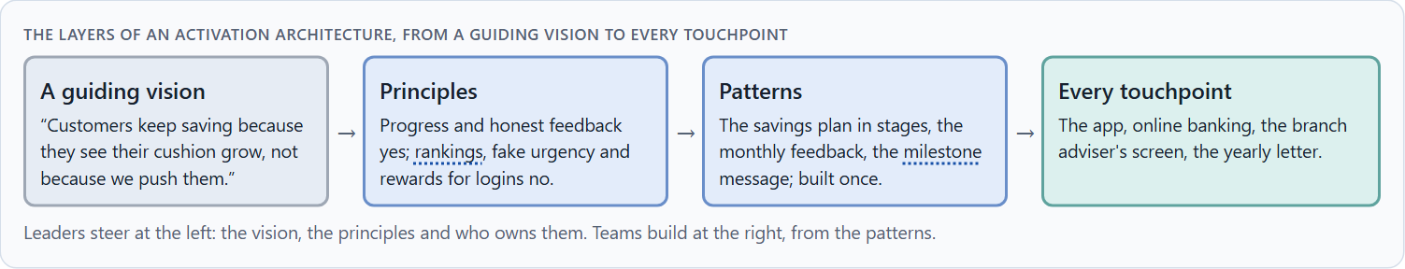
Gamification as activation architecture, not a game layer
B1 · 20 min · Core
At senior level gamification is not a feature request but activation architecture: a guiding vision for what people should feel and do, principles on which levers the company uses and which not, patterns built once, and an order of what comes first. It steers behaviour, so it is a responsibility.
The layers of an activation architecture, from a guiding vision to every touchpoint.
Screenshot of the Neuro-UX Lab (aion-ux-lab.vercel.app), own work; AI-assisted, labelled on the image; the example company is fictional.
Sources: Nicholson 2015 · Ryan & Deci 2000 · Hamari et al. 2014 · Patel et al. 2017
Notes:
B1 · Gamification as activation architecture, not a game layer · 20 min · Core
Case assumption: Brightwater Savings, Vera, Kaspar, Rhea and Dominik are made up for this example. Lasting motivation through competence and autonomy follows Ryan and Deci (2000); meaningful gamification follows Nicholson (2015). The findings in the table of real evidence are real research results, rules and cases; the sources are listed below.
Go deeper (optional reading): A guiding vision for activation is short and testable. “Customers keep saving because they see their cushion grow, not because we push them” can be checked on every screen: does this element show growth, or does it push? “Make saving fun” cannot be checked, and it invites every mechanic anyone suggests.
Sources: Nicholson 2015 · Ryan & Deci 2000 · Hamari et al. 2014 · Patel et al. 2017

Slide 29
B1 · In plain words
THE IDEA
WHY IT MATTERS
In many companies gamification arrives as a feature request: “add badges”, “make it fun”. At senior level it is part of the activation and experience architecture: a guiding vision for what people should feel and do, principles that say which levers the company uses and which it does not, patterns for progress, feedback and recognition built once for every product, and a plan for which journeys come first. It also steers behaviour, so it is a matter of responsibility: a mechanic that moves people should be one the company would explain to them.
Block 3.1 asks for a guiding vision for activation and retention, three decisions on progress, reinforcement, the depth of gamification, storytelling and long-term retention, and an order of which journeys, functions or touchpoints come first. You decide the architecture, not single mechanics.
HOW TO READ THE PICTURE
Left Brightwater Savings adding mechanics one request at a time, right building an activation architecture. Below, the layers from a guiding vision to every touchpoint.
Sources: Nicholson 2015 · Ryan & Deci 2000 · Hamari et al. 2014 · Patel et al. 2017
Notes:
B1 · Gamification as activation architecture, not a game layer · 20 min · Core
Case assumption: Brightwater Savings, Vera, Kaspar, Rhea and Dominik are made up for this example. Lasting motivation through competence and autonomy follows Ryan and Deci (2000); meaningful gamification follows Nicholson (2015). The findings in the table of real evidence are real research results, rules and cases; the sources are listed below.
Go deeper (optional reading): A guiding vision for activation is short and testable. “Customers keep saving because they see their cushion grow, not because we push them” can be checked on every screen: does this element show growth, or does it push? “Make saving fun” cannot be checked, and it invites every mechanic anyone suggests.
Sources: Nicholson 2015 · Ryan & Deci 2000 · Hamari et al. 2014 · Patel et al. 2017

Slide 30
B1 · Gamification as an activation architecture: evidence
Part | Real finding | What it means
Context decides | The effects of gamification depended greatly on the context and the users (Hamari et al. 2014). | An activation strategy names the context and the group before it names a mechanic.
A design framework | Nicholson's framework for meaningful gamification starts with the user's own purposes and lets the user choose how to take part (Nicholson 2015). | Build the architecture from the goal outwards, not from the game layer inwards.
Evidence of effect and decay | A trial showed a clear effect during the game and a smaller one after it (Patel et al. 2017, as reported). | Plan the phases: start, hold, hand over.
Sources: Nicholson 2015 · Ryan & Deci 2000 · Hamari et al. 2014 · Patel et al. 2017
Notes:
B1 · Gamification as activation architecture, not a game layer · 20 min · Core
Case assumption: Brightwater Savings, Vera, Kaspar, Rhea and Dominik are made up for this example. Lasting motivation through competence and autonomy follows Ryan and Deci (2000); meaningful gamification follows Nicholson (2015). The findings in the table of real evidence are real research results, rules and cases; the sources are listed below.
Go deeper (optional reading): A guiding vision for activation is short and testable. “Customers keep saving because they see their cushion grow, not because we push them” can be checked on every screen: does this element show growth, or does it push? “Make saving fun” cannot be checked, and it invites every mechanic anyone suggests.
Sources: Nicholson 2015 · Ryan & Deci 2000 · Hamari et al. 2014 · Patel et al. 2017

Slide 31
B1 · How to decide when this comes up in the task
Check where activation is decided today: in a vision, or one request at a time?
1
Write a guiding vision that says what motivation people should feel, and what the company will not do.
2
Turn it into principles on levers, and into patterns every team uses.
3
Decide which journeys come first: where most people start and leave.
4
Treat every mechanic that steers behaviour as something the company would explain to the people it steers.
5
Sources: Nicholson 2015 · Ryan & Deci 2000 · Hamari et al. 2014 · Patel et al. 2017
Notes:
B1 · Gamification as activation architecture, not a game layer · 20 min · Core
Case assumption: Brightwater Savings, Vera, Kaspar, Rhea and Dominik are made up for this example. Lasting motivation through competence and autonomy follows Ryan and Deci (2000); meaningful gamification follows Nicholson (2015). The findings in the table of real evidence are real research results, rules and cases; the sources are listed below.
Go deeper (optional reading): A guiding vision for activation is short and testable. “Customers keep saving because they see their cushion grow, not because we push them” can be checked on every screen: does this element show growth, or does it push? “Make saving fun” cannot be checked, and it invites every mechanic anyone suggests.
Sources: Nicholson 2015 · Ryan & Deci 2000 · Hamari et al. 2014 · Patel et al. 2017

Slide 32
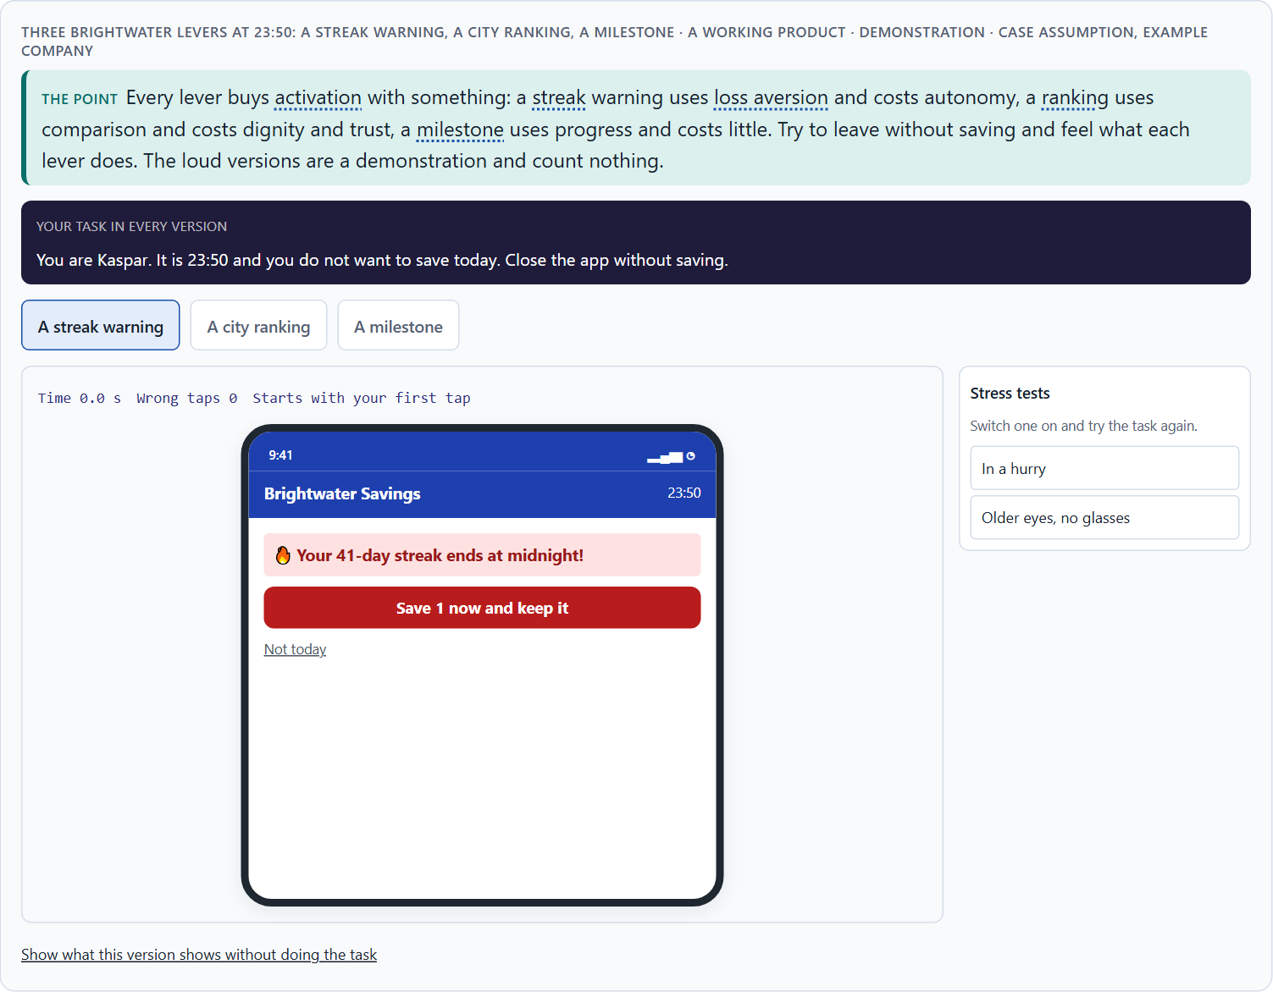
Motivation against seriousness and autonomy: the conflicts of activation
B2 · 20 min · Core
Activation sits between motivation and seriousness, between steering behaviour and user autonomy, between brand effect and the user's interest, and all of them against economic viability. Decide per lever and per journey, say what you give up, and choose what you measure on purpose.
Three Brightwater levers at 23:50: a streak warning, a city ranking, a milestone · demonstration.
Screenshot of the Neuro-UX Lab (aion-ux-lab.vercel.app), own work; AI-assisted, labelled on the image; the example company is fictional.
Sources: Tversky & Kahneman 1991 · Festinger 1954 · Deci et al. 1999 · Patel et al. 2017 · Hamari et al. 2014 · Ryan & Deci 2000
Notes:
B2 · Motivation against seriousness and autonomy: the conflicts of activation · 20 min · Core
Case assumption: Brightwater Savings, Vera, Kaspar, Rhea and Dominik are made up for this example. The three levers are a reading of the example, not a rule for every product. The findings in the table of real evidence are real research results, rules and cases; the sources are listed below.
Go deeper (optional reading): Activation numbers cannot see the risks of a lever. A streak warning at midnight raises daily activity; it does not show the people who stopped altogether after the streak broke, or the ones who now open the app with a small feeling of dread. Decide which numbers you will look at, and over which period, before you decide on the lever, or the lever will choose the numbers for you.
Sources: Tversky & Kahneman 1991 · Festinger 1954 · Deci et al. 1999 · Patel et al. 2017 · Hamari et al. 2014 · Ryan & Deci 2000

Slide 33
B2 · In plain words
THE IDEA
WHY IT MATTERS
Activation sits between goals that pull apart: motivation against seriousness (lively against trustworthy), activation against user autonomy (steering behaviour against letting people choose), brand effect against the user's interest, and all of these against economic viability (what it costs and what it brings). A metric can pull too: if the company counts sessions in the first week, the design that wins is the one with the loudest rewards. The way through is to decide per journey and per lever, say what you give up, and choose what you measure on purpose.
Block 3.1 asks for three guiding decisions, a risk analysis of wrong assumptions about motivation, target group and mechanics, and a governance model for conflicts between brand, user interest and economic viability. Each is a decision between conflicting goals.
HOW TO READ THE PICTURE
Three Brightwater Savings levers, each with what it gives and what it costs in trust or autonomy.
Sources: Tversky & Kahneman 1991 · Festinger 1954 · Deci et al. 1999 · Patel et al. 2017 · Hamari et al. 2014 · Ryan & Deci 2000
Notes:
B2 · Motivation against seriousness and autonomy: the conflicts of activation · 20 min · Core
Case assumption: Brightwater Savings, Vera, Kaspar, Rhea and Dominik are made up for this example. The three levers are a reading of the example, not a rule for every product. The findings in the table of real evidence are real research results, rules and cases; the sources are listed below.
Go deeper (optional reading): Activation numbers cannot see the risks of a lever. A streak warning at midnight raises daily activity; it does not show the people who stopped altogether after the streak broke, or the ones who now open the app with a small feeling of dread. Decide which numbers you will look at, and over which period, before you decide on the lever, or the lever will choose the numbers for you.
Sources: Tversky & Kahneman 1991 · Festinger 1954 · Deci et al. 1999 · Patel et al. 2017 · Hamari et al. 2014 · Ryan & Deci 2000

Slide 34
B2 · Standing conflicts of activation
Conflict | Who usually stands for each side | What to ask
Motivation against seriousness | Marketing, against the experts. | Can it be lively and credible at once?
Activation against autonomy | Growth targets, against the user's own choice. | Would people choose this push if asked?
Brand effect against user interest | Visibility for the company, against the user's goal. | Whose interest does this mechanic serve?
All of these against economic viability | Finance, against everyone. | What does it cost, and what does it bring over months?
Sources: Tversky & Kahneman 1991 · Festinger 1954 · Deci et al. 1999 · Patel et al. 2017 · Hamari et al. 2014 · Ryan & Deci 2000
Notes:
B2 · Motivation against seriousness and autonomy: the conflicts of activation · 20 min · Core
Case assumption: Brightwater Savings, Vera, Kaspar, Rhea and Dominik are made up for this example. The three levers are a reading of the example, not a rule for every product. The findings in the table of real evidence are real research results, rules and cases; the sources are listed below.
Go deeper (optional reading): Activation numbers cannot see the risks of a lever. A streak warning at midnight raises daily activity; it does not show the people who stopped altogether after the streak broke, or the ones who now open the app with a small feeling of dread. Decide which numbers you will look at, and over which period, before you decide on the lever, or the lever will choose the numbers for you.
Sources: Tversky & Kahneman 1991 · Festinger 1954 · Deci et al. 1999 · Patel et al. 2017 · Hamari et al. 2014 · Ryan & Deci 2000

Slide 35
B2 · Conflicts of activation, with evidence
Conflict | What the evidence says | A way to decide
Motivation against seriousness | Gamification worked in a trial about health (Patel et al. 2017, as reported), but effects depend on context (Hamari et al. 2014). | Test lively elements in the serious setting with its users before scaling.
Activation against autonomy | Autonomy is one of the three basic needs for lasting motivation (Ryan and Deci 2000), and announced rewards can undermine interest (Deci et al. 1999). | Ask: would people choose this push if asked?
Cost against effect | In the trial the effect shrank after the game ended (Patel et al. 2017, as reported). | Count the cost over months, not only the first weeks.
Sources: Tversky & Kahneman 1991 · Festinger 1954 · Deci et al. 1999 · Patel et al. 2017 · Hamari et al. 2014 · Ryan & Deci 2000
Notes:
B2 · Motivation against seriousness and autonomy: the conflicts of activation · 20 min · Core
Case assumption: Brightwater Savings, Vera, Kaspar, Rhea and Dominik are made up for this example. The three levers are a reading of the example, not a rule for every product. The findings in the table of real evidence are real research results, rules and cases; the sources are listed below.
Go deeper (optional reading): Activation numbers cannot see the risks of a lever. A streak warning at midnight raises daily activity; it does not show the people who stopped altogether after the streak broke, or the ones who now open the app with a small feeling of dread. Decide which numbers you will look at, and over which period, before you decide on the lever, or the lever will choose the numbers for you.
Sources: Tversky & Kahneman 1991 · Festinger 1954 · Deci et al. 1999 · Patel et al. 2017 · Hamari et al. 2014 · Ryan & Deci 2000

Slide 36
B2 · How to decide when this comes up in the task
Name each conflict as two goals and say who stands for each: marketing, sales, the experts, the users.
1
Decide per lever: progress and honest feedback cost little; loss aversion costs autonomy; comparison costs trust.
2
Treat the metric as a decision: what you count, and over which period, decides which design wins.
3
Write the rule down, so the conflict is not fought again for every mechanic.
4
Say what the choice gives up; a decision that gives up nothing has not been made.
5
Sources: Tversky & Kahneman 1991 · Festinger 1954 · Deci et al. 1999 · Patel et al. 2017 · Hamari et al. 2014 · Ryan & Deci 2000
Notes:
B2 · Motivation against seriousness and autonomy: the conflicts of activation · 20 min · Core
Case assumption: Brightwater Savings, Vera, Kaspar, Rhea and Dominik are made up for this example. The three levers are a reading of the example, not a rule for every product. The findings in the table of real evidence are real research results, rules and cases; the sources are listed below.
Go deeper (optional reading): Activation numbers cannot see the risks of a lever. A streak warning at midnight raises daily activity; it does not show the people who stopped altogether after the streak broke, or the ones who now open the app with a small feeling of dread. Decide which numbers you will look at, and over which period, before you decide on the lever, or the lever will choose the numbers for you.
Sources: Tversky & Kahneman 1991 · Festinger 1954 · Deci et al. 1999 · Patel et al. 2017 · Hamari et al. 2014 · Ryan & Deci 2000

Slide 37
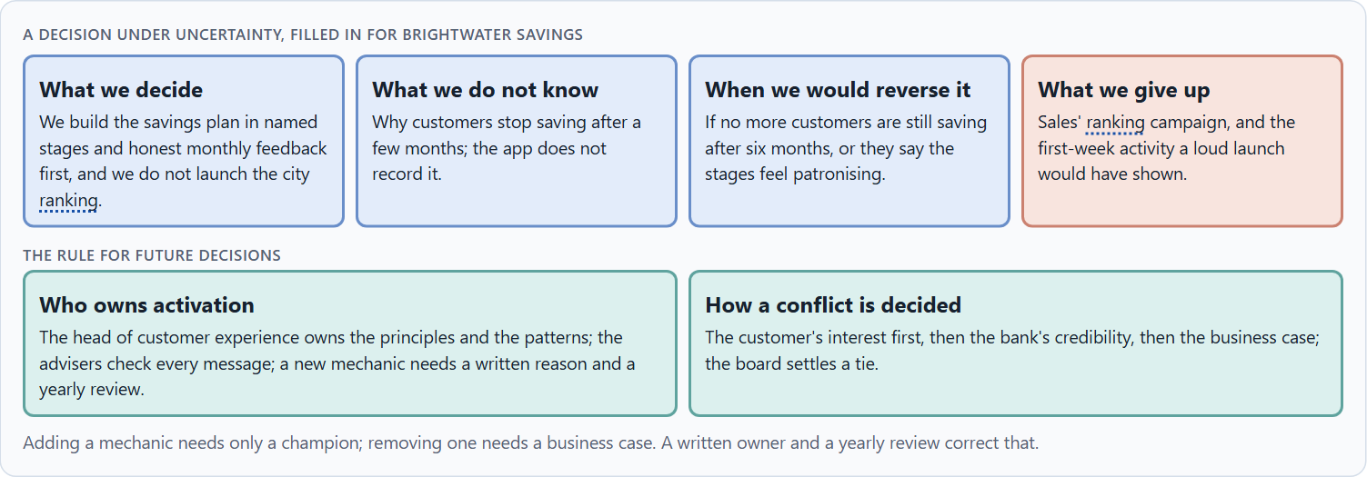
Who answers for a mechanic, and deciding without knowing who stays
B3 · 20 min · Core
Adding a mechanic needs only a champion; removing one needs a business case, so mechanics pile up. Governance: a named owner, written principles, a way to remove, an escalation rule. A decision with little data says what it decides, does not know, would reverse and gives up.
A decision under uncertainty, filled in for Brightwater Savings.
Screenshot of the Neuro-UX Lab (aion-ux-lab.vercel.app), own work; AI-assisted, labelled on the image; the example company is fictional.
Sources: Simon 1956 · Klein 2007 · Nicholson 2015 · EU Digital Services Act · Patel et al. 2017
Notes:
B3 · Who answers for a mechanic, and deciding without knowing who stays · 20 min · Core
Case assumption: Brightwater Savings, Vera, Kaspar, Rhea and Dominik are made up for this example. Deciding with limited information follows Simon (1956); the premortem follows Klein (2007). The findings in the table of real evidence are real research results, rules and cases; the sources are listed below.
Go deeper (optional reading): A works council, a regulator and a journalist all ask the same thing in different words: who decided this, on what principle, and what would have led to a different decision? A company that can answer in one paragraph is in a different position from one that cannot, whatever the mechanic. In a field where trust is the product, a missing decision record is itself the finding. Write the paragraph before anyone asks.
Sources: Simon 1956 · Klein 2007 · Nicholson 2015 · EU Digital Services Act · Patel et al. 2017

Slide 38
B3 · In plain words
THE IDEA
WHY IT MATTERS
Mechanics pile up because adding one needs only a champion, while removing one needs a business case. Left alone for a few years, that makes a product loud without anyone having decided it. Governance corrects it: a named owner of the activation principles, a written rule for which levers are used, a way to remove a mechanic, and an escalation rule for conflicts between brand, user interest and economics. A works council, a regulator or a journalist will ask who decided, on what principle, and what would have changed the decision. With incomplete data, a decision says what you decide, what you do not know, when you would reverse it and what you give up.
Block 3.1 asks for a governance model for activation principles, a decision despite patchy data, and a statement to the management. This card gives you the parts of each.
HOW TO READ THE PICTURE
The four boxes at the top are the parts of a decision, filled in for Brightwater Savings. The two boxes below are the rule for future decisions.
Sources: Simon 1956 · Klein 2007 · Nicholson 2015 · EU Digital Services Act · Patel et al. 2017
Notes:
B3 · Who answers for a mechanic, and deciding without knowing who stays · 20 min · Core
Case assumption: Brightwater Savings, Vera, Kaspar, Rhea and Dominik are made up for this example. Deciding with limited information follows Simon (1956); the premortem follows Klein (2007). The findings in the table of real evidence are real research results, rules and cases; the sources are listed below.
Go deeper (optional reading): A works council, a regulator and a journalist all ask the same thing in different words: who decided this, on what principle, and what would have led to a different decision? A company that can answer in one paragraph is in a different position from one that cannot, whatever the mechanic. In a field where trust is the product, a missing decision record is itself the finding. Write the paragraph before anyone asks.
Sources: Simon 1956 · Klein 2007 · Nicholson 2015 · EU Digital Services Act · Patel et al. 2017

Slide 39
B3 · Four parts of activation governance
Part | The question | An example (Brightwater)
Who owns what | Who owns the principles and patterns; who uses them? | The head of customer experience owns them; every team uses them.
Who checks | Who makes sure no mechanic harms or misleads? | The advisers check every message; legal checks rankings and data.
How a mechanic leaves | Who can remove a mechanic, and when? | A yearly review; the owner removes what no longer earns its place.
How a conflict is decided | What happens when brand, customer and business disagree? | Customer first, then credibility, then the business case; the board settles a tie.
Sources: Simon 1956 · Klein 2007 · Nicholson 2015 · EU Digital Services Act · Patel et al. 2017
Notes:
B3 · Who answers for a mechanic, and deciding without knowing who stays · 20 min · Core
Case assumption: Brightwater Savings, Vera, Kaspar, Rhea and Dominik are made up for this example. Deciding with limited information follows Simon (1956); the premortem follows Klein (2007). The findings in the table of real evidence are real research results, rules and cases; the sources are listed below.
Go deeper (optional reading): A works council, a regulator and a journalist all ask the same thing in different words: who decided this, on what principle, and what would have led to a different decision? A company that can answer in one paragraph is in a different position from one that cannot, whatever the mechanic. In a field where trust is the product, a missing decision record is itself the finding. Write the paragraph before anyone asks.
Sources: Simon 1956 · Klein 2007 · Nicholson 2015 · EU Digital Services Act · Patel et al. 2017

Slide 40
B3 · Who answers for a mechanic: rules and evidence
Part | Evidence or rule | What it means
Who checks | Article 25 of the EU Digital Services Act forbids manipulative interface design on online platforms. | Have legal and the specialists check every ranking, notification and countdown.
How a mechanic leaves | Effects decay after a mechanic ends or loses its novelty (Patel et al. 2017, as reported). | Review each mechanic every year; remove what no longer earns its place.
Who owns | Meaningful gamification has to be designed around the user's purposes (Nicholson 2015). | Give one owner the principles and let every team build within them.
Sources: Simon 1956 · Klein 2007 · Nicholson 2015 · EU Digital Services Act · Patel et al. 2017
Notes:
B3 · Who answers for a mechanic, and deciding without knowing who stays · 20 min · Core
Case assumption: Brightwater Savings, Vera, Kaspar, Rhea and Dominik are made up for this example. Deciding with limited information follows Simon (1956); the premortem follows Klein (2007). The findings in the table of real evidence are real research results, rules and cases; the sources are listed below.
Go deeper (optional reading): A works council, a regulator and a journalist all ask the same thing in different words: who decided this, on what principle, and what would have led to a different decision? A company that can answer in one paragraph is in a different position from one that cannot, whatever the mechanic. In a field where trust is the product, a missing decision record is itself the finding. Write the paragraph before anyone asks.
Sources: Simon 1956 · Klein 2007 · Nicholson 2015 · EU Digital Services Act · Patel et al. 2017

Slide 41
B3 · How to decide when this comes up in the task
Name who owns the activation principles and patterns, and who only uses them.
1
Require a short written reason for every new mechanic: its lever, whom it may put last, who can remove it.
2
Review every mechanic once a year, and remove what no longer earns its place.
3
Settle conflicts by the user's interest, then credibility, then economics; say who settles a tie.
4
Say what you decide, what you do not know, when you would reverse it and what you give up.
5
Sources: Simon 1956 · Klein 2007 · Nicholson 2015 · EU Digital Services Act · Patel et al. 2017
Notes:
B3 · Who answers for a mechanic, and deciding without knowing who stays · 20 min · Core
Case assumption: Brightwater Savings, Vera, Kaspar, Rhea and Dominik are made up for this example. Deciding with limited information follows Simon (1956); the premortem follows Klein (2007). The findings in the table of real evidence are real research results, rules and cases; the sources are listed below.
Go deeper (optional reading): A works council, a regulator and a journalist all ask the same thing in different words: who decided this, on what principle, and what would have led to a different decision? A company that can answer in one paragraph is in a different position from one that cannot, whatever the mechanic. In a field where trust is the product, a missing decision record is itself the finding. Write the paragraph before anyone asks.
Sources: Simon 1956 · Klein 2007 · Nicholson 2015 · EU Digital Services Act · Patel et al. 2017

Slide 42
Sources (1)
Deterding, S., Dixon, D., Khaled, R., & Nacke, L. (2011). From game design elements to gamefulness: Defining “gamification”. Proceedings of the 15th International Academic MindTrek Conference, 9–15.
Hamari, J., Koivisto, J., & Sarsa, H. (2014). Does gamification work? A literature review of empirical studies on gamification. Proceedings of the 47th Hawaii International Conference on System Sciences, 3025–3034.
Nicholson, S. (2015). A RECIPE for meaningful gamification. In T. Reiners & L. Wood (Eds.), Gamification in Education and Business (pp. 1–20). Springer.
Ryan, R. M., & Deci, E. L. (2000). Self-determination theory and the facilitation of intrinsic motivation, social development, and well-being. American Psychologist, 55(1), 68–78.
Bandura, A. (1977). Self-efficacy: Toward a unifying theory of behavioral change. Psychological Review, 84(2), 191–215.
Festinger, L. (1954). A theory of social comparison processes. Human Relations, 7(2), 117–140.
Kivetz, R., Urminsky, O., & Zheng, Y. (2006). The goal-gradient hypothesis resurrected: Purchase acceleration, illusionary goal progress, and customer retention. Journal of Marketing Research, 43(1), 39–58.

Slide 43
Sources (2)
Deci, E. L., Koestner, R., & Ryan, R. M. (1999). A meta-analytic review of experiments examining the effects of extrinsic rewards on intrinsic motivation. Psychological Bulletin, 125(6), 627–668.
Tversky, A., & Kahneman, D. (1991). Loss aversion in riskless choice: A reference-dependent model. Quarterly Journal of Economics, 106(4), 1039–1061.
Lepper, M. R., Greene, D., & Nisbett, R. E. (1973). Undermining children's intrinsic interest with extrinsic reward: A test of the “overjustification” hypothesis. Journal of Personality and Social Psychology, 28(1), 129–137.
Patel, M. S., Benjamin, E. J., Volpp, K. G., et al. (2017). Effect of a game-based intervention designed to enhance social incentives to increase physical activity among families: The BE FIT randomized clinical trial. JAMA Internal Medicine, 177(11), 1586–1593.
Gibbons, S. (2018). Using Prioritization Matrices to Inform UX Decisions. Nielsen Norman Group. https://www.nngroup.com/articles/prioritization-matrices/
Mathur, A., Acar, G., Friedman, M. J., Lucherini, E., Mayer, J., Chetty, M., & Narayanan, A. (2019). Dark patterns at scale: Findings from a crawl of 11K shopping websites. Proceedings of the ACM on Human-Computer Interaction, 3(CSCW), 1–32.
Regulation (EU) 2022/2065 of the European Parliament and of the Council (Digital Services Act), Article 25. https://eur-lex.europa.eu/eli/reg/2022/2065/oj

Slide 44
Sources (3)
Simon, H. A. (1956). Rational choice and the structure of the environment. Psychological Review, 63(2), 129–138.
Klein, G. (2007). Performing a project premortem. Harvard Business Review, 85(9), 18–19.

Slide 45
About these slides, sources and AI use
AI
AI-assisted content
Where to find more
AI-assisted content: these slides were drafted with an AI language model (Claude, Anthropic) from the course's own Neuro-UX Lab and were read, corrected and approved by Muhammad Muchson, who is responsible for their accuracy.
Pictures are screenshots of the course's own Neuro-UX Lab. Each one carries an AI label on the image and a source line under it.
Companies and people in the examples are fictional. Numbers inside an example are labelled Case assumption and are not data.
Neuro-UX Lab for this day: https://aion-ux-lab.vercel.app/day/9/
Handouts: the Materi and Task Word documents of the day.
Version 1.0, 29.10.2026. Reviewer and approver: Muhammad Muchson.

