Slide 1
UX DEVELOPER · DAY 9
Gamification strategies, and storytelling with gamification
Training slides: tasks, coaching, case study and feedback
Module 4 (day 3 of 3)
Trainer: Muhammad Muchson · Case: MoveWell
Contains AI-assisted content

Slide 2
The day at a glance (1)
UE | Min | What | What happens
1 | 45 | Knowledge transfer · Level 1 | The trainer presents the cards of Materi A (A1, A2, A3, A4, A5, about 60 min of cards) in the Neuro-UX Lab; participants follow in the handout.
2 | 45 | Level 1 · Task 1 | Individual work on Block 1.1 (Core, about 10 min): the first product of the day is read and its effect described. Pairs then compare their results and the trainer collects open questions.
3 | 45 | Level 1 · Task 2 | Three options are rated on the same criteria and one is chosen under the stated conditions: Block 1.2 (Core, about 8 min).
4 | 45 | Coaching · transition from Level 1 to Level 2 | Trainer-led. A short talk on the day's coaching focus, then the reflection questions in pairs. The bridge: from describing an effect to a decision you answer for. There is no worksheet block in this unit.
5–6 | 90 | Level 2 · Case study MoveWell (2 UE) incl. model solution | UE5: the trainer presents the case; participants work on Block 2.1 (Core, about 15 min). UE6: groups compare their results and defend them; the trainer closes with the model solution.
7 | 45 | Level 2 + 3 · Feedback round with a management perspective | Groups present their reasoning, not only their result. The trainer asks the day's Level 3 input questions and leads the discussion.
One UE is 45 minutes; breaks are not shown.
Notes:
One UE (teaching unit) is counted as 45 minutes; breaks are not shown.

Slide 3
The day at a glance (2)
UE | Min | What | What happens
8 | 45 | Level 3 · Transfer project, Chief Experience Officer (3 UE: UE8–10) | The trainer presents Materi B (B1, B2, B3; use the "In plain words" and "How to decide" boxes, the rest is handout) and sets the role and the situation.
9 | 45 | Level 3 · Transfer project | Individual work or in pairs on Block 3.1 (Core, about 20 min): the strategy memo.
10 | 45 | Level 3 · Transfer project | Participants present their decision and what they give up, including the one decision made under uncertainty; the trainer debriefs with the model solution.
One UE is 45 minutes; breaks are not shown.
Notes:
One UE (teaching unit) is counted as 45 minutes; breaks are not shown.

Slide 4
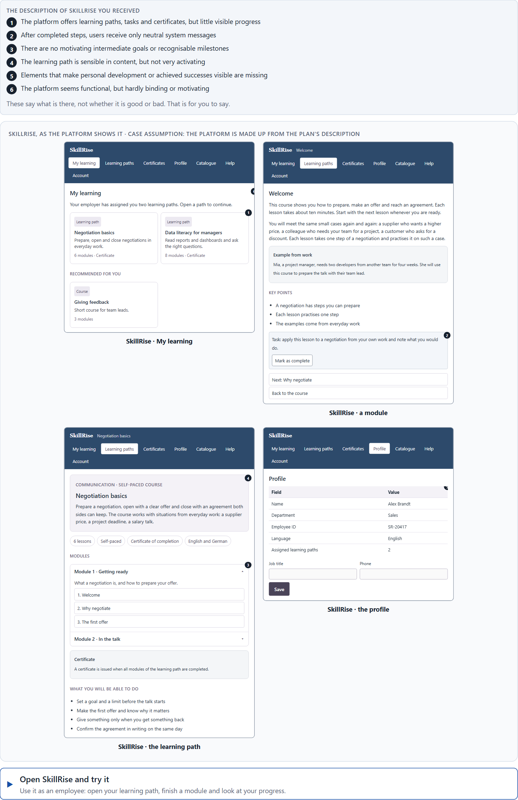
Block 1.1 · Recognise activation and retention potential in a digital offer: SkillRise
Level 1 · Knowledge · about 10 min
You receive the description of a fictional learning and development platform, SkillRise, for professional further training. Open it and use it as an employee who has been given a learning path by their employer: finish a module and look at your progress. You need no prior knowledge: notice whether you want to come back tomorrow, not only whether the steps work. The aim is to recognise motivation and retention mechanisms systematically and tell them apart from pure functionality.
Screenshot of the Neuro-UX Lab (aion-ux-lab.vercel.app), own work; AI-assisted, labelled on the image; the example company is fictional.
Draws on: A1 · Gamification, playful design and a game · A2 · Why people react to progress, feedback and recognition · A3 · Points, badges, levels, streaks.
Notes:
Block 1.1 · Recognise activation and retention potential in a digital offer: SkillRise · about 10 min. Draws on: A1 · Gamification, playful design and a game · A2 · Why people react to progress, feedback and recognition · A3 · Points, badges, levels, streaks.

Slide 5
Block 1.1 · What you work on
Describe spontaneously what effect the offer could have on motivation and retention
1
Name at least 5 places where activation or retention is weakened or promoted
2
Assign the observations to the categories motivation, progress, recognition, feedback, retention and self-efficacy
3
Write an effect statement for three points: “For users this could mean that …”
4
Prioritise the two biggest weaknesses with regard to user activation
5
Notes:
Block 1.1 · Recognise activation and retention potential in a digital offer: SkillRise · about 10 min. Draws on: A1 · Gamification, playful design and a game · A2 · Why people react to progress, feedback and recognition · A3 · Points, badges, levels, streaks.

Slide 6
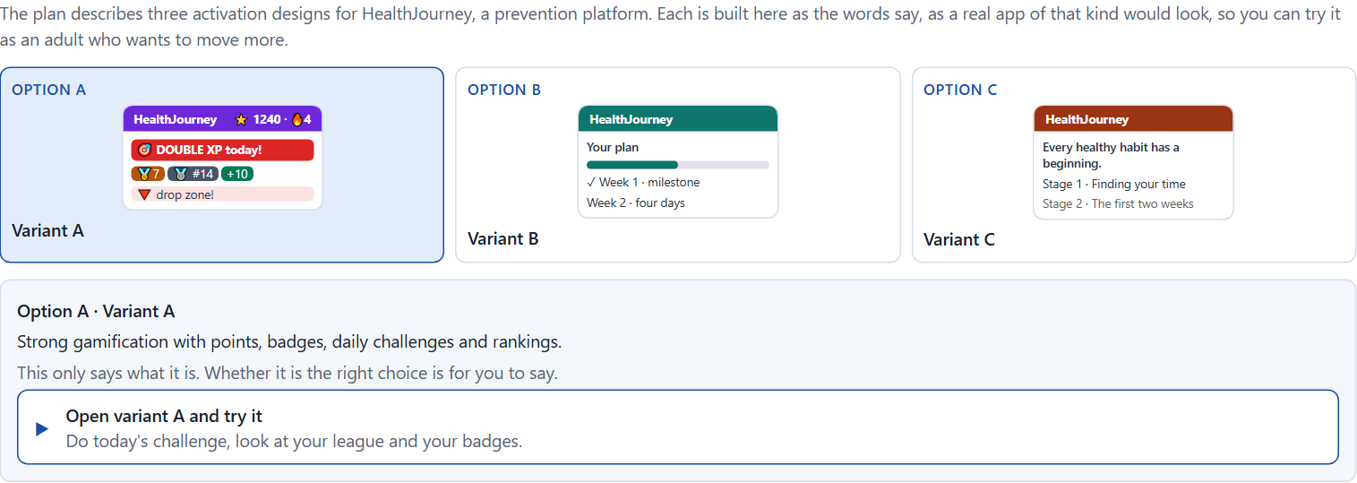
Block 1.2 · Rate gamification under conflicting goals: HealthJourney
Level 1 · Knowledge · about 8 min
HealthJourney is a platform for health prevention. Three designs for its activation logic are described in words: A) strong gamification with points, badges, daily challenges and rankings; B) a restrained activation logic with progress displays, milestones and confirming feedback; C) a narratively embedded user journey with motivating stages, but less visible classic reward elements. The conditions: the target group is adults aged 25 to 65, the company wants to motivate but stay serious and trustworthy, the budget for technical extensions is limited, there are no user tests yet, the release is in 10 weeks, and marketing demands high activation while the department warns against too playful an approach. Decide anyway, and say what you assume.
Screenshot of the Neuro-UX Lab (aion-ux-lab.vercel.app), own work; AI-assisted, labelled on the image; the example company is fictional.
Draws on: A3 · Points, badges, levels, streaks · A4 · Story and game together, and a quick spike against lasting use · A5 · Intrinsic motivation, credible gamification in serious fields, and weighing a measure.
Notes:
Block 1.2 · Rate gamification under conflicting goals: HealthJourney · about 8 min. Draws on: A3 · Points, badges, levels, streaks · A4 · Story and game together, and a quick spike against lasting use · A5 · Intrinsic motivation, credible gamification in serious fields, and weighing a measure.

Slide 7
Block 1.2 · What you work on
Rate each variant on motivation, credibility, long-term retention, clarity and user acceptance
1
Decide which variant is the most viable under the given conditions
2
Name the conflicts of goals between activation, seriousness and user autonomy
3
Which risks remain despite your decision?
4
Formulate a recommendation to the project management
5
Notes:
Block 1.2 · Rate gamification under conflicting goals: HealthJourney · about 8 min. Draws on: A3 · Points, badges, levels, streaks · A4 · Story and game together, and a quick spike against lasting use · A5 · Intrinsic motivation, credible gamification in serious fields, and weighing a measure.

Slide 8
Coaching · UE4
Transition: Level 1 to Level 2
From game mechanics to a responsible architecture of activation
From describing an effect to a decision you answer for.
Notes:
UE4 · Coaching: transition from Level 1 to Level 2. Trainer-led: a short talk on the coaching focus, then the reflection questions in pairs.

Slide 9
Coaching · questions we talk through
Why is gamification more than points, badges and rewards?
How can storytelling and gamification be combined sensibly?
1
5
Which mechanics foster real motivation, and which only short-term stimuli?
How do I deal with conflicts between motivation, seriousness and simplicity?
2
6
How do I tell whether activation fits the situation of use and the target group?
Which decisions are operational, which strategic for attachment, return and acceptance by users?
3
7
When does gamification strengthen self-efficacy, and when does it feel manipulative or childish?
4
Notes:
UE4 · Coaching: transition from Level 1 to Level 2. Trainer-led: a short talk on the coaching focus, then the reflection questions in pairs.

Slide 10
Coaching · reflect in pairs
1
2
3
Where is gamification used superficially and interchangeably in the market?
Which form of feedback motivates lastingly and not only briefly?
When does an activation mechanic become a reputation risk?
Notes:
UE4 · Coaching: transition from Level 1 to Level 2. Trainer-led: a short talk on the coaching focus, then the reflection questions in pairs.

Slide 11
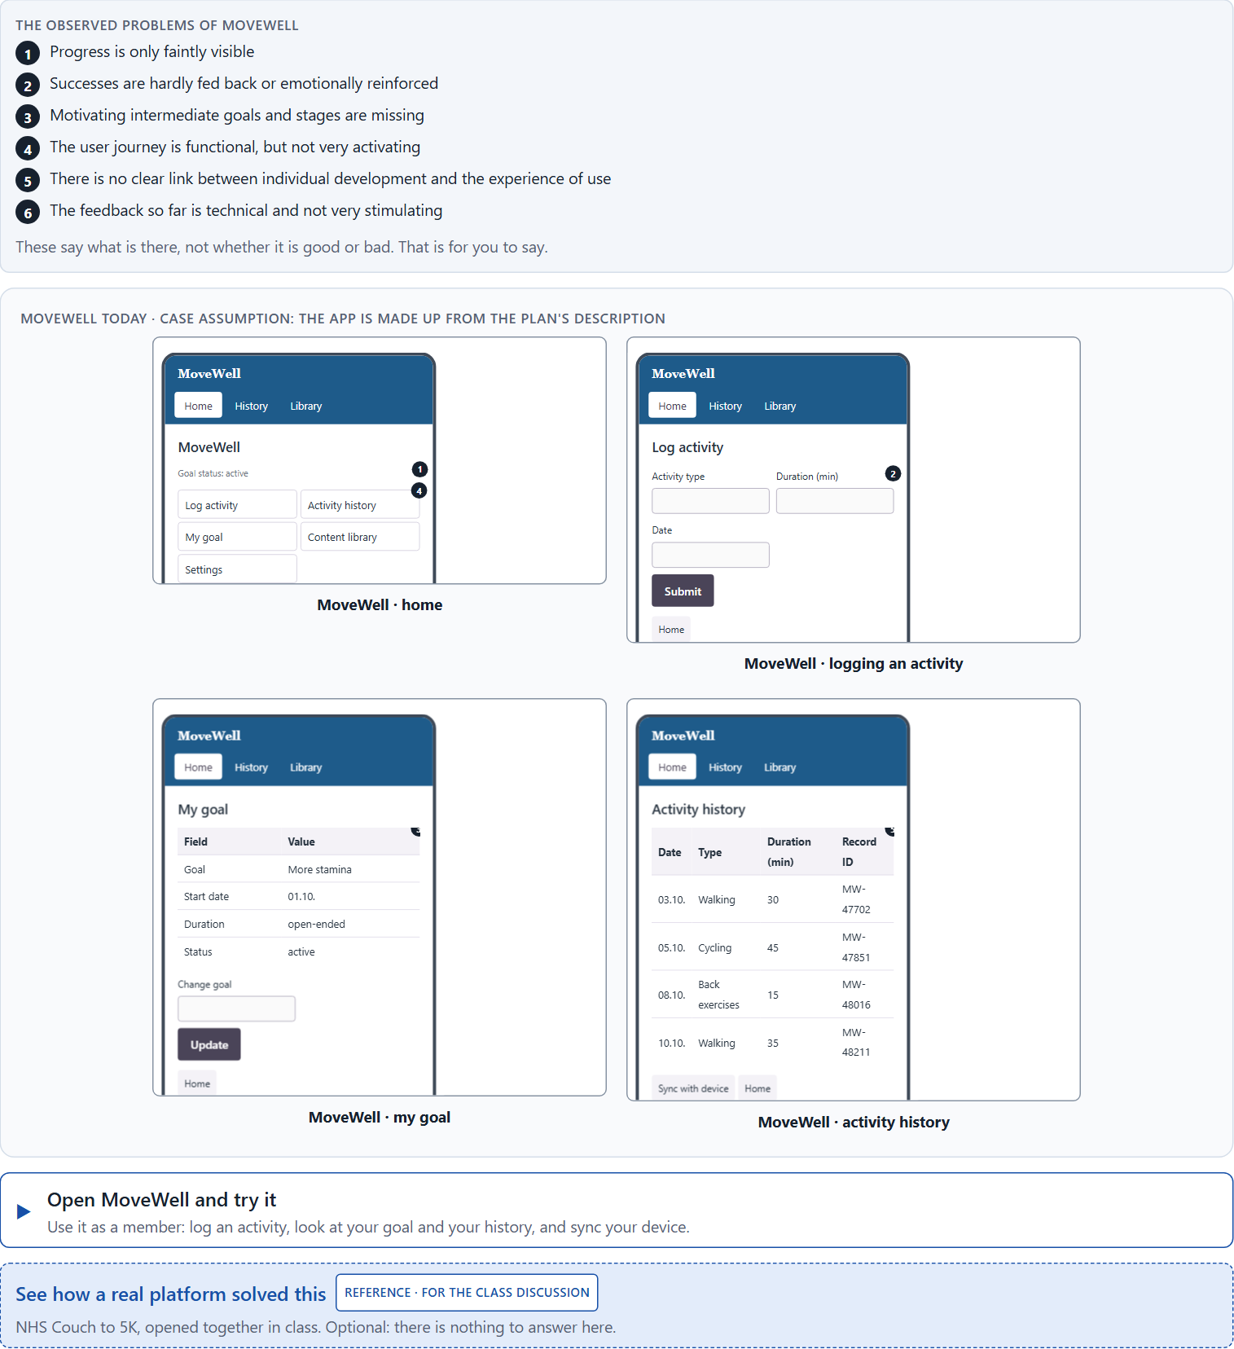
Block 2.1 · Case study: an activation strategy for the prevention programme MoveWell
Level 2 · Case study · UE5–6 · about 15 min
A health provider runs MoveWell, a digital platform for exercise, prevention and personal health goals. Its content is of high quality, but many users leave after a short time. The platform is experienced as sensible, but not very motivating. The company wants to raise activation and retention without losing seriousness or credibility. The observed problems: progress is only faintly visible; successes are hardly fed back or emotionally reinforced; motivating intermediate goals and stages are missing; the user journey is functional but not very activating; there is no clear link between individual development and the experience of use; and the feedback so far is technical and not very stimulating. The conditions: a budget of €150,000, 12 weeks for the implementation, a brand that must stay trustworthy and close to health, no complete relaunch, limited technical resources for complex features, and only partial user data. You work through six steps.
Screenshot of the Neuro-UX Lab (aion-ux-lab.vercel.app), own work; AI-assisted, labelled on the image; the example company is fictional.
Draws on: A1 · Gamification, playful design and a game · A2 · Why people react to progress, feedback and recognition · A3 · Points, badges, levels, streaks · A4 · Story and game together, and a quick spike against lasting use · A5 · Intrinsic motivation, credible gamification in serious fields, and weighing a measure.
Notes:
Block 2.1 · Case study: an activation strategy for the prevention programme MoveWell · about 15 min. Draws on: A1 · Gamification, playful design and a game · A2 · Why people react to progress, feedback and recognition · A3 · Points, badges, levels, streaks · A4 · Story and game together, and a quick spike against lasting use · A5 · Intrinsic motivation, credible gamification in serious fields, and weighing a measure.

Slide 12
Block 2.1 · What you work on
Analyse the central deficits in activation and retention
1
Assign the problems to the categories progress, feedback, motivation, self-efficacy, credibility and long-term retention
2
Develop 4 prioritised measures for improvement
3
Justify your selection using effect on users, feasibility, risk and time pressure
4
Make a prioritisation decision for the first 12 weeks
5
Formulate a recommendation to the division management
6
Notes:
Block 2.1 · Case study: an activation strategy for the prevention programme MoveWell · about 15 min. Draws on: A1 · Gamification, playful design and a game · A2 · Why people react to progress, feedback and recognition · A3 · Points, badges, levels, streaks · A4 · Story and game together, and a quick spike against lasting use · A5 · Intrinsic motivation, credible gamification in serious fields, and weighing a measure.

Slide 13
Feedback round · how each group presents
Each group presents its prioritised measures in 5 minutes
1
The reasoning runs along effect, feasibility, risk and responsibility
2
Each group names one measure it deliberately postponed
3
Notes:
UE7 · Feedback round with a management perspective. Groups present their reasoning, not only their result.

Slide 14
Feedback round · questions to answer
Which measure raises motivation fastest?
Which risks arise when activation is weighted higher than credibility?
1
4
Which measure is strategically most important for lasting attachment?
Which decision can be answered for despite an incomplete data situation?
2
5
Where was gamification integrated sensibly, and where is there a danger of reward inflation?
3
Notes:
UE7 · Feedback round with a management perspective. Groups present their reasoning, not only their result.

Slide 15
Level 3 input and discussion
INPUT LEVEL 3
DISCUSSION
At senior level gamification becomes an architecture of behaviour and experience
Good management decisions balance motivation, ethics, brand impact and economics
Being able to answer for a decision shows in prioritising activation mechanics deliberately, suited to the target group and safe for the reputation
When does gamification turn from a chance for activation into a risk for trust?
Notes:
UE7 · Feedback round with a management perspective. Groups present their reasoning, not only their result.

Slide 16
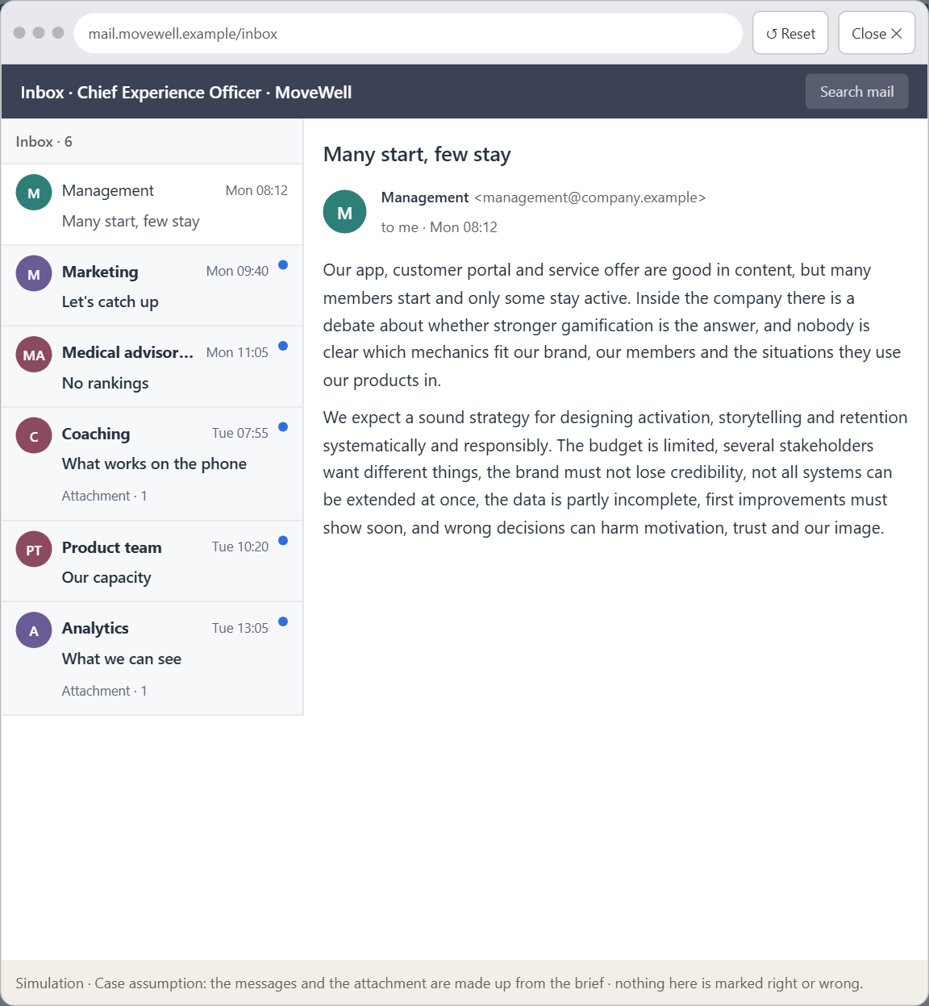
Block 3.1 · A strategic activation and retention architecture for digital user experiences
Level 3 · Transfer project · UE8–10 · about 20 min
You take the perspective of the Chief Experience Officer of the health provider that runs MoveWell. The company has an app, a customer portal and a digital service offer. It sees that many users start, but only some stay active over time. The offers are experienced as good in content, but not very motivating and hardly binding. Inside the company there is a debate about whether stronger gamification is the answer, without anyone being clear which mechanics fit the brand, the target group and the situations people use the products in. The management expects a sound strategy for designing activation, storytelling and retention systematically and responsibly. You are not to choose single game mechanics, but to develop a sound decision architecture for motivation, the experience of progress, narrative activation and lasting retention.
Screenshot of the Neuro-UX Lab (aion-ux-lab.vercel.app), own work; AI-assisted, labelled on the image; the example company is fictional.
Draws on: B1 · Gamification as activation architecture, not a game layer · B2 · Motivation against seriousness and autonomy · B3 · Who answers for a mechanic, and deciding without knowing who stays.
Notes:
Block 3.1 · A strategic activation and retention architecture for digital user experiences · about 20 min. Draws on: B1 · Gamification as activation architecture, not a game layer · B2 · Motivation against seriousness and autonomy · B3 · Who answers for a mechanic, and deciding without knowing who stays.

Slide 17
Block 3.1 · What you work on
1
A guiding vision for activation and retention: which motivation and which experience of use should be created systematically?
2
Three strategic guiding decisions on progress, reinforcement, the depth of gamification, storytelling and long-term retention
3
A prioritised architecture of measures: which journeys, functions or touchpoints are improved first, and why?
4
A risk analysis: which wrong assumptions about motivation, target group and game mechanics would be especially critical?
5
A governance model: who is responsible for the activation principles, and how are conflicts between brand, user interest and economic viability decided?
6
A decision under uncertainty: make at least one prioritised decision despite patchy data and justify it responsibly
7
A management statement: a recommendation to the management with a clear priority and a strategic reason
Notes:
Block 3.1 · A strategic activation and retention architecture for digital user experiences · about 20 min. Draws on: B1 · Gamification as activation architecture, not a game layer · B2 · Motivation against seriousness and autonomy · B3 · Who answers for a mechanic, and deciding without knowing who stays.

Slide 18
Reflect before you leave
1
2
3
Which decision did you make today, and what did you give up to make it?
Which assumption would you check first with real users, and how?
What will you do differently in your next project because of today?
Use two minutes alone, then one minute with your neighbour.

Slide 19
About these slides, sources and AI use
AI
AI-assisted content
Where to find more
AI-assisted content: these slides were drafted with an AI language model (Claude, Anthropic) from the course's own Neuro-UX Lab and were read, corrected and approved by Muhammad Muchson, who is responsible for their accuracy.
Pictures are screenshots of the course's own Neuro-UX Lab. Each one carries an AI label on the image and a source line under it.
Companies and people in the examples are fictional. Numbers inside an example are labelled Case assumption and are not data.
The coaching and feedback questions are the course plan's own, translated into English.
Neuro-UX Lab for this day: https://aion-ux-lab.vercel.app/day/9/
Handouts: the Materi and Task Word documents of the day.
Version 1.0, 29.10.2026. Reviewer and approver: Muhammad Muchson.

