Slide 1
UX DEVELOPER · DAY 10
Intelligent interfaces and AI-supported interaction
Training slides: tasks, coaching, case study and feedback
Module 5 (day 1 of 2)
Trainer: Muhammad Muchson · Case: CareGuide
Contains AI-assisted content

Slide 2
The day at a glance (1)
UE | Min | What | What happens
1 | 45 | Knowledge transfer · Level 1 | The trainer presents the cards of Materi A (A1, A2, A3, A4, A5, about 60 min of cards) in the Neuro-UX Lab; participants follow in the handout.
2 | 45 | Level 1 · Task 1 | Individual work on Block 1.1 (Core, about 10 min): the first product of the day is read and its effect described. Pairs then compare their results and the trainer collects open questions.
3 | 45 | Level 1 · Task 2 | Three options are rated on the same criteria and one is chosen under the stated conditions: Block 1.2 (Core, about 8 min).
4 | 45 | Coaching · transition from Level 1 to Level 2 | Trainer-led. A short talk on the day's coaching focus, then the reflection questions in pairs. The bridge: from describing an effect to a decision you answer for. There is no worksheet block in this unit.
5–6 | 90 | Level 2 · Case study CareGuide (2 UE) incl. model solution | UE5: the trainer presents the case; participants work on Block 2.1 (Core, about 15 min). UE6: groups compare their results and defend them; the trainer closes with the model solution.
7 | 45 | Level 2 + 3 · Feedback round with a management perspective | Groups present their reasoning, not only their result. The trainer asks the day's Level 3 input questions and leads the discussion.
One UE is 45 minutes; breaks are not shown.
Notes:
One UE (teaching unit) is counted as 45 minutes; breaks are not shown.

Slide 3
The day at a glance (2)
UE | Min | What | What happens
8 | 45 | Level 3 · Transfer project, Chief Experience Officer (3 UE: UE8–10) | The trainer presents Materi B (B1, B2, B3; use the "In plain words" and "How to decide" boxes, the rest is handout) and sets the role and the situation.
9 | 45 | Level 3 · Transfer project | Individual work or in pairs on Block 3.1 (Core, about 20 min): the strategy memo.
10 | 45 | Level 3 · Transfer project | Participants present their decision and what they give up, including the one decision made under uncertainty; the trainer debriefs with the model solution.
One UE is 45 minutes; breaks are not shown.
Notes:
One UE (teaching unit) is counted as 45 minutes; breaks are not shown.

Slide 4
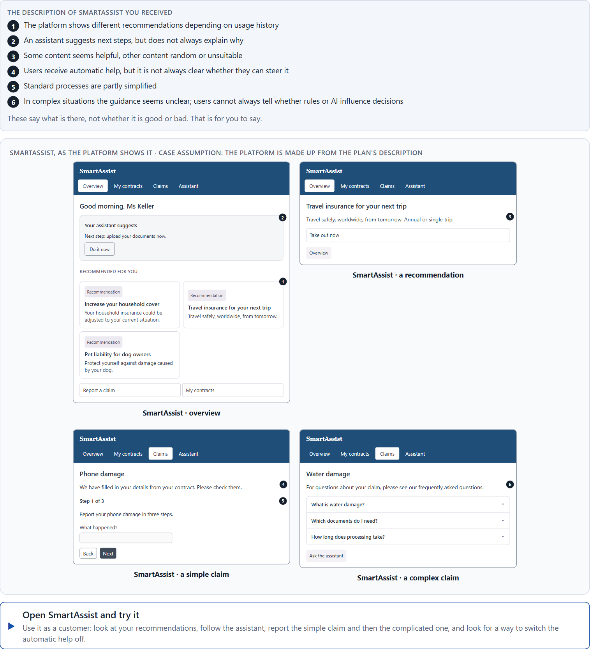
Block 1.1 · Recognise the potentials and risks of intelligent interaction: SmartAssist
Level 1 · Knowledge · about 10 min
You receive the description of a fictional service platform, SmartAssist, for insurance matters, contract overviews and claims. Open it and use it as a customer: look at your recommendations, follow the assistant's next step, report a simple claim and a complicated one. You need no prior knowledge: notice when the platform seems to know what you need, and when you do not know why it does what it does. The aim is to recognise intelligent interaction patterns systematically and judge them from the user's side.
Screenshot of the Neuro-UX Lab (aion-ux-lab.vercel.app), own work; AI-assisted, labelled on the image; the example company is fictional.
Draws on: A1 · Rule-based, adaptive or learning · A2 · How AI guides, recommends and helps · A3 · What intelligent interfaces give, and how they go wrong · A4 · Why, change, undo.
Notes:
Block 1.1 · Recognise the potentials and risks of intelligent interaction: SmartAssist · about 10 min. Draws on: A1 · Rule-based, adaptive or learning · A2 · How AI guides, recommends and helps · A3 · What intelligent interfaces give, and how they go wrong · A4 · Why, change, undo.

Slide 5
Block 1.1 · What you work on
Describe spontaneously which chances and risks the offer could have from the user's point of view
1
Name at least 5 places where intelligent interaction seems helpful or problematic
2
Assign the observations to the categories relevance, transparency, control, trust, support and misadaptation
3
Write an effect statement for three points: “For users this could mean that …”
4
Prioritise the two biggest chances and the two biggest risks of the system
5
Notes:
Block 1.1 · Recognise the potentials and risks of intelligent interaction: SmartAssist · about 10 min. Draws on: A1 · Rule-based, adaptive or learning · A2 · How AI guides, recommends and helps · A3 · What intelligent interfaces give, and how they go wrong · A4 · Why, change, undo.

Slide 6
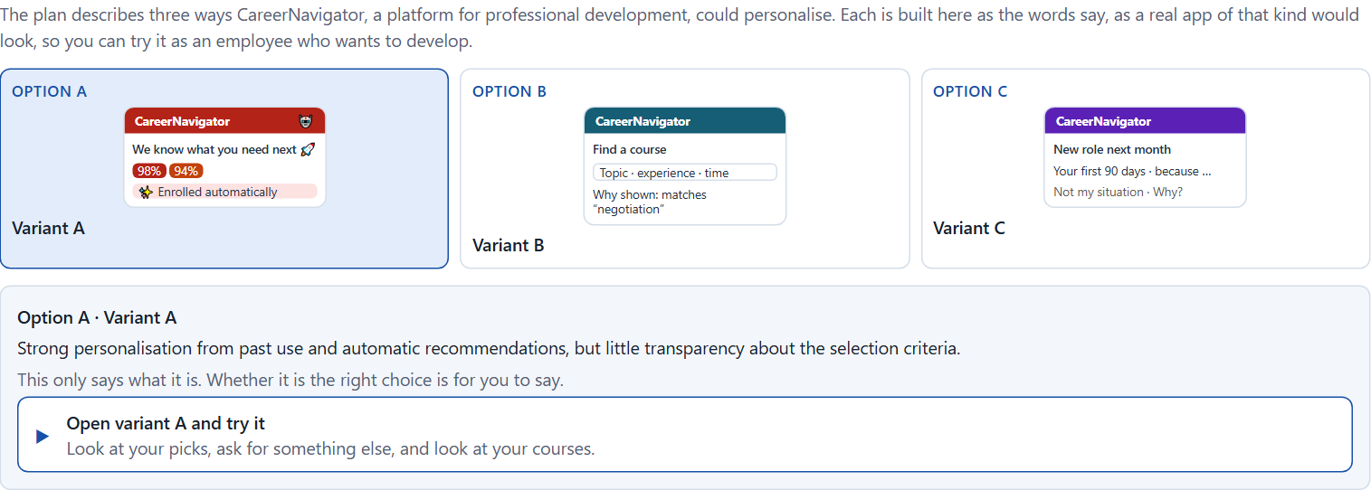
Block 1.2 · Rate adaptive and personalised UX under conflicting goals: CareerNavigator
Level 1 · Knowledge · about 8 min
CareerNavigator is a platform for professional development and learning recommendations. Three designs for its further development are described in words: A) strong personalisation based on past use and automatic recommendations, but little transparency about the selection criteria; B) restrained personalisation with clear explainability and high user control, but less comfort and less automation; C) adaptive support with situational recommendations and optional ways to intervene, but a higher implementation effort. The conditions: the target group is working people with different levels of experience, the company wants to look modern, helpful and trustworthy, the budget for the technical implementation is limited, the release is in 12 weeks, user data is only partly available, and the department demands high service quality while the data protection officers demand transparency and ways to control. Decide anyway, and say what you assume.
Screenshot of the Neuro-UX Lab (aion-ux-lab.vercel.app), own work; AI-assisted, labelled on the image; the example company is fictional.
Draws on: A2 · How AI guides, recommends and helps · A4 · Why, change, undo · A5 · Data, context and situation, and weighing a measure.
Notes:
Block 1.2 · Rate adaptive and personalised UX under conflicting goals: CareerNavigator · about 8 min. Draws on: A2 · How AI guides, recommends and helps · A4 · Why, change, undo · A5 · Data, context and situation, and weighing a measure.

Slide 7
Block 1.2 · What you work on
Rate each variant on relevance, transparency, control, trust, efficiency and user acceptance
1
Decide which variant is the most viable under the given conditions
2
Name the conflicts of goals between automation, personalisation and user autonomy
3
Which risks remain despite your decision?
4
Formulate a recommendation to the project management
5
Notes:
Block 1.2 · Rate adaptive and personalised UX under conflicting goals: CareerNavigator · about 8 min. Draws on: A2 · How AI guides, recommends and helps · A4 · Why, change, undo · A5 · Data, context and situation, and weighing a measure.

Slide 8
Coaching · UE4
Transition: Level 1 to Level 2
Intelligent is more than automated: personalisation, transparency and control
From describing an effect to a decision you answer for.
Notes:
UE4 · Coaching: transition from Level 1 to Level 2. Trainer-led: a short talk on the coaching focus, then the reflection questions in pairs.

Slide 9
Coaching · questions we talk through
How do I tell an intelligent interface from one that is only automated?
How do I weigh comfort, privacy, traceability and efficiency?
1
5
What is the value of personalisation for the user?
How do I argue towards stakeholders who see AI mainly as a signal of innovation?
2
6
How do transparency and control build trust?
Which decisions are operational, which strategic?
3
7
Where does automation relieve, and where does it create risk?
4
Notes:
UE4 · Coaching: transition from Level 1 to Level 2. Trainer-led: a short talk on the coaching focus, then the reflection questions in pairs.

Slide 10
Coaching · reflect in pairs
1
2
3
Where does adaptive UX help, and where does it create uncertainty?
Which kind of support builds trust?
When does missing transparency become a reputation risk?
Notes:
UE4 · Coaching: transition from Level 1 to Level 2. Trainer-led: a short talk on the coaching focus, then the reflection questions in pairs.

Slide 11
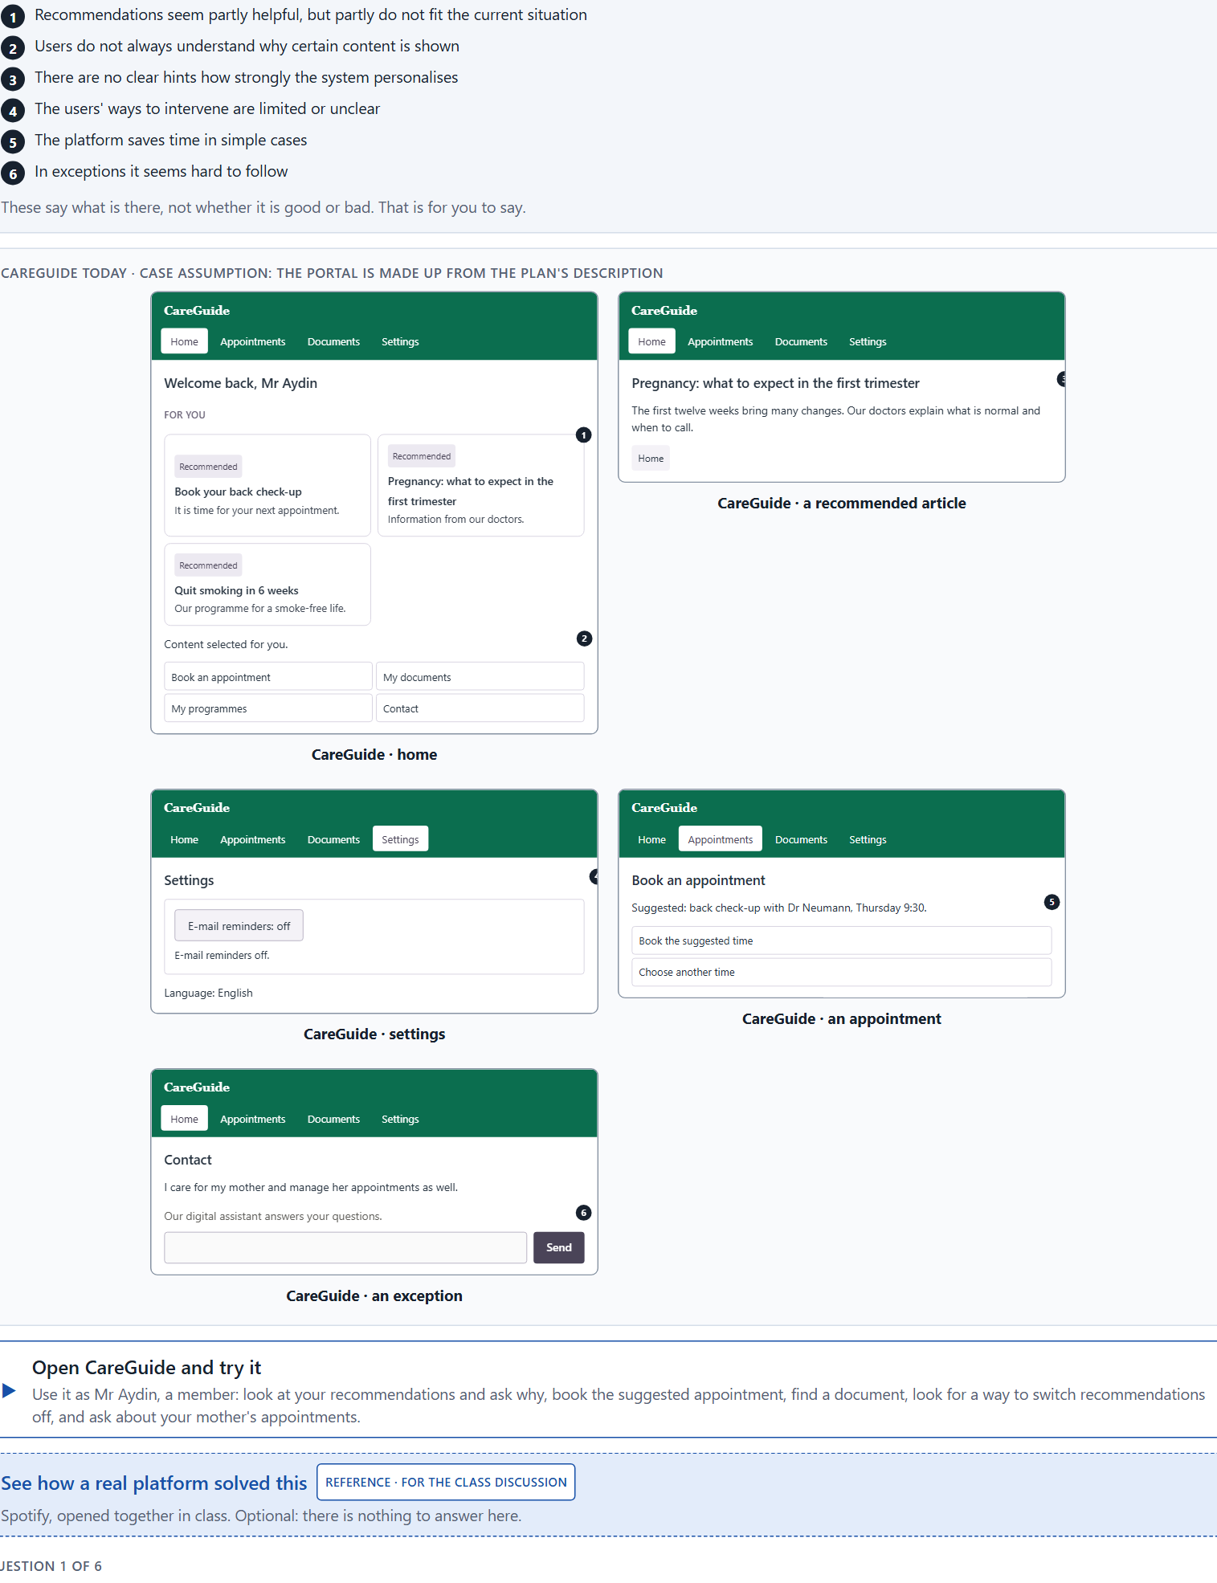
Block 2.1 · Case study: developing the digital service portal CareGuide
Level 2 · Case study · UE5–6 · about 15 min
A provider in health and prevention runs CareGuide, a digital portal for information, appointment management, documents and individual recommendations. The company wants to make the portal more intelligent, so that users get suitable content, next steps and relevant help faster. At the same time it is unsure about trust, comprehensibility and the danger of unsuitable personalisation. The observed problems: recommendations seem partly helpful, but partly do not fit the current situation; users do not always understand why certain content is shown; there are no clear hints how strongly the system personalises; the users' ways to intervene are limited or unclear; the platform saves time in simple cases but seems hard to follow in exceptions; and departments see chances for efficiency while data protection warns of opacity and loss of trust. The conditions: a budget of €180,000, 14 weeks for the implementation, no complete relaunch, a brand that must stay trustworthy and supportive, data quality that is partly heterogeneous, and first results that must show soon. You work through six steps.
Screenshot of the Neuro-UX Lab (aion-ux-lab.vercel.app), own work; AI-assisted, labelled on the image; the example company is fictional.
Draws on: A1 · Rule-based, adaptive or learning · A2 · How AI guides, recommends and helps · A3 · What intelligent interfaces give, and how they go wrong · A4 · Why, change, undo · A5 · Data, context and situation, and weighing a measure.
Notes:
Block 2.1 · Case study: developing the digital service portal CareGuide · about 15 min. Draws on: A1 · Rule-based, adaptive or learning · A2 · How AI guides, recommends and helps · A3 · What intelligent interfaces give, and how they go wrong · A4 · Why, change, undo · A5 · Data, context and situation, and weighing a measure.

Slide 12
Block 2.1 · What you work on
Analyse the central chances and risks of the intelligent guidance in the portal
1
Assign the observations to the categories relevance, transparency, control, trust, efficiency and misadaptation
2
Develop 4 prioritised measures for improvement
3
Justify your selection using effect on users, feasibility, risk and time pressure
4
Make a prioritisation decision for the first 14 weeks
5
Formulate a recommendation to the division management
6
Notes:
Block 2.1 · Case study: developing the digital service portal CareGuide · about 15 min. Draws on: A1 · Rule-based, adaptive or learning · A2 · How AI guides, recommends and helps · A3 · What intelligent interfaces give, and how they go wrong · A4 · Why, change, undo · A5 · Data, context and situation, and weighing a measure.

Slide 13
Feedback round · how each group presents
Each group presents its prioritised measures in 5 minutes
1
The reasoning runs along effect, feasibility, risk and responsibility
2
Each group names one measure it deliberately postponed
3
Notes:
UE7 · Feedback round with a management perspective. Groups present their reasoning, not only their result.

Slide 14
Feedback round · questions to answer
Which measure builds trust fastest?
Where was personalisation put above transparency?
1
4
Which measure is the most strategic?
Which decision is responsible despite the data situation?
2
5
Where is AI sensible, and where is it only technical over-staging?
3
Notes:
UE7 · Feedback round with a management perspective. Groups present their reasoning, not only their result.

Slide 15
Level 3 input and discussion
INPUT LEVEL 3
DISCUSSION
Decision architecture for intelligent and adaptive interfaces
Balance innovation, user interest, privacy, trust and economics
Prioritise so that the reputation stays safe
When does AI-supported user guidance turn from an advantage of innovation into a risk for trust?
Notes:
UE7 · Feedback round with a management perspective. Groups present their reasoning, not only their result.

Slide 16
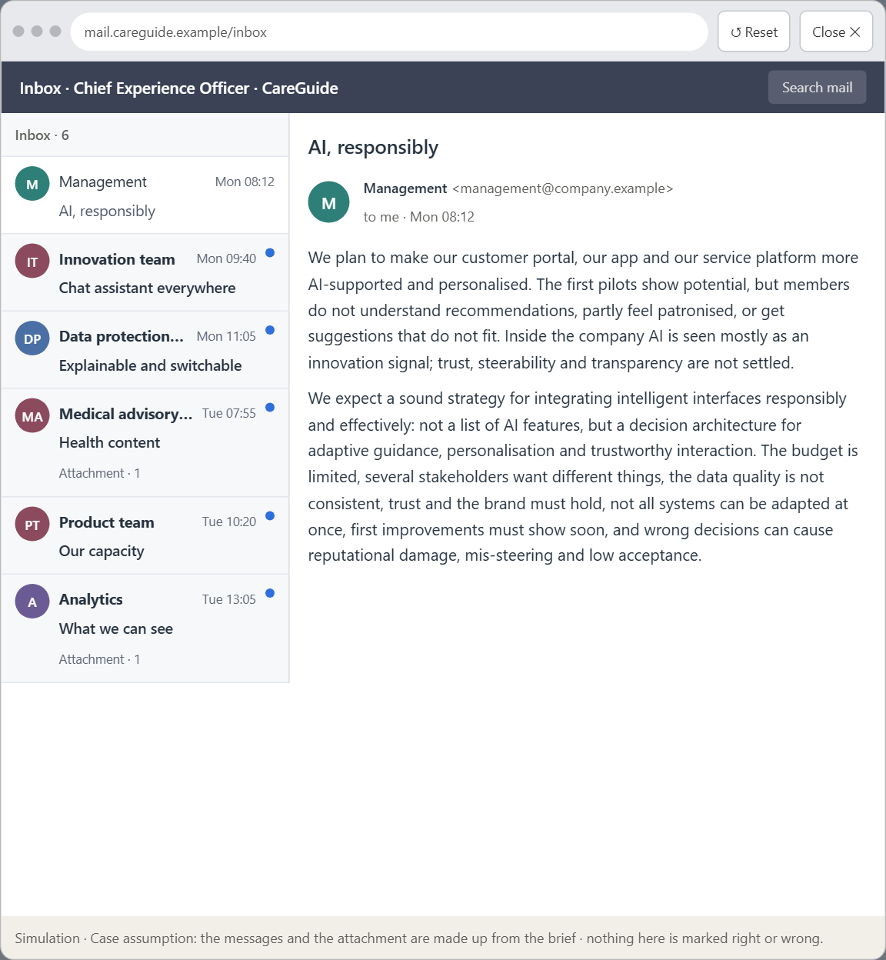
Block 3.1 · A strategic UX architecture for intelligent and adaptive interfaces
Level 3 · Transfer project · UE8–10 · about 20 min
You take the perspective of the Chief Experience Officer of the health and prevention provider that runs CareGuide. The company has a customer portal, an app and a service platform, and plans to make its digital offers more AI-supported and personalised. First pilot functions show potential, but also risks: users do not understand recommendations, partly feel patronised, or get suggestions that do not fit. Inside the company AI is seen mostly as an innovation signal, while questions of trust, steerability and transparency are not yet answered. The management expects a sound strategy for integrating intelligent interfaces responsibly and effectively. You are not to choose single AI features, but to develop a sound decision architecture for adaptive guidance, personalisation and trustworthy interaction.
Screenshot of the Neuro-UX Lab (aion-ux-lab.vercel.app), own work; AI-assisted, labelled on the image; the example company is fictional.
Draws on: B1 · Intelligent UX as a decision architecture, not a technology trend · B2 · Personalisation against transparency and trust · B3 · Who answers for an intelligent interface, and deciding with patchy data.
Notes:
Block 3.1 · A strategic UX architecture for intelligent and adaptive interfaces · about 20 min. Draws on: B1 · Intelligent UX as a decision architecture, not a technology trend · B2 · Personalisation against transparency and trust · B3 · Who answers for an intelligent interface, and deciding with patchy data.

Slide 17
Block 3.1 · What you work on
1
A guiding vision for intelligent UX: which form of support, personalisation and user autonomy should be created systematically?
2
Three strategic guiding decisions on transparency, control, adaptivity, depth of personalisation and trustworthy AI interaction
3
A prioritised architecture of measures: which journeys, functions or touchpoints are extended intelligently first, and why?
4
A risk analysis: which wrong assumptions about user behaviour, data quality and the effect of AI would be especially critical?
5
A governance model: who is responsible for intelligent UX principles, and how are conflicts between innovation, data protection, trust and economic viability decided?
6
A decision under uncertainty: make at least one prioritised decision despite patchy data and justify it responsibly
7
A management statement: a recommendation to the management with a clear priority and a strategic reason
Notes:
Block 3.1 · A strategic UX architecture for intelligent and adaptive interfaces · about 20 min. Draws on: B1 · Intelligent UX as a decision architecture, not a technology trend · B2 · Personalisation against transparency and trust · B3 · Who answers for an intelligent interface, and deciding with patchy data.

Slide 18
Reflect before you leave
1
2
3
Which decision did you make today, and what did you give up to make it?
Which assumption would you check first with real users, and how?
What will you do differently in your next project because of today?
Use two minutes alone, then one minute with your neighbour.

Slide 19
About these slides, sources and AI use
AI
AI-assisted content
Where to find more
AI-assisted content: these slides were drafted with an AI language model (Claude, Anthropic) from the course's own Neuro-UX Lab and were read, corrected and approved by Muhammad Muchson, who is responsible for their accuracy.
Pictures are screenshots of the course's own Neuro-UX Lab. Each one carries an AI label on the image and a source line under it.
Companies and people in the examples are fictional. Numbers inside an example are labelled Case assumption and are not data.
The coaching and feedback questions are the course plan's own, translated into English.
Neuro-UX Lab for this day: https://aion-ux-lab.vercel.app/day/10/
Handouts: the Materi and Task Word documents of the day.
Version 1.0, 29.10.2026. Reviewer and approver: Muhammad Muchson.

