Slide 1
UX DEVELOPER · DAY 12
Accessibility, standards and neurodiversity
Training slides: tasks, coaching, case study and feedback
Module 6 (day 1 of 2)
Trainer: Muhammad Muchson · Case: CitizenConnect
Contains AI-assisted content

Slide 2
The day at a glance (1)
UE | Min | What | What happens
1 | 45 | Knowledge transfer · Level 1 | The trainer presents the cards of Materi A (A1, A2, A3, A4, A5, about 60 min of cards) in the Neuro-UX Lab; participants follow in the handout.
2 | 45 | Level 1 · Task 1 | Individual work on Block 1.1 (Core, about 10 min): the first product of the day is read and its effect described. Pairs then compare their results and the trainer collects open questions.
3 | 45 | Level 1 · Task 2 | Three options are rated on the same criteria and one is chosen under the stated conditions: Block 1.2 (Core, about 8 min).
4 | 45 | Coaching · transition from Level 1 to Level 2 | Trainer-led. A short talk on the day's coaching focus, then the reflection questions in pairs. The bridge: from describing an effect to a decision you answer for. There is no worksheet block in this unit.
5–6 | 90 | Level 2 · Case study CitizenConnect (2 UE) incl. model solution | UE5: the trainer presents the case; participants work on Block 2.1 (Core, about 15 min). UE6: groups compare their results and defend them; the trainer closes with the model solution.
7 | 45 | Level 2 + 3 · Feedback round with a management perspective | Groups present their reasoning, not only their result. The trainer asks the day's Level 3 input questions and leads the discussion.
One UE is 45 minutes; breaks are not shown.
Notes:
One UE (teaching unit) is counted as 45 minutes; breaks are not shown.

Slide 3
The day at a glance (2)
UE | Min | What | What happens
8 | 45 | Level 3 · Transfer project, Chief Experience Officer (3 UE: UE8–10) | The trainer presents Materi B (B1, B2, B3; use the "In plain words" and "How to decide" boxes, the rest is handout) and sets the role and the situation.
9 | 45 | Level 3 · Transfer project | Individual work or in pairs on Block 3.1 (Core, about 20 min): the strategy memo.
10 | 45 | Level 3 · Transfer project | Participants present their decision and what they give up, including the one decision made under uncertainty; the trainer debriefs with the model solution.
One UE is 45 minutes; breaks are not shown.
Notes:
One UE (teaching unit) is counted as 45 minutes; breaks are not shown.

Slide 4
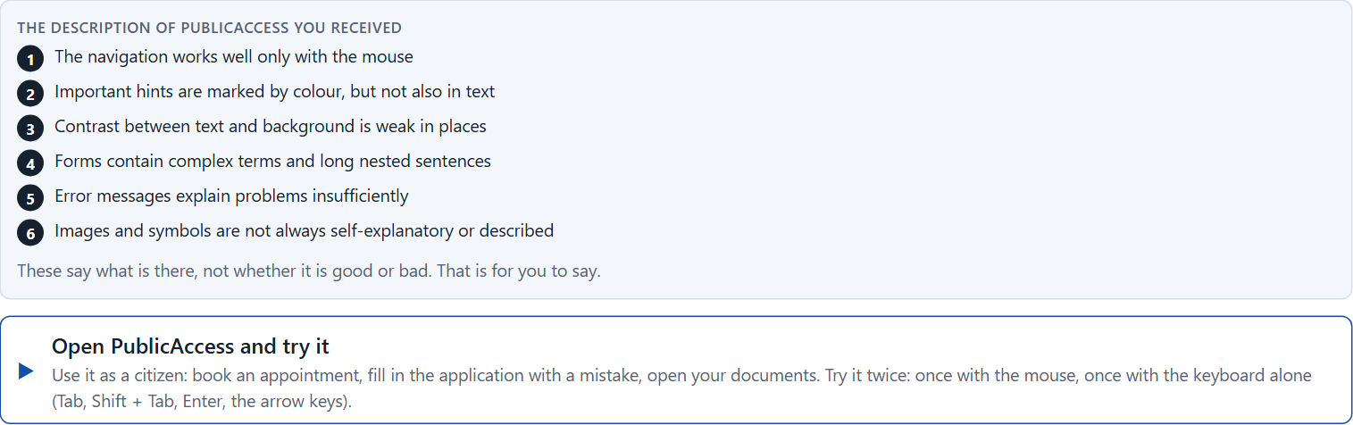
Block 1.1 · Recognise barriers in a digital offer without prior knowledge: PublicAccess
Level 1 · Knowledge · about 10 min
You receive the description of a fictional service portal, PublicAccess, for citizen services, appointments and documents. Open it and use it as a citizen: book an appointment, find a document, fill in a form and make a mistake. Then try the same with the keyboard alone (Tab, Enter, the arrow keys). You need no prior knowledge: notice where you get stuck, and imagine who else would. The aim is to recognise barriers systematically and to understand accessibility from the user's side, not only as a technical matter.
Screenshot of the Neuro-UX Lab (aion-ux-lab.vercel.app), own work; AI-assisted, labelled on the image; the example company is fictional.
Draws on: A1 · Accessibility, usability and inclusive design · A2 · Barriers in perception · A3 · Barriers in interaction · A4 · Barriers in language and structure.
Notes:
Block 1.1 · Recognise barriers in a digital offer without prior knowledge: PublicAccess · about 10 min. Draws on: A1 · Accessibility, usability and inclusive design · A2 · Barriers in perception · A3 · Barriers in interaction · A4 · Barriers in language and structure.

Slide 5
Block 1.1 · What you work on
Describe spontaneously which hurdles the offer could have for different groups of users
1
Name at least 5 possible barriers in the interface
2
Assign the observations to the categories perceivability, operability, comprehensibility, error tolerance and participation
3
Write an effect statement for three points: “For users this could mean that …”
4
Prioritise the two most serious barriers with regard to usability and the risk of exclusion
5
Notes:
Block 1.1 · Recognise barriers in a digital offer without prior knowledge: PublicAccess · about 10 min. Draws on: A1 · Accessibility, usability and inclusive design · A2 · Barriers in perception · A3 · Barriers in interaction · A4 · Barriers in language and structure.

Slide 6
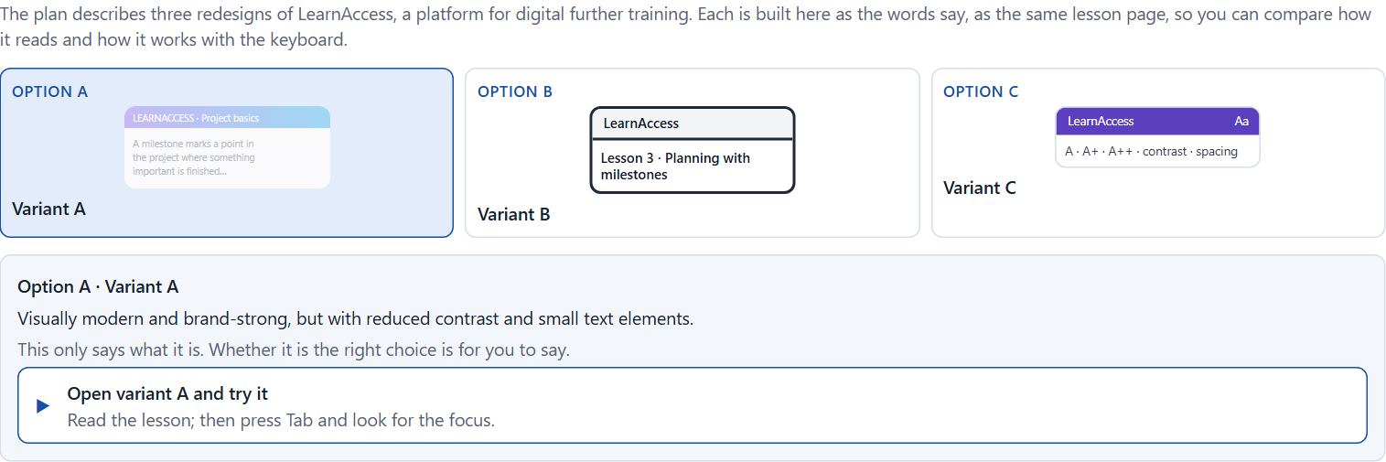
Block 1.2 · Rate inclusive design under conflicting goals: LearnAccess
Level 1 · Knowledge · about 8 min
LearnAccess is a platform for digital further training that is to be redesigned. Three variants are described in words: A) visually modern and brand-strong, but with reduced contrast and small text; B) clearly structured, high in contrast, in plain language and well focusable, but less “premium” in its brand; C) good basic accessibility with some optional adaptation functions, but a higher technical effort. The conditions: the target group is very heterogeneous, the company wants to look modern and inclusive, the budget for technical changes is limited, the release is in 10 weeks, legal requirements must be met, and the department and marketing set different priorities. Decide anyway, and say what you assume.
Screenshot of the Neuro-UX Lab (aion-ux-lab.vercel.app), own work; AI-assisted, labelled on the image; the example company is fictional.
Draws on: A1 · Accessibility, usability and inclusive design · A2 · Barriers in perception · A4 · Barriers in language and structure · A5 · Standards, law and risk.
Notes:
Block 1.2 · Rate inclusive design under conflicting goals: LearnAccess · about 8 min. Draws on: A1 · Accessibility, usability and inclusive design · A2 · Barriers in perception · A4 · Barriers in language and structure · A5 · Standards, law and risk.

Slide 7
Block 1.2 · What you work on
Rate each variant on accessibility, comprehensibility, brand effect, feasibility, legal certainty and user-friendliness
1
Decide which variant is the most viable under the given conditions
2
Name the conflicts of goals between design ambition, accessibility and effort
3
Which risks remain despite your decision?
4
Formulate a recommendation to the project management
5
Notes:
Block 1.2 · Rate inclusive design under conflicting goals: LearnAccess · about 8 min. Draws on: A1 · Accessibility, usability and inclusive design · A2 · Barriers in perception · A4 · Barriers in language and structure · A5 · Standards, law and risk.

Slide 8
Coaching · UE4
Transition: Level 1 to Level 2
From the standard to the person: accessibility and neurodiversity as a task of leadership
From describing an effect to a decision you answer for.
Notes:
UE4 · Coaching: transition from Level 1 to Level 2. Trainer-led: a short talk on the coaching focus, then the reflection questions in pairs.

Slide 9
Coaching · questions we talk through
Why is accessibility not an add-on but a quality of the whole product?
How do I argue towards stakeholders who see accessibility as a legal minimum only?
1
5
How do I recognise barriers for people with ADHD, autism or dyslexia?
Which decisions are operational, which strategic?
2
6
Which standards (such as WCAG) help, and where do they not go far enough?
Who answers for accessibility in the organisation?
3
7
How do I weigh the cost of accessibility against its benefit and its risks?
4
Notes:
UE4 · Coaching: transition from Level 1 to Level 2. Trainer-led: a short talk on the coaching focus, then the reflection questions in pairs.

Slide 10
Coaching · reflect in pairs
1
2
3
Where do products meet the standard and still stay unusable for many?
Which barrier is most often overlooked in projects?
When does missing accessibility become a risk for the company?
Notes:
UE4 · Coaching: transition from Level 1 to Level 2. Trainer-led: a short talk on the coaching focus, then the reflection questions in pairs.

Slide 11
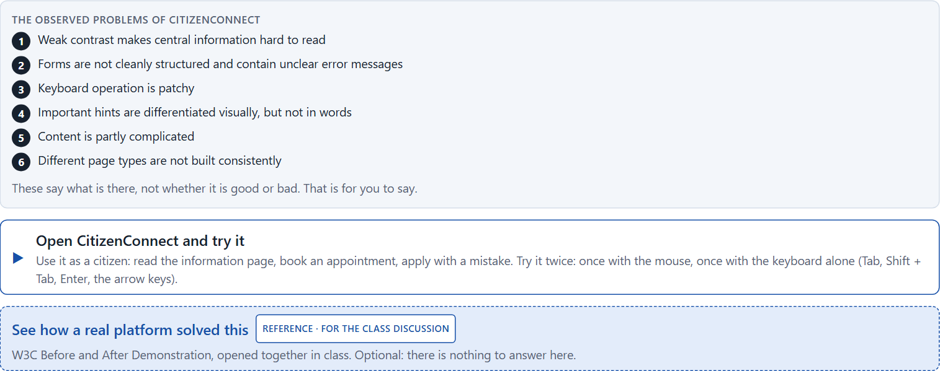
Block 2.1 · Case study: making the portal CitizenConnect more accessible
Level 2 · Case study · UE5–6 · about 15 min
A municipal service platform offers information, appointment bookings and application processes digitally. It is heavily used, but complaints about poor legibility, unclear navigation and poor operability with assistive technologies keep coming. The organisation wants to make the portal more accessible and inclusive without a complete relaunch. The observed problems: weak contrast makes central information hard to read; forms are not cleanly structured and contain unclear error messages; keyboard operation is patchy; important hints are differentiated visually but not in words; content is partly complicated; and different page types are not built consistently. The conditions: a budget of €160,000, 14 weeks for the implementation, no complete relaunch, legal requirements that must be considered first, several departments that supply content, and first improvements that must show soon. You work through six steps.
Screenshot of the Neuro-UX Lab (aion-ux-lab.vercel.app), own work; AI-assisted, labelled on the image; the example company is fictional.
Draws on: A1 · Accessibility, usability and inclusive design · A2 · Barriers in perception · A3 · Barriers in interaction · A4 · Barriers in language and structure · A5 · Standards, law and risk.
Notes:
Block 2.1 · Case study: making the portal CitizenConnect more accessible · about 15 min. Draws on: A1 · Accessibility, usability and inclusive design · A2 · Barriers in perception · A3 · Barriers in interaction · A4 · Barriers in language and structure · A5 · Standards, law and risk.

Slide 12
Block 2.1 · What you work on
Analyse the central barriers and gaps in inclusion of the portal
1
Assign the problems to the categories perceivability, operability, comprehensibility, error tolerance and consistency
2
Develop 4 prioritised measures for improvement
3
Justify your selection using effect on users, legal certainty, feasibility, risk and time pressure
4
Make a prioritisation decision for the first 14 weeks
5
Formulate a recommendation to the division management
6
Notes:
Block 2.1 · Case study: making the portal CitizenConnect more accessible · about 15 min. Draws on: A1 · Accessibility, usability and inclusive design · A2 · Barriers in perception · A3 · Barriers in interaction · A4 · Barriers in language and structure · A5 · Standards, law and risk.

Slide 13
Feedback round · how each group presents
Each group presents its prioritised measures in 5 minutes
1
The reasoning runs along effect, feasibility, risk and responsibility
2
Each group names one measure it deliberately postponed
3
Notes:
UE7 · Feedback round with a management perspective. Groups present their reasoning, not only their result.

Slide 14
Feedback round · questions to answer
Which measure removes the most serious barrier fastest?
Which risks remain despite the prioritisation?
1
4
Which measure matters most for lasting accessibility?
Which decision can be answered for despite an incomplete data situation?
2
5
Where was the user's situation considered, and where only the standard?
3
Notes:
UE7 · Feedback round with a management perspective. Groups present their reasoning, not only their result.

Slide 15
Level 3 input and discussion
INPUT LEVEL 3
DISCUSSION
Accessibility is a question of leadership and governance, not only of design
Good decisions balance inclusion, legal requirements, cost and time
Responsibility shows in naming who owns accessibility and how it is checked
When does missing accessibility become a structural failure of leadership?
Notes:
UE7 · Feedback round with a management perspective. Groups present their reasoning, not only their result.

Slide 16
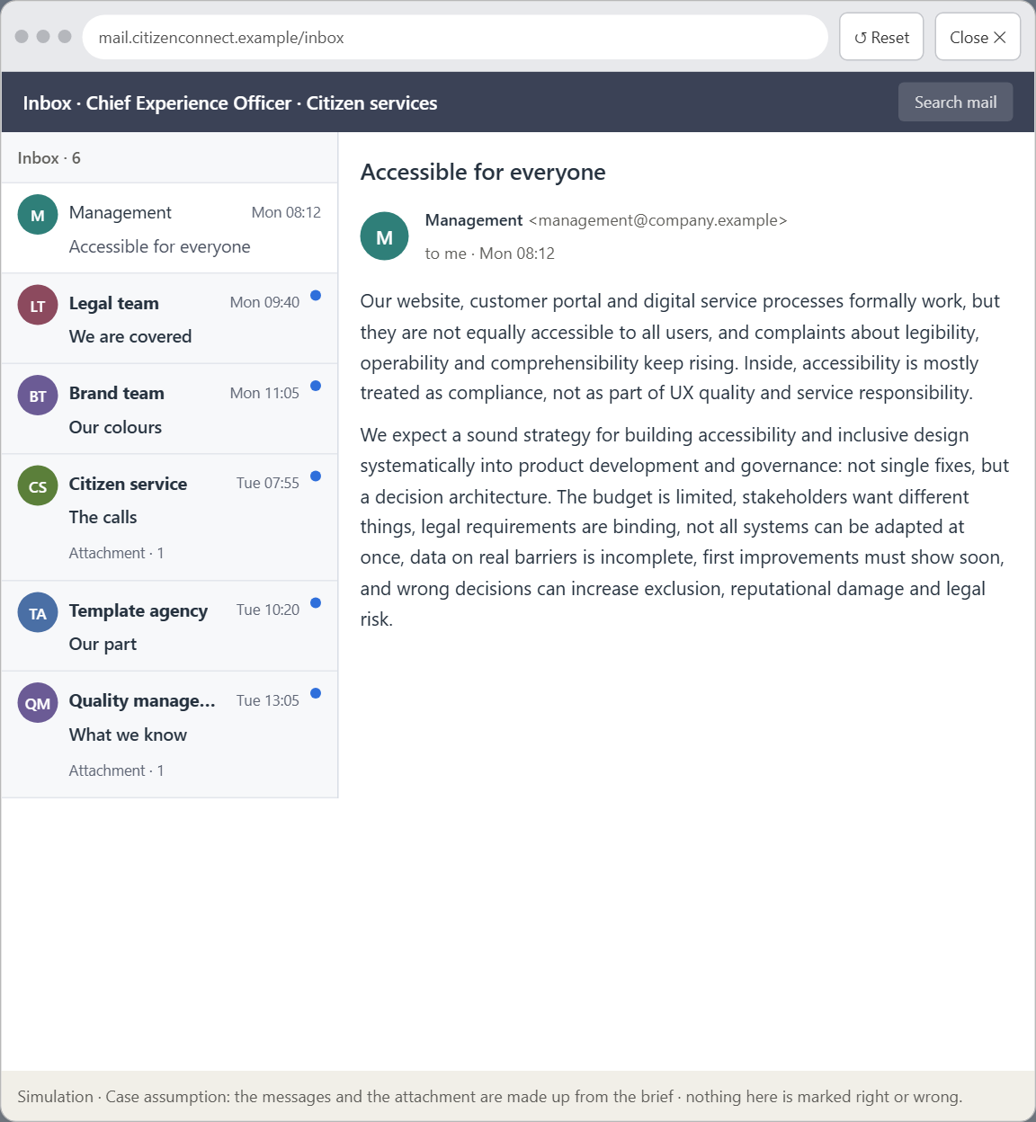
Block 3.1 · A strategic accessibility and inclusion architecture for digital services
Level 3 · Transfer project · UE8–10 · about 20 min
You take the perspective of the Chief Experience Officer of the organisation behind CitizenConnect: a website, a customer portal and digital service processes. Its systems formally work, but they are not equally accessible to all users, and complaints about legibility, operability and comprehensibility keep rising. Inside, accessibility is seen mostly as a compliance topic, not as an integral part of UX quality and service responsibility. The management expects a sound strategy for building accessibility and inclusive design systematically into product development and governance. You are not to repair single barriers, but to develop a sound decision architecture for accessibility, inclusion and legally secure UX quality.
Screenshot of the Neuro-UX Lab (aion-ux-lab.vercel.app), own work; AI-assisted, labelled on the image; the example company is fictional.
Draws on: B1 · Accessibility as quality and responsibility, not a compliance task · B2 · Effort, standards, diversity, law · B3 · Who owns accessibility, and deciding with incomplete data.
Notes:
Block 3.1 · A strategic accessibility and inclusion architecture for digital services · about 20 min. Draws on: B1 · Accessibility as quality and responsibility, not a compliance task · B2 · Effort, standards, diversity, law · B3 · Who owns accessibility, and deciding with incomplete data.

Slide 17
Block 3.1 · What you work on
1
A guiding vision of digital participation: which form of accessibility, comprehensibility and quality of use should be guaranteed systematically?
2
Three strategic guiding decisions on accessibility standards, inclusive design, prioritising barriers and governance
3
A prioritised architecture of measures: which journeys, components or systems are improved first, and why?
4
A risk analysis: which wrong assumptions about user diversity, effort and legal certainty would be especially critical?
5
A governance model: who is responsible for accessibility principles, and how are conflicts between brand, technology, law and user interest decided?
6
A decision under uncertainty: make at least one prioritised decision despite patchy data and justify it responsibly
7
A management statement: a recommendation to the management with a clear priority and a strategic reason
Notes:
Block 3.1 · A strategic accessibility and inclusion architecture for digital services · about 20 min. Draws on: B1 · Accessibility as quality and responsibility, not a compliance task · B2 · Effort, standards, diversity, law · B3 · Who owns accessibility, and deciding with incomplete data.

Slide 18
Reflect before you leave
1
2
3
Which decision did you make today, and what did you give up to make it?
Which assumption would you check first with real users, and how?
What will you do differently in your next project because of today?
Use two minutes alone, then one minute with your neighbour.

Slide 19
About these slides, sources and AI use
AI
AI-assisted content
Where to find more
AI-assisted content: these slides were drafted with an AI language model (Claude, Anthropic) from the course's own Neuro-UX Lab and were read, corrected and approved by Muhammad Muchson, who is responsible for their accuracy.
Pictures are screenshots of the course's own Neuro-UX Lab. Each one carries an AI label on the image and a source line under it.
Companies and people in the examples are fictional. Numbers inside an example are labelled Case assumption and are not data.
The coaching and feedback questions are the course plan's own, translated into English.
Neuro-UX Lab for this day: https://aion-ux-lab.vercel.app/day/12/
Handouts: the Materi and Task Word documents of the day.
Version 1.0, 29.10.2026. Reviewer and approver: Muhammad Muchson.

