Slide 1
UX DEVELOPER · DAY 14
Immersive technologies and neuroscientific UX basics
Knowledge transfer slides
Module 7 (day 1 of 3)
Trainer: Muhammad Muchson · Materi A and B · v1.0
Contains AI-assisted content

Slide 2
What we cover today
Today is about interfaces that leave the screen: augmented, virtual and mixed reality, spatial and sensory interaction. You learn what each technology is, what immersion does to attention and cognitive load, where it intensifies an experience and where it overwhelms, how to tell real user value from fascination, and which ethical questions come with it. Then you use it on three platforms, including a real 3D machine with AR overlays you can turn (and, on a phone, place in your room), and you look at what a headset maker and a government service manual advise. This document holds everything you need to study Day 14 without the website. Every card says what the idea is in plain words, shows it in a picture, gives the details and ends with the rules you use in the tasks.
Materi A · 60 min
Materi B · 60 min
A1 From screen to space: AR, VR, MR and other future interfaces (12 min)
A2 Presence, attention and load: what the brain does in immersive space (12 min)
A3 Intensify or overwhelm: the chances and risks of immersive UX (12 min)
A4 Fascination or impact: user value, maturity and marketability (12 min)
A5 Ethics and responsibility, and weighing a measure (12 min)
B1 Future technologies as decision architecture, not a trend (20 min)
B2 Innovation, value, maturity, risk, ethics: the conflicts of the future (20 min)
B3 Who decides on future technologies, and deciding without test data (20 min)

Slide 3
A
Materi A
Route 1 · Levels 1 and 2
About 60 minutes, five cards. Levels 1 and 2: analyse the chances and risks of an AR service platform, rate three innovation approaches for a health platform under conflicting goals, then analyse an industrial company's immersive plans, develop four measures, justify them and decide on the first 16 weeks. The cards give you the ideas and the rules you use in Task 1.

Slide 4
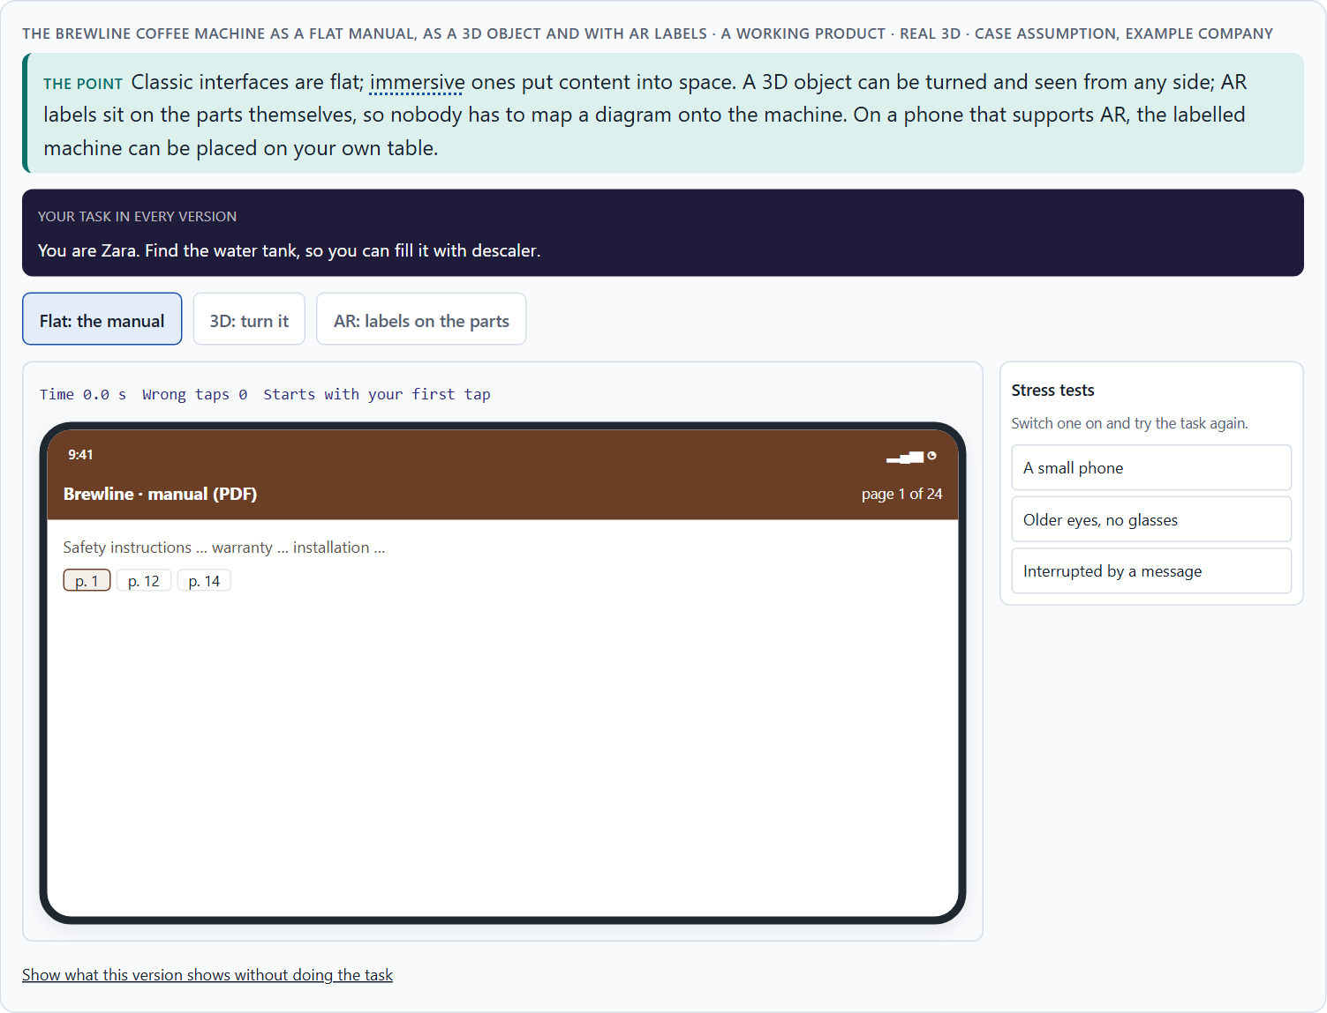
From screen to space: AR, VR, MR and other future interfaces
A1 · 12 min · Core
Classic interfaces are flat; immersive ones put content into space. AR lays information over the real world, VR replaces it, MR lets digital objects sit in the real room. Spatial interfaces, sensory interaction and context-adaptive systems add depth, touch, sound and situation. Each solves different problems at different cost and maturity.
The Brewline coffee machine as a flat manual, as a 3D object and with AR labels · real 3D.
Screenshot of the Neuro-UX Lab (aion-ux-lab.vercel.app), own work; AI-assisted, labelled on the image; the example company is fictional.
Sources: Milgram & Kishino 1994 · Slater & Sanchez-Vives 2016 · Apple HIG
Notes:
A1 · From screen to space: AR, VR, MR and other future interfaces · 12 min · Core
Case assumption: Brewline, Zara, Edgar, Kim and Ruth are made up for this example; the 3D machine is a generic model. The continuum from the real world through AR to VR follows Milgram and Kishino (1994). The findings in the table of real evidence are real research results, rules and cases; the sources are listed below.
Go deeper (optional reading): Flat and spatial are not better and worse; they are good at different things. A list of steps is faster to scan on a flat screen; the place of a part is faster to find in space. Most good immersive products combine both: the step in a calm panel, the place on the object.
Sources: Milgram & Kishino 1994 · Slater & Sanchez-Vives 2016 · Apple HIG

Slide 5
A1 · In plain words
THE IDEA
WHY IT MATTERS
Classic interfaces are flat: a screen you look at. Immersive interfaces put content into space. Augmented reality (AR) lays digital information over the real world; virtual reality (VR) replaces the world with a digital one; mixed reality (MR) lets digital objects sit in and react to the real room. Spatial interfaces use position and depth, sensory interaction adds touch, sound or gesture, and context-adaptive systems change with the situation. Each solves different problems, at different cost and maturity.
Block 1.1 asks what BuildVision's AR overlays and spatial visualisation add, Block 1.2 rates HealthSpace's AR and VR designs, and Block 2.1 asks which of IndustryXR's ideas offer real immersive value. This card tells the technologies apart.
HOW TO READ THE PICTURE
A real 3D Brewline coffee machine you can turn: as a flat picture, as a 3D object, and with AR labels anchored to its parts. On a phone, “View in your space” places it on your table.
Sources: Milgram & Kishino 1994 · Slater & Sanchez-Vives 2016 · Apple HIG
Notes:
A1 · From screen to space: AR, VR, MR and other future interfaces · 12 min · Core
Case assumption: Brewline, Zara, Edgar, Kim and Ruth are made up for this example; the 3D machine is a generic model. The continuum from the real world through AR to VR follows Milgram and Kishino (1994). The findings in the table of real evidence are real research results, rules and cases; the sources are listed below.
Go deeper (optional reading): Flat and spatial are not better and worse; they are good at different things. A list of steps is faster to scan on a flat screen; the place of a part is faster to find in space. Most good immersive products combine both: the step in a calm panel, the place on the object.
Sources: Milgram & Kishino 1994 · Slater & Sanchez-Vives 2016 · Apple HIG

Slide 6
A1 · Future interfaces and what they are good for
Technology | What it does | Good for | Needs
Augmented reality (AR) | Lays information over the real world. | Help at an object; seeing if something fits. | A phone or glasses, light, a stable view.
Virtual reality (VR) | Replaces the world with a digital one. | Practice without risk; places you cannot visit. | A headset, space, short sessions.
Mixed reality (MR) | Digital objects in and reacting to the real room. | Planning in place; working on a virtual object. | Advanced headsets; mapping of the room.
Spatial interfaces | Use position and depth. | Seeing structure and order. | 3D content.
Sensory interaction | Touch, sound, gesture. | Hands-busy work; feedback without looking. | Sensors; careful design.
Context-adaptive systems | Change with the situation. | The right help at the right moment. | Good data about the situation.
Sources: Milgram & Kishino 1994 · Slater & Sanchez-Vives 2016 · Apple HIG
Notes:
A1 · From screen to space: AR, VR, MR and other future interfaces · 12 min · Core
Case assumption: Brewline, Zara, Edgar, Kim and Ruth are made up for this example; the 3D machine is a generic model. The continuum from the real world through AR to VR follows Milgram and Kishino (1994). The findings in the table of real evidence are real research results, rules and cases; the sources are listed below.
Go deeper (optional reading): Flat and spatial are not better and worse; they are good at different things. A list of steps is faster to scan on a flat screen; the place of a part is faster to find in space. Most good immersive products combine both: the step in a calm panel, the place on the object.
Sources: Milgram & Kishino 1994 · Slater & Sanchez-Vives 2016 · Apple HIG

Slide 7
A1 · From screen to space: the concepts and where they come from
Concept | Real source | What it means for a decision
The continuum | Milgram and Kishino placed displays on a reality–virtuality continuum, from the real world through augmented and mixed reality to a fully virtual one (Milgram and Kishino 1994). | Say where on the continuum a product sits: it decides what it can show, what it needs and what it risks.
Presence | Slater and Sanchez-Vives describe presence as the feeling of being in the virtual place, built from immersion and the plausibility of what happens there (Slater and Sanchez-Vives 2016). | Immersion is a means: ask what presence adds to the task.
Immersion for a reason | Apple's guidelines advise to reserve immersion for meaningful moments, to attend to comfort, and to let people choose when to enter and leave (Apple, Immersive experiences). | Offer the immersive mode as a choice, with an easy exit.
Sources: Milgram & Kishino 1994 · Slater & Sanchez-Vives 2016 · Apple HIG
Notes:
A1 · From screen to space: AR, VR, MR and other future interfaces · 12 min · Core
Case assumption: Brewline, Zara, Edgar, Kim and Ruth are made up for this example; the 3D machine is a generic model. The continuum from the real world through AR to VR follows Milgram and Kishino (1994). The findings in the table of real evidence are real research results, rules and cases; the sources are listed below.
Go deeper (optional reading): Flat and spatial are not better and worse; they are good at different things. A list of steps is faster to scan on a flat screen; the place of a part is faster to find in space. Most good immersive products combine both: the step in a calm panel, the place on the object.
Sources: Milgram & Kishino 1994 · Slater & Sanchez-Vives 2016 · Apple HIG

Slide 8
A1 · How to decide when this comes up in the task
Say which technology a proposal means: AR, VR, MR, spatial, sensory or context-adaptive.
1
Ask what it adds over a flat screen for this task: place, depth, hands-free, practice without risk.
2
Ask what it needs: devices, light, network, space, content.
3
Remember that AR keeps people in their world; VR takes them out of it.
4
Treat “the metaverse” as a word, not a plan: ask for the task.
5
Sources: Milgram & Kishino 1994 · Slater & Sanchez-Vives 2016 · Apple HIG
Notes:
A1 · From screen to space: AR, VR, MR and other future interfaces · 12 min · Core
Case assumption: Brewline, Zara, Edgar, Kim and Ruth are made up for this example; the 3D machine is a generic model. The continuum from the real world through AR to VR follows Milgram and Kishino (1994). The findings in the table of real evidence are real research results, rules and cases; the sources are listed below.
Go deeper (optional reading): Flat and spatial are not better and worse; they are good at different things. A list of steps is faster to scan on a flat screen; the place of a part is faster to find in space. Most good immersive products combine both: the step in a calm panel, the place on the object.
Sources: Milgram & Kishino 1994 · Slater & Sanchez-Vives 2016 · Apple HIG

Slide 9
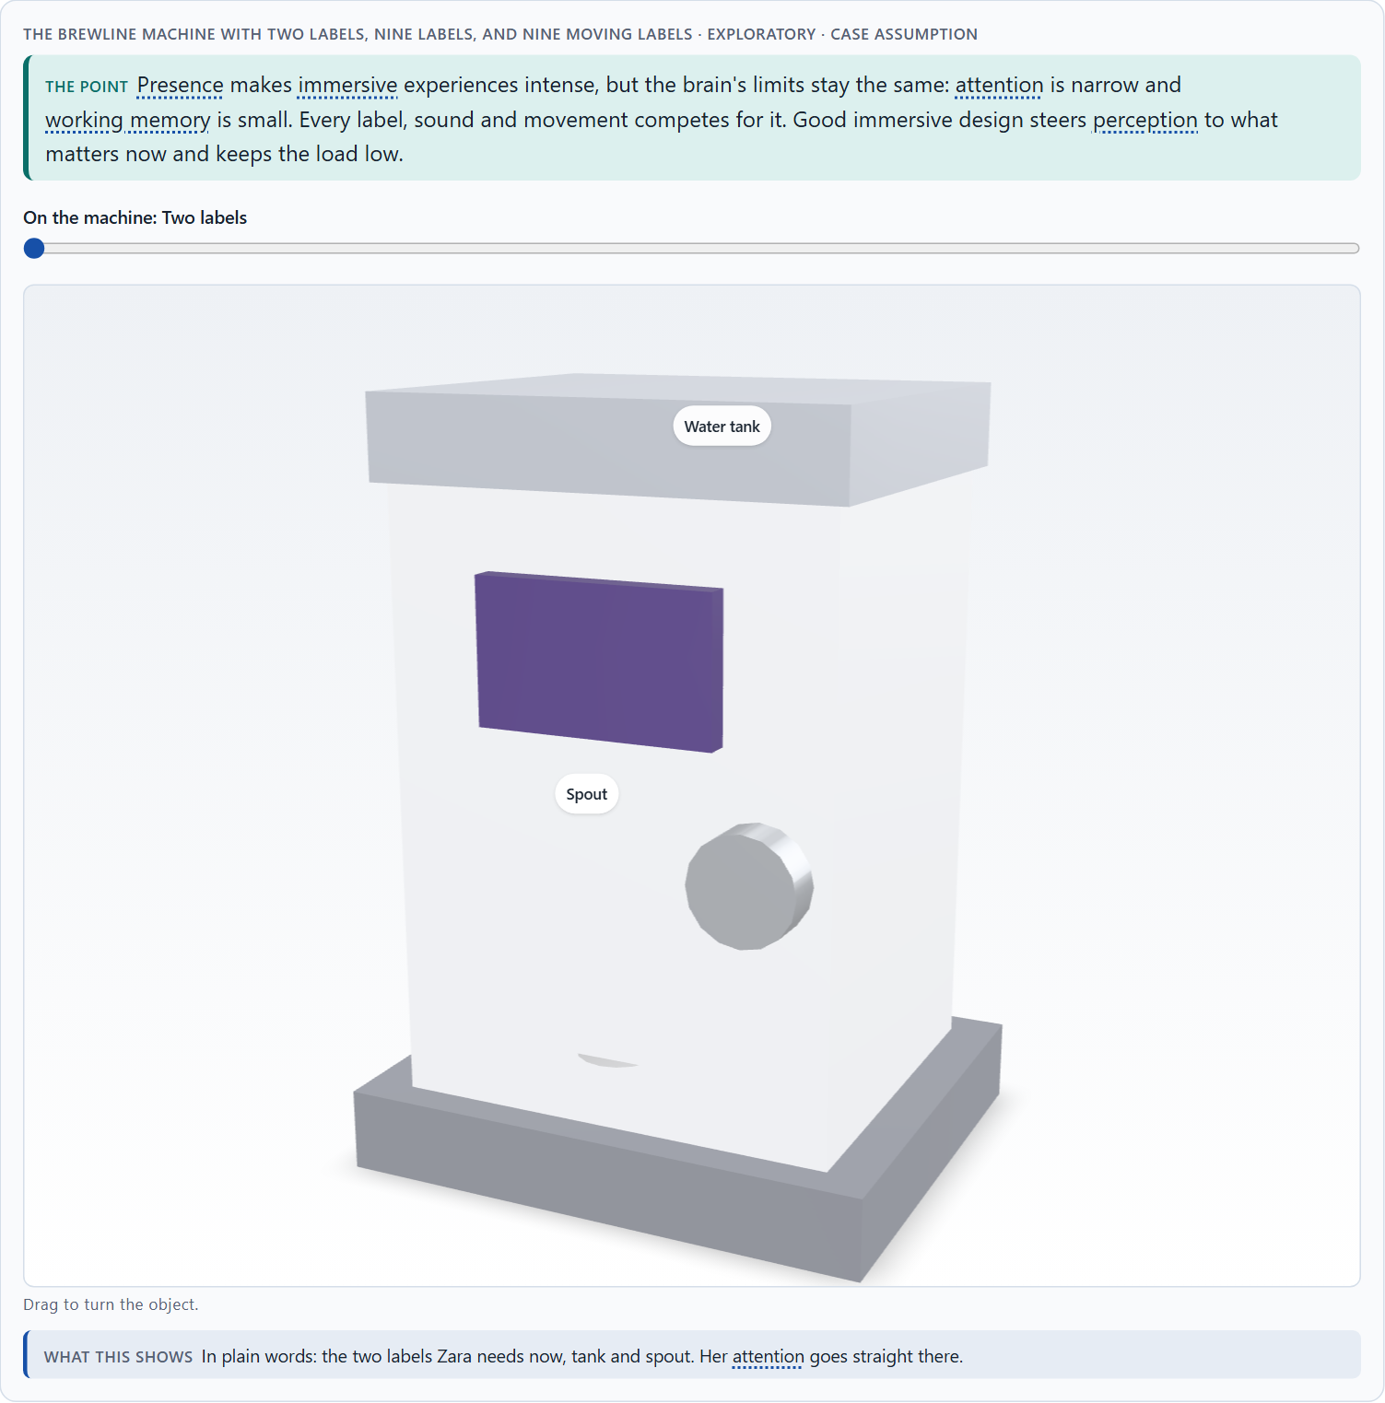
Presence, attention and load: what the brain does in immersive space
A2 · 12 min · Core
Immersion creates presence: the feeling of being there, with space, attention, the body and several senses involved. The brain's limits stay: attention is narrow, working memory small, and under stress people follow the most visible cue. Good immersive design steers perception, keeps load low and supports decisions.
The Brewline machine with two labels, nine labels, and nine moving labels · Exploratory.
Screenshot of the Neuro-UX Lab (aion-ux-lab.vercel.app), own work; AI-assisted, labelled on the image; the example company is fictional.
Sources: Slater & Sanchez-Vives 2016 · Lavie 2005 · Rebenitsch & Owen 2016
Notes:
A2 · Presence, attention and load: what the brain does in immersive space · 12 min · Core
Case assumption: Brewline, Zara, Edgar, Kim and Ruth are made up for this example; the 3D machine is a generic model. Presence follows Slater and Sanchez-Vives (2016); selective attention under load follows Lavie (2005). The findings in the table of real evidence are real research results, rules and cases; the sources are listed below.
Go deeper (optional reading): Presence is double-edged. The feeling of being there is what makes VR training memorable, and it is also why a badly designed scene can feel threatening or exhausting. The same intensity that teaches a safety procedure can overwhelm someone who is already anxious.
Sources: Slater & Sanchez-Vives 2016 · Lavie 2005 · Rebenitsch & Owen 2016

Slide 10
A2 · In plain words
THE IDEA
WHY IT MATTERS
In immersive space people feel present: they are “there”. Space, presence, attention, embodiment (using the body) and several senses at once make experiences intense. The brain's limits stay the same: attention is narrow, working memory small, and every overlay, sound and movement competes for it. Good immersive design steers perception (what people notice first), keeps cognitive load low, and remembers that decisions under stress follow the most visible cue, not the most important one.
Block 1.1 asks why BuildVision's users are impressed but overwhelmed in stressful situations, Block 1.2 about acceptance of immersive formats, and Block 2.1 about IndustryXR's attention steering and overload risks. This card explains what immersion does to attention and load.
HOW TO READ THE PICTURE
The same Brewline machine with two AR labels, with nine, and with nine plus movement and sound cues.
Sources: Slater & Sanchez-Vives 2016 · Lavie 2005 · Rebenitsch & Owen 2016
Notes:
A2 · Presence, attention and load: what the brain does in immersive space · 12 min · Core
Case assumption: Brewline, Zara, Edgar, Kim and Ruth are made up for this example; the 3D machine is a generic model. Presence follows Slater and Sanchez-Vives (2016); selective attention under load follows Lavie (2005). The findings in the table of real evidence are real research results, rules and cases; the sources are listed below.
Go deeper (optional reading): Presence is double-edged. The feeling of being there is what makes VR training memorable, and it is also why a badly designed scene can feel threatening or exhausting. The same intensity that teaches a safety procedure can overwhelm someone who is already anxious.
Sources: Slater & Sanchez-Vives 2016 · Lavie 2005 · Rebenitsch & Owen 2016

Slide 11
A2 · Neuroscience basics, and what they mean in immersive space
Basic | What it means | For immersive design
Attention | Only a little can be attended to at once. | One focus per step; quiet everything else.
Cognitive load | Working memory fills up fast. | Show, don't make people remember; short steps.
Perception steering | Contrast, movement, sound and position decide what is noticed. | Make the important thing the most noticeable.
Stimulus processing | More stimuli, more effort; some people are more sensitive. | Fewer stimuli; a calm option.
Decision behaviour | Under stress, people take the most available cue. | Make the right action the obvious one.
Sources: Slater & Sanchez-Vives 2016 · Lavie 2005 · Rebenitsch & Owen 2016
Notes:
A2 · Presence, attention and load: what the brain does in immersive space · 12 min · Core
Case assumption: Brewline, Zara, Edgar, Kim and Ruth are made up for this example; the 3D machine is a generic model. Presence follows Slater and Sanchez-Vives (2016); selective attention under load follows Lavie (2005). The findings in the table of real evidence are real research results, rules and cases; the sources are listed below.
Go deeper (optional reading): Presence is double-edged. The feeling of being there is what makes VR training memorable, and it is also why a badly designed scene can feel threatening or exhausting. The same intensity that teaches a safety procedure can overwhelm someone who is already anxious.
Sources: Slater & Sanchez-Vives 2016 · Lavie 2005 · Rebenitsch & Owen 2016

Slide 12
A2 · Presence, attention and load: findings
Finding | What it shows | What it means for a screen in space
Perceptual load | Attention is limited, and under load what is processed depends on what competes for it (Lavie 2005). | One focus per step: every extra object in space competes with the task.
Cybersickness | Papers that cite the main review report that between about 30% and 80% of users get symptoms in virtual environments, and the estimates vary widely with hardware, people and measures (Rebenitsch and Owen 2016, as reported). | Plan for sickness as a normal case: short sessions, stable views, a comfort option.
Plausibility | Presence depends on the plausibility of what happens as well as on the display (Slater and Sanchez-Vives 2016). | Labels that drift or lag break the illusion: test tracking in the real room.
Sources: Slater & Sanchez-Vives 2016 · Lavie 2005 · Rebenitsch & Owen 2016
Notes:
A2 · Presence, attention and load: what the brain does in immersive space · 12 min · Core
Case assumption: Brewline, Zara, Edgar, Kim and Ruth are made up for this example; the 3D machine is a generic model. Presence follows Slater and Sanchez-Vives (2016); selective attention under load follows Lavie (2005). The findings in the table of real evidence are real research results, rules and cases; the sources are listed below.
Go deeper (optional reading): Presence is double-edged. The feeling of being there is what makes VR training memorable, and it is also why a badly designed scene can feel threatening or exhausting. The same intensity that teaches a safety procedure can overwhelm someone who is already anxious.
Sources: Slater & Sanchez-Vives 2016 · Lavie 2005 · Rebenitsch & Owen 2016

Slide 13
A2 · How to decide when this comes up in the task
Count what competes for attention in the scene: labels, sounds, movement.
1
Show only what the person needs for this step.
2
Use movement and sound sparingly: they capture attention whether people want it or not.
3
Design the most important cue to be the most visible one.
4
Test in the stressful moment, when attention narrows most.
5
Sources: Slater & Sanchez-Vives 2016 · Lavie 2005 · Rebenitsch & Owen 2016
Notes:
A2 · Presence, attention and load: what the brain does in immersive space · 12 min · Core
Case assumption: Brewline, Zara, Edgar, Kim and Ruth are made up for this example; the 3D machine is a generic model. Presence follows Slater and Sanchez-Vives (2016); selective attention under load follows Lavie (2005). The findings in the table of real evidence are real research results, rules and cases; the sources are listed below.
Go deeper (optional reading): Presence is double-edged. The feeling of being there is what makes VR training memorable, and it is also why a badly designed scene can feel threatening or exhausting. The same intensity that teaches a safety procedure can overwhelm someone who is already anxious.
Sources: Slater & Sanchez-Vives 2016 · Lavie 2005 · Rebenitsch & Owen 2016

Slide 14
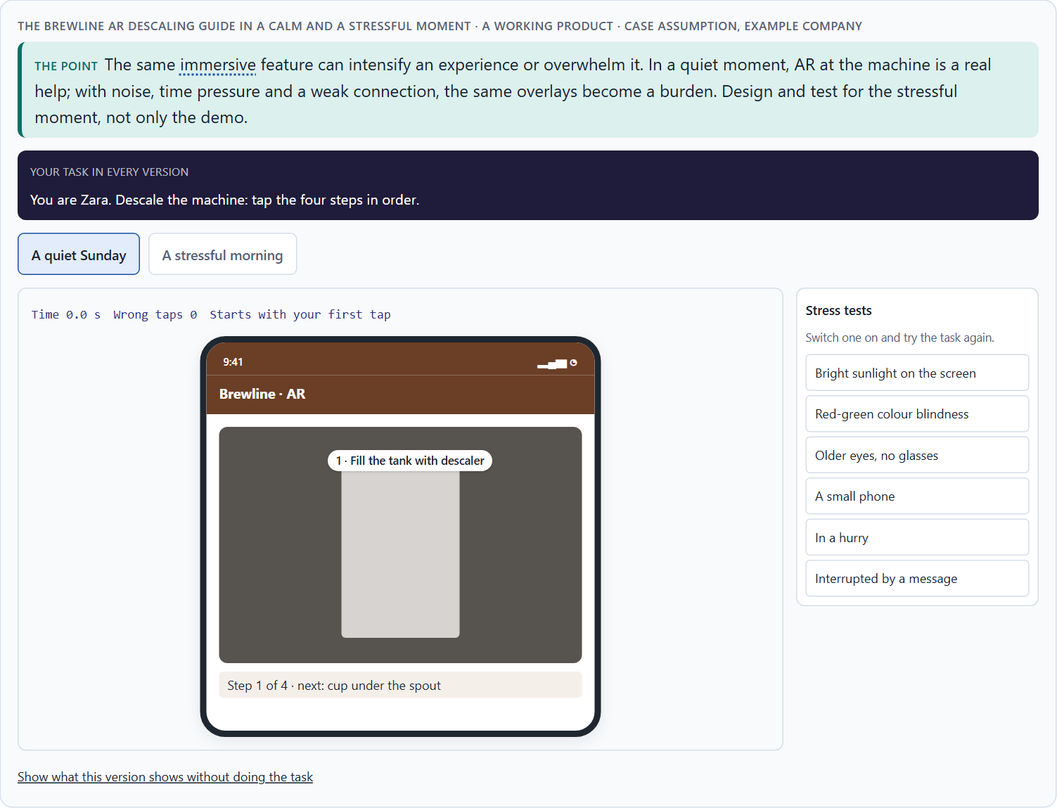
Intensify or overwhelm: the chances and risks of immersive UX
A3 · 12 min · Core
Immersive UX can intensify experiences or overwhelm people. Chances: better visualisation, support in the situation, training, experiencing complex content, new interaction. Risks: stimulus overload, disorientation, low acceptance, technical hurdles and high implementation effort. The same feature can help in calm and hurt in stress.
The Brewline AR descaling guide in a calm and a stressful moment.
Screenshot of the Neuro-UX Lab (aion-ux-lab.vercel.app), own work; AI-assisted, labelled on the image; the example company is fictional.
Sources: Rebenitsch & Owen 2016 · Lavie 2005 · Kaplan et al. 2021
Notes:
A3 · Intensify or overwhelm: the chances and risks of immersive UX · 12 min · Core
Case assumption: Brewline, Zara, Edgar, Kim and Ruth are made up for this example; the 3D machine is a generic model. Motion sickness in VR follows Rebenitsch and Owen (2016). The findings in the table of real evidence are real research results, rules and cases; the sources are listed below.
Go deeper (optional reading): Users are often impressed in the first test and overwhelmed in the third week. The first test measures novelty; daily use measures value. A pilot that ends after the wow phase has not tested anything that matters for an investment decision.
Sources: Rebenitsch & Owen 2016 · Lavie 2005 · Kaplan et al. 2021

Slide 15
A3 · In plain words
THE IDEA
WHY IT MATTERS
Immersive technology can intensify an experience or overwhelm it. Its chances: better visualisation (seeing inside a machine), support in the situation (help at the object), training (practising without risk), experiencing complex content (a building before it is built), and new forms of interaction. Its risks: stimulus overload, disorientation, low acceptance, technical hurdles (devices, connection, light, noise) and high implementation effort. The same feature can be a help in a quiet room and a burden in a stressful moment.
Block 1.1 asks for BuildVision's chances and risks and its two biggest of each, Block 1.2 for HealthSpace's risks, and Block 2.1 for IndustryXR's central chances and risks. This card gives you both lists by name.
HOW TO READ THE PICTURE
The Brewline descaling guide in AR, once on a quiet Sunday and once with a crying child, a beeping machine and a weak connection.
Sources: Rebenitsch & Owen 2016 · Lavie 2005 · Kaplan et al. 2021
Notes:
A3 · Intensify or overwhelm: the chances and risks of immersive UX · 12 min · Core
Case assumption: Brewline, Zara, Edgar, Kim and Ruth are made up for this example; the 3D machine is a generic model. Motion sickness in VR follows Rebenitsch and Owen (2016). The findings in the table of real evidence are real research results, rules and cases; the sources are listed below.
Go deeper (optional reading): Users are often impressed in the first test and overwhelmed in the third week. The first test measures novelty; daily use measures value. A pilot that ends after the wow phase has not tested anything that matters for an investment decision.
Sources: Rebenitsch & Owen 2016 · Lavie 2005 · Kaplan et al. 2021

Slide 16
A3 · Chances and risks of immersive UX
Chance | Example (Brewline) | Risk | What it looks like
Better visualisation | See inside the machine. | Stimulus overload | Nine labels and an advert.
Support in the situation | The descaling step on the tank. | Disorientation | Labels that drift with a weak signal.
Training | Café staff practise milk foam in VR. | Low acceptance | Edgar will not use AR at all.
Experiencing complex content | How the brewing unit works. | Technical hurdles | Steam, bad light, old phones.
New interaction | Ask the machine with your hands full. | High effort | Content for every model, every update.
Sources: Rebenitsch & Owen 2016 · Lavie 2005 · Kaplan et al. 2021
Notes:
A3 · Intensify or overwhelm: the chances and risks of immersive UX · 12 min · Core
Case assumption: Brewline, Zara, Edgar, Kim and Ruth are made up for this example; the 3D machine is a generic model. Motion sickness in VR follows Rebenitsch and Owen (2016). The findings in the table of real evidence are real research results, rules and cases; the sources are listed below.
Go deeper (optional reading): Users are often impressed in the first test and overwhelmed in the third week. The first test measures novelty; daily use measures value. A pilot that ends after the wow phase has not tested anything that matters for an investment decision.
Sources: Rebenitsch & Owen 2016 · Lavie 2005 · Kaplan et al. 2021

Slide 17
A3 · Intensify or overwhelm: what the evidence says
Topic | Real finding | What it means for a product
Training | A meta-analysis of studies on the transfer of training found that training in virtual, augmented or mixed reality was about as effective as training in a non-simulated environment, not better (Kaplan et al. 2021). | Its case rests on what the real setting cannot offer: danger, cost, access.
Visualisation and situational help | Immersive displays can show what cannot be seen, such as the inside of a machine, but each added object adds load (Lavie 2005). | Show the one thing the step needs.
Sickness and comfort | A large share of users get cybersickness symptoms, with wide variation between studies (Rebenitsch and Owen 2016, as reported). | Make the comfort option easy to find, and never rely on the long session.
Acceptance and effort | The people and the setting decide whether it is used at all; there is no figure that holds for every product. | Test with the actual users in the actual place.
Sources: Rebenitsch & Owen 2016 · Lavie 2005 · Kaplan et al. 2021
Notes:
A3 · Intensify or overwhelm: the chances and risks of immersive UX · 12 min · Core
Case assumption: Brewline, Zara, Edgar, Kim and Ruth are made up for this example; the 3D machine is a generic model. Motion sickness in VR follows Rebenitsch and Owen (2016). The findings in the table of real evidence are real research results, rules and cases; the sources are listed below.
Go deeper (optional reading): Users are often impressed in the first test and overwhelmed in the third week. The first test measures novelty; daily use measures value. A pilot that ends after the wow phase has not tested anything that matters for an investment decision.
Sources: Rebenitsch & Owen 2016 · Lavie 2005 · Kaplan et al. 2021

Slide 18
A3 · How to decide when this comes up in the task
Name the chance: what does immersion make possible that a screen does not?
1
Name the risk next to it: overload, disorientation, acceptance, technology, effort.
2
Picture the worst realistic moment of use: noise, gloves, time pressure, bad light, no network.
3
Ask who will not or cannot use it: older users, people prone to motion sickness, people without the device.
4
Count the effort beyond the demo: devices, content, updates, support.
5
Sources: Rebenitsch & Owen 2016 · Lavie 2005 · Kaplan et al. 2021
Notes:
A3 · Intensify or overwhelm: the chances and risks of immersive UX · 12 min · Core
Case assumption: Brewline, Zara, Edgar, Kim and Ruth are made up for this example; the 3D machine is a generic model. Motion sickness in VR follows Rebenitsch and Owen (2016). The findings in the table of real evidence are real research results, rules and cases; the sources are listed below.
Go deeper (optional reading): Users are often impressed in the first test and overwhelmed in the third week. The first test measures novelty; daily use measures value. A pilot that ends after the wow phase has not tested anything that matters for an investment decision.
Sources: Rebenitsch & Owen 2016 · Lavie 2005 · Kaplan et al. 2021

Slide 19
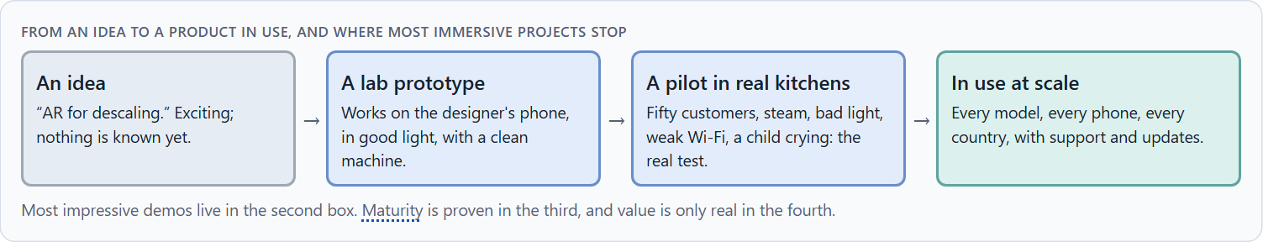
Fascination or impact: user value, maturity and marketability
A4 · 12 min · Core
A future technology is relevant only when it creates real value for users: it solves a real problem better than a classic interface. Four things decide together: the user's need, the innovation, its maturity in the real environment, and its marketability. Fascination is not a reason.
From an idea to a product in use, and where most immersive projects stop.
Screenshot of the Neuro-UX Lab (aion-ux-lab.vercel.app), own work; AI-assisted, labelled on the image; the example company is fictional.
Sources: GOV.UK Service Manual · Apple HIG · Kaplan et al. 2021 · GOV.UK Service Standard
Notes:
A4 · Fascination or impact: user value, maturity and marketability · 12 min · Core
Case assumption: Brewline, Zara, Edgar, Kim and Ruth are made up for this example; the 3D machine is a generic model. Reserving immersion for meaningful moments follows Apple's guidelines; reframing a solution as a problem follows the GOV.UK Service Manual. The findings in the table of real evidence are real research results, rules and cases; the sources are listed below.
Go deeper (optional reading): Demonstrative use cases are attractive because they are easy to show and hard to evaluate. A useful test: would a customer miss it if it disappeared next month? A descaling guide they used twice, yes; a trade-fair showroom they saw once, no.
Sources: GOV.UK Service Manual · Apple HIG · Kaplan et al. 2021 · GOV.UK Service Standard

Slide 20
A4 · In plain words
THE IDEA
WHY IT MATTERS
A future technology is relevant only when it creates real value for users: it solves a real problem better than a classic interface would. Four things decide together: the user's need, the innovation itself, its maturity (does it work reliably, in the real environment, for real users?) and its marketability (will people use it, can it be built and paid for at scale?). Fascination is not a reason; many impressive demos solve nothing.
Block 1.1 asks which of BuildVision's uses are helpful and which only demonstrative, Block 1.2 rates user value, maturity and economics, and Block 2.1 asks to prioritise IndustryXR's use cases by value and feasibility. This card gives you the test.
HOW TO READ THE PICTURE
Brewline's five ideas placed by user value and maturity. Below, the steps from an idea to a product in use.
Sources: GOV.UK Service Manual · Apple HIG · Kaplan et al. 2021 · GOV.UK Service Standard
Notes:
A4 · Fascination or impact: user value, maturity and marketability · 12 min · Core
Case assumption: Brewline, Zara, Edgar, Kim and Ruth are made up for this example; the 3D machine is a generic model. Reserving immersion for meaningful moments follows Apple's guidelines; reframing a solution as a problem follows the GOV.UK Service Manual. The findings in the table of real evidence are real research results, rules and cases; the sources are listed below.
Go deeper (optional reading): Demonstrative use cases are attractive because they are easy to show and hard to evaluate. A useful test: would a customer miss it if it disappeared next month? A descaling guide they used twice, yes; a trade-fair showroom they saw once, no.
Sources: GOV.UK Service Manual · Apple HIG · Kaplan et al. 2021 · GOV.UK Service Standard

Slide 21
A4 · Fascination or impact: how to test value and maturity
Source | Real practice | What it means for a decision
Test the riskiest assumption | The GOV.UK Service Manual advises to define the problem, to test the riskiest assumptions with throwaway prototypes and to decide on the evidence, including the decision to stop (GOV.UK Service Manual). | Start with a cheap test of the value, not with a build.
The case for the real setting | Training in extended reality was equally effective as non-simulated training (Kaplan et al. 2021). | Use immersive technology where the real thing is dangerous, rare or expensive.
Phases and assessment | Services in the UK government are assessed against the Service Standard at the discovery, alpha, beta and live phases (GOV.UK Service Standard). | Define what a pilot must show before it may grow.
Sources: GOV.UK Service Manual · Apple HIG · Kaplan et al. 2021 · GOV.UK Service Standard
Notes:
A4 · Fascination or impact: user value, maturity and marketability · 12 min · Core
Case assumption: Brewline, Zara, Edgar, Kim and Ruth are made up for this example; the 3D machine is a generic model. Reserving immersion for meaningful moments follows Apple's guidelines; reframing a solution as a problem follows the GOV.UK Service Manual. The findings in the table of real evidence are real research results, rules and cases; the sources are listed below.
Go deeper (optional reading): Demonstrative use cases are attractive because they are easy to show and hard to evaluate. A useful test: would a customer miss it if it disappeared next month? A descaling guide they used twice, yes; a trade-fair showroom they saw once, no.
Sources: GOV.UK Service Manual · Apple HIG · Kaplan et al. 2021 · GOV.UK Service Standard

Slide 22
A4 · How to decide when this comes up in the task
Name the user's problem first, then the technology.
1
Compare with the classic solution: is the immersive one clearly better for this task?
2
Judge maturity in the real environment, not in the lab.
3
Ask whether people will use it and whether it can be built, run and paid for at scale.
4
Leave out what only impresses.
5
Sources: GOV.UK Service Manual · Apple HIG · Kaplan et al. 2021 · GOV.UK Service Standard
Notes:
A4 · Fascination or impact: user value, maturity and marketability · 12 min · Core
Case assumption: Brewline, Zara, Edgar, Kim and Ruth are made up for this example; the 3D machine is a generic model. Reserving immersion for meaningful moments follows Apple's guidelines; reframing a solution as a problem follows the GOV.UK Service Manual. The findings in the table of real evidence are real research results, rules and cases; the sources are listed below.
Go deeper (optional reading): Demonstrative use cases are attractive because they are easy to show and hard to evaluate. A useful test: would a customer miss it if it disappeared next month? A descaling guide they used twice, yes; a trade-fair showroom they saw once, no.
Sources: GOV.UK Service Manual · Apple HIG · Kaplan et al. 2021 · GOV.UK Service Standard

Slide 23
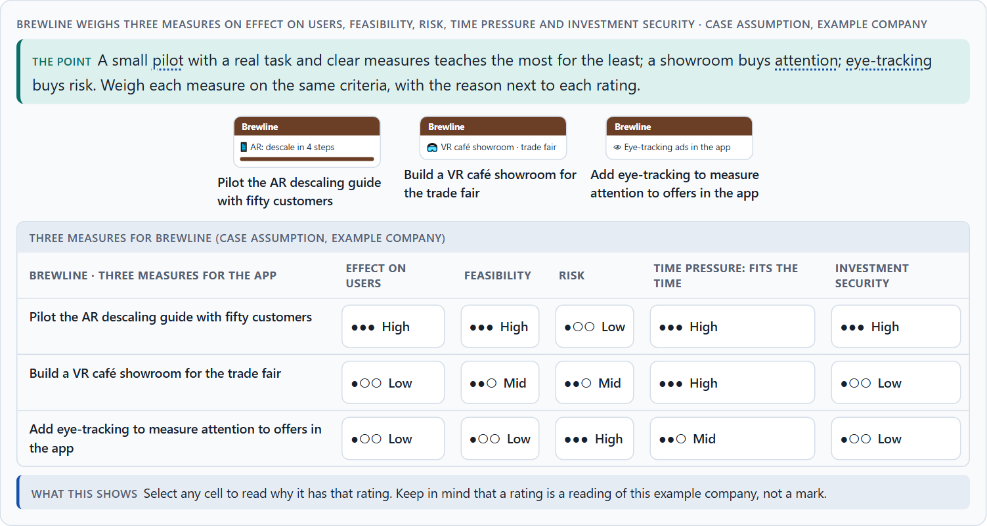
Ethics and responsibility, and weighing a measure
A5 · 12 min · Core
Immersive and neuro-based interfaces see more of people than screens: rooms, bodies, gaze. They can make people sick, exclude those without devices, and steer attention in the company's interest. Responsible leaders prioritise by effect, economics and responsibility, not fascination. Weigh measures on effect, feasibility, risk, time pressure and investment security.
Brewline weighs three measures on effect on users, feasibility, risk, time pressure and investment security.
Screenshot of the Neuro-UX Lab (aion-ux-lab.vercel.app), own work; AI-assisted, labelled on the image; the example company is fictional.
Sources: Rebenitsch & Owen 2016 · Gibbons 2018 · Miller et al. 2020 · Apple HIG
Notes:
A5 · Ethics and responsibility, and weighing a measure · 12 min · Core
Case assumption: Brewline, Zara, Edgar, Kim and Ruth are made up for this example; the 3D machine is a generic model. Rating options on the same criteria follows Gibbons (2018); the five criteria are the ones the plan names for the case study. The findings in the table of real evidence are real research results, rules and cases; the sources are listed below.
Go deeper (optional reading): Neuro-informed design knows how attention works, which makes it powerful in both directions. The same knowledge that puts the right step in front of a technician can put an offer in front of a tired customer. The line between guidance and manipulation is whose interest the steering serves.
Sources: Rebenitsch & Owen 2016 · Gibbons 2018 · Miller et al. 2020 · Apple HIG

Slide 24
A5 · In plain words
THE IDEA
WHY IT MATTERS
Immersive and neuro-based interfaces raise their own ethical questions: cameras that scan homes and workplaces, data about where people look and how their body moves, motion sickness and exhaustion, exclusion of people who cannot use headsets, and attention steering that can slip into manipulation. Responsible leaders prioritise future technologies by effect, economics and responsibility, not by fascination. To put measures in order, weigh each on effect on users, feasibility, risk, time pressure and investment security.
Block 1.2 asks about trust and risk in health, and Block 2.1 asks for four prioritised measures for IndustryXR, justified on effect on users, feasibility, risk, time pressure and investment security. The example uses Brewline and its own measures, so the answer for the task cases is not given.
HOW TO READ THE PICTURE
Five ethical questions asked of three Brewline ideas. Then three measures rated on five criteria.
Sources: Rebenitsch & Owen 2016 · Gibbons 2018 · Miller et al. 2020 · Apple HIG
Notes:
A5 · Ethics and responsibility, and weighing a measure · 12 min · Core
Case assumption: Brewline, Zara, Edgar, Kim and Ruth are made up for this example; the 3D machine is a generic model. Rating options on the same criteria follows Gibbons (2018); the five criteria are the ones the plan names for the case study. The findings in the table of real evidence are real research results, rules and cases; the sources are listed below.
Go deeper (optional reading): Neuro-informed design knows how attention works, which makes it powerful in both directions. The same knowledge that puts the right step in front of a technician can put an offer in front of a tired customer. The line between guidance and manipulation is whose interest the steering serves.
Sources: Rebenitsch & Owen 2016 · Gibbons 2018 · Miller et al. 2020 · Apple HIG

Slide 25
A5 · Ethics and responsibility: a real finding
Topic | Real finding | What it means for a measure
Identifiability of movement | In a study with more than 500 participants who watched 360-degree videos, a simple model identified people with above 95% accuracy from less than five minutes of head and hand tracking data (Miller et al. 2020, as reported). | Treat motion data as personal data, even without a name attached.
Comfort and choice | Apple's guidelines ask that people choose when to enter and exit an immersive experience and that comfort is considered (Apple, Immersive experiences). | Build consent, comfort and an exit into the first version.
Who is harmed | Sickness, disorientation and data exposure fall on the user (Rebenitsch and Owen 2016; Miller et al. 2020). | Ask who could be harmed before asking what could be shown.
Sources: Rebenitsch & Owen 2016 · Gibbons 2018 · Miller et al. 2020 · Apple HIG
Notes:
A5 · Ethics and responsibility, and weighing a measure · 12 min · Core
Case assumption: Brewline, Zara, Edgar, Kim and Ruth are made up for this example; the 3D machine is a generic model. Rating options on the same criteria follows Gibbons (2018); the five criteria are the ones the plan names for the case study. The findings in the table of real evidence are real research results, rules and cases; the sources are listed below.
Go deeper (optional reading): Neuro-informed design knows how attention works, which makes it powerful in both directions. The same knowledge that puts the right step in front of a technician can put an offer in front of a tired customer. The line between guidance and manipulation is whose interest the steering serves.
Sources: Rebenitsch & Owen 2016 · Gibbons 2018 · Miller et al. 2020 · Apple HIG

Slide 26
A5 · How to decide when this comes up in the task
What does it record about people and their surroundings, and where does it go?
1
Who is left out, and what do they use instead?
2
Can it make people sick, tired or anxious?
3
Does it steer attention for the user or for the company?
4
Rate every measure on the same five criteria, with a reason; a rating is a judgement, never a mark.
5
Sources: Rebenitsch & Owen 2016 · Gibbons 2018 · Miller et al. 2020 · Apple HIG
Notes:
A5 · Ethics and responsibility, and weighing a measure · 12 min · Core
Case assumption: Brewline, Zara, Edgar, Kim and Ruth are made up for this example; the 3D machine is a generic model. Rating options on the same criteria follows Gibbons (2018); the five criteria are the ones the plan names for the case study. The findings in the table of real evidence are real research results, rules and cases; the sources are listed below.
Go deeper (optional reading): Neuro-informed design knows how attention works, which makes it powerful in both directions. The same knowledge that puts the right step in front of a technician can put an offer in front of a tired customer. The line between guidance and manipulation is whose interest the steering serves.
Sources: Rebenitsch & Owen 2016 · Gibbons 2018 · Miller et al. 2020 · Apple HIG

Slide 27
B
Materi B
Route 2 · Level 3
About 60 minutes, three cards, led by the facilitator. Level 3 in the Chief Experience Officer's chair: a guiding vision for future UX innovation, three strategic decisions, an order of what is piloted first, a risk analysis, a governance model, one decision under uncertainty and a statement to the management. The cards give you the ideas you use in Task 2.

Slide 28
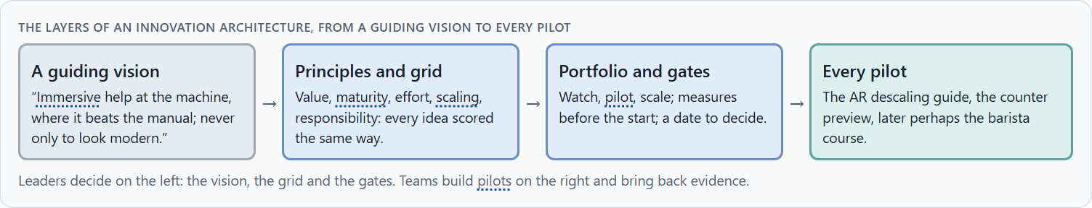
Future technologies as decision architecture, not a trend
B1 · 20 min · Core
At senior level future technologies are a decision architecture for innovation, service quality and differentiation: a guiding vision of the immersive value wanted, a portfolio that separates watching, piloting and scaling, one evaluation grid, and stage gates where pilots prove themselves. Innovation is managed like an investment.
The layers of an innovation architecture, from a guiding vision to every pilot.
Screenshot of the Neuro-UX Lab (aion-ux-lab.vercel.app), own work; AI-assisted, labelled on the image; the example company is fictional.
Sources: GOV.UK Service Manual · Apple HIG · Milgram & Kishino 1994
Notes:
B1 · Future technologies as decision architecture, not a trend · 20 min · Core
Case assumption: Brewline, Zara, Edgar, Kim and Ruth are made up for this example; the 3D machine is a generic model. Discovery, alpha and the decision to go on or stop follow the GOV.UK Service Manual. The findings in the table of real evidence are real research results, rules and cases; the sources are listed below.
Go deeper (optional reading): Innovation labs often produce demos rather than products, because a demo is the end of their task. A portfolio changes the task: the lab's job is to produce evidence for a decision, and a stopped pilot with clear evidence is a success.
Sources: GOV.UK Service Manual · Apple HIG · Milgram & Kishino 1994

Slide 29
B1 · In plain words
THE IDEA
WHY IT MATTERS
At senior level, future technologies are not a trend to follow but a decision architecture for innovation, service quality and differentiation: a guiding vision of what immersive value the company wants, a portfolio that separates watching, piloting and scaling, an evaluation grid (value, maturity, effort, scaling potential, responsibility), and stage gates where a pilot must prove itself before it grows. Innovation is managed like an investment, not like a showcase.
Block 3.1 asks for a guiding vision for future UX innovation, three decisions on technology use, maturity assessment, user value and portfolio, and an order of which use cases, touchpoints or product areas are piloted first. You decide the architecture, not single trend technologies.
HOW TO READ THE PICTURE
Left Brewline chasing headsets to look innovative, right running an innovation portfolio with gates. Below, the layers from a guiding vision to every pilot.
Sources: GOV.UK Service Manual · Apple HIG · Milgram & Kishino 1994
Notes:
B1 · Future technologies as decision architecture, not a trend · 20 min · Core
Case assumption: Brewline, Zara, Edgar, Kim and Ruth are made up for this example; the 3D machine is a generic model. Discovery, alpha and the decision to go on or stop follow the GOV.UK Service Manual. The findings in the table of real evidence are real research results, rules and cases; the sources are listed below.
Go deeper (optional reading): Innovation labs often produce demos rather than products, because a demo is the end of their task. A portfolio changes the task: the lab's job is to produce evidence for a decision, and a stopped pilot with clear evidence is a success.
Sources: GOV.UK Service Manual · Apple HIG · Milgram & Kishino 1994

Slide 30
B1 · Future technologies as decision architecture: structures
Part | Real example | What it means
A map of the field | The reality–virtuality continuum organises the technologies into one map (Milgram and Kishino 1994). | Use one map for the portfolio, so bets are comparable.
Phased evidence | The GOV.UK phases move from discovery to alpha, beta and live, each with a test of the riskiest assumption (GOV.UK Service Manual). | Give each bet a phase and a question.
Platform rules | Apple's guidelines set expectations for comfort and for entering and leaving immersion (Apple, Immersive experiences). | Build on the rules of the platform instead of inventing your own.
Sources: GOV.UK Service Manual · Apple HIG · Milgram & Kishino 1994
Notes:
B1 · Future technologies as decision architecture, not a trend · 20 min · Core
Case assumption: Brewline, Zara, Edgar, Kim and Ruth are made up for this example; the 3D machine is a generic model. Discovery, alpha and the decision to go on or stop follow the GOV.UK Service Manual. The findings in the table of real evidence are real research results, rules and cases; the sources are listed below.
Go deeper (optional reading): Innovation labs often produce demos rather than products, because a demo is the end of their task. A portfolio changes the task: the lab's job is to produce evidence for a decision, and a stopped pilot with clear evidence is a success.
Sources: GOV.UK Service Manual · Apple HIG · Milgram & Kishino 1994

Slide 31
B1 · How to decide when this comes up in the task
Check how future technologies are decided today: by enthusiasm, or by a grid?
1
Write a guiding vision: what immersive value, for whom, and what is not done for show.
2
Separate watching, piloting and scaling in one portfolio.
3
Use one evaluation grid: value, maturity, effort, scaling, responsibility.
4
Put a gate before every step up: measures set in advance, a date to decide.
5
Sources: GOV.UK Service Manual · Apple HIG · Milgram & Kishino 1994
Notes:
B1 · Future technologies as decision architecture, not a trend · 20 min · Core
Case assumption: Brewline, Zara, Edgar, Kim and Ruth are made up for this example; the 3D machine is a generic model. Discovery, alpha and the decision to go on or stop follow the GOV.UK Service Manual. The findings in the table of real evidence are real research results, rules and cases; the sources are listed below.
Go deeper (optional reading): Innovation labs often produce demos rather than products, because a demo is the end of their task. A portfolio changes the task: the lab's job is to produce evidence for a decision, and a stopped pilot with clear evidence is a success.
Sources: GOV.UK Service Manual · Apple HIG · Milgram & Kishino 1994

Slide 32
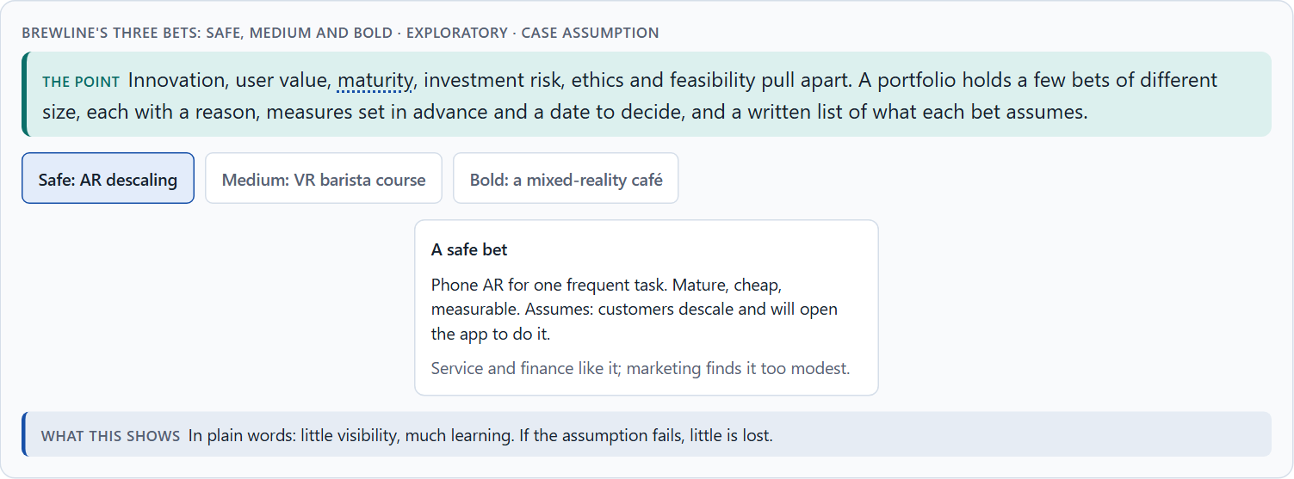
Innovation, value, maturity, risk, ethics: the conflicts of the future
B2 · 20 min · Core
Future technologies sit between the degree of innovation and user value, visibility and maturity, investment risk and the risk of falling behind, ethics and speed, and feasibility. A portfolio of a few bets of different size, each with a reason, measures set in advance and a decision date, makes the conflicts manageable; write down what each bet assumes.
Brewline's three bets: safe, medium and bold · Exploratory.
Screenshot of the Neuro-UX Lab (aion-ux-lab.vercel.app), own work; AI-assisted, labelled on the image; the example company is fictional.
Sources: GOV.UK Service Manual · Slater & Sanchez-Vives 2016 · Kaplan et al. 2021 · Rebenitsch & Owen 2016 · Miller et al. 2020
Notes:
B2 · Innovation, value, maturity, risk, ethics: the conflicts of the future · 20 min · Core
Case assumption: Brewline, Zara, Edgar, Kim and Ruth are made up for this example; the 3D machine is a generic model. The bets are a reading of the example, not a rule for every company. The findings in the table of real evidence are real research results, rules and cases; the sources are listed below.
Go deeper (optional reading): A future technology becomes a reputational risk when it is launched as a promise and experienced as a gimmick: when the headline outruns the product. The safest way to protect reputation is to let the evidence lead the announcement, not the other way round.
Sources: GOV.UK Service Manual · Slater & Sanchez-Vives 2016 · Kaplan et al. 2021 · Rebenitsch & Owen 2016 · Miller et al. 2020

Slide 33
B2 · In plain words
THE IDEA
WHY IT MATTERS
Future technologies sit between goals that pull apart: the degree of innovation against user value, visibility against maturity, investment risk against the risk of falling behind, ethics against speed, and all of them against feasibility. The way through is a portfolio: a few bets of different size and maturity, each with a reason, success measures set in advance, and a date to decide whether to scale, change or stop; and a written list of the assumptions each bet rests on.
Block 3.1 asks for three decisions, a risk analysis of wrong assumptions about innovation, user behaviour, market maturity and economics, and a governance model for conflicts between visibility, effect, risk and effort. Each is a decision between conflicting goals.
HOW TO READ THE PICTURE
Brewline's three bets, a safe one, a medium one and a bold one, with what each costs and what it can teach.
Sources: GOV.UK Service Manual · Slater & Sanchez-Vives 2016 · Kaplan et al. 2021 · Rebenitsch & Owen 2016 · Miller et al. 2020
Notes:
B2 · Innovation, value, maturity, risk, ethics: the conflicts of the future · 20 min · Core
Case assumption: Brewline, Zara, Edgar, Kim and Ruth are made up for this example; the 3D machine is a generic model. The bets are a reading of the example, not a rule for every company. The findings in the table of real evidence are real research results, rules and cases; the sources are listed below.
Go deeper (optional reading): A future technology becomes a reputational risk when it is launched as a promise and experienced as a gimmick: when the headline outruns the product. The safest way to protect reputation is to let the evidence lead the announcement, not the other way round.
Sources: GOV.UK Service Manual · Slater & Sanchez-Vives 2016 · Kaplan et al. 2021 · Rebenitsch & Owen 2016 · Miller et al. 2020

Slide 34
B2 · Standing conflicts of future technologies
Conflict | Who usually stands for each side | What to ask
Innovation against user value | The board and the lab, against users and service. | Which user problem does it solve better?
Visibility against maturity | Marketing, against engineering. | Does it work in the real environment, at scale?
Investment risk against falling behind | Finance, against strategy. | What is the smallest bet that teaches us enough?
Ethics against speed | Data protection and safety, against the launch date. | What does it record, and who could be harmed?
Sources: GOV.UK Service Manual · Slater & Sanchez-Vives 2016 · Kaplan et al. 2021 · Rebenitsch & Owen 2016 · Miller et al. 2020
Notes:
B2 · Innovation, value, maturity, risk, ethics: the conflicts of the future · 20 min · Core
Case assumption: Brewline, Zara, Edgar, Kim and Ruth are made up for this example; the 3D machine is a generic model. The bets are a reading of the example, not a rule for every company. The findings in the table of real evidence are real research results, rules and cases; the sources are listed below.
Go deeper (optional reading): A future technology becomes a reputational risk when it is launched as a promise and experienced as a gimmick: when the headline outruns the product. The safest way to protect reputation is to let the evidence lead the announcement, not the other way round.
Sources: GOV.UK Service Manual · Slater & Sanchez-Vives 2016 · Kaplan et al. 2021 · Rebenitsch & Owen 2016 · Miller et al. 2020

Slide 35
B2 · Conflicts of the future, with evidence
Conflict | What the evidence says | A way to decide
Innovation against user value | Training in extended reality was about as effective as non-simulated training, not more (Kaplan et al. 2021). | Ask which user problem it solves better than the plain way.
Visibility against maturity | Cybersickness estimates range from about 30% to 80% of users in the reviewed work (Rebenitsch and Owen 2016, as reported). | Show it only where it works in the real environment, at scale.
Investment risk against falling behind | Government practice tests the riskiest assumption with a throwaway prototype first (GOV.UK Service Manual). | Choose the smallest bet that teaches enough.
Ethics against speed | Tracking data of five minutes can identify a person among hundreds (Miller et al. 2020, as reported). | Ask what it records and who could be harmed.
Sources: GOV.UK Service Manual · Slater & Sanchez-Vives 2016 · Kaplan et al. 2021 · Rebenitsch & Owen 2016 · Miller et al. 2020
Notes:
B2 · Innovation, value, maturity, risk, ethics: the conflicts of the future · 20 min · Core
Case assumption: Brewline, Zara, Edgar, Kim and Ruth are made up for this example; the 3D machine is a generic model. The bets are a reading of the example, not a rule for every company. The findings in the table of real evidence are real research results, rules and cases; the sources are listed below.
Go deeper (optional reading): A future technology becomes a reputational risk when it is launched as a promise and experienced as a gimmick: when the headline outruns the product. The safest way to protect reputation is to let the evidence lead the announcement, not the other way round.
Sources: GOV.UK Service Manual · Slater & Sanchez-Vives 2016 · Kaplan et al. 2021 · Rebenitsch & Owen 2016 · Miller et al. 2020

Slide 36
B2 · How to decide when this comes up in the task
Name each conflict as two goals and say who stands for each: board, units, safety, finance, users.
1
Hold a few bets of different size: safe, medium, bold.
2
Write down the assumptions each bet rests on: innovation, user behaviour, market maturity, economics.
3
Set the measures and the decision date before the pilot starts.
4
Say what the choice gives up.
5
Sources: GOV.UK Service Manual · Slater & Sanchez-Vives 2016 · Kaplan et al. 2021 · Rebenitsch & Owen 2016 · Miller et al. 2020
Notes:
B2 · Innovation, value, maturity, risk, ethics: the conflicts of the future · 20 min · Core
Case assumption: Brewline, Zara, Edgar, Kim and Ruth are made up for this example; the 3D machine is a generic model. The bets are a reading of the example, not a rule for every company. The findings in the table of real evidence are real research results, rules and cases; the sources are listed below.
Go deeper (optional reading): A future technology becomes a reputational risk when it is launched as a promise and experienced as a gimmick: when the headline outruns the product. The safest way to protect reputation is to let the evidence lead the announcement, not the other way round.
Sources: GOV.UK Service Manual · Slater & Sanchez-Vives 2016 · Kaplan et al. 2021 · Rebenitsch & Owen 2016 · Miller et al. 2020

Slide 37
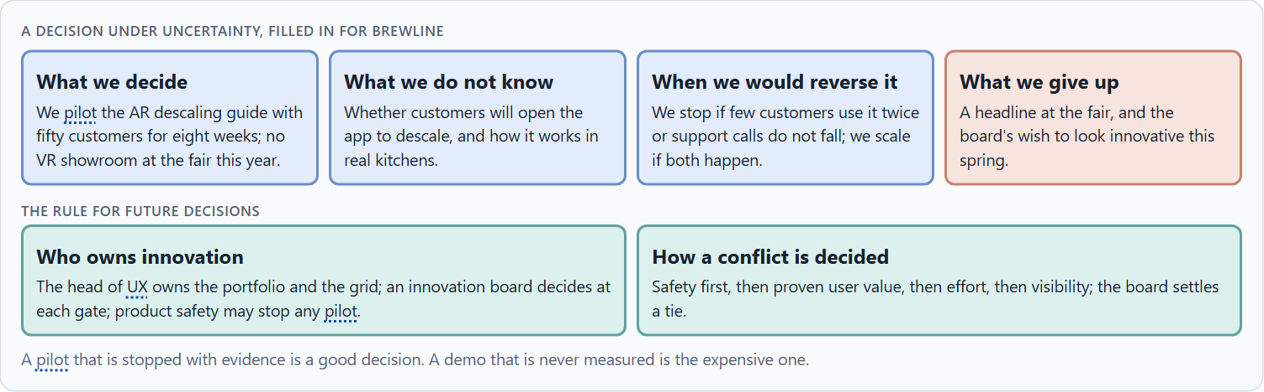
Who decides on future technologies, and deciding without test data
B3 · 20 min · Core
Future technologies need an owner of the portfolio, one evaluation grid for every idea, stage gates with measures set before a pilot, the right to stop a pilot (not a failure), and a rule for when visibility, effect, risk and effort disagree. With patchy tests, a decision says what it decides, does not know, would reverse and gives up.
A decision under uncertainty, filled in for Brewline.
Screenshot of the Neuro-UX Lab (aion-ux-lab.vercel.app), own work; AI-assisted, labelled on the image; the example company is fictional.
Sources: GOV.UK Service Manual · Simon 1956 · Klein 2007 · GOV.UK Service Standard · Miller et al. 2020
Notes:
B3 · Who decides on future technologies, and deciding without test data · 20 min · Core
Case assumption: Brewline, Zara, Edgar, Kim and Ruth are made up for this example; the 3D machine is a generic model. “It's not a failure to stop” follows the GOV.UK Service Manual; deciding with limited information follows Simon (1956); the premortem follows Klein (2007). The findings in the table of real evidence are real research results, rules and cases; the sources are listed below.
Go deeper (optional reading): The most expensive innovation decisions are the ones nobody made: pilots that were never stopped and never scaled, kept alive by goodwill. A gate with a date forces the decision. Write the stop criteria down before the pilot starts, when nobody is attached to it yet.
Sources: GOV.UK Service Manual · Simon 1956 · Klein 2007 · GOV.UK Service Standard · Miller et al. 2020

Slide 38
B3 · In plain words
THE IDEA
WHY IT MATTERS
Future technologies need owners and gates: someone who owns the innovation portfolio, an evaluation grid used for every idea, stage gates with success measures set before a pilot starts, the right to stop a pilot (it is not a failure), and a rule for when visibility, effect, risk and effort disagree. Real test data is usually missing at the start; a decision under uncertainty says what you decide, what you do not know, when you would reverse it and what you give up.
Block 3.1 asks for a governance model for future technologies in the UX portfolio, a decision despite missing tests, and a statement to the management. This card gives you the parts of each.
HOW TO READ THE PICTURE
The four boxes at the top are the parts of a decision, filled in for Brewline. The two boxes below are the rule for future decisions.
Sources: GOV.UK Service Manual · Simon 1956 · Klein 2007 · GOV.UK Service Standard · Miller et al. 2020
Notes:
B3 · Who decides on future technologies, and deciding without test data · 20 min · Core
Case assumption: Brewline, Zara, Edgar, Kim and Ruth are made up for this example; the 3D machine is a generic model. “It's not a failure to stop” follows the GOV.UK Service Manual; deciding with limited information follows Simon (1956); the premortem follows Klein (2007). The findings in the table of real evidence are real research results, rules and cases; the sources are listed below.
Go deeper (optional reading): The most expensive innovation decisions are the ones nobody made: pilots that were never stopped and never scaled, kept alive by goodwill. A gate with a date forces the decision. Write the stop criteria down before the pilot starts, when nobody is attached to it yet.
Sources: GOV.UK Service Manual · Simon 1956 · Klein 2007 · GOV.UK Service Standard · Miller et al. 2020

Slide 39
B3 · Four parts of innovation governance
Part | The question | An example (Brewline)
Owner and grid | Who owns the portfolio; how is every idea scored? | The head of UX; value, maturity, effort, scaling, responsibility.
Gates | What must a pilot show before it grows? | Use, completion, support calls, cost, by a set date.
Stop right | Who may stop a pilot? | The innovation board; product safety at any time.
How a conflict is decided | What happens when visibility, effect, risk and effort disagree? | Safety, then proven value, then effort, then visibility; the board settles a tie.
Sources: GOV.UK Service Manual · Simon 1956 · Klein 2007 · GOV.UK Service Standard · Miller et al. 2020
Notes:
B3 · Who decides on future technologies, and deciding without test data · 20 min · Core
Case assumption: Brewline, Zara, Edgar, Kim and Ruth are made up for this example; the 3D machine is a generic model. “It's not a failure to stop” follows the GOV.UK Service Manual; deciding with limited information follows Simon (1956); the premortem follows Klein (2007). The findings in the table of real evidence are real research results, rules and cases; the sources are listed below.
Go deeper (optional reading): The most expensive innovation decisions are the ones nobody made: pilots that were never stopped and never scaled, kept alive by goodwill. A gate with a date forces the decision. Write the stop criteria down before the pilot starts, when nobody is attached to it yet.
Sources: GOV.UK Service Manual · Simon 1956 · Klein 2007 · GOV.UK Service Standard · Miller et al. 2020

Slide 40
B3 · Who decides on future technologies: real practice
Part | Real example | What it means
Gates | Each phase of a UK government service ends with an assessment against the Service Standard (GOV.UK Service Standard). | Write the gate for each pilot: use, completion, support, cost, by a date.
The stop right | The guidance says to decide on evidence, including to stop (GOV.UK Service Manual). | Name who may stop a pilot, and give product safety a stop at any time.
The record | Motion data is identifying (Miller et al. 2020, as reported). | Record what each pilot collects, and who can see it.
Sources: GOV.UK Service Manual · Simon 1956 · Klein 2007 · GOV.UK Service Standard · Miller et al. 2020
Notes:
B3 · Who decides on future technologies, and deciding without test data · 20 min · Core
Case assumption: Brewline, Zara, Edgar, Kim and Ruth are made up for this example; the 3D machine is a generic model. “It's not a failure to stop” follows the GOV.UK Service Manual; deciding with limited information follows Simon (1956); the premortem follows Klein (2007). The findings in the table of real evidence are real research results, rules and cases; the sources are listed below.
Go deeper (optional reading): The most expensive innovation decisions are the ones nobody made: pilots that were never stopped and never scaled, kept alive by goodwill. A gate with a date forces the decision. Write the stop criteria down before the pilot starts, when nobody is attached to it yet.
Sources: GOV.UK Service Manual · Simon 1956 · Klein 2007 · GOV.UK Service Standard · Miller et al. 2020

Slide 41
B3 · How to decide when this comes up in the task
Name who owns the innovation portfolio and the grid.
1
Set the measures and the decision date before every pilot.
2
Give a board the right to scale, change or stop, and safety the right to stop.
3
Settle conflicts by safety first, then proven value, then effort, then visibility; say who settles a tie.
4
Say what you decide, what you do not know, when you would reverse it and what you give up.
5
Sources: GOV.UK Service Manual · Simon 1956 · Klein 2007 · GOV.UK Service Standard · Miller et al. 2020
Notes:
B3 · Who decides on future technologies, and deciding without test data · 20 min · Core
Case assumption: Brewline, Zara, Edgar, Kim and Ruth are made up for this example; the 3D machine is a generic model. “It's not a failure to stop” follows the GOV.UK Service Manual; deciding with limited information follows Simon (1956); the premortem follows Klein (2007). The findings in the table of real evidence are real research results, rules and cases; the sources are listed below.
Go deeper (optional reading): The most expensive innovation decisions are the ones nobody made: pilots that were never stopped and never scaled, kept alive by goodwill. A gate with a date forces the decision. Write the stop criteria down before the pilot starts, when nobody is attached to it yet.
Sources: GOV.UK Service Manual · Simon 1956 · Klein 2007 · GOV.UK Service Standard · Miller et al. 2020

Slide 42
Sources (1)
Milgram, P., & Kishino, F. (1994). A taxonomy of mixed reality visual displays. IEICE Transactions on Information and Systems, E77-D(12), 1321–1329.
Slater, M., & Sanchez-Vives, M. V. (2016). Enhancing our lives with immersive virtual reality. Frontiers in Robotics and AI, 3, 74.
Apple Inc. Human Interface Guidelines: Immersive experiences. https://developer.apple.com/design/human-interface-guidelines/immersive-experiences (read 29.10.2026).
Lavie, N. (2005). Distracted and confused?: Selective attention under load. Trends in Cognitive Sciences, 9(2), 75–82.
Rebenitsch, L., & Owen, C. (2016). Review on cybersickness in applications and visual displays. Virtual Reality, 20(2), 101–125.
Kaplan, A. D., Cruit, J., Endsley, M., Beers, S. M., Sawyer, B. D., & Hancock, P. A. (2021). The effects of virtual reality, augmented reality, and mixed reality as training enhancement methods: A meta-analysis. Human Factors, 63(4), 706–726. https://doi.org/10.1177/0018720820904229
Government Digital Service. Service Manual: How the discovery phase works; How the alpha phase works. https://www.gov.uk/service-manual/agile-delivery (read 29.10.2026).

Slide 43
Sources (2)
GOV.UK Service Manual. Service Standard. https://www.gov.uk/service-manual/service-standard
Gibbons, S. (2018). Using Prioritization Matrices to Inform UX Decisions. Nielsen Norman Group. https://www.nngroup.com/articles/prioritization-matrices/
Miller, M. R., Herrera, F., Jun, H., Landay, J. A., & Bailenson, J. N. (2020). Personal identifiability of user tracking data during observation of 360-degree VR video. Scientific Reports, 10, 17404. https://doi.org/10.1038/s41598-020-74486-y
Simon, H. A. (1956). Rational choice and the structure of the environment. Psychological Review, 63(2), 129–138.
Klein, G. (2007). Performing a project premortem. Harvard Business Review, 85(9), 18–19.

Slide 44
About these slides, sources and AI use
AI
AI-assisted content
Where to find more
AI-assisted content: these slides were drafted with an AI language model (Claude, Anthropic) from the course's own Neuro-UX Lab and were read, corrected and approved by Muhammad Muchson, who is responsible for their accuracy.
Pictures are screenshots of the course's own Neuro-UX Lab. Each one carries an AI label on the image and a source line under it.
Companies and people in the examples are fictional. Numbers inside an example are labelled Case assumption and are not data.
Neuro-UX Lab for this day: https://aion-ux-lab.vercel.app/day/14/
Handouts: the Materi and Task Word documents of the day.
Version 1.0, 29.10.2026. Reviewer and approver: Muhammad Muchson.

