Slide 1
UX DEVELOPER · DAY 15
Eye-tracking and gaze behaviour, neurofeedback and brain-computer interfaces
Training slides: tasks, coaching, case study and feedback
Module 7 (day 2 of 3)
Trainer: Muhammad Muchson · Case: VisionMind Lab
Contains AI-assisted content

Slide 2
The day at a glance (1)
UE | Min | What | What happens
1 | 45 | Knowledge transfer · Level 1 | The trainer presents the cards of Materi A (A1, A2, A3, A4, A5, about 60 min of cards) in the Neuro-UX Lab; participants follow in the handout.
2 | 45 | Level 1 · Task 1 | Individual work on Block 1.1 (Core, about 10 min): the first product of the day is read and its effect described. Pairs then compare their results and the trainer collects open questions.
3 | 45 | Level 1 · Task 2 | Three options are rated on the same criteria and one is chosen under the stated conditions: Block 1.2 (Core, about 8 min).
4 | 45 | Coaching · transition from Level 1 to Level 2 | Trainer-led. A short talk on the day's coaching focus, then the reflection questions in pairs. The bridge: from describing an effect to a decision you answer for. There is no worksheet block in this unit.
5–6 | 90 | Level 2 · Case study VisionMind Lab (2 UE) incl. model solution | UE5: the trainer presents the case; participants work on Block 2.1 (Core, about 15 min). UE6: groups compare their results and defend them; the trainer closes with the model solution.
7 | 45 | Level 2 + 3 · Feedback round with a management perspective | Groups present their reasoning, not only their result. The trainer asks the day's Level 3 input questions and leads the discussion.
One UE is 45 minutes; breaks are not shown.
Notes:
One UE (teaching unit) is counted as 45 minutes; breaks are not shown.

Slide 3
The day at a glance (2)
UE | Min | What | What happens
8 | 45 | Level 3 · Transfer project, Chief Experience Officer (3 UE: UE8–10) | The trainer presents Materi B (B1, B2, B3; use the "In plain words" and "How to decide" boxes, the rest is handout) and sets the role and the situation.
9 | 45 | Level 3 · Transfer project | Individual work or in pairs on Block 3.1 (Core, about 20 min): the strategy memo.
10 | 45 | Level 3 · Transfer project | Participants present their decision and what they give up, including the one decision made under uncertainty; the trainer debriefs with the model solution.
One UE is 45 minutes; breaks are not shown.
Notes:
One UE (teaching unit) is counted as 45 minutes; breaks are not shown.

Slide 4
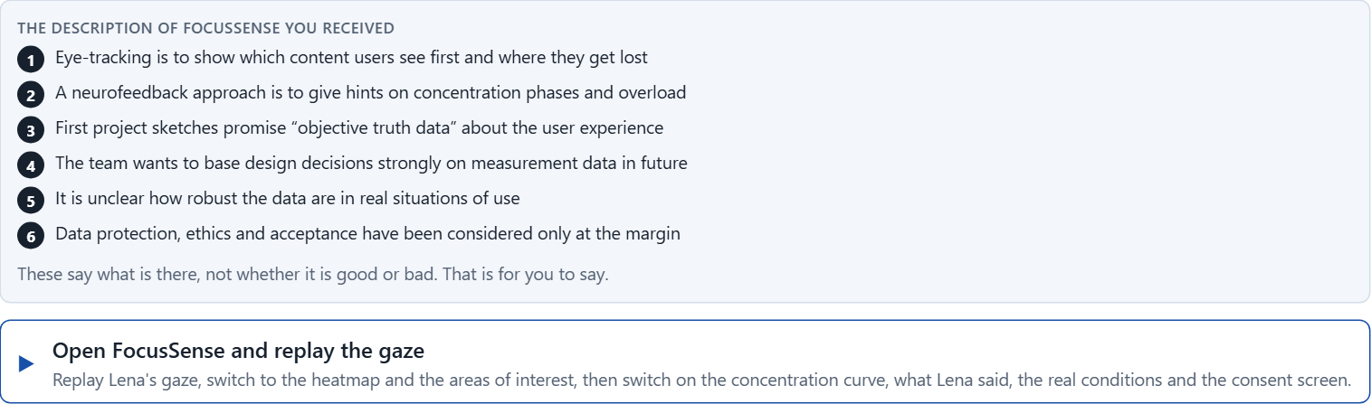
Block 1.1 · Weigh the insight value and limits of neuro-based UX technologies: FocusSense
Level 1 · Knowledge · about 10 min
You receive the description of a fictional innovation project, FocusSense, for analysing and improving a digital learning portal. Open it: replay a learner's gaze on a lesson page, switch between the scanpath and the heatmap, look at the neurofeedback “concentration” curve, then read what the learner said afterwards and look at the recording under real conditions. You need no prior knowledge: notice what the data shows, and what someone would have to add to it. The aim is to judge neuro-based UX technologies in a differentiated way and to tell measurement, interpretation and management use apart.
Screenshot of the Neuro-UX Lab (aion-ux-lab.vercel.app), own work; AI-assisted, labelled on the image; the example company is fictional.
Draws on: A1 · What eye-tracking measures · A2 · Looking is not understanding · A3 · Neurofeedback and brain-computer interfaces at their real maturity · A5 · Ethics, data protection and voluntariness, and weighing a measure.
Notes:
Block 1.1 · Weigh the insight value and limits of neuro-based UX technologies: FocusSense · about 10 min. Draws on: A1 · What eye-tracking measures · A2 · Looking is not understanding · A3 · Neurofeedback and brain-computer interfaces at their real maturity · A5 · Ethics, data protection and voluntariness, and weighing a measure.

Slide 5
Block 1.1 · What you work on
Describe spontaneously which chances and risks this project could have from a professional and an organisational point of view
1
Name at least 5 places where eye-tracking, neurofeedback or BCI could create real insight or problematic over-stretching
2
Assign the observations to the categories insight value, interpretation risk, ethics, acceptance, feasibility and decision relevance
3
Write an effect statement for three points: “For users, the team or the company this could mean that …”
4
Prioritise the two biggest chances and the two biggest risks of the project
5
Notes:
Block 1.1 · Weigh the insight value and limits of neuro-based UX technologies: FocusSense · about 10 min. Draws on: A1 · What eye-tracking measures · A2 · Looking is not understanding · A3 · Neurofeedback and brain-computer interfaces at their real maturity · A5 · Ethics, data protection and voluntariness, and weighing a measure.

Slide 6
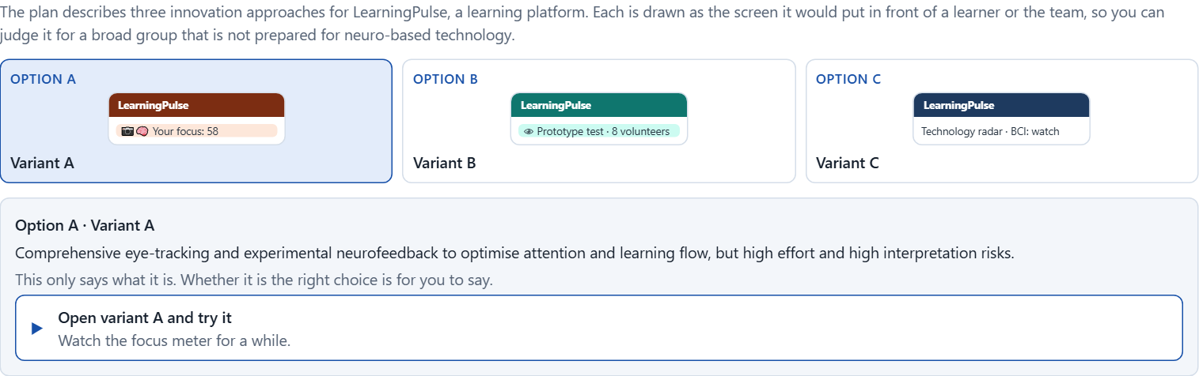
Block 1.2 · Rate eye-tracking and BCI-based approaches under conflicting goals: LearningPulse
Level 1 · Knowledge · about 8 min
LearningPulse is a learning platform. Three innovation approaches are described in words: A) comprehensive eye-tracking and experimental neurofeedback to optimise attention and learning flow, but with high effort and high interpretation risks; B) targeted eye-tracking for prototype tests and interface analysis, without direct integration into the product; C) exploratory observation of BCI technologies with little immediate product use, but low risk and high learning potential. The conditions: the company wants to appear innovative and close to science, the budget for research and piloting is limited, the target group is broad and not prepared for neuro-based technologies, data protection and ethical questions are sensitive, there are only few practical references in its own market, and first results are to be visible within 5 months. Decide anyway, and say what you assume.
Screenshot of the Neuro-UX Lab (aion-ux-lab.vercel.app), own work; AI-assisted, labelled on the image; the example company is fictional.
Draws on: A3 · Neurofeedback and brain-computer interfaces at their real maturity · A4 · Insight, interpretation risk and decision relevance · A5 · Ethics, data protection and voluntariness, and weighing a measure.
Notes:
Block 1.2 · Rate eye-tracking and BCI-based approaches under conflicting goals: LearningPulse · about 8 min. Draws on: A3 · Neurofeedback and brain-computer interfaces at their real maturity · A4 · Insight, interpretation risk and decision relevance · A5 · Ethics, data protection and voluntariness, and weighing a measure.

Slide 7
Block 1.2 · What you work on
Rate each variant on insight gain, validity, risk, acceptance, market proximity and economic viability
1
Decide which variant is the most viable under the given conditions
2
Name the conflicts of goals between research ambition, market maturity and responsible introduction
3
Which risks remain despite your decision?
4
Formulate a recommendation to the project lead
5
Notes:
Block 1.2 · Rate eye-tracking and BCI-based approaches under conflicting goals: LearningPulse · about 8 min. Draws on: A3 · Neurofeedback and brain-computer interfaces at their real maturity · A4 · Insight, interpretation risk and decision relevance · A5 · Ethics, data protection and voluntariness, and weighing a measure.

Slide 8
Coaching · UE4
Transition: Level 1 to Level 2
From fascination with measurement to responsible insight and interaction architecture
From describing an effect to a decision you answer for.
Notes:
UE4 · Coaching: transition from Level 1 to Level 2. Trainer-led: a short talk on the coaching focus, then the reflection questions in pairs.

Slide 9
Coaching · questions we talk through
When does eye-tracking give real UX value, and when only seemingly objective data?
How do I handle conflicts between innovation ambition, evidence and fitness for everyday use?
1
5
How do I recognise whether gaze data are interpreted sensibly or over-stretched?
How do I argue towards stakeholders who treat neuro data as indisputable truth?
2
6
What do ethics, data protection and voluntariness demand?
Which decisions are operational, which strategic for the research portfolio, product development and trust?
3
7
When is neurofeedback a sensible UX instrument, and when is it too experimental?
4
Notes:
UE4 · Coaching: transition from Level 1 to Level 2. Trainer-led: a short talk on the coaching focus, then the reflection questions in pairs.

Slide 10
Coaching · reflect in pairs
1
2
3
Where is “measurable” confused with “reliable”?
Which use of eye-tracking is sensible now, and which is still exploratory?
When does neuro-based UX turn from a chance for insight into an ethics or reputation risk?
Notes:
UE4 · Coaching: transition from Level 1 to Level 2. Trainer-led: a short talk on the coaching focus, then the reflection questions in pairs.

Slide 11
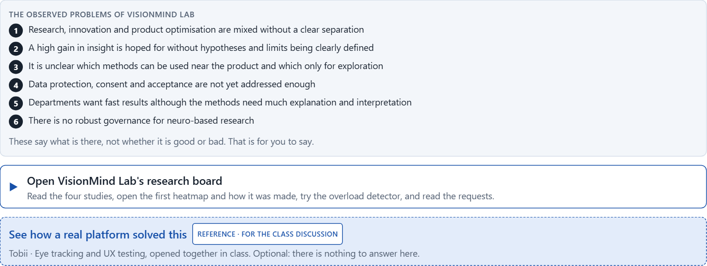
Block 2.1 · Case study: an evaluation strategy for the UX research project VisionMind Lab
Level 2 · Case study · UE5–6 · about 15 min
A company wants to extend its UX research and is examining eye-tracking, neurofeedback and first brain-computer interface concepts to optimise a complex service portal. The aim is to understand attention paths better, to recognise overload and, in the long run, to open up new forms of interaction. Inside there is great excitement about what can be measured; at the same time, experience with interpreting the data, ethics governance and product-near evaluation criteria is missing. The observed problems: research, innovation and product optimisation are mixed without a clear separation; a high gain in insight is hoped for without hypotheses and limits being clearly defined; it is unclear which methods can be used near the product and which only for exploration; data protection, consent and acceptance are not yet addressed enough; departments want fast results although the methods need much explanation and interpretation; and there is no robust governance for neuro-based research. The conditions: a budget of €240,000 for research, piloting and evaluation, 18 weeks for the first pilot and decision phase, the company wants to appear innovative but must not create trust risks, product integration is only realistic to a limited extent in the short term, there is little data in its own market, and first insights must be prepared for management. You work through six steps.
Screenshot of the Neuro-UX Lab (aion-ux-lab.vercel.app), own work; AI-assisted, labelled on the image; the example company is fictional.
Draws on: A1 · What eye-tracking measures · A2 · Looking is not understanding · A3 · Neurofeedback and brain-computer interfaces at their real maturity · A4 · Insight, interpretation risk and decision relevance · A5 · Ethics, data protection and voluntariness, and weighing a measure.
Notes:
Block 2.1 · Case study: an evaluation strategy for the UX research project VisionMind Lab · about 15 min. Draws on: A1 · What eye-tracking measures · A2 · Looking is not understanding · A3 · Neurofeedback and brain-computer interfaces at their real maturity · A4 · Insight, interpretation risk and decision relevance · A5 · Ethics, data protection and voluntariness, and weighing a measure.

Slide 12
Block 2.1 · What you work on
Analyse the central chances and risks of the research project
1
Assign the observations to the categories insight value, validity, ethics, data protection, market proximity and decision readiness
2
Develop 4 prioritised measures for a responsible pilot and evaluation strategy
3
Justify your selection using effect on users, feasibility, risk, time pressure and reputation security
4
Make a prioritisation decision for the first 18 weeks
5
Formulate a recommendation to the division head
6
Notes:
Block 2.1 · Case study: an evaluation strategy for the UX research project VisionMind Lab · about 15 min. Draws on: A1 · What eye-tracking measures · A2 · Looking is not understanding · A3 · Neurofeedback and brain-computer interfaces at their real maturity · A4 · Insight, interpretation risk and decision relevance · A5 · Ethics, data protection and voluntariness, and weighing a measure.

Slide 13
Feedback round · how each group presents
Each group presents its prioritised measures in 5 minutes
1
The reasoning runs along effect, feasibility, risk and responsibility
2
Each group names one measure it deliberately postponed
3
Notes:
UE7 · Feedback round with a management perspective. Groups present their reasoning, not only their result.

Slide 14
Feedback round · questions to answer
Which measure gives the most insight at acceptable risk?
Which risks arise if neuro measurements are marketed faster than they are understood?
1
4
Which measure is the most important strategically for a responsible neuro-based UX roadmap?
Which decision is responsible despite little market experience?
2
5
Where was robust research prioritised, and where only fascination with data?
3
Notes:
UE7 · Feedback round with a management perspective. Groups present their reasoning, not only their result.

Slide 15
Level 3 input and discussion
INPUT LEVEL 3
DISCUSSION
Neuro-based UX at senior level is a question of insight governance, ethics and innovation responsibility
Balance research interest, closeness to the market, data protection, validity and economics
Responsibility shows in not only producing data but clearly limiting and steering its strategic use
When does a data-driven innovation project become a trust problem although it seems scientifically interesting?
Notes:
UE7 · Feedback round with a management perspective. Groups present their reasoning, not only their result.

Slide 16
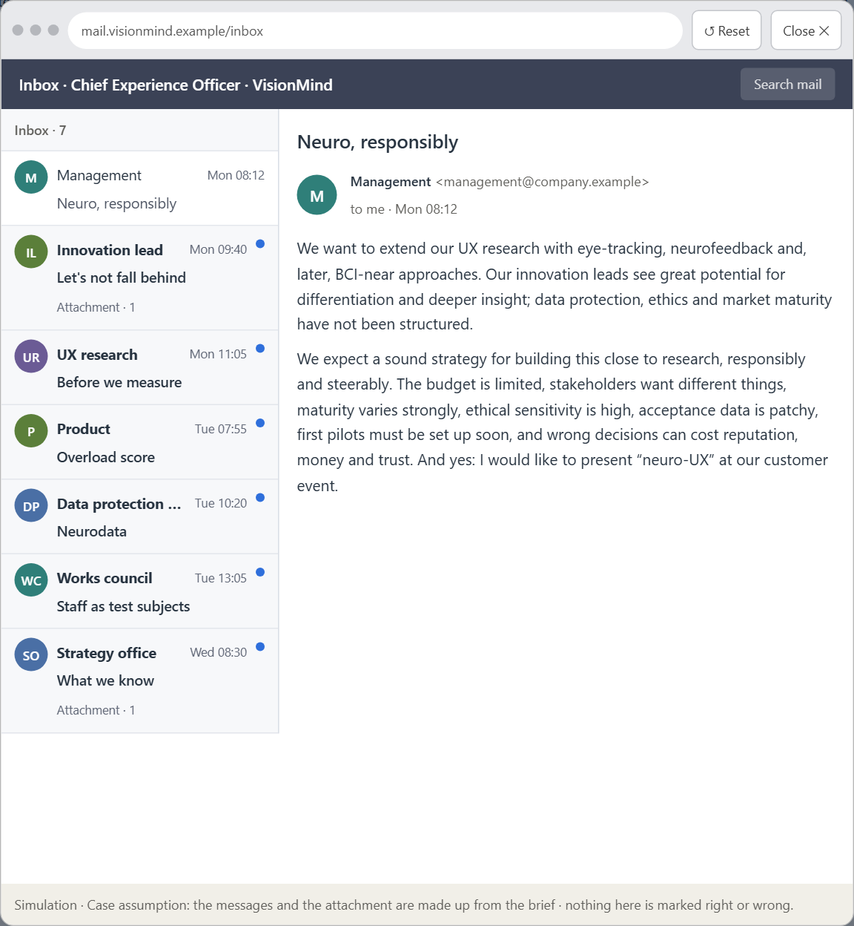
Block 3.1 · A strategic research and UX architecture for eye-tracking, neurofeedback and BCI-near innovation
Level 3 · Transfer project · UE8–10 · about 20 min
You take the perspective of the Chief Experience Officer of a company with complex digital products, the company behind VisionMind Lab. It wants to extend its UX research and is examining where eye-tracking, neurofeedback and, later, BCI-near approaches can be used sensibly. Innovation leads see great potential for differentiation and deeper insight into users; data protection, ethics and market maturity have not been structured. The management expects a sound strategy for building neuro-based technologies close to research, responsibly and in a steerable way. Your task is not to introduce new measurement methods uncritically, but to develop a sound decision architecture for insight, ethics governance, piloting and the strategic use of neuro-based UX technologies.
Screenshot of the Neuro-UX Lab (aion-ux-lab.vercel.app), own work; AI-assisted, labelled on the image; the example company is fictional.
Draws on: B1 · Neuro-based UX as an insight architecture, not measurement fascination · B2 · Value, validity, effort, ethics, data protection, maturity · B3 · Governance for neurodata, and deciding with thin evidence.
Notes:
Block 3.1 · A strategic research and UX architecture for eye-tracking, neurofeedback and BCI-near innovation · about 20 min. Draws on: B1 · Neuro-based UX as an insight architecture, not measurement fascination · B2 · Value, validity, effort, ethics, data protection, maturity · B3 · Governance for neurodata, and deciding with thin evidence.

Slide 17
Block 3.1 · What you work on
1
A guiding vision for neuro-based UX research and interaction: which form of insight, innovation and user value should be pursued systematically?
2
Three strategic guiding decisions on eye-tracking, neurofeedback, BCI proximity, ethics, data protection and product connection
3
A prioritised architecture of measures: which research questions, pilot fields or products are looked at first, and why?
4
A risk analysis: which wrong assumptions about data quality, user acceptance, market maturity and strategic value would be especially critical?
5
A governance model: who is responsible for neuro-based research, ethical approvals and the strategic translation into product or innovation decisions?
6
A decision under uncertainty: make at least one prioritised decision despite patchy evidence and justify it responsibly
7
A management statement: a recommendation to the management with a clear priority and a strategic reason
Notes:
Block 3.1 · A strategic research and UX architecture for eye-tracking, neurofeedback and BCI-near innovation · about 20 min. Draws on: B1 · Neuro-based UX as an insight architecture, not measurement fascination · B2 · Value, validity, effort, ethics, data protection, maturity · B3 · Governance for neurodata, and deciding with thin evidence.

Slide 18
Reflect before you leave
1
2
3
Which decision did you make today, and what did you give up to make it?
Which assumption would you check first with real users, and how?
What will you do differently in your next project because of today?
Use two minutes alone, then one minute with your neighbour.

Slide 19
About these slides, sources and AI use
AI
AI-assisted content
Where to find more
AI-assisted content: these slides were drafted with an AI language model (Claude, Anthropic) from the course's own Neuro-UX Lab and were read, corrected and approved by Muhammad Muchson, who is responsible for their accuracy.
Pictures are screenshots of the course's own Neuro-UX Lab. Each one carries an AI label on the image and a source line under it.
Companies and people in the examples are fictional. Numbers inside an example are labelled Case assumption and are not data.
The coaching and feedback questions are the course plan's own, translated into English.
Neuro-UX Lab for this day: https://aion-ux-lab.vercel.app/day/15/
Handouts: the Materi and Task Word documents of the day.
Version 1.0, 29.10.2026. Reviewer and approver: Muhammad Muchson.

