Slide 1
UX DEVELOPER · DAY 16
Immersive prototyping and testing, future strategies and ethical aspects
Knowledge transfer slides
Module 7 (day 3 of 3)
Trainer: Muhammad Muchson · Materi A and B · v1.0
Contains AI-assisted content

Slide 2
What we cover today
Today is about turning experiments into decisions. You learn the steps from a concept idea through a prototype and a pilot to a scalable solution, what an immersive prototype must do before it can be tested, which aspects to test (orientation, presence, overload, error robustness, acceptance, transfer to real use), the ethical questions new interaction and neurotechnologies raise, and why a technology has to be responsible, connectable and governable, not only new. Then you use it on three platforms, including real 3D prototypes you can turn, and you look at what a headset maker requires before an app goes to market and what the European Union bans and demands. This document holds everything you need to study Day 16 without the website. Every card says what the idea is in plain words, shows it in a picture, gives the details and ends with the rules you use in the tasks.
Materi A · 60 min
Materi B · 60 min
A1 From concept idea to scalable solution: the ladder of immersive prototyping (12 min)
A2 Testing immersive systems: orientation, presence, overload, error robustness, acceptance, transfer (12 min)
A3 Feasible or responsible: future-proof UX strategy and its ethical questions (12 min)
A4 Responsible, connectable, governable: maturity, learning and the UX portfolio (12 min)
A5 When not to scale, and weighing a scaling decision (12 min)
B1 Future-proof UX as a responsible innovation and decision architecture (20 min)
B2 Innovation pressure, ethics, economics, value, maturity, portfolio: the conflicts (20 min)
B3 Who decides to scale, pause or stop, and deciding with incomplete data (20 min)

Slide 3
A
Materi A
Route 1 · Levels 1 and 2
About 60 minutes, five cards. Levels 1 and 2: judge an immersive innovation project strategically, organisationally and ethically, rate three strategy options under uncertainty, then analyse a company's immersive prototypes, develop four measures for a responsible scaling decision, justify them and decide on the first 16 weeks. The cards give you the ideas and the rules you use in Task 1.

Slide 4
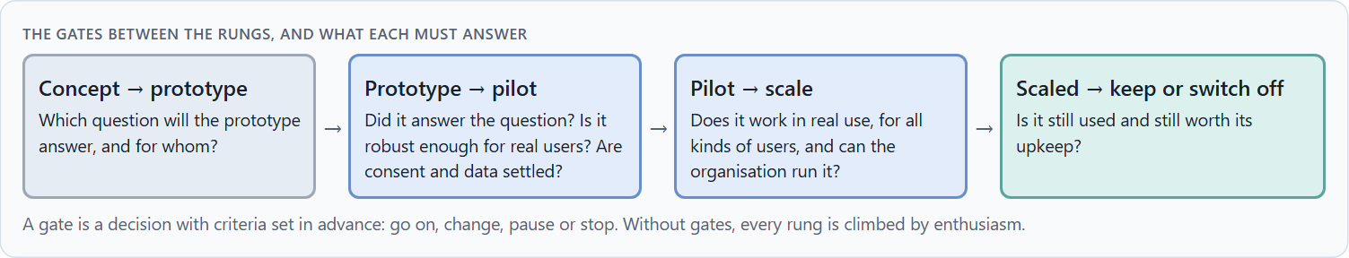
From concept idea to scalable solution: the ladder of immersive prototyping
A1 · 12 min · Core
An immersive idea climbs a ladder: a concept idea says what could be, a prototype makes one question testable, a pilot shows whether it works for real users in one place, a scalable solution keeps working for many with support and an owner. Each rung proves something different, with a gate before the next. A prototype must fit the context of use, make the interaction clear, be technically robust, resilient and testable.
The gates between the rungs, and what each must answer.
Screenshot of the Neuro-UX Lab (aion-ux-lab.vercel.app), own work; AI-assisted, labelled on the image; the example company is fictional.
Sources: Houde & Hill 1997 · Buchenau & Fulton Suri 2000 · Cooper 1990 · GOV.UK Service Standard
Notes:
A1 · From concept idea to scalable solution: the ladder of immersive prototyping · 12 min · Core
Case assumption: Fernwood, Leila, Sam, Rafael and Greta are made up for this example; the corridor and the reports are drawn for the lesson. What prototypes prototype follows Houde and Hill (1997) and Buchenau and Fulton Suri (2000); gates between stages follow Cooper (1990). The findings in the table of real evidence are real research results, rules and cases; the sources are listed below.
Go deeper (optional reading): The go/no-go meeting is the moment a ladder is either climbed or abandoned. It works only if the criteria were written before the rung, by people who will not be judged by the answer. Otherwise every prototype passes, because everyone in the room wants it to.
Sources: Houde & Hill 1997 · Buchenau & Fulton Suri 2000 · Cooper 1990 · GOV.UK Service Standard

Slide 5
A1 · In plain words
THE IDEA
WHY IT MATTERS
An immersive idea climbs a ladder. A concept idea describes what could be. A prototype makes one question testable, for example “can guests find their room with AR arrows?”. A pilot puts a working version in front of real users in one place for a limited time. A scalable solution keeps working for many people, places and devices, with support and maintenance. Each rung proves something different, and each needs a gate before the next. An immersive prototype must fit the context of use, make the interaction clear, be technically robust, cope with stress (resilience) and be testable.
Block 1.1 asks where RealityFlow's prototyping is not clarified enough, Block 1.2 compares strategies that climb at different speeds, and Block 2.1 asks which of NextWorld UX's prototypes is ready to scale. This card gives you the rungs and what each must prove.
HOW TO READ THE PICTURE
Fernwood's AR wayfinding on four rungs: a sketch, a prototype, a pilot in one hotel, and forty hotels. Below, the five requirements a prototype must meet.
Sources: Houde & Hill 1997 · Buchenau & Fulton Suri 2000 · Cooper 1990 · GOV.UK Service Standard
Notes:
A1 · From concept idea to scalable solution: the ladder of immersive prototyping · 12 min · Core
Case assumption: Fernwood, Leila, Sam, Rafael and Greta are made up for this example; the corridor and the reports are drawn for the lesson. What prototypes prototype follows Houde and Hill (1997) and Buchenau and Fulton Suri (2000); gates between stages follow Cooper (1990). The findings in the table of real evidence are real research results, rules and cases; the sources are listed below.
Go deeper (optional reading): The go/no-go meeting is the moment a ladder is either climbed or abandoned. It works only if the criteria were written before the rung, by people who will not be judged by the answer. Otherwise every prototype passes, because everyone in the room wants it to.
Sources: Houde & Hill 1997 · Buchenau & Fulton Suri 2000 · Cooper 1990 · GOV.UK Service Standard

Slide 6
A1 · What an immersive prototype must have
Requirement | The question | Example (Fernwood)
Context of use | Where, when and by whom will it be used? | Late arrivals with luggage, tired, in a new wing.
Clarity of interaction | Is it obvious what to do? | One arrow, one room number, nothing else.
Technical robustness | Does it work on the devices guests have? | Old phones, low battery, weak signal.
Resilience | Does it cope with stress and failure? | A fallback route when tracking is lost.
Testability | Can a test show something? | A task, a measure: found the room without asking staff.
Sources: Houde & Hill 1997 · Buchenau & Fulton Suri 2000 · Cooper 1990 · GOV.UK Service Standard
Notes:
A1 · From concept idea to scalable solution: the ladder of immersive prototyping · 12 min · Core
Case assumption: Fernwood, Leila, Sam, Rafael and Greta are made up for this example; the corridor and the reports are drawn for the lesson. What prototypes prototype follows Houde and Hill (1997) and Buchenau and Fulton Suri (2000); gates between stages follow Cooper (1990). The findings in the table of real evidence are real research results, rules and cases; the sources are listed below.
Go deeper (optional reading): The go/no-go meeting is the moment a ladder is either climbed or abandoned. It works only if the criteria were written before the rung, by people who will not be judged by the answer. Otherwise every prototype passes, because everyone in the room wants it to.
Sources: Houde & Hill 1997 · Buchenau & Fulton Suri 2000 · Cooper 1990 · GOV.UK Service Standard

Slide 7
A1 · The ladder in real practice
Rung or tool | Real source or example | What it means for a decision
What a prototype answers | A prototype can answer questions about the role of a product, its look and feel, and its implementation (Houde and Hill 1997). | Say which question each rung answers, and do not read more into it.
Experience prototyping | Experience prototypes let people live through a situation rather than only look at a design (Buchenau and Fulton Suri 2000). | For immersive systems test the experience in the place of use, not a screenshot.
Gates | A stage-gate system separates stages by gates where a project must meet criteria to continue, change or stop (Cooper 1990). UK government services pass discovery, alpha, beta and live, each with an assessment (GOV.UK Service Standard). | Write the gate criteria before the pilot starts.
A real case on the ladder | Google ran an Explorer programme for Glass from 2013, ended the sale of the consumer version in January 2015, sold an enterprise edition from 2017 and stopped selling it in March 2023 (press reports, as reported). | A product can leave a rung or step back to another: the ladder is not a one-way road.
Sources: Houde & Hill 1997 · Buchenau & Fulton Suri 2000 · Cooper 1990 · GOV.UK Service Standard
Notes:
A1 · From concept idea to scalable solution: the ladder of immersive prototyping · 12 min · Core
Case assumption: Fernwood, Leila, Sam, Rafael and Greta are made up for this example; the corridor and the reports are drawn for the lesson. What prototypes prototype follows Houde and Hill (1997) and Buchenau and Fulton Suri (2000); gates between stages follow Cooper (1990). The findings in the table of real evidence are real research results, rules and cases; the sources are listed below.
Go deeper (optional reading): The go/no-go meeting is the moment a ladder is either climbed or abandoned. It works only if the criteria were written before the rung, by people who will not be judged by the answer. Otherwise every prototype passes, because everyone in the room wants it to.
Sources: Houde & Hill 1997 · Buchenau & Fulton Suri 2000 · Cooper 1990 · GOV.UK Service Standard

Slide 8
A1 · How to decide when this comes up in the task
Say which rung a project is really on, whatever its slides say.
1
Name the one question a prototype must answer.
2
Check the five requirements: context of use, clear interaction, robustness, resilience, testability.
3
Set the gate criteria before the rung is climbed.
4
Count the cost of the last rung: maps, support, updates, an owner.
5
Sources: Houde & Hill 1997 · Buchenau & Fulton Suri 2000 · Cooper 1990 · GOV.UK Service Standard
Notes:
A1 · From concept idea to scalable solution: the ladder of immersive prototyping · 12 min · Core
Case assumption: Fernwood, Leila, Sam, Rafael and Greta are made up for this example; the corridor and the reports are drawn for the lesson. What prototypes prototype follows Houde and Hill (1997) and Buchenau and Fulton Suri (2000); gates between stages follow Cooper (1990). The findings in the table of real evidence are real research results, rules and cases; the sources are listed below.
Go deeper (optional reading): The go/no-go meeting is the moment a ladder is either climbed or abandoned. It works only if the criteria were written before the rung, by people who will not be judged by the answer. Otherwise every prototype passes, because everyone in the room wants it to.
Sources: Houde & Hill 1997 · Buchenau & Fulton Suri 2000 · Cooper 1990 · GOV.UK Service Standard

Slide 9
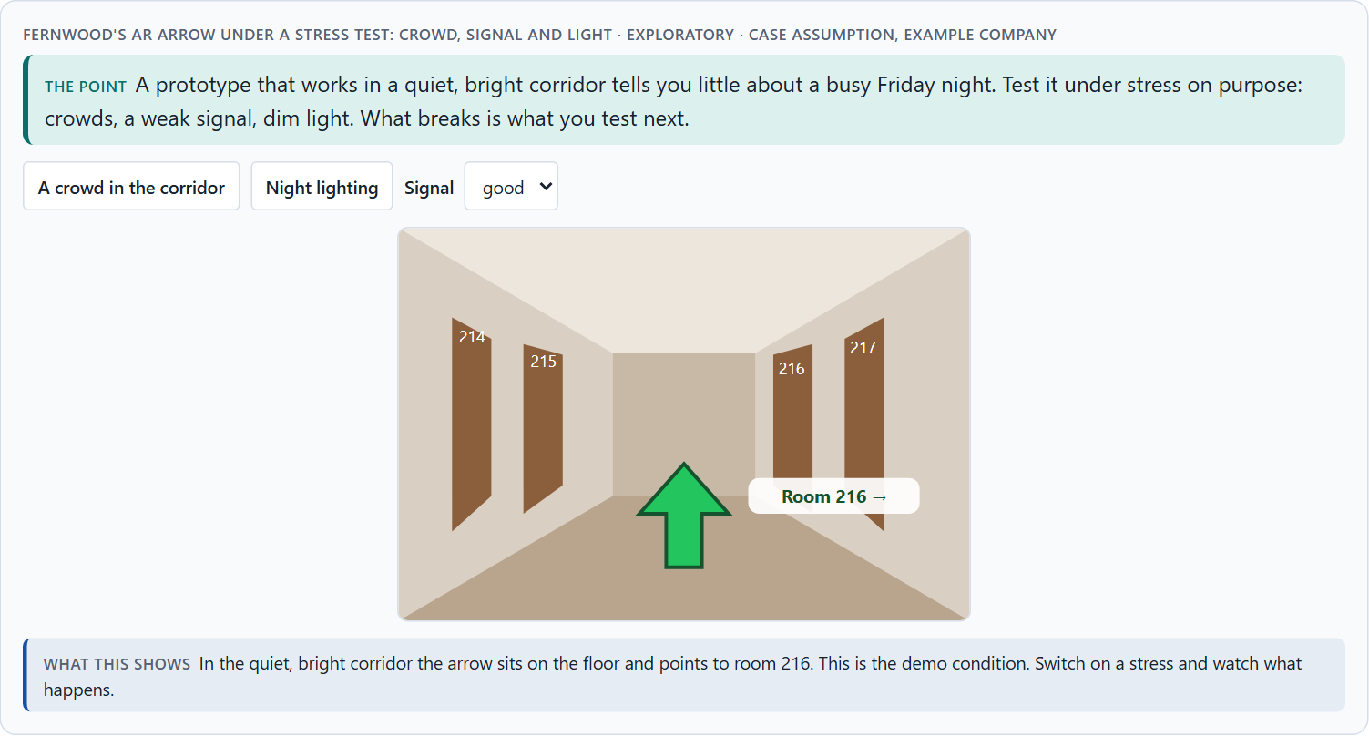
Testing immersive systems: orientation, presence, overload, error robustness, acceptance, transfer
A2 · 12 min · Core
Immersive systems need six kinds of test: orientation (do people know where they are), presence (do they feel there, and does it help), overload (is it too much), error robustness (what happens when something fails), acceptance (will all kinds of people use it again) and transfer (does it work in real use). Transfer is the most underestimated and the most decisive for scaling.
Fernwood's AR arrow under a stress test: crowd, signal and light · Exploratory.
Screenshot of the Neuro-UX Lab (aion-ux-lab.vercel.app), own work; AI-assisted, labelled on the image; the example company is fictional.
Sources: Witmer & Singer 1998 · Kennedy et al. 1993 · Meta Horizon Store policies · Kaplan et al. 2021 · Miller et al. 2020
Notes:
A2 · Testing immersive systems: orientation, presence, overload, error robustness, acceptance, transfer · 12 min · Core
Case assumption: Fernwood, Leila, Sam, Rafael and Greta are made up for this example; the corridor and the reports are drawn for the lesson. Asking about presence follows Witmer and Singer (1998); asking about simulator sickness follows Kennedy et al. (1993); rating comfort on one scale before release follows Meta's store policies. The findings in the table of real evidence are real research results, rules and cases; the sources are listed below.
Go deeper (optional reading): Grade the evidence, not only the result. A finding from five colleagues in a quiet room is a hint; the same finding from thirty real guests on busy nights is evidence. Write the grade next to every result, so that a hint is never presented as proof.
Sources: Witmer & Singer 1998 · Kennedy et al. 1993 · Meta Horizon Store policies · Kaplan et al. 2021 · Miller et al. 2020

Slide 10
A2 · In plain words
THE IDEA
WHY IT MATTERS
Immersive systems need tests that a screen never needed. Orientation: do people know where they are and where to go? Presence: do they feel there, and is that helpful? Overload: is it too much to take in? Error robustness: what happens when the signal drops or someone makes a mistake? Acceptance: will people use it again, all kinds of people? Transfer: does what works in the test work in real use, with noise, time pressure and other people? Transfer is the most underestimated, and the most decisive for scaling.
Block 1.1 asks where RealityFlow's testing is unclear, and Block 2.1 asks why NextWorld UX's feedback cannot be compared and what makes a prototype ready to scale. This card gives you the six aspects and a way to test each.
HOW TO READ THE PICTURE
Fernwood's AR arrow under test. Below, the six test aspects with how to test each.
Sources: Witmer & Singer 1998 · Kennedy et al. 1993 · Meta Horizon Store policies · Kaplan et al. 2021 · Miller et al. 2020
Notes:
A2 · Testing immersive systems: orientation, presence, overload, error robustness, acceptance, transfer · 12 min · Core
Case assumption: Fernwood, Leila, Sam, Rafael and Greta are made up for this example; the corridor and the reports are drawn for the lesson. Asking about presence follows Witmer and Singer (1998); asking about simulator sickness follows Kennedy et al. (1993); rating comfort on one scale before release follows Meta's store policies. The findings in the table of real evidence are real research results, rules and cases; the sources are listed below.
Go deeper (optional reading): Grade the evidence, not only the result. A finding from five colleagues in a quiet room is a hint; the same finding from thirty real guests on busy nights is evidence. Write the grade next to every result, so that a hint is never presented as proof.
Sources: Witmer & Singer 1998 · Kennedy et al. 1993 · Meta Horizon Store policies · Kaplan et al. 2021 · Miller et al. 2020

Slide 11
A2 · Six test aspects and how to test them
Aspect | How to test it | Example (Fernwood)
Orientation | Give a task; watch where people hesitate or turn back. | Find room 216 from the lift.
Presence | Ask a short presence questionnaire after the session. | Did the VR room feel like a real room?
Overload | Count what competes for attention; ask how demanding it was. | Arrow, number, offers, sounds.
Error robustness | Cause failures on purpose: lost signal, a wrong turn. | Tracking lost in the lift lobby.
Acceptance | Ask again after the second and third use; include sceptics. | Would Sam use it on his next stay?
Transfer | Test in the real place and moment, not the lab. | Friday night, crowd, night lighting.
Sources: Witmer & Singer 1998 · Kennedy et al. 1993 · Meta Horizon Store policies · Kaplan et al. 2021 · Miller et al. 2020
Notes:
A2 · Testing immersive systems: orientation, presence, overload, error robustness, acceptance, transfer · 12 min · Core
Case assumption: Fernwood, Leila, Sam, Rafael and Greta are made up for this example; the corridor and the reports are drawn for the lesson. Asking about presence follows Witmer and Singer (1998); asking about simulator sickness follows Kennedy et al. (1993); rating comfort on one scale before release follows Meta's store policies. The findings in the table of real evidence are real research results, rules and cases; the sources are listed below.
Go deeper (optional reading): Grade the evidence, not only the result. A finding from five colleagues in a quiet room is a hint; the same finding from thirty real guests on busy nights is evidence. Write the grade next to every result, so that a hint is never presented as proof.
Sources: Witmer & Singer 1998 · Kennedy et al. 1993 · Meta Horizon Store policies · Kaplan et al. 2021 · Miller et al. 2020

Slide 12
A2 · Testing immersive systems: instruments and rules
Aspect | Real instrument or rule | What it means for a test
Overload and sickness | The Simulator Sickness Questionnaire asks about 16 symptoms on a four-step scale and scores nausea, oculomotor strain and disorientation (Kennedy et al. 1993). | Use a standard instrument before and after a session, not an ad hoc question.
Presence | The Presence Questionnaire gives a structured way to ask how present people felt (Witmer and Singer 1998). | Ask after the session, and relate it to the task, not only to the feeling.
Comfort on a platform | Meta's store policies ask apps to rate their comfort on one scale and to show content ratings and warnings before release (Meta Horizon Store policies). | Plan for the rating the platform will require.
Transfer | XR training was about as effective as non-simulated training in a meta-analysis (Kaplan et al. 2021). | Test in the real place and moment: the lab result is not the transfer.
Data | Motion tracking data identified people with above 95% accuracy in a study of over 500 participants (Miller et al. 2020, as reported). | Decide what a test records, and for how long it is kept.
Sources: Witmer & Singer 1998 · Kennedy et al. 1993 · Meta Horizon Store policies · Kaplan et al. 2021 · Miller et al. 2020
Notes:
A2 · Testing immersive systems: orientation, presence, overload, error robustness, acceptance, transfer · 12 min · Core
Case assumption: Fernwood, Leila, Sam, Rafael and Greta are made up for this example; the corridor and the reports are drawn for the lesson. Asking about presence follows Witmer and Singer (1998); asking about simulator sickness follows Kennedy et al. (1993); rating comfort on one scale before release follows Meta's store policies. The findings in the table of real evidence are real research results, rules and cases; the sources are listed below.
Go deeper (optional reading): Grade the evidence, not only the result. A finding from five colleagues in a quiet room is a hint; the same finding from thirty real guests on busy nights is evidence. Write the grade next to every result, so that a hint is never presented as proof.
Sources: Witmer & Singer 1998 · Kennedy et al. 1993 · Meta Horizon Store policies · Kaplan et al. 2021 · Miller et al. 2020

Slide 13
A2 · How to decide when this comes up in the task
Test in the worst realistic moment: crowds, dark, no signal, time pressure.
1
Ask about presence and discomfort with standard questions after each session.
2
Break things on purpose and watch what people do.
3
Test with the people least like the team: older, newer, tired, sceptical.
4
Make every test comparable: the same tasks and measures across prototypes.
5
Sources: Witmer & Singer 1998 · Kennedy et al. 1993 · Meta Horizon Store policies · Kaplan et al. 2021 · Miller et al. 2020
Notes:
A2 · Testing immersive systems: orientation, presence, overload, error robustness, acceptance, transfer · 12 min · Core
Case assumption: Fernwood, Leila, Sam, Rafael and Greta are made up for this example; the corridor and the reports are drawn for the lesson. Asking about presence follows Witmer and Singer (1998); asking about simulator sickness follows Kennedy et al. (1993); rating comfort on one scale before release follows Meta's store policies. The findings in the table of real evidence are real research results, rules and cases; the sources are listed below.
Go deeper (optional reading): Grade the evidence, not only the result. A finding from five colleagues in a quiet room is a hint; the same finding from thirty real guests on busy nights is evidence. Write the grade next to every result, so that a hint is never presented as proof.
Sources: Witmer & Singer 1998 · Kennedy et al. 1993 · Meta Horizon Store policies · Kaplan et al. 2021 · Miller et al. 2020

Slide 14
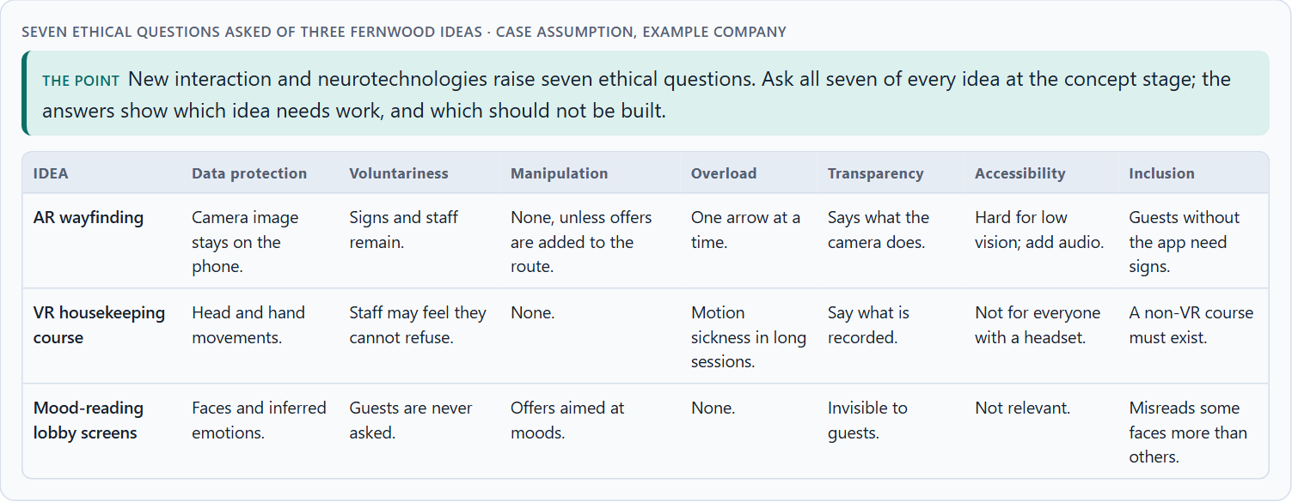
Feasible or responsible: future-proof UX strategy and its ethical questions
A3 · 12 min · Core
Feasibility asks “can we build it?”; a responsible UX strategy asks “should we, for whom, and how?”. New interaction and neurotechnologies raise seven ethical questions: data protection, voluntariness, potential for manipulation, cognitive overload, transparency, accessibility and inclusion. They are cheapest to answer at the concept stage and most expensive after scaling.
Seven ethical questions asked of three Fernwood ideas.
Screenshot of the Neuro-UX Lab (aion-ux-lab.vercel.app), own work; AI-assisted, labelled on the image; the example company is fictional.
Sources: Stilgoe, Owen & Macnaghten 2013 · European Commission, AI Act · EU AI Act 2024
Notes:
A3 · Feasible or responsible: future-proof UX strategy and its ethical questions · 12 min · Core
Case assumption: Fernwood, Leila, Sam, Rafael and Greta are made up for this example; the corridor and the reports are drawn for the lesson. Anticipation, reflection, inclusion and responsiveness follow Stilgoe, Owen and Macnaghten (2013); the EU bans emotion recognition at work and in education and harmful manipulation (European Commission, AI Act). The findings in the table of real evidence are real research results, rules and cases; the sources are listed below.
Go deeper (optional reading): The biggest blind spots sit between feasibility and responsibility: a team that can build something rarely asks whether it should, and the people who would ask are rarely in the room when it is built. Invite them to the concept stage, not the launch.
Sources: Stilgoe, Owen & Macnaghten 2013 · European Commission, AI Act · EU AI Act 2024

Slide 15
A3 · In plain words
THE IDEA
WHY IT MATTERS
Technological feasibility asks “can we build it?”. A responsible UX strategy asks “should we, for whom, and how?”. New interaction and neurotechnologies raise seven ethical questions: data protection (what is recorded), voluntariness (can people say no), potential for manipulation (does it steer people for us), cognitive overload (is it too much), transparency (do people know what happens), accessibility (can everyone use it) and inclusion (who is left out). They are cheapest to answer at the concept stage and most expensive after scaling.
Block 1.1 asks where RealityFlow's ethics are unclear, Block 1.2 rates the ethics of three strategies, and Block 2.1 asks to build ethics into the scaling logic. This card gives you the questions by name.
HOW TO READ THE PICTURE
Left Fernwood asking “can we build it?”, right “should we, and how?”. Below, the seven ethical questions asked of three Fernwood ideas.
Sources: Stilgoe, Owen & Macnaghten 2013 · European Commission, AI Act · EU AI Act 2024
Notes:
A3 · Feasible or responsible: future-proof UX strategy and its ethical questions · 12 min · Core
Case assumption: Fernwood, Leila, Sam, Rafael and Greta are made up for this example; the corridor and the reports are drawn for the lesson. Anticipation, reflection, inclusion and responsiveness follow Stilgoe, Owen and Macnaghten (2013); the EU bans emotion recognition at work and in education and harmful manipulation (European Commission, AI Act). The findings in the table of real evidence are real research results, rules and cases; the sources are listed below.
Go deeper (optional reading): The biggest blind spots sit between feasibility and responsibility: a team that can build something rarely asks whether it should, and the people who would ask are rarely in the room when it is built. Invite them to the concept stage, not the launch.
Sources: Stilgoe, Owen & Macnaghten 2013 · European Commission, AI Act · EU AI Act 2024

Slide 16
A3 · Feasible or responsible: a framework and the rules
Source | Real framework or rule | What it means for a strategy
Responsible innovation | Stilgoe, Owen and Macnaghten name four dimensions: anticipation, reflexivity, inclusion and responsiveness (Stilgoe et al. 2013). | Ask the four questions at every gate: what could follow, what are we assuming, who is missing, what will we change?
Banned practice | The EU AI Act prohibits emotion recognition in workplaces and educational institutions, with exceptions for medical and safety reasons (Article 5(1)(f)). | Some applications are not allowed at all: check before you build.
Transparency | People have to be told that they are interacting with an AI system, unless that is obvious (EU AI Act, Article 50). | Label AI in immersive scenes, including AI characters.
Social acceptance | Glass met a public backlash, with signs in businesses and the name “Glassholes”, in the account of press reports (as reported). | Include the people around the user in the inclusion question.
Sources: Stilgoe, Owen & Macnaghten 2013 · European Commission, AI Act · EU AI Act 2024
Notes:
A3 · Feasible or responsible: future-proof UX strategy and its ethical questions · 12 min · Core
Case assumption: Fernwood, Leila, Sam, Rafael and Greta are made up for this example; the corridor and the reports are drawn for the lesson. Anticipation, reflection, inclusion and responsiveness follow Stilgoe, Owen and Macnaghten (2013); the EU bans emotion recognition at work and in education and harmful manipulation (European Commission, AI Act). The findings in the table of real evidence are real research results, rules and cases; the sources are listed below.
Go deeper (optional reading): The biggest blind spots sit between feasibility and responsibility: a team that can build something rarely asks whether it should, and the people who would ask are rarely in the room when it is built. Invite them to the concept stage, not the launch.
Sources: Stilgoe, Owen & Macnaghten 2013 · European Commission, AI Act · EU AI Act 2024

Slide 17
A3 · How to decide when this comes up in the task
Ask all seven questions of every idea before the first prototype.
1
Write down what is recorded, inferred and kept, and for how long.
2
Check that saying no is possible and costs nothing.
3
Ask whose interest any steering serves.
4
Name who cannot use it, and what they get instead.
5
Sources: Stilgoe, Owen & Macnaghten 2013 · European Commission, AI Act · EU AI Act 2024
Notes:
A3 · Feasible or responsible: future-proof UX strategy and its ethical questions · 12 min · Core
Case assumption: Fernwood, Leila, Sam, Rafael and Greta are made up for this example; the corridor and the reports are drawn for the lesson. Anticipation, reflection, inclusion and responsiveness follow Stilgoe, Owen and Macnaghten (2013); the EU bans emotion recognition at work and in education and harmful manipulation (European Commission, AI Act). The findings in the table of real evidence are real research results, rules and cases; the sources are listed below.
Go deeper (optional reading): The biggest blind spots sit between feasibility and responsibility: a team that can build something rarely asks whether it should, and the people who would ask are rarely in the room when it is built. Invite them to the concept stage, not the launch.
Sources: Stilgoe, Owen & Macnaghten 2013 · European Commission, AI Act · EU AI Act 2024

Slide 18
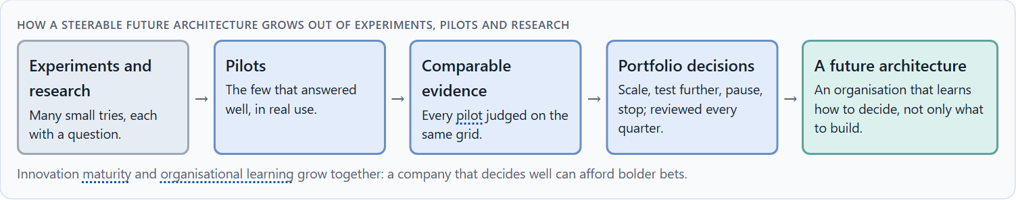
Responsible, connectable, governable: maturity, learning and the UX portfolio
A4 · 12 min · Core
A new technology must be responsible (no avoidable harm), connectable (fits the products, processes and systems already run) and governable (someone can decide, measure and stop it). How far a company can go depends on the technology's maturity and on its own ability to learn. Together they shape the UX portfolio: scale, test further, pause, stop.
How a steerable future architecture grows out of experiments, pilots and research.
Screenshot of the Neuro-UX Lab (aion-ux-lab.vercel.app), own work; AI-assisted, labelled on the image; the example company is fictional.
Sources: Argyris & Schön 1978 · Cooper 1990 · GOV.UK Service Standard · GOV.UK Service Manual
Notes:
A4 · Responsible, connectable, governable: maturity, learning and the UX portfolio · 12 min · Core
Case assumption: Fernwood, Leila, Sam, Rafael and Greta are made up for this example; the corridor and the reports are drawn for the lesson. Learning by questioning one's own assumptions follows Argyris and Schön (1978); deciding at gates follows Cooper (1990). The findings in the table of real evidence are real research results, rules and cases; the sources are listed below.
Go deeper (optional reading): Keep a quarter log: every three months, one line per initiative saying what was decided and why. After a year the log shows whether the company learns from its experiments, or only starts new ones.
Sources: Argyris & Schön 1978 · Cooper 1990 · GOV.UK Service Standard · GOV.UK Service Manual

Slide 19
A4 · In plain words
THE IDEA
WHY IT MATTERS
A new technology must be not only innovative but responsible (it does no avoidable harm), connectable (it fits the products, processes and systems the company already runs) and governable (someone can decide about it, measure it and stop it). How far a company can go depends on the maturity of the technology and on its own ability to learn: an organisation that tests, compares and decides well can hold more bold bets. Together they shape the UX portfolio: what is scaled, what is tested further, what is paused, what is stopped.
Block 1.1 asks about RealityFlow's scalability and organisational capability, Block 1.2 rates capacity to innovate and steerability, and Block 2.1 asks to focus NextWorld UX's portfolio. This card gives you the three tests and the four moves of a portfolio.
HOW TO READ THE PICTURE
Fernwood's five initiatives on a portfolio board. Below, how experiments grow into a steerable future architecture.
Sources: Argyris & Schön 1978 · Cooper 1990 · GOV.UK Service Standard · GOV.UK Service Manual
Notes:
A4 · Responsible, connectable, governable: maturity, learning and the UX portfolio · 12 min · Core
Case assumption: Fernwood, Leila, Sam, Rafael and Greta are made up for this example; the corridor and the reports are drawn for the lesson. Learning by questioning one's own assumptions follows Argyris and Schön (1978); deciding at gates follows Cooper (1990). The findings in the table of real evidence are real research results, rules and cases; the sources are listed below.
Go deeper (optional reading): Keep a quarter log: every three months, one line per initiative saying what was decided and why. After a year the log shows whether the company learns from its experiments, or only starts new ones.
Sources: Argyris & Schön 1978 · Cooper 1990 · GOV.UK Service Standard · GOV.UK Service Manual

Slide 20
A4 · Maturity, learning and the portfolio: real practice
Idea | Real source | What it means for a portfolio
Stages and gates | Cooper's stage-gate system manages new products through stages with gates (Cooper 1990). | Run every immersive line through the same gates, so lines can be compared.
Learning | Organisations learn when they question the assumptions behind their actions, not only the actions (Argyris and Schön 1978). | At each gate ask what the pilot taught about the assumptions, not only about the product.
Phased government practice | UK government services move through discovery, alpha, beta and live, and the Service Standard is applied at each (GOV.UK Service Standard; GOV.UK Service Manual). | Limit the number of lines in each phase.
Sources: Argyris & Schön 1978 · Cooper 1990 · GOV.UK Service Standard · GOV.UK Service Manual
Notes:
A4 · Responsible, connectable, governable: maturity, learning and the UX portfolio · 12 min · Core
Case assumption: Fernwood, Leila, Sam, Rafael and Greta are made up for this example; the corridor and the reports are drawn for the lesson. Learning by questioning one's own assumptions follows Argyris and Schön (1978); deciding at gates follows Cooper (1990). The findings in the table of real evidence are real research results, rules and cases; the sources are listed below.
Go deeper (optional reading): Keep a quarter log: every three months, one line per initiative saying what was decided and why. After a year the log shows whether the company learns from its experiments, or only starts new ones.
Sources: Argyris & Schön 1978 · Cooper 1990 · GOV.UK Service Standard · GOV.UK Service Manual

Slide 21
A4 · How to decide when this comes up in the task
Ask three questions of every initiative: responsible, connectable, governable?
1
Place it by maturity: concept, prototype, pilot, scalable.
2
Make one of four moves: scale, test further, pause, stop.
3
Review the portfolio regularly, not only when something goes wrong.
4
Ask what the organisation learned, not only what it built.
5
Sources: Argyris & Schön 1978 · Cooper 1990 · GOV.UK Service Standard · GOV.UK Service Manual
Notes:
A4 · Responsible, connectable, governable: maturity, learning and the UX portfolio · 12 min · Core
Case assumption: Fernwood, Leila, Sam, Rafael and Greta are made up for this example; the corridor and the reports are drawn for the lesson. Learning by questioning one's own assumptions follows Argyris and Schön (1978); deciding at gates follows Cooper (1990). The findings in the table of real evidence are real research results, rules and cases; the sources are listed below.
Go deeper (optional reading): Keep a quarter log: every three months, one line per initiative saying what was decided and why. After a year the log shows whether the company learns from its experiments, or only starts new ones.
Sources: Argyris & Schön 1978 · Cooper 1990 · GOV.UK Service Standard · GOV.UK Service Manual

Slide 22
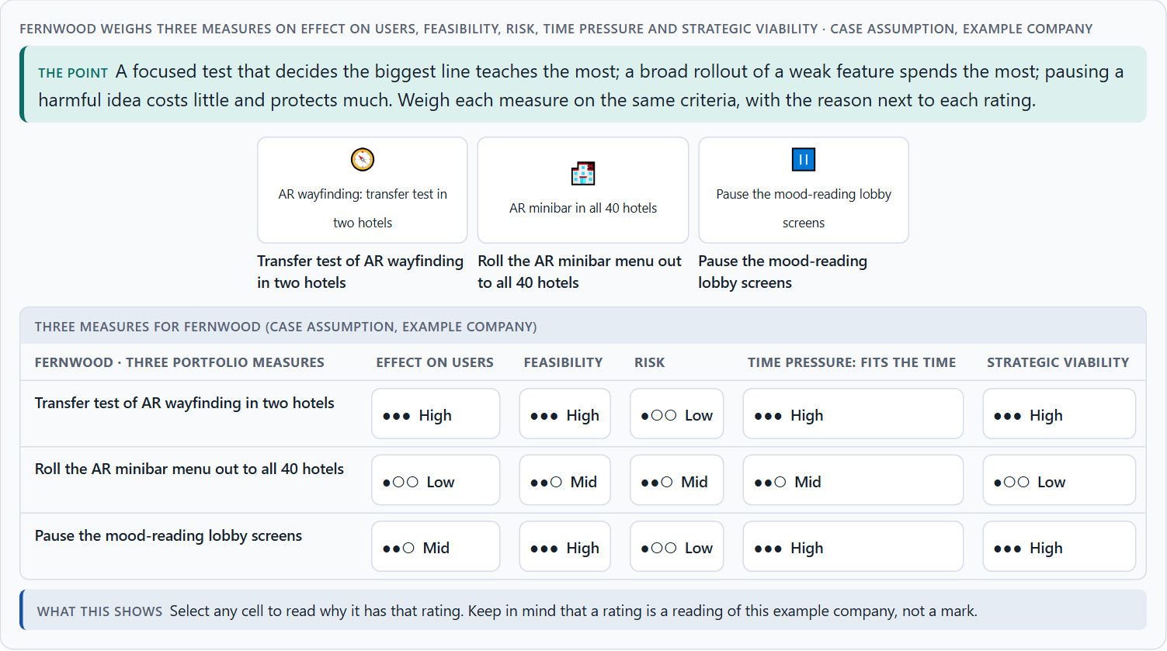
When not to scale, and weighing a scaling decision
A5 · 12 min · Core
Not scaling can be the best decision. Signs: it impresses but is rarely used again; it works only for some; it has not been tested in real use; its ethics are not settled; the organisation cannot support it; it does not fit the strategy. Weigh measures on effect on users, feasibility, risk, time pressure and strategic viability, with a reason for every rating.
Fernwood weighs three measures on effect on users, feasibility, risk, time pressure and strategic viability.
Screenshot of the Neuro-UX Lab (aion-ux-lab.vercel.app), own work; AI-assisted, labelled on the image; the example company is fictional.
Sources: Cooper 1990 · Gibbons 2018 · Kaplan et al. 2021 · Miller et al. 2020 · Rebenitsch & Owen 2016 · GOV.UK Service Manual
Notes:
A5 · When not to scale, and weighing a scaling decision · 12 min · Core
Case assumption: Fernwood, Leila, Sam, Rafael and Greta are made up for this example; the corridor and the reports are drawn for the lesson. Rating options on the same criteria follows Gibbons (2018); the five criteria are the ones the plan names for the case study. The findings in the table of real evidence are real research results, rules and cases; the sources are listed below.
Go deeper (optional reading): When ethics are only looked at after scaling, every answer is expensive: the system is built, people rely on it, and changing it means breaking promises. The same question asked at the concept stage costs a conversation.
Sources: Cooper 1990 · Gibbons 2018 · Kaplan et al. 2021 · Miller et al. 2020 · Rebenitsch & Owen 2016 · GOV.UK Service Manual

Slide 23
A5 · In plain words
THE IDEA
WHY IT MATTERS
Not scaling can be the best decision. Signs that a technology should not be scaled yet: it impresses but is rarely used again; it works only for some users; it has not been tested in real use; its ethics are not settled; the organisation cannot support it; or it does not fit the strategy. To put measures in order, weigh each on effect on users, feasibility, risk, time pressure and strategic viability, with a reason for every rating.
Block 1.1 asks for the biggest strategic risks, and Block 2.1 asks for four measures for a responsible scaling decision, justified on effect on users, feasibility, risk, time pressure and strategic viability. The example uses Fernwood and its own measures, so the answer for the task cases is not given.
HOW TO READ THE PICTURE
Six signs that Fernwood should not scale yet, as a checklist you can try on its AR minibar. Then three measures rated on five criteria.
Sources: Cooper 1990 · Gibbons 2018 · Kaplan et al. 2021 · Miller et al. 2020 · Rebenitsch & Owen 2016 · GOV.UK Service Manual
Notes:
A5 · When not to scale, and weighing a scaling decision · 12 min · Core
Case assumption: Fernwood, Leila, Sam, Rafael and Greta are made up for this example; the corridor and the reports are drawn for the lesson. Rating options on the same criteria follows Gibbons (2018); the five criteria are the ones the plan names for the case study. The findings in the table of real evidence are real research results, rules and cases; the sources are listed below.
Go deeper (optional reading): When ethics are only looked at after scaling, every answer is expensive: the system is built, people rely on it, and changing it means breaking promises. The same question asked at the concept stage costs a conversation.
Sources: Cooper 1990 · Gibbons 2018 · Kaplan et al. 2021 · Miller et al. 2020 · Rebenitsch & Owen 2016 · GOV.UK Service Manual

Slide 24
A5 · When not to scale: findings and a case
Reason not to scale | Real evidence | What it means for a decision
No advantage over the plain way | Training in extended reality was equally effective as non-simulated training (Kaplan et al. 2021). | If the plain way is as good, the case for scaling is cost, access or safety, not effect.
A harm that grows with scale | Motion tracking data can identify people (Miller et al. 2020, as reported), and sickness symptoms affect a large share of users (Rebenitsch and Owen 2016, as reported). | Ask what would be regretted if it went wrong at scale.
A product can be stopped | Google stopped selling Glass to consumers in January 2015 and the enterprise edition in March 2023 (press reports, as reported); government practice includes the decision to stop (GOV.UK Service Manual). | Name the stop decision as an expected outcome, not as a failure.
Sources: Cooper 1990 · Gibbons 2018 · Kaplan et al. 2021 · Miller et al. 2020 · Rebenitsch & Owen 2016 · GOV.UK Service Manual
Notes:
A5 · When not to scale, and weighing a scaling decision · 12 min · Core
Case assumption: Fernwood, Leila, Sam, Rafael and Greta are made up for this example; the corridor and the reports are drawn for the lesson. Rating options on the same criteria follows Gibbons (2018); the five criteria are the ones the plan names for the case study. The findings in the table of real evidence are real research results, rules and cases; the sources are listed below.
Go deeper (optional reading): When ethics are only looked at after scaling, every answer is expensive: the system is built, people rely on it, and changing it means breaking promises. The same question asked at the concept stage costs a conversation.
Sources: Cooper 1990 · Gibbons 2018 · Kaplan et al. 2021 · Miller et al. 2020 · Rebenitsch & Owen 2016 · GOV.UK Service Manual

Slide 25
A5 · How to decide when this comes up in the task
Check the six signs before every step to scale.
1
Treat a pause as a decision with a date to look again.
2
Treat a stop as a result: write down what was learned.
3
Rate every measure on the same five criteria, with a reason; a rating is a judgement, never a mark.
4
Prefer the measure that decides the biggest question for the least.
5
Sources: Cooper 1990 · Gibbons 2018 · Kaplan et al. 2021 · Miller et al. 2020 · Rebenitsch & Owen 2016 · GOV.UK Service Manual
Notes:
A5 · When not to scale, and weighing a scaling decision · 12 min · Core
Case assumption: Fernwood, Leila, Sam, Rafael and Greta are made up for this example; the corridor and the reports are drawn for the lesson. Rating options on the same criteria follows Gibbons (2018); the five criteria are the ones the plan names for the case study. The findings in the table of real evidence are real research results, rules and cases; the sources are listed below.
Go deeper (optional reading): When ethics are only looked at after scaling, every answer is expensive: the system is built, people rely on it, and changing it means breaking promises. The same question asked at the concept stage costs a conversation.
Sources: Cooper 1990 · Gibbons 2018 · Kaplan et al. 2021 · Miller et al. 2020 · Rebenitsch & Owen 2016 · GOV.UK Service Manual

Slide 26
B
Materi B
Route 2 · Level 3
About 60 minutes, three cards, led by the facilitator. Level 3 in the Chief Experience Officer's chair: a guiding vision for future-proof UX, three strategic decisions, what continues, pauses or ends, a risk analysis, a governance model, one decision under uncertainty and a statement to the management. The cards give you the ideas you use in Task 2.

Slide 27
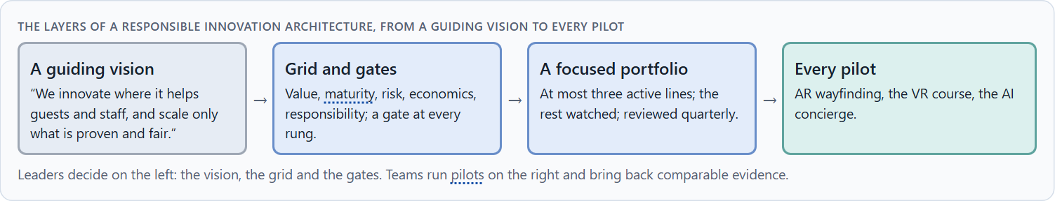
Future-proof UX as a responsible innovation and decision architecture
B1 · 20 min · Core
At senior level, future-proof UX is a responsible innovation and decision architecture: a guiding vision of the innovation and responsibility wanted, one evaluation grid with comparable evidence, gates from prototype to pilot to scale with ethics built in, and a portfolio reviewed regularly. Experiments become a future when each one ends in a decision.
The layers of a responsible innovation architecture, from a guiding vision to every pilot.
Screenshot of the Neuro-UX Lab (aion-ux-lab.vercel.app), own work; AI-assisted, labelled on the image; the example company is fictional.
Sources: Stilgoe, Owen & Macnaghten 2013 · Cooper 1990 · EU AI Act 2024
Notes:
B1 · Future-proof UX as a responsible innovation and decision architecture · 20 min · Core
Case assumption: Fernwood, Leila, Sam, Rafael and Greta are made up for this example; the corridor and the reports are drawn for the lesson. Responsible innovation follows Stilgoe, Owen and Macnaghten (2013); gates follow Cooper (1990). The findings in the table of real evidence are real research results, rules and cases; the sources are listed below.
Go deeper (optional reading): A future project is strategically connected when it would still matter if the technology changed: when it serves a lasting need of customers or staff. If it only matters because the technology is new, it is symbolic innovation, and it will age with the technology.
Sources: Stilgoe, Owen & Macnaghten 2013 · Cooper 1990 · EU AI Act 2024

Slide 28
B1 · In plain words
THE IDEA
WHY IT MATTERS
At senior level, future-proof UX is a responsible innovation and decision architecture: a guiding vision of the innovation and responsibility the company wants, one evaluation grid with comparable evidence, gates from prototype to pilot to scale with ethics built in, and a portfolio reviewed regularly. A steerable future architecture grows out of experiments, pilots and research when each one ends in a decision, not in a demo.
Block 3.1 asks for a guiding vision for future-proof UX, three decisions on prototyping, testing, scaling, ethics and portfolio, and what continues, pauses or ends. You decide the architecture, not single technologies.
HOW TO READ THE PICTURE
Left Fernwood collecting experiments, right running a steerable future architecture. Below, the layers from a guiding vision to every pilot.
Sources: Stilgoe, Owen & Macnaghten 2013 · Cooper 1990 · EU AI Act 2024
Notes:
B1 · Future-proof UX as a responsible innovation and decision architecture · 20 min · Core
Case assumption: Fernwood, Leila, Sam, Rafael and Greta are made up for this example; the corridor and the reports are drawn for the lesson. Responsible innovation follows Stilgoe, Owen and Macnaghten (2013); gates follow Cooper (1990). The findings in the table of real evidence are real research results, rules and cases; the sources are listed below.
Go deeper (optional reading): A future project is strategically connected when it would still matter if the technology changed: when it serves a lasting need of customers or staff. If it only matters because the technology is new, it is symbolic innovation, and it will age with the technology.
Sources: Stilgoe, Owen & Macnaghten 2013 · Cooper 1990 · EU AI Act 2024

Slide 29
B1 · Future-proof UX as a responsible decision architecture: structures
Part | Real source | What it means
Four dimensions | Anticipation, reflexivity, inclusion and responsiveness (Stilgoe et al. 2013). | Build the four questions into the process, not into a slide.
Gates | Stage-gate (Cooper 1990) and the phases of the GOV.UK Service Standard. | Define who decides at each gate and on what.
Law as a design input | EU AI Act, Articles 5 and 50. | Put the legal limits into the brief, not into the final review.
Sources: Stilgoe, Owen & Macnaghten 2013 · Cooper 1990 · EU AI Act 2024
Notes:
B1 · Future-proof UX as a responsible innovation and decision architecture · 20 min · Core
Case assumption: Fernwood, Leila, Sam, Rafael and Greta are made up for this example; the corridor and the reports are drawn for the lesson. Responsible innovation follows Stilgoe, Owen and Macnaghten (2013); gates follow Cooper (1990). The findings in the table of real evidence are real research results, rules and cases; the sources are listed below.
Go deeper (optional reading): A future project is strategically connected when it would still matter if the technology changed: when it serves a lasting need of customers or staff. If it only matters because the technology is new, it is symbolic innovation, and it will age with the technology.
Sources: Stilgoe, Owen & Macnaghten 2013 · Cooper 1990 · EU AI Act 2024

Slide 30
B1 · How to decide when this comes up in the task
Write a guiding vision: what innovation, for whom, and what responsibility.
1
Use one evaluation grid for every prototype and pilot.
2
Put an ethics gate before every pilot and every step to scale.
3
Keep a focused portfolio and review it every quarter.
4
Tell operational decisions (one pilot) from strategic ones (portfolio, governance, market position).
5
Sources: Stilgoe, Owen & Macnaghten 2013 · Cooper 1990 · EU AI Act 2024
Notes:
B1 · Future-proof UX as a responsible innovation and decision architecture · 20 min · Core
Case assumption: Fernwood, Leila, Sam, Rafael and Greta are made up for this example; the corridor and the reports are drawn for the lesson. Responsible innovation follows Stilgoe, Owen and Macnaghten (2013); gates follow Cooper (1990). The findings in the table of real evidence are real research results, rules and cases; the sources are listed below.
Go deeper (optional reading): A future project is strategically connected when it would still matter if the technology changed: when it serves a lasting need of customers or staff. If it only matters because the technology is new, it is symbolic innovation, and it will age with the technology.
Sources: Stilgoe, Owen & Macnaghten 2013 · Cooper 1990 · EU AI Act 2024

Slide 31
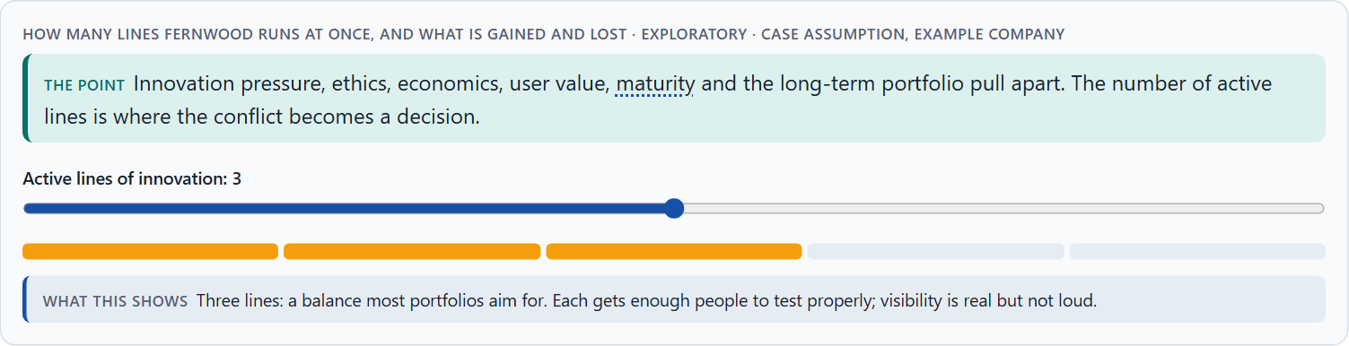
Innovation pressure, ethics, economics, value, maturity, portfolio: the conflicts
B2 · 20 min · Core
Future-proof UX sits between innovation pressure and maturity, ethics and speed, economic viability and a pioneer role, user value and visibility, the next quarter and the long-term portfolio. More active lines bring more visibility and less learning per line. A good portfolio states which conflicts it accepts and writes down what each line assumes.
How many lines Fernwood runs at once, and what is gained and lost · Exploratory.
Screenshot of the Neuro-UX Lab (aion-ux-lab.vercel.app), own work; AI-assisted, labelled on the image; the example company is fictional.
Sources: European Commission, AI Act · Stilgoe, Owen & Macnaghten 2013 · Kaplan et al. 2021 · Miller et al. 2020 · EU AI Act 2024
Notes:
B2 · Innovation pressure, ethics, economics, value, maturity, portfolio: the conflicts · 20 min · Core
Case assumption: Fernwood, Leila, Sam, Rafael and Greta are made up for this example; the corridor and the reports are drawn for the lesson. The lines and their trade-offs are a reading of the example, not a rule for every company. The findings in the table of real evidence are real research results, rules and cases; the sources are listed below.
Go deeper (optional reading): Stopping an innovation is the better leadership decision when continuing it would teach nothing new, cost trust, or keep people from work that matters more. The sign of a mature portfolio is not how much it starts, but how calmly it stops.
Sources: European Commission, AI Act · Stilgoe, Owen & Macnaghten 2013 · Kaplan et al. 2021 · Miller et al. 2020 · EU AI Act 2024

Slide 32
B2 · In plain words
THE IDEA
WHY IT MATTERS
Future-proof UX sits between goals that pull apart: innovation pressure against maturity, ethics against speed, economic viability against the pioneer role, user value against visibility, and the next quarter against the long-term portfolio. More active lines bring more visibility and less learning per line; fewer lines bring focus and the risk of missing something. A good portfolio states which conflicts it accepts, and writes down what each line assumes.
Block 3.1 asks for three decisions, a risk analysis of wrong assumptions about future technologies, market maturity, user acceptance and governance, and a governance model for conflicts. Each is a decision between conflicting goals.
HOW TO READ THE PICTURE
A slider for how many lines Fernwood runs at once, from one to five.
Sources: European Commission, AI Act · Stilgoe, Owen & Macnaghten 2013 · Kaplan et al. 2021 · Miller et al. 2020 · EU AI Act 2024
Notes:
B2 · Innovation pressure, ethics, economics, value, maturity, portfolio: the conflicts · 20 min · Core
Case assumption: Fernwood, Leila, Sam, Rafael and Greta are made up for this example; the corridor and the reports are drawn for the lesson. The lines and their trade-offs are a reading of the example, not a rule for every company. The findings in the table of real evidence are real research results, rules and cases; the sources are listed below.
Go deeper (optional reading): Stopping an innovation is the better leadership decision when continuing it would teach nothing new, cost trust, or keep people from work that matters more. The sign of a mature portfolio is not how much it starts, but how calmly it stops.
Sources: European Commission, AI Act · Stilgoe, Owen & Macnaghten 2013 · Kaplan et al. 2021 · Miller et al. 2020 · EU AI Act 2024

Slide 33
B2 · Standing conflicts of future-proof UX
Conflict | Who usually stands for each side | What to ask
Innovation pressure against maturity | Management and innovation, against product and IT. | Which rung is it really on?
Ethics against speed | Data protection and works council, against the launch date. | What would we regret if it went wrong at scale?
Pioneer role against economic viability | Strategy, against finance. | What is the smallest step that keeps us ahead?
Short-term signal against long-term portfolio | Marketing, against the portfolio owner. | Will this still matter when the technology changes?
Sources: European Commission, AI Act · Stilgoe, Owen & Macnaghten 2013 · Kaplan et al. 2021 · Miller et al. 2020 · EU AI Act 2024
Notes:
B2 · Innovation pressure, ethics, economics, value, maturity, portfolio: the conflicts · 20 min · Core
Case assumption: Fernwood, Leila, Sam, Rafael and Greta are made up for this example; the corridor and the reports are drawn for the lesson. The lines and their trade-offs are a reading of the example, not a rule for every company. The findings in the table of real evidence are real research results, rules and cases; the sources are listed below.
Go deeper (optional reading): Stopping an innovation is the better leadership decision when continuing it would teach nothing new, cost trust, or keep people from work that matters more. The sign of a mature portfolio is not how much it starts, but how calmly it stops.
Sources: European Commission, AI Act · Stilgoe, Owen & Macnaghten 2013 · Kaplan et al. 2021 · Miller et al. 2020 · EU AI Act 2024

Slide 34
B2 · Conflicts of future-proof UX, with evidence
Conflict | What the evidence says | A way to decide
Innovation pressure against maturity | A consumer product can be withdrawn after a few years (Google Glass, 2013 to 2015, as reported). | Ask which rung it is really on.
Ethics against speed | Some applications are banned outright (EU AI Act, Article 5(1)(f)), and tracking data identifies people (Miller et al. 2020, as reported). | Ask what would be regretted if it went wrong at scale.
Pioneer role against viability | XR training was not more effective than plain training (Kaplan et al. 2021). | Choose the smallest step that keeps you informed.
Short-term signal against the portfolio | An enterprise edition was sold for six years and then stopped (Google Glass, 2017 to 2023, as reported). | Ask whether it will still matter when the technology changes.
Sources: European Commission, AI Act · Stilgoe, Owen & Macnaghten 2013 · Kaplan et al. 2021 · Miller et al. 2020 · EU AI Act 2024
Notes:
B2 · Innovation pressure, ethics, economics, value, maturity, portfolio: the conflicts · 20 min · Core
Case assumption: Fernwood, Leila, Sam, Rafael and Greta are made up for this example; the corridor and the reports are drawn for the lesson. The lines and their trade-offs are a reading of the example, not a rule for every company. The findings in the table of real evidence are real research results, rules and cases; the sources are listed below.
Go deeper (optional reading): Stopping an innovation is the better leadership decision when continuing it would teach nothing new, cost trust, or keep people from work that matters more. The sign of a mature portfolio is not how much it starts, but how calmly it stops.
Sources: European Commission, AI Act · Stilgoe, Owen & Macnaghten 2013 · Kaplan et al. 2021 · Miller et al. 2020 · EU AI Act 2024

Slide 35
B2 · How to decide when this comes up in the task
Name each conflict as two goals and say who stands for each: management, innovation, IT, departments, data protection, users.
1
Decide how many lines can be tested properly at once.
2
Write down what each line assumes about technology, market, acceptance and governance.
3
Check which lines fall under stricter rules, such as AI that recognises emotions.
4
Say what the choice gives up.
5
Sources: European Commission, AI Act · Stilgoe, Owen & Macnaghten 2013 · Kaplan et al. 2021 · Miller et al. 2020 · EU AI Act 2024
Notes:
B2 · Innovation pressure, ethics, economics, value, maturity, portfolio: the conflicts · 20 min · Core
Case assumption: Fernwood, Leila, Sam, Rafael and Greta are made up for this example; the corridor and the reports are drawn for the lesson. The lines and their trade-offs are a reading of the example, not a rule for every company. The findings in the table of real evidence are real research results, rules and cases; the sources are listed below.
Go deeper (optional reading): Stopping an innovation is the better leadership decision when continuing it would teach nothing new, cost trust, or keep people from work that matters more. The sign of a mature portfolio is not how much it starts, but how calmly it stops.
Sources: European Commission, AI Act · Stilgoe, Owen & Macnaghten 2013 · Kaplan et al. 2021 · Miller et al. 2020 · EU AI Act 2024

Slide 36
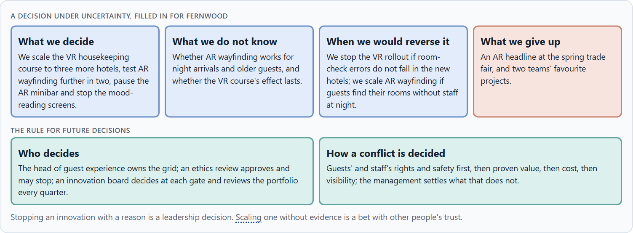
Who decides to scale, pause or stop, and deciding with incomplete data
B3 · 20 min · Core
Scaling needs owners: someone who owns the evaluation grid, an ethics and data protection review that approves before a pilot and before scaling and may stop anything, a board that decides at each gate to scale, test further, pause or stop, and a regular portfolio review. With incomplete data, a decision says what it decides, does not know, would reverse and gives up.
A decision under uncertainty, filled in for Fernwood.
Screenshot of the Neuro-UX Lab (aion-ux-lab.vercel.app), own work; AI-assisted, labelled on the image; the example company is fictional.
Sources: European Commission, AI Act · Simon 1956 · Klein 2007 · Cooper 1990 · Stilgoe, Owen & Macnaghten 2013 · GOV.UK Service Manual
Notes:
B3 · Who decides to scale, pause or stop, and deciding with incomplete data · 20 min · Core
Case assumption: Fernwood, Leila, Sam, Rafael and Greta are made up for this example; the corridor and the reports are drawn for the lesson. Monitoring after launch follows the European Commission's summary of the AI Act; deciding with limited information follows Simon (1956); the premortem follows Klein (2007). The findings in the table of real evidence are real research results, rules and cases; the sources are listed below.
Go deeper (optional reading): Write the stop criteria before the pilot starts, when nobody is attached to it yet. The person who may stop an initiative should not be the person whose bonus depends on it.
Sources: European Commission, AI Act · Simon 1956 · Klein 2007 · Cooper 1990 · Stilgoe, Owen & Macnaghten 2013 · GOV.UK Service Manual

Slide 37
B3 · In plain words
THE IDEA
WHY IT MATTERS
Scaling needs owners: someone who owns the evaluation grid and scores every initiative, an ethics and data protection review that approves before a pilot and before scaling and may stop anything, a board that decides at each gate to scale, test further, pause or stop, and a regular portfolio review. With incomplete data, a decision says what it decides, what it does not know, when it would reverse and what it gives up.
Block 3.1 asks for a governance model for innovation evaluation, ethical approvals, scaling decisions and portfolio adjustments, a decision despite incomplete data, and a statement to the management. This card gives you the parts of each.
HOW TO READ THE PICTURE
The four boxes at the top are the parts of a decision, filled in for Fernwood. The two boxes below are the rule for future decisions.
Sources: European Commission, AI Act · Simon 1956 · Klein 2007 · Cooper 1990 · Stilgoe, Owen & Macnaghten 2013 · GOV.UK Service Manual
Notes:
B3 · Who decides to scale, pause or stop, and deciding with incomplete data · 20 min · Core
Case assumption: Fernwood, Leila, Sam, Rafael and Greta are made up for this example; the corridor and the reports are drawn for the lesson. Monitoring after launch follows the European Commission's summary of the AI Act; deciding with limited information follows Simon (1956); the premortem follows Klein (2007). The findings in the table of real evidence are real research results, rules and cases; the sources are listed below.
Go deeper (optional reading): Write the stop criteria before the pilot starts, when nobody is attached to it yet. The person who may stop an initiative should not be the person whose bonus depends on it.
Sources: European Commission, AI Act · Simon 1956 · Klein 2007 · Cooper 1990 · Stilgoe, Owen & Macnaghten 2013 · GOV.UK Service Manual

Slide 38
B3 · Four responsibilities of innovation governance
Responsibility | The question | An example (Fernwood)
Innovation evaluation | Who scores every initiative on one grid? | The head of guest experience and a small team.
Ethical approval | Who says yes before a pilot and before scaling, and may stop? | An ethics and data review with the data protection officer.
Scaling decision | Who decides scale, test further, pause or stop at each gate? | An innovation board.
Portfolio adjustment | Who reviews the whole portfolio, and how often? | The board, every quarter, at most three active lines.
Sources: European Commission, AI Act · Simon 1956 · Klein 2007 · Cooper 1990 · Stilgoe, Owen & Macnaghten 2013 · GOV.UK Service Manual
Notes:
B3 · Who decides to scale, pause or stop, and deciding with incomplete data · 20 min · Core
Case assumption: Fernwood, Leila, Sam, Rafael and Greta are made up for this example; the corridor and the reports are drawn for the lesson. Monitoring after launch follows the European Commission's summary of the AI Act; deciding with limited information follows Simon (1956); the premortem follows Klein (2007). The findings in the table of real evidence are real research results, rules and cases; the sources are listed below.
Go deeper (optional reading): Write the stop criteria before the pilot starts, when nobody is attached to it yet. The person who may stop an initiative should not be the person whose bonus depends on it.
Sources: European Commission, AI Act · Simon 1956 · Klein 2007 · Cooper 1990 · Stilgoe, Owen & Macnaghten 2013 · GOV.UK Service Manual

Slide 39
B3 · Who decides to scale, pause or stop: real practice
Responsibility | Real source | What it means
Evaluation | A common grid for every initiative is what stage-gate systems use (Cooper 1990). | Score every initiative on one grid: value, maturity, effort, scaling, responsibility.
Ethical approval | The four dimensions of responsible innovation include inclusion and responsiveness (Stilgoe et al. 2013). | Put an ethics and data review before every pilot and before scaling.
The decision | Government practice names the decision to stop as one of the possible outcomes (GOV.UK Service Manual). | Give the board the right to scale, test further, pause or stop.
Sources: European Commission, AI Act · Simon 1956 · Klein 2007 · Cooper 1990 · Stilgoe, Owen & Macnaghten 2013 · GOV.UK Service Manual
Notes:
B3 · Who decides to scale, pause or stop, and deciding with incomplete data · 20 min · Core
Case assumption: Fernwood, Leila, Sam, Rafael and Greta are made up for this example; the corridor and the reports are drawn for the lesson. Monitoring after launch follows the European Commission's summary of the AI Act; deciding with limited information follows Simon (1956); the premortem follows Klein (2007). The findings in the table of real evidence are real research results, rules and cases; the sources are listed below.
Go deeper (optional reading): Write the stop criteria before the pilot starts, when nobody is attached to it yet. The person who may stop an initiative should not be the person whose bonus depends on it.
Sources: European Commission, AI Act · Simon 1956 · Klein 2007 · Cooper 1990 · Stilgoe, Owen & Macnaghten 2013 · GOV.UK Service Manual

Slide 40
B3 · How to decide when this comes up in the task
Name who owns the grid and scores every initiative.
1
Name who approves ethically and may stop, including data protection and employee representatives.
2
Name who decides at each gate, and how often the portfolio is reviewed.
3
Settle conflicts by rights and safety first, then proven value, then cost, then visibility; say who settles a tie.
4
Say what you decide, what you do not know, when you would reverse it and what you give up.
5
Sources: European Commission, AI Act · Simon 1956 · Klein 2007 · Cooper 1990 · Stilgoe, Owen & Macnaghten 2013 · GOV.UK Service Manual
Notes:
B3 · Who decides to scale, pause or stop, and deciding with incomplete data · 20 min · Core
Case assumption: Fernwood, Leila, Sam, Rafael and Greta are made up for this example; the corridor and the reports are drawn for the lesson. Monitoring after launch follows the European Commission's summary of the AI Act; deciding with limited information follows Simon (1956); the premortem follows Klein (2007). The findings in the table of real evidence are real research results, rules and cases; the sources are listed below.
Go deeper (optional reading): Write the stop criteria before the pilot starts, when nobody is attached to it yet. The person who may stop an initiative should not be the person whose bonus depends on it.
Sources: European Commission, AI Act · Simon 1956 · Klein 2007 · Cooper 1990 · Stilgoe, Owen & Macnaghten 2013 · GOV.UK Service Manual

Slide 41
Sources (1)
Houde, S., & Hill, C. (1997). What do prototypes prototype? In M. Helander, T. Landauer, & P. Prabhu (Eds.), Handbook of Human-Computer Interaction (2nd ed., pp. 367–381). Elsevier.
Buchenau, M., & Fulton Suri, J. (2000). Experience prototyping. Proceedings of DIS 2000, 424–433. ACM.
Cooper, R. G. (1990). Stage-gate systems: A new tool for managing new products. Business Horizons, 33(3), 44–54.
GOV.UK Service Manual. Service Standard. https://www.gov.uk/service-manual/service-standard
Witmer, B. G., & Singer, M. J. (1998). Measuring presence in virtual environments: A presence questionnaire. Presence: Teleoperators and Virtual Environments, 7(3), 225–240.
Kennedy, R. S., Lane, N. E., Berbaum, K. S., & Lilienthal, M. G. (1993). Simulator Sickness Questionnaire: An enhanced method for quantifying simulator sickness. The International Journal of Aviation Psychology, 3(3), 203–220.
Meta Platforms Technologies. App policies, Meta Horizon Store. https://developers.meta.com/horizon/policy/store-policies/ (read 29.10.2026).

Slide 42
Sources (2)
Kaplan, A. D., Cruit, J., Endsley, M., Beers, S. M., Sawyer, B. D., & Hancock, P. A. (2021). The effects of virtual reality, augmented reality, and mixed reality as training enhancement methods: A meta-analysis. Human Factors, 63(4), 706–726. https://doi.org/10.1177/0018720820904229
Miller, M. R., Herrera, F., Jun, H., Landay, J. A., & Bailenson, J. N. (2020). Personal identifiability of user tracking data during observation of 360-degree VR video. Scientific Reports, 10, 17404. https://doi.org/10.1038/s41598-020-74486-y
Stilgoe, J., Owen, R., & Macnaghten, P. (2013). Developing a framework for responsible innovation. Research Policy, 42(9), 1568–1580.
European Commission. AI Act. Shaping Europe's digital future. https://digital-strategy.ec.europa.eu/en/policies/regulatory-framework-ai (read 29.10.2026).
Regulation (EU) 2024/1689 of the European Parliament and of the Council laying down harmonised rules on artificial intelligence (Artificial Intelligence Act). Official Journal of the European Union, 12 July 2024.
Argyris, C., & Schön, D. A. (1978). Organizational learning: A theory of action perspective. Addison-Wesley.
Government Digital Service. Service Manual: How the discovery phase works; How the alpha phase works. https://www.gov.uk/service-manual/agile-delivery (read 29.10.2026).

Slide 43
Sources (3)
Gibbons, S. (2018). Using Prioritization Matrices to Inform UX Decisions. Nielsen Norman Group. https://www.nngroup.com/articles/prioritization-matrices/
Rebenitsch, L., & Owen, C. (2016). Review on cybersickness in applications and visual displays. Virtual Reality, 20(2), 101–125.
Simon, H. A. (1956). Rational choice and the structure of the environment. Psychological Review, 63(2), 129–138.
Klein, G. (2007). Performing a project premortem. Harvard Business Review, 85(9), 18–19.

Slide 44
About these slides, sources and AI use
AI
AI-assisted content
Where to find more
AI-assisted content: these slides were drafted with an AI language model (Claude, Anthropic) from the course's own Neuro-UX Lab and were read, corrected and approved by Muhammad Muchson, who is responsible for their accuracy.
Pictures are screenshots of the course's own Neuro-UX Lab. Each one carries an AI label on the image and a source line under it.
Companies and people in the examples are fictional. Numbers inside an example are labelled Case assumption and are not data.
Neuro-UX Lab for this day: https://aion-ux-lab.vercel.app/day/16/
Handouts: the Materi and Task Word documents of the day.
Version 1.0, 29.10.2026. Reviewer and approver: Muhammad Muchson.

