Slide 1

INNOVATION. AUTOMATION. ANALYTICS
PROJECT ON
SWIGGY DELIVERY TIME PREDICTION
An End-to-End Machine Learning Regression Project
Presented By:
Mohammed Sirajuddin Shahzaib
Batch No:470

Slide 2
Agenda
Introduction
CRISP-ML(Q) Methodology
Business Problem
Project Objective
Dataset Overview
Exploratory Data Analysis
Data Preprocessing
Model Building
Model Evaluation & Selection
Hyperparameter Tuning
Final Business Insights
Recommendations
Challenges
Applications
Conclusion
2

Slide 3

Introduction
Swiggy is one of India's leading online food delivery platforms, connecting customers with restaurants through a digital ordering system.
Providing accurate delivery time estimates (ETA) is critical for customer satisfaction and efficient delivery operations.
This project builds a Machine Learning regression model that predicts food delivery time using rider attributes, order details, distance, weather, and traffic conditions.
Accurate predictions help improve customer trust, optimize delivery operations, and reduce order cancellations.
3

Slide 4
CRISP-ML(Q) Methodology
A structured framework guiding this Machine Learning project from problem understanding to monitoring.
1
Business & Data Understanding
2
Data Preparation
3
Model Building
Identify the delivery-time prediction problem and explore the dataset.
Clean missing values, encode categorical fields, scale numeric features.
Train multiple regression algorithms on the prepared data.
4
Model Evaluation
5
Model Deployment
6
Monitoring & Maintenance
Compare models using RMSE, MSE and R² score.
Package the tuned model for real-world ETA predictions.
Track performance and retrain as delivery patterns evolve.
4

Slide 5

Business Problem
Swiggy delivers thousands of food orders every day, and customers expect accurate delivery-time estimates when placing an order.
Delivery time varies widely due to traffic conditions, weather, distance, rider availability, and multiple simultaneous deliveries.
Inaccurate ETAs lead to customer dissatisfaction, order cancellations, and operational inefficiencies.
This ultimately results in reduced customer trust, fewer repeat orders, and increased cancellation / refund costs.
5

Slide 6

Objective of the Project
Build a Machine Learning-based delivery-time prediction system.
Predict the expected delivery time for each individual orders.
Improve ETA (Estimated Time of Arrival) accuracy shown to customers.
Enhance customer satisfaction with reliable delivery estimates.
Help optimize delivery operations and rider allocation.
Reduce delivery delays and order cancellations.
6

Slide 7
Dataset Overview
45,502
Total Records
26
Total Columns
rider_id | Unique identifier for each delivery partner
age | Age of the delivery partner
ratings | Average customer rating of the rider
vehicle_condition | Condition of the rider's vehicle (0=Poor, 1=Average, 2=Good)
type_of_vehicle | Vehicle used for delivery (motorcycle, scooter, etc.)
type_of_order | Type of food ordered (snack, meal, drinks, buffet)
multiple_deliveries | Number of deliveries assigned to the rider in a single trip
pickup_time_minutes | Time taken by the restaurant to prepare the order
is_weekend | Whether the order was placed on a weekend
7

Slide 8
Dataset Overview (contd.)
weather | Weather during delivery (sunny, cloudy, fog, stormy, sandstorms, windy)
traffic | Traffic condition during delivery (low, medium, high, jam)
festival | Whether the order was placed on a festival day
city_type | Classification of city (semi-urban, urban, metropolitan)
city_name | Code of the city (BANG, HYD, CHEN, INDO, etc.)
distance | Distance in km between restaurant and delivery location
order_day / order_month | Day of month and month the order was placed
order_day_of_week | Day of the week (Monday - Sunday)
order_time_hour / order_time_of_day | Hour (0-23) and time bucket of the order
time_taken | Target variable - actual delivery time in minutes
8

Slide 9
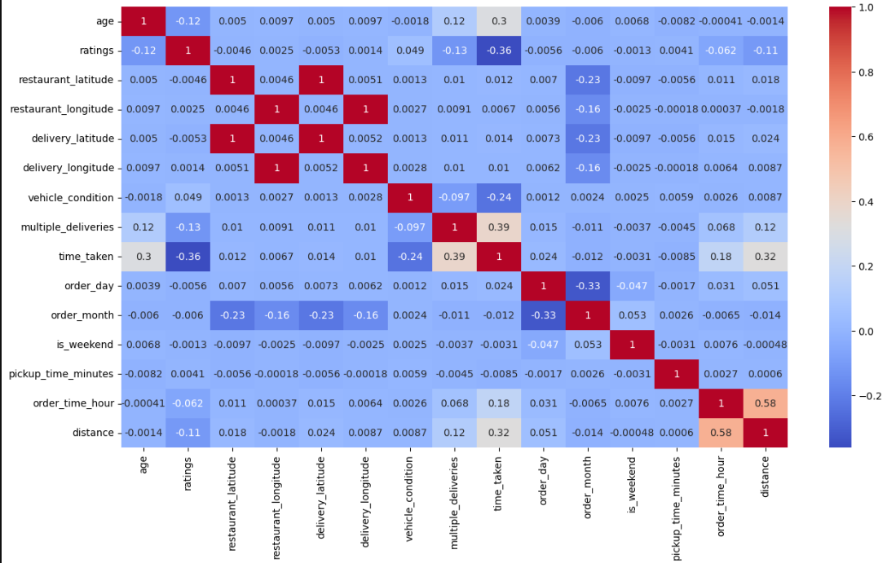
Exploratory Data Analysis
Correlation of numeric features with delivery time (time_taken)
Key Observations
More multiple_deliveries per trip and longer distance strongly increase delivery time.
Older rider age shows a mild positive correlation with delivery time.
Higher rider ratings are linked to faster deliveries (negative correlation).
Better vehicle_condition is also linked to shorter delivery times.
No missing-data duplicates were found in the dataset.
9

Slide 10
Data Preprocessing
Data Cleaning & Preparation
Removed columns not useful for modeling: rider_id, order_date, restaurant_latitude/longitude, delivery_latitude/longitude.
Defined the target variable as time_taken and separated features (X) from the target (y).
Handled missing values using SimpleImputer:
Numerical columns → Median
Categorical columns → Most Frequent (Mode)
age, ratings, multiple_deliveries, pickup_time_minutes,
order_time_hour, distance
weather, traffic, festival, city_type
Missing-value counts included: age (1,854), ratings (1,908), weather (525), traffic (510), multiple_deliveries (993), festival (228), city_type (1,198), pickup_time_minutes (1,640).
10

Slide 11
Data Preprocessing – Encoding & Scaling
Numerical features standardized with StandardScaler (mean = 0, std = 1).
One-Hot Encoding applied to nominal columns: weather, type_of_order, type_of_vehicle, festival, city_name, order_day_of_week.
Ordinal Encoding applied to ordered columns:
traffic → ['low', 'medium', 'high', 'jam'] city_type → ['semiurban', 'urban', 'metropolitan']
Pipeline & Column Transformer
Numerical
Pipeline
Nominal
Pipeline
Ordinal
Pipeline
Combined via
ColumnTransformer
Train–Test Split: 70% Training / 30% Testing (random_state = 42)
11

Slide 12

Model Building
The problem is treated as a Regression task since the target variable, delivery time (in minutes), is continuous. Multiple algorithms were trained and compared using the same preprocessing pipeline:
Linear Regression
K-Nearest Neighbors (KNN) Regressor
Decision Tree Regressor
Random Forest Regressor
Gradient Boosting Regressor
XGBoost Regressor
Each model was trained using a Pipeline (Preprocessing + Algorithm) for consistency and reproducibility.
12

Slide 13
Model Evaluation
Models compared on held-out test data using MSE, RMSE and R² score
Model | MAE | RMSE | R² Score
Linear Regression | 5.226 | 6.533 | 0.518
KNN Regressor | 4.847 | 6.244 | 0.560
Decision Tree | 4.269 | 5.670 | 0.637
Random Forest | 3.282 | 4.167 | 0.804
Gradient Boosting | 3.751 | 4.697 | 0.751
XGBoost (default) | 3.313 | 4.163 | 0.805
13

Slide 14
Hyperparameter Tuning
Method: RandomizedSearchCV
Best Parameters Found
Model tuned: XGBoost Regressor
5-fold cross-validation, scoring = R²
20 random parameter combinations tested (n_iter = 20)
n_estimators | 100
learning_rate | 0.05
max_depth | 9
subsample | 0.9
colsample_bytree | 0.8
Search space:
n_estimators → [100, 200, 300, 500]
learning_rate → [0.01, 0.05, 0.1, 0.2]
max_depth → [3, 5, 7, 9]
subsample → [0.7, 0.8, 0.9, 1.0]
colsample_bytree → [0.7, 0.8, 0.9, 1.0]
Best CV R² Score:
0.816
Train R² (tuned): 0.871 | Test R² (tuned): 0.818
14

Slide 15


Model Selection
Models compared using MAE, RMSE (error metrics) and R² score (goodness of fit).
The tuned XGBoost Regressor achieved the strongest, most balanced performance — high test R² with a manageable train–test gap (low overfitting compared to the untuned Decision Tree).
Why XGBoost?
Highest R² among all models tested
Lowest RMSE / MAE on test data
Handles non-linear relationships between distance, traffic, weather and delivery time
Robust to outliers and mixed feature types
Efficient training and fast inference for production use
Final Model: XGBoost Regressor
(tuned via RandomizedSearchCV)
Test R² = 0.818 | RMSE ≈ 4.16 min
15

Slide 16
Final Business Insights
multiple_deliveries
distance
Riders juggling several orders on one trip show the strongest link to longer delivery times.
Greater restaurant-to-customer distance is the next biggest driver of delivery time.
rider age & ratings
vehicle_condition
Higher-rated, experienced riders tend to complete deliveries faster.
Better-maintained vehicles are associated with shorter delivery times.
order_time_hour
traffic, weather & festivals
Delivery time shifts moderately across different hours of the day.
Category-level analysis (EDA) shows heavy traffic, poor weather, and festival days visibly stretch delivery time.
16

Slide 17
Recommendations
Use the tuned XGBoost model to power live ETA predictions shown to customers.
Cap or carefully sequence multiple_deliveries per trip during peak hours to control delivery-time spikes.
Prioritize rider allocation and route optimization on long-distance orders.
Build traffic- and weather-aware buffers into ETAs during high-traffic zones and adverse weather.
Introduce festival-specific staffing and planning to absorb demand surges.
Encourage vehicle maintenance and reward high-rated, experienced riders.
Periodically retrain the model as new order and traffic data becomes available.
17

Slide 18

Challenges
Handling a substantial volume of missing values across numerical and categorical fields.
Selecting the best-performing model among six different regression algorithms.
Tuning hyperparameters efficiently without excessive computation time.
Balancing model complexity against bias variance tradeoff
18

Slide 19





Applications
Scalable to Other Delivery Services
The same modeling approach — feature engineering + regression — can be applied to:
Food Delivery Platforms
Grocery & Quick-Commerce Delivery
E-commerce Last-Mile Delivery
Courier Services
Logistics & Fleet Companies
19

Slide 20

Conclusion
This project successfully addressed Swiggy’s challenge of accurate delivery-time prediction (ETA) using a robust Machine Learning pipeline. The tuned XGBoost model captures the impact of distance, traffic, weather, rider performance and order characteristics, delivering a test R² of 0.818.
Business Impact
Improves customer trust and satisfaction
Reduces order cancellations and refund costs
Optimizes rider allocation and operational efficiency
Decreases support workload from delivery delays
A production-ready, deployable ML pipeline has been built — ready to be integrated into a real-time ETA service.

Slide 21
Q&A
Questions & Discussion

Slide 22

THANK YOU

