Slide 1

NexusBuy E – Commerce Application
Omar Atef Hassan Ahmed Rehan 19103202
Lecturer:-
Prof. Dr. Osama Badawy

Slide 3
01
02
03
TABLE OF CONTENTS
INTRODUCTION
NEXUSBUY MODELING
COLLECTIONS
04
PROTOTYPE
05
CONCLUSION

Slide 4
01
INTRODUCTION

Slide 5
INTRODUCTION
NoSQL databases are a category of DBMSs, which differ to traditional RDBMS in terms of data models, scalability and flexibility.
They emerged to combat the challenges posed by Big data.

Slide 6
INTRODUCTION
E-commerce, short for electronic commerce, refers to the buying and selling of goods and services over the internet.
So we proposed the E-Commerce idea since there is a variety of data and amount of data entering the database daily is big.

Slide 7
02
NEXUSBUY MODELING

Slide 8
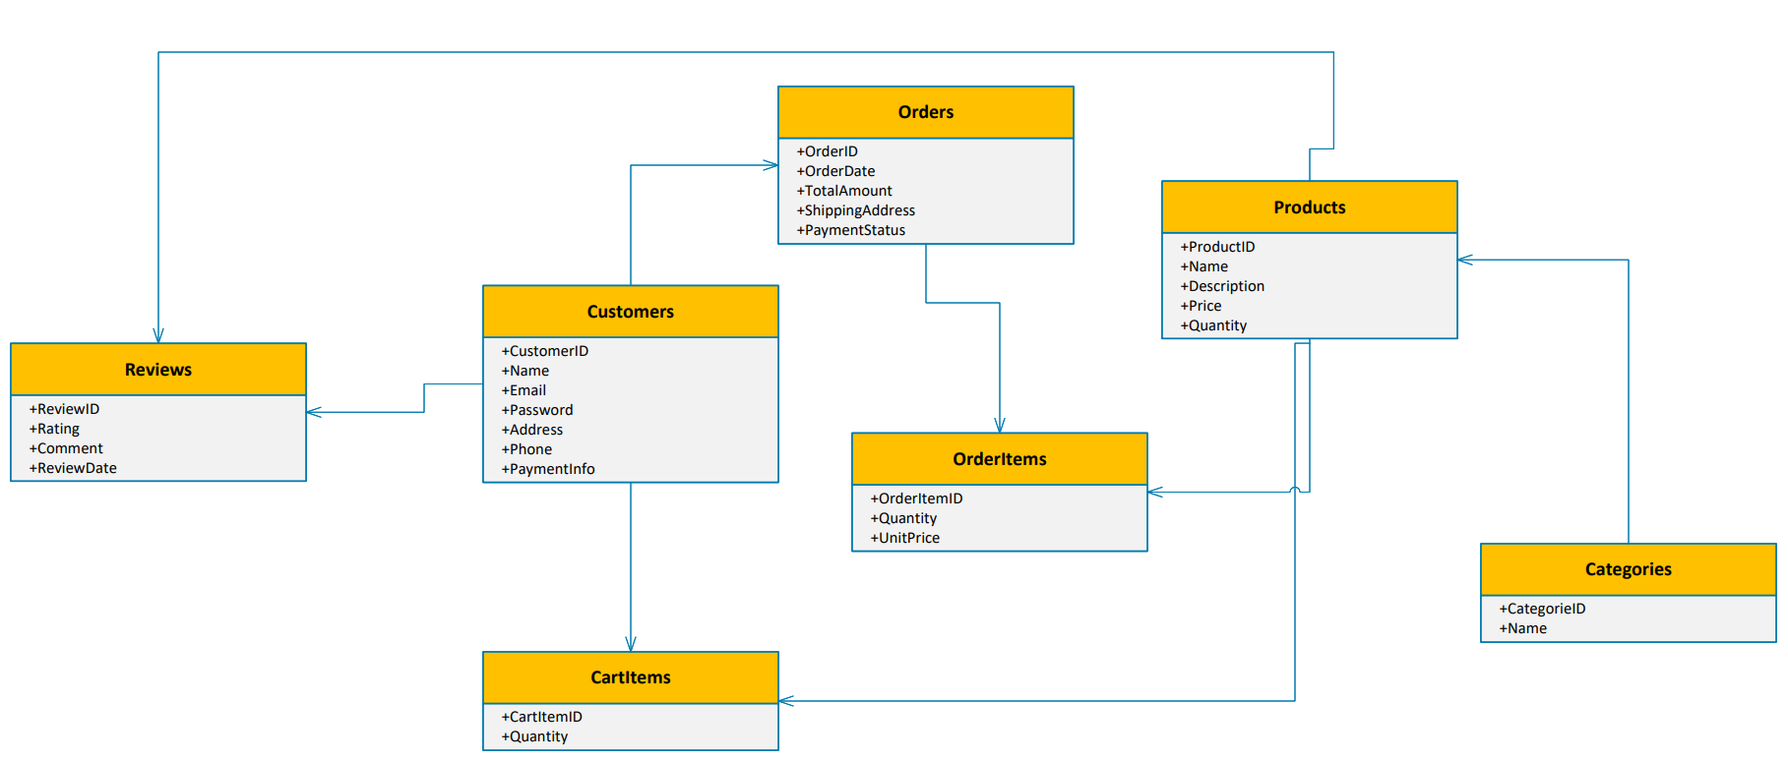

Slide 9
03
COLLECTIONS AND CRUD OPERATIONS

Slide 10
Collections
Customers:-
- This collection stores information about the users of the E-Commerce platform.
- It includes details such as customer id, name,
contact information, address and account related data such as e-mail and password.

Slide 11
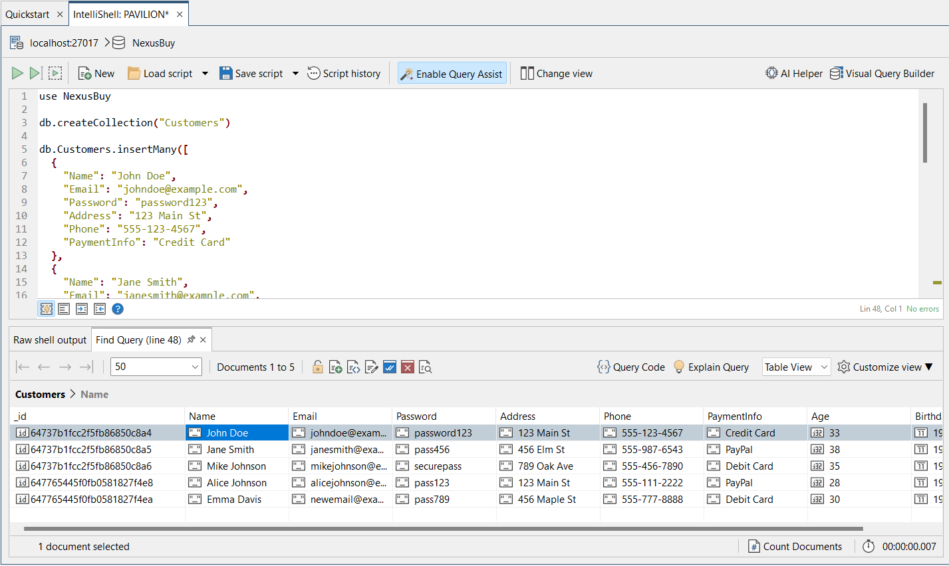
To show all data of a collection we use query:-
db.Customers.find()
Collection_Name

Slide 12
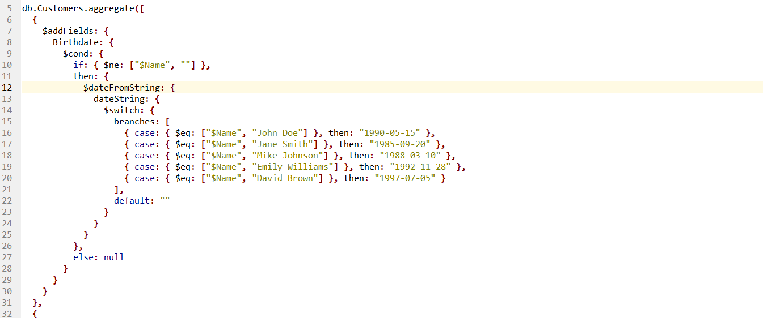
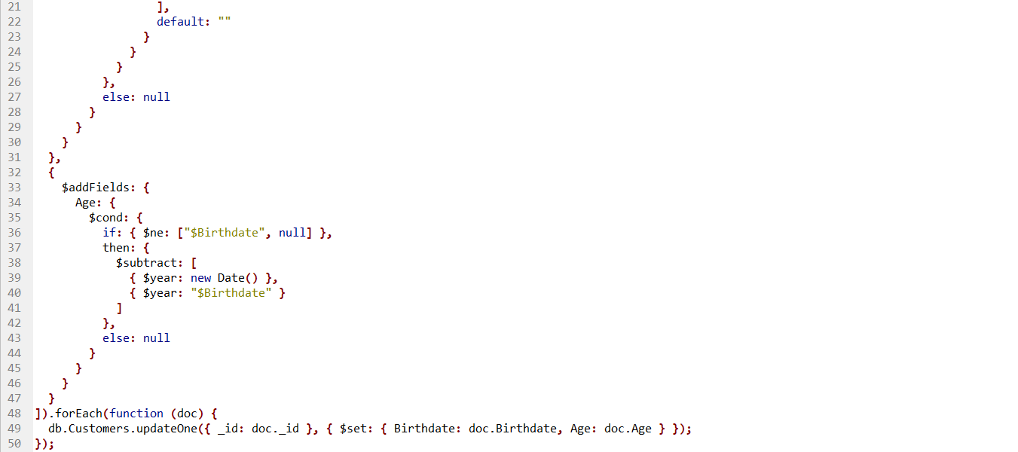
Now we can insert two different documents "Birth of date" and "Age" for "Customers"
collection, which we can calculate the age based on the customer's birth of date.

Slide 13
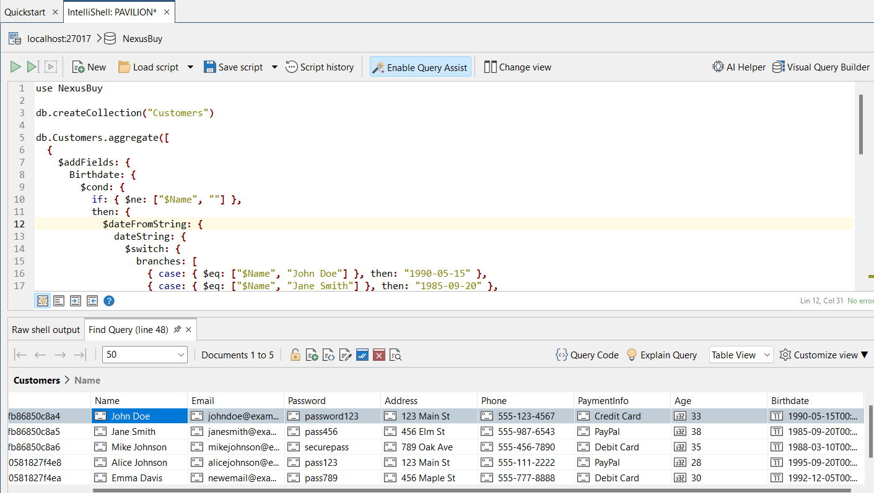
Result of “db.Customers.aggregate”

Slide 14
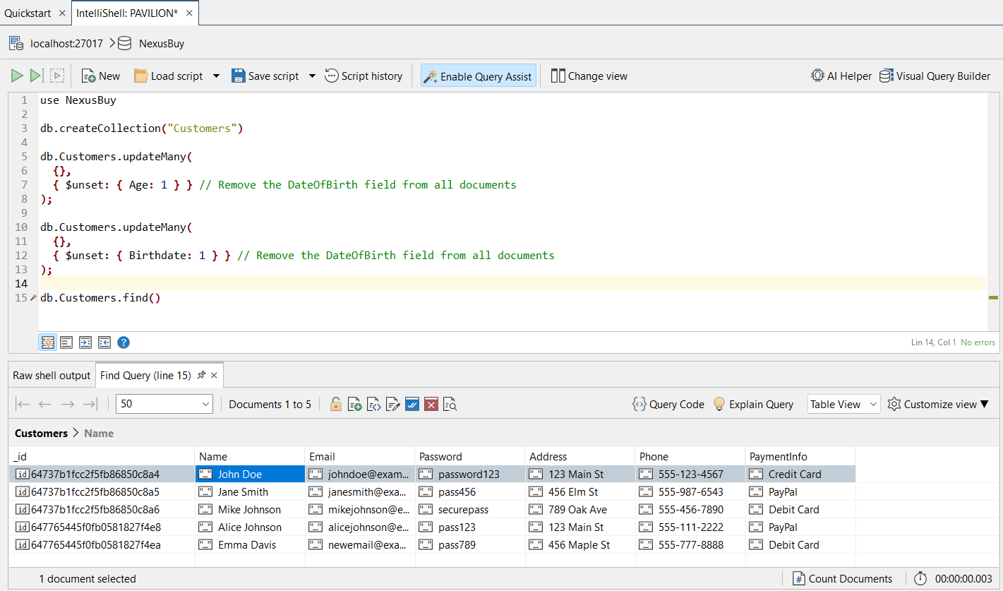
We can also delete any extra document if needed

Slide 15
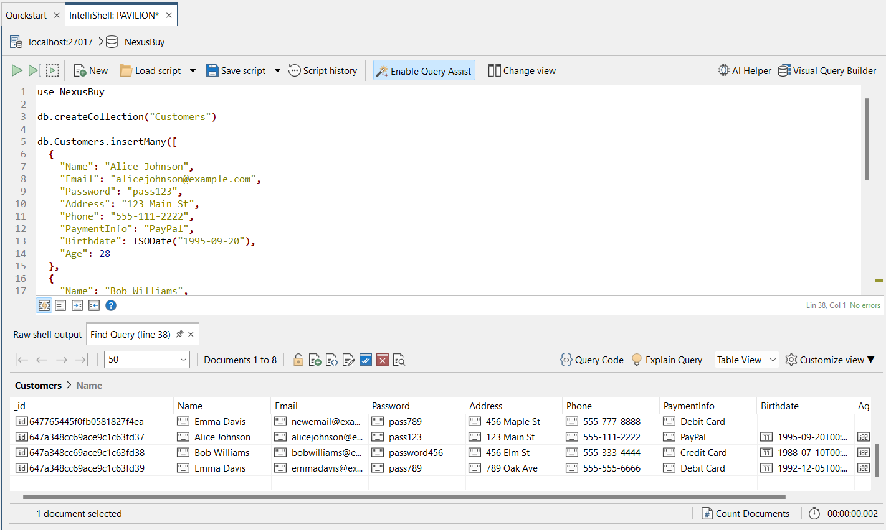
Also there a new customers able to create accounts

Slide 16
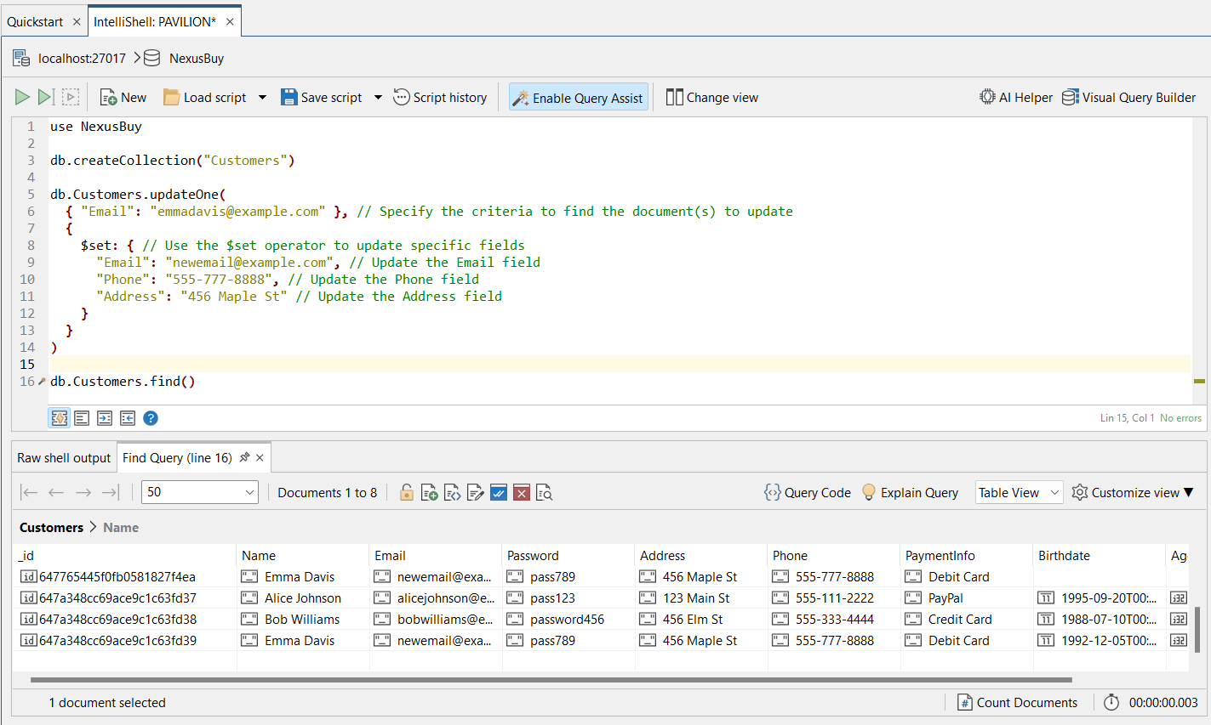
Any customers can update his/her data

Slide 17
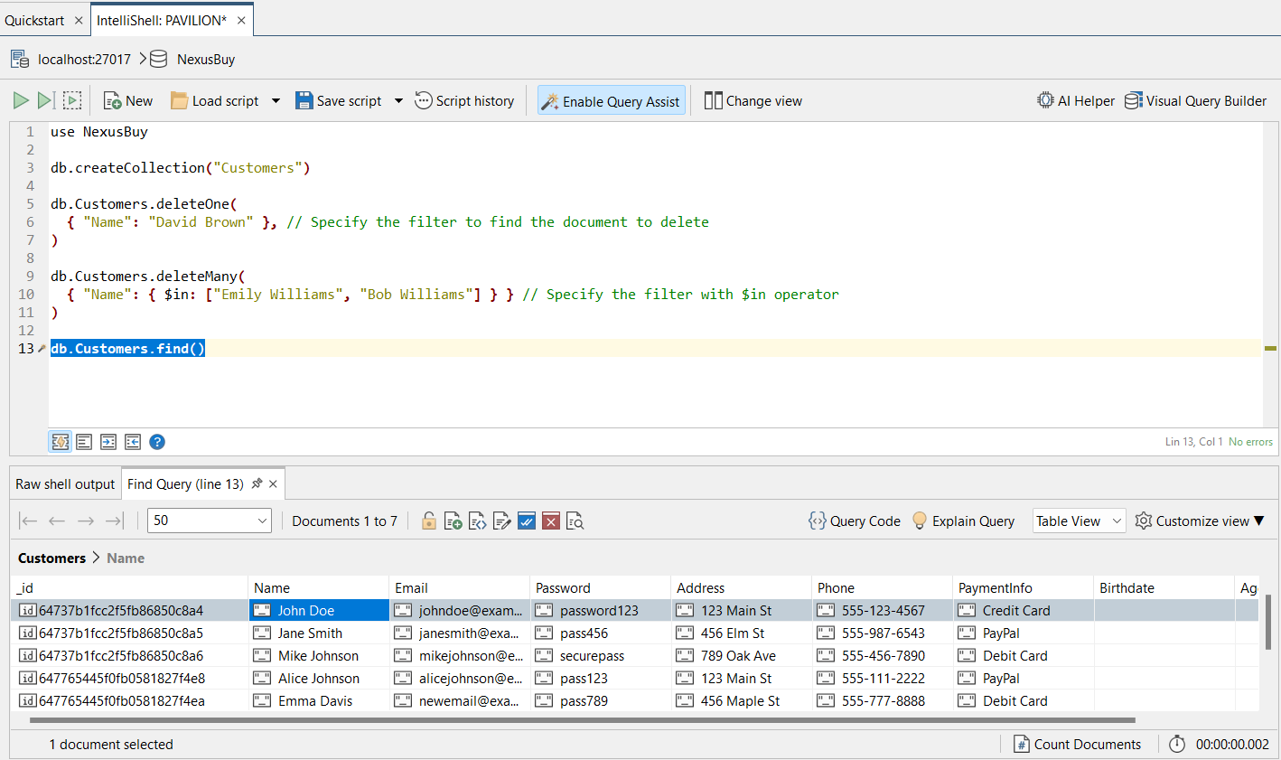
Customers able to delete their accounts
As shown here there is no deleted data on the table

Slide 18
Collections
Categories:-
- This collection represents the different product categories or product groupings available in the e-commerce platform.
- It contains information about each category such as category id and name.

Slide 19
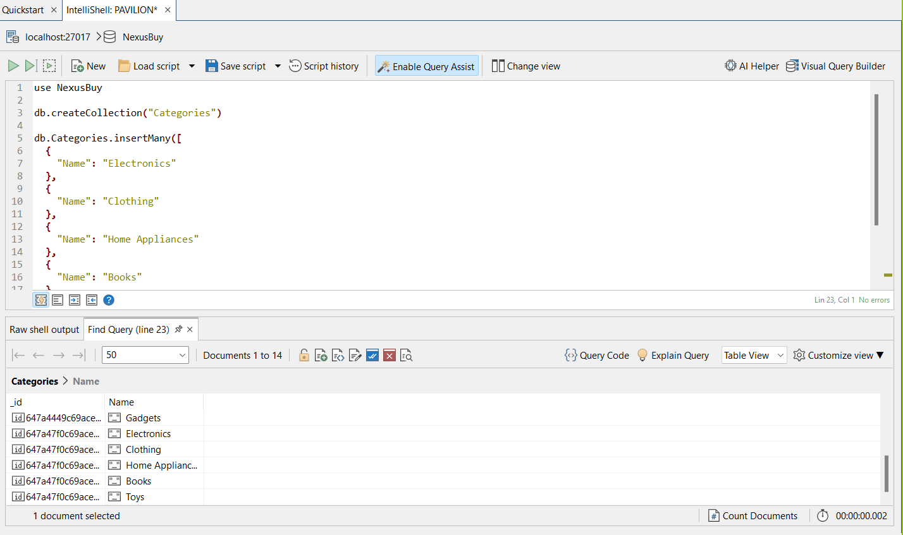

Slide 20
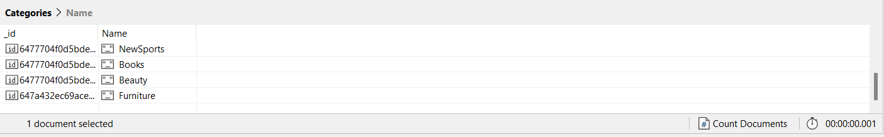
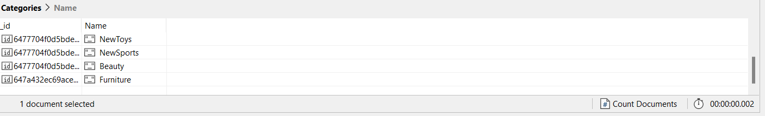
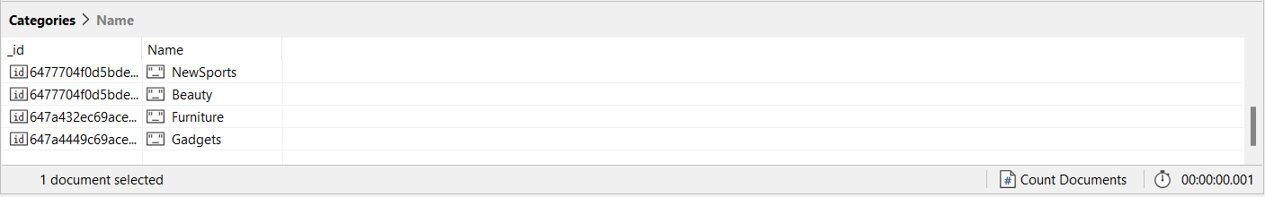
Admin could add new category
Admin could delete category if needed
Admin could update any category if needed

Slide 21
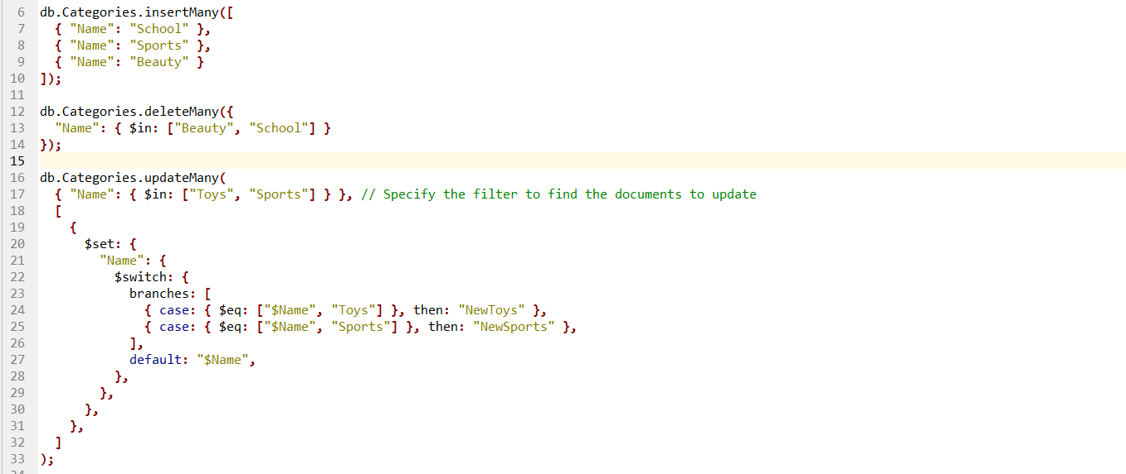
Admin can also do the same with multiple categories

Slide 22
Collections
Products:-
- This collection stores the information related to individual products offered on the e-commerce platform.
- It includes details like product ID, name, description, price, Quantity and Category embedded.

Slide 23
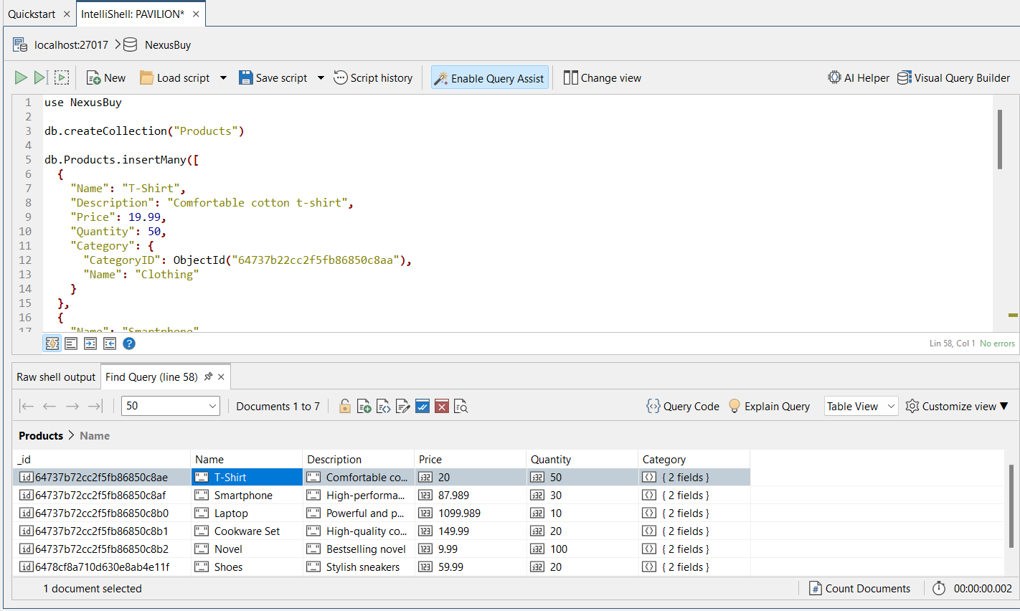

Slide 24
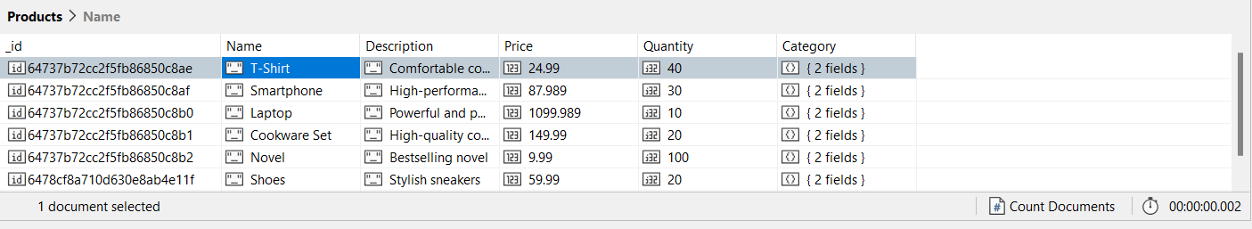
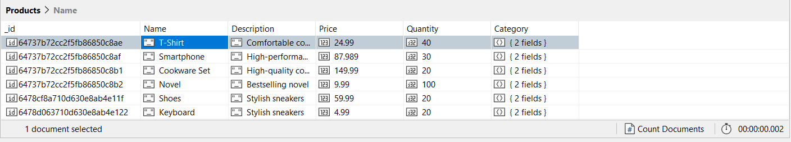
Laptop product has been deleted from the table

Slide 25
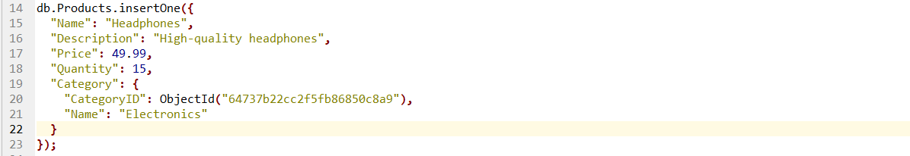
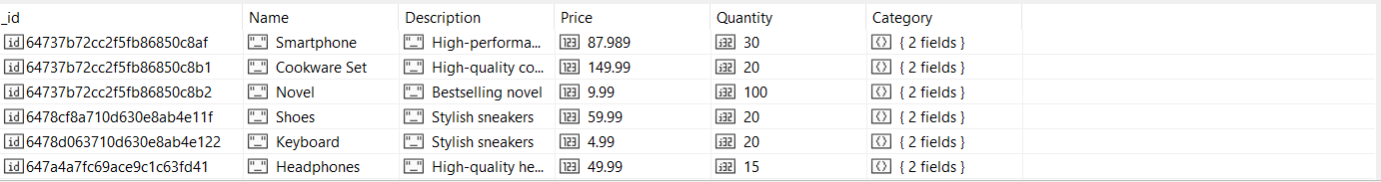
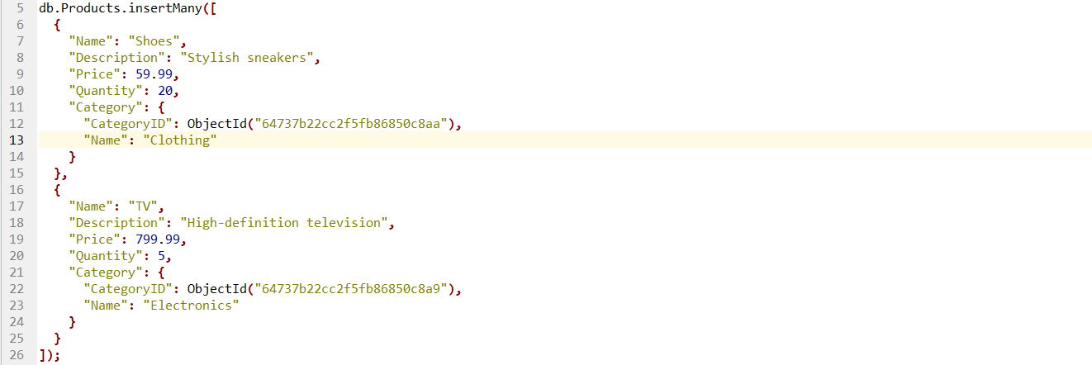
Headphones has been inserted on the table
Admin can insert Multiple products

Slide 26
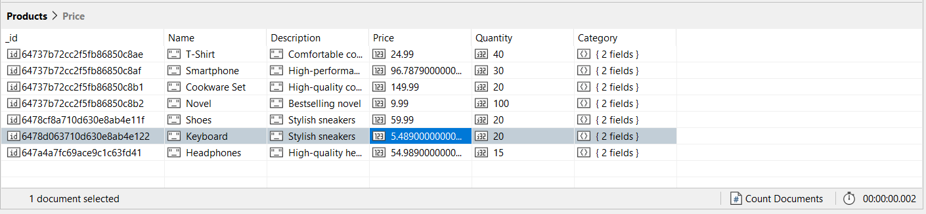
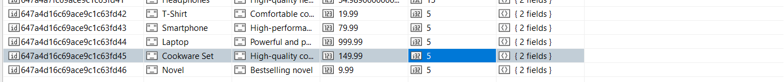
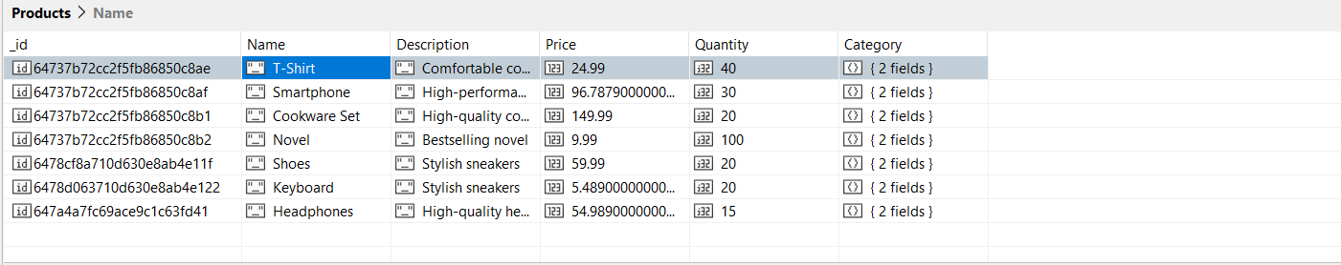
Here we have some products with 5 quantities
We have deleted products less than 10 quantities

Slide 27
Collections
Orders:-
- This collection stores the information related to individual orders on the e-commerce platform.
- It includes details like order ID, date, Total Amount, shipping address, payment status and Customer embedded.

Slide 28
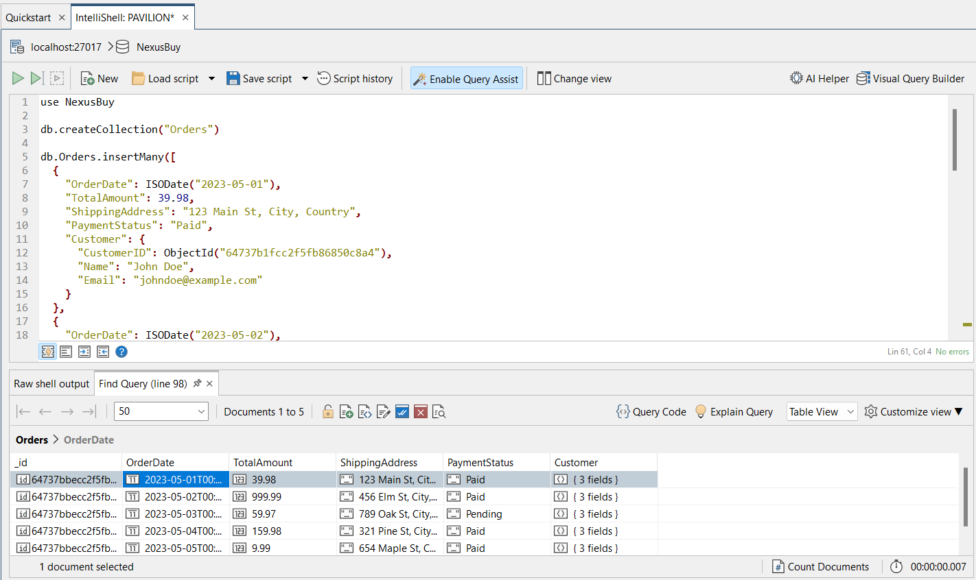

Slide 29
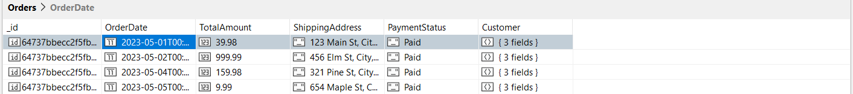
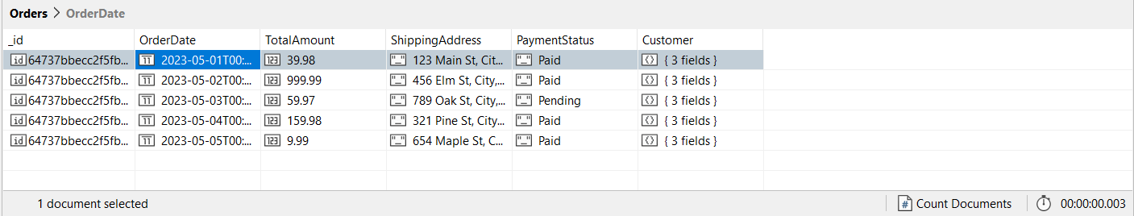
We used CRUD operations on this collection for analysis, for example here to see how many customer paid
Query to find all Month orders

Slide 30
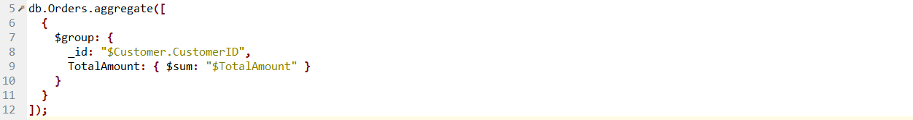
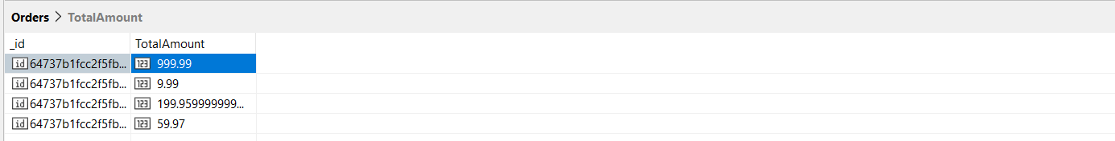
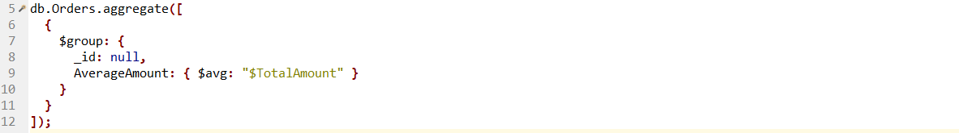
Calculate total “Total Amount” for each customer
Calculate Average Amount

Slide 31
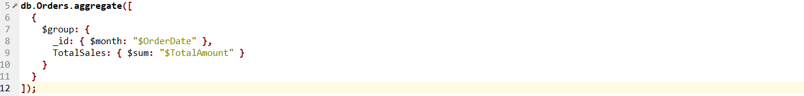
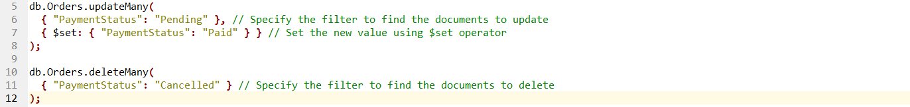
Calculate the total sales by month
These both queries can be used if needed
One is used to update status payment for the customer if any bug happened on the application
And the other query are just delete any cancelled payments to increase performance

Slide 32
Collections
OrderItems:-
- This collection stores the information related to individual order items on the e-commerce platform.
- It includes details like order item ID, quantity, Unit Price and order embedded.

Slide 33
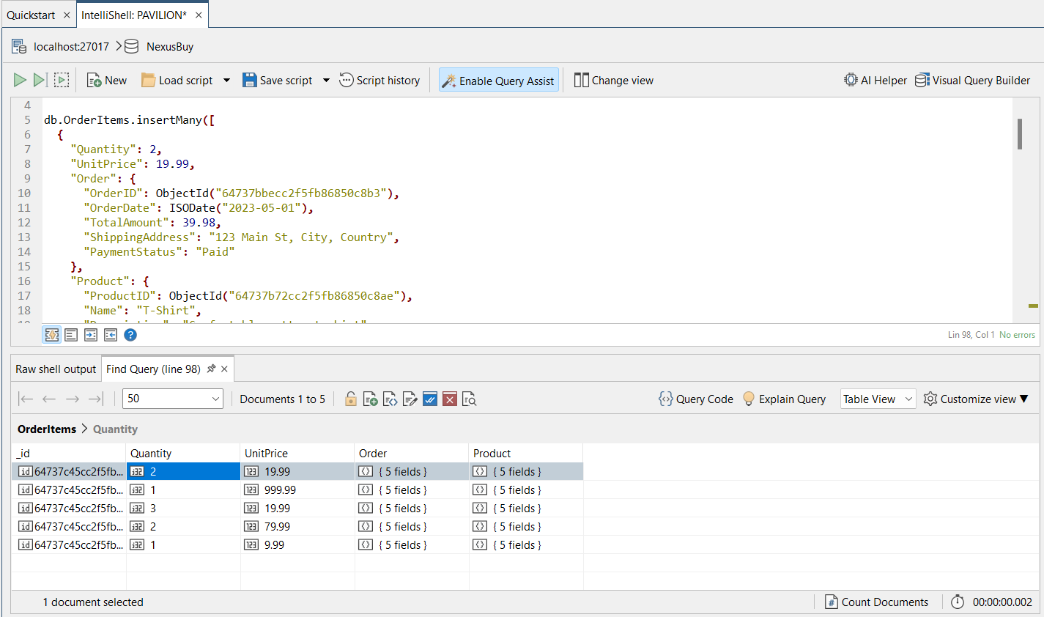

Slide 34
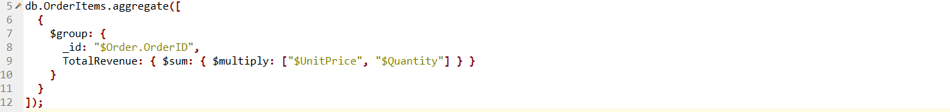
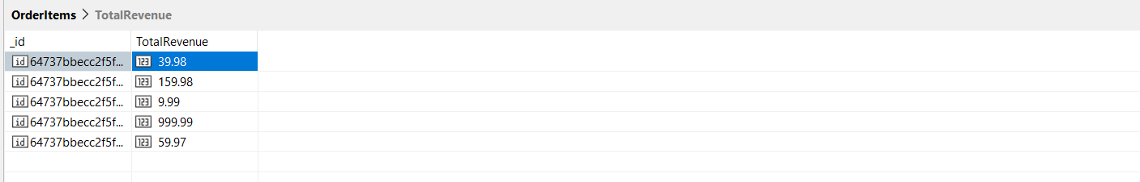
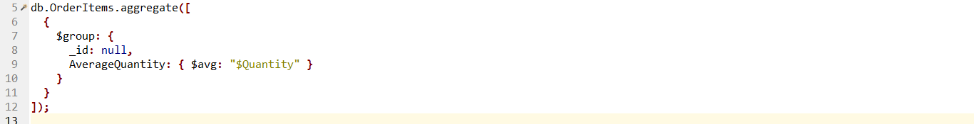
Calculate the total revenue for each order
Get the average quantity of products ordered

Slide 35
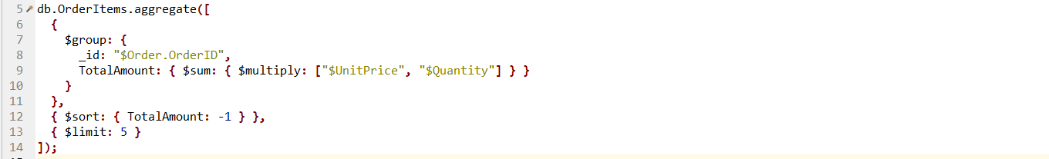
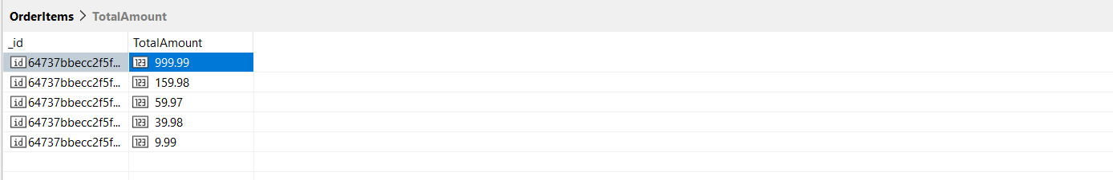
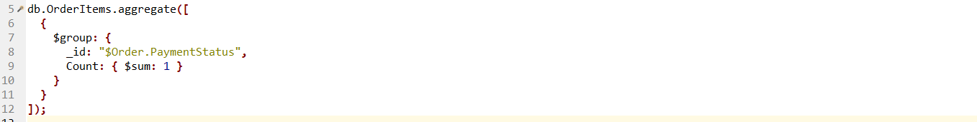
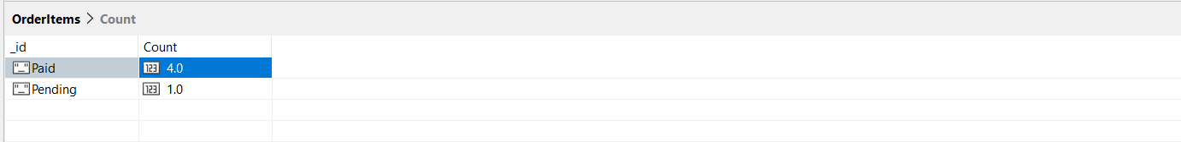
Find the orders with the highest total amount
Count the number of orders with different payment statuses

Slide 36
Collections
CartItems:-
- This collection stores the information related to individual cart items offered on the e-commerce platform.
- It includes details like cart item ID, quantity, and customer & products embedded.

Slide 37
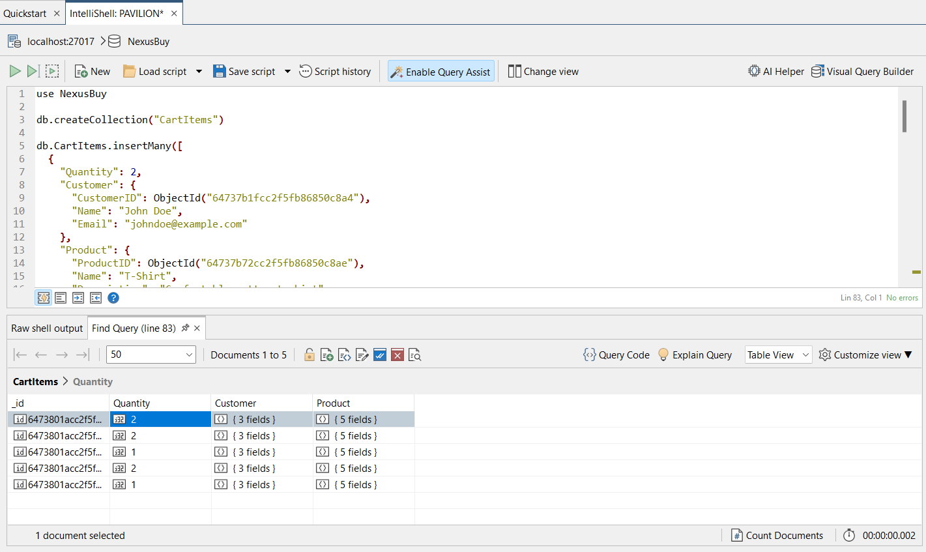

Slide 38
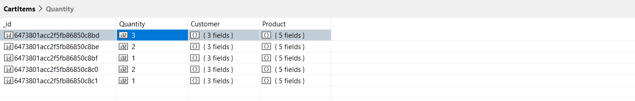
Customer update quantity numbers on his/her cart

Slide 39
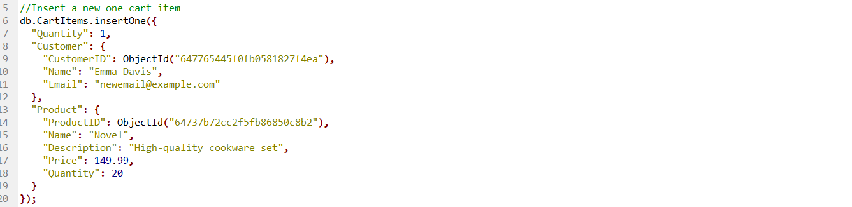
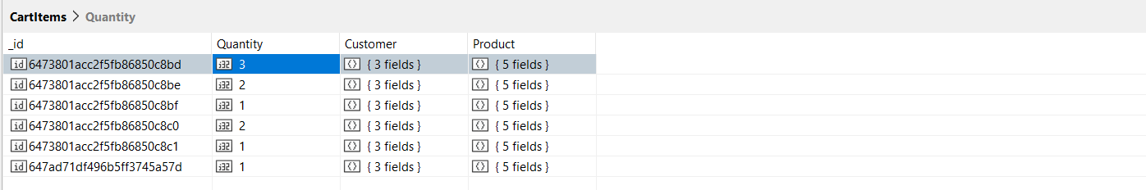

Any Customer has an account could add any product into his/her cart
Customer could delete his/her cart item
The third cart item has been deleted as shown

Slide 40
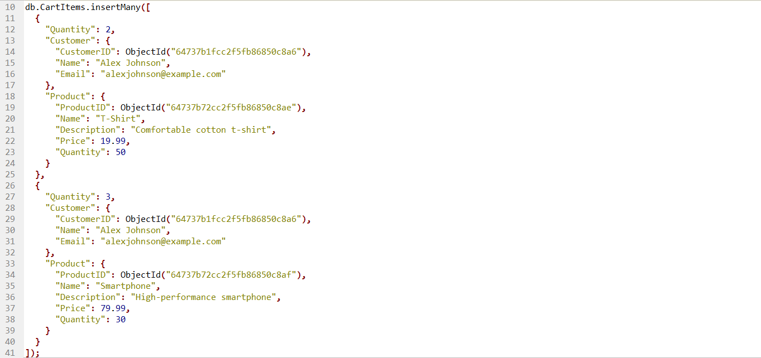
The same here, customer could update multiple cart items
Customer could insert many cart items at the same time
Customer could delete multiple cart items

Slide 41
Collections
Reviews:-
- This collection stores the information related to individual review on the e-commerce platform.
- It includes details like review ID, rating, comment, review date and customer & product embedded.

Slide 42
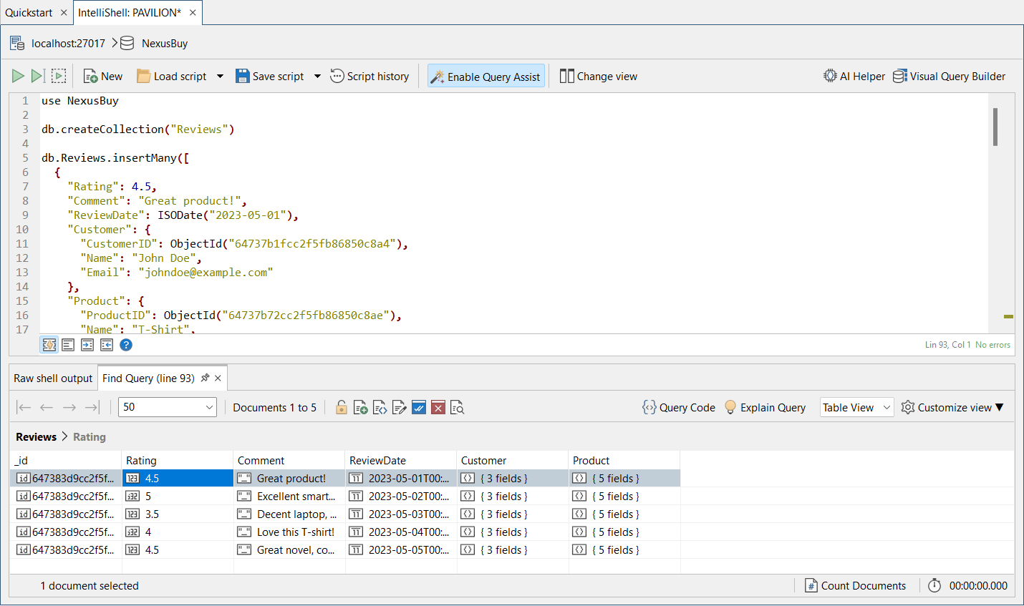

Slide 43
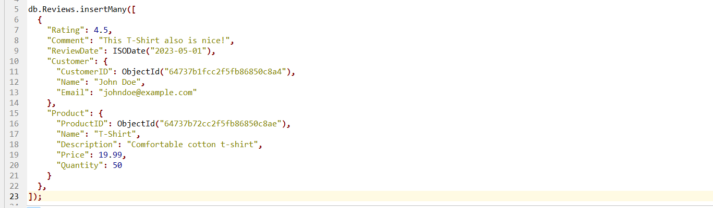
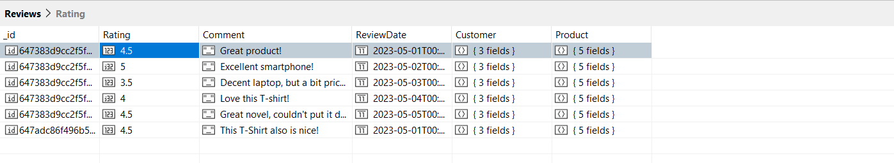
The same customer can put another review to another product

Slide 44
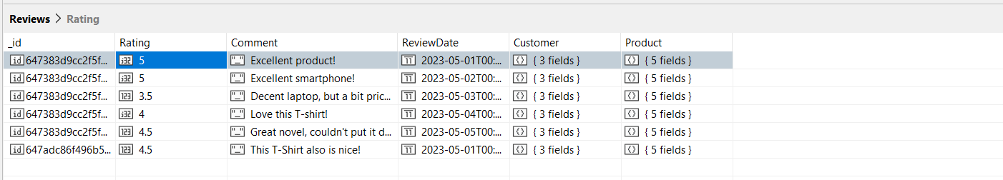
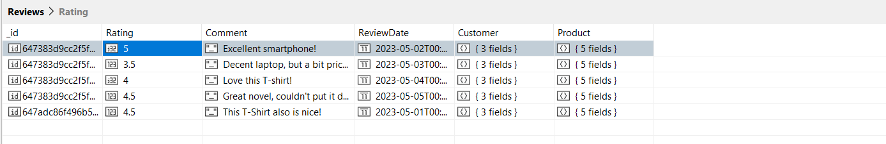
Customer can update his/her Review
Review “Excellent Product” has been deleted

Slide 45
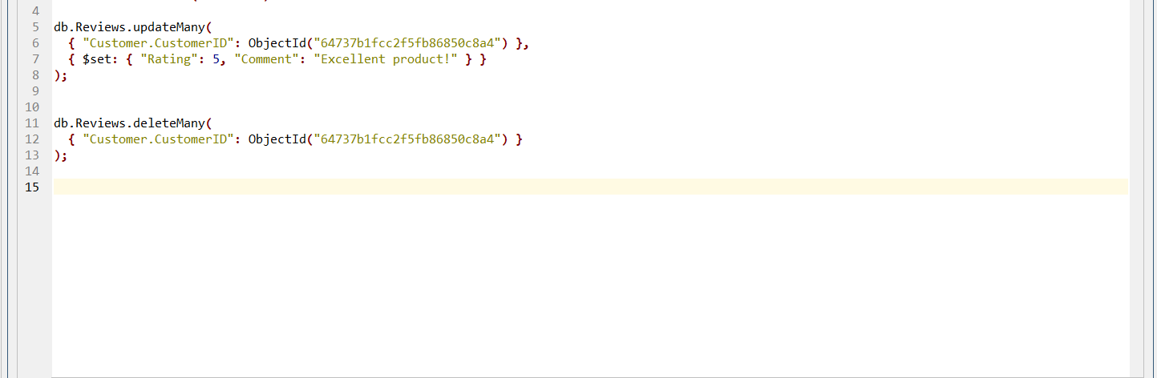
The same thing for multiple reviews

Slide 46
04
PROTOTYPE

Slide 47

1- START APP

Slide 48

2- CREATE ACCOUNT

Slide 49

3- HOME PAGE

Slide 50

4- CUSTOMER PROFILE

Slide 51

5- PRODUCT PAGE

Slide 52

6- PRODUCT STATS 1

Slide 53

7- PRODUCT STATS 2

Slide 54

8- CART PAGE

Slide 55

9- REVIEWS PAGE

Slide 56
05
CONCLUSION

Slide 57
CONCLUSION
we would like to say that NoSQL DBs is very important in receiving big data. Also, it is very flexible in analytics and data search.
E-Commerce applications are very important to have NoSQL DBs, because the big variety of data.
Would like to say Thank you to you!

