Slide 1
History
1943, Warren McCulloch and Walter Pitts developed the first mathematical model of a neuron
1958, Frank Rosenblatt developed the perceptron algorithm
1974, Paul Werbos developed the backpropagation algorithm
1990s, SVMs were developed
2010, GPU was effectively used for deep learning. CPUs not optimized for the large-scale matrix operations required for neural network training
2012, Alex Krizhevsky and his team developed a deep CNN called AlexNet, which won the ImageNet Large Scale Visual

Slide 2
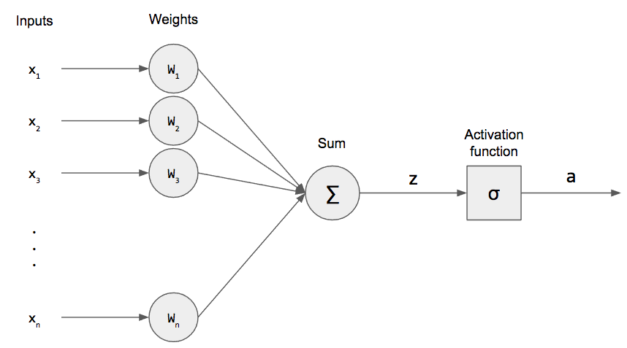
Single layer perceptron

Slide 3
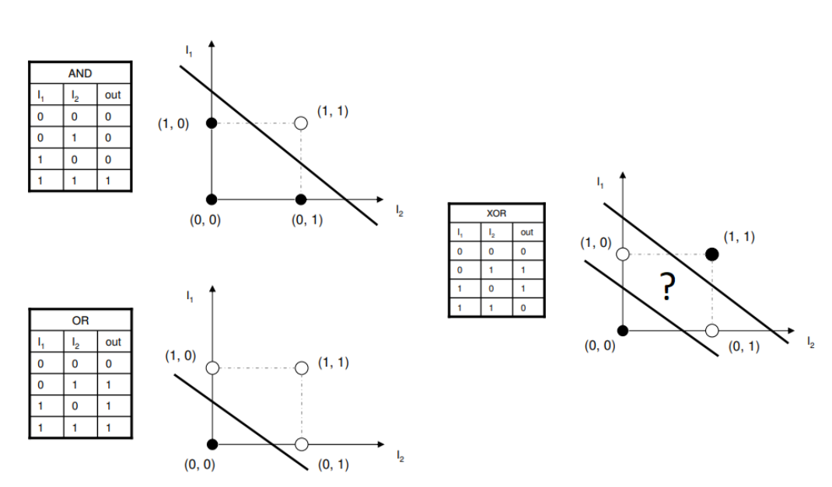
Single layer perceptron (Limitation)

Slide 4
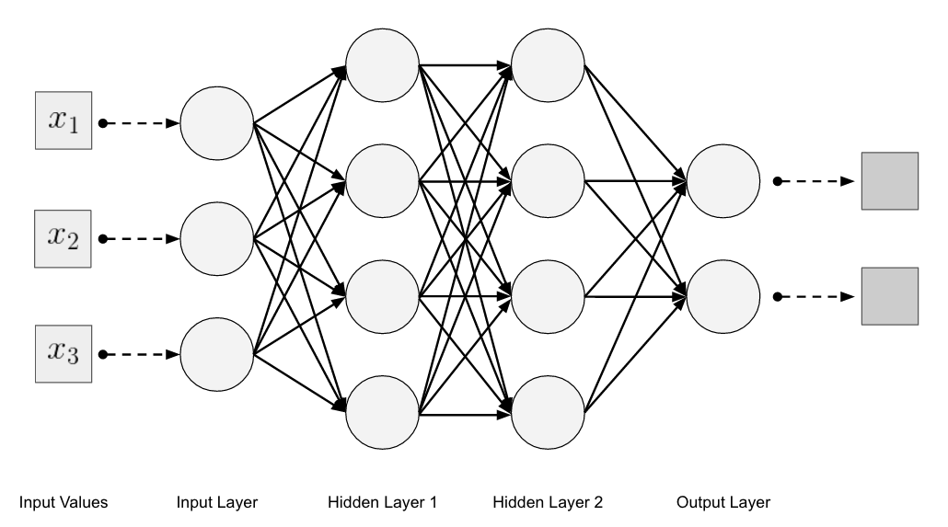
Multi-Layer Perceptron
Notes:
"Deep learning was developed as a concept well before the computational resources, algorithms, and data sets were available to make it practical and effective. It was only with the advent of large-scale data processing, improvements in hardware, and breakthroughs in neural network architecture that deep learning became a viable approach for solving complex problems."

Slide 5
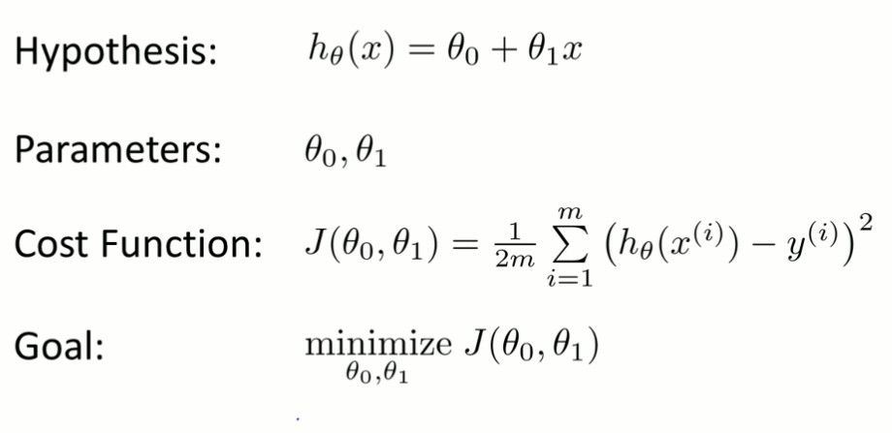
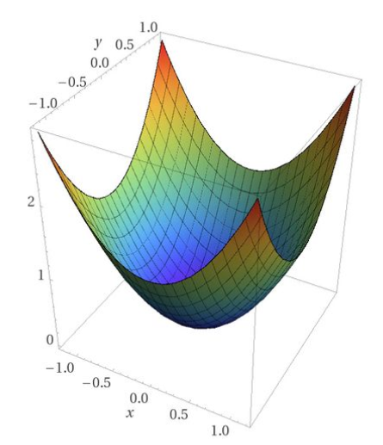
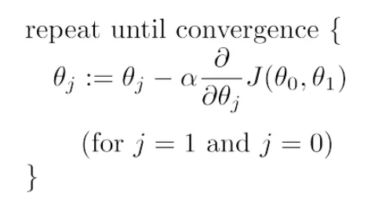
Gradient Descent
Notes:
Used to minimize the loss function of a model by adjusting its parameters. first-order optimization algorithm.

Slide 6
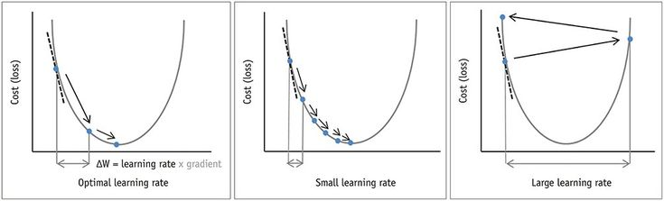
Gradient Descent & Learning Rate
Notes:
Batch/Mini/stochastic
Momentum-Based Gradient Descent (RMSprop) - uses a moving average of past gradients to update the model parameters, which helps the algorithm converge faster and reduce oscillations.
Adam - uses a moving average of past gradients and a moving average of past squared gradients to adapt the learning rate for each parameter.
Other hacks – Add momentum near the convergence point

Slide 7
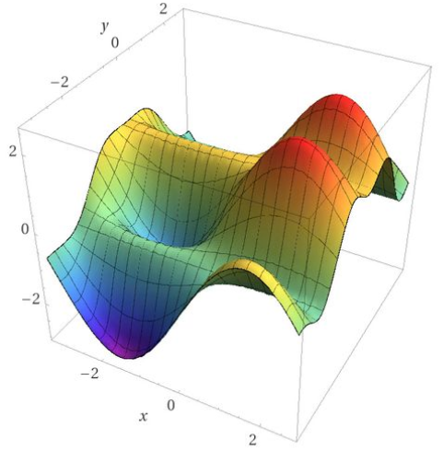
Gradient Descent
Notes:
A second-order optimization algorithm, also known as a quasi-Newton method. second-order methods use both the gradient and the Hessian matrix of the objective function
Second-order optimization algorithms include the Newton's method, the Broyden-Fletcher-Goldfarb-Shanno (BFGS) method, and the limited-memory BFGS (L-BFGS) method.

Slide 8
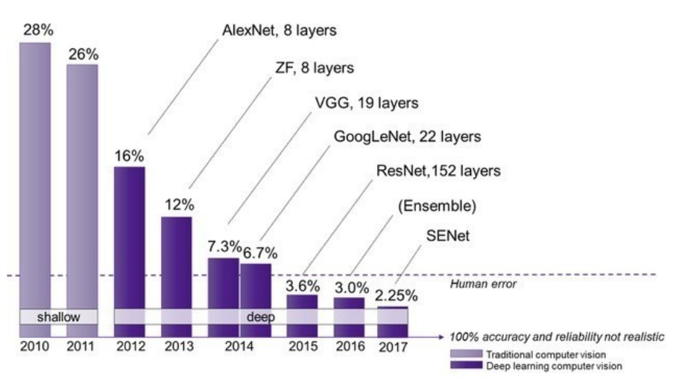
Surpassing human level capabilities

Slide 9
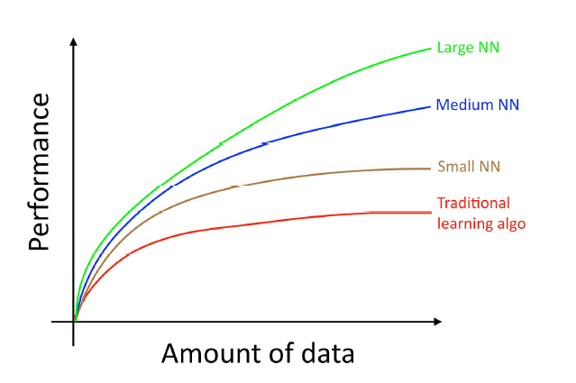
Surpassing human level capabilities
Notes:
Vanishing gradients: As the gradients propagated back through the network during training, they became smaller and smaller, making it difficult to update the weights of the earlier layers. This problem was especially severe for activation functions such as the sigmoid function, which has a very small gradient when its inputs are far from zero.
Exploding gradients: In some cases, the gradients could explode and become too large to handle, leading to instability and poor performance.
Computational resources: Training deep neural networks requires a large amount of computational resources, which were not readily available in the past.
Lack of data: Deep neural networks require large amounts of data to learn effectively, and in the past, there was a limited amount of data available for training.

Slide 10
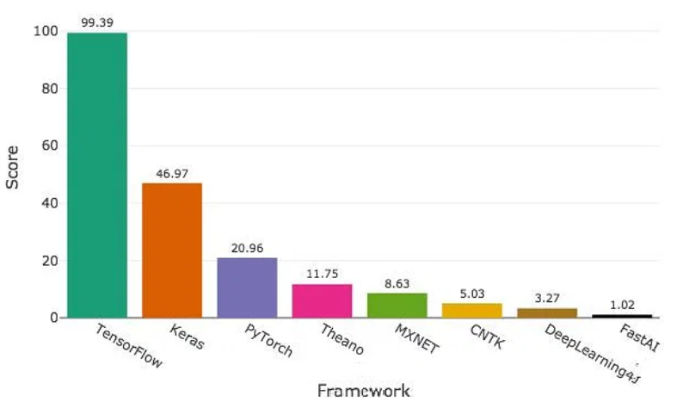
Popular frameworks
Notes:
"Deep learning was developed as a concept well before the computational resources, algorithms, and data sets were available to make it practical and effective. It was only with the advent of large-scale data processing, improvements in hardware, and breakthroughs in neural network architecture that deep learning became a viable approach for solving complex problems."

Slide 11
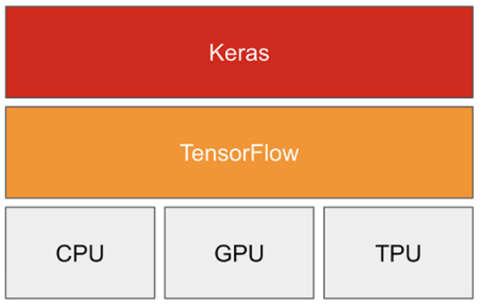
Keras API on TF

Slide 12
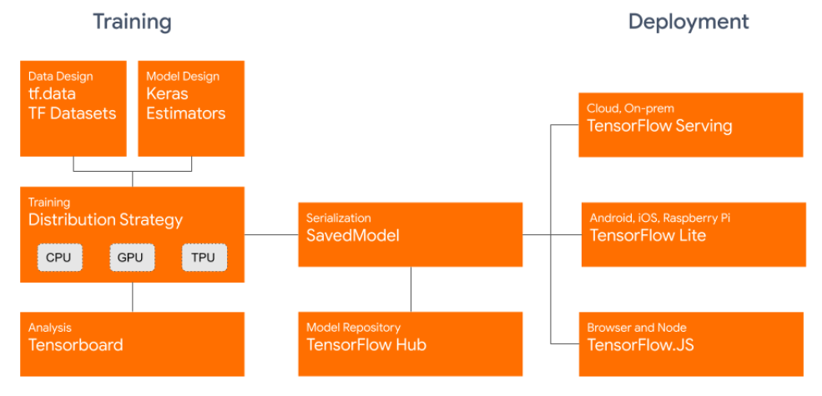
Tensorflow - Ecosystem

Slide 13
Modelling in Tensorflow
Create Model (Sequential / functional / model subclassing)
Compile (Set optimizer and loss)
Fit to data for a desired epoch
Notes:
optimizer is an algorithm that is used to update the weights of a neural network during training in order to minimize the loss function.
epoch is a complete iteration over the entire training dataset during model training. During each epoch, the model is trained on each sample in the training dataset exactly once, and the weights of the model are updated according to the optimizer's update rule.
The number of epochs is an important hyperparameter in model training, as it determines how long the model will train for and how much it will learn from the data.

Slide 14
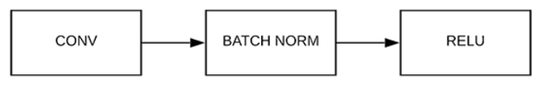
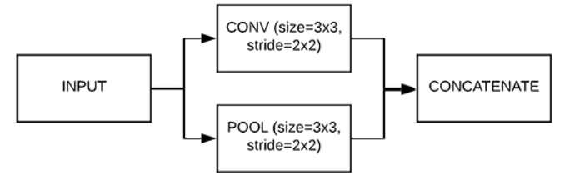
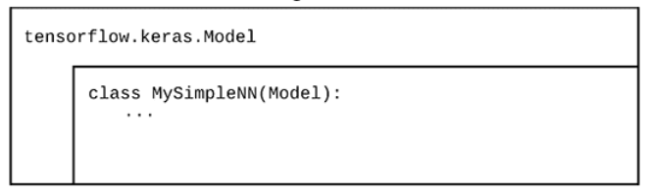
3 ways to create Model
Sequential API
Functional API
Model Subclassing

Slide 15
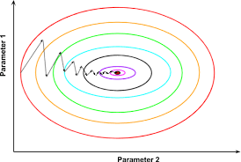
Optimizer
Notes:
optimizer is an algorithm that is used to update the weights of a neural network during training in order to minimize the loss function.
Batch/Mini/stochastic
SGD
Momentum-Based Gradient Descent (RMSprop) - uses a moving average of past gradients to update the model parameters, which helps the algorithm converge faster and reduce oscillations.
Adam - uses a moving average of past gradients and a moving average of past squared gradients to adapt the learning rate for each parameter.
Other hacks – Add momentum near the convergence point

Slide 16
Loss
Properties
Common Loss Functions
Notes:
Non-Negative – bounded on one side
Convexity
Differentiability
Scale-Invariance – MAE vs MSE
Robustness – Huber loss is more robust to outliers
Task-Specific
Common Loss Function
Mean Squared Error (MSE)
Binary Cross-Entropy
Categorical Cross-Entropy
Kullback-Leibler Divergence (KL Divergence)
Hinge Loss
Huber Loss

Slide 17
Fit on Data
Notes:
epoch is a complete iteration over the entire training dataset during model training. During each epoch, the model is trained on each sample in the training dataset exactly once, and the weights of the model are updated according to the optimizer's update rule.
The number of epochs is an important hyperparameter in model training, as it determines how long the model will train for and how much it will learn from the data.

Slide 18
Topics
Convolutional Neural Networks (CNNs)
Reinforcement Learning
Recurrent Neural Networks (RNNs)
Transfer Learning
Generative Adversarial Networks (GANs)
Attention Mechanisms
Autoencoders
Notes:
Convolutional Neural Networks (CNNs): CNNs are a type of neural network that is commonly used for image recognition tasks. They use convolutional layers to detect features in the input image, which are then used to classify the image.
Recurrent Neural Networks (RNNs): RNNs are a type of neural network that can process sequences of inputs, such as time-series data or natural language text. They use recurrent layers to maintain a memory of previous inputs, allowing them to capture temporal dependencies.
Transfer Learning: Transfer learning is a technique that allows a pre-trained model to be used as a starting point for a new task. This can significantly reduce the amount of data and computing resources needed to train a new model.
Generative Adversarial Networks (GANs): GANs are a type of neural network that can generate realistic samples of data, such as images or text. They consist of two networks, a generator and a discriminator, that are trained in a adversarial manner.
Attention Mechanisms: Attention mechanisms allow a model to selectively focus on certain parts of the input when making predictions. They have been used to improve performance in tasks such as machine translation and image captioning.
Autoencoders: Autoencoders are a type of neural network that can be used for unsupervised learning, dimensionality reduction, and data compression. They consist of an encoder network that maps inputs to a lower-dimensional latent space, and a decoder network that reconstructs the inputs from the latent space.
Reinforcement Learning: Reinforcement learning is a type of machine learning that involves an agent learning to take actions in an environment in order to maximize a reward signal. It has been used to create agents that can play games like Go and Chess at a superhuman level.

