Slide 1
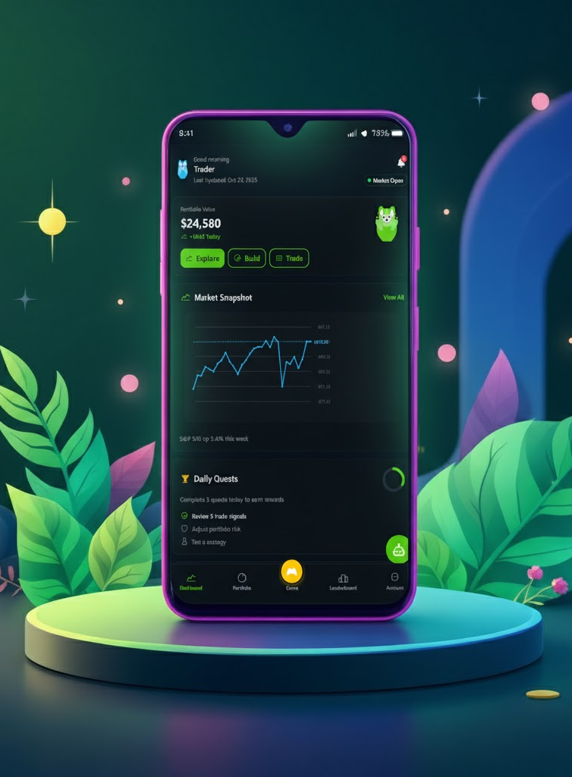
WealthArena
Empowering Beginners to invest with Confidence

Slide 2
What We'll Explore Today
01
02
03
The Opportunity
The Challenge
Our Solution
Market demand for accessible trading education
Why beginners struggle without proper guidance
WealthArena's integrated learning platform
04
05
06
Our Technology
Results
Vision
AI-powered recommendations and
architecture
Metrics of our results
Progress achieved and future roadmap

Slide 3

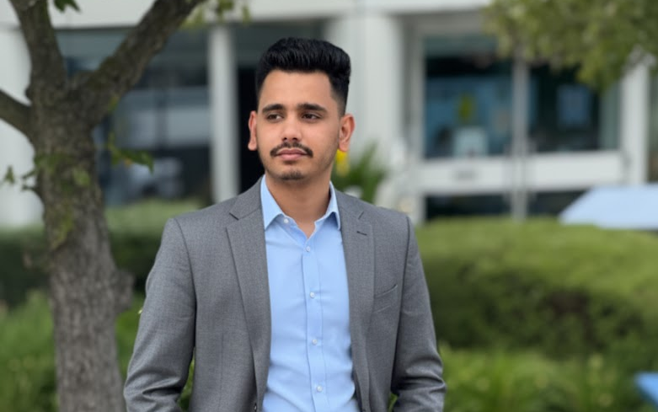
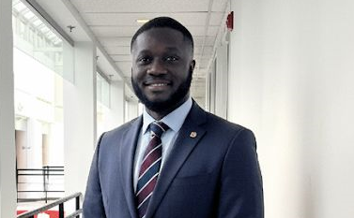
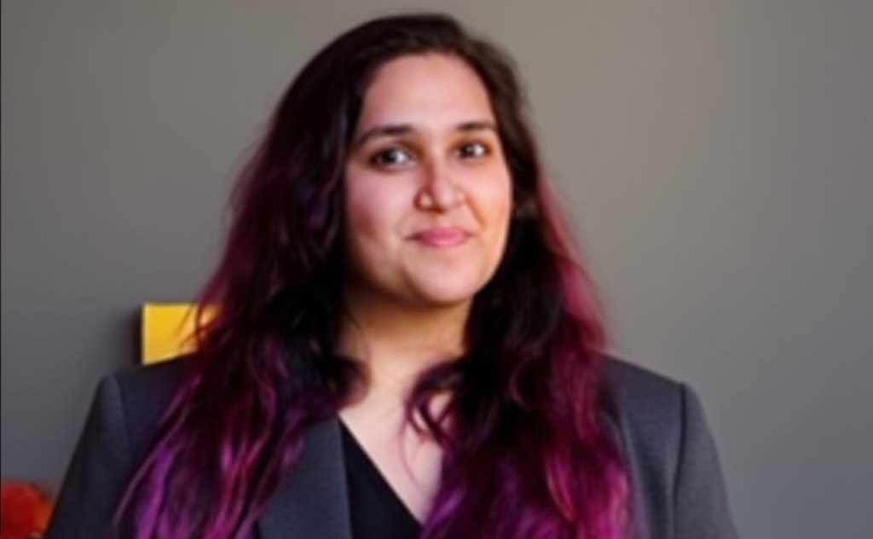
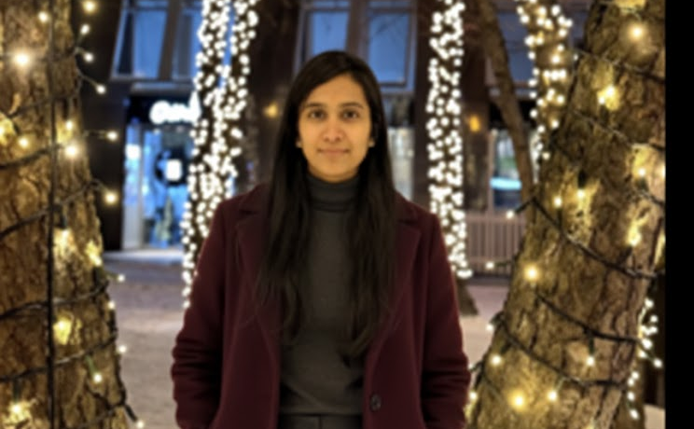
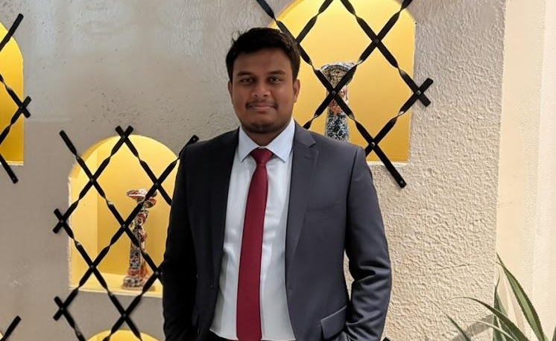
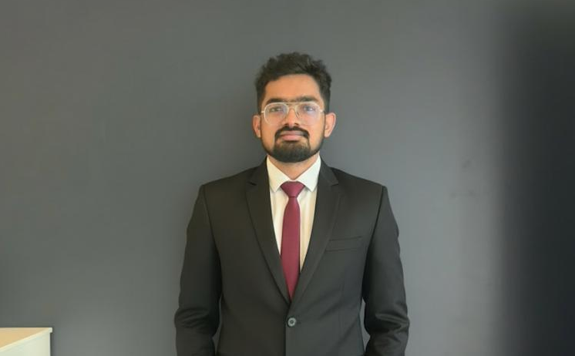

Meet the WealthArena Team
Clifford Addison
Shivam Bhargav
Kanika
Project Lead & AI Engineer 1
Technical Lead & CS Engineer 1
AI Engineer 2
Neha Nareshbhai Patel
Harsha Vardhan Reddy
Amruth Raj
CS Engineer 2
AI Engineer 3
AI Engineer 4

Slide 4

The Market Opportunity
30K+
A$ 1500 per user
60%+
New traders monthly
Trading losses annually
Without proper guidance
Approximately across major Australian markets and platforms
Beginner traders in Australia due to lack of education
Traders entering markets lack formal financial education or mentorship
* The numbers displayed are approximate numbers calculated from references

Slide 5
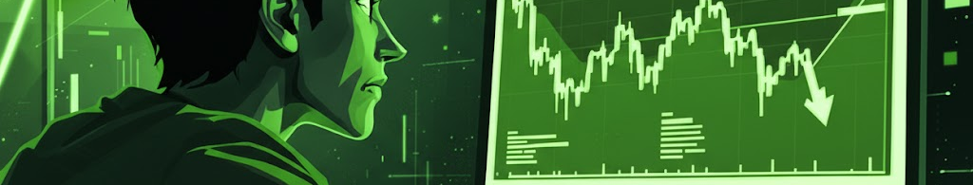
The Problem: Why Beginners Struggle
Information Gap
Unreliable Resources
Generic YouTube channels teach broad strategies without assessing individual risk tolerance, budget constraints, or market conditions.
Scattered, outdated, or biased trading advice leads to poor portfolio decisions and significant financial losses.
Scam Vulnerability
No Personalization
Inexperienced traders fall prey to fraudulent schemes, pump-and-dump tactics, and predatory trading systems.
One-size-fits-all platforms ignore unique circumstances, leaving beginners exposed to excessive risk exposure.

Slide 6
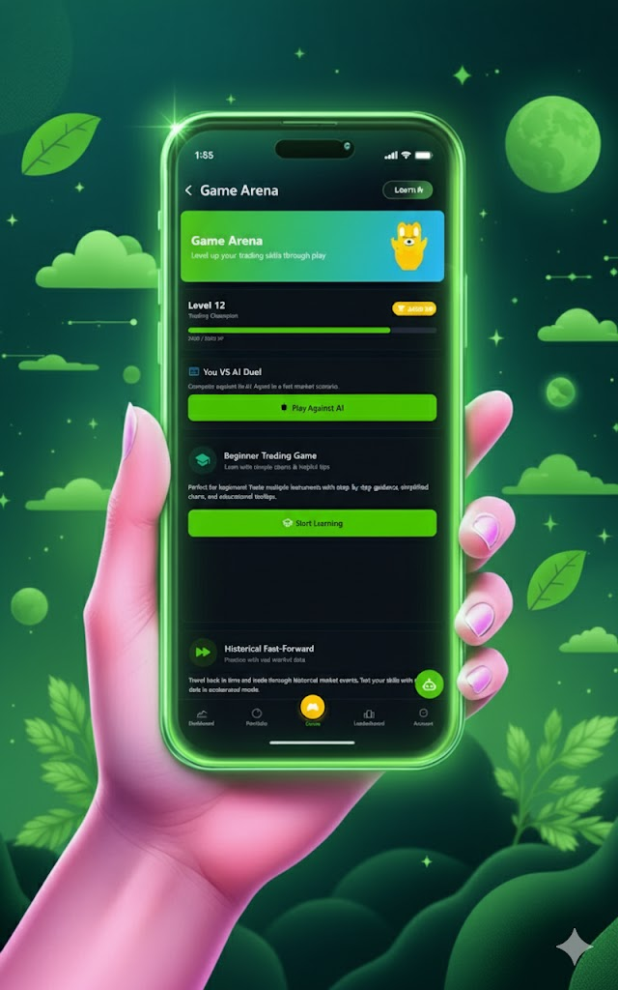
How WealthArena Solves This
📚 Personalized Education
🤖 AI Chatbot
Interactive games and structured courses tailored to learning style
24/7 instant answers to trading questions, risk assessment, and guidance
📊 Smart Portfolio Builder
Risk-based recommendations analyzing budget and investment goals

Slide 7





Technology Stack
Frontend
Backend
Database
React, Tailwind CSS
Flask, FastAPI, Docker
AzureSQL, Azure Data Lake
ML Stack
Deployment
TensorFlow, PyTorch, HuggingFace, scikit-learn
Azure VM, GitHub Actions, Docker Compose

Slide 8
Project Development Timeline
Phase
Timeline
Key Deliverables
Status
Phase 1: Foundation
Week 3 to Week 5
MVP platform, basic education modules, beta chatbot
✅ Complete
Phase 2: Intelligence
Week 6 to Week 8
RL model test and portfolio analyzer
✅ Complete
Phase 3: Scale
Week 9 to Week 13
Integrating all data with rl model and integrate with the front end
🔄 In Progress
Phase 4: Growth
Week 14 (Final Demo)
Final touches and improving the overall application
📅 Planned

Slide 9
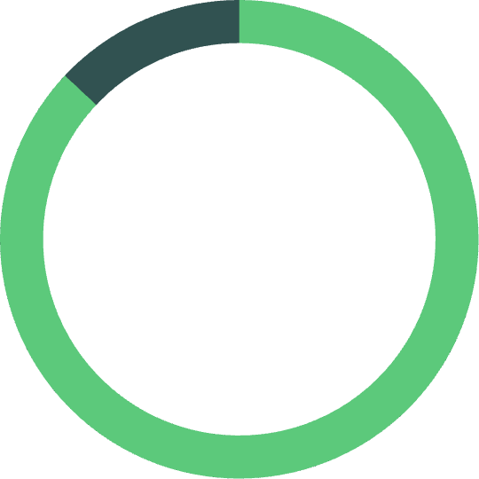

Results So Far
87%
5
250K+
Chat bot Accuracy
RL Agents Trained
Lines of Code
Chatbot accuracy on test data
Reinforcement learning agents trained for portfolio optimization
Lines of code developed for the platform
4M+
35+
1885+
Data Stored
Cryptos, Forex, and Commodities
Market Coverage
Rows of data stored in database
Symbols tracked
ASX stocks symbols tracked
Our beta testing demonstrates strong platform effectiveness across all core metrics.

Slide 10

Next Steps
Expand MVP to select global markets
Expand our project from Australian Markets to major Global markets.
Integrate multilingual chatbot
Make WealthArena accessible to diverse users across globe.
Launch premium “Risk Simulator” tier
Offer advanced insights and personalized portfolio risk forecasting.
Partner with fintech accelerators for scale
Gain mentorship, visibility, and access to strategic investors.

Slide 11
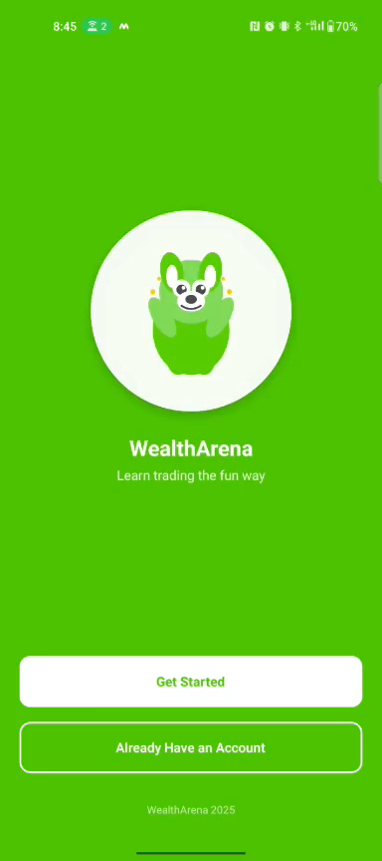
Demo
https://drive.google.com/file/d/1GCRqyDkdaj2j0R73FRo_O6xSSoMnd0Up/view?usp=drivesdk

Slide 12
References
ASX Limited. (2023). Australian investor study 2023 (Report).
https://www.asx.com.au/content/dam/asx/blog/asx-australian-investor-study-2023.pdf. Australian Securities Exchange
Australian Securities and Investments Commission. (2022). Report 735: Retail investor research (SEC Newgate study).
https://download.asic.gov.au/media/z1nj5m5e/rep735-published-11-august-2022.pdf. download.asic.gov.au
Australian Securities and Investments Commission. (2022). REP 735: Retail investor research (web summary).
https://www.asic.gov.au/regulatory-resources/find-a-document/reports/rep-735-retail-investor-research/. ASIC
Australian Securities and Investments Commission. (2022, Mar.). INFO 269: Discussing financial products and services online
https://www.asic.gov.au/regulatory-resources/financial-services/giving-financial-product-advice/discussing-financial-products-and-services-online/. ASIC
Australian Securities and Investments Commission. (2020, Oct. 23). ASIC product intervention order strengthens CFD protections
https://www.asic.gov.au/about-asic/news-centre/find-a-media-release/2020-releases/20-254mr-asic-product-intervention-order-strengthens-cfd-protections/. ASIC
Australian Securities and Investments Commission. (2020, Nov. 11). Read this before trading CFDs (News item).
https://www.asic.gov.au/about-asic/news-centre/news-items/read-this-before-trading-cfds/. ASIC
National Anti-Scam Centre, Australian Competition and Consumer Commission. (2025, Mar. 11)
Targeting scams: Report of the National Anti-Scam Centre on scams data and activity 2024 (Annual report).
https://www.scamwatch.gov.au/system/files/targeting-scams-report-2024.pdf. scamwatch.gov.au
National Anti-Scam Centre, Australian Competition and Consumer Commission. (2024, May). Investment scam fusion cell: Final report.
https://www.accc.gov.au/system/files/NASC-Investment-scam-fusion-cell-final-report-2024.pdf. ACCC
International Organization of Securities Commissions. (2023, Mar. 30). Retail Market Conduct Task Force: Final report.
https://www.iosco.org/library/pubdocs/pdf/IOSCOPD730.pdf. iosco.org
International Organization of Securities Commissions. (2025). Finfluencers: Final report with policy recommendations.
https://www.iosco.org/library/pubdocs/pdf/IOSCOPD795.pdf. iosco.org
Barber, B. M., & Odean, T. (2000). Trading is hazardous to your wealth: The common stock investment performance of individual investors. Journal of Finance, 55(2), 773–806.
https://faculty.haas.berkeley.edu/odean/papers%20current%20versions/individual_investor_performance_final.pdf. faculty.haas.berkeley.edu
Barber, B. M., Lee, Y.-T., Liu, Y.-J., & Odean, T. (2011). Do day traders rationally learn about their ability? Review of Financial Studies, 24(2), 513–563.
https://faculty.haas.berkeley.edu/odean/papers/Day%20Traders/Day%20Trading%20and%20Learning%20110217.pdf. faculty.haas.berkeley.edu

Slide 13

Questions?
Thank you for your time and consideration.
We are now ready to get grilled

