Slide 1

Notes:
[Sources]
Local AI : RE HTML presentation render (slide 1).
[/Sources]

Slide 2
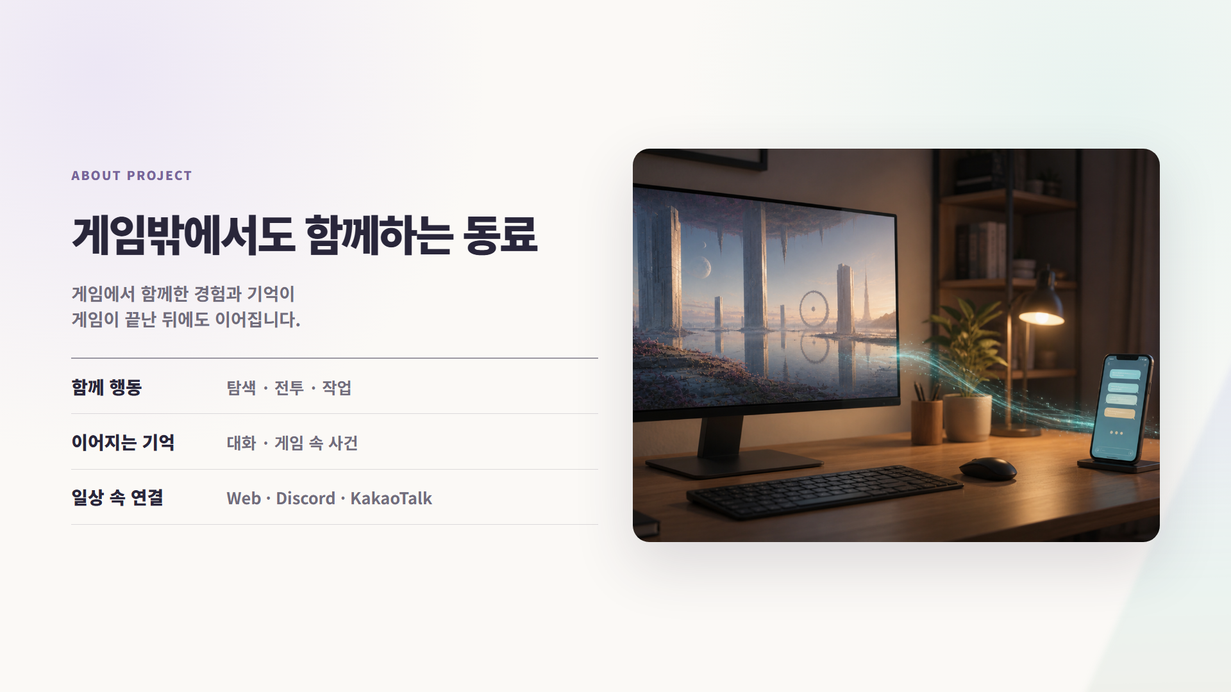
Notes:
[Sources]
Local AI : RE HTML presentation render (slide 2).
[/Sources]

Slide 3
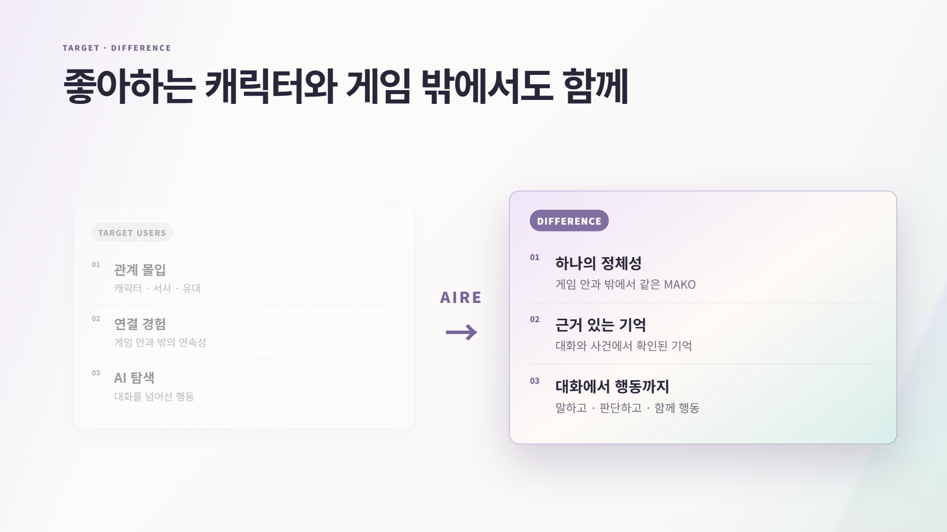
Notes:
[Sources]
Local AI : RE HTML presentation render (slide 3).
[/Sources]

Slide 4
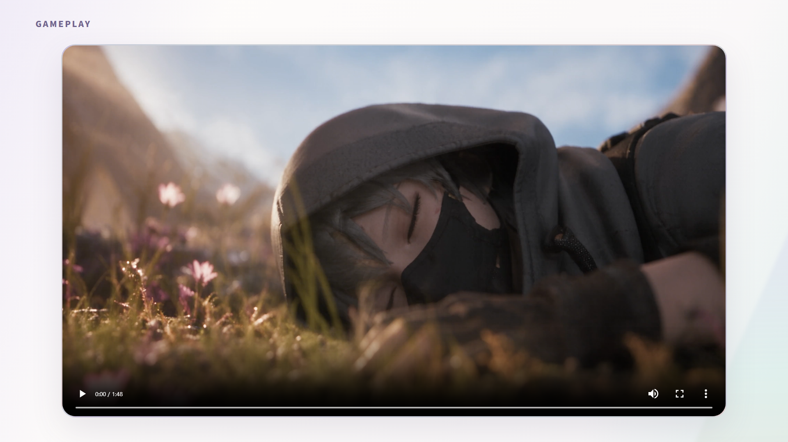
Notes:
[Sources]
Local AI : RE HTML presentation render (slide 4).
[/Sources]

Slide 5
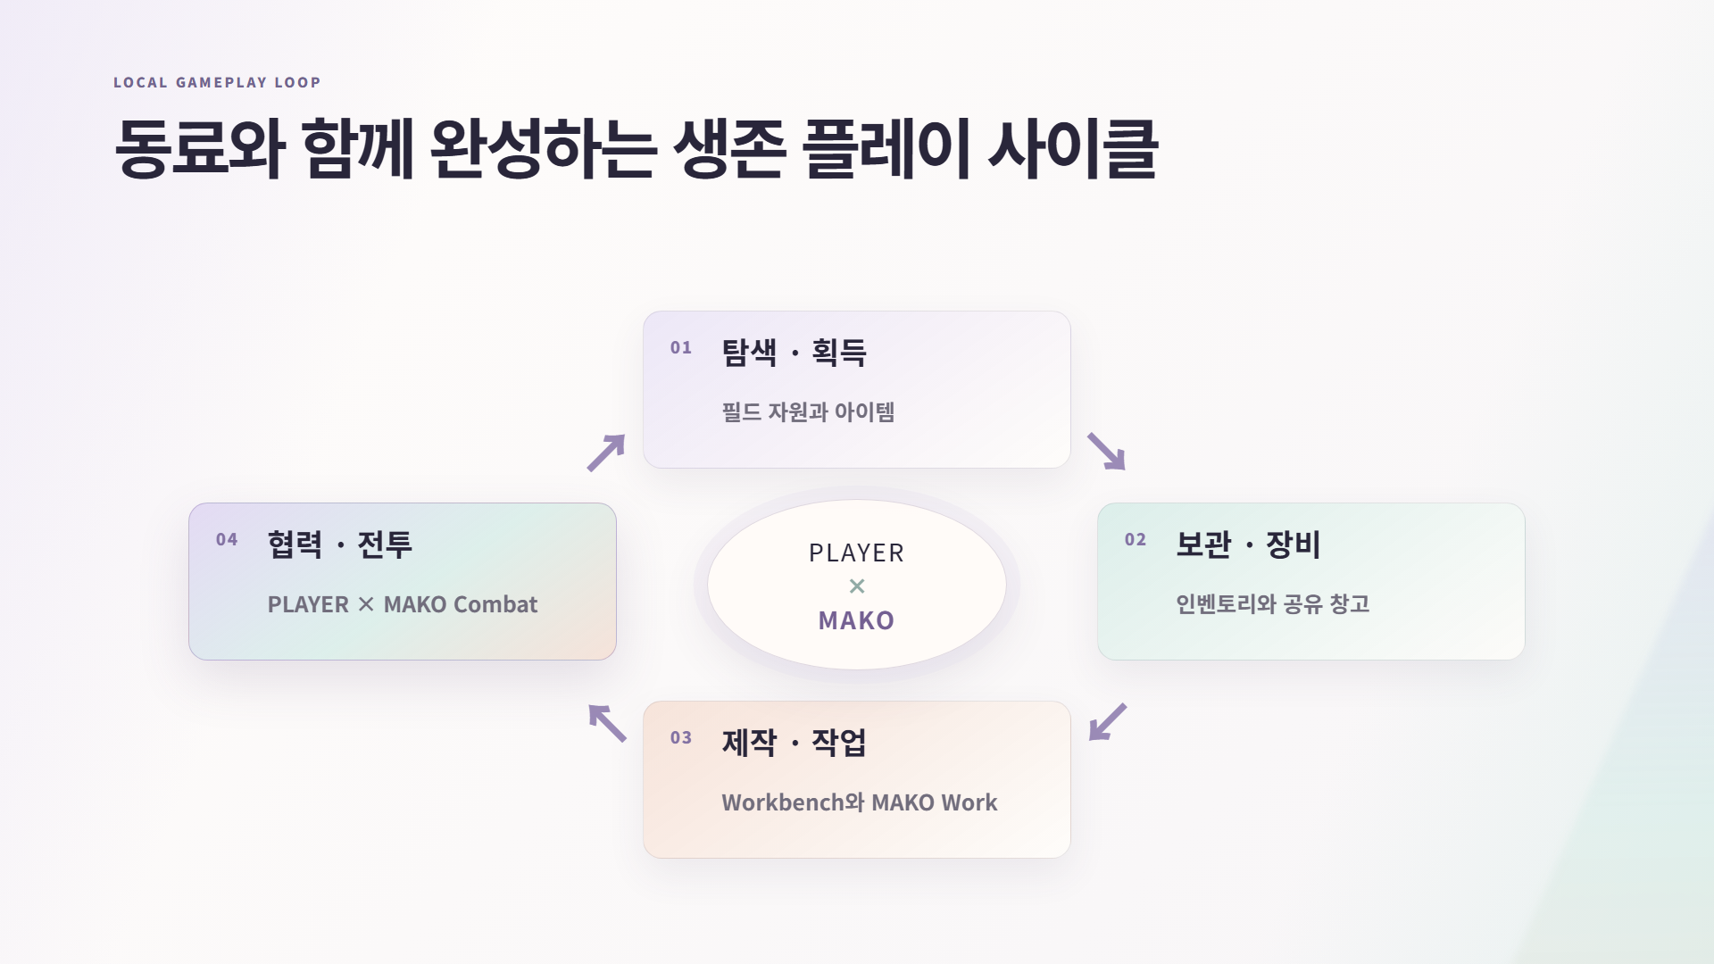
Notes:
[Sources]
Local AI : RE HTML presentation render (slide 5).
[/Sources]

Slide 6
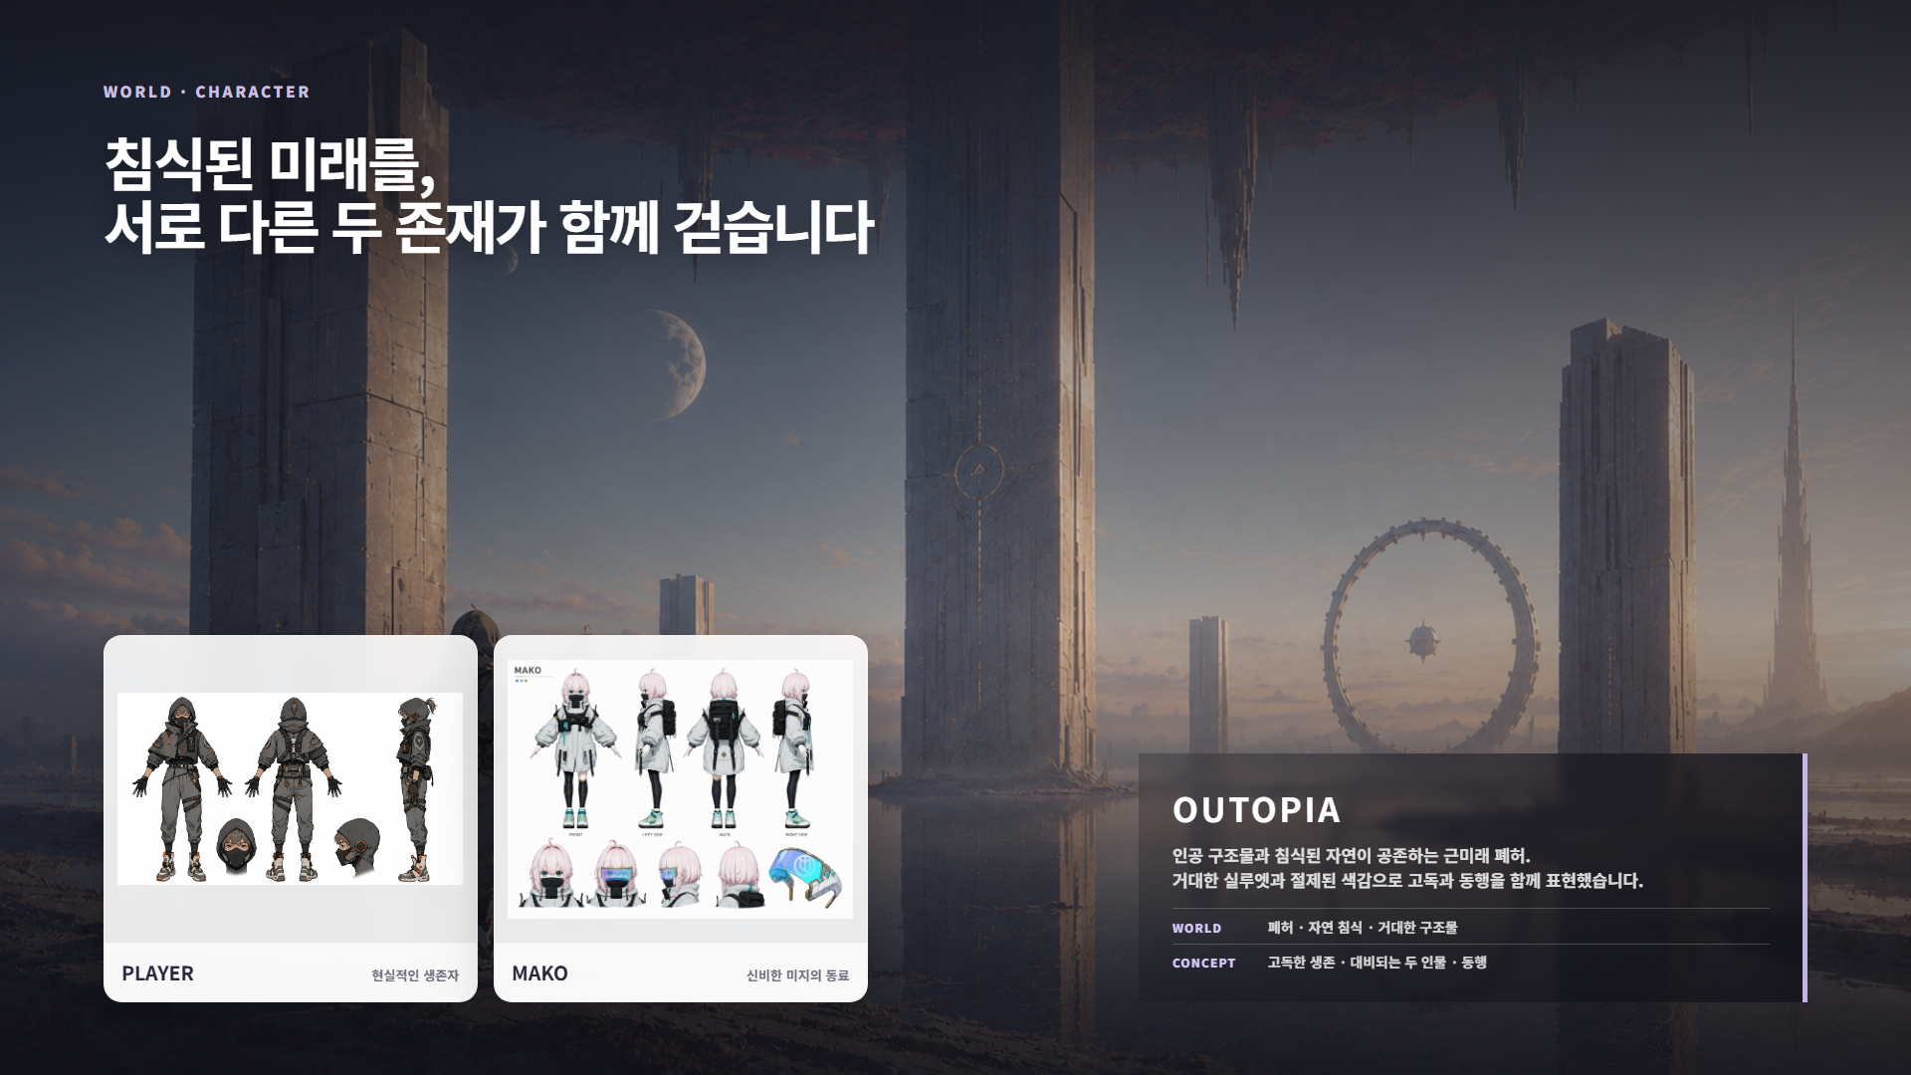
Notes:
[Sources]
Local AI : RE HTML presentation render (slide 6).
[/Sources]

Slide 7
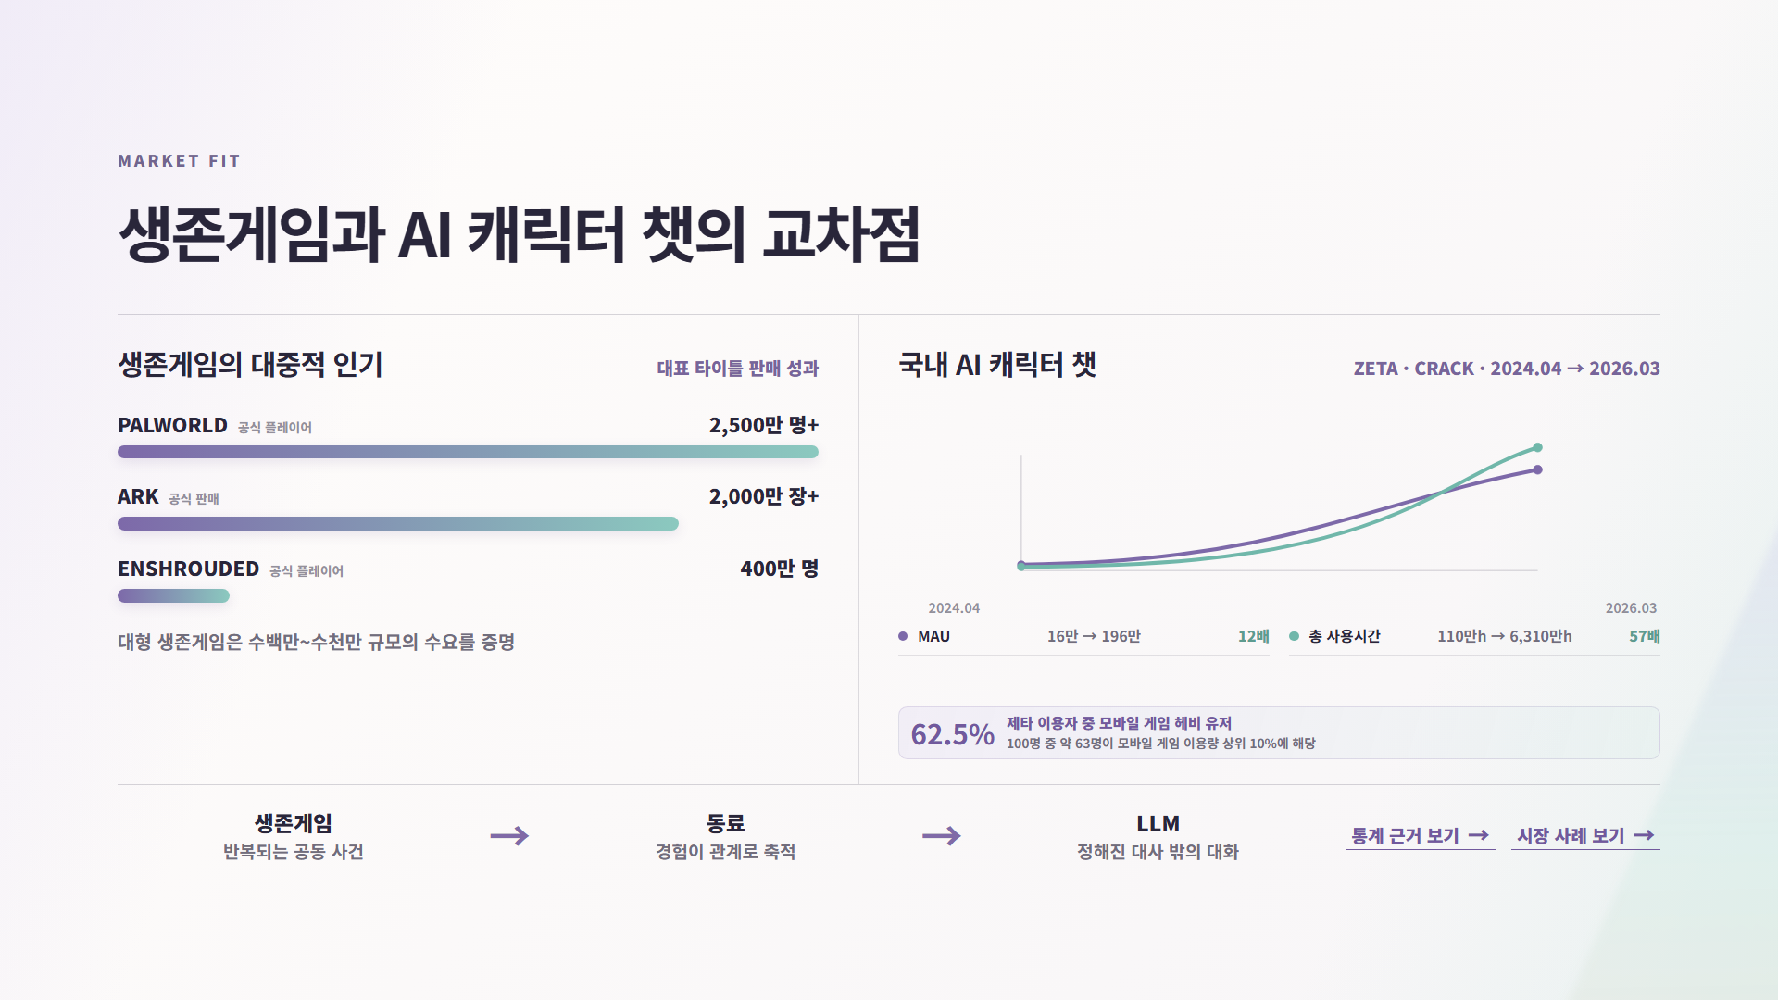
Notes:
[Sources]
Local AI : RE HTML presentation render (slide 7).
[/Sources]

Slide 8
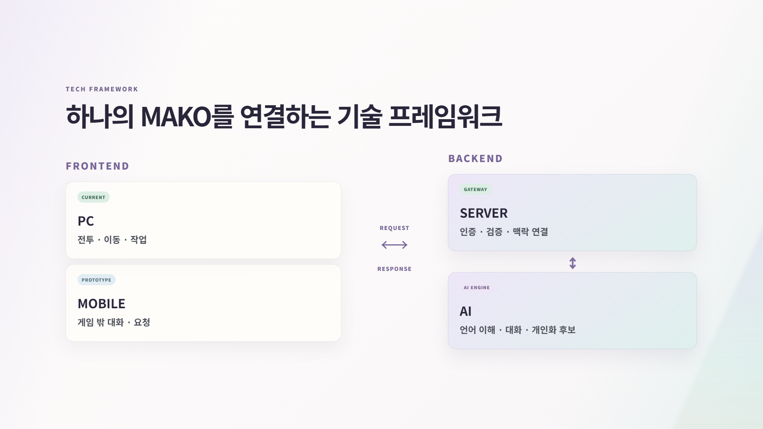
Notes:
[Sources]
Local AI : RE HTML presentation render (slide 8).
[/Sources]

Slide 9
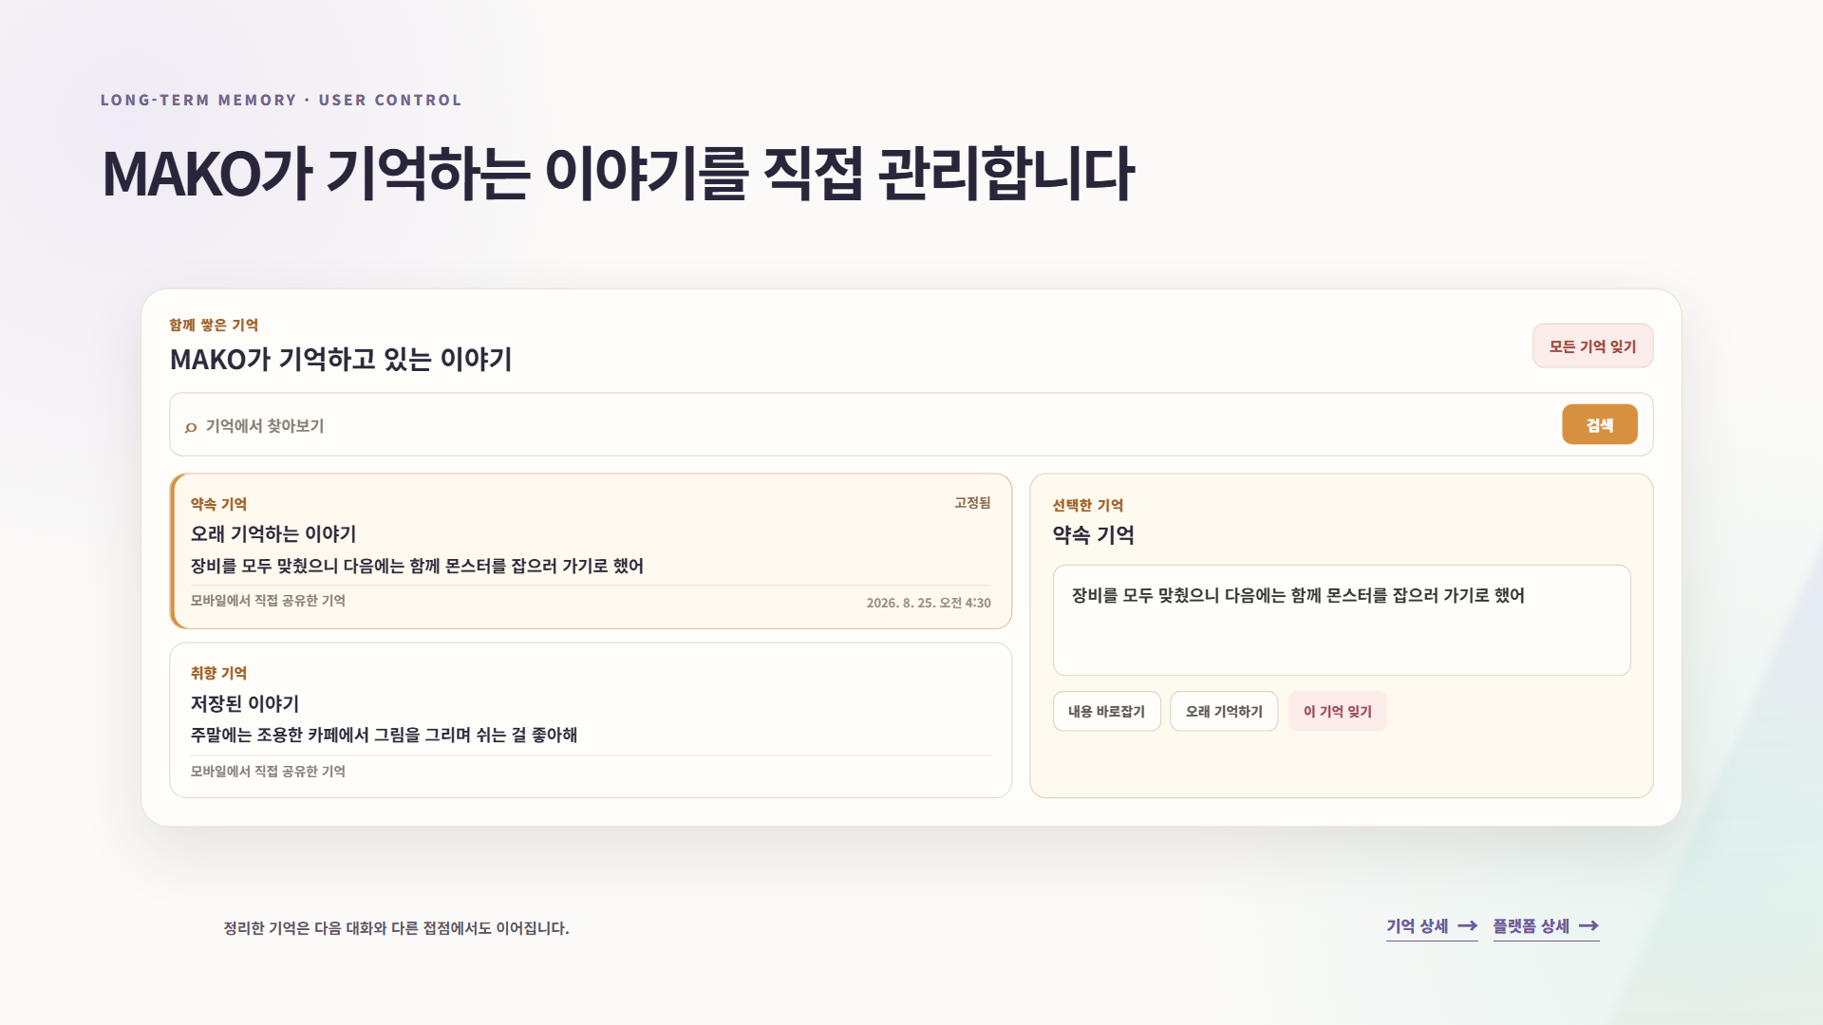
Notes:
[Sources]
Local AI : RE HTML presentation render (slide 9).
[/Sources]

Slide 10
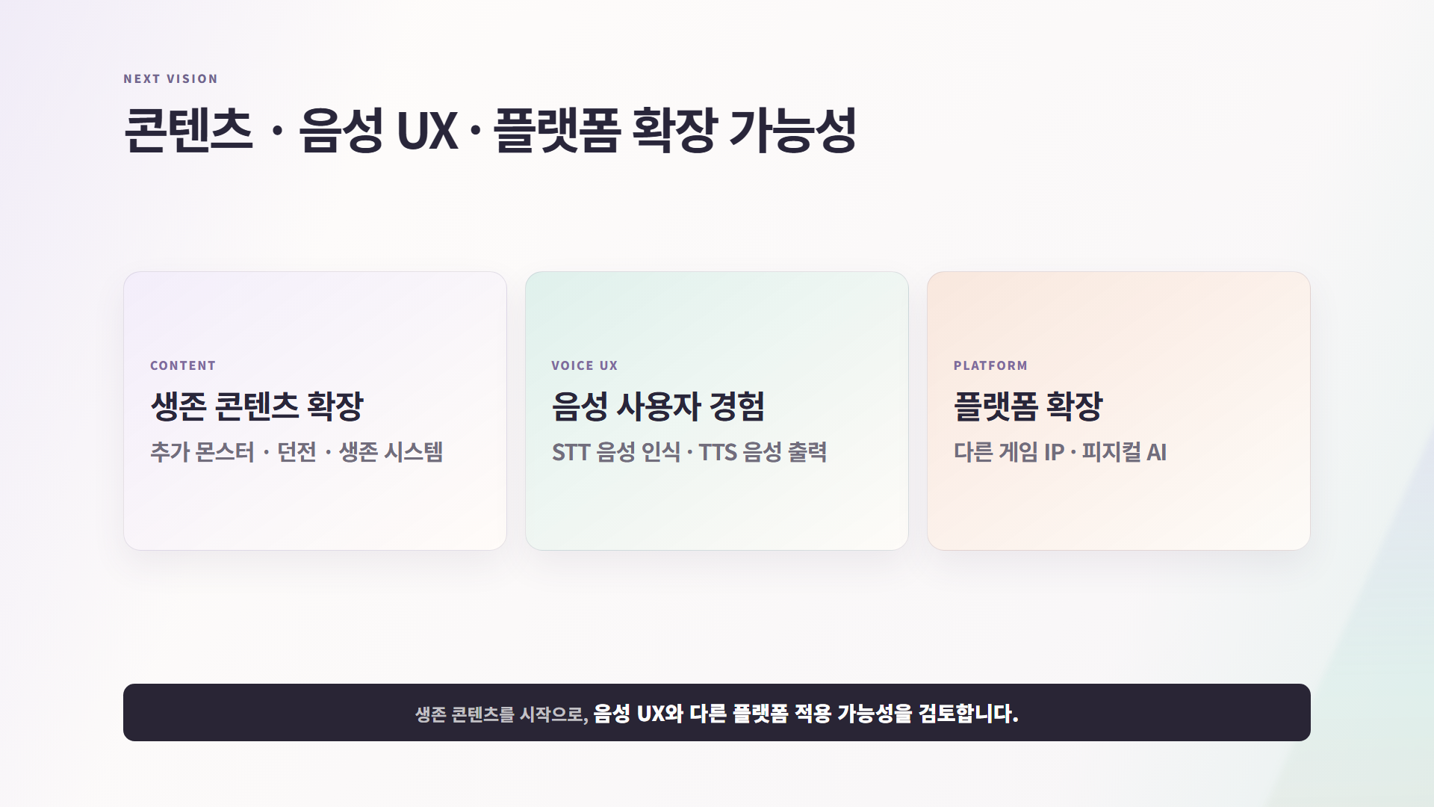
Notes:
[Sources]
Local AI : RE HTML presentation render (slide 10).
[/Sources]

Slide 11

Notes:
[Sources]
Local AI : RE HTML presentation render (slide 11).
[/Sources]

Slide 12
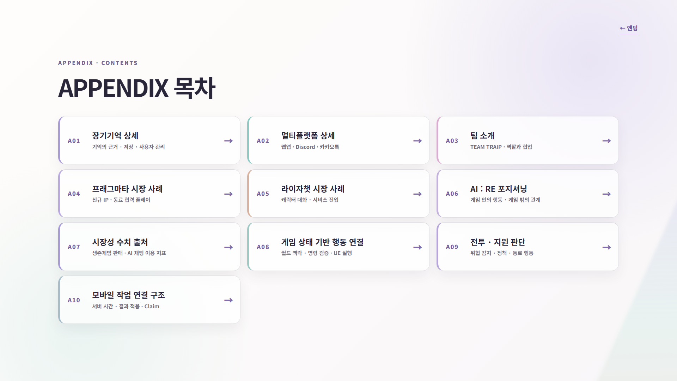
Notes:
[Sources]
Local AI : RE HTML presentation render (slide 12).
[/Sources]

Slide 13
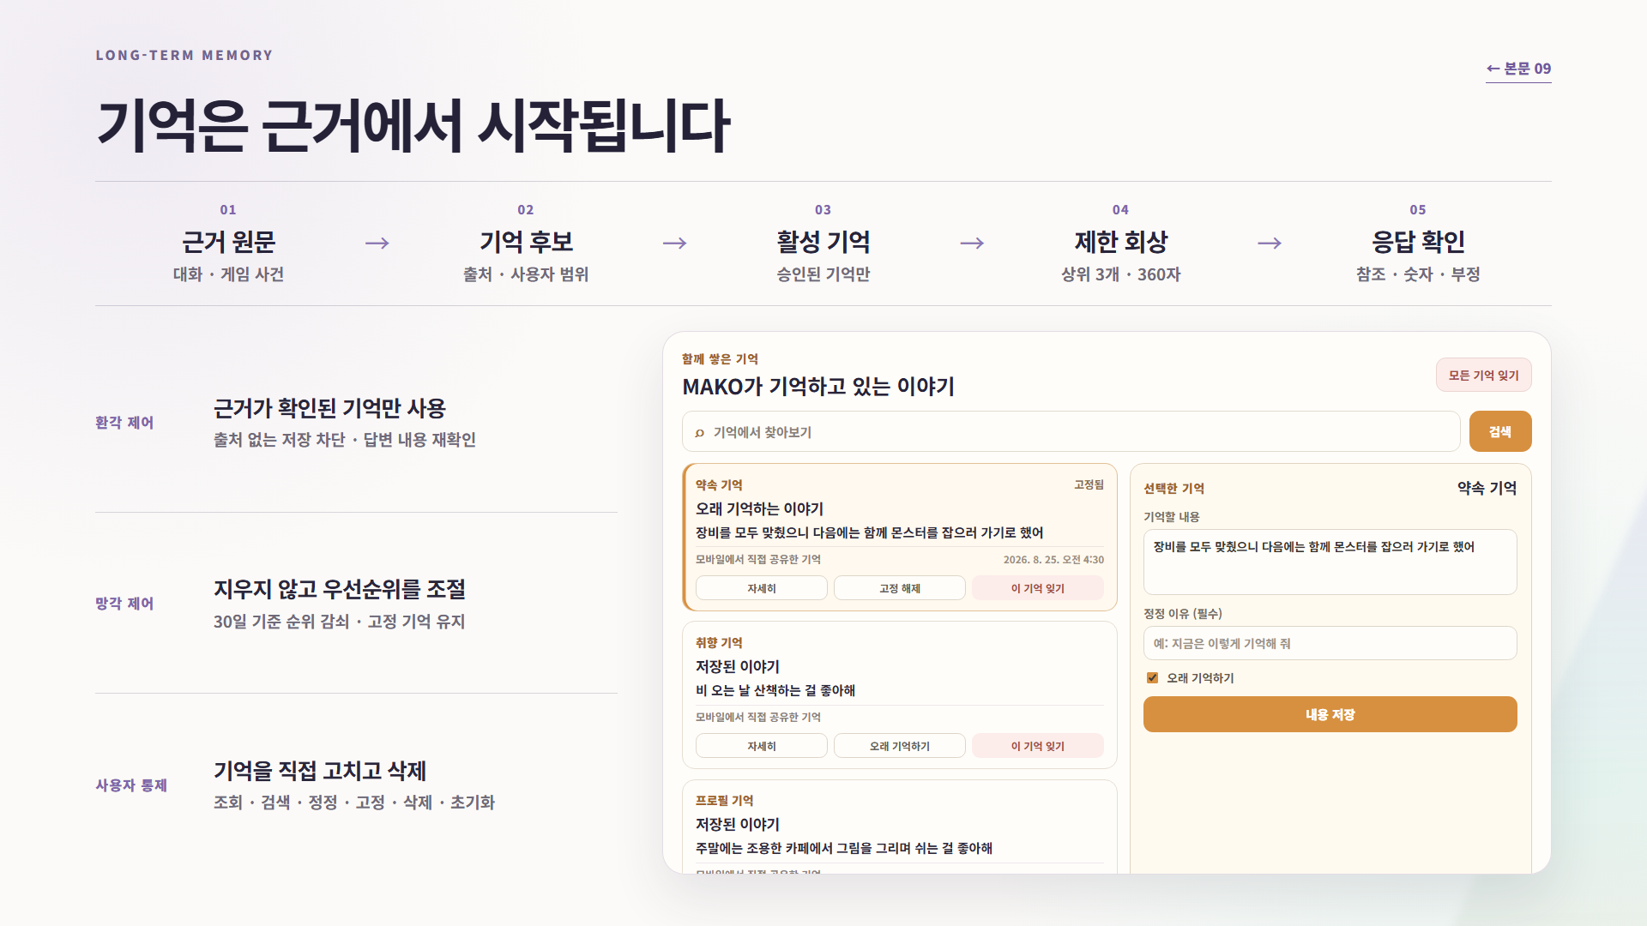
Notes:
[Sources]
Local AI : RE HTML presentation render (slide 13).
[/Sources]

Slide 14

Notes:
[Sources]
Local AI : RE HTML presentation render (slide 14).
[/Sources]

Slide 15
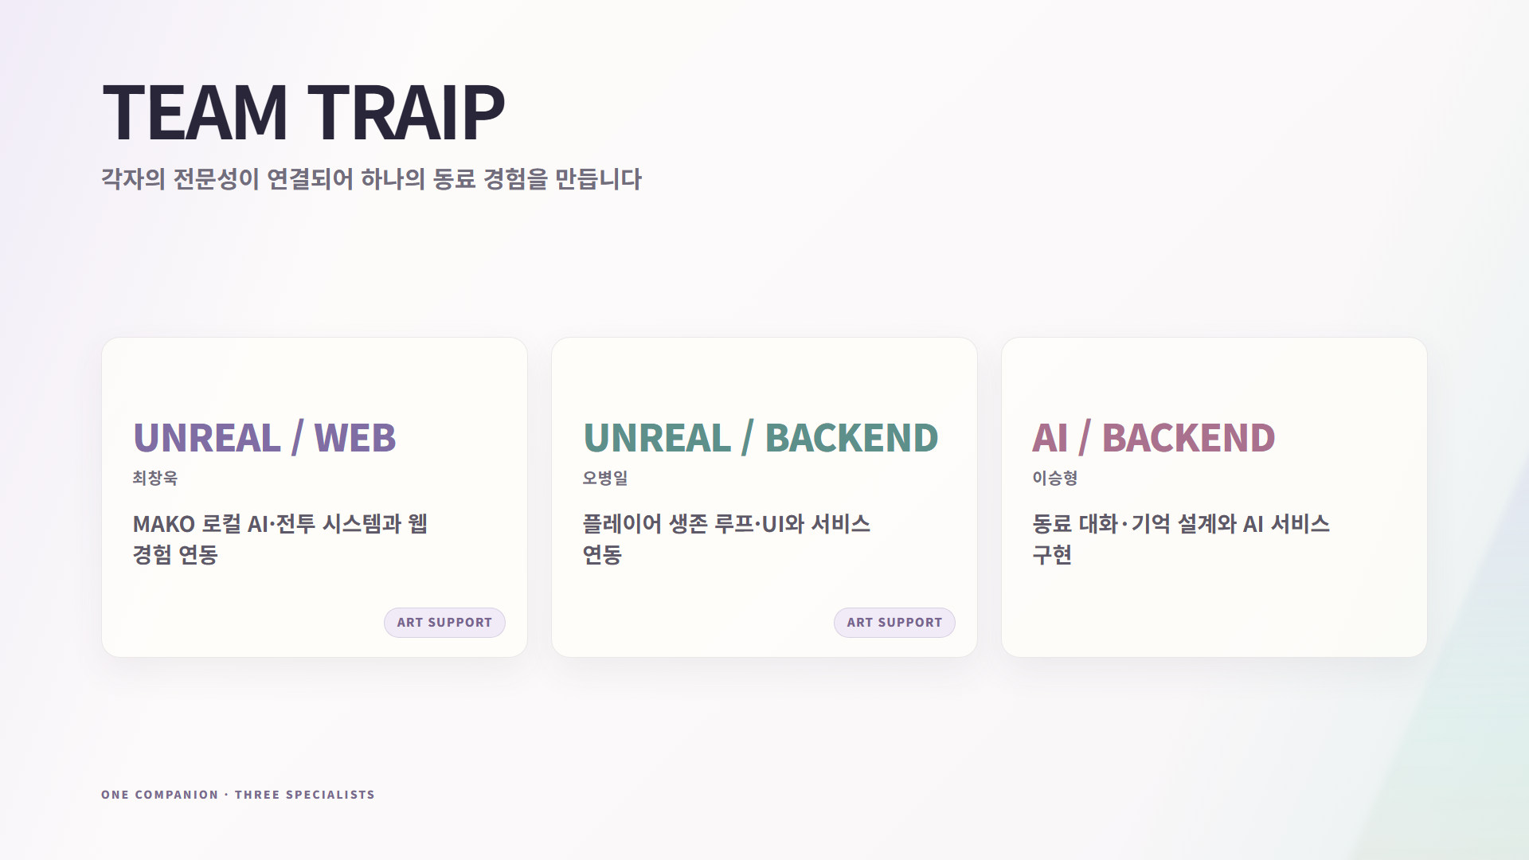
Notes:
[Sources]
Local AI : RE HTML presentation render (slide 15).
[/Sources]

Slide 16
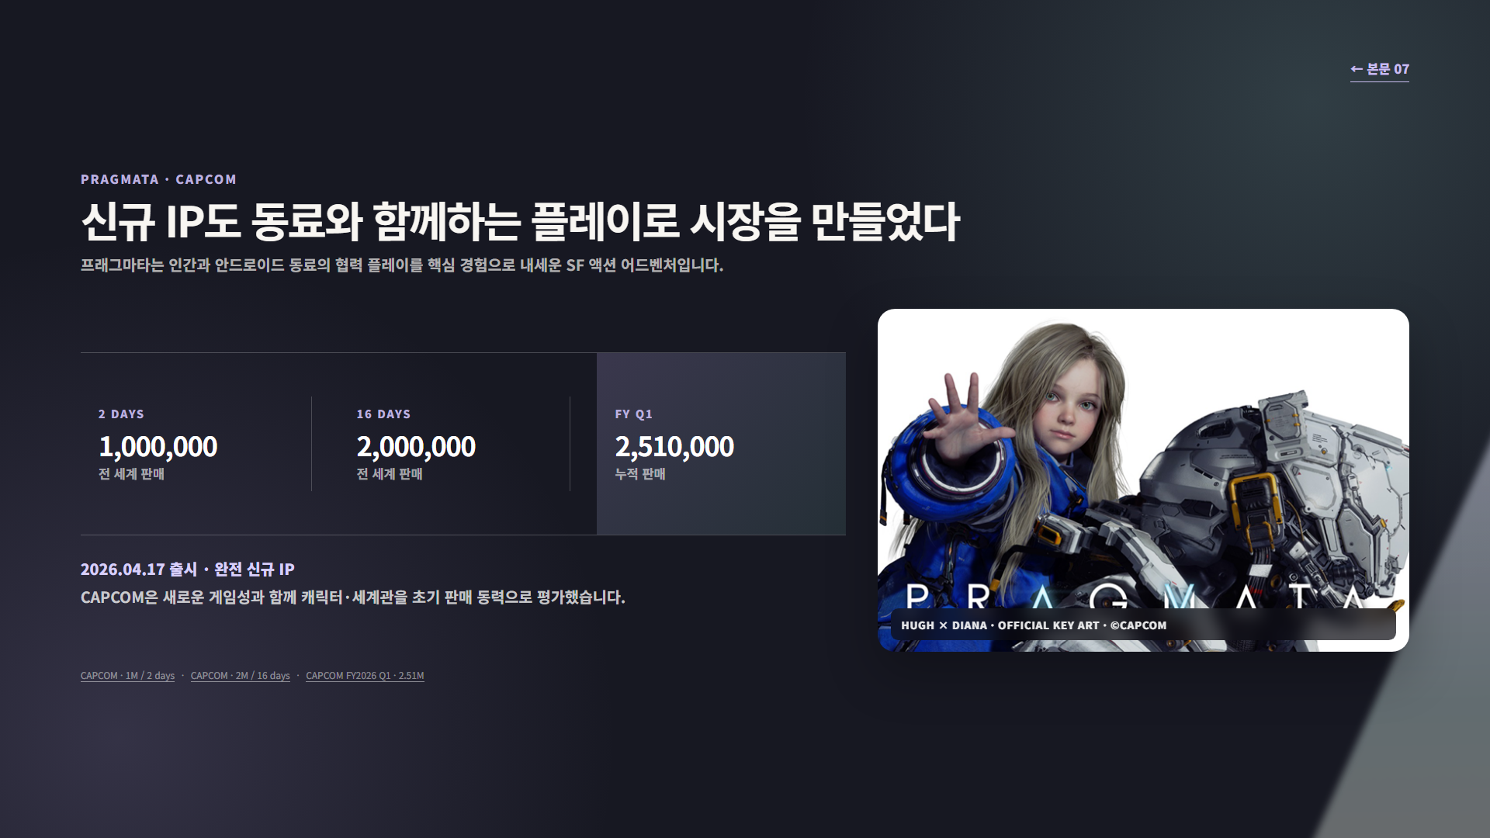
Notes:
[Sources]
Local AI : RE HTML presentation render (slide 16).
[/Sources]

Slide 17
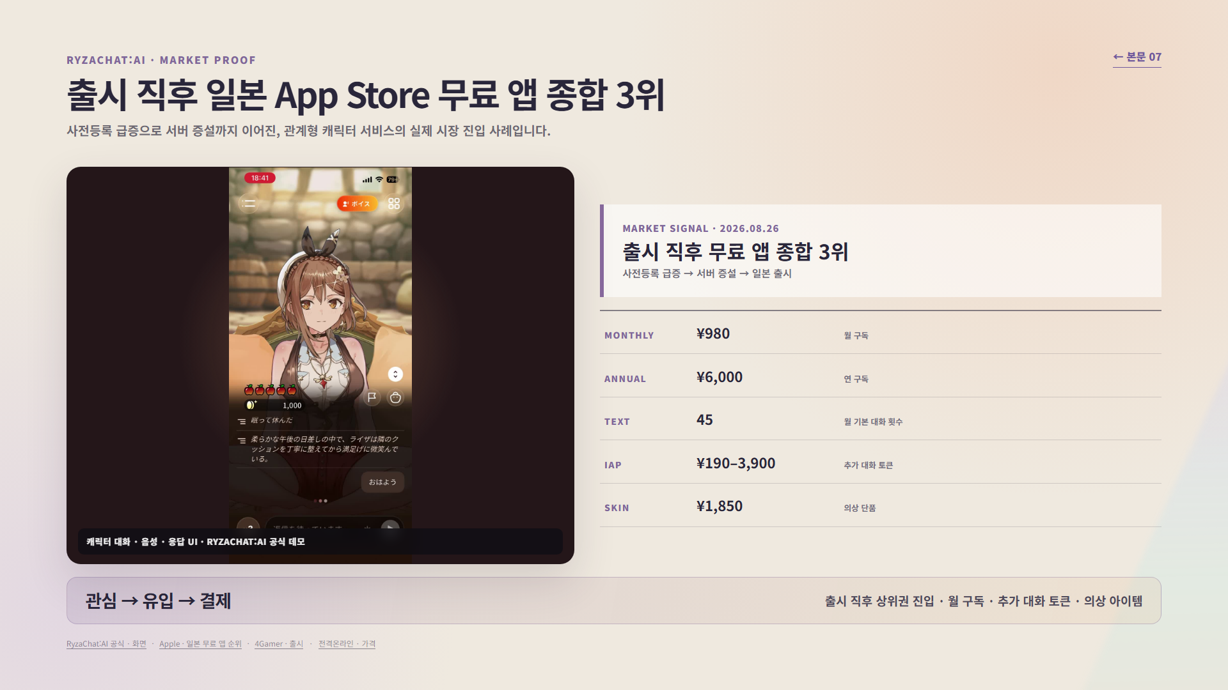
Notes:
[Sources]
Local AI : RE HTML presentation render (slide 17).
[/Sources]

Slide 18
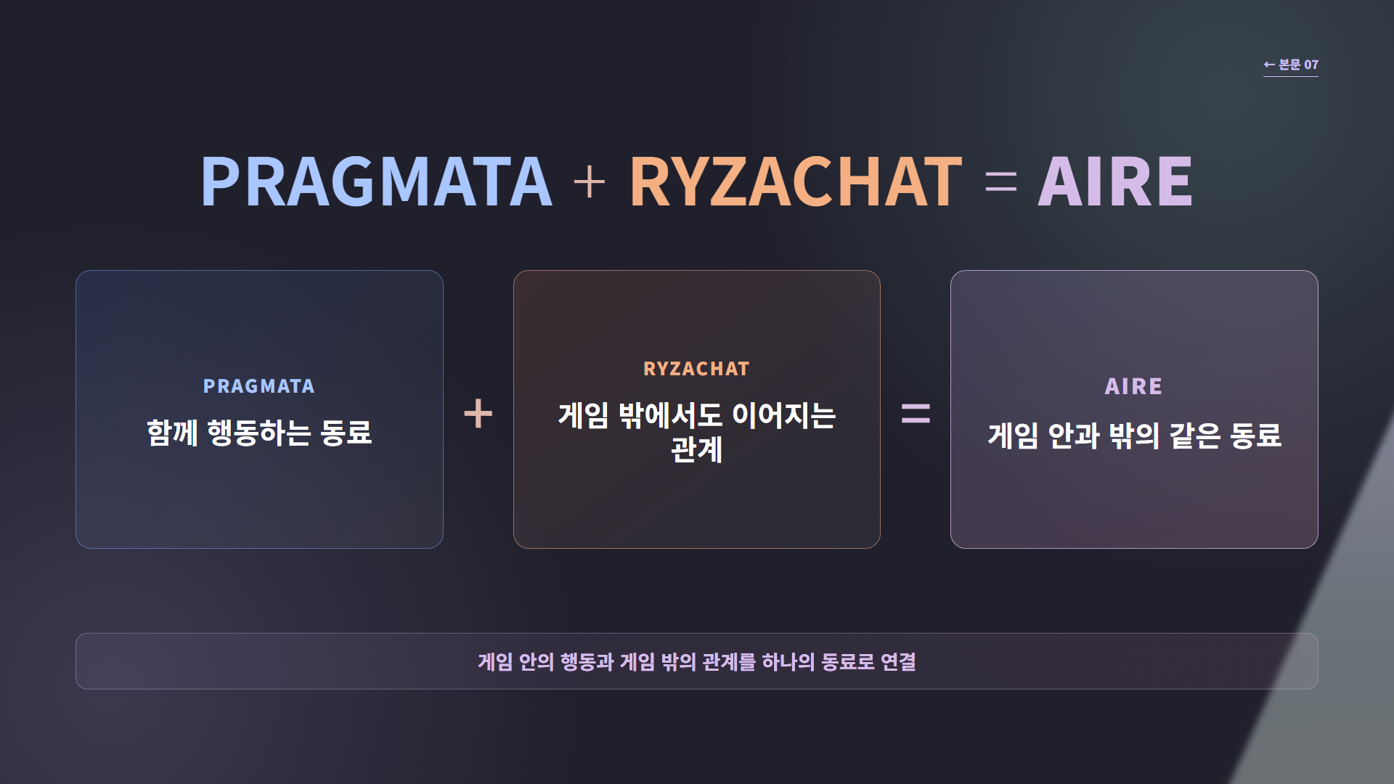
Notes:
[Sources]
Local AI : RE HTML presentation render (slide 18).
[/Sources]

Slide 19
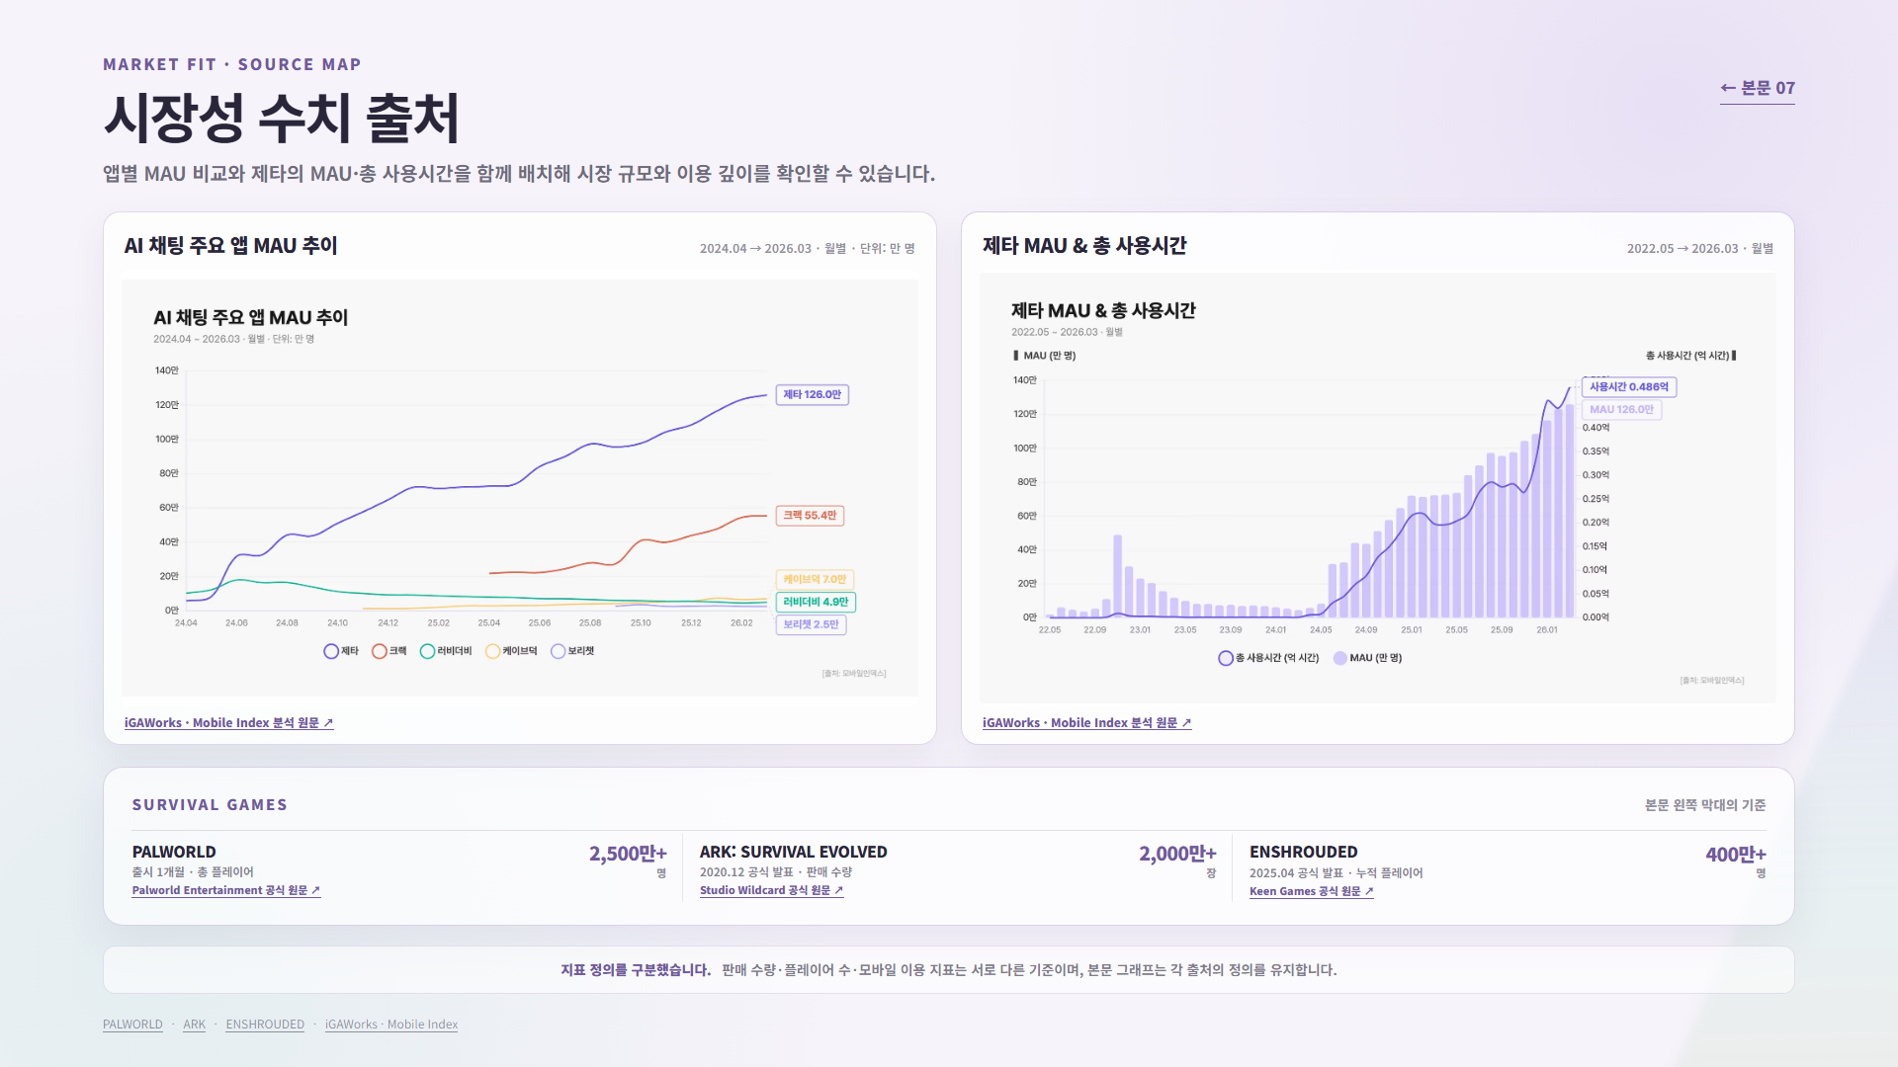
Notes:
[Sources]
Local AI : RE HTML presentation render (slide 19).
[/Sources]

Slide 20
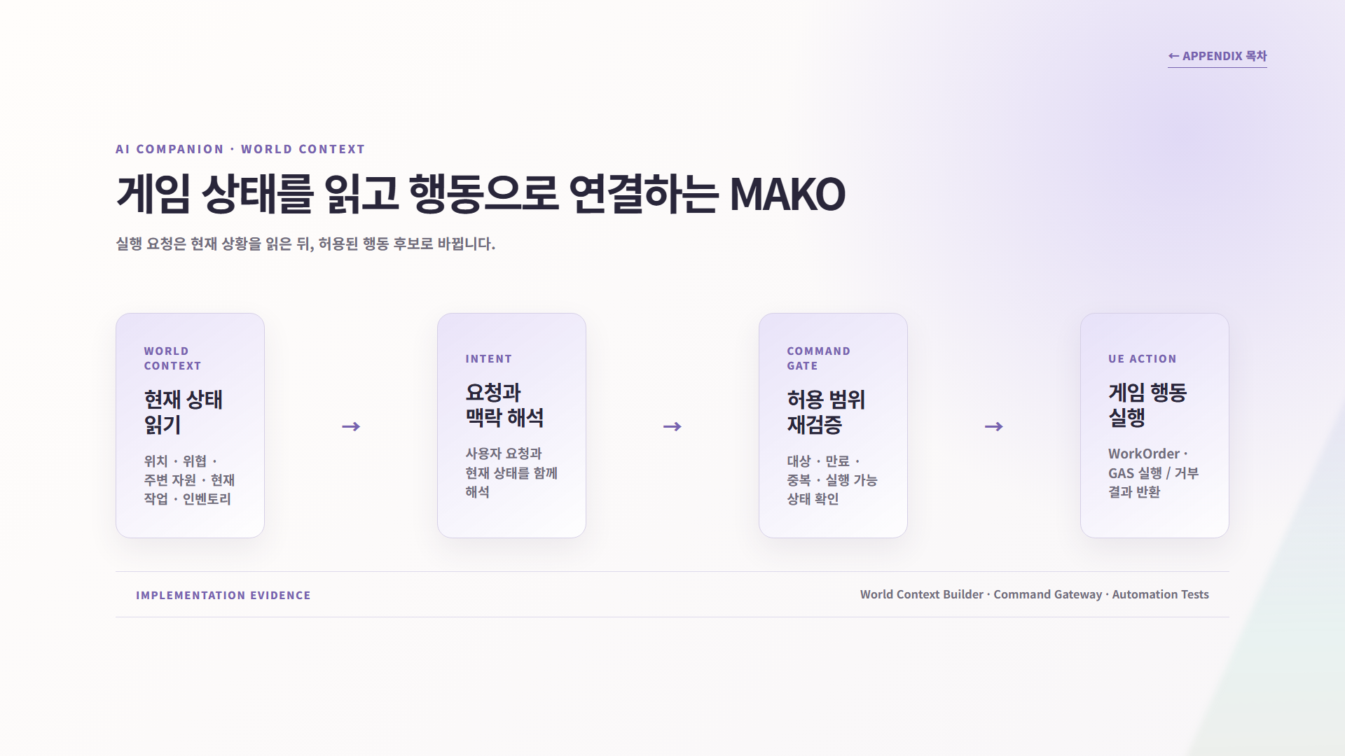
Notes:
[Sources]
Local AI : RE HTML presentation render (slide 20).
[/Sources]

Slide 21
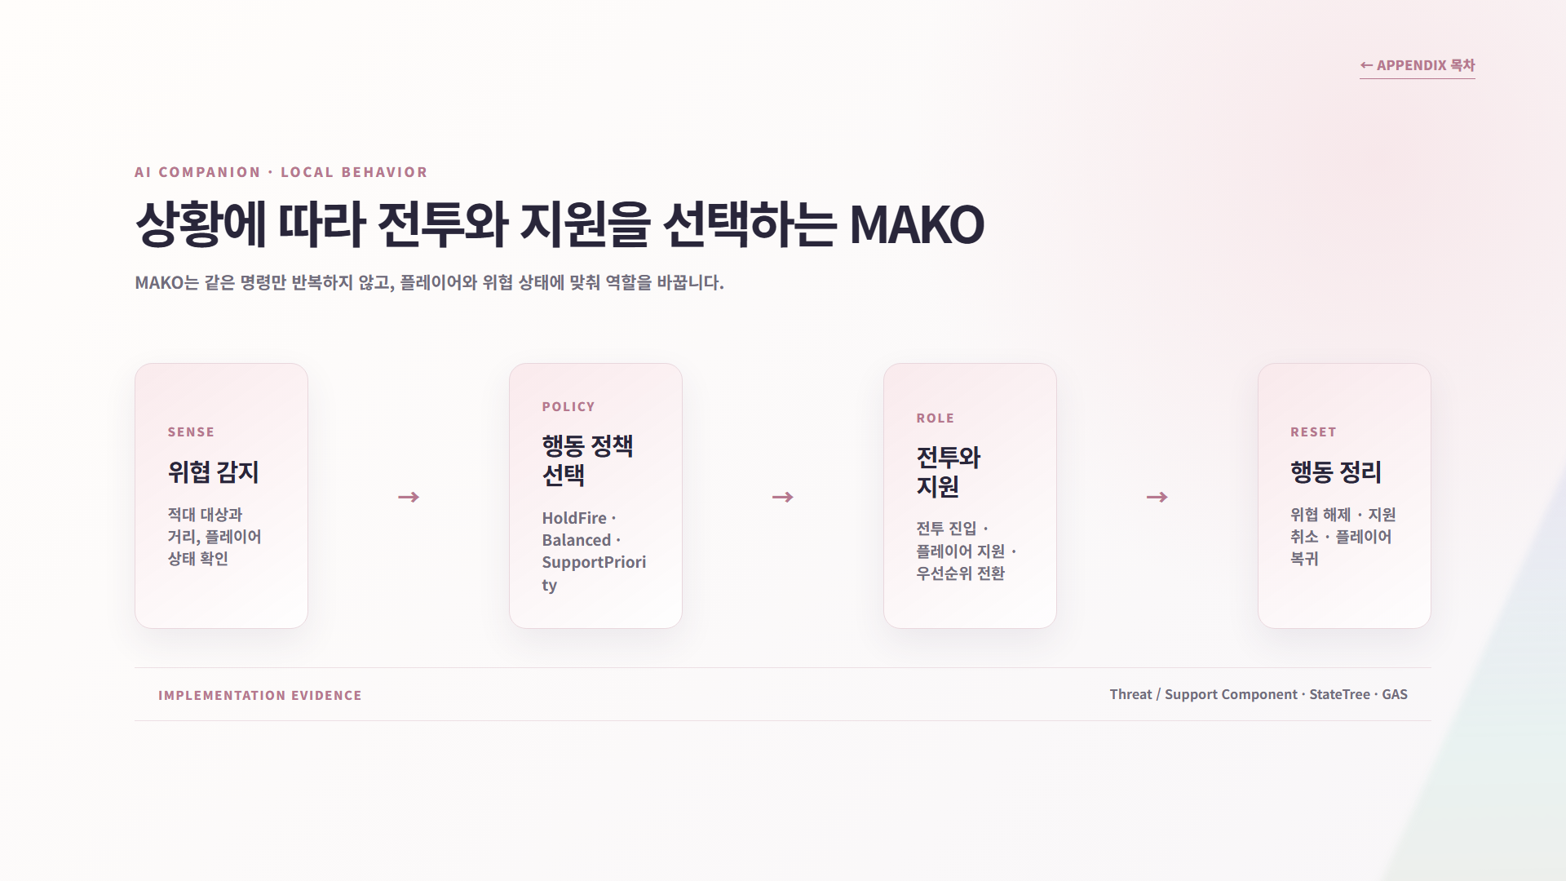
Notes:
[Sources]
Local AI : RE HTML presentation render (slide 21).
[/Sources]

Slide 22
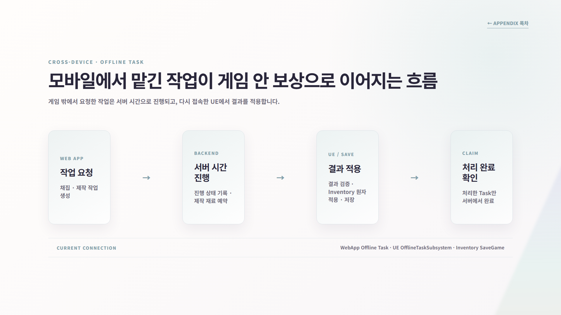
Notes:
[Sources]
Local AI : RE HTML presentation render (slide 22).
[/Sources]

