Slide 1

Notes:
[Sources]
- Current HTML presentation: index.html, styles.css, presentation.js
- Rasterized after print animations reached their final state.

Slide 2

Notes:
[Sources]
- Current HTML presentation: index.html, styles.css, presentation.js
- Rasterized after print animations reached their final state.

Slide 3

Notes:
[Sources]
- Current HTML presentation: index.html, styles.css, presentation.js
- Rasterized after print animations reached their final state.

Slide 4

Notes:
[Sources]
- Current HTML presentation: index.html, styles.css, presentation.js
- Rasterized after print animations reached their final state.

Slide 5
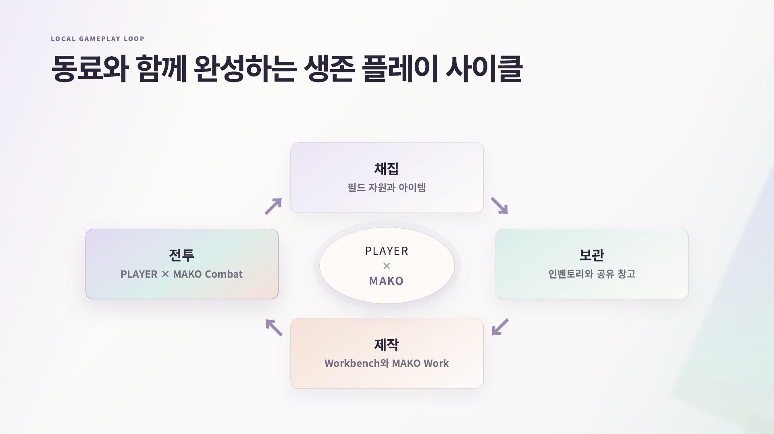
Notes:
[Sources]
- Current HTML presentation: index.html, styles.css, presentation.js
- Rasterized after print animations reached their final state.

Slide 6
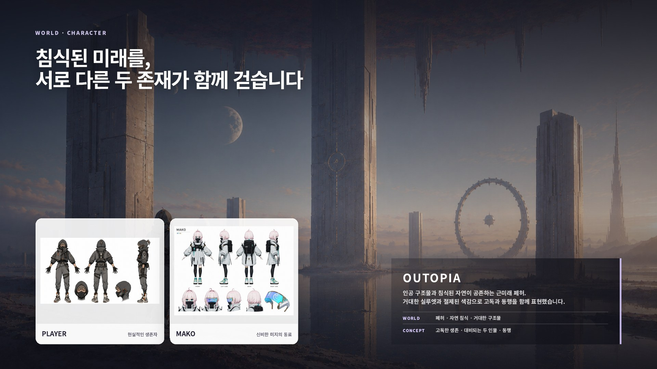
Notes:
[Sources]
- Current HTML presentation: index.html, styles.css, presentation.js
- Rasterized after print animations reached their final state.

Slide 7

Notes:
[Sources]
- Current HTML presentation: index.html, styles.css, presentation.js
- Rasterized after print animations reached their final state.

Slide 8

Notes:
[Sources]
- Current HTML presentation: index.html, styles.css, presentation.js
- Rasterized after print animations reached their final state.

Slide 9

Notes:
[Sources]
- Current HTML presentation: index.html, styles.css, presentation.js
- Rasterized after print animations reached their final state.

Slide 10

Notes:
[Sources]
- Current HTML presentation: index.html, styles.css, presentation.js
- Rasterized after print animations reached their final state.

Slide 11

Notes:
[Sources]
- Current HTML presentation: index.html, styles.css, presentation.js
- Rasterized after print animations reached their final state.

Slide 12
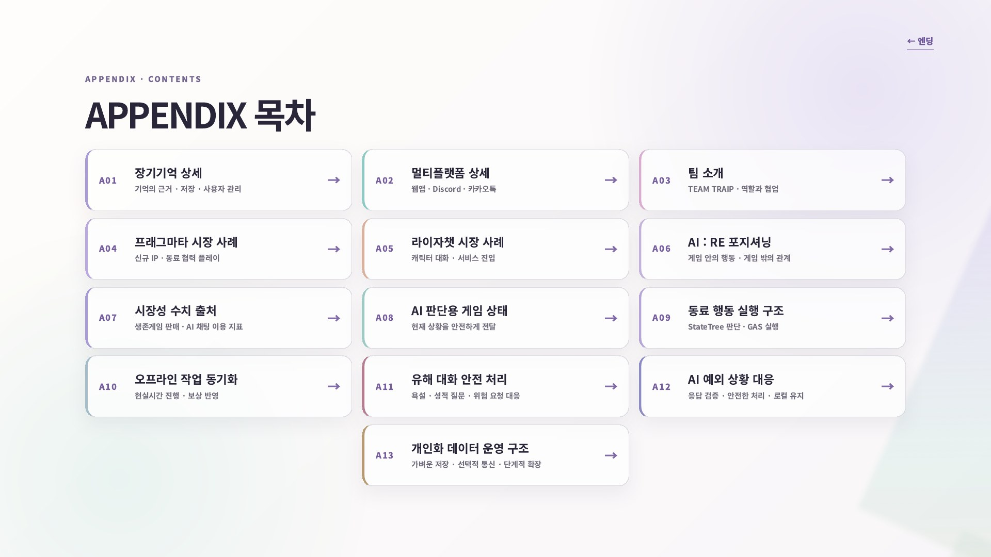
Notes:
[Sources]
- Current HTML presentation: index.html, styles.css, presentation.js
- Rasterized after print animations reached their final state.

Slide 13

Notes:
[Sources]
- Current HTML presentation: index.html, styles.css, presentation.js
- Rasterized after print animations reached their final state.

Slide 14

Notes:
[Sources]
- Current HTML presentation: index.html, styles.css, presentation.js
- Rasterized after print animations reached their final state.

Slide 15

Notes:
[Sources]
- Current HTML presentation: index.html, styles.css, presentation.js
- Rasterized after print animations reached their final state.

Slide 16

Notes:
[Sources]
- Current HTML presentation: index.html, styles.css, presentation.js
- Rasterized after print animations reached their final state.

Slide 17

Notes:
[Sources]
- Current HTML presentation: index.html, styles.css, presentation.js
- Rasterized after print animations reached their final state.

Slide 18

Notes:
[Sources]
- Current HTML presentation: index.html, styles.css, presentation.js
- Rasterized after print animations reached their final state.

Slide 19
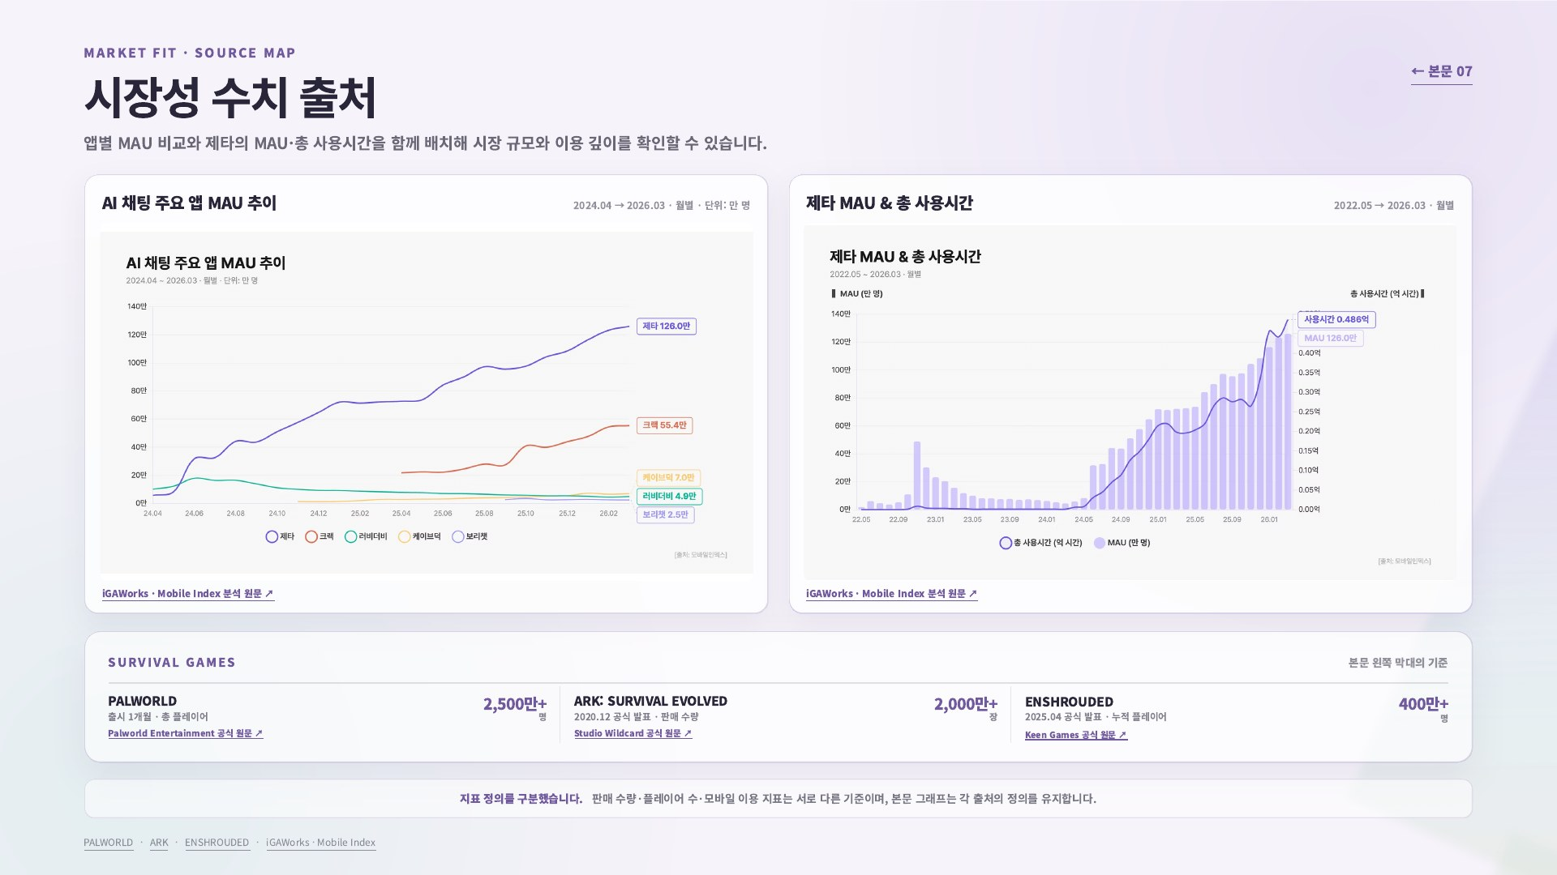
Notes:
[Sources]
- Current HTML presentation: index.html, styles.css, presentation.js
- Rasterized after print animations reached their final state.

Slide 20

Notes:
[Sources]
- Current HTML presentation: index.html, styles.css, presentation.js
- Rasterized after print animations reached their final state.

Slide 21

Notes:
[Sources]
- Current HTML presentation: index.html, styles.css, presentation.js
- Rasterized after print animations reached their final state.

Slide 22

Notes:
[Sources]
- Current HTML presentation: index.html, styles.css, presentation.js
- Rasterized after print animations reached their final state.

Slide 23

Notes:
[Sources]
- Current HTML presentation: index.html, styles.css, presentation.js
- Rasterized after print animations reached their final state.

Slide 24

Notes:
[Sources]
- Current HTML presentation: index.html, styles.css, presentation.js
- Rasterized after print animations reached their final state.

Slide 25

Notes:
[Sources]
- Current HTML presentation: index.html, styles.css, presentation.js
- Rasterized after print animations reached their final state.

