Slide 1
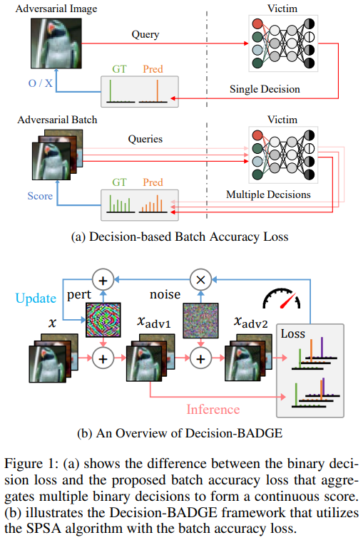
Figure 1: (a) shows the difference between the binary decision loss and the proposed batch accuracy loss that aggregates multiple binary decisions to form a continuous score. (b) illustrates the Decision-BADGE framework that utilizes the SPSA algorithm with the batch accuracy loss.

Slide 2
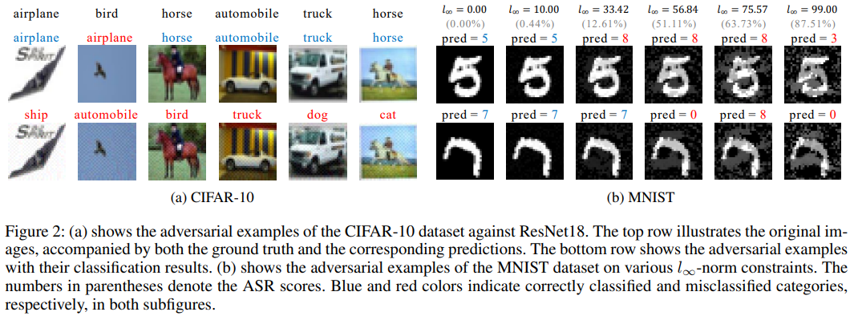

Slide 3
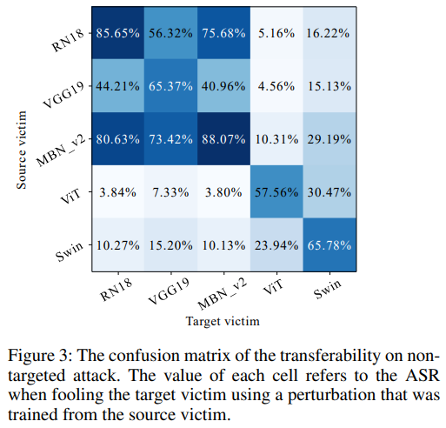
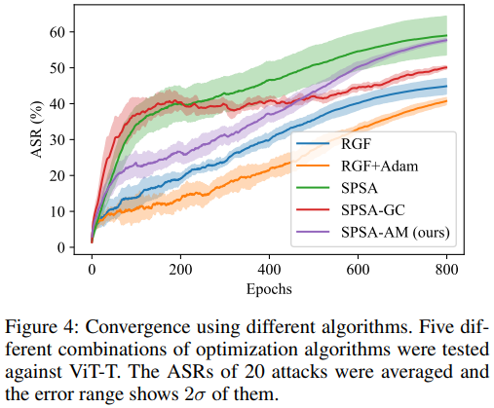

Slide 4
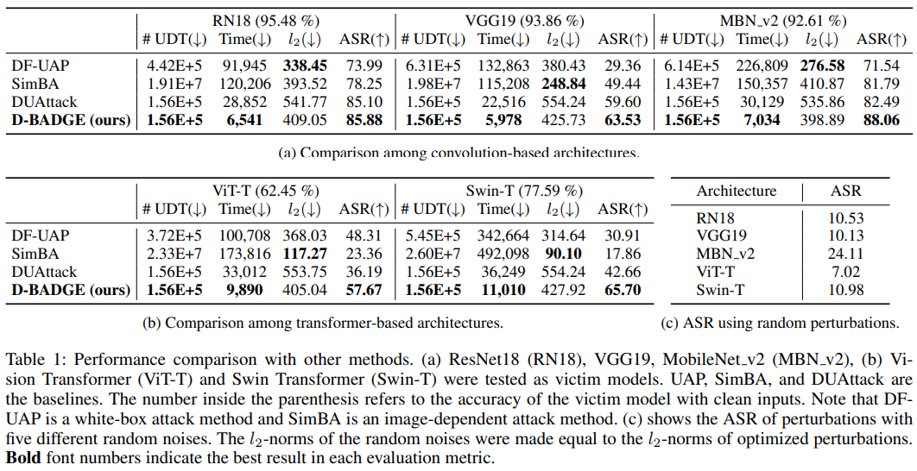

Slide 5
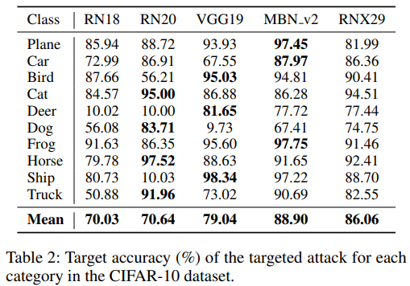
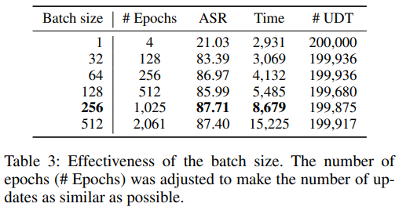
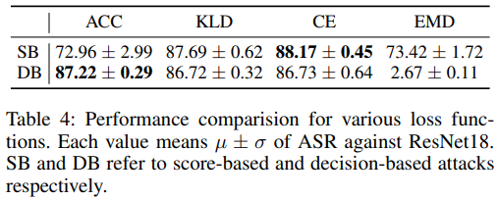

Slide 6
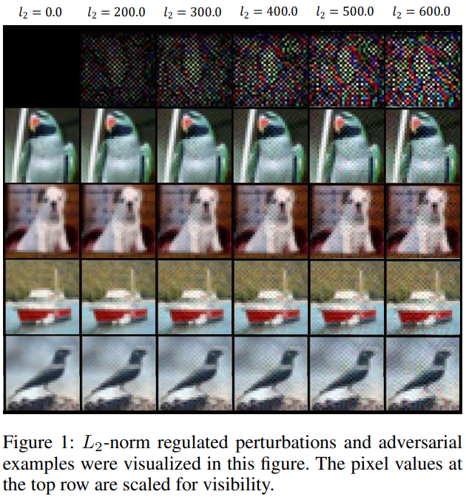
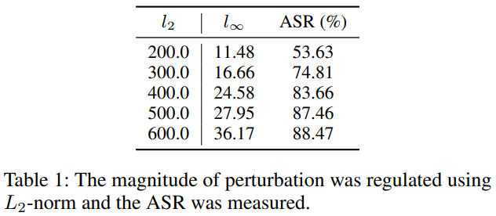
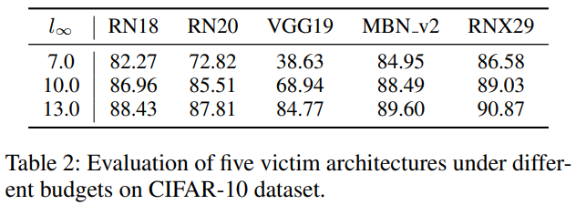
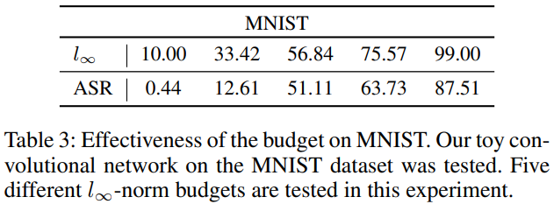

Slide 7
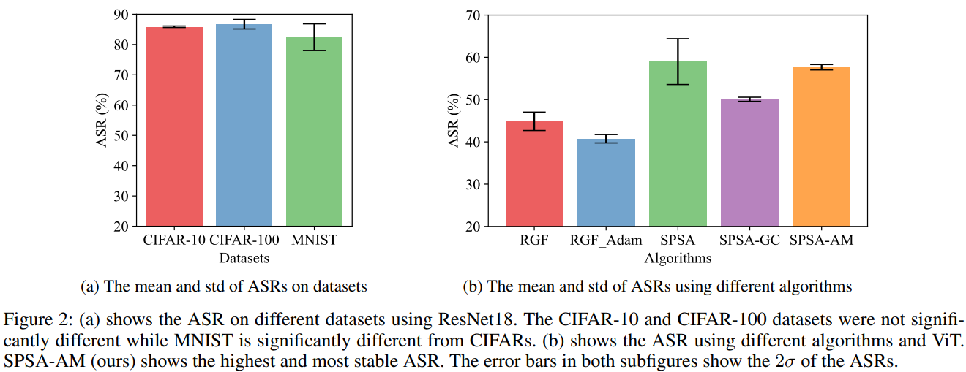
Figure 2: (a) shows the ASR on different datasets using ResNet18. The CIFAR-10 and CIFAR-100 datasets were not significantly diff-erent while MNIST is significantly different from CIFARs. (b) shows the ASR using different algorithms and ViT. SPSA-AM (ours) shows the highest and most stable ASR. The error bars in both subfigures show the 2$σ$ of the ASRs.

Slide 8
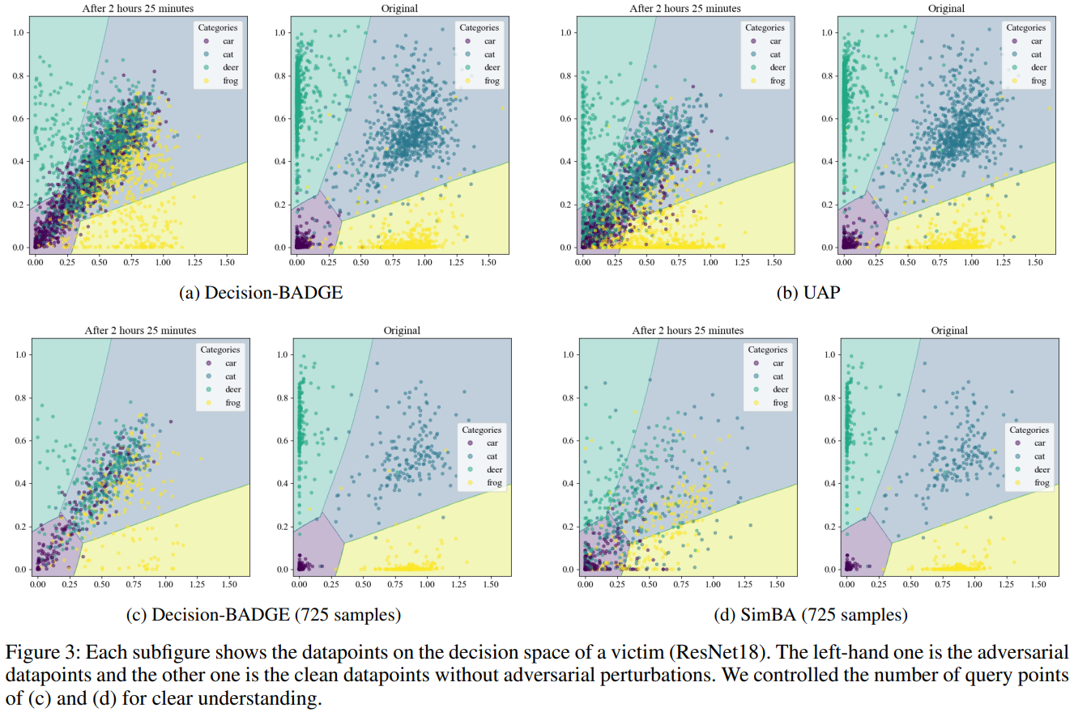
Figure 3: Each subfigure shows the datapoints on the decision space of a victim (ResNet18). The left-hand one is the adversarial data-points and the other one is the clean datapoints without adversarial perturbations. We controlled the number of query points of (c) and (d) for clear understanding.

