Slide 1

Trex Dino Bot by AIRex
Nilax Gajjar - 100872763
Tahseen Siddiqi – 100889810 Parth Dave - 100872777
Shruti Jonalagada Ramu- 100872358
Niharika Varma - 100873255

Slide 2
Scope
Developing AI algorithms for improved game play, such as obstacle avoidance or maximizing score.
Using the AI system for educational or research purposes, such as studying reinforcement learning or computer vision.
Analyzing and visualizing the AI system's decision-making process during game play.
Incorporating human-AI cooperative play, where the AI system assists or competes with human players.
Deploy model and game on available platforms for demo.

Slide 3
Why is reinforcement learning?
Reinforcement learning is used in the AI Dino Game to allow the agent to learn how to play the game through trial and error.
The agent receives feedback in the form of rewards or penalties for its actions, and uses this feedback to update its policy and make better decisions in the future.
Reinforcement learning provides a natural framework for modeling the decision-making process in a game setting, where the agent's goal is to maximize its score.
Reinforcement learning allows the AI to adapt and improve its game play over time, without the need for explicit programming of game strategies.
The use of reinforcement learning in the AI Dino Game allows for the exploration of new and innovative approaches to game playing, and provides a testbed for studying and advancing reinforcement learning algorithms.

Slide 4
Why is computer vision?
Computer vision is used in the AI Dino Game to enable the agent to perceive and understand the game environment.
The agent uses computer vision techniques to process the game screen and extract relevant information, such as the position of obstacles and the background.
Computer vision helps the AI to make informed decisions by providing a clear representation of the game state.
The use of computer vision in the AI Dino Game allows for real-time processing and analysis of game images, leading to faster and more accurate decision making.
The integration of computer vision and reinforcement learning in the AI Dino Game can lead to more advanced and sophisticated game playing strategies, beyond what is possible with rule-based systems.
The application of computer vision in the AI Dino Game provides a testbed for evaluating and improving computer vision algorithms, and advancing the field as a whole.

Slide 5
Tech Stack
Programming languages: Implementing and integrating computer vision algorithms using programming languages such as Python, Java Script, Java.
OpenCV: Using the OpenCV library for image processing and computer vision tasks, such as object detection and feature extraction.
Selenium: The popular browser automation tool Selenium was utilized to control the browser and retrieve relevant information from the AI Dino Game, such as the current score.

Slide 6
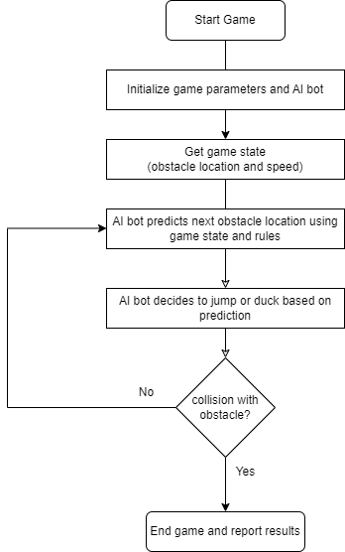
FLOWCHART

Slide 7
Game Modes
Normal Mode: In this mode, user simply play game like normal player with keyboard.
Voice Mode: User can play game with keyboard/voice or both.
AI Mode: In this mode, the user may choose the type of AI participation (Train Bot, User Trained Bot, Reinforcement Bot), the input method (Keyboard or Voice), the type of obstacles (Ground or Air), and the speed (High, Medium, or Low).

Slide 8
Use Cases
An AI bot playing T-Rex Dino game on behalf of human or compete with actual player.

Slide 9
Thank you

