Slide 1
Parallel JavaScript Update
Intel and Mozilla

Slide 2
Agenda
Work since January
Overview
Design goals
Key insight
API overview and examples
Differences with sequential methods
Lessons learned
Use cases

Slide 3
Summary Since January
Major Focus was on implementation
Use case driven performance tuning
Harvey Mudd collaboration
Project implementing OpenCV algorithms
Demos rewritten to use typed object API
Deform and Blocks
Spec language draft

Slide 4
Design Goals
Ease of use
Deterministic where possible
Follow current syntax, semantics, and security
Platform independent
Support all kinds of platforms, parallel or not
Perform well on different parallel architectures (multi-core, GPUs, SIMD Vectors…)
Extract reasonable performance out of parallel hardware
Extracting all performance a secondary goal
You Can’t Break the Web

Slide 5
Key Insight: Temporal Immutability
During concurrent execution
A computation can read or write its local data
A computation can read shared state
Parent waits patiently
Whitelist thread-safe/temporally immutability primitives
Violations or best effort failure result in a sequential schedule
Otherwise
Nothing changes
Current JavaScript programs are unaffected
The sweet spot between Functional and OO
Notes:
04

Slide 6



Parallel JavaScript API (ES7) (Stay within developer’s comfort zone)
Extend JavaScript’s Array type and Typed Objects API
High-level parallel methods
mapPar, reducePar, filterPar, scatterPar, scanPar, buildPar
Elemental Functions
input.mapPar(
e => { var avg = (e[0] + e[1] + e[2]) / 3;
return [avg, avg, avg, 255];
})
Simple Yet Powerful

Slide 7
Sum using reducePar
Sequential
Data parallel
var i;
var a = [1, 2, 3, 4];
var sum = 0;
for (i=0; i<a.length; i++) {
sum += a[i];
}
var pa = [1, 2, 3, 4];
var sum = pa.reducePar(
(a, b) => a+b
); // 10
PrefixSum
var prefixSum = pa.scanPar(
(a, b) => a+b
); // [1,3,6,10]

Slide 8
buildPar, scatterPar, filterPar
Reverse
var pa = Array.buildPar(4, (i) => i); //[0,1,2,3]
var reversedPa = pa.scatterPar(
(e, index, c) => c.length – index – 1
); //[3,2,1,0]
Positive
var pa = [1, -7, 3, 5]
var positivePa = pa.filterPar(
(e) => e > 0;
); //[1,3,5]

Slide 9
Non-determinism
Inherent in reduction: reducePar, scanPar, scatterPar
“It’s all about the scheduler” Guy Blelloch
Result

Slide 10
Non-determinism
Inherent in reduction: reducePar, scanPar, scatterPar
“It’s all about the scheduler” Guy Blelloch
Result
Associativity provides determinism
Result from a legal schedule:
No out of thin air results

Slide 11
Spec wording
reducePar and scanPar use values from the Original O array and results pushed onto an A array
Repeat in an arbitrary and implementation dependent order len-1 times
Select 2 previously unselected indices, k1 and k2 from O or A

Slide 12
Why parallel versions?
Sufficiently sophisticated compiler argument
New semantics to reduce, scan, and scatter
Mental Model is temporal immutability and
developing parallel algorithms instead of
parallelizing sequential algorithms
Auto-parallelization is a long time unsolved problem
Intent improves tooling and feedback
Formalizing Parallelizable subset definition difficult

Slide 13
What we have learned
We can see the horizon and there are no show stoppers
Multiple prototypes: Intel(FF, V8/Crosswalk)
Production: Mozilla closely tracking spec
Scaling is achievable in parallelizable parts of application
Falling back to sequential schedule better than throw
Out pointers to kernel functions are useful for reducing memory pressure and avoiding copying
Allocation pressure is crucial to performance in larger kernels

Slide 14
Pressure on Memory Management Latency
During parallel computation global heap is immutable
Only the return value escapes an elemental function
Rollback to GC safe point trivial
Simple concurrent approach
Each elemental function gets a local heap
Elemental function copies return value to the global heap
Local heap recycled immediately
No global synchronization required
Semantics Enable GC Concurrency

Slide 15
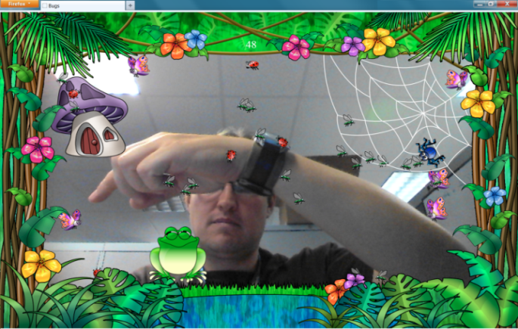
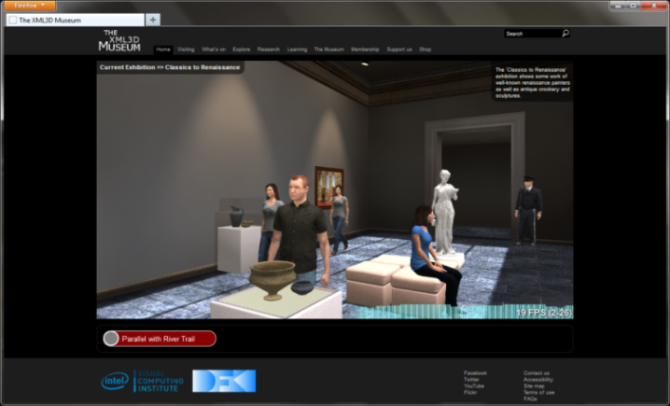
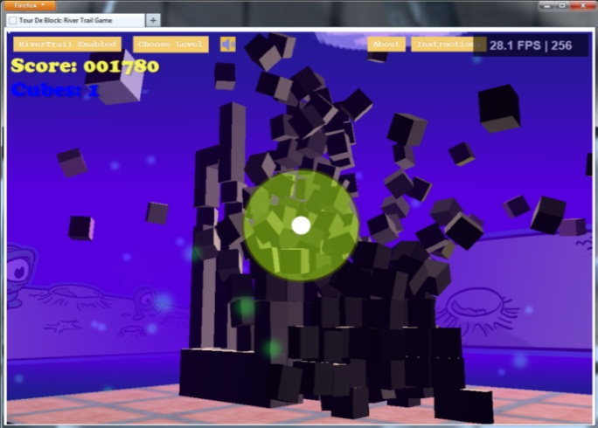
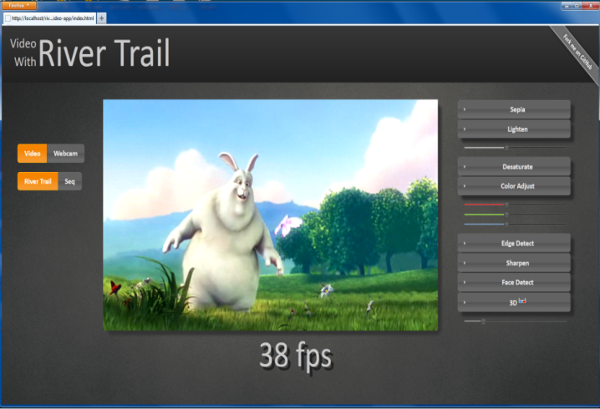
Lessons from use cases
Visual Computing
3D Animation
Physics-based Gaming
Video
Notes:
Bugs Game: ~3300 SLOC

Slide 16
Next steps
More use cases and use-case driven performance work
Typed Object and PJS are being co-designed
Firming up spec language
https://github.com/RLH/ParallelJavaScript/wiki

Slide 17


Three dog tug by Nate Bolt, from http://www.flickr.com/photos/boltron/623602756/
17

Slide 18

Q&A

Slide 19
Legal Disclaimer
INFORMATION IN THIS DOCUMENT IS PROVIDED IN CONNECTION WITH INTEL® PRODUCTS. NO LICENSE, EXPRESS OR IMPLIED, BY ESTOPPEL OR OTHERWISE, TO ANY INTELLECTUAL PROPERTY RIGHTS IS GRANTED BY THIS DOCUMENT. EXCEPT AS PROVIDED IN INTEL’S TERMS AND CONDITIONS OF SALE FOR SUCH PRODUCTS, INTEL ASSUMES NO LIABILITY WHATSOEVER, AND INTEL DISCLAIMS ANY EXPRESS OR IMPLIED WARRANTY, RELATING TO SALE AND/OR USE OF INTEL® PRODUCTS INCLUDING LIABILITY OR WARRANTIES RELATING TO FITNESS FOR A PARTICULAR PURPOSE, MERCHANTABILITY, OR INFRINGEMENT OF ANY PATENT, COPYRIGHT OR OTHER INTELLECTUAL PROPERTY RIGHT. INTEL PRODUCTS ARE NOT INTENDED FOR USE IN MEDICAL, LIFE SAVING, OR LIFE SUSTAINING APPLICATIONS.
Intel may make changes to specifications and product descriptions at any time, without notice.
All products, dates, and figures specified are preliminary based on current expectations, and are subject to change without notice.
Intel, processors, chipsets, and desktop boards may contain design defects or errors known as errata, which may cause the product to deviate from published specifications. Current characterized errata are available on request.
River Trail and other code names featured are used internally within Intel to identify products that are in development and not yet publicly announced for release. Customers, licensees and other third parties are not authorized by Intel to use code names in advertising, promotion or marketing of any product or services and any such use of Intel's internal code names is at the sole risk of the user
Software and workloads used in performance tests may have been optimized for performance only on Intel microprocessors. Performance tests, such as SYSmark* and MobileMark*, are measured using specific computer systems, components, software, operations and functions. Any change to any of those factors may cause the results to vary. You should consult other information and performance tests to assist you in fully evaluating your contemplated purchases, including the performance of that product when combined with other products.
Intel processor numbers are not a measure of performance. Processor numbers differentiate features within each processor family, not across different processor families. Go to: http://www.intel.com/products/processor_number
Intel product plans in this presentation do not constitute Intel plan of record product roadmaps. Please contact your Intel representative to obtain Intel's current plan of record product roadmaps.
Intel, Core and the Intel logo are trademarks of Intel Corporation in the United States and other countries.
*Other names and brands may be claimed as the property of others.
Copyright ©2012 Intel Corporation.

Slide 20
Backup

